Slide 1
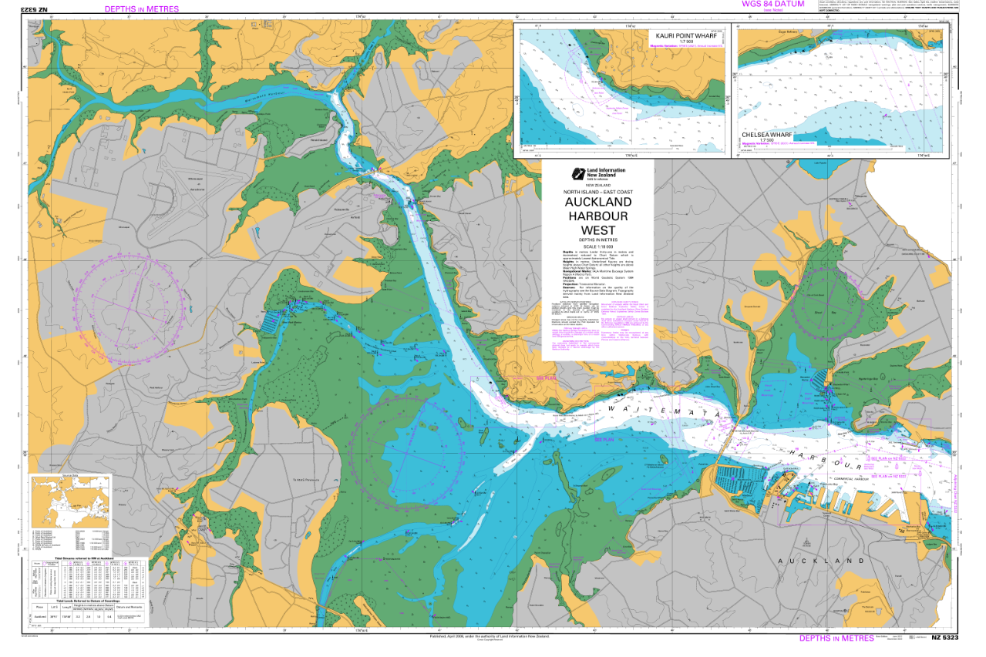
Lucas creek
Rangitopuni creek
Hob.
CB
Henderson Creek
SB

Slide 2
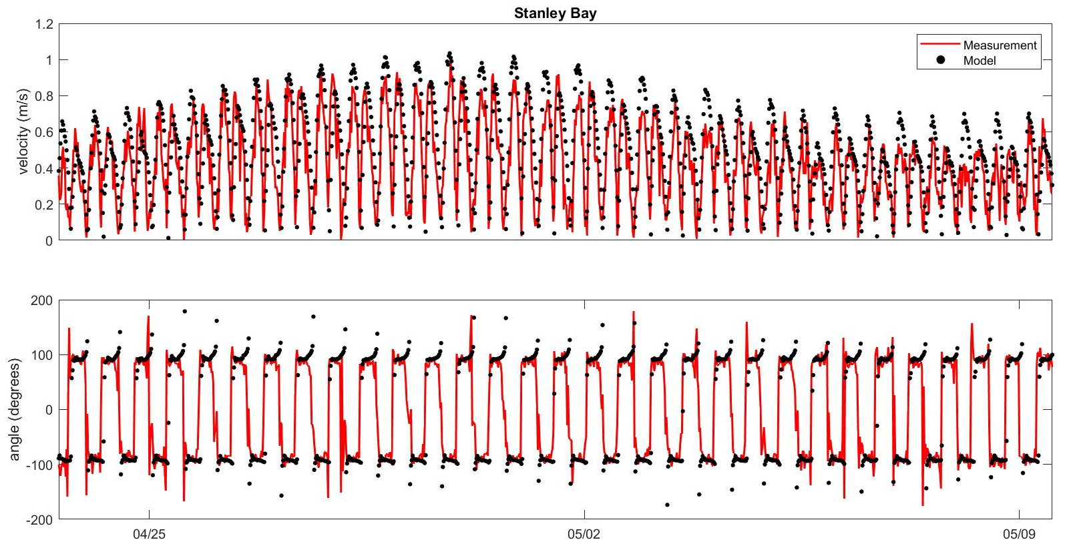
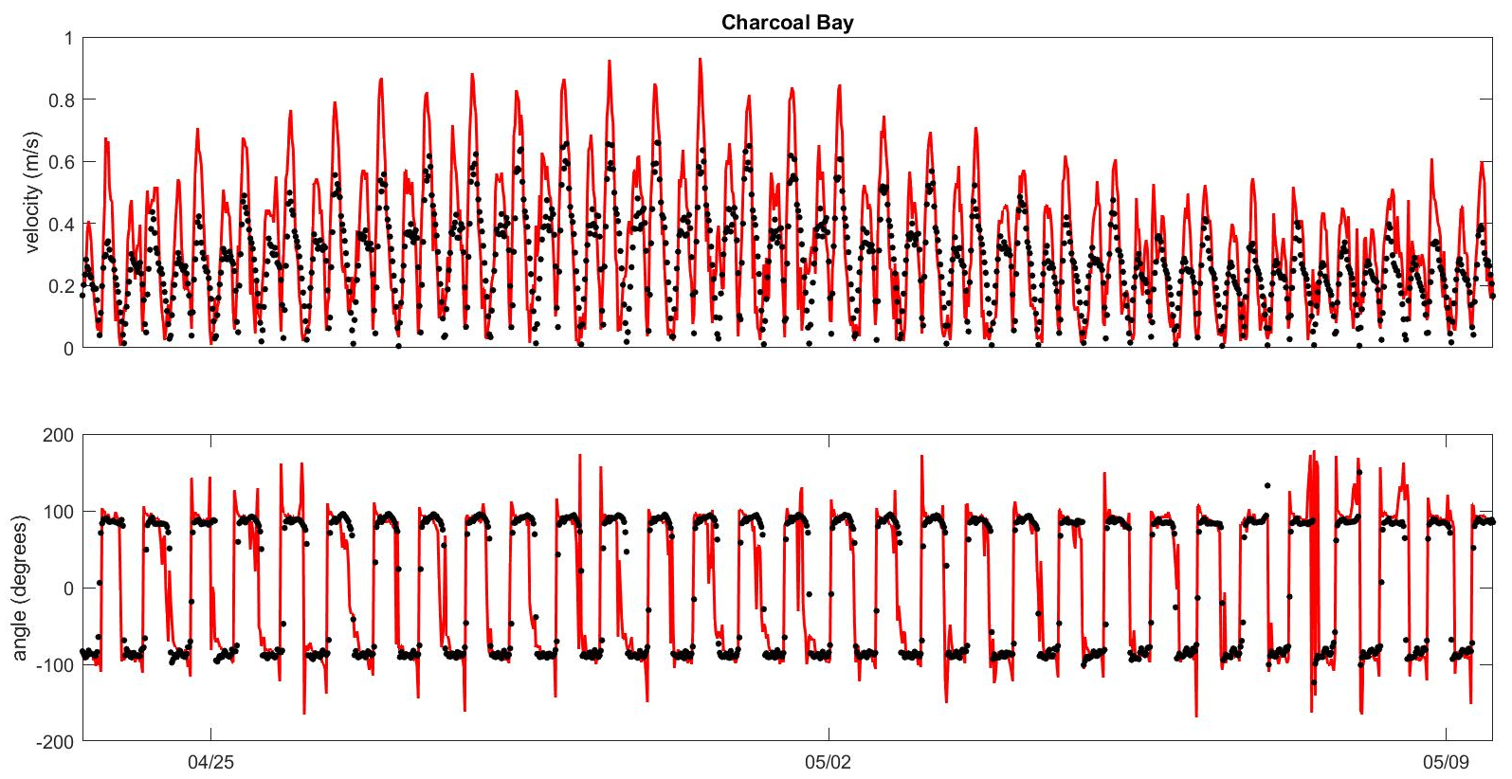
Model validation
Surface velocity (Stanley Bay, SB; Charcoal Bay, CB)
Model Skill (Nash-Sutcliffe Efficiency, NSE. The closer to 1 the better) :
0.56 for velocity magnitude; 0.86 for the along-stream velocity component
Pearson’s R:
0.74 for velocity magnitude; 0.93 for the along-stream velocity component
Model Skill (Nash-Sutcliffe Efficiency, NSE. The closer to 1 the better) :
0.11 for velocity magnitude; 0.73 for the along-stream velocity component
Pearson’s R:
0.79 for velocity magnitude; 0.92 for the along-stream velocity component
Summary:
1. Along-stream velocity is well modelled; the challenge consists in improving the cross-stream component, which is notoriously difficult for estuarine models
2. For upstream locations near abrupt bathymetry changes, close to coastlines, e.g. CB, the result is not very satisfactory yet.

Slide 3
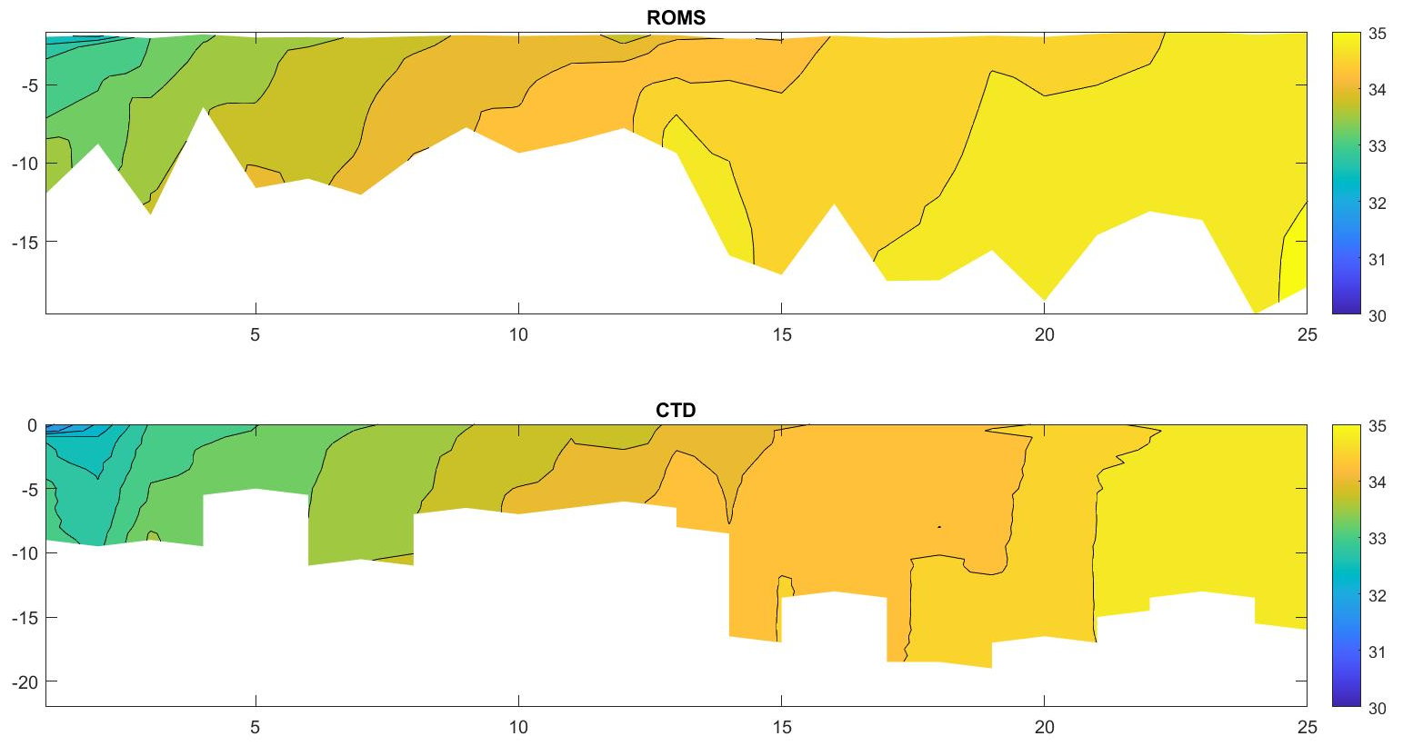
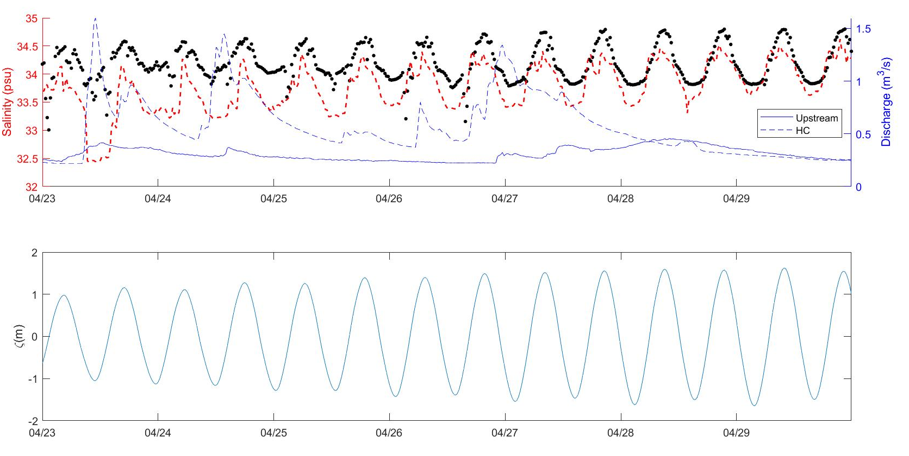
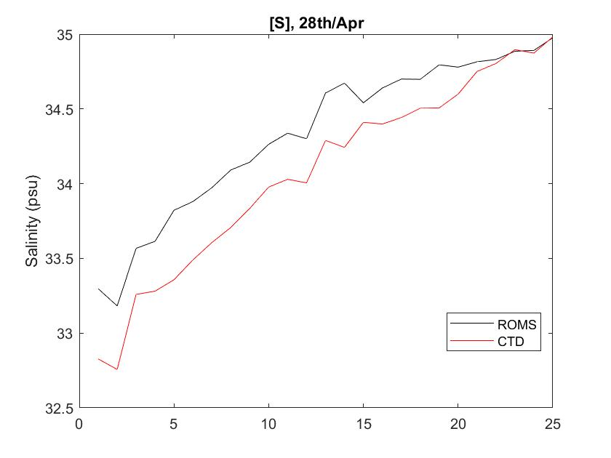
Adding rivers to the model (on-going);
28th/Apr: salinity transect
Salinity validation at Hobsonville
Depth Averaged Salinity
Still some problems. (1) Hard to find or design an initial salinity field; (2) under-estimated upstream-downstream salinity gradient; (3) unsatisfactory drifter-tracking results (problems with residual currents?)

