Slide 2
Predicting Transport in the East Australian Current:
Observation Impact from a regional reanalysis
Carter et. al., 2012
2016 ROMS Asia-Pacific Workshop
Institute for Marine and Antarctic Studies
Hobart Waterfront, Tasmania, Australia
October 17 - 21, 2016
Colette Kerry^{1,} Moninya Roughan¹, Brian Powell² and Peter Oke³
¹ Coastal and Regional Oceanography Lab, School of Mathematics and Statistics, UNSW Australia, Sydney NSW, 2052 Australia
² Department of Oceanography, School of Ocean and Earth Sciences, University of Hawaii at Manoa, Honolulu, HI, United States
³ CSIRO Marine and Atmospheric Research, Hobart, Australia
Notes:
I’ll be presenting a reanalysis of the south east Australian region, using ROMS 4D-Var, that I’ve been working on at UNSW with Moninya Roughan, and working with Brian Powell from the UH and Peter Oke from CSIRO.
The southeast Australian region is dominated by the EAC which is the WBC of the south pacific subtropical gyre.
I’ll then go to the present our observation impact work, where we use the tools Andy talked about to quantify how specific data streams impact on estimates of volume transport in the EAC.
In solving this state-estimation problem, we compute the dynamical covariance between the observations and the model that allows us to directly compute the impact of each observation on the circulation estimate.

Slide 3
A high resolution reanalysis for the East Australian Current: ROMS model
Variable horizontal resolution
2.5-6km cross shore
5km alongshore
30 s-levels
Smoothing with emphasis on maintaining shelf width, key to EAC separation
BRAN 3p5 initial and boundary conditions
ACCESS-R 12km for atmospheric forcing
Notes:
The model domain extends from Fraser Island in the north to south of the NSW Victoria border in the south.
The northern boundary is north of where the EAC is found to be most coherent, here off of Brisbane. The the EAC typically separates from the coast at about 32S, just south of Coffs Harbour, turning eastward and forming an energetic eddy field which is referred to as the Tasman Front.
The model has a 5km resolution in the alongshore direction and variable resolution in the cross shore direction, with 2.5km along the continental shelf and shelf slope, increasing gradually to 6km at the eastern boundary.
It has 30 terrain following s-levels, with stretching function developed by Suoza and Powell at UH that has a more uniform surface layer thickness that is better suited to assimilation of SST data and of surface radial velocities from HF radars. We have higher vertical resolution in the upper 500m to resolve the wind driven mesoscale circulation and near the bottom for improved resolution of bottom boundary layer.
We smoothed the bathymetry to minimise HPG errors, which arised because of the steep shelf slope, with an emphasis on maintaining the continental shelf width which may be a driver of EAC separation.
To asses the consistency of the free running model in representing the mean and variability of the ocean circulation we ran a 10 year simulation. This plot shows the RMS observation anomaly from the 10 year simulation and from 10 years of AVISO data, and we can see that the model represents the SSH variability well. We also looked at mean vertical sections of temperature and compared them to the CSIRO atlas of regional seas, which is a compilation of observations since the 1950s, and the model mean matched well, and compared our EAC transport estimates to the literature and our model does well in terms of capturing the mean and variability.
Bry and initial conditions from BRAN
Surface forcing from BOM’s ACCESS
In models using terrain-following coordinate systems, steep topographic gradients generate numerical errors associated with the computation of the pressure gradient term resulting in artificial along-slope flows
In order to reduce the pressure gradient errors to an acceptable level, some smoothing of the continental slope was required. A smoothing method was applied in which a high priority was placed on maintaining the shelf width. Priority was also given to preserve the seamounts that were considered to potentially play a role in steering of the EAC
PGE test gives bottom velocity magnitudes less than 4cm/s everywhere in the domain – magnitudes approaching 2-4cm/s occur over small areas of the steepest continental slope regions and the seamounts.
Show cross section plots of raw bathy. My smoothed, and a generic smoothing that gets rid of the shelf
Grid is merged at its boundaries with the bathymetry from OceanMAPS

Slide 4
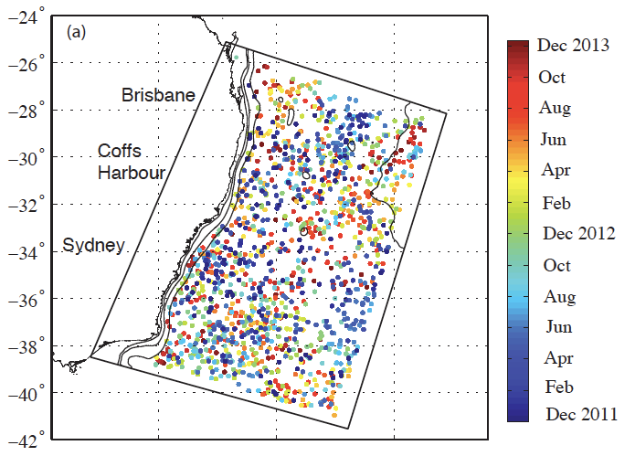
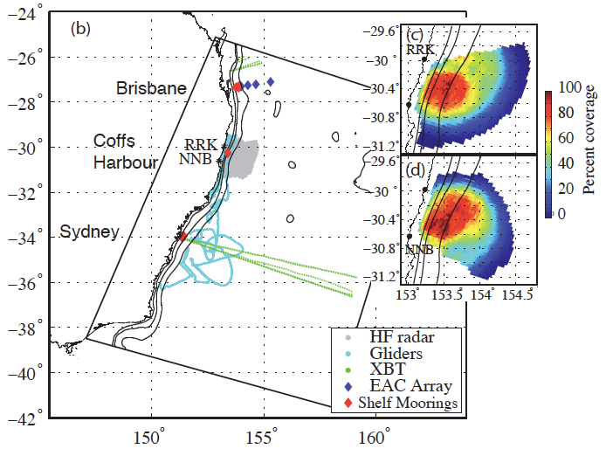
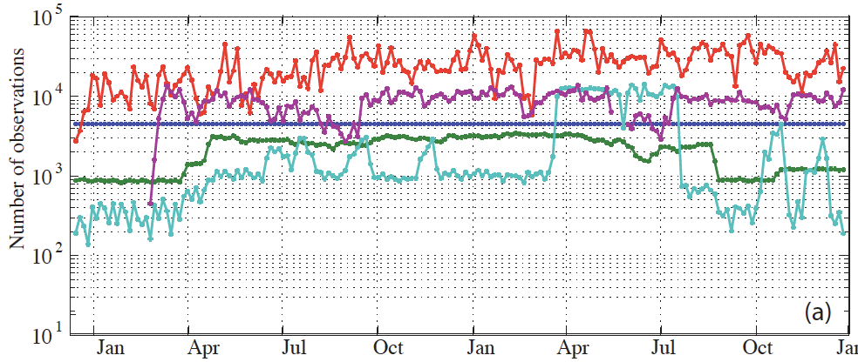
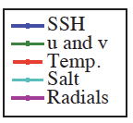
A high resolution reanalysis for the East Australian Current: Observations
Argo floats
AVISO SSH
NAVO SST
1229 Argo profiles
XBTs
Shelf moorings
EAC Array
Gliders
HF radar
Notes:
We perform the reanalysis over a 2-year period, 2012-2013, as this was the period over which we had the most available observations.
We had a HF radar array off of Coffs Harbour, that measures surface radial currents up to ~100km offshore.
Shelf moorings in about 100m of water off of Sydney and Coffs Harbour, 2 shelf moorings off of Brisbane in 200 and 400m of water. And a deep water mooring array off of Brisbane called the EAC transport array, which is a 5 mooring array that extends about 200km offshore and measures T, S and velocities throughout the water column.
Gliders, shown by the cyan. Most of the gliders obs are on the NSW shelf in less than 100m of water, but we had a few glider missions offshore of Sydney in Tasman Sea eddies.
XBT lines along the Brisbane-Figi route and the Sydney-Wellington route.
Argo floats
An SST product from the US Naval Oceanographic Office
And gridded SSH from AVISO
This is the number of processed observations for each assimilation window, and we can see that temperature dominates followed by the radials
US Naval Oceanographic Offices Global Area Coverage Advanced Very High Resolution Radiometer level-2 product (NAVOCEANOs GAC AVHRR L2P SST).
Expendable Bathythermographs - Sydney-Wellington and Brisbane-Fiji
Ocean Gliders – NSW node of Australia’s integrated Marine Observing System
Shelf moorings and EAC array – T and S low pass filtered at inertial freq, u and v low pass filtered at 30 hours to remove tides, obs applied 6 hourly
Radar griidded to the model grid and a 24 hour box car filter applied to remove tides
In the work that I’ll be presenting today, we use the reanalysis to directly compute the impact of each data stream on estimates of EAC transport. And I’d like you to particularly take note of the HF radar array, which measures surface currents up to ~ 100km offshore of of Coffs Harbour, and the EAC transport array, which a 5-mooring array that extends about 200km offshore and measures T, S and velocities throughout the water column.
(Combining a model with 2.6 million grid cells with ~ 40-100,000 obs per 5-day window)

Slide 5
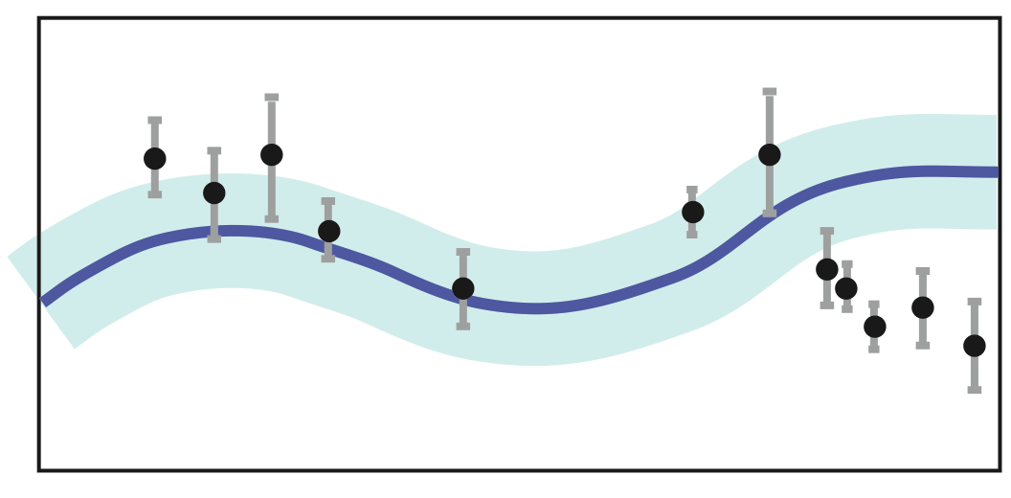
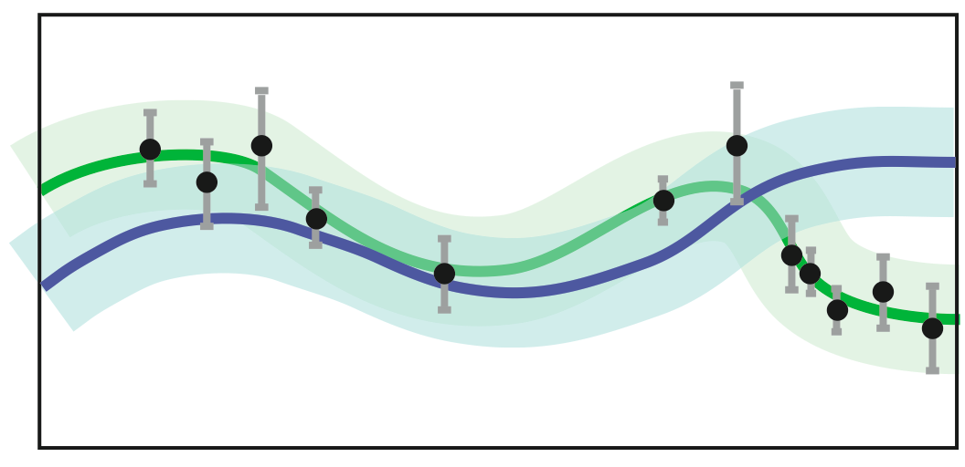
4D-Variational Data Assimilation
The ‘Background’
4-D Var generates increments to adjust the model
initial conditions,
boundary forcing, and
surface forcings
such that the difference between the model solution of the time-evolving flow and all available observations is minimised over an assimilation interval.
The ‘Analysis’
The ‘Forecast’
Notes:
We use strong constraint DA with the primal form that Andy talked about

Slide 6
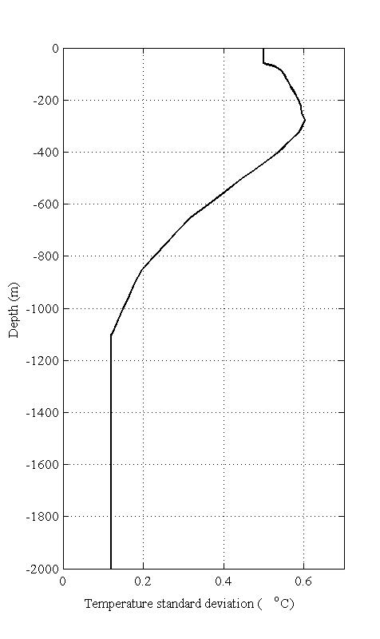
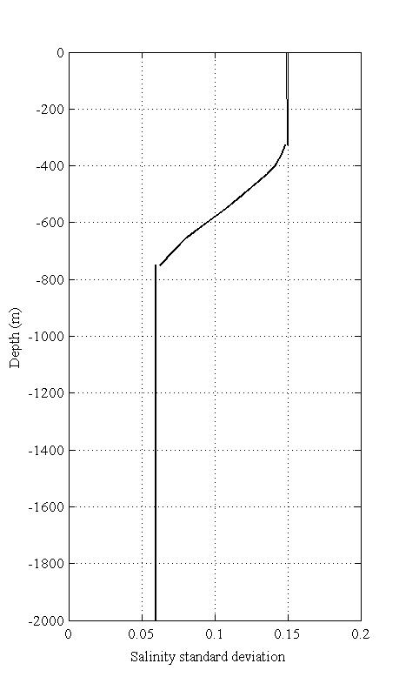
A high resolution reanalysis for the East Australian Current: Assimilation configuration
Observation error covariances
Instrument error
Errors of representativeness
Model discretisation in time and space
Processes not resolved by the model
0.15
0.6degC
Notes:
We solve for these increments by minimising a cost function that is made up by an observation term and a background term.
One of the most important tasks in setting up an assimilation system is the specification of the prior observation and background errors.
The observation errors act as a scaling factor in the cost function so that we do not ‘over-fit’ to uncertain observations, and can arise from instrument error and errors of representativeness, which can arise from model discretisation in time and space, and processes not resolved by the model. The instrument errors are typically much lower than the other errors.
Our model does not include the tides, and the mooring T, S and velocity data is collected at 5 or 10 minute sampling frequency. We low-pass filter the observations to remove tides and inertial oscillations, and apply the observations 6-hourly.
For the HF radar data, we apply a 24-hour boxcar filter to remove the tides and then grid the radials onto the model grid. We assimilate the radial vectors, rather than the velocities which have correlated errors.
For each data streams, if there are several observations that occur in the same model grid cell in the same time step, we average them and apply only a single observation in that grid cell and at that time, and compute the variance to use in the observation error specification.
We generated nominal minimum error profiles for the subsurface observations, that are scaled versions of the variance profiles from the 10 year free running model, and the observation error is given by the maximum of that value and the variance of the gridded observations.
For the offshore regions, the nominal minimum error profiles for T and S look like this.
On the shelf, the errors are inflated by a factor of ~2, because there are more small scale shelf processes that are not resolved by the model.

Slide 7
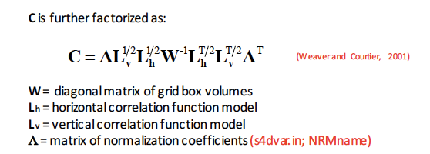
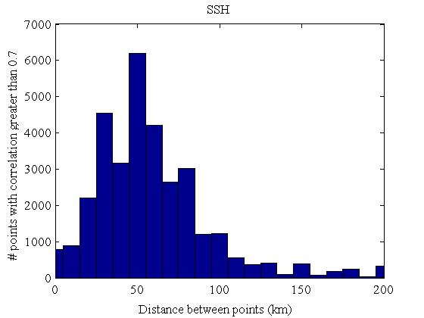
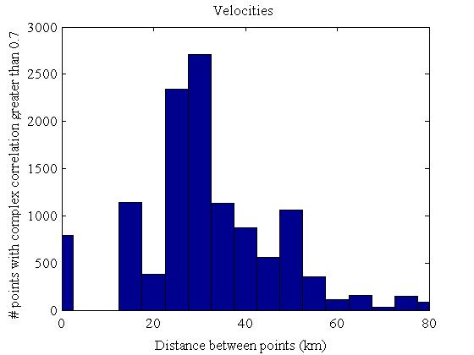
A high resolution reanalysis for the East Australian Current: Assimilation configuration
Background error covariances
Only use the univariant component (no balanced terms)
Standard deviations – sqrt of the mean 5-day variances from 10-year fwd run
Gaussian spatial correlation function – solution of diffusion operation – dependent on grid and length scales of variability
Length scales assumed to be homogeneous and isotropic
Horz length scales:
100km SSH and Temperature
70km Velocities
Notes:
For the background error covariances, this is taken from Andy’s slides, except that I’ve called it P instead of B.
We only use the univariant component, so we don’t have these balanced terms.
For the standard deviations we use the square root of the mean of the 5-day variances from the 10-year free running model.
And to compute the correlation matrix C, we need to specify the horz and vertical length scales of variability for each state variable, which are assumed to be homogeneous and isotropic.
For the horz length scales, we specify 100km for SSH and temperature, and 70km for velocities.
For SSH, from the free running model, we computed the correlation of each point with every other point, and this plot shows the number of points with correlation greater than 0.7 plotted against the distance between the points, and this X shows the 100km mark.
Likewise for the surface velocities, this is the number of points with complex correlation greater than 0.7 against the distance between the points, and the X shows the 70km mark.

Slide 8
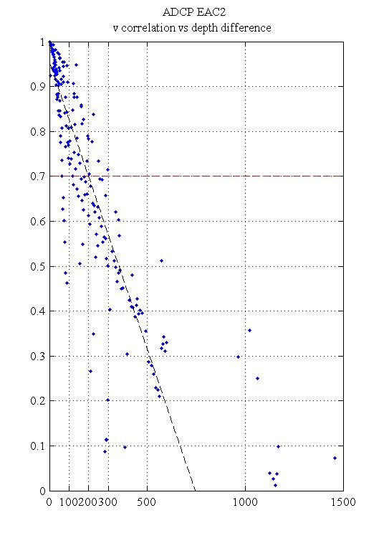
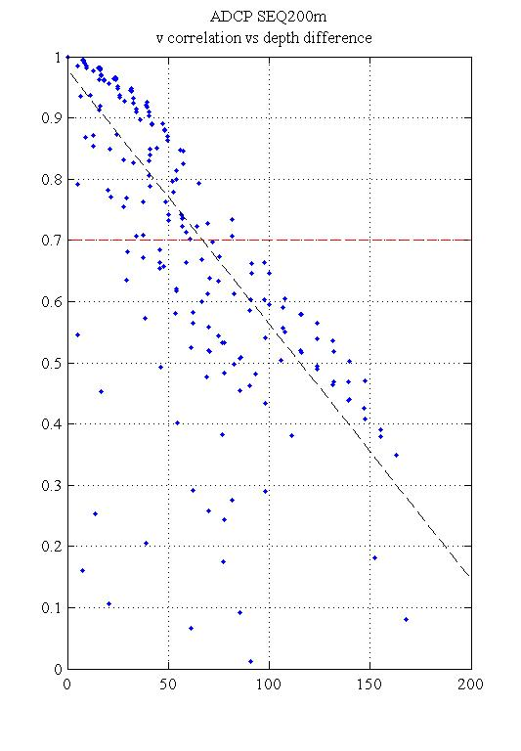
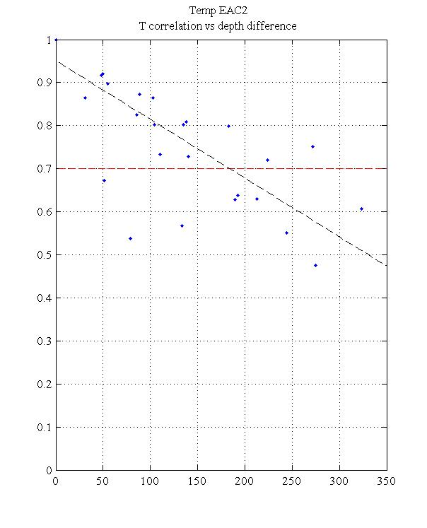
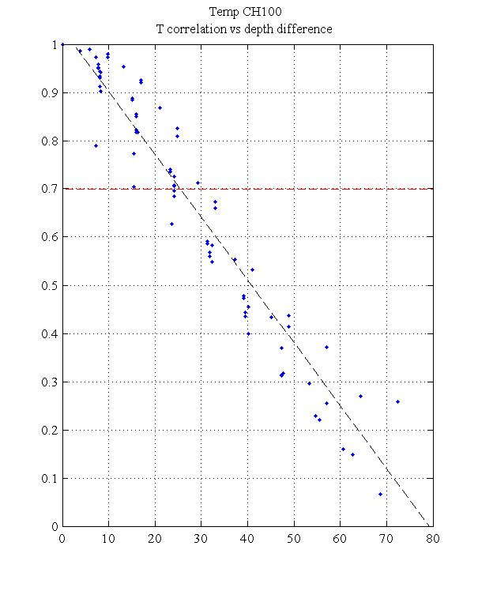
A high resolution reanalysis for the East Australian Current: Assimilation configuration
Vertical length scales:
50m Salinity
10m Temperature
50m Velocities
v – EAC2
v – SEQ200
Temp – EAC2
Temp – CH100
200m
70m
180m
25m
Notes:
In the vertical we used the data from the shelf moorings and the EAC array, and calculated the correlation between the observations at each depth and every other depth. The vertical length scales vary considerably between the moorings and these are just a few examples. So we have the correlation plotted against the vertical distance between the points. Here for velocity at one of the deep water moorings, the length scale to a correlation of 0.7 is about 200m, and for this shelf mooring in 200m of water the length scale is 70m.
For velocities from all of the moorings, the vertical length scales to correlation of 0.7 ranged from 20-200m. We chose 50m, as the deep water moorings cross the main core of the EAC were the vertical decorrelation length scales are likely to be greater than in the rest of the offshore domain.
For temperature, the vertical length scales to a correlation of 0.7 range from 15-30m for the shallow shelf moorings (NSW moorings, SEQ 200), 70m for SEQ 400 and 100-200m for the EAC deepwater array moorings. Salinity length scales are similar. For salinity we chose 50m, and for temperature we chose a lower value of 10m as SST observations dominate and the decorrelation length scales near the surface are smaller.

Slide 9
A high resolution reanalysis for the East Australian Current: Assimilation configuration
5-day assimilation windows
14 inner loops, 1 outer loop
Boundaries updated daily
Atmospheric forcing updated 12-hourly
Notes:
Linearity experiments to compare the evolution of realistic perturbations in the TL model and the NL model found that 5-days was a good choice for the assimilation window length as the non-linearities did not become too large.
We use 14 inner loops, and 1 outer loop. This plot shows the TL cost function over the initial cost function for each of the 14 inner loops, averaged over the 2 years, and we can see that the curve flattens out which indicates that 14 loops is a reasonable choice. The magenta dot shows the final NL cost function over the initial cost function, and this mismatch shows that some nonlinearities do persist.
On this main figure, the black line is the initial cost function for each assimilation window over the 2 years, the final TL cost function is in blue, and the final NL cost function in magenta. The final NL cost function matches the TL cost function well. And this is crucial for the observation impact calculations to be valid.
In the assimilation, we update the boundaries daily and the surface forcing 12-hourly.

Slide 10
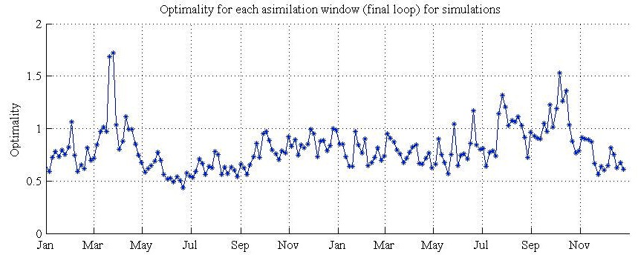
A high resolution reanalysis for the East Australian Current: Assimilation configuration
Desroziers et al. (2005), Diagnosis of observation, background and analysis-error statistics in observation space.
The ‘optimality’ value provides a measure of how well the system
approaches an optimal fit
Notes:
Correct specification of the prior observation and background error covariances is important and a measure of the of the consistency of these prior choices can be made using a set of diagnostics based on the innovation statistics, presented in Desroziers et al. (2005). We put quite a bit of effort into ensuring that our prior specified error variances and those diagnosed after the assimilation match fairly well.
Example, SSH… and radials
Another simple diagnostic to check the validity of the observation and background error covariances is the optimality value, which provides a measure of how well the system approaches an optimal fit and is given by twice the final cost function divided by the number of observations. A value of 1 indicates correct specification of the uncertainties. For the 5-day analysis windows over the 2-year assimilation, the values range from 0.4-1.7 with a mean value of 0.8.

Slide 11
A high resolution reanalysis for the East Australian Current: Reanalysis performance
AVISO SSH
Argo
XBT
Gliders
HF radar velocities
Notes:
Looking now at the assimilation performance in terms of some of the observations that are assimilated …
SSH
For temperature from the Argo, XBT and glider observations,…..
For the surface velocities measured under the HF radar footprint,

Slide 12
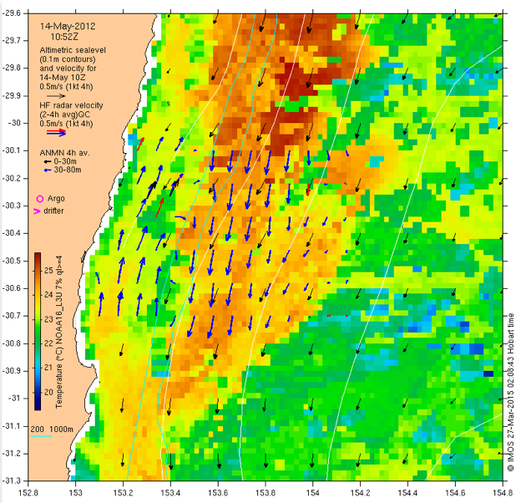
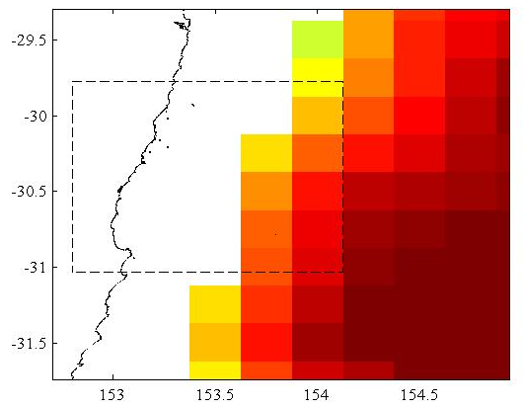
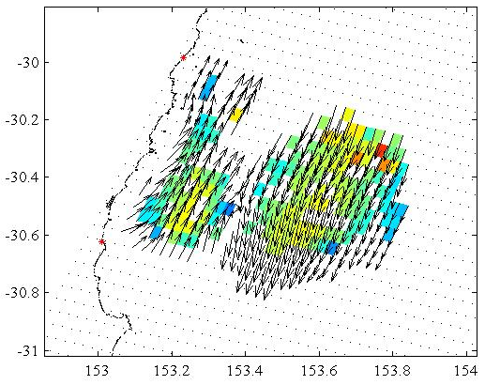
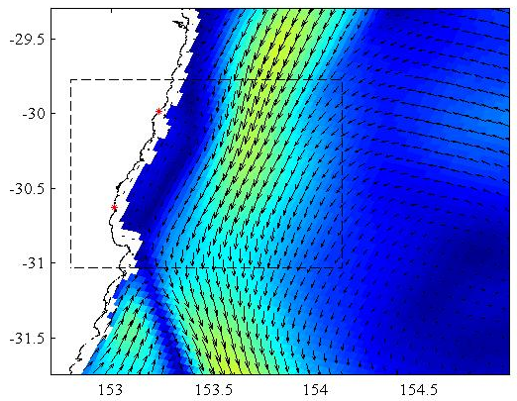
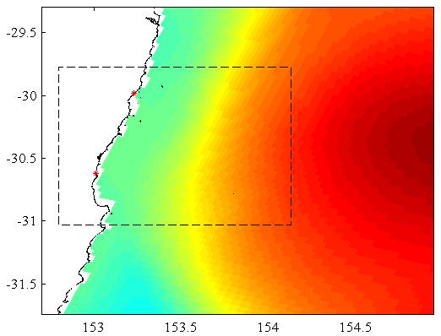
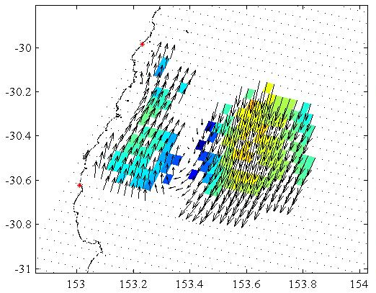
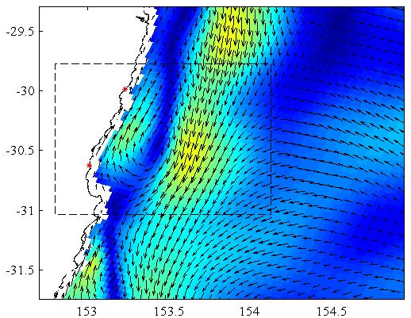
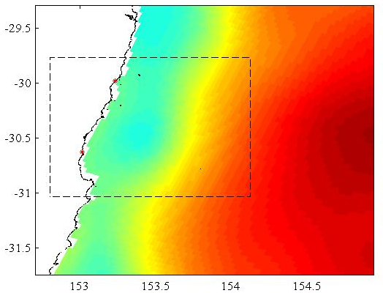
A high resolution reanalysis for the East Australian Current: Reanalysis performance
HF Radar, specific example
(May 14 2012)
SSH obs (AVISO)
Velocities from assimilated radials
Forecast velocities
Forecast SSH
Velocities from analysis radials
Analysis velocities
Analysis SSH
Notes:
This is a neat example of the HF radar assimilation, where we have this submesoscale recirculation feature captured by the observed radials, that is not present in the forecast velocities
Down here in the analysis velocities, we now have this northward coastal flow, and this is manifested in the analysis SSH with this submesoscale cyclonic feature.

Slide 13
A high resolution reanalysis for the East Australian Current: Reanalysis performance
Notes:
These are the complex correlations between the free running model and the observations (blue) and the analysis and observations (magenta) for velocities from the deep water mooring array, and the shelf moorings.
For the deep water array, for the upper 400m which is the region influenced by the mesoscale eddies, the complex correlations are close to 1 in the analysis, expect for out here at the most offshore mooring which is outside of the main EAC core.
And for the shelf moorings the complex correlations are also high in the analysis.
Correlation is so low at-10m at CH100 as there is only < a month of data at that depth

Slide 14
A high resolution reanalysis for the East Australian Current: Reanalysis performance
RMS potential density difference
Argo floats (assimilated)
Ship Bourne CTD casts (not assimilated)
Notes:
To truly assess assimilation performance we need to look at how it performs relative to independent (non-assimilated) observations. We withheld some ship bourne CTD cast observations which were taken over the 2 years.
So here we’re looking at potential density. On the right, for the CTD cast observations, the black line represent the RMS observation anomaly, which describes the typical variability profile of the observation. The blue line shows the RMSD between the 2-year free running model and the observations, and the magenta line shows the RMSD between the analysis and the observations. We can see that, for the non-assimilated observations, the analysis error is reduced by about half compared to the free running model.
On the left is a similar plot but for the assimilated Argo observations, and the reduction in error in the analysis compared to the free running model is very similar.
So the fact that we are achieving a similar error reduction for the non-assimilated CTD cast observations as we are for the assimilated Argo floats indicates that the assimilation is performing well and improving our ocean state estimate throughout the domain.

Slide 15
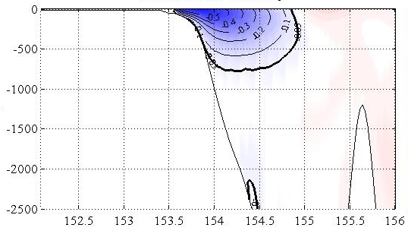
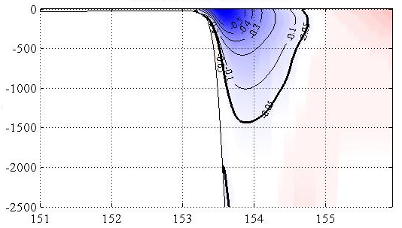
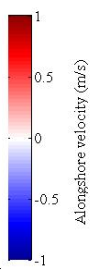
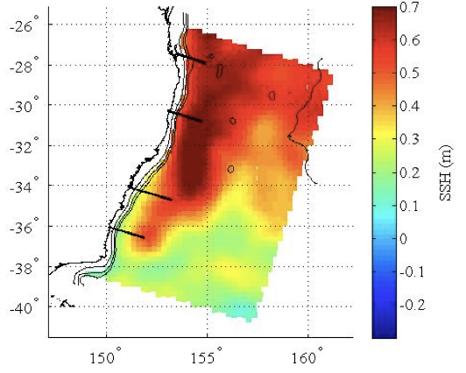
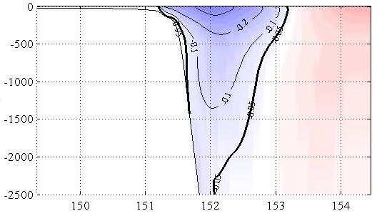
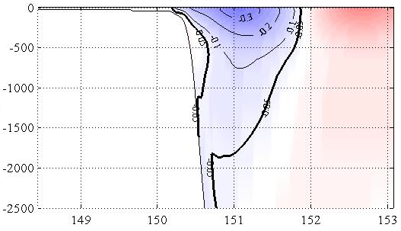
Which observations best capture the dynamics?
Mean alongshore velocity (m/s)
With 4D-Var, we can quantify how individual observations contribute to the changes in estimates of certain circulation metrics.
Alongshore volume transport:
Brisbane– 27.5S
Coffs Harbour
– 30.3S
27.5S
30.3S
Sydney – 33.9S
33.9S
36.2S
Narooma – 36.2S
Notes:
So moving now to the observation impacts. As Andy described earlier, we can use outputs from our assimilation calculations to quantify how individual observations contribute to the changes in estimates of certain circulation metrics
Here we define our circulation metric as Volume transport through shore normal sections. We look at 4 sections, off of Brisbane, Coffs harbour, Sydney and Narooma.
The EAC is most coherent off of Brisbane, it typically separates from the coast just south of CH, and this region between CH and Sydney is typically highly eddy dominated. And down at Narooma the portion of the EAC that hasn’t separated from the coast continues southward.

Slide 16
Which observations best capture the dynamics?
Alongshore volume transport:
Brisbane – 27.5S
Coffs Harbour – 30.3S
Sydney – 33.9S
Narooma – 36.2S
Notes:
These are the transport time series through the 4 sections. The background transport in black, and the analysis transport in magenta.
The differences between the background and the analysis vary between about plus minus 8Sv.

Slide 17
Which observations best capture the dynamics?
Brisbane– 27.5S
Coffs Harbour – 30.3S
Notes:
Here I’m presenting the impacts from 1 Jan 2012 through to May 2013.
In the top plot we see the number of each observation type for each window. And below we see how much each observation type contributes to the difference in the 5-day averaged volume transport, for the Brisbane and Coffs Harbour sections.
We can see that SSH (dark blue) and SST (royal blue) are impactful data streams.
Off of Brisbane, which is where the EAC array and the SEQ moorings are, they have a significant impact on the transport estimates (these are the dark red and red). And you can see that downstream at CH the EAC array observations also impact the estimates.
At CH the HF radar (in the green) dominates the impacts, and it also impacts estimates upstream at the EAC array.

Slide 18
Which observations best capture the dynamics?
Sydney – 33.9S
Narooma – 36.2S
Notes:
Moving downstream to Sydney and Narooma, the EAC array and HF radar continue to have significant impact on the volume transport estimates. As do SSH and SST.
And in April 2013 the number of glider observations significantly increases corresponding to a couple of glider missions in the eddies off of Sydney, and their impacts on transport through the Sydney section is particularly high.

Slide 19
Which observations best capture the dynamics?
 | Mean % of all observations | Mean % impact Brisbane | Mean % impact Coffs Harbour | Mean % impact Sydney | Mean % impact Narooma
AVISO SSH | 10.1 | -2.7 | 19.2 | 17.6 | 15.1
NAVO SST | 40.6 | 49.7 | 32.9 | 27.3 | 35.5
HF radar | 19.3 | 26.0 | 33.2 | 32.8 | 30.6
EAC array | 12.1 | 15.9 | 2.5 | 8.7 | 9.9
Gliders | 6.9 | 6.6 | 4.9 | 9.1 | 3.4
27.5S
30.3S
33.9S
36.2S
Notes:
In an attempt to summarise the mean impacts of the 5 most impactful observations, I put this table together.
The table is for the one-year time period starting from when the HF radar AND the EAC array were available, from May 2012 to May 2013.
SSH makes up about 10% of the observations. It has very small impact off of Brisbane, as we are quite close to the boundary where we are receiving BRAN boundary conditions, and SSH variability is relatively low here.
In the downstream, more eddy dominated regions, SSH has a a significant impact.

Slide 20
Which observations best capture the dynamics?
 | Mean % of all observations | Mean % impact Brisbane | Mean % impact Coffs Harbour | Mean % impact Sydney | Mean % impact Narooma
AVISO SSH | 10.1 | -2.7 | 19.2 | 17.6 | 15.1
NAVO SST | 40.6 | 49.7 | 32.9 | 27.3 | 35.5
HF radar | 19.3 | 26.0 | 33.2 | 32.8 | 30.6
EAC array | 12.1 | 15.9 | 2.5 | 8.7 | 9.9
Gliders | 6.9 | 6.6 | 4.9 | 9.1 | 3.4
27.5S
30.3S
33.9S
36.2S
Notes:
SST makes up about 40% of all observations. Its percentage impact is high off of Brisbane, and slightly lower but still very significant off of Coffs Harbour, Sydney and Narooma.

Slide 21
Which observations best capture the dynamics?
 | Mean % of all observations | Mean % impact Brisbane | Mean % impact Coffs Harbour | Mean % impact Sydney | Mean % impact Narooma
AVISO SSH | 10.1 | -2.7 | 19.2 | 17.6 | 15.1
NAVO SST | 40.6 | 49.7 | 32.9 | 27.3 | 35.5
HF radar | 19.3 | 26.0 | 33.2 | 32.8 | 30.6
EAC array | 12.1 | 15.9 | 2.5 | 8.7 | 9.9
Gliders | 6.9 | 6.6 | 4.9 | 9.1 | 3.4
27.5S
30.3S
33.9S
36.2S
Notes:
As expected, the radar dominates the impacts at CH, but it also has a very strong impact both up and downstream from its location, with mean impacts of about 30% at all 4 sections.

Slide 22
Which observations best capture the dynamics?
 | Mean % of all observations | Mean % impact Brisbane | Mean % impact Coffs Harbour | Mean % impact Sydney | Mean % impact Narooma
AVISO SSH | 10.1 | -2.7 | 19.2 | 17.6 | 15.1
NAVO SST | 40.6 | 49.7 | 32.9 | 27.3 | 35.5
HF radar | 19.3 | 26.0 | 33.2 | 32.8 | 30.6
EAC array | 12.1 | 15.9 | 2.5 | 8.7 | 9.9
Gliders | 6.9 | 6.6 | 4.9 | 9.1 | 3.4
27.5S
30.3S
33.9S
36.2S
Notes:
And the EAC transport array has a strong impact on estimates at its location (off of Brisbane) as well as at Sydney and Narooma.
At CH there are some specific assimilation windows where the impact of the EAC array on CH transport is opposite to the combined impact of all observations, which gives a negative impact at these times, hence this mean small number.

Slide 23
Which observations best capture the dynamics?
 | Mean % of all observations | Mean % impact Brisbane | Mean % impact Coffs Harbour | Mean % impact Sydney | Mean % impact Narooma
AVISO SSH | 10.1 | -2.7 | 19.2 | 17.6 | 15.1
NAVO SST | 40.6 | 49.7 | 32.9 | 27.3 | 35.5
HF radar | 19.3 | 26.0 | 33.2 | 32.8 | 30.6
EAC array | 12.1 | 15.9 | 2.5 | 8.7 | 9.9
Gliders | 6.9 | 6.6 | 4.9 | 9.1 | 3.4
27.5S
30.3S
33.9S
36.2S
Notes:
And the gliders only begin to have a significant impact in April of 2013 when the number of observations is great and the gliders are in the eddies off of Sydney. They have the strongest impact at Sydney, but also impacts at the other 3 sections.

Slide 24
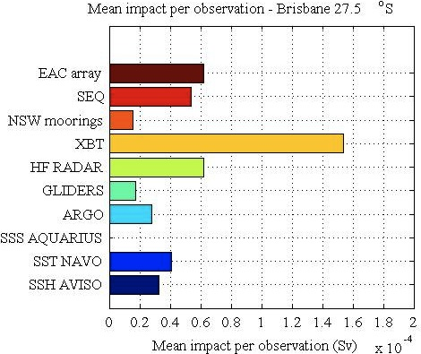
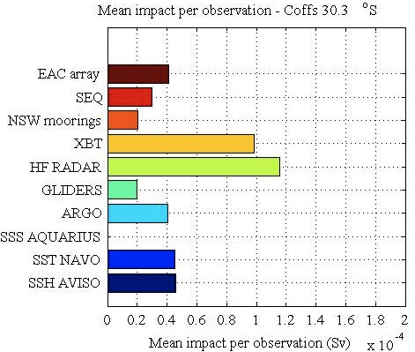
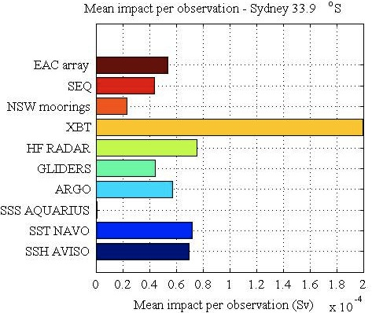
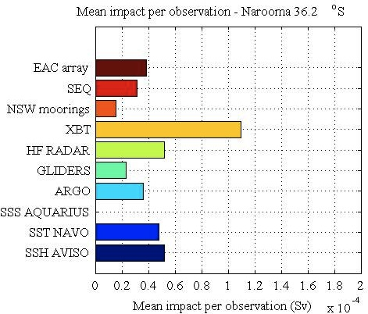
Impact per observation
Impacts - Sydney – 33.9S
Impacts per observation - Sydney – 33.9S
Brisbane – 27.5S
Coffs Harbour – 30.3S
Sydney – 33.9S
Narooma – 36.2S
EAC array
SEQ
NSW
XBT
HF radar
Gliders
Argo
SSS Aqu.
SST NAVO
SSH AVISO

Slide 25
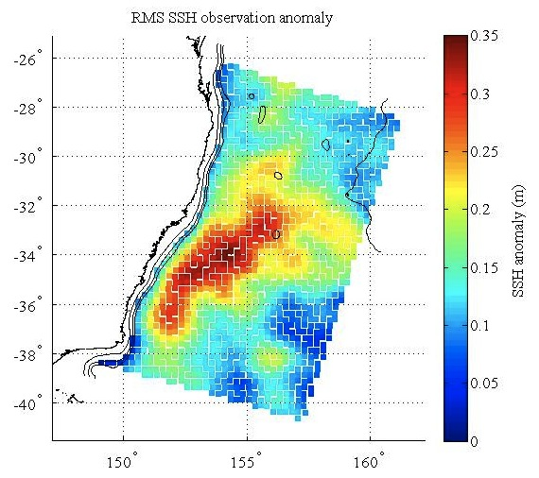
Which observations best capture the dynamics?
Next… EKE……
Second order Taylor Expansion
Notes:
Next we want to look at observation impact on a circulation metric that describes eddy formation, most probably EKE spatially-averaged over a certain area, depth, and over each 5 day time window.

Slide 26
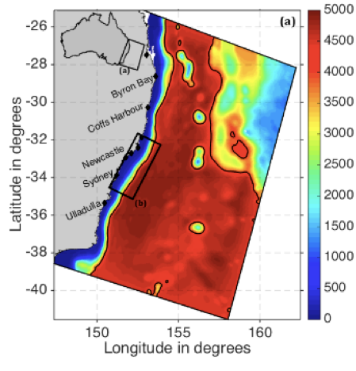
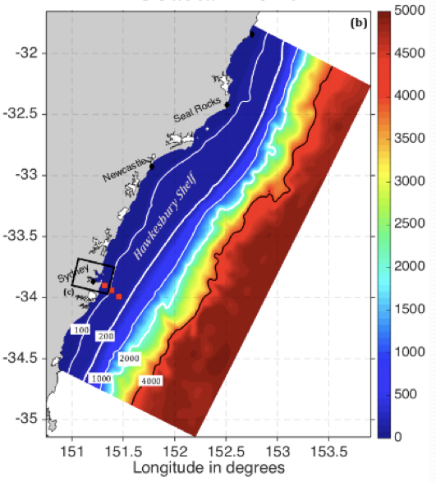
Where to next?
Balanced terms in the background error covariance matrix, assimilation of alongtrack SSH
Anisotropic decorrelation length scales for background error covariances
Designing an optimal observing system (IMOS)
Predictability at the coastal scale
EAC Model
Coastal Model
Notes:
Moving forward, we want to look at including balanced terms in the P, with the major motivation being to assimilate alongtrack SSH
We’d like to look at applying anisotrophic decorrelation length scales, because the length scales of variability on the shelf vary markedly from those offshore.
And we’re also moving towards looking at predictability at the coastal scale, where shelf processes with shorter decorrelation time scales dominate. I haven’t talked much about forecasting, but with the mesoscale ocean circulation the forecast skill is typically heavily dependent on the initial state estimate. But as we move to smaller scales the forecast skill likely to be less dependent on the initial conditions and more dependent on the forcing and on the model parameters….. And I would like to include parameter uncertainties in the cost function and see if we can use this to optimise model parameters.
…

