Slide 1
Modelling regional ice/ocean interaction in ROMS
Complications in ice shelf-ocean modelling revealed through idealised simulations:
Lessons learnt from the ISOMIP+ experiments
David Gwyther ¹, Kazuya Kusahara², Ben Galton-Fenzi ^{3,2}, Mike Dinniman⁴ and discussions with many others…
¹ Institute for Marine and Antarctic Studies, University of Tasmania, Hobart, Tasmania
² Antarctic Climate & Ecosystem CRC, University of Tasmania, Hobart, Tasmania
³Australian Antarctic Division, Kingston, Tasmania
⁴ Centre for Coastal Physical Oceanography, Old Dominion University, Virginia, USA

Slide 2
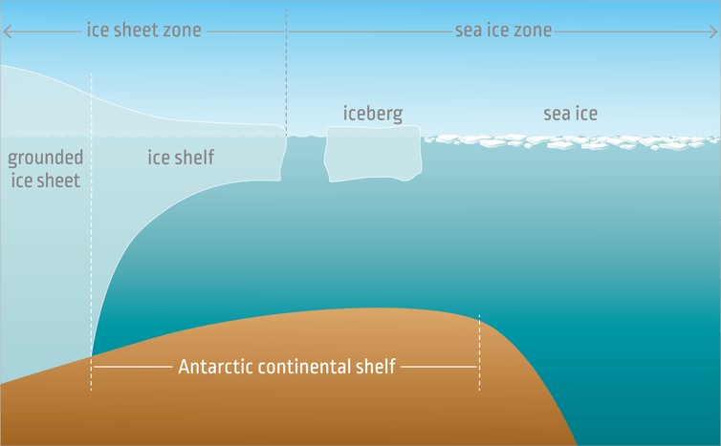
Land ice vs. sea ice
King, Galton-Fenzi, Hobbs (2016)

Slide 3
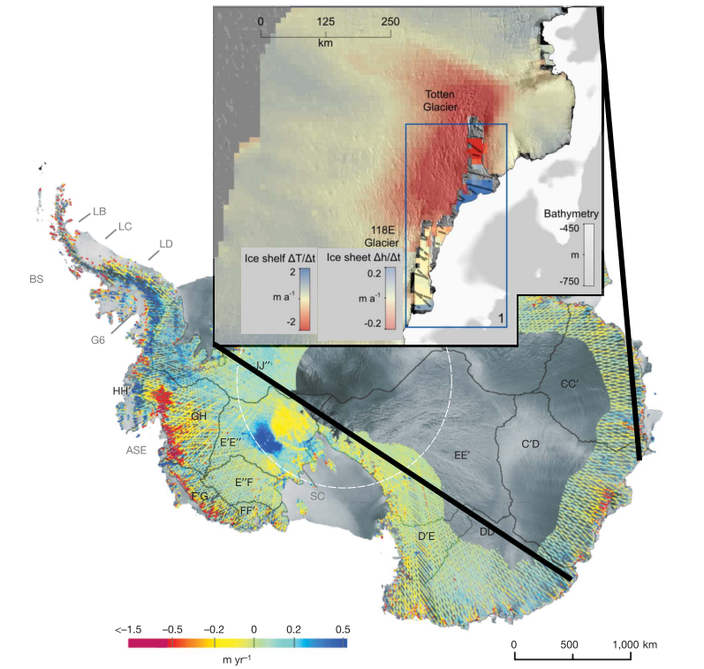
Ice/ocean modelling and SLR
Basal melting -> ice shelf thinning
Ice shelf thinning -> less buttressing of glaciers, and hence sea level rise
> 50m of SLR, >20m of marine-based SLR
Understanding ice/ocean interaction is critically important
^{Pritchard et al., 2012}

Slide 4
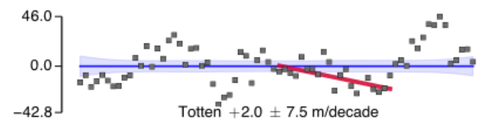
Benefits of ice/ocean models
Spatial issues
Temporal issues
Logistical issues with in situ observations
Difficult to understand bigger picture from point observations
Thickness
change (m)
^{Paolo et al., 2015}

Slide 5
Challenges of ice/ocean models
Unresolved processes
e.g. turbulence, melting
Poorly understood physics
e.g. feedback between melting and surface roughness
Model vs. real-world
e.g. Numerical diffusion, errors, complex physics
Comparing models
e.g. different model platforms simulate ice/ocean interaction differently
This is what I will talk about

Slide 6
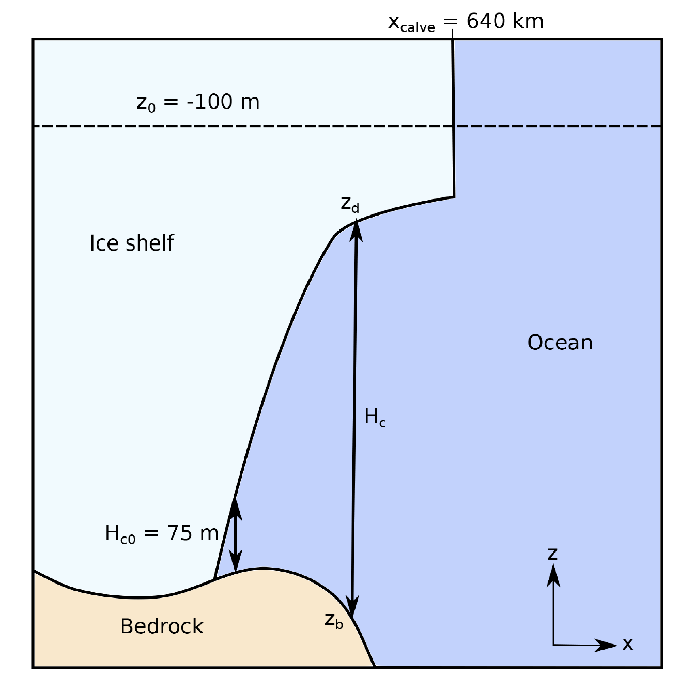
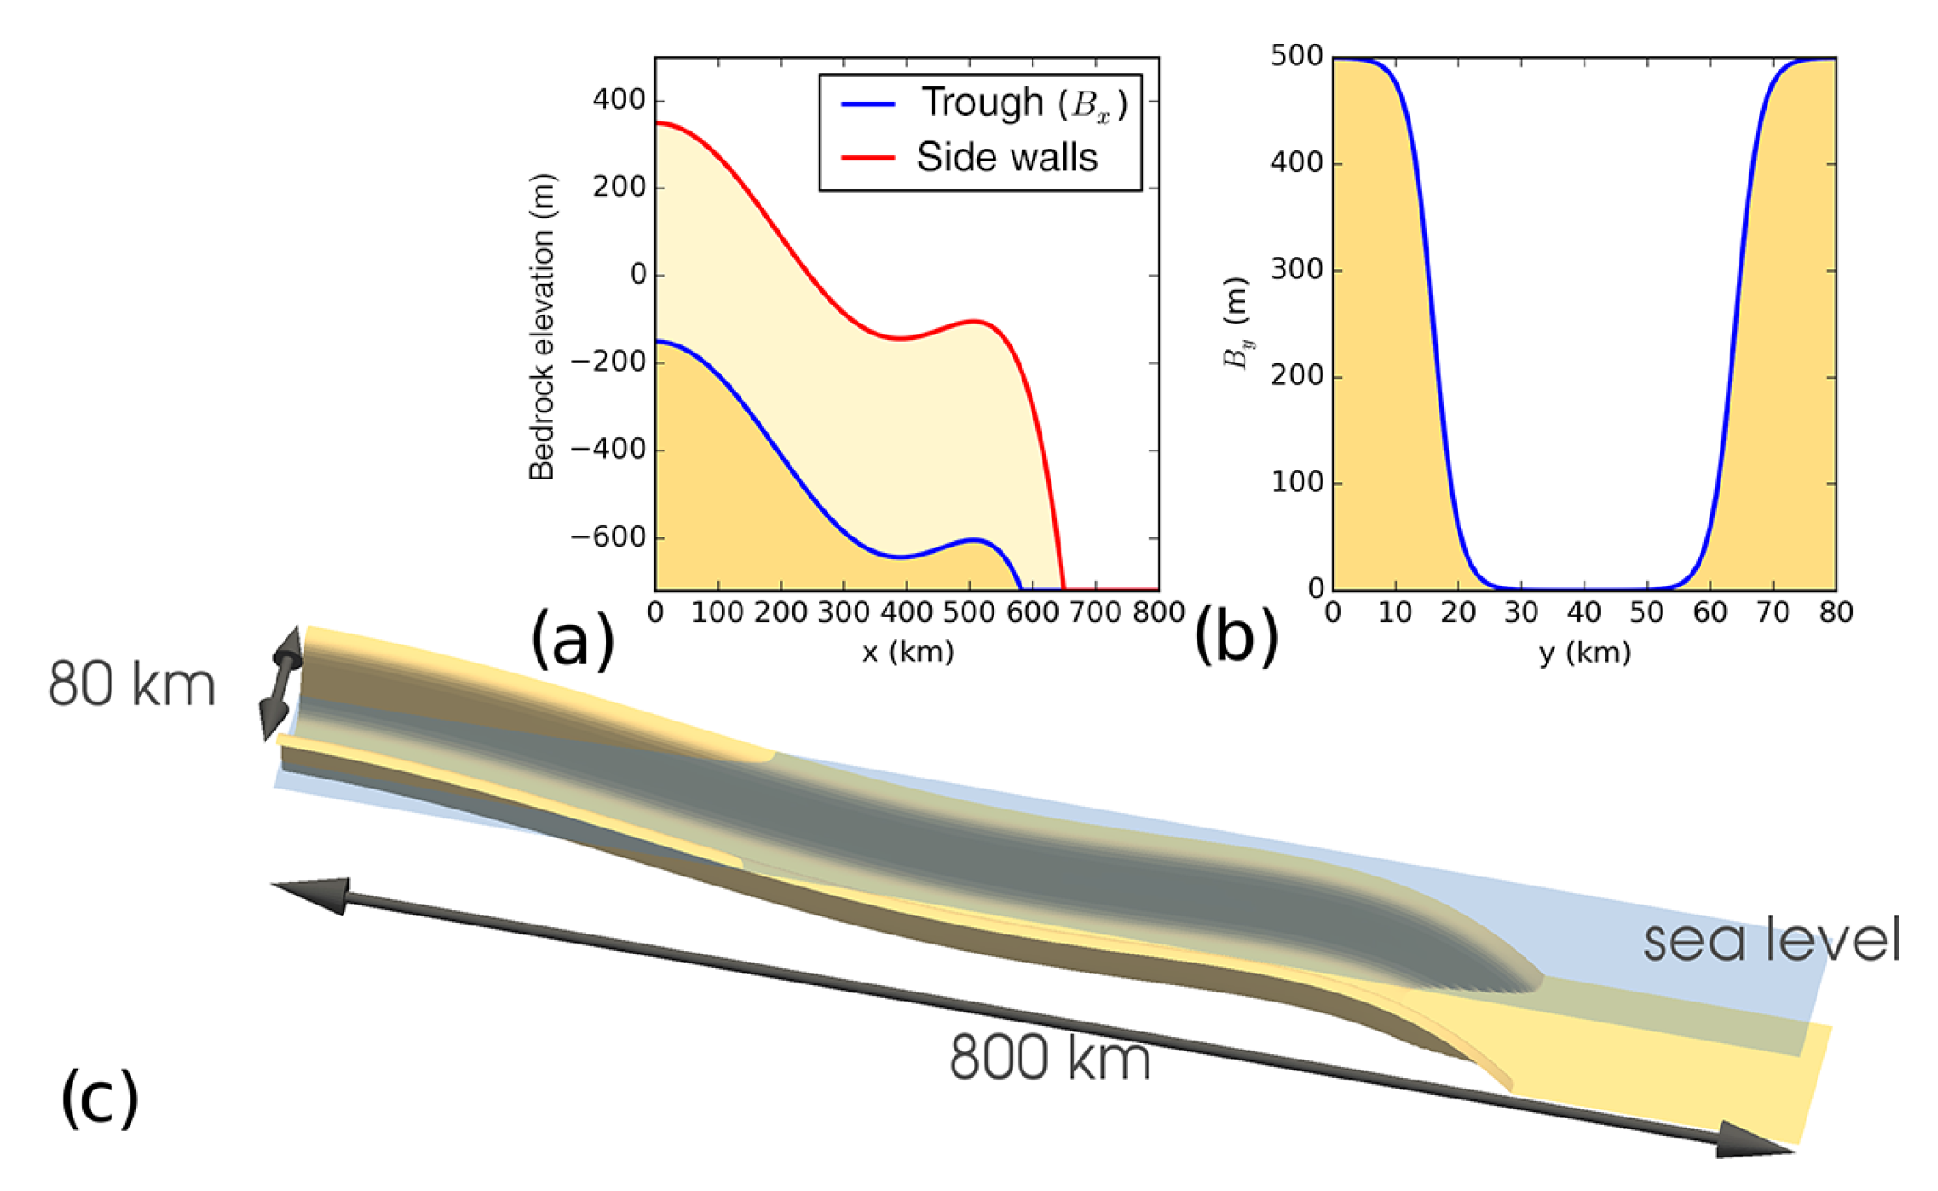
ISOMIP+ (a part of MISOMIP)
Marine Ice Sheet Ocean Model Intercomparison Project (MISOMIP)
Ice Shelf-Ocean Model Intercomparison Project +
Simplified geometry & forcing, common parameterisations of physics
Builds upon past ISOMIP-like experiments, e.g.
Grosfeld et al., 1997; Hunter, 2008; Holland et al., 2008; Losch, 2008; Little et al. 2008, 2009; Goldberg et al. 2012; Kimura et al. 2013; Dansereau et al. 2014, Gwyther et al. 2015, 2016.
^{Asay-Davis et al., 2016}

Slide 7
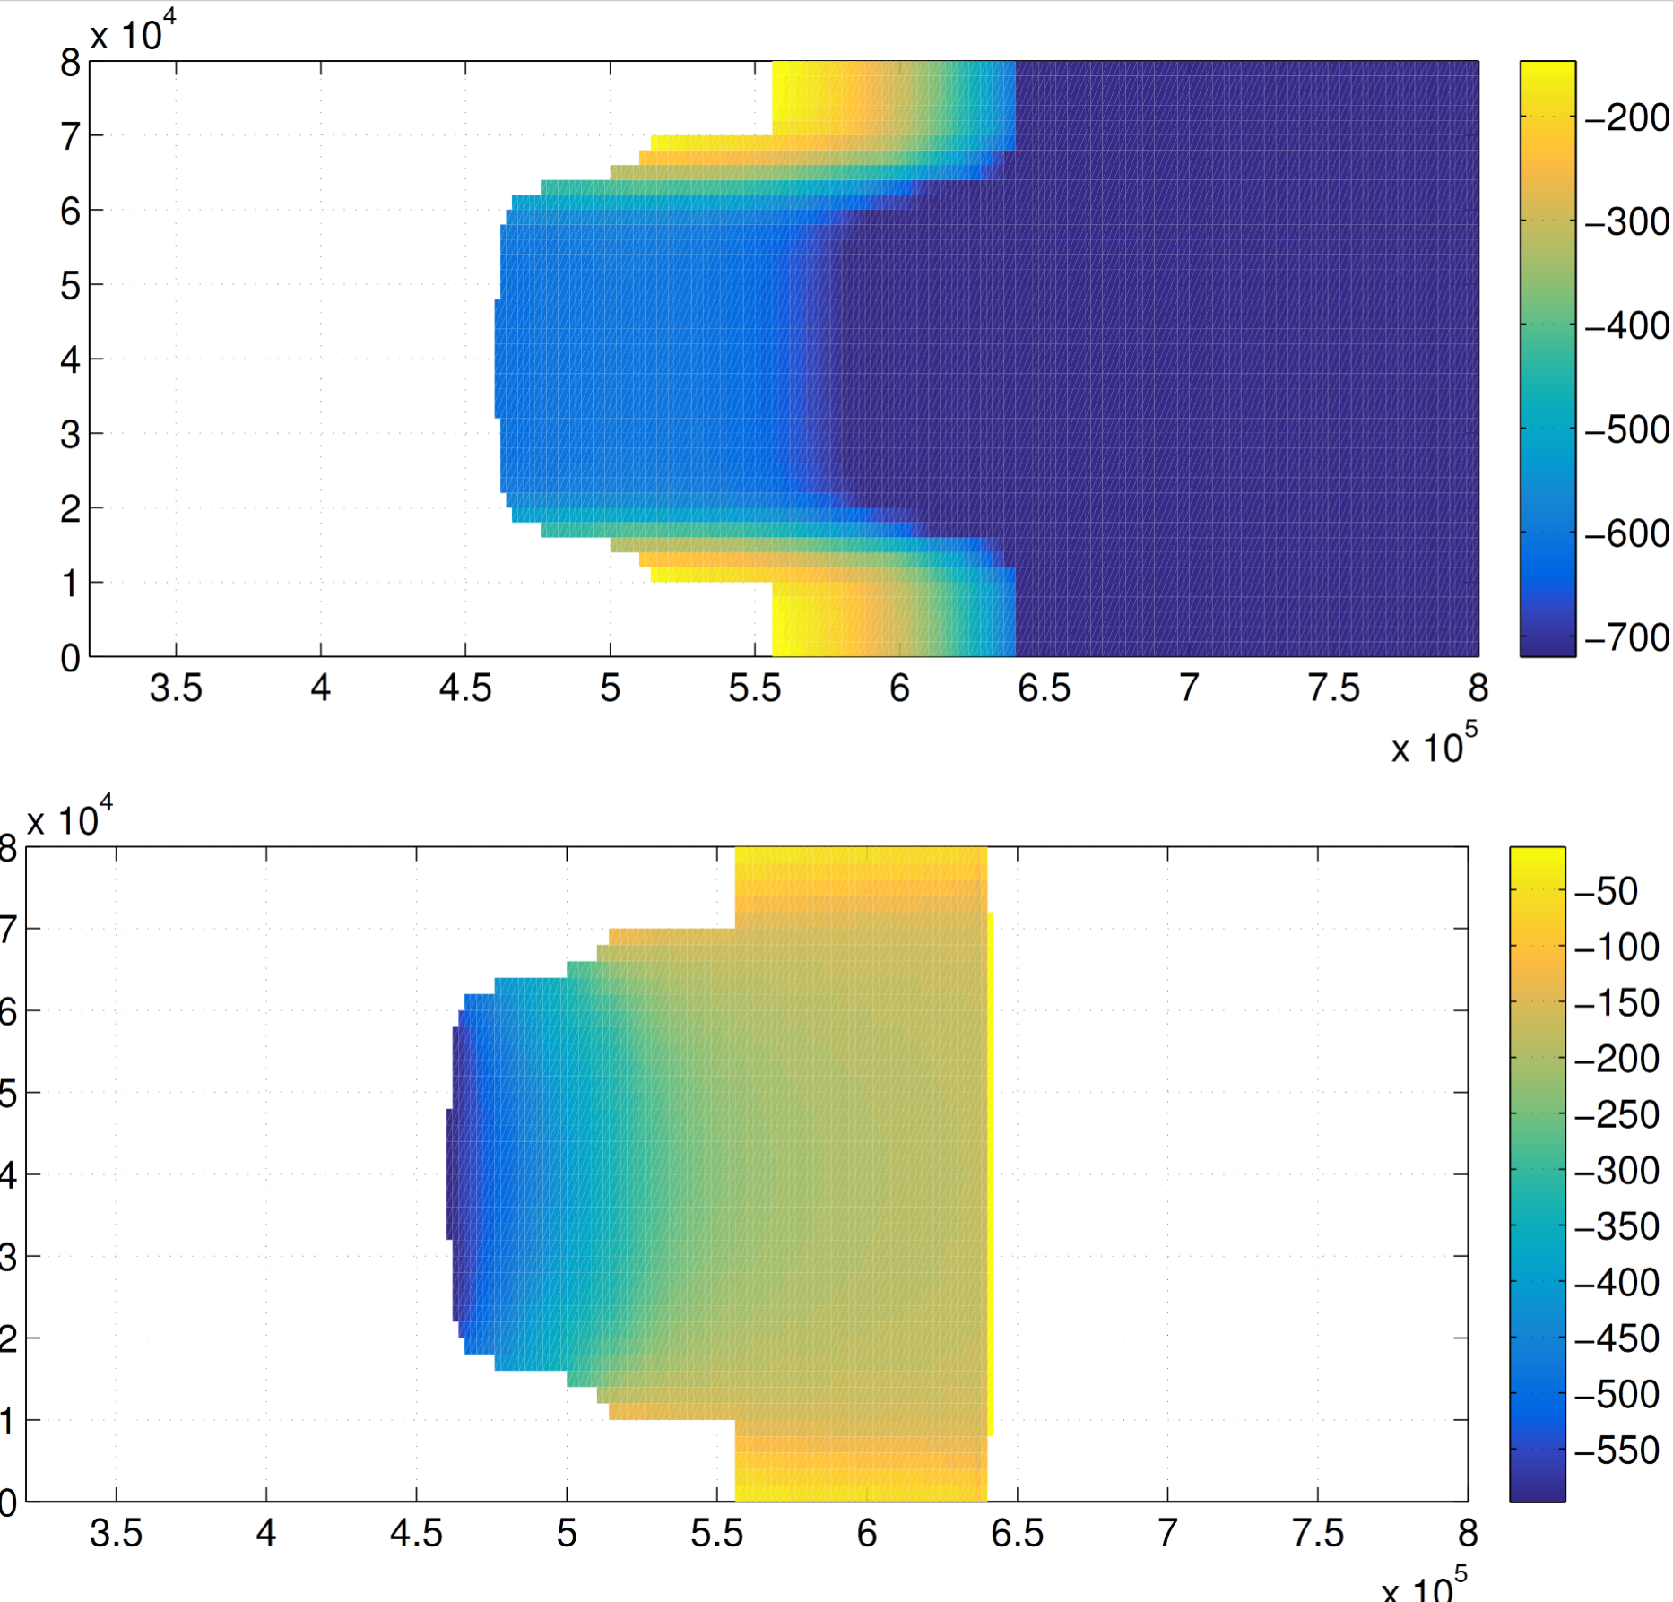
Bathymetry
Ice draft
(depth of ice below MSL)

Slide 8
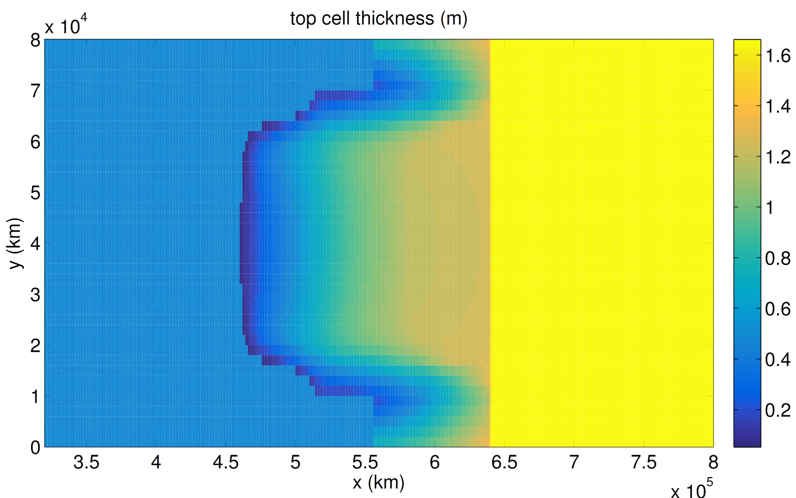
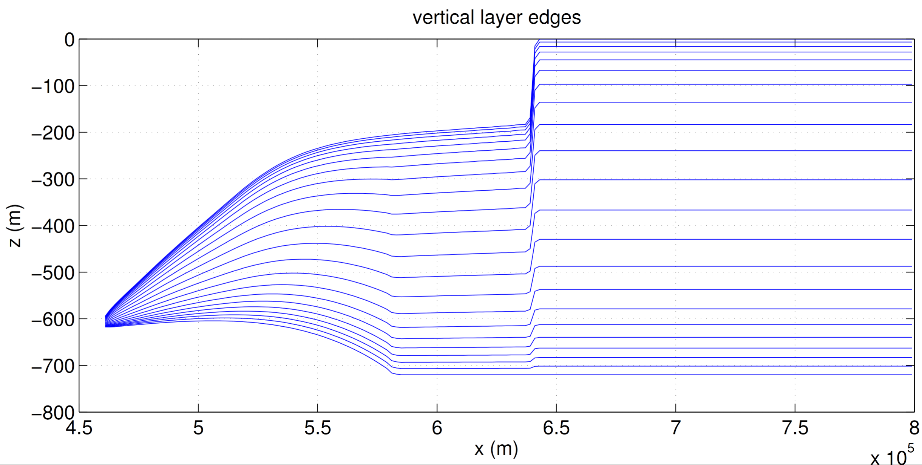
Our contribution to ISOMIP+ is ROMS
Regional Ocean Modelling System (ROMS)
Modified for ice/ocean interaction (Dinniman et al., 2007; Galton-Fenzi et al., 2012) with thermodynamic interaction and pressure of overlying ice.
Terrain-following (or sigma-level) vertical coordinate

Slide 9
Results of ISOMIP+
Ocean1 (warming ocean)
Ocean2 (cooling ocean)

Slide 10
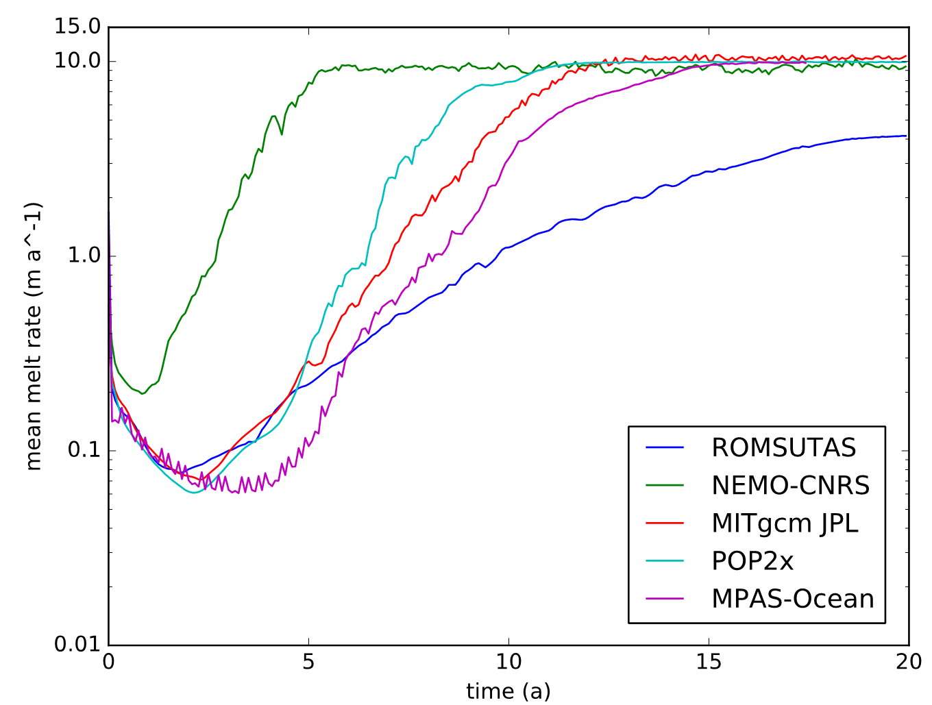
Big differences from other models
In ROMS, melting is slower to respond and weaker than z-coordinate models
We don’t know what the correct answer is…
^{Asay-Davis et al., in prep.}

Slide 11
Quirks of parameterizing melt rates
Three-equation parameterisation (Holland and Jenkins, 1999)
Melting is function of thermal driving and velocity.
Discretisation of cells in sigma vs z-level:
Calculating thermal driving
Distributing meltwater
“mixed layer depth” assumption (Losch, 2008)

Slide 12
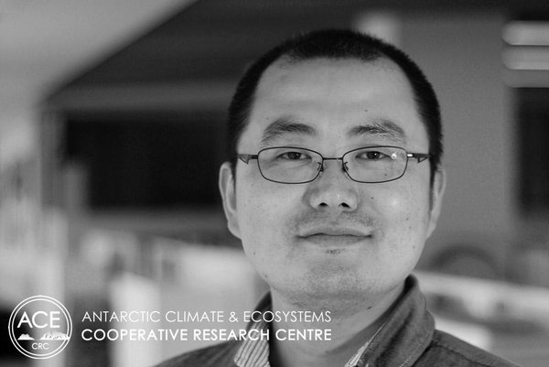
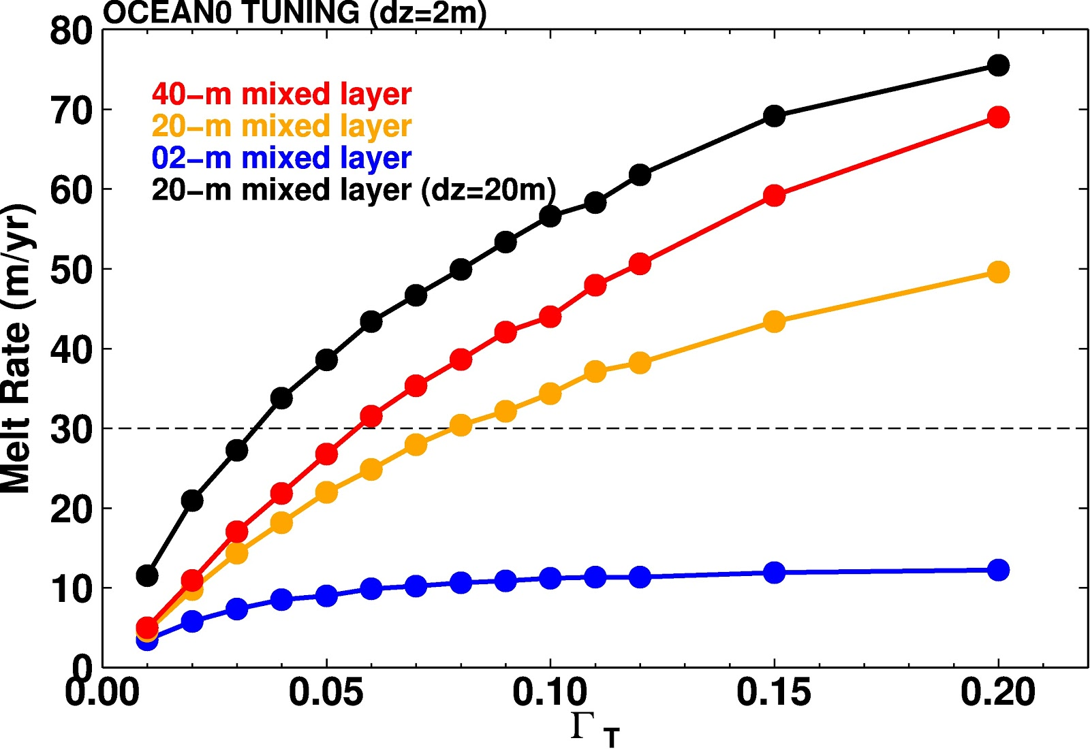
Tests comparing z-level to sigma-level
Z-level model results from Kazu Kusahara (ACE CRC) from COCO
Decreasing ‘mixed layer thickness’, decreases melt rate
Increasing resolution decreases melt rate

Slide 13
Tests comparing z-level to sigma-level
Z-level model results from Kazu Kusahara (ACE CRC) from COCO
Decreasing ‘mixed layer thickness’, decreases melt rate
Increasing resolution decreases melt rate

Slide 14
ROMS vs. z-level models
In ROMS:
Fresh, low density buoyant meltwater stabilises and cools top of column
Thermal driving is thus weaker
In COCO/z-level models:
Meltwater is distributed over a greater depth – assumed implicit vertical mixing
Thermal driving is calculated at deeper location in water column
Consider vertical discretisation for any source of vertical mixing (e.g. topography, surface fluxes and stress)
Don’t treat the model like a black box!

Slide 15
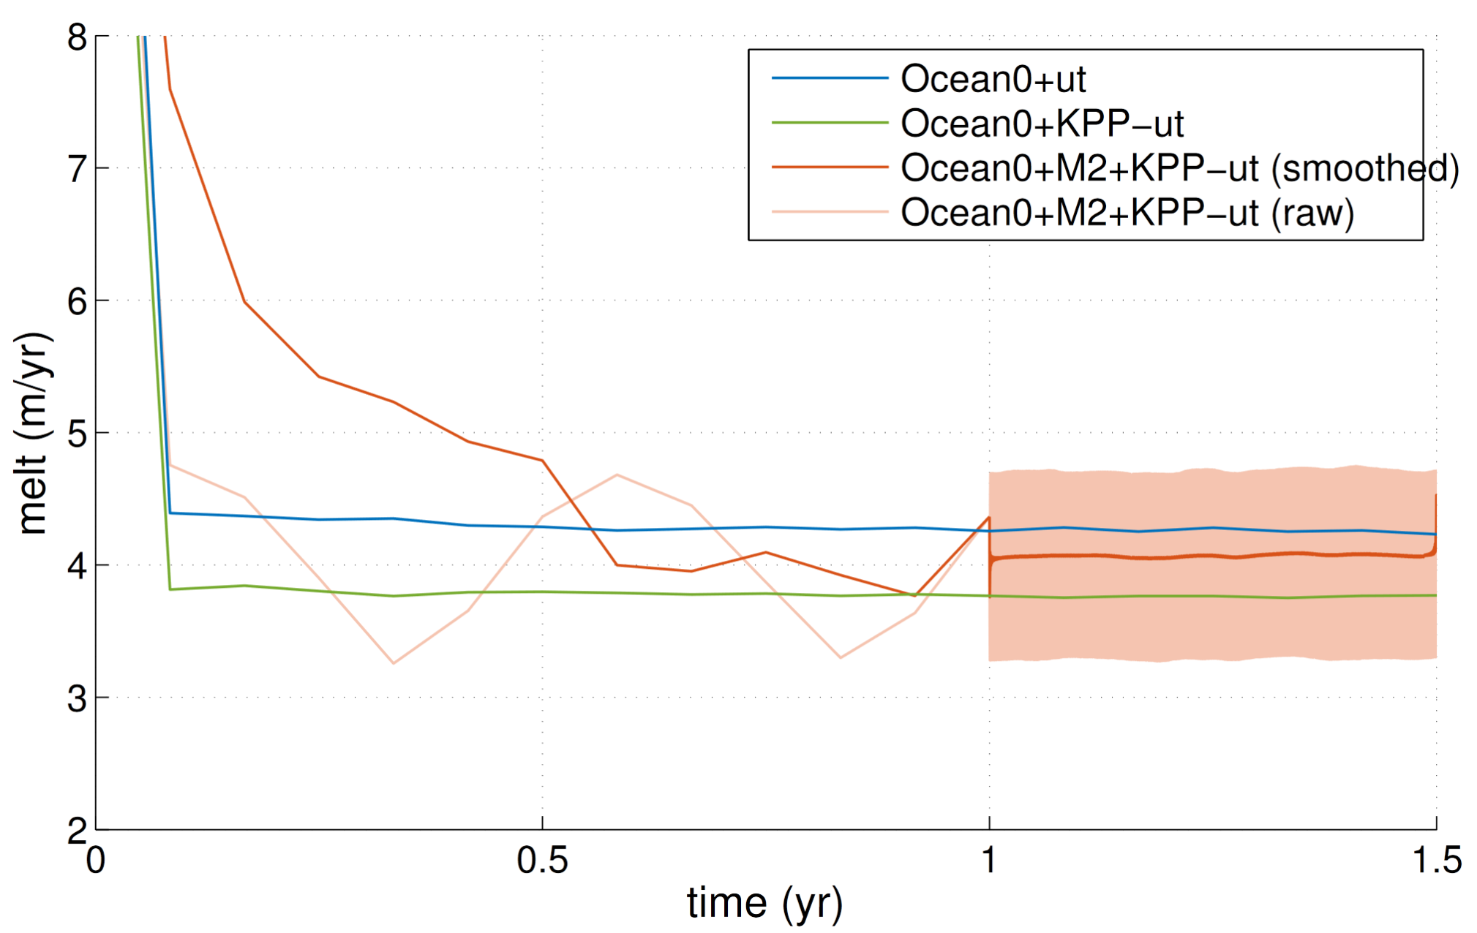
Compensation with other mixing?
spinup
Couldn’t match other model melt rates (between 10-15 m/yr)

Slide 16
Compensation with other mixing?
Couldn’t match other model melt rates (between 10-15 m/yr) in THIS experimental framework
More complex vertical mixing is weaker than constant vertical mixing chosen in these experiments
z-level models (in these experiments) are matching observed melt rates with vertical mixing much higher than might be realistic (?)
spinup

Slide 17
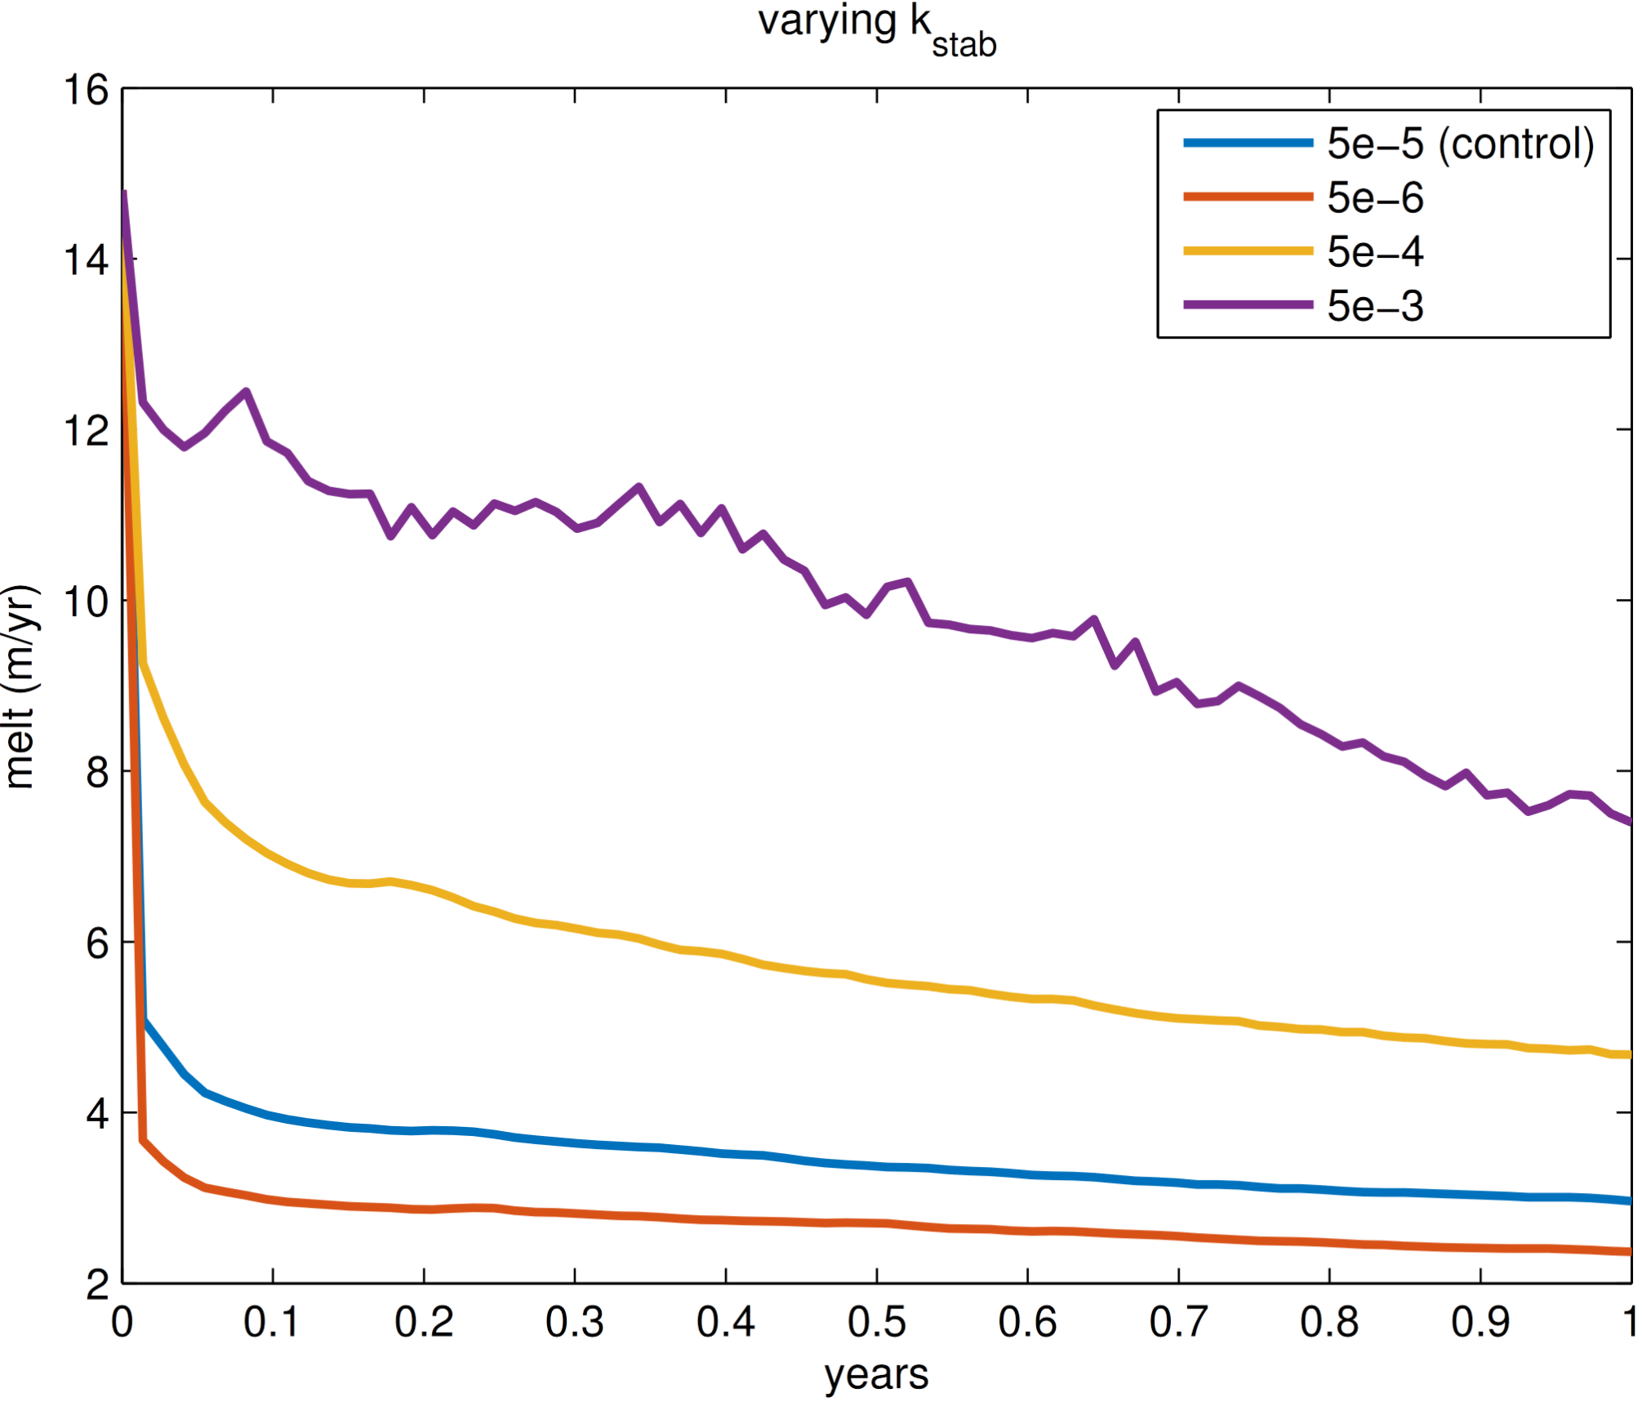
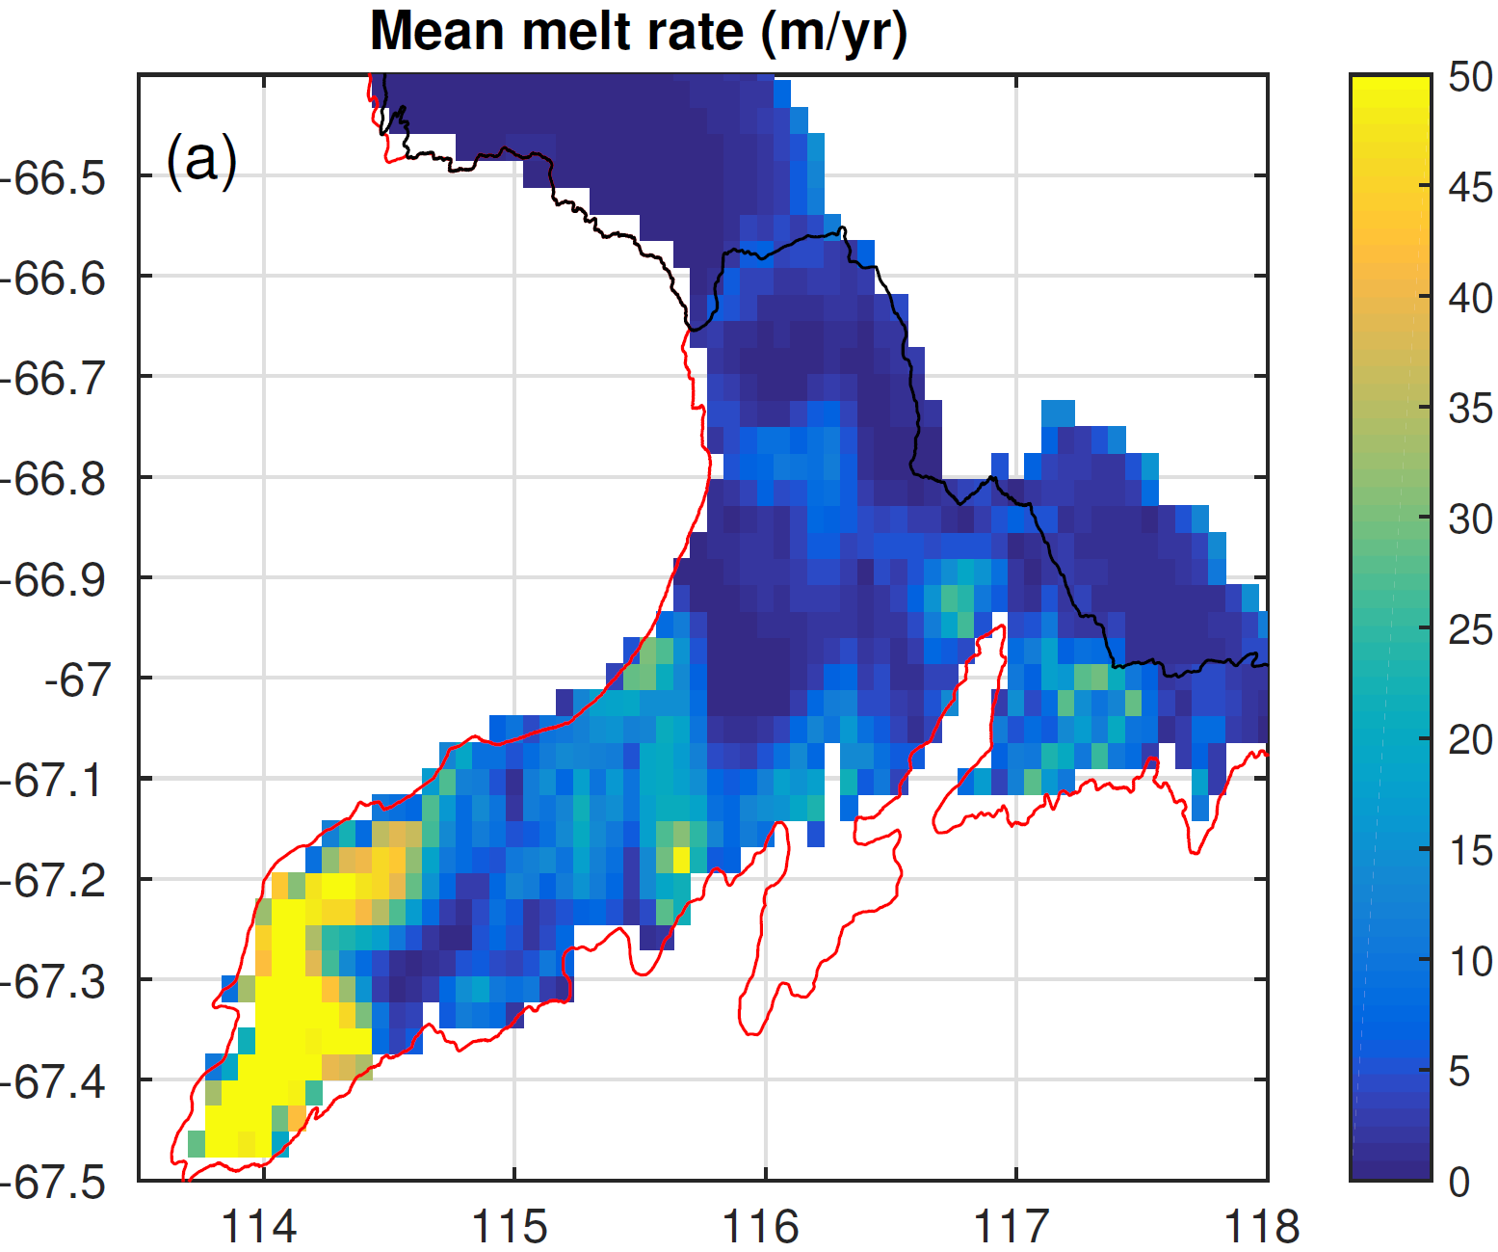
ROMS can produce high melt rates!
ROMS can produce strong melt, if the boundary layer stratification is broken down (increased vertical eddy diffusivity)
Totten Glacier ice shelf model displays high melt rate. Sources of vertical mixing include complex tides, complex bathy/topography, etc.

Slide 18
Conclusions
ROMS has thinner vertical levels (in general)
No implied vertical mixing, stratified meltwater layer, cooler thermal driving, less melt
Z-level models generally lower vertical resolution
Implicit mixing of meltwater, weaker stratification, stronger thermal driving, higher melt
In ISOMIP+, ROMS melts lower, but z-level models move towards ROMS at high res
Widespread deficiencies in the application of the ice/ocean melt parameterisation.
We don’t know what the correct answer is: more observations of the ice/ocean system needed
Also relevant for any sources of vertical mixing in sigma- vs. z-level models

Slide 19
Thank you!

Slide 20
ISOMIP+ specs
Horizontal grid res = 2km, 21 vertical levels
Linear equation of state
3-equation parameterisation with constant heat/salt fluxes
Quadratic drag with coefficient = $2.5×{10}^{−3}$
Constant offset to friction velocity, $u_{tidal}=0.01$m/s
Insulating ice
Convective vertical viscosity = 0.1 m^2/s
Convective vertical diffusivity = 0.1 m^2/s
Stable vertical eddy viscosity = ${10}^{−3}$ m^2/s
Stable vertical eddy diffusivity = $5×10^−5$ m^2/s
Northern 10 km relaxed at a rate of 0.1/day

