Slide 1
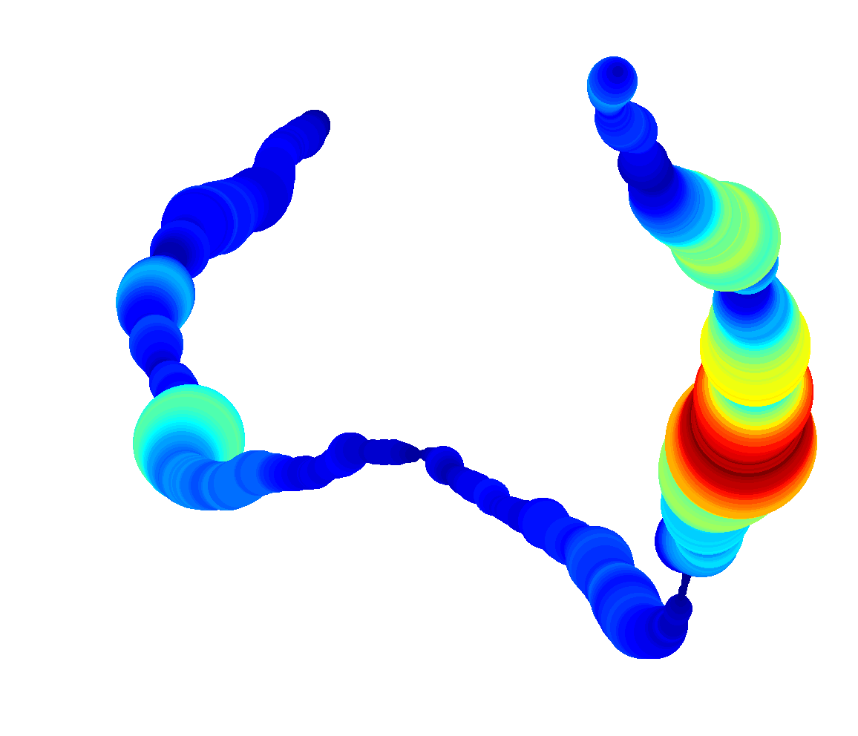
ozROMS - a high resolution16 year re-analysis product for Australian and Indonesian Seas
EMS Wijeratne¹, Charitha Pattiaratchi¹ and Roger Proctor²
¹ The UWA Oceans Institute, The University of Western Australia
² University of Tasmania, Hobart, Tasmania, Australia.
Acknowledgments
The study was funded by the Australian National Network in Marine Science (ANNIMS) springboard program with the title ‘Ocean-shelf exchange with an emphasis on the roles of waves, tides, eddies and cross-shelf flows.
Access to the super-computing facilities of the Pawsey Centre (Magnus) was enabled through the partner allocation scheme.

Slide 2
Outline
Background/Motivation/Goals
Model setup
Prediction Vs observation
Simulation results
(Meso-scale processes, boundary current transport )
Summary
Notes:
This is my presentation outline.
Firstly, I will brief background of the project
Then I will show you OzROMS grid and forcing configuration.
Then, I will go thorough few slides on model validation process
Finally, I will show you some simulation results, particularly, model
calculated along shelf and cross-shelf net volume fluxes.
Prior to OzROMS configuration, we conducted a set of experiments,
we tested different domain extends, forcing resolution etc.

Slide 3
Background/Motivation/Goals
To configure ROMS 3D model covering whole Australia region;
relatively high spatial resolution
includes all realistic forcing
Estimate oceanic inflows to surface and subsurface boundary currents around Australia
Capturing offshore ocean basin flows that directly contribute to surface and sub-surface boundary currents
Capturing seasonal signal (sea level, transport etc.)
Grid resolution (shelf slope bathymetry, islands) and forcing fields (atmospheric and tides) to obtain the optimum parameters for simulation

Slide 4
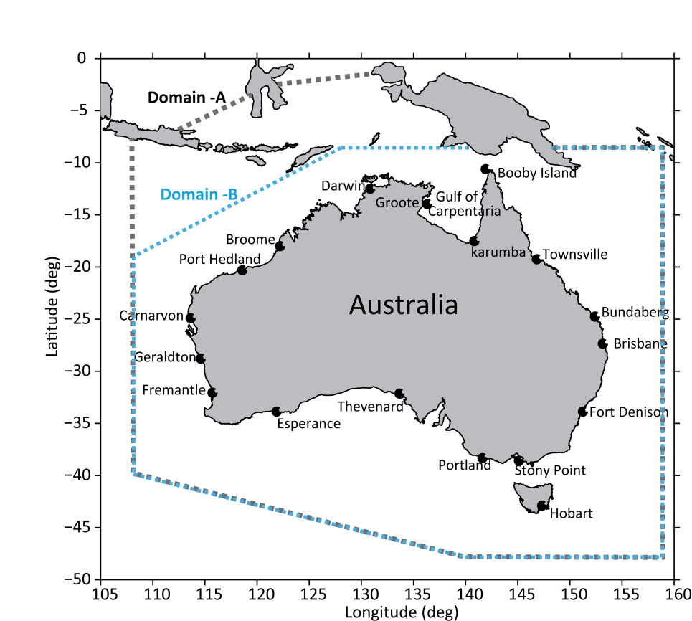
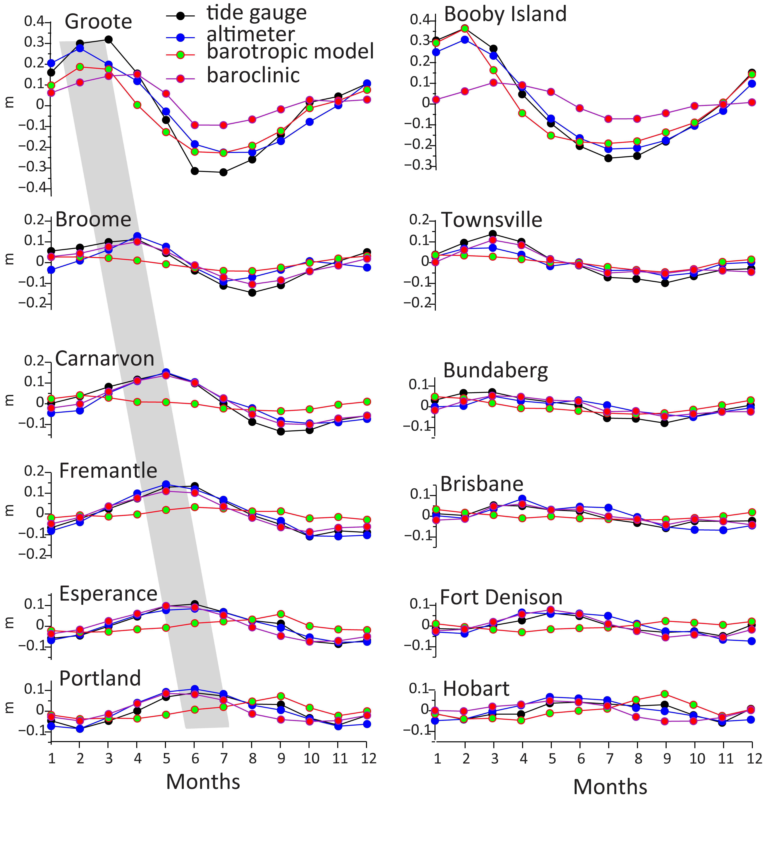
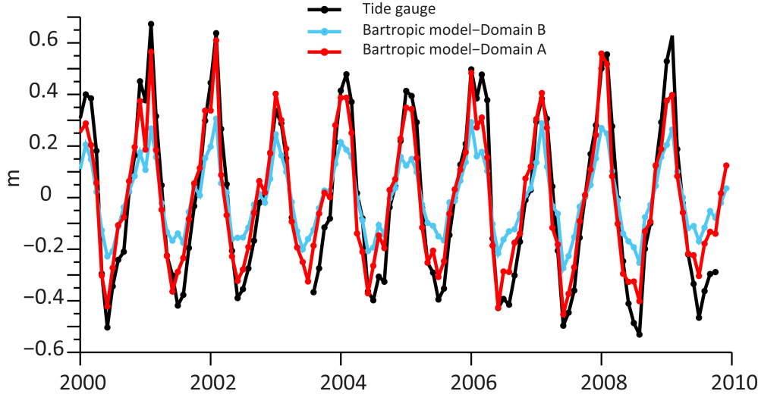
Background/Motivation/Goals
Barotropic model boundary (black dash lines for Domain-A and light blue lines for Domain-B ) and tide gauge sites (●).
Monthly mean sea level components at different sites along the coastline.

Slide 5
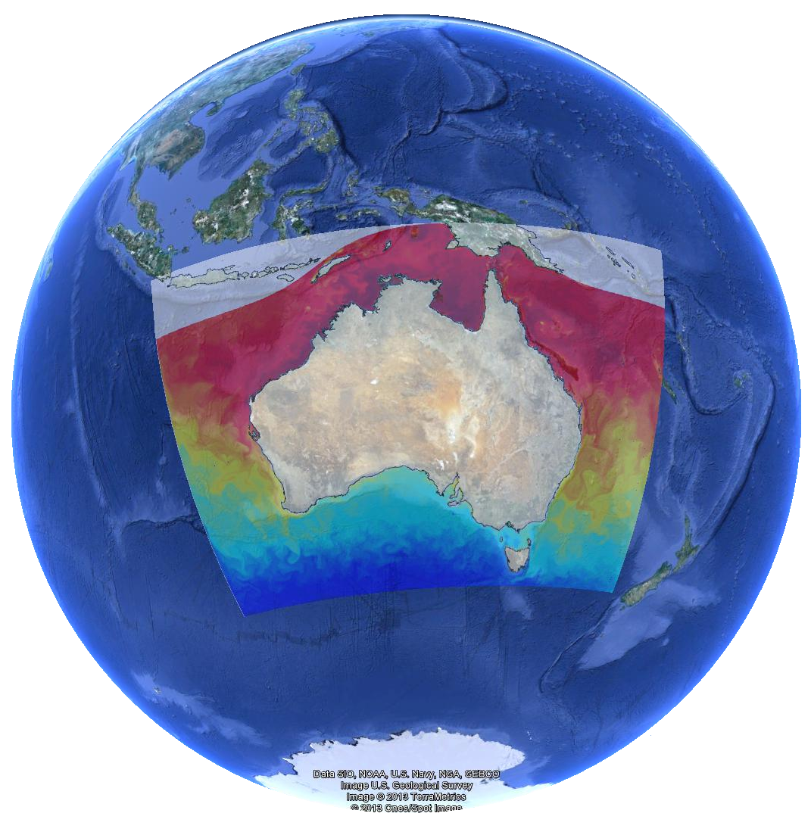
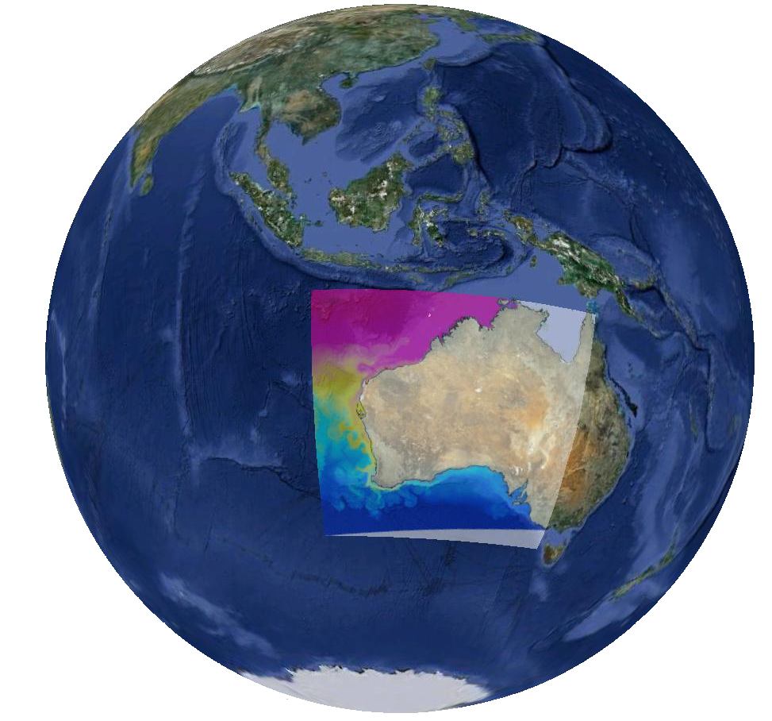
Background/Motivation
/Goals
2015-2016
2011-2014
2010-2011

Slide 6
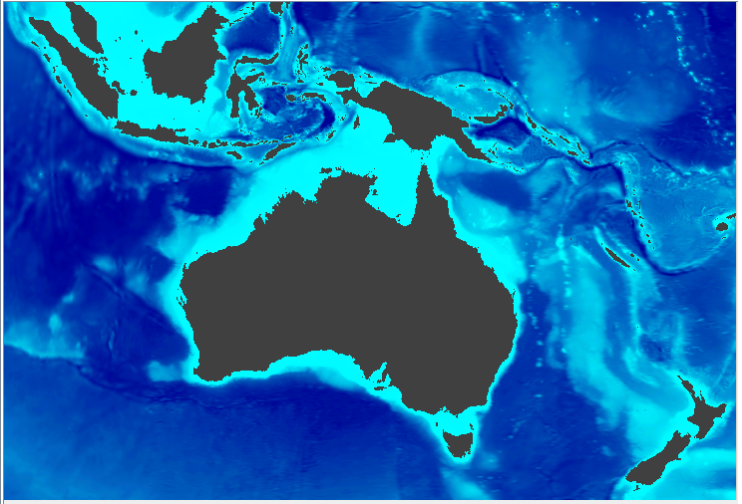
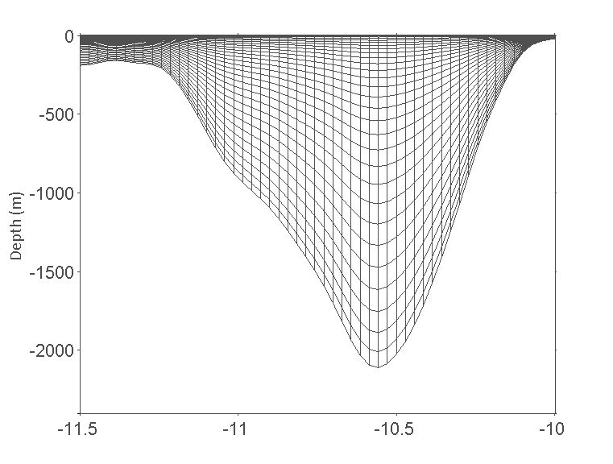
Model setup- Bathymetry/Grid
Bathymetry: GEBCO 30 Sec bathymetry
Coastline derived from bathymetry
100 % HyCOM Bathymetry
100% GEBCO (30 arc-second)
~3-4 km horizontal grid resolution (2160 × 2160)
30 s-layers

Slide 7
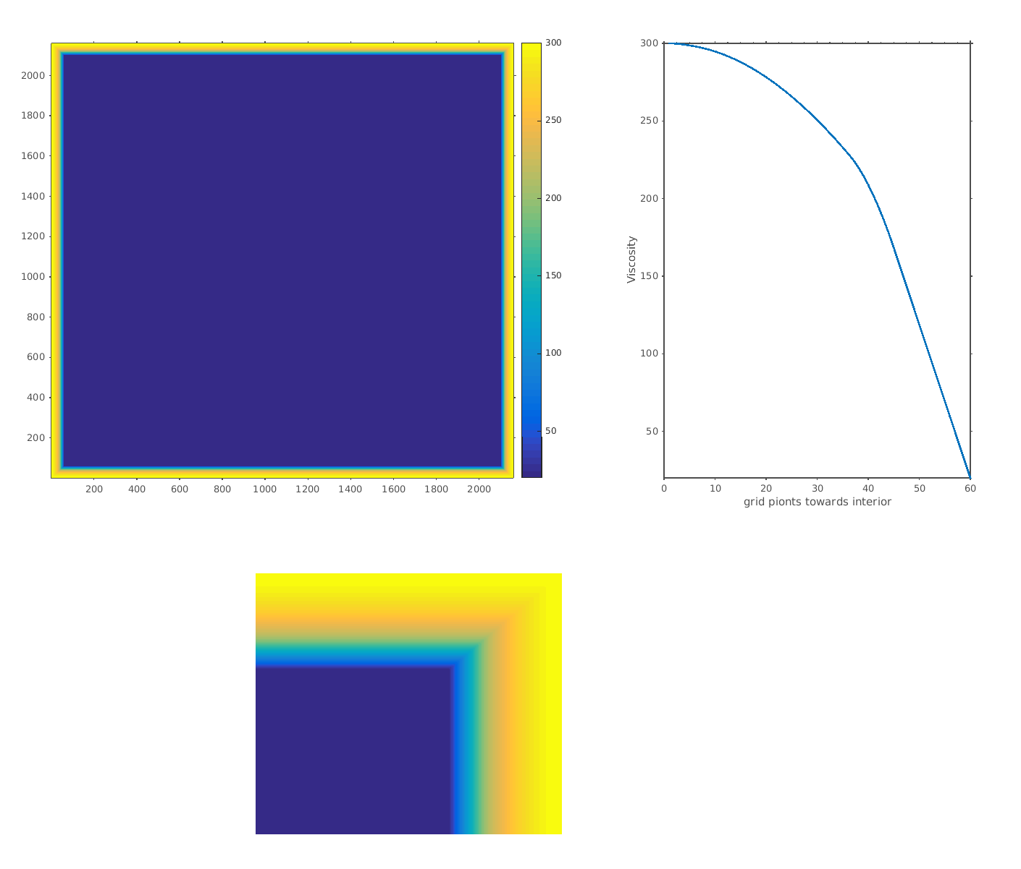
Sponge/Nudging
Sponge: ~180 km (60 grid points).
Nudging with HyCOM (03 day average)
20
300

Slide 8
Initial condition and forcing
Initial : HYCOM data (Jan 1999, one year spin up)
Atmospheric :
03 hr and 0.125º resolution ECMWF Interim archive
Open boundary :
daily HYCOM, radiation/nudging open boundary conditions
Open boundary tide :
OSU-TPX07.2, Chapman condition for elevation and the Flather condition for depth-averaged current ellipses.
Eight primary (M2, S2, N2, K2, K1, O1, P1, Q1), two long period (Mf, Mm) and three non-linear (M4, MS4, MN4) harmonic constituents
SS and SST are relaxed to daily HYCOM
No river inputs !!

Slide 9
NtileI == 20 ! I-direction partition NtileJ == 36 ! J-direction partition Cores 720 cores=32 Nodes (32*24) ???
Partition and super computer nodes/cores allocation
#!/bin/bash -l
# 36 nodes, 24 MPI processes/node, 864 MPI processes total
#SBATCH --job-name="OZROMSIND"
#SBATCH --time=10:00:00
#SBATCH --nodes=36
#SBATCH --ntasks=720
#SBATCH --output=ausind.%j.o
#SBATCH --error=ausind.%j.e
#SBATCH --account=pawsey0121
#======START=====
echo "The current job ID is $SLURM_JOB_ID"
echo "Running on $SLURM_JOB_NUM_NODES nodes"
echo "Using $SLURM_NTASKS_PER_NODE tasks per node"
echo "A total of $SLURM_NTASKS tasks is used"
echo "Node list:"
module load cray-netcdf
module load PrgEnv-cray/5.2.82
module swap PrgEnv-cray/5.2.82 PrgEnv-intel
export PATH=$HOME/bin:$PATH
sacct --format=JobID,NodeList%100 -j $SLURM_JOB_ID
aprun -n 720 -N 20 ./oceanM ocean_ozromsind00x.in
#=====END====
Tilling
Cores require for computation and writing model outputs
36 Nodes
36x20 (720) cores for computation
36x4 (144) cores for writing model outputs
Magnus is a Cray XC40 supercomputer, 1488 compute nodes
Each compute node has two sockets each housing one 2.6GHz Intel Xeon
Each Xeon has 12 hardware cores, making a total of 24 cores per node
Each node has 64 GB of DDR4 memory shared between 24 cores

Slide 10
Model prediction capability
Model predictions compared against direct observations;
Tide gauge, Radar, ARGO profiles, Glider transects, temperature loggers,
Satellite SST, altimeter
Model predicted capability for known meso-scale process
Upwelling
Dense water formation and cascading
Leeuwin Current/ under current and associated eddies
East Australian current and associated process
Internal tides/waves, shelf and edge waves
Inertial motion @ critical latitude

Slide 11
Predicted hourly water levels (tide+ surge+ mean sea levels)
The model captured both tidal amplitudes and phase variation around the entire Australian coast. Resonances on the northwest shelf, Bass Strait and Queensland Coast

Slide 12
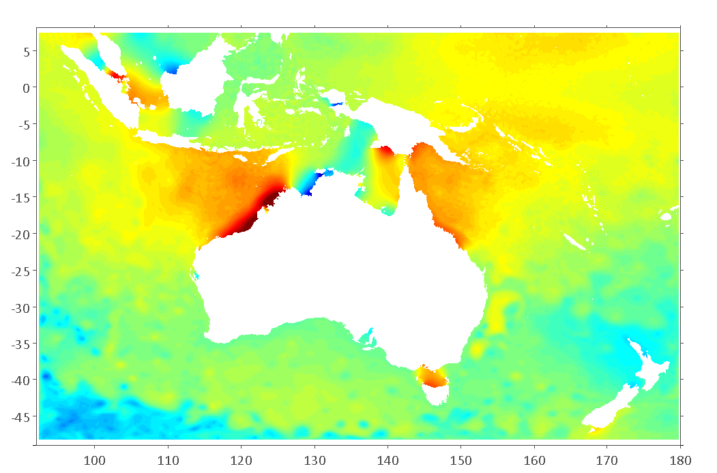
Comparison with tide gauge observations
No | Station
1 | Booby Island
2 | Darwin
3 | Broome
4 | Fremantle
5 | Esperance
6 | Thevenard
7 | Portland
8 | Spring Bay
9 | Fort Denison
10 | Brisbane
11 | Burnett Heads
12 | Townsville
1
2
12
3
11
10
4
5
6
9
7
8
Selected (for this presentation) tide gauge sites along the Australian coast line. Background snapshot of predicted water level
Tide gauge data from NTC, Australia

Slide 13
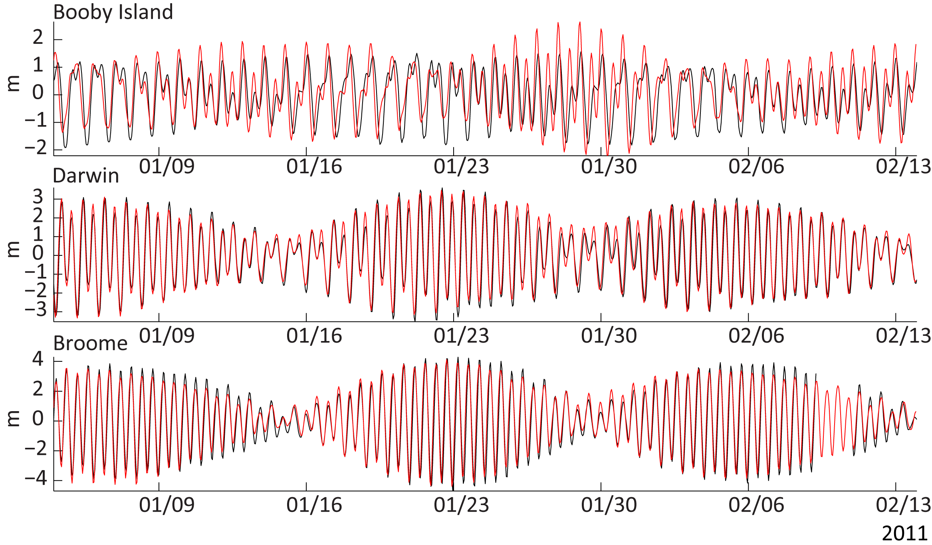
Comparison with tide gauge observations –Northwest shelf
Skill=0.62
Skill=0.84
Skill=0.86
Tide gauge
Predicted
Skill assessment was based on Willmott et al., 2012, 1 perfect
Notes:
This figure shows comparison between OzROMS predicted water levels and tide gauges @ Booby Island, Darwin and Broome. Tide gauge data shows in black line and OzROMS prediction in red line. Model prediction for Darwin and Broome are good, but @ Booby island model overestimating.

Slide 14
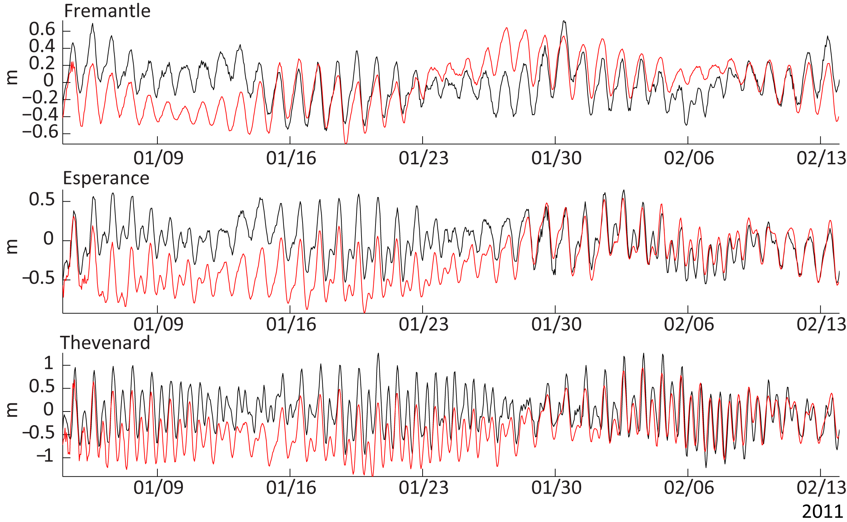
Comparison with tide gauge observations –Western and south Australia
Skill=0.68
Skill=0.74
Skill=0.72
Tide gauge
Predicted
Skill assessment was based on Willmott et al., 2012, 1 perfect
Notes:
This figure shows comparison between predicted water levels and tide gauges @ Fremantle, Esperance and Thevenard. As same as previous figure, Tide gauge data in black line and OzROMS prediction in red line. tide is under predicting for these stations. But, as you can see there is surge between 25 Jan to 03 Feb. This is related to cyclone Bianca, I'll come back to this in next slides.

Slide 15
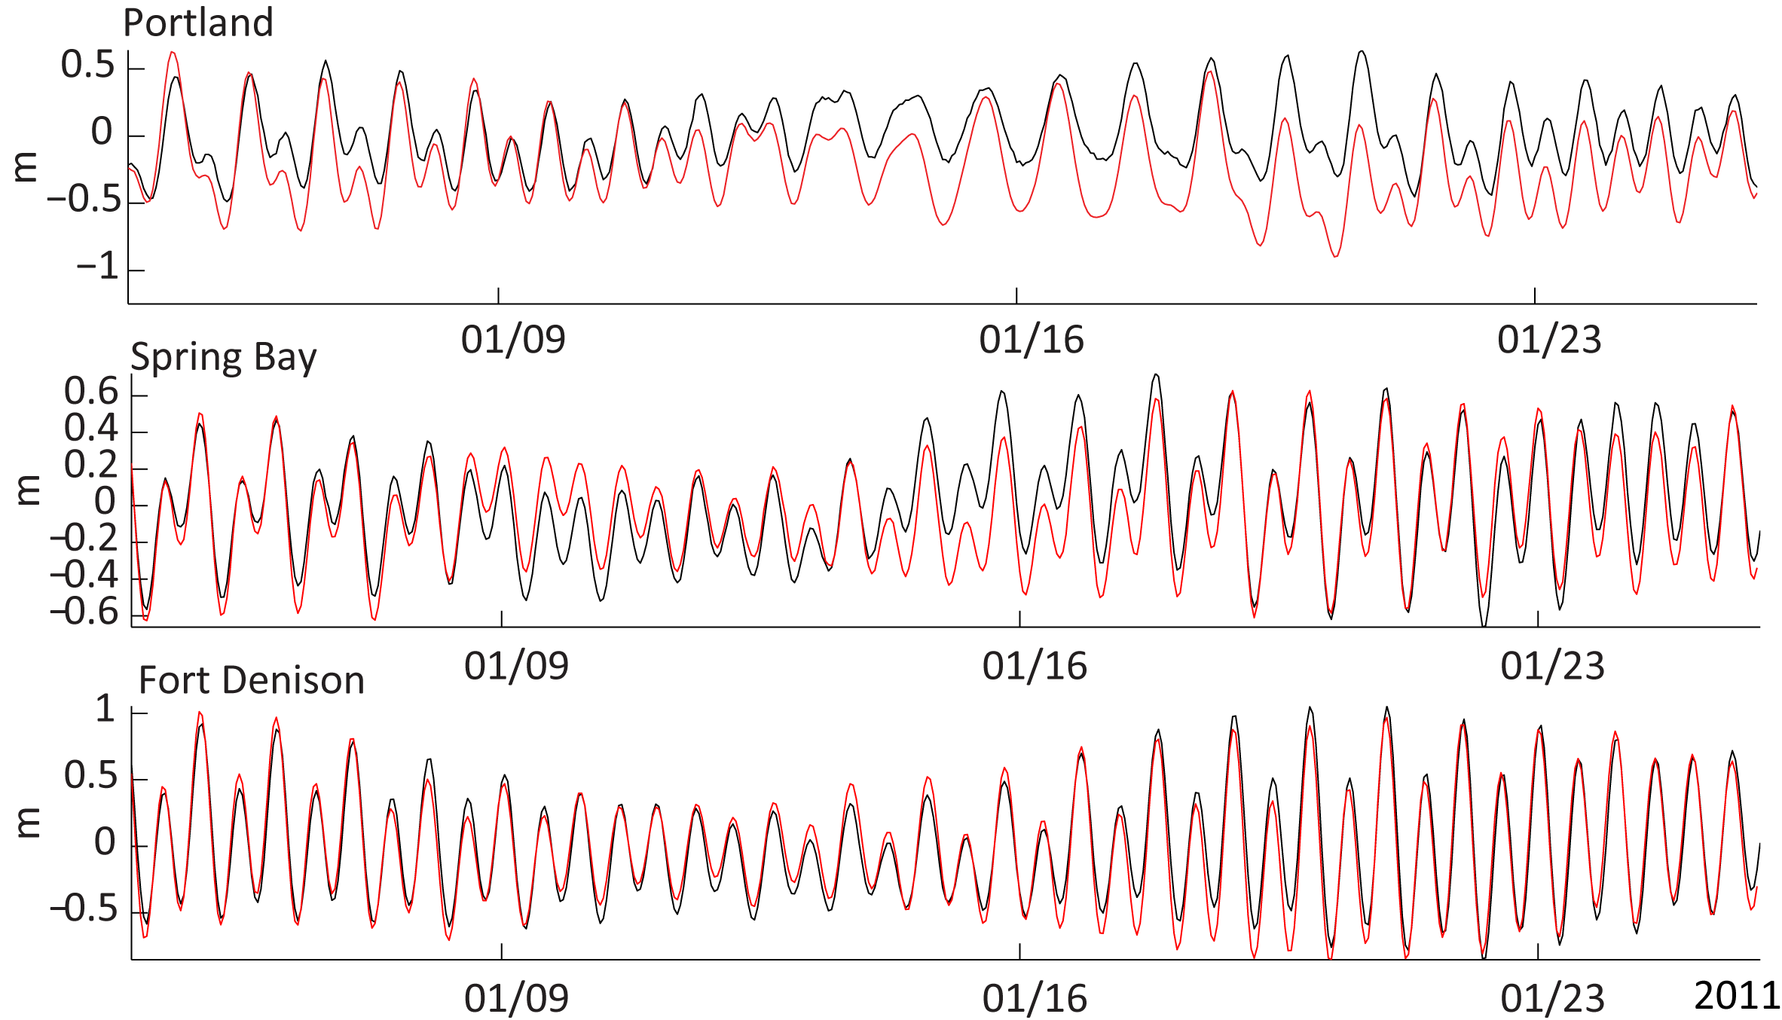
Comparison with tide gauge observations –South and south east Australia
Skill=0.82
Skill=0.86
Skill=0.94
Tide gauge
Predicted
Skill assessment was based on Willmott et al., 2012, 1 perfect
Notes:
These are results for Portland, Spring Bay and Fort Denison. Model under predicting water levels @ Portland .

Slide 16
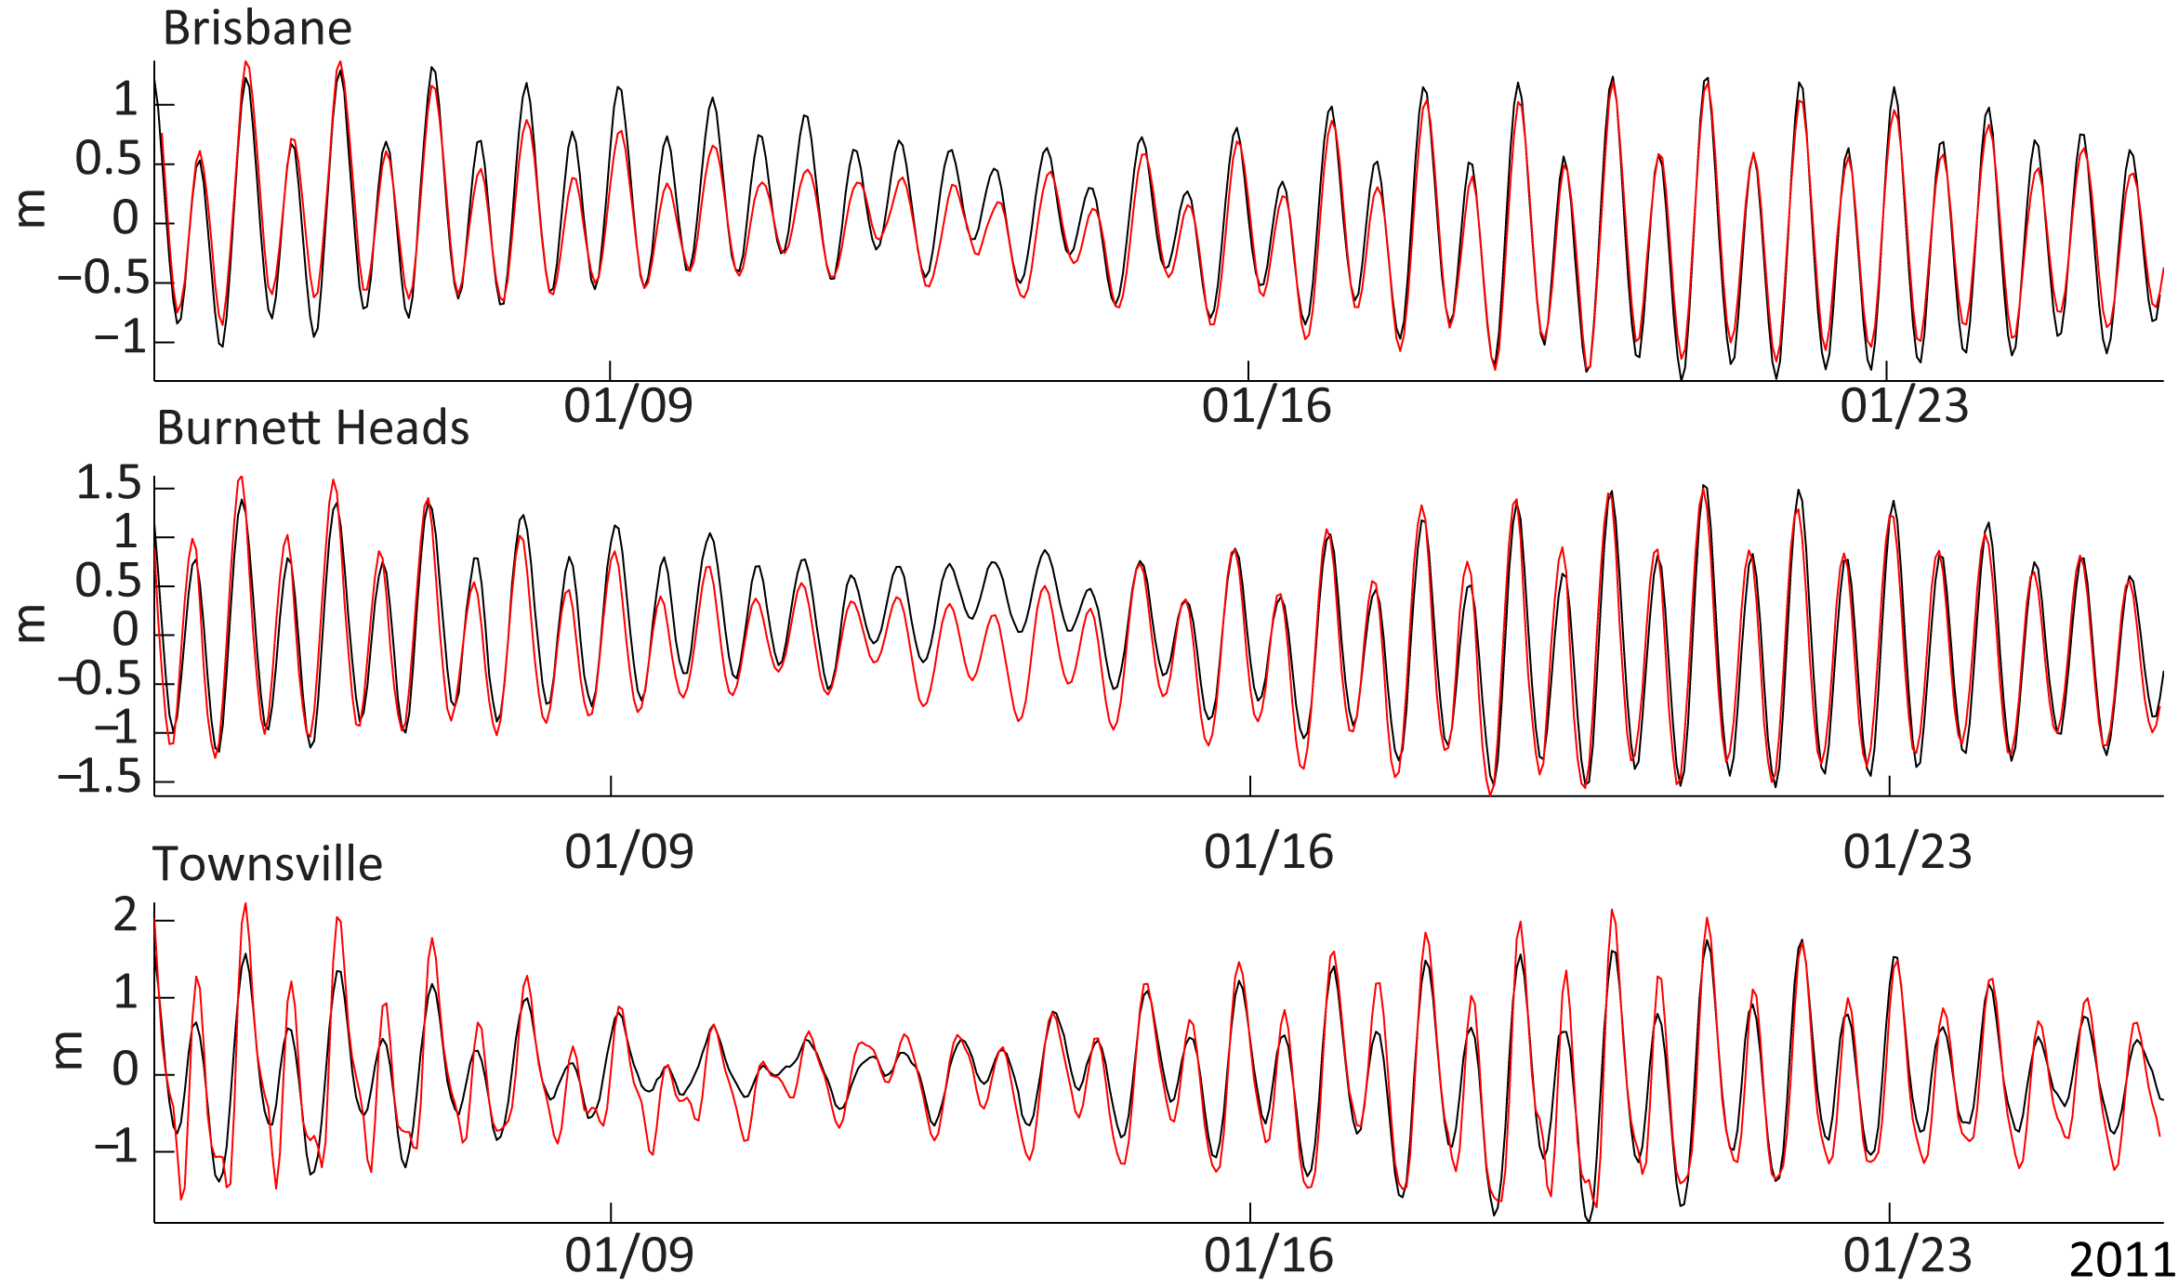
Comparison with tide gauge observations –East and north east Australia
Skill=0.88
Skill=0.92
Skill=0.78
Tide gauge
Predicted
Skill assessment was based on Willmott et al., 2012, 1 perfect
Notes:
These are results for Brisbane, Burnett head and Townsville. Model again under predicting tides. Overall, we believed model predicting sea level in reasonably well. More significantly, model reproducing resonance amplification of the tidal amplitudes in North-West shelf, Bass Strait and Queensland. Overall, mean errors in predicted elevations in whole Australian coast are less than 20 %.

Slide 17
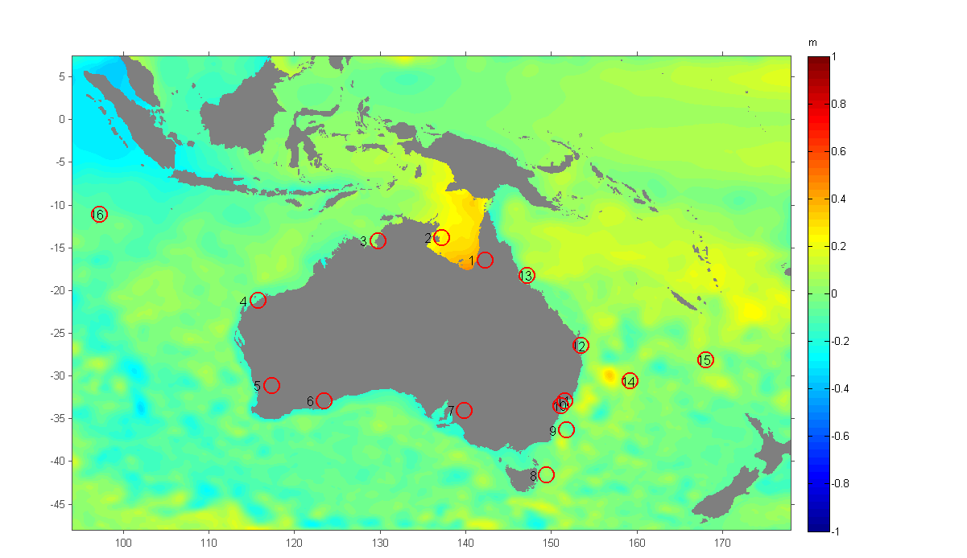
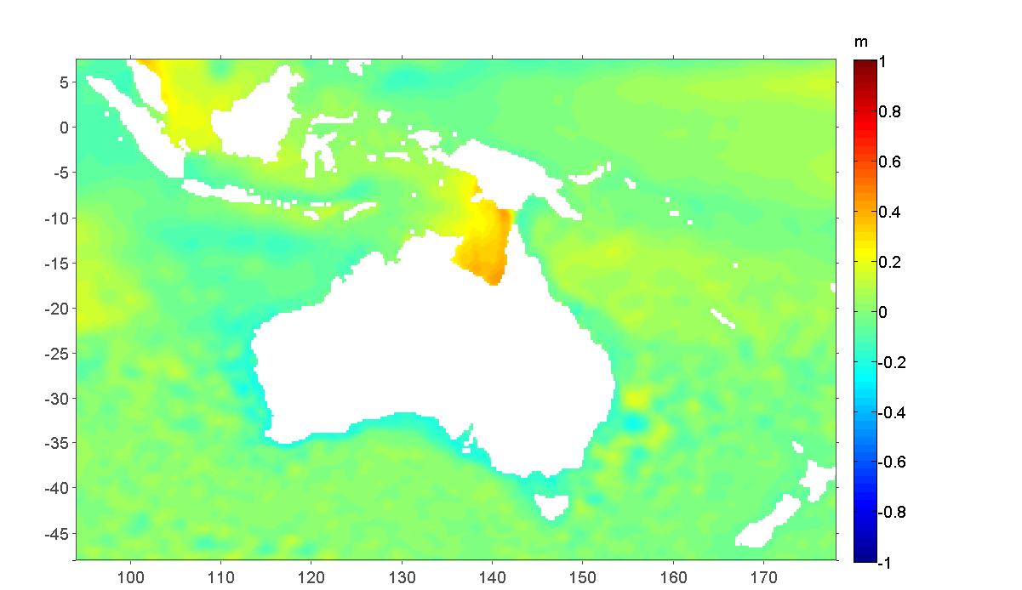
Comparison between measured and predicted monthly mean sea levels
Predicted
Satellite altimetry
Spatial distribution of mean sea level difference between January and June (mean of January- mean of June) around Australia. The mean sea levels estimated by satellite altimetry (Source: AVISO) are shown in the right panel and those from the model are shown in the left panel. Circles denotes tide gauge sites.

Slide 18
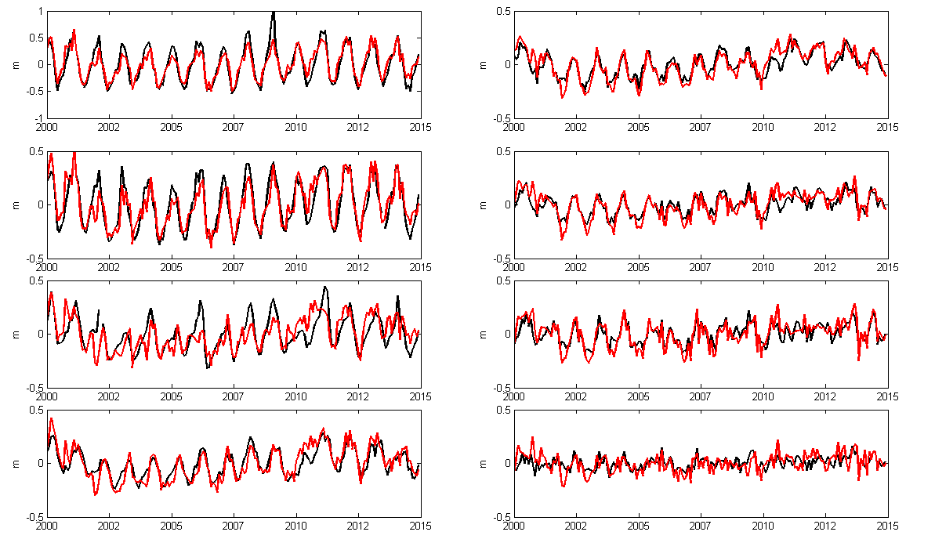
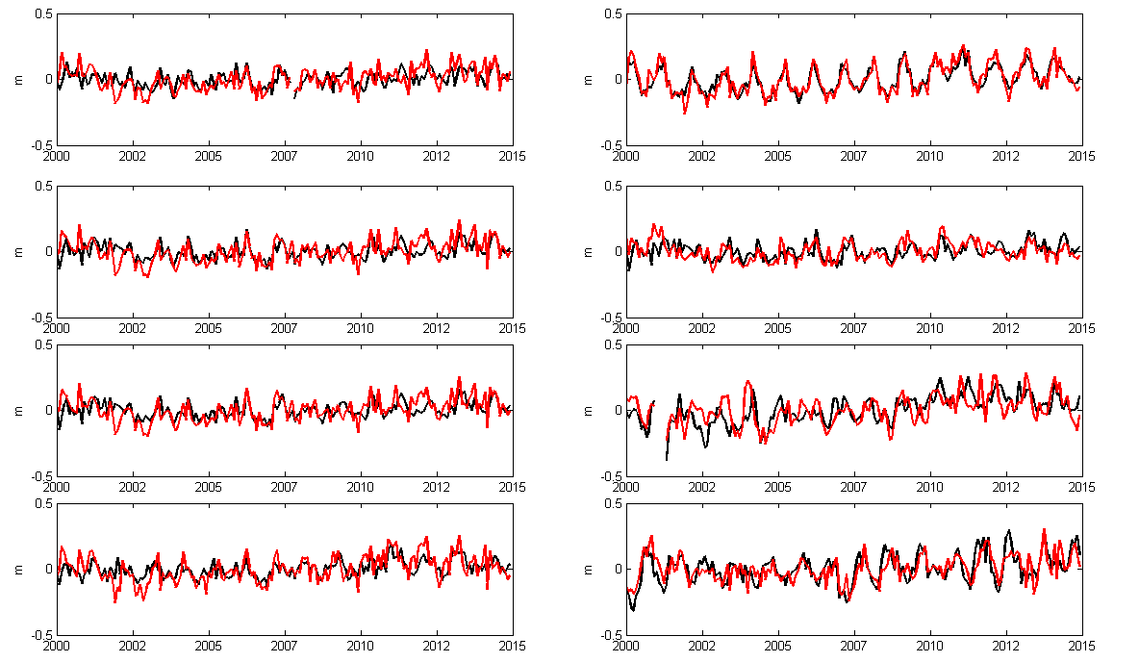
St-1
St-5
St-9
St-13
The model captured seasonal pattern for all sites and reproduces between 60% and 90% of the observed annual amplitude.
Tide gauge data from NTC, Australia

Slide 19
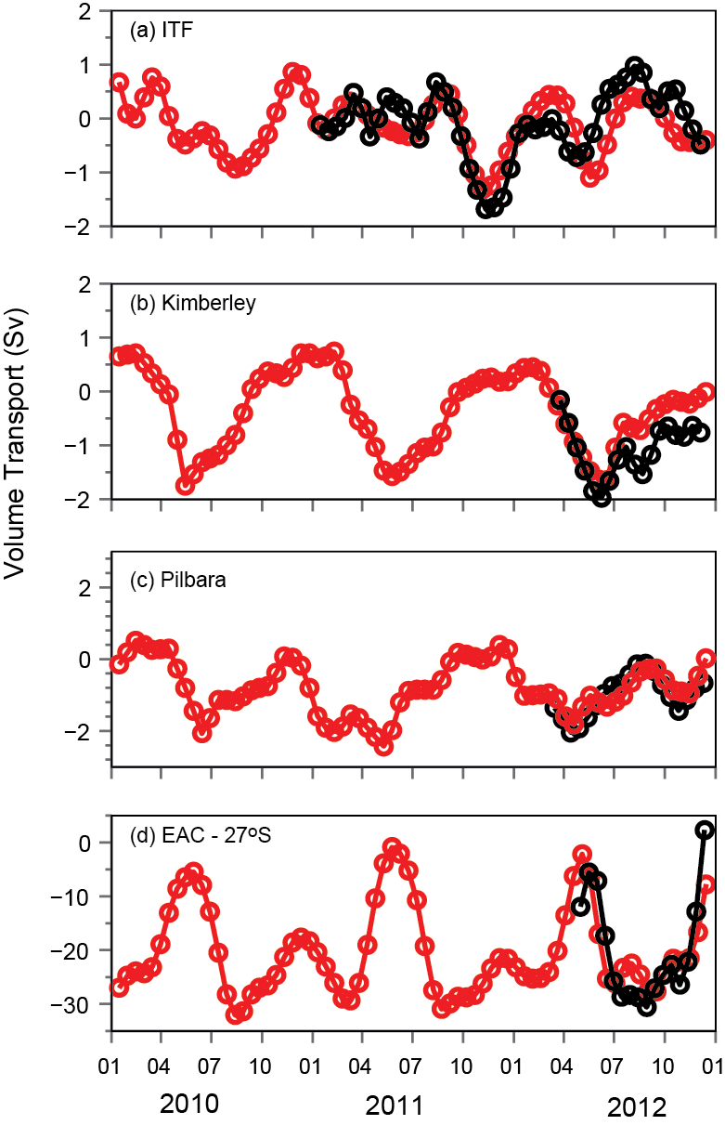
Comparison of the mean transport variability at ITF (shallow shelf section), Kimberly, Pilbara and 27o S east coast mooring arrays
(a)
Skill
=0.82
Skill
=0.84
(b)
Skill
=0.87
Skill
=0.78
Vertically integrated currents between 0 and 1000 m (a) and 0 and 2000 m (b) depth. The mean values are obtained from the entire simulation (2000-2015).
Comparison between IMOS ADCP mooring arrays (black) and predicted (red) volume fluxes at four sections

Slide 20
Meso-scale processes

Slide 21
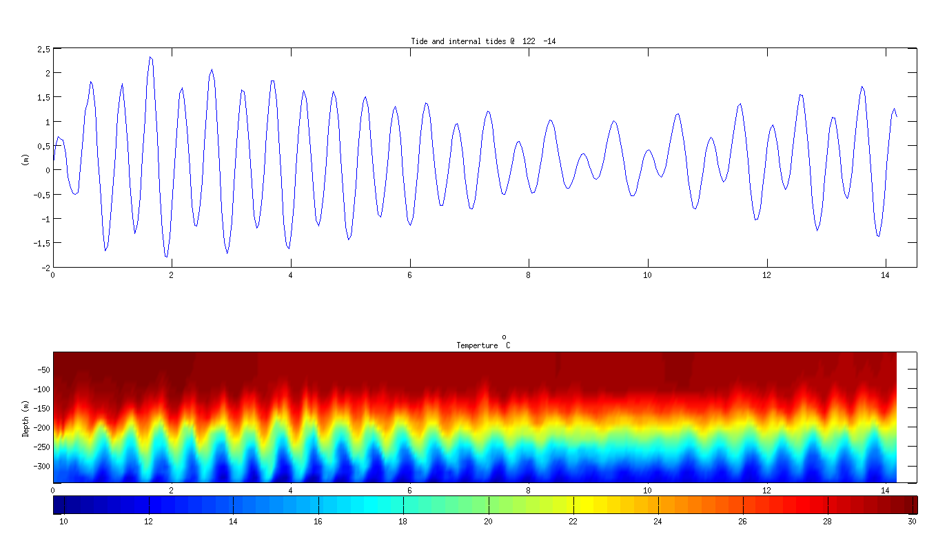
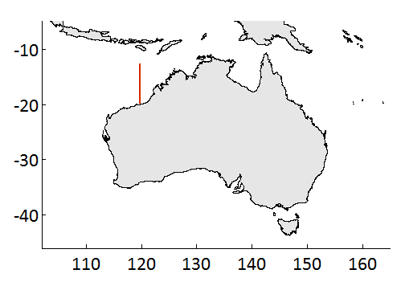
NW shelf internal waves
O
Notes:
This animation shows tide-induced internal
waves @ NW shelf frommodel.
Internal waves forms at the continental shelf break.
As you can see in upper animation, internal tides
steepening as they shoal onto the slope.
We also found, when the ray slope is less than the
topographic slope, the onshore propagating internal
tide is reflected offshore.
Below animation shows temperature variation @ 20
m depth, as you can clearly see inward propagating
waves.
Also you can see upwelling around Scott reef.

Slide 22
NW shelf internal waves

Slide 23
NW shelf internal waves

Slide 24
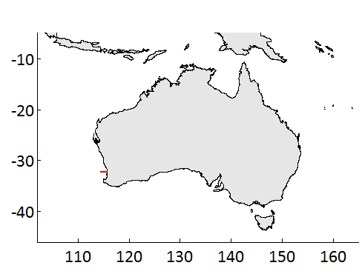
Winter cooling and dense shelf water formation
07-09 July 2010 transect
Glider -transect
(Source: IMOS data)
Oz-ROMS
O
Notes:
This animation shows density anomaly predicted
by model @ -33 Lat section, during winter, July
2010.
Upper figure shows temperature transect from
Glider in July 2010.
As we know, dense water formation occurs as high
evaporation of the shallow water in summer leads
to increased salinity, and therefore increased
density.
In winter the water cools, becomes even
denser, and is pulled down by gravity to deeper
waters.

Slide 25
Winter cooling and dense shelf water formation
07-09 July 2010 transect
Glider -transect
(Source: IMOS data)

Slide 26
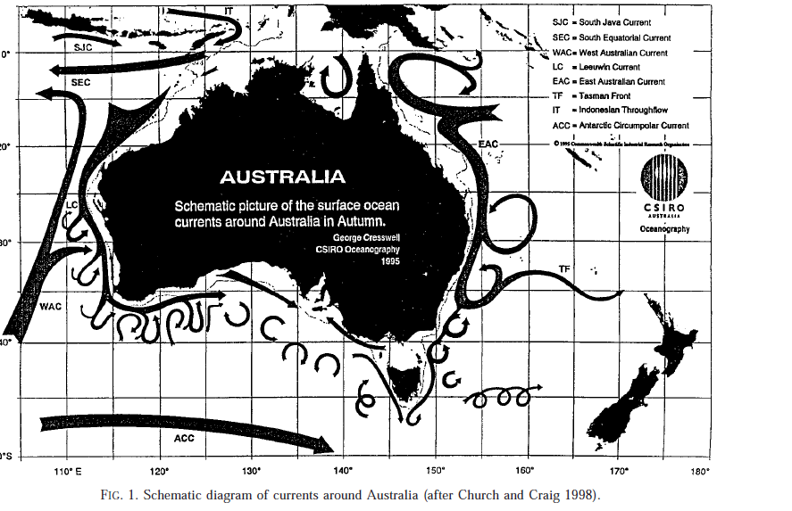
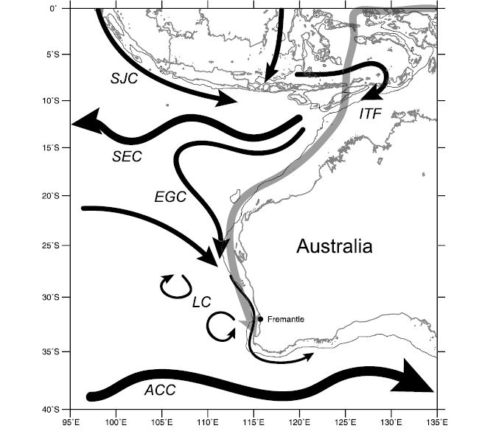
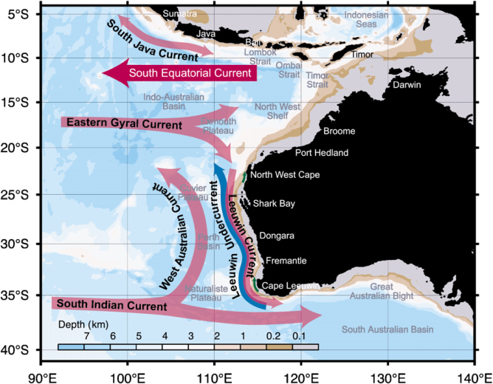
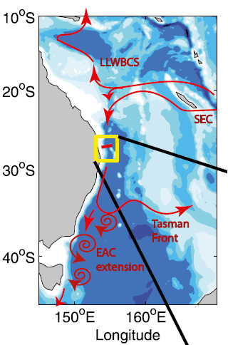
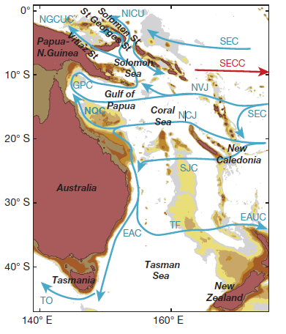
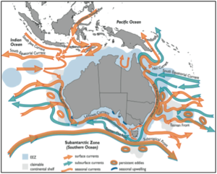
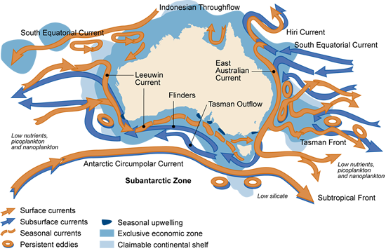
Boundary currents around Australia and inflows/outflows from/to the ocean basins
Craig, 1998
Feng et at., 2003
Domingues et al., 2007
Image source: CSIRO)
Hu et al., 2015
Sloyan et al., 2016

Slide 27
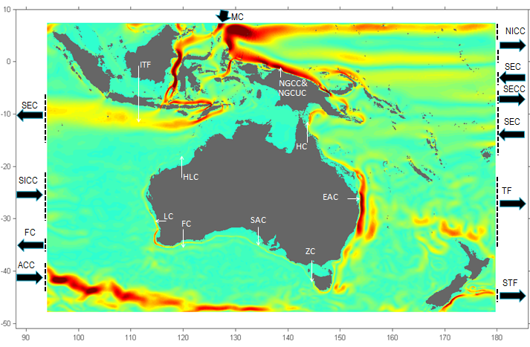
Boundary currents around Australia and inflows/outflows from/to the ocean basins
ITF= Indonesian Through Flow
SEC=South Equatorial Current
SEC-I=SEC of Indian Ocean
SEC-P=SEC of Pacific Ocean
ACC= Antarctic Circu. Current
SICC=South IO Countercurrent
HLC=Holloway Current
LC=Leeuwin Current
LU=Leeuwin Under Current
FC= Flinders Current
SAC=South Australian Current
TO=Tasman Out Flow
TF=Tasman Front
EAC=East Australian Current
ZC= Zeehan Current
NECC= North Equ. Count. Current
SECC= South Equ. Count. Current
NGCC= New Guinea Coastal Current
NGCUC= NGC Under Current
MC= Mindanao Current.
LU
TO
m²s⁻¹
Vertically integrated currents between 0 and 300 m depth. The mean values are obtained from the entire simulation (2000-2015).

Slide 28
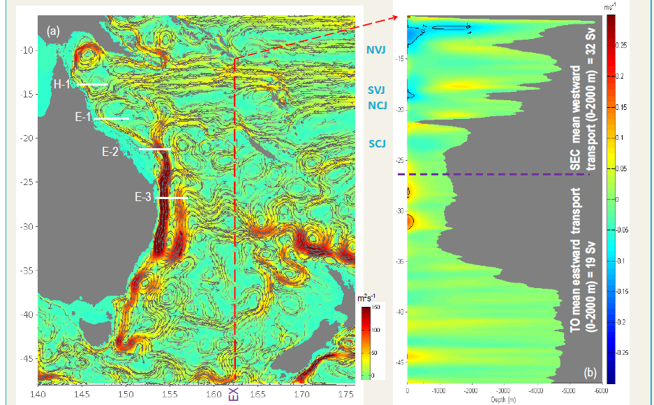
South Equatorial Current (SEC) Inflow, East Australian Current (EAC) Transport and Tasman Front (TF)
(a) Predicted mean vertically integrated currents between 0 and 2000 m depth, (b) Eastward (red) and westward (blue) mean currents through EX meridional transect. The SEC bifurcates at ~15º S to initiate the Hiri Current (HRC), a clockwise circulation that flows into the Gulf of Papua and the poleward East Australian Current (EAC). The North Vanuatu Jet (NVJ) inflow appeared to be equally distributed between northward flow (to HRC) and southward flow (to EAC).

Slide 29
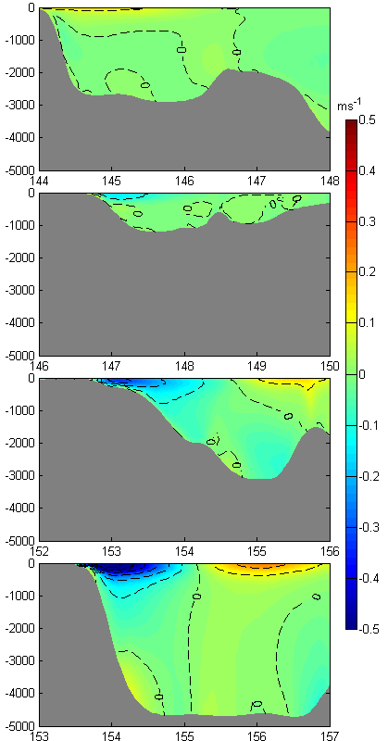
South Equatorial Current (SEC) Inflow, East Australian Current (EAC) Transport and Tasman Front (TF)
(g) Transport through E-2
H-1
(c) H-1
E-1
E-2
E-3
(d) E-1
(h) Transport through E-3
(e) E-2
(c) , (d), (e) and (f) are mean velocity transects at H-1, E-1, E-2 and E-3. Blue = southward and Red= Northward. (g) Transport through E-2 transect shown in figure 2e and (h) transport through E-3 transect.
Predicted mean transport : E-2 =15.3 Sv
E-3 = 22.8 Sv. an inflow of ~7.5 Sv needs to be supplied from SCJ
(f) E-3

Slide 30
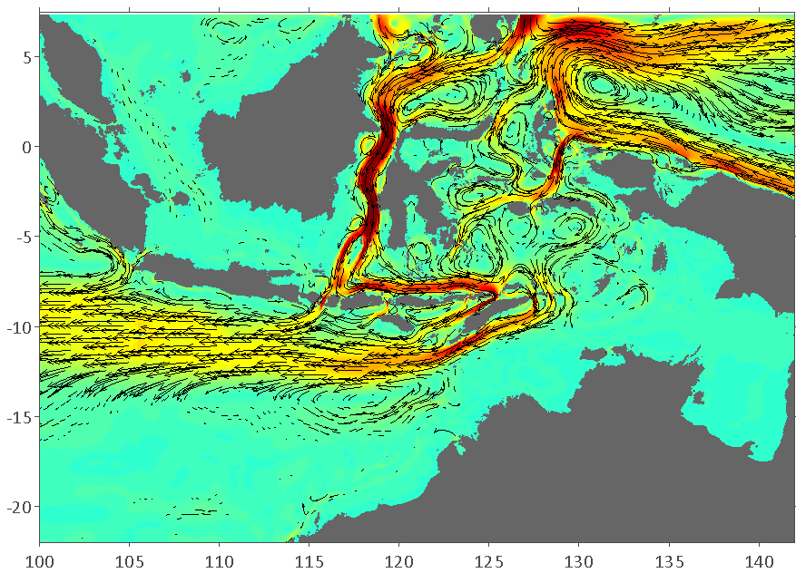
Indonesian Throughflow (ITF) Mean Transport and Pathways
MAK
LIT
ITF
The ozROMS predicted mean vertically integrated currents between 0 and 1000 m depth over the Indonesian archipelago and the pathways of the Indonesian Throughflow (ITF). Main inflow passages are Makassar (MAK) and Lifamatola (LIT) Straits.

Slide 31
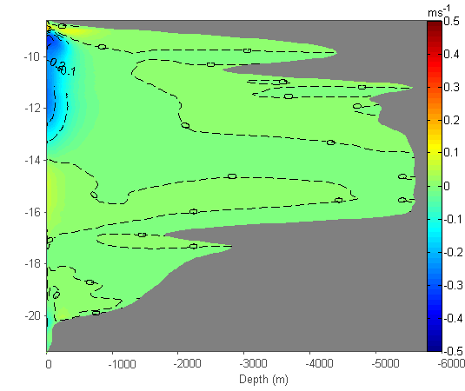
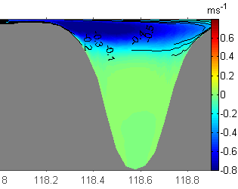
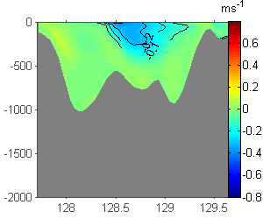
Indonesian Throughflow (ITF) Mean Transport and Pathways
12.8±6 Sv
(b) MAK
(a) ITF
5.4±2 Sv
(c) LIT

Slide 32
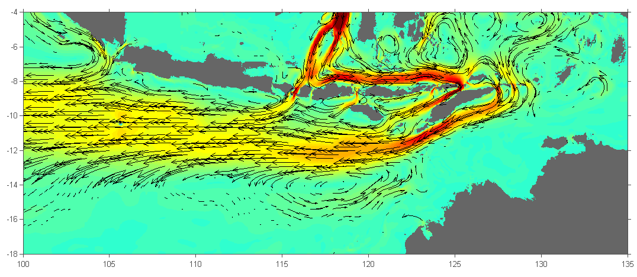
Indonesian Throughflow (ITF) Mean Transport and Pathways
Predicted total ITF mean transport over the period (2000-2015) is17.82 Sv at 115º E transect
Flows through;
Timor Passage = 8.4 Sv
Ombai Strait = 4.6 Sv
Lombok Strait =3.8 Sv
Other connections = 1.02 Sv

Slide 33
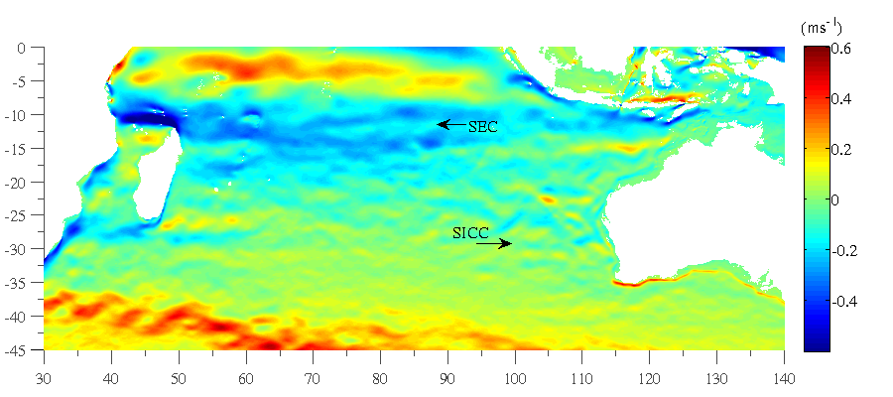
SICC Inflows, Leeuwin Current (LC) and
Leeuwin Under Current (LU)
Surface mean (2010-2012) eastward and westward currents from HYCOM showing South Indian Counter Currents (SICC). Colorbar plus values denotes eastward current and minus for westward current

Slide 34
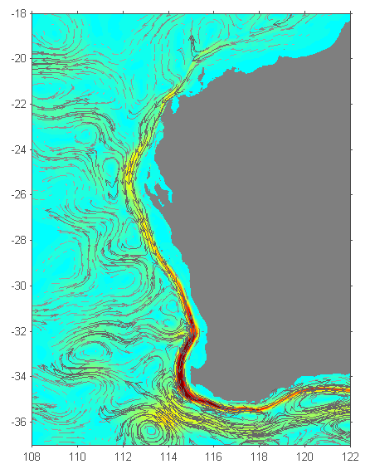
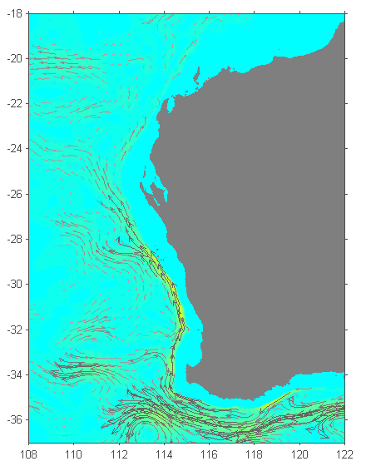
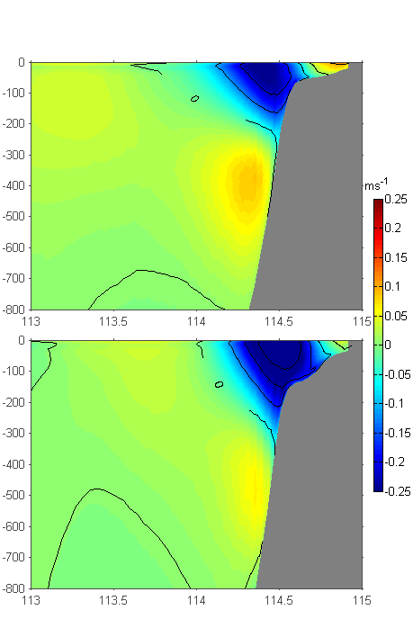
SICC Inflows, Leeuwin Current (LC) and
Leeuwin Under Current (LU)
(a)
(b)
(c)
L-1
L-2
(d)
The model predicted mean vertically integrated currents: (a) integrated between 0 and 300 m depth; and, (b) integrated from 300 m to 800 m depth. (c) and (d) are mean current transects at 30 and 34º south, blue=southward and red=northward.

Slide 35
SICC Inflows, Leeuwin Current (LC) and
Leeuwin Under Current (LU)
L-1, 30ºS
L-2, 34ºS
At transect L-1 (30ºS), upper panel, the southward transport is 2.12 Sv. The model predicted an increase in the transport ~ 1 Sv within the LC immediately downstream of 32º S, at transect L-2 (34ºS), bottom panel, the southward transport is 3.34 Sv.

Slide 36
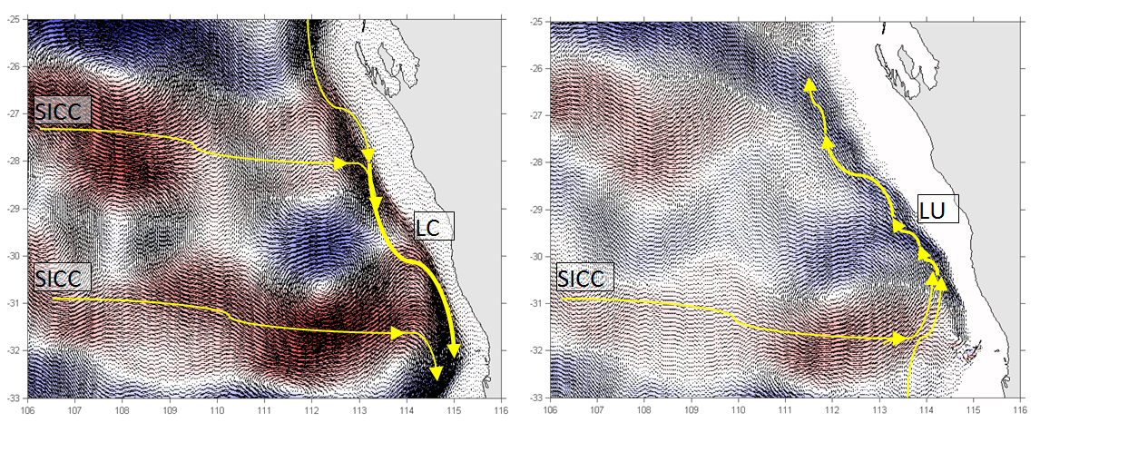
SICC Inflows, Leeuwin Current (LC) and
Leeuwin Under Current (LU)
Inflow from the SICC contributed to the strengthening of the LU towards north (between 32º S and 30º S).

Slide 37
Summary
Hindcast simulations without any data assimilation over a 16 year period (January 2000 to December 2015) were completed, the model outputs of hourly sea levels, daily averaged; salinity, temperature and velocity fields have been saved and are available through the UWA OPeNDAP Server (http://130.95.29.56:8080/thredds/catalog.html).

