Slide 1
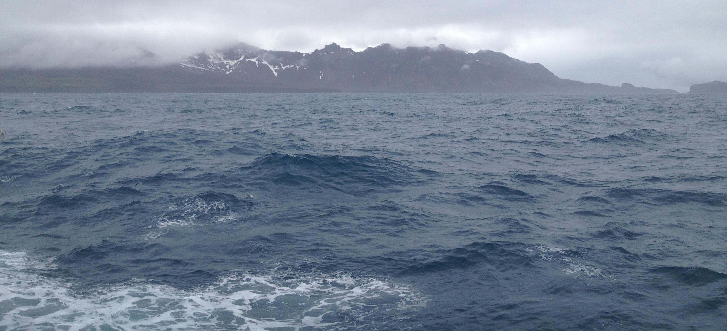
Surface Mixing in ROMS
Along with some old PIG stuff
Robin Robertson
Physical Environmental, and Mathematical Sciences

Slide 2


Polar Oceanography Session
Mixing Session
Looking for Polar Co-conveners
Will be looking for abstracts
Please join us in Singapore
2018: Honolulu 3-8 June
2019: Singapore, 28 July-2 August

Slide 3
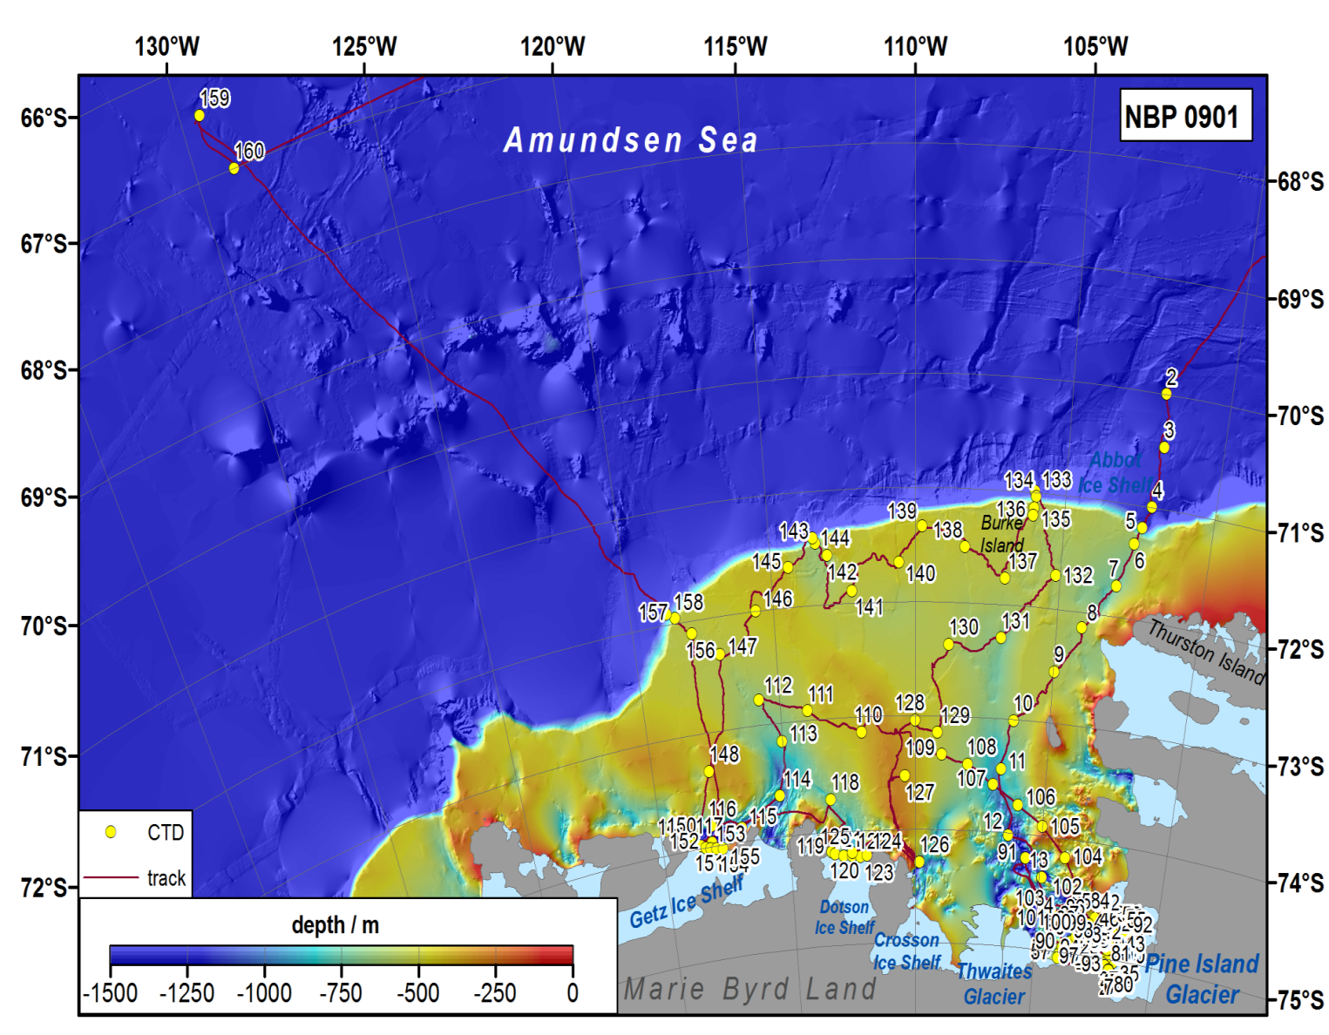
The Old PIG Stuff: Amundsen Sea
Courtesy of Frank Nitsche, 2009

Slide 4
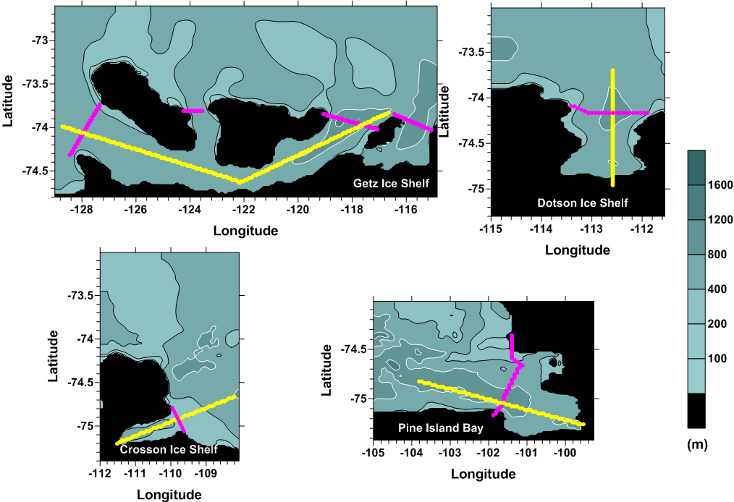
Transect Locations

Slide 5
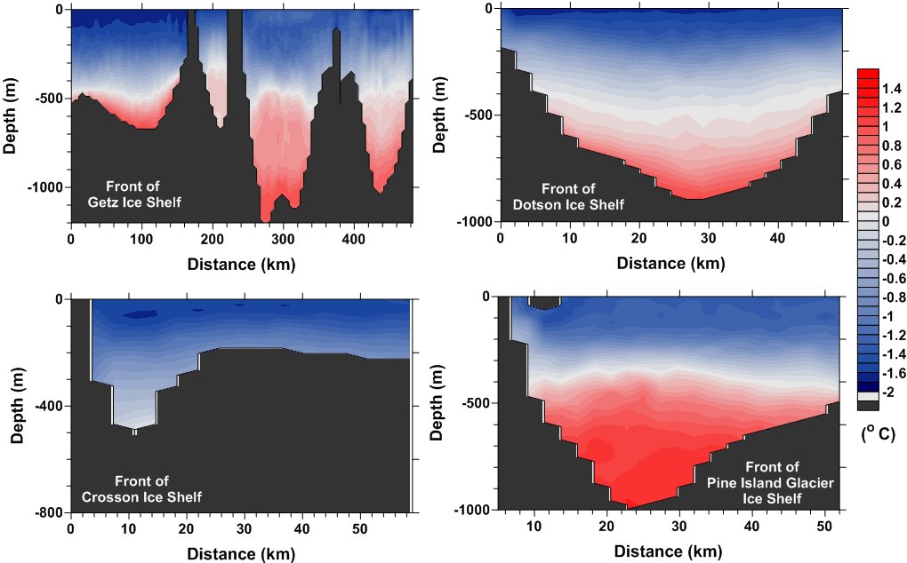
Temperature at Ice Shelf Fronts
Some stuff

Slide 6
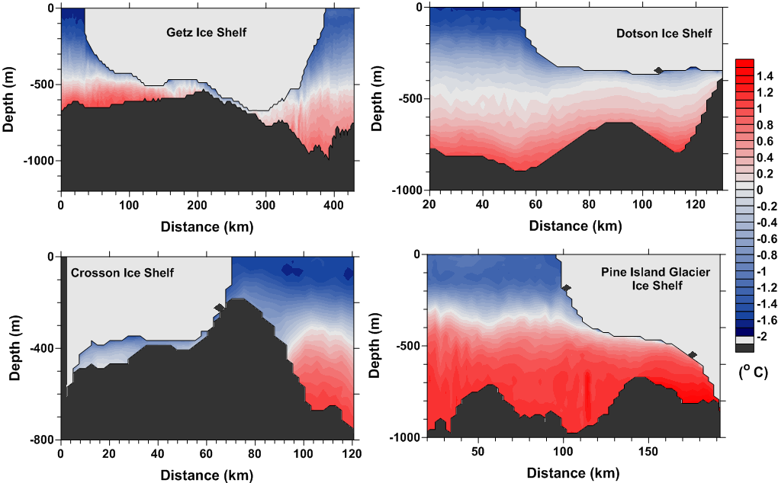
Temperature under the Ice Shelves
Some stuff

Slide 7
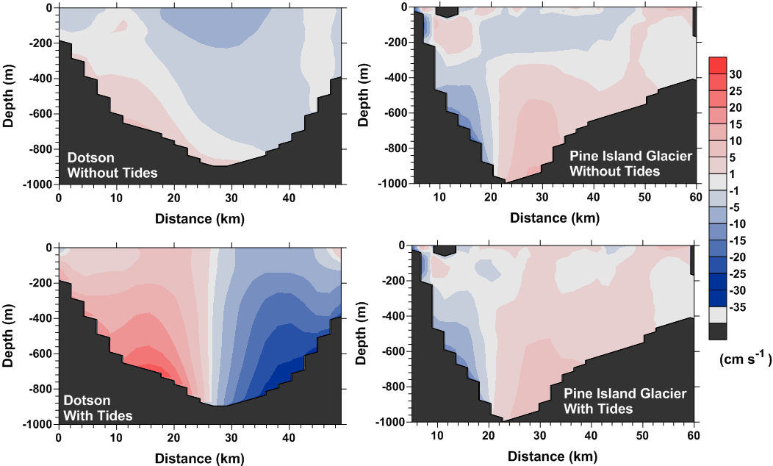
Mean Velocities Cross-Ice Shelf
With and Without Tides
Looking out from the ice shelf cavity

Slide 8
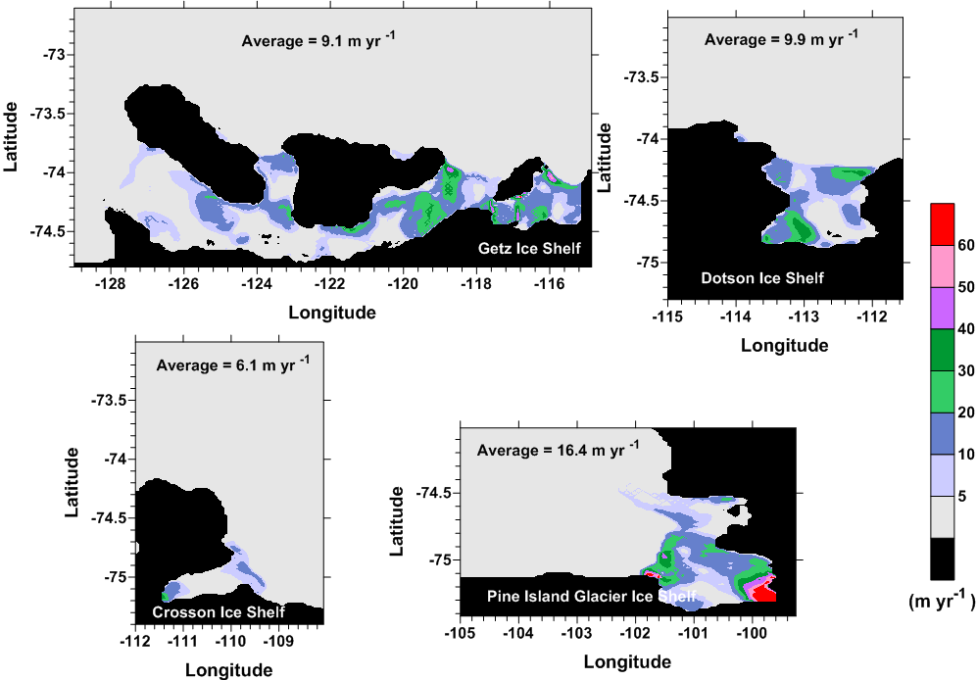
Melt Rates

Slide 9
Tidal Influence on Melt Rate
 | Without Tides | With Tides | % Difference
Getz | 7.9 m/a | 9.1 m/a | 15%
Dotson | 6.5 m/a | 9.9 m/a | 52 %
Crosson | 8.8 m/a | 6.1 m/a | -30 %
Pine Island | 16.9 m/a | 16.4 m/a | -3%
Robertson, 2013

Slide 10
Amundsen Sea
Courtesy of Frank Nitsche, 2009

Slide 11
Critical Latitude Effects

Slide 12
Tidal Influence on Melt Rate
 | Without Tides | With Tides | % Difference
Getz | 7.9 m/a | 9.1 m/a | 15%
Dotson | 6.5 m/a | 9.9 m/a | 52 %
Crosson | 8.8 m/a | 6.1 m/a | -30 %
Pine Island | 16.9 m/a | 20.2 m/a | 20%
Robertson, R. (2013) Tidally induced increases in melting of Amundsen Sea ice shelves, J. Geophys Res.-Oceans, 118, 1-8, doi:10.1002/jgrc.20236.

Slide 13
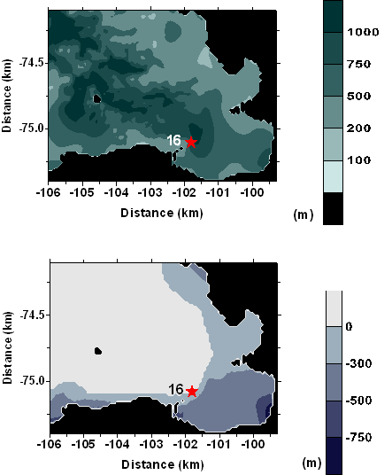
Observations (NBP0901)
Looking at Influences of
Tides and
Topography
Water Depth
Ice Shelf
Thickness

Slide 14
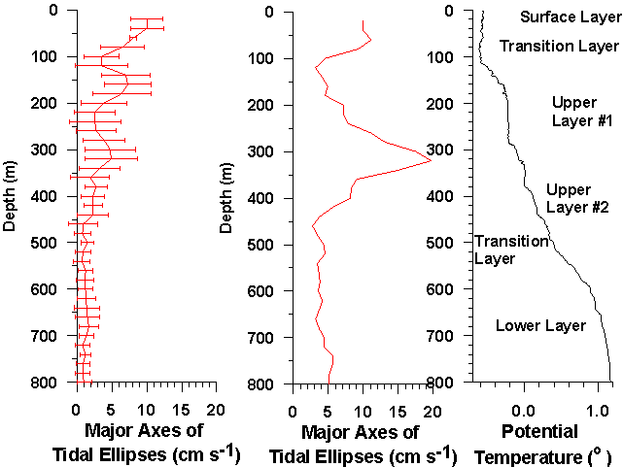
Tidal Velocities
Semidiurnal
Diurnal
Peak in Diurnal at 360 m depth is attributed to harmonics from semidiurnal

Slide 15
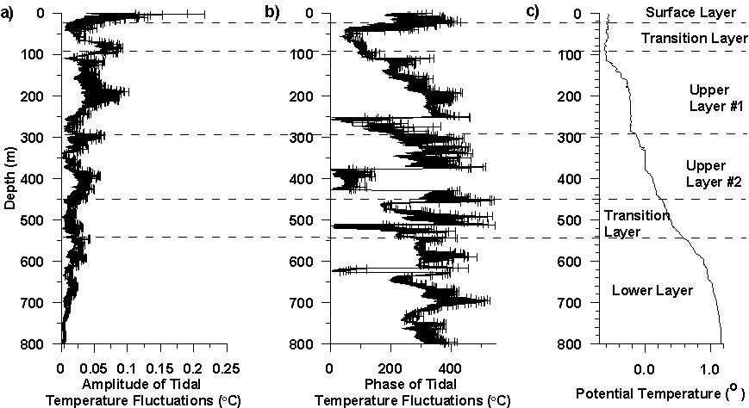
Semidiurnal Tides: Temperatures
Surface Layer
  ~ 0.07ºC
Upper Layer #1
  ~ 0.04ºC
Upper Layer #2
  ~ 0.03ºC
Lower Layer
  ~ 0.02ºC

Slide 16
Propagation of T and S Anomalies
Propagate down at ~0.006 m/s
Speed of a M₂ internal tide in continuous stratification (vertical wavelength of 160 m) = ~0.005 m/s
  Horizontal Wavelength = 46.3 km
  ~ Size of southern end of bay

Slide 17
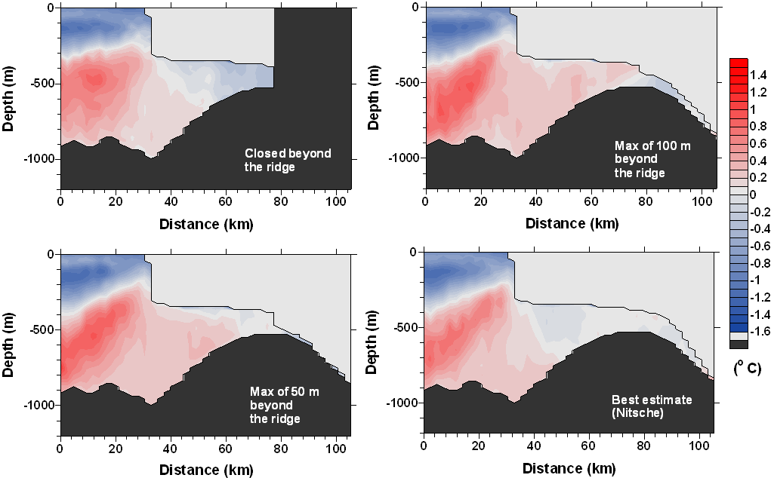
Topography of the Ice Shelf Cavity (and Temperature)
Notes:
17

Slide 18
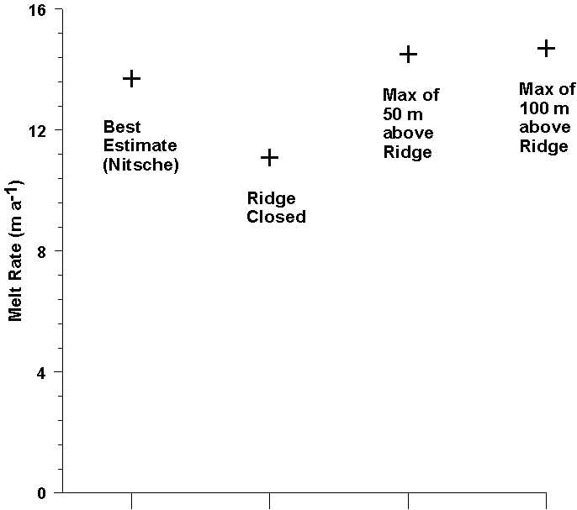
Melt Dependence on Topography
Least melting with the ridge closed off
Highest with 50 or 100 m of water under ice shelf
Notes:
18

Slide 19
Now, Surface Mixing
New client interested in surface temperature field
  Upper 100 m, particularly upper 50 m
  Improve the mixed layer depth estimation
First step, is to see how they well the vertical mixing parameterizations perform
Evaluate the performance of different vertical mixing parameterizations for the upper 100 m of the ocean

Slide 20
The Problem with Mixing
Myriad mechanisms
Wide range of scales
Occurs in local areas, “hot spots”
Occurs sporadically
Difficult to measure and simulate
Models can’t simulate all the mechanisms
  Insufficient resolution
  Use sub-grid scale parameterizations to represent mixing
  For example, Climate models don’t include tides

Slide 21
Sub-grid Scale Parameterizations
Many
  Mellor-Yamada 2.5 level turbulence closure
  Large-McWilliams-Doney Kpp
  Generic Length Scale: many versions
  Nakanishi-Niino
Based on boundary layer experiments in labs
  Not based on ocean
  Imitate mainly frictional boundary layer
  Mid-water column mixing due to shear instabilities is not in the parameterization and often absent
  Wave mixing, Langmuir cells, and other surface processes often absent

Slide 22
Evaluation of Sub-Grid Scale Parameterizations
Comparison of ten different mixing parameterizations in a model for tidal mixing
  Mellor-Yamada 2.5 level turbulence closure
  Large-McWilliams-Doney Kpp
  Generic Length Scale: many (5) versions
  Nakanishi-Niino
  Generalized Ocean Mixing
  Brunt-Väisäla Frequency

Slide 23
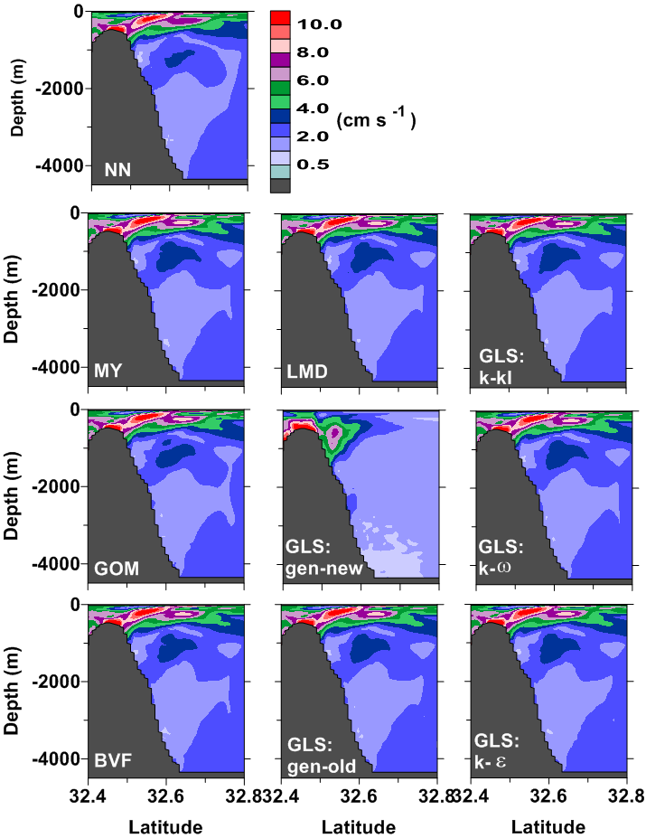
Essentially No Difference in Velocities
All schemes generate essentially the same tidal velocities
Higher frequencies the same too

Slide 24
Diffusivity Estimates are another story
Means
Widely different estimates
  Orders of magnitude
Comparison of ten different mixing parameterizations in a model for tidal mixing

Slide 25
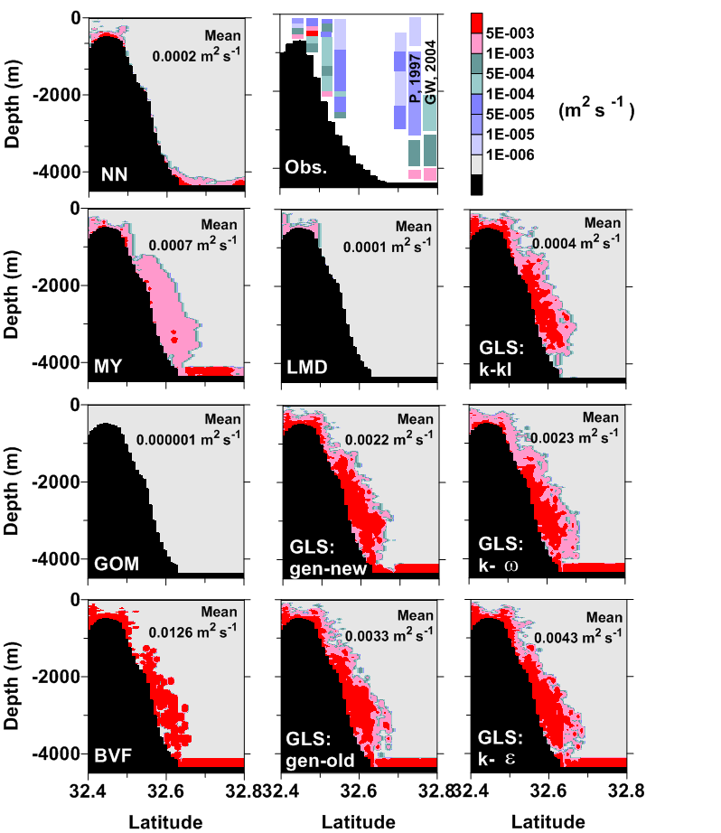
Difficulty in comparison
Observations are a snapshot in time
  Might be minimum
  Might be maximum
Model estimates
  Mean previous slide
  Standard Deviation

Slide 26
Repeat for Surface Mixing
Which vertical mixing parameterization best simulates wind mixing in the upper 100 m of the ocean, particularly the upper 50 m
Investigated 4 vertical mixing parameterizations
  Nakanishi-Niino
  Mellor-Yamada 2.5
  Large-McWilliams-Doney Kpp (LMD)
  Generic Length Scale: generic (Umlauf and Burchard)
Looking at several different sites

Slide 27
Key Dynamics
Solar Radiation – included (but not clouds)
Winds - included
Currents – not included
Tides - included
Eddies– not included
Fronts– not included
Upwelling – not included (duration too short)
Locally Generated Internal Tides - included
Propagating Internal Tides – not included

Slide 28
The Model Setup
Regional Ocean Model System (ROMS 3.4)
Several sites
Most Hydrography from Mooring Data:
  Thermistors every 8 m, starting 16 m below the surface
  Initially uniform horizontally
  ADCP for currents
10 day simulations
  only tidal forcing for the first 5 days
  wind and tidal forcing for the last 5 days (wind ramped up day 4)
  looking at last 5 days.
~ 1 km horizontal resolution, (<2 m resolution largest)

Slide 29
The Cases
Four 5-day periods were selected from 4 Port Hacking mooring deployments (16 cases)
Three 5-day periods were selected from the Southern Ocean Time Series (SOTS) data
Thermistor data from Jervis Bay, Australia
Selections were made to include times mixed layer changed, either deepening or shallowing
Here focus on one case:
  Winds strengthening from 4-5 m s⁻¹ to 12 m s⁻¹
  [Winds consistent ~8 m s⁻¹ then strengthening to 12 m s⁻¹]

Slide 30
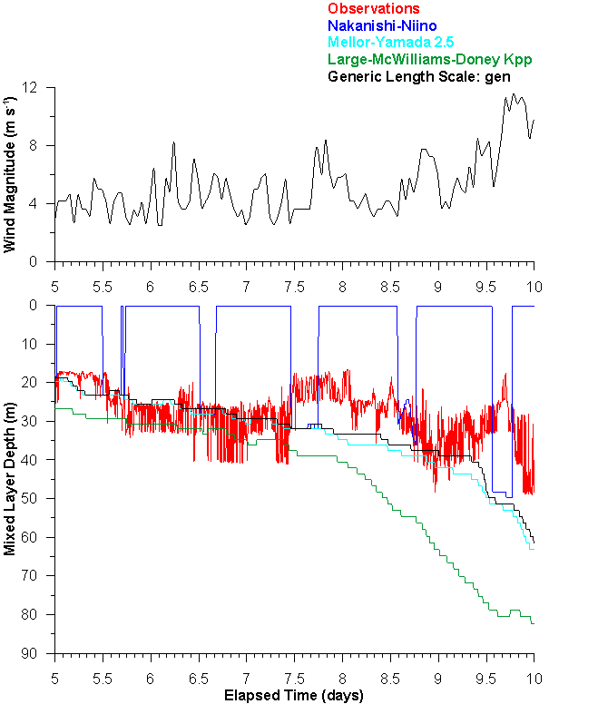
Case 1: Mixed Layer Development
Mixed layer defined as 0.3ºC difference from 15 m
Best Performance
  Nakanishi-Niino
  Mellor-Yamada 2.5
  GLS
Nakanishi-Niino reflects daily solar influence

Slide 31
Temperatures with Time
Observations have deepening thermocline
Thermocline weakening for model cases
LMD mixes slightly more than others in the upper 60 m
None do an adequate job
All overmix with time

Slide 32
Mean East-West Velocities
Observations have much stronger velocities, probably eddies, tides or inertial oscillations
If internal tidal, propagating from outside the domain
Nakanishi-Niino has highest velocities

Slide 33
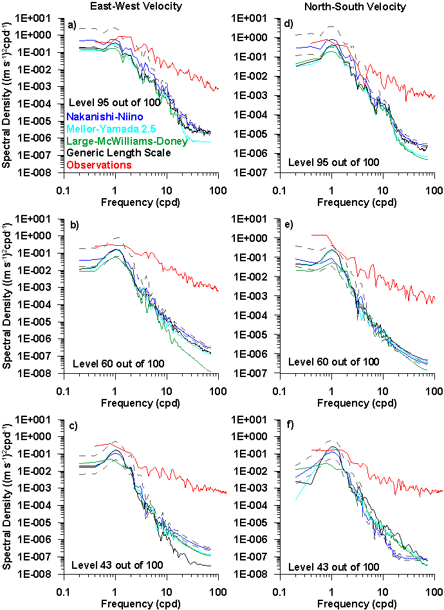
Horizontal
Velocity Spectra
Observations have much higher energy, and flatter slope, indicating generation of internal waves
Similar response for all vertical mixing parameterizations

Slide 34
Vertical
Velocities
No vertical velocity observations
Similar response for MY, LMD, GLS
Nakanishi-Niino has largest vertical velocities, particularly in upper 40 m

Slide 35
Temperatures with Time
Observations have deepening thermocline
Thermocline weakening for model cases
LMD mixes slightly more than others in the upper 60 m
None do an adequate job
All overmix with time

Slide 36
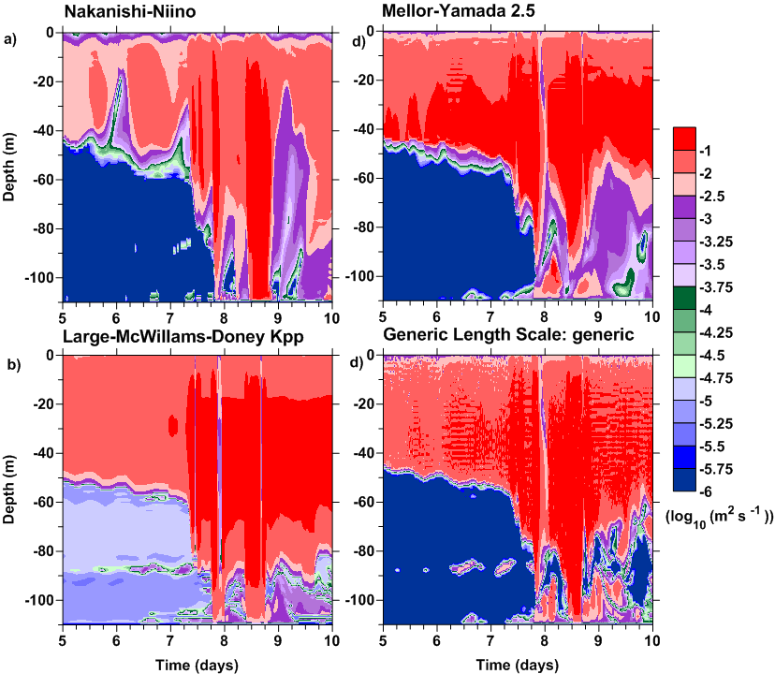
Diffusivity with Time
Nakanishi-Niino has lower diffusivities
After 7.8 days, high diffusivities to the bottom for all

Slide 37
Mean Temperature
Diffusivity
Mean Temperature Diffusivities experience high values, in the upper 40 m
Nakanishi-Niiino
  Values lower and shallower
  Wave-like response
Internal wave response at 75 m for GLS, LMD, and NN

Slide 38
Distribution of Diffusivities
Distribution is bimodal (or trimodal) with one huge mode near zero and another smaller mode (~5-10%) at high levels
Large standard deviations result

Slide 39
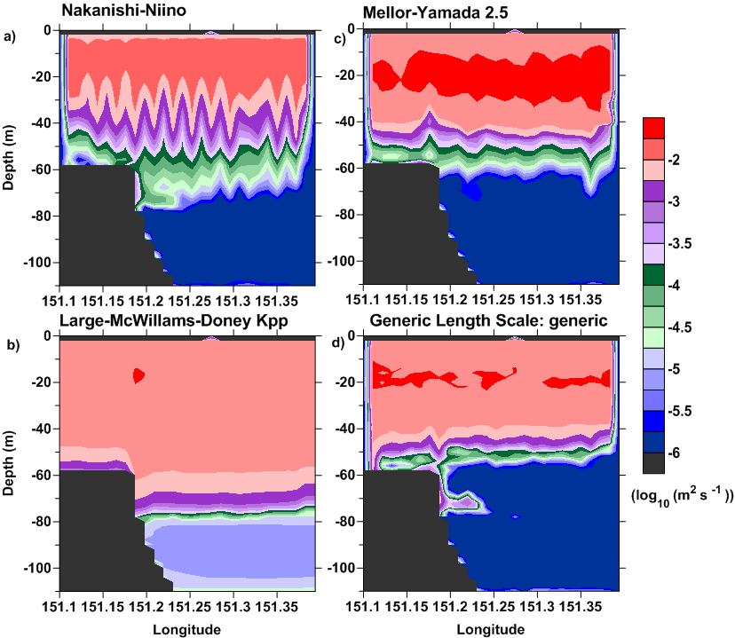
Significant Diffusivities
Average of highest 1/3 of the values
Mean Temperature Diffusivities experience high values, in the upper 40 m
Nakanishi-Niiino
  Values lower and shallower
  Wave-like response
Internal wave response at 75 m for GLS, LMD, and NN or instability
Nakanishi-Niino lower

Slide 40
Diffusivity
Variability
Standard Deviations of Temperature Diffusivities are very large, > 10⁻² m² s⁻¹ for most of the region, except for Nakanishi-Niino
Nakanishi-Niino has wave-like response at 40 m

Slide 41
Caveats for These Cases
Uppermost thermistor too deep to resolve surface solar radiation changes
Winds not at site
Passage of eddies and fronts, remotely generated internal waves, and upwelling influencing mixed layer depth and dynamics
Basically need a better data set with a complete set of flux measurements and finely spaced thermistors in upper 50 m, including one in the top 0.5 m

Slide 42
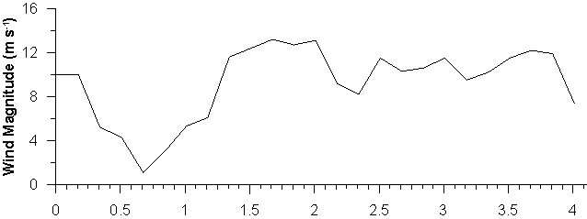
Jervis Bay
Temperatures are similar
Nakanishi-Niino less mixing than others
Others all similar to each other and more similar to observations

Slide 43
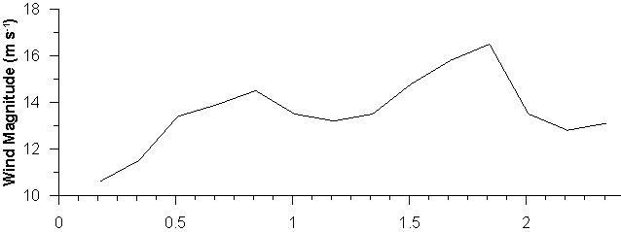
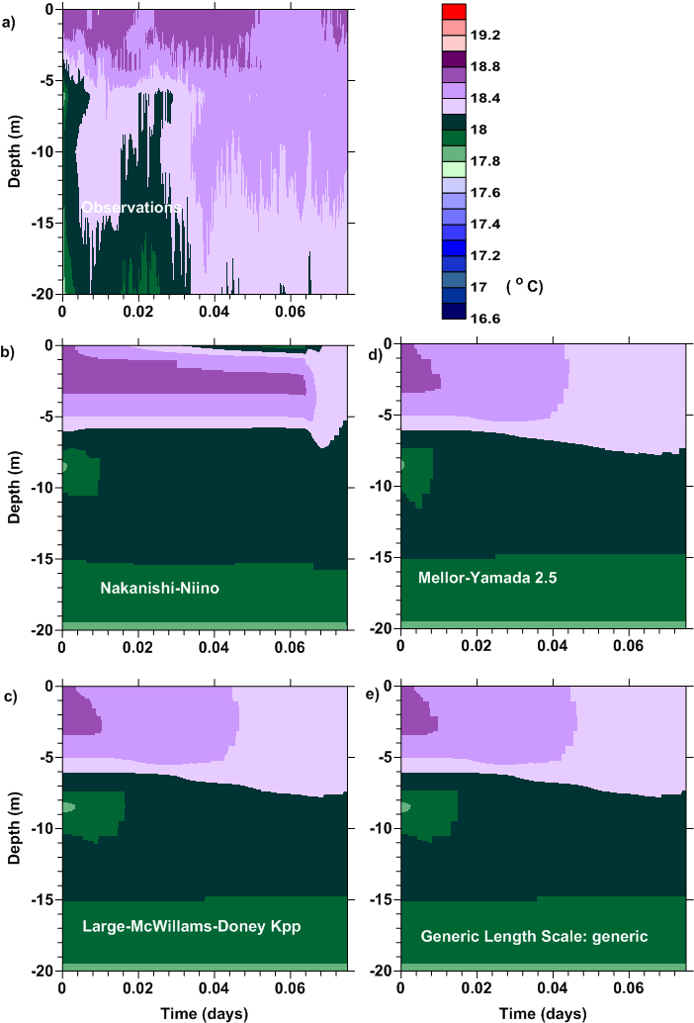
Jervis Bay
Temperatures are similar
Nakanishi-Niino less mixing than others
Others all similar to each other and less similar to observations
Insufficient mixing or too little solar radiation

Slide 44
Summary
Model gets some of the dynamics in the surface 10 m, but we can do better
Performance worse in stronger winds
Large-McWilliams-Doney Kpp generates too much mixing for the surface mixed layer
Nakanishi-Niino performs best and has more high frequency content; but Mellor-Yamada and GLS almost equivlent; no clear leader
All can be unstable for convection (surface cooling at night and with winds)
Definitely more work to be done, very much a work in progress
Need better model performance and other observational data sets

Slide 45
Where to From Here
Looking at other regions with better data sets
  Higher definition of surface temperatures
  Winds at mooring
  Regions more dominated by winds, fewer eddies, weaker currents
  Baltic Sea data set (Kantha)
  Looking for other observational data sets
Modify Nakanishi-Niino to be more stable OR …
  Investigate other vertical advection schemes
  Influence of vertical resolution at surface (now ~.25 m)
  Better representation of wind wave mixing
Reinvestigate for different wind and stratification conditions:
  Performance
  Vertical Resolution dependence

Slide 46
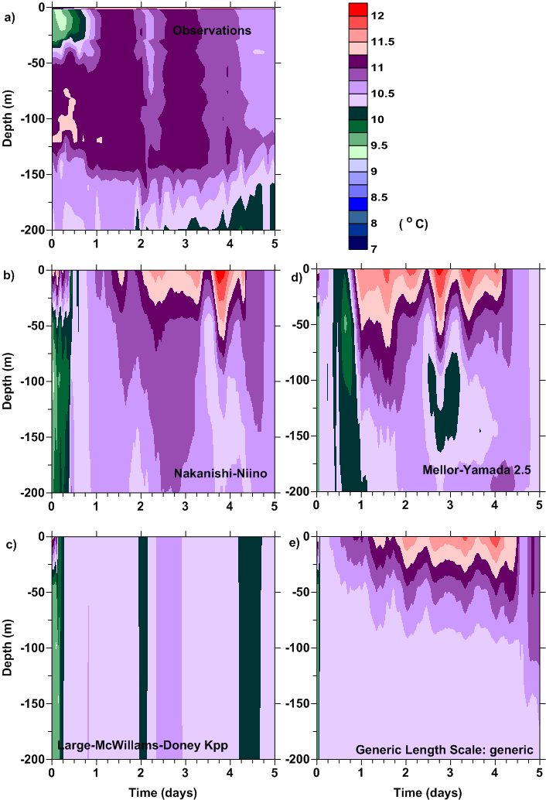
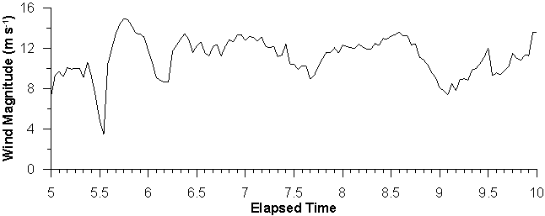
SOTS
Temperatures over time
Solar radiation is too high or mixing too low

Slide 47
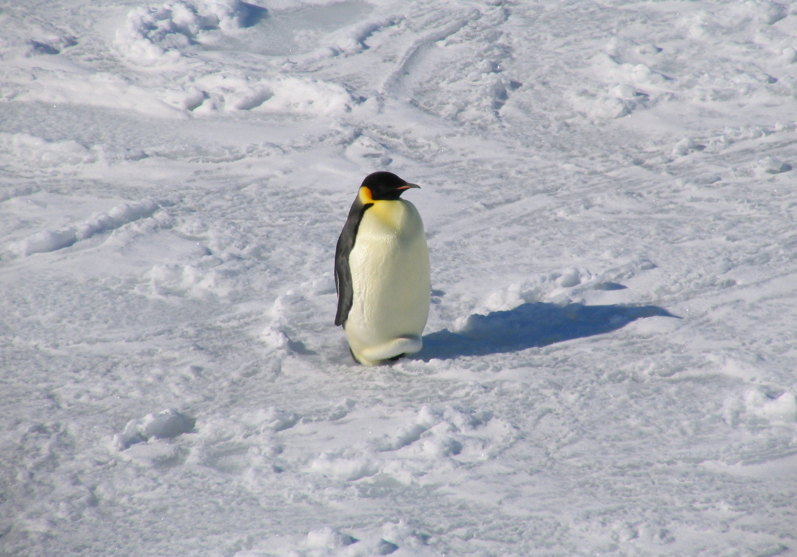
Questions

Slide 49
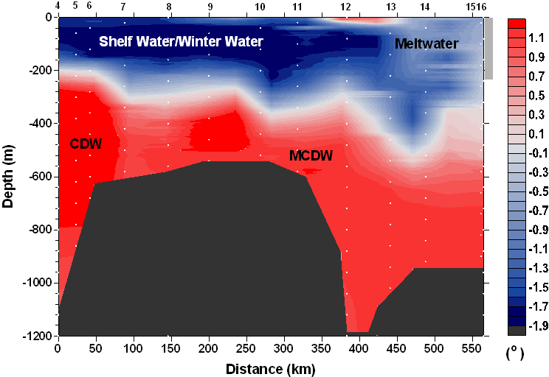
Across the Shelf to the PIG

Slide 50
Along the Front of the Ice Shelf (the PIG’s Snout)
The ice shelf front/snout Yo-Yo
θ
S
DO
Meltwater
Finestructure
Looking out of the ice shelf

Slide 51
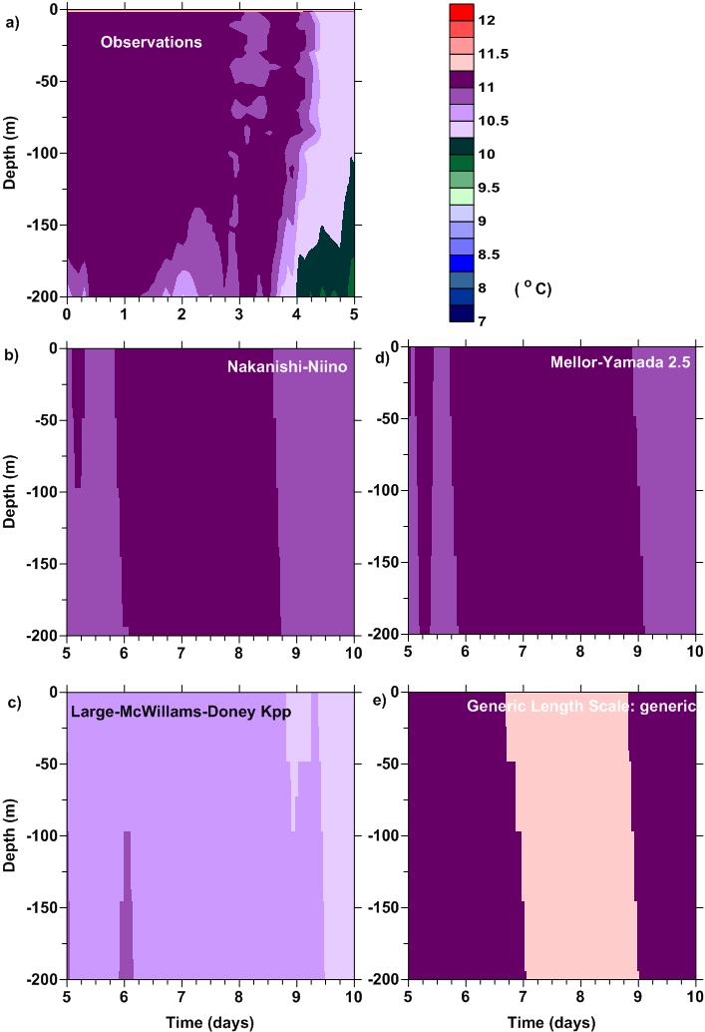
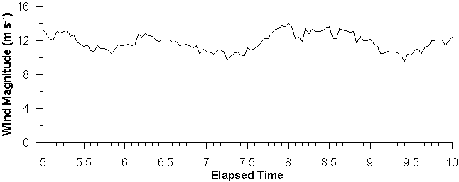
SOTS
Temperatures over time

Slide 52
Case 2: Mixed Layer Development
Mixed layer defined as 1ºC difference from the “surface” (16m)
All models show deepening mixed layer, but overestimate the depth of mixing

Slide 53
Case 2: Surface Mixed Layer Development
Surface layer defined as 0.3ºC difference from the “surface” (16m)
Nakanishi-Niino and LMD reflect daily solar influence
Similar performance, all too deep

Slide 54
Temperature Fields with Time
Observations have thermocline that weakens at day 9
Thermocline weakening for model cases earlier and does not reestablish
Nakanishi-Niino has the most similar temperatures

Slide 55
Mean East-West Velocities
Observations have much stronger velocities, probably an eddy plus internal tides
Model simulations also have internal tides and are more similar after day 8, but quite different

Slide 56
Vertical
Velocities
No vertical velocity observations
Similar response for MY, LMD, GLS
Nakanishi-Niino has largest vertical velocities, particularly in upper 40 m

Slide 57
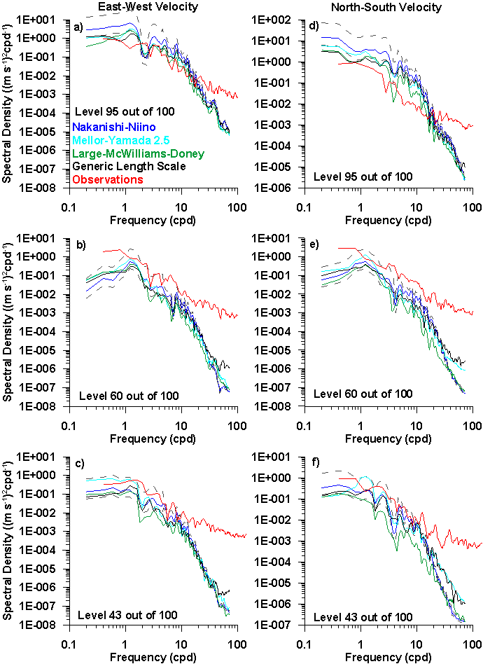
Horizontal
Velocity Spectra
All model results follow same slope, similar to Garrett-Munk
Observations have more high frequency energy, > 10 cpd
Dashed line = 95% confidence

Slide 58
Mean Temperature
Diffusivity
Mean Temperature Diffusivities experience high values, in the upper 80 m
Nakanishi-Niiino
  Values lower and shallower

Slide 59
Temperature Diffusivities
Temperature Diffusivities are still very large, > 10⁻² m² s⁻¹ for most of the region above 40-80 m
Nakanishi-Niino lower

