Slide 1
Australia’s Marine Virtual Laboratory, MARVL: enabling efficient ocean model configuration
Roger Proctor and the MARVL team

Slide 2
Rationale for MARVL
High-resolution models are historically time-consuming to configure
– often taking weeks to months to properly prepare.
Collecting the relevant data and making it suitable for the model at hand is a tedious task
We have sought to build a web browser toolkit for accelerating this initial phase of development for a number of community models, including ROMS

Slide 3
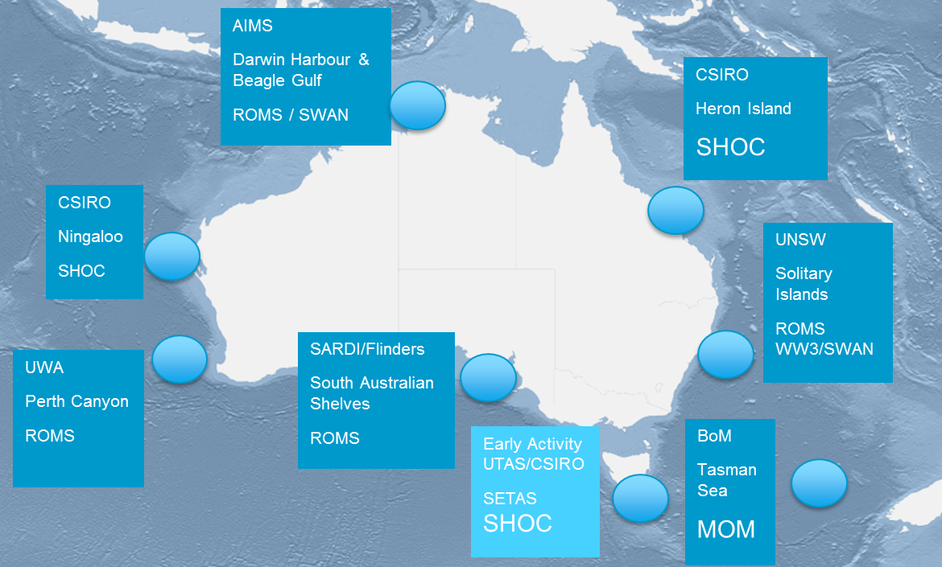
MARVL development
MARVL is a Virtual Laboratory under the NeCTAR Virtual Laboratory program supplemented by ANDS
MARVL development is a partnership between CSIRO, IMOS and TPAC
MARVL testing has involved the Australian marine research community – CSIRO, IMOS, AIMS, BoM, UNSW, UWA, SARDI and ‘others’ – Phil Gillibrand (UHI, UK), Brian King (RPS APASA) & John Wilkin (Rutgers U)

Slide 4
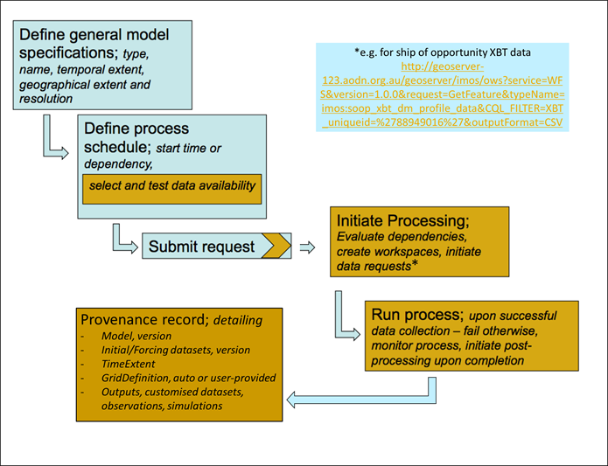
MARVL in a nutshell
Initiate Processing:
Evaluate dependencies, create workspaces, initiate data requests including for observations*
*e.g. for ship of opportunity XBT data
http://geoserver-123.aodn.org.au/geoserver/imos/ows?service=WFS&version=1.0.0&request=GetFeature&typeName=imos:soop_xbt_dm_profile_data&CQL_FILTER=XBT_uniqueid=%2788949016%27&outputFormat=CSV
www.marvl.org.au

Slide 5
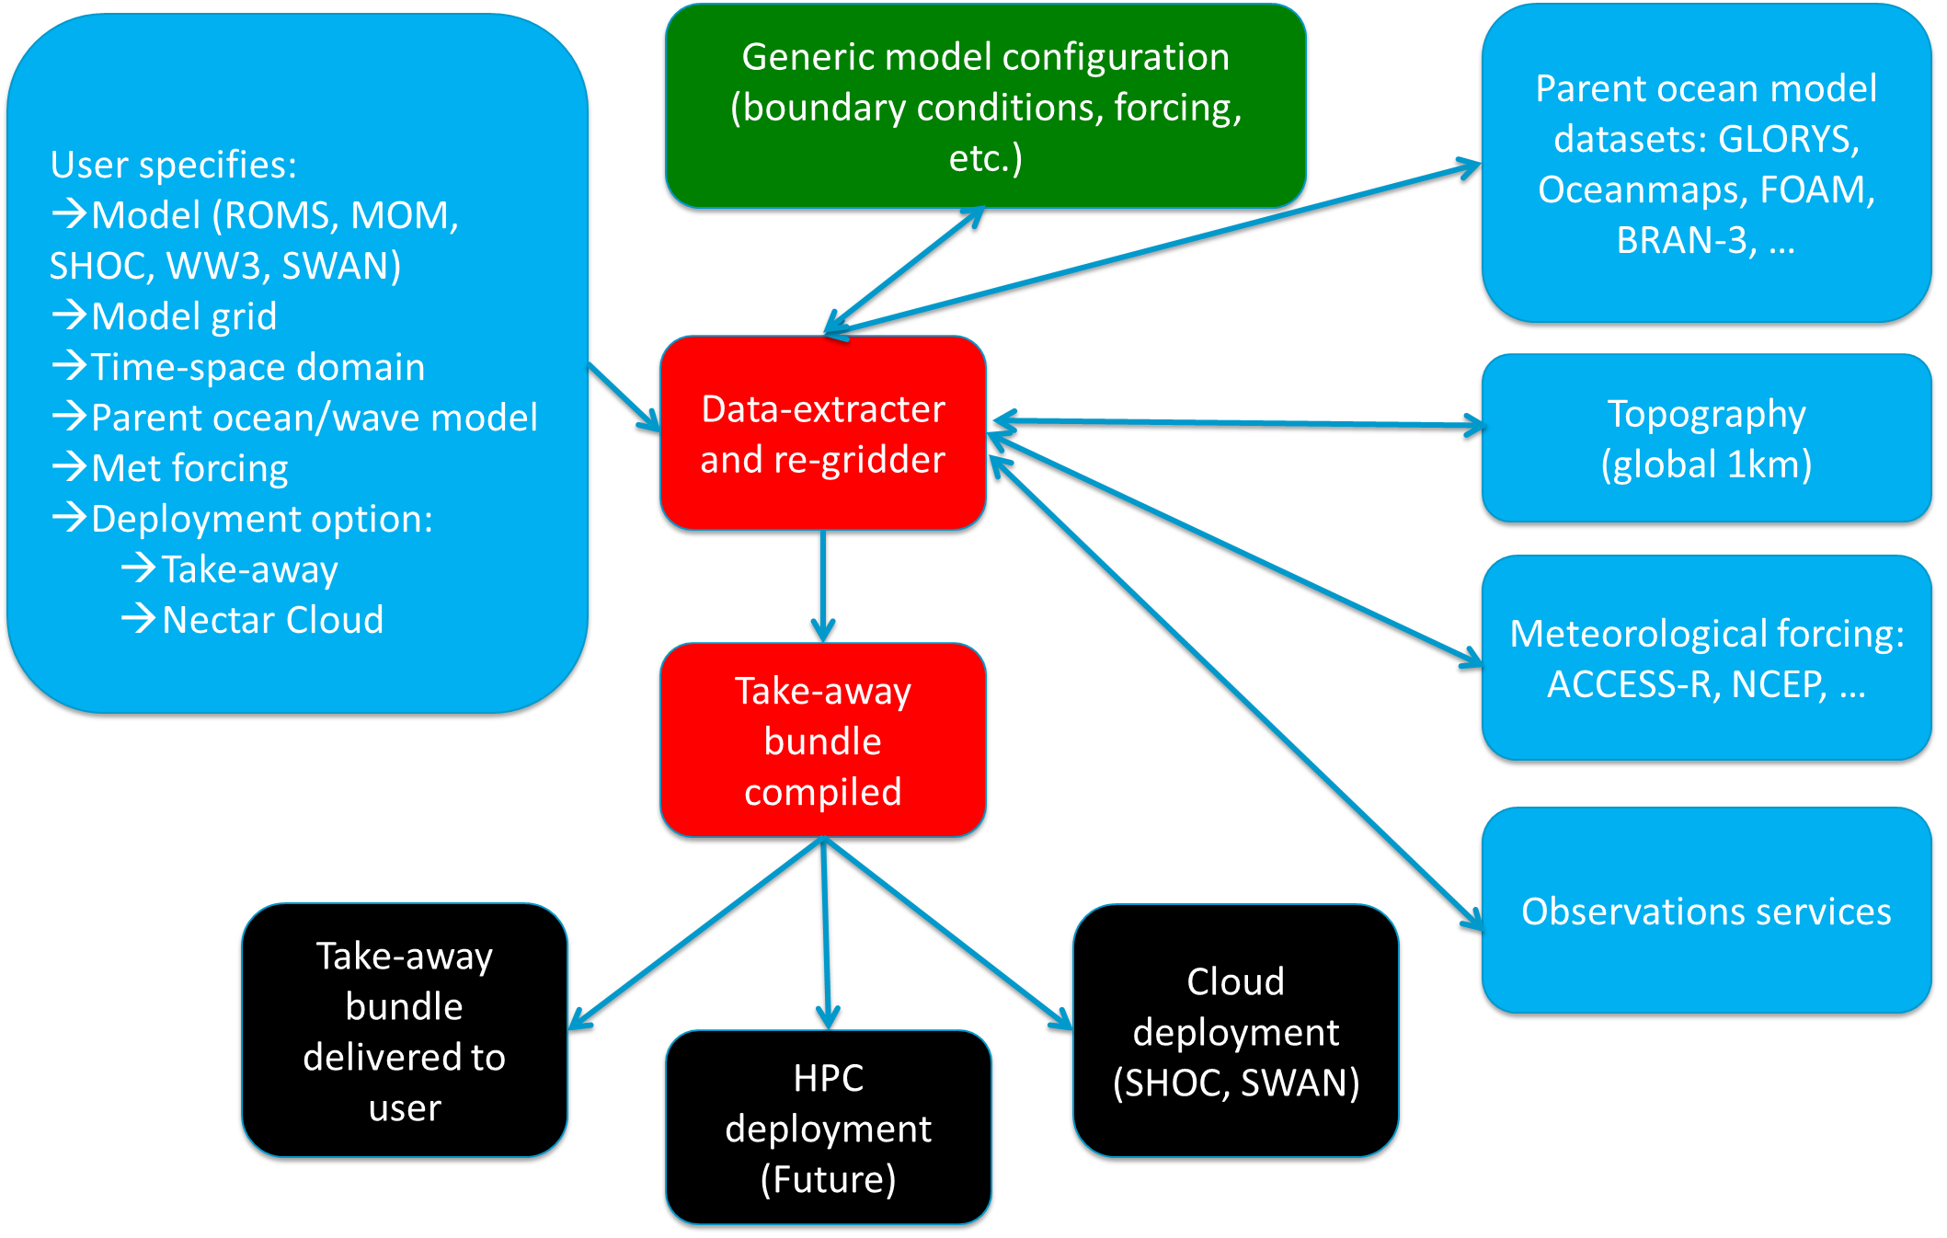
MARVL schematic

Slide 6
MARVL features
Five community models – 3 hydrodynamic (ROMS, MOM4, SHOC), 2 wave (WW3, SWAN)
Reanalysis datasets for ocean initial and boundary conditions (BRAN3, GLORYS, Oceanmaps, FOAM), and for atmospheric forcing (ACCESS-R, NCEP)
Global 1km bathymetry
Help assistant (beginner, expert)
Some user customisation, model dependent, e.g. upload own grid, modify parameters
Takeaway bundles for all models, cloud simulation for (at present) SWAN & SHOC
Summary log file, fragments extracted for provenance record (in progress).

Slide 7
How to use MARVL?
If Australian affiliation, get an AAF account - http://aaf.edu.au/
If not, register through ‘Virtual Home’ – contact roger.proctor@utas.edu.au
In 2017 we should be able to use eduGain, the international login
Get the URL - https://portal.marvl.org.au
Jump in!
Er, that’s it

Slide 8
Quick walk through - https://portal.marvl.org.au

Slide 10
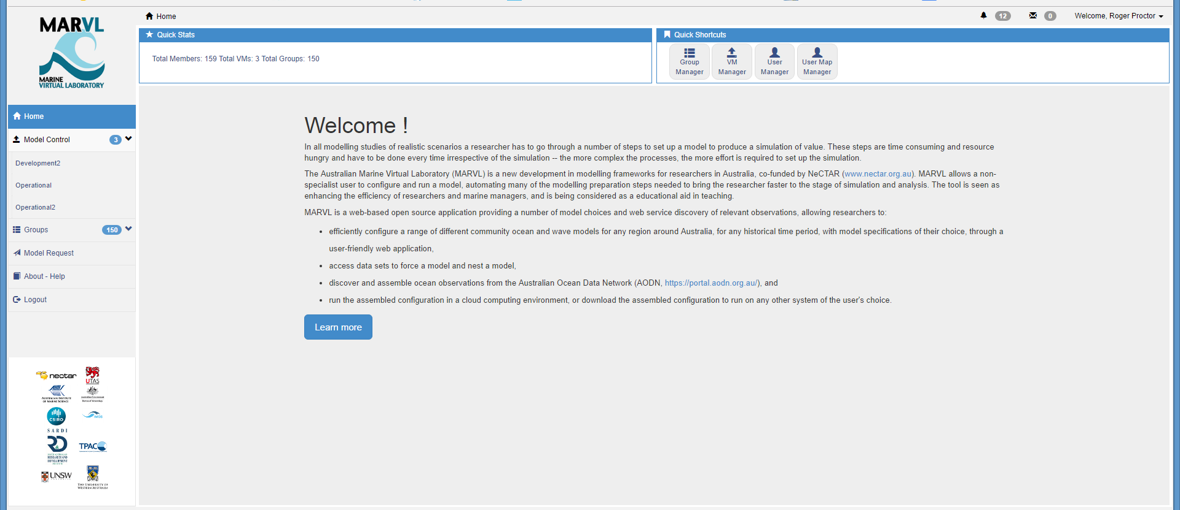

Slide 12
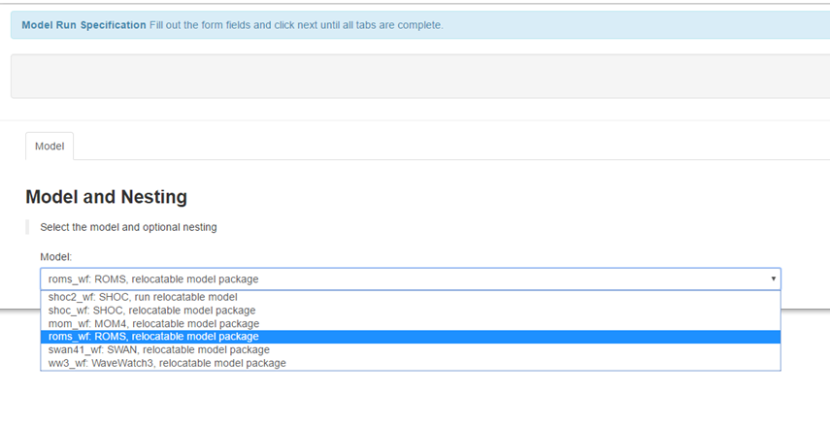

Slide 13
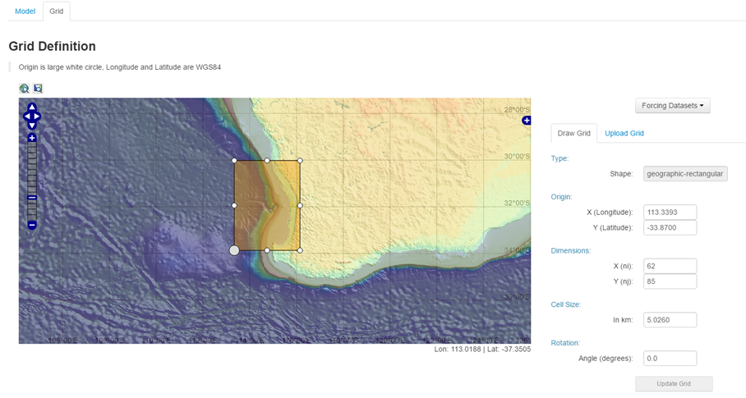

Slide 14
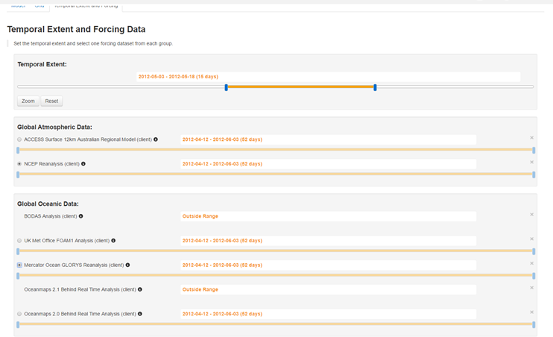

Slide 15
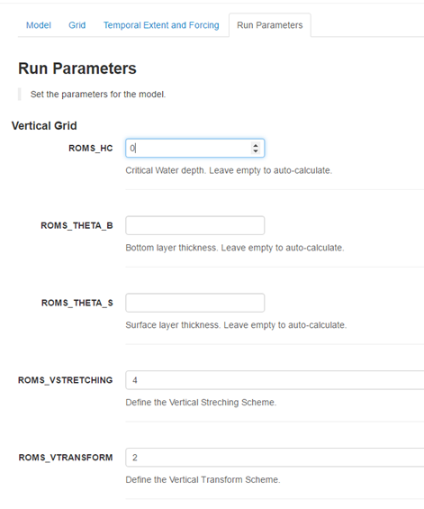

Slide 16
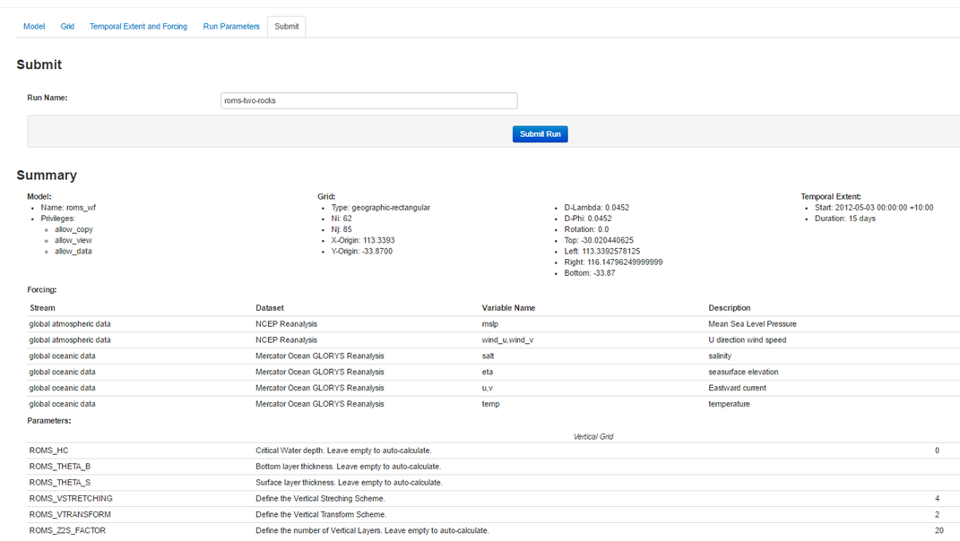

Slide 17
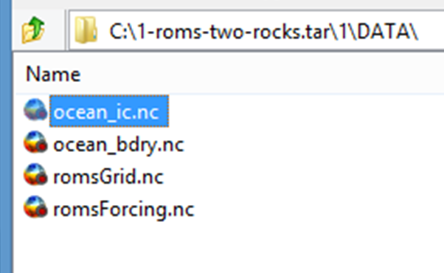
MARVL Outputs
Monitoring panel and download
File Bundles

Slide 18
Feedback from recent testing
Phil Gillibrand … interest in marine renewable energy
used SHOC, both download bundle and cloud simulation
worked well in both ways
some issues uploading own grids
need better help documentation
extend time period for downloaded datasets
add other models, e.g. unstructured, and make datasets global
Brian King … interest in search and rescue (SAR) applications
found interface easy to use
models suitable for SAR applications
need forecasting capability for SAR applications
SHOC model output not compatible with existing SAR trajectory models
potentially useful tool for operational SAR subject to modifications

Slide 19
John Wilkin …
ROMS model focus, test case for the greater Hauraki Gulf in New Zealand
the process of getting started was not intuitive
better labelling of tasks
projections other than square required
generated grid file compliant
need additional met parameters for surface fluxes
like improved provenance
need improved print capability for Summary page
bug in surface forcing interpolation
romsForcing.nc has incorrect formulation for surface flux
have to customize varinfo.dat to read the variable names in romsForcing.nc
make better use of the ROMS CDL variable templates
need improved logic to ingest user-defined grid file (errors in coordinates)
improvements would make MARVL a useful tool

Slide 21
Possible improvements to better serve ROMS users (John’s recommendations)
Improved HELP content and documentation
Better step-by-step labelling
Capture provenance data
Revise interpolation (more judicious land/sea mask usage)
Revise surface flux outputs
Improve grid upload ingest (to fix erroneous geolocation)
Adopt ROMS variable labelling
Install latest version of ROMS

Slide 22
Want to know more about MARVL?
Read all about it
Oke et al, 2016,
Geosci. Model Dev., 9, 3297-3307.
Online

Slide 23
Thanks for listening, now I can go home!
roger.proctor@utas.edu.au

