Slide 1

Kuroshio intrusion northeast of Taiwan
---An application of ROMS to the East China Sea
Xiaohui Liu; Dake Chen; Jilan Su
State Key Laboratory of Satellite Ocean Environment Dynamics (SOED)
Second Institute of Oceanography (SIO), State Oceanic Administration, China
Changming Dong
Nanjing University of Information Science and Technology, Nanjing, China; UCLA, USA
2016.10.20; Hobart, Australia

Slide 2
Contents
Background
Model setup
Results
Summary

Slide 3
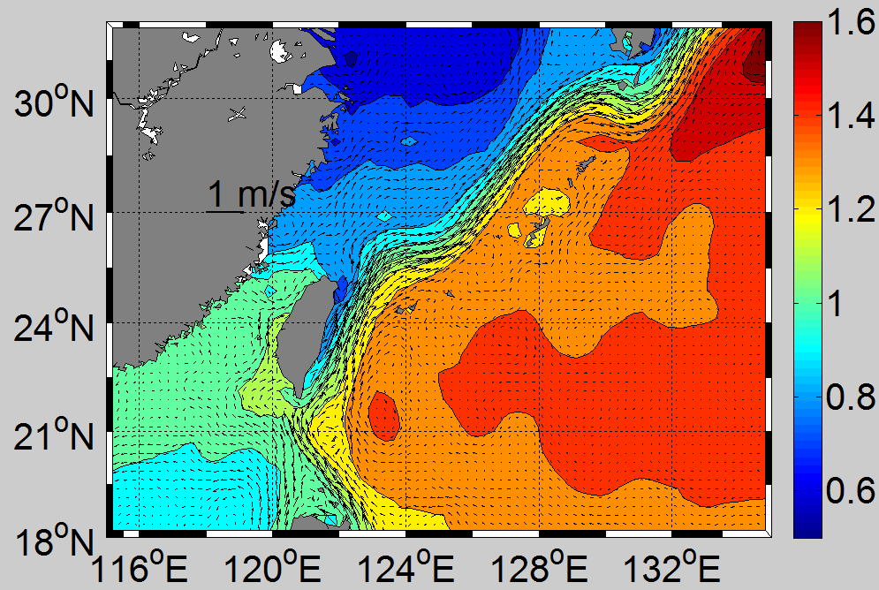
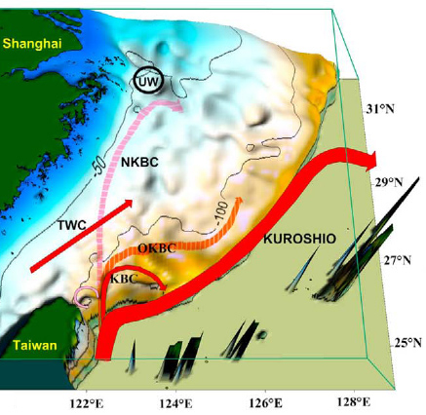
Background (1)
Kuroshio on-shelf intrusion exerts strong influence on the circulation system and marine ecosystems of the China Seas
Near bottom salinity
AVISO, MDT
(Yang et al. 2012)
NASA/JPL
N Transport
Q_{SW+TW+IW}=205*10⁹ mol/yr
Q_{Ri}=29*10⁹ mol/yr
UW
(Chen, 1996)
(Yang et al. 2012)

Slide 4
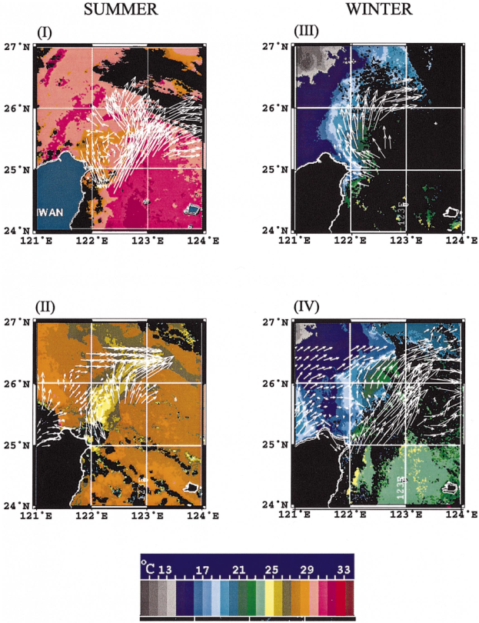
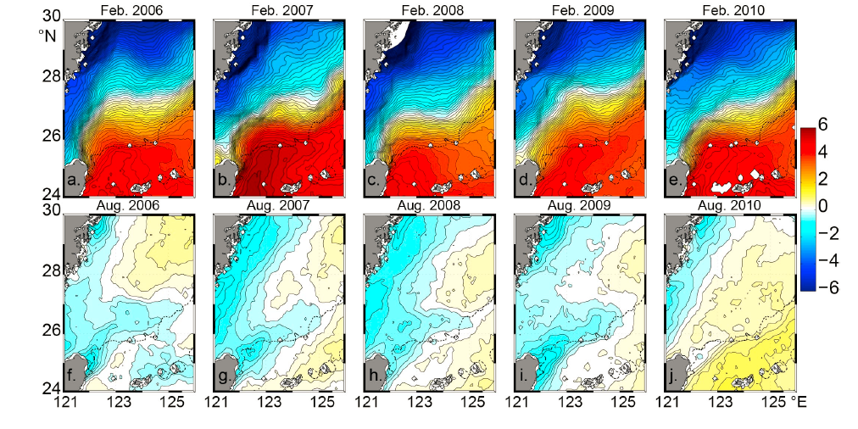
Background (2)
The Kuroshio intrusion varies with different time scale, such as seasonal, interannual and intra-seasonal scales.
SST Anomaly （Data Source: REMSS）
Tang et al.，2000

Slide 5
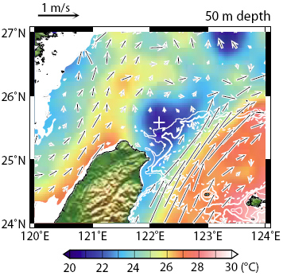
Background (3)
Upwelling forms “cold dome”, which is more obvious in summer seasons
Jan et al., 2010

Slide 6
Questions:
(1) Pattern and variability of the Kuroshio intrusion?
(2) Influence factors and dynamics of the Kuroshio intrusion?
(3) Upwelling process?

Slide 7
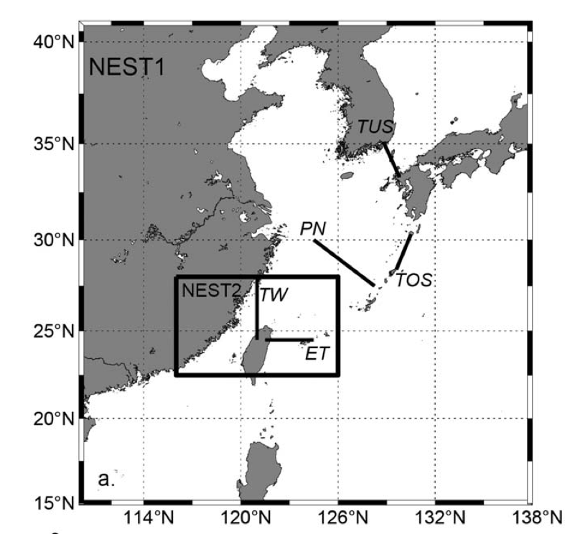
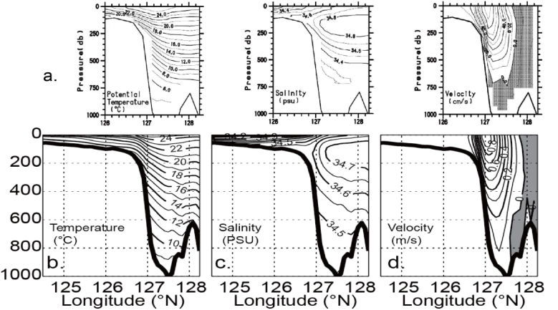
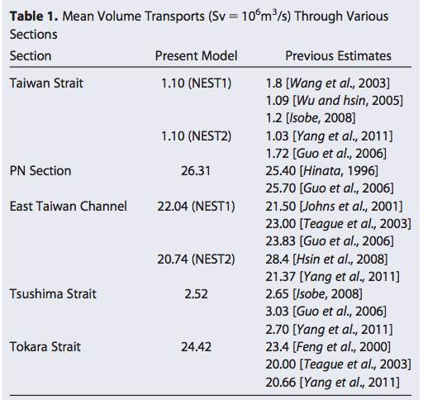
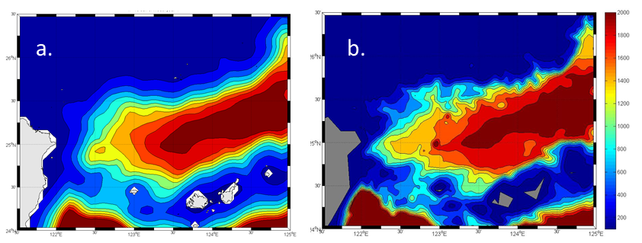
Vertical layers : 32 S-layers
Simulating time : 2000 - 2009
Open boundary condition : HYCOM reanalysis
Surface forcing : COADS heat flux
quikSCAT daily wind stress
ROMS Model Setup (1)
1/54 degree
~2 km
1/18 degree
~5 km

Slide 8
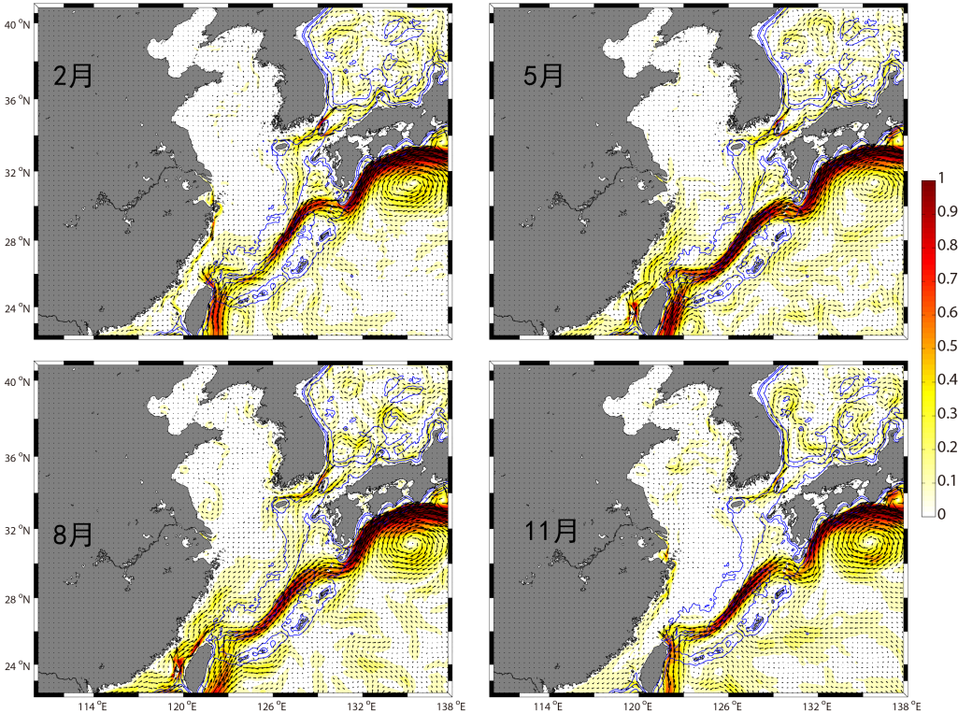
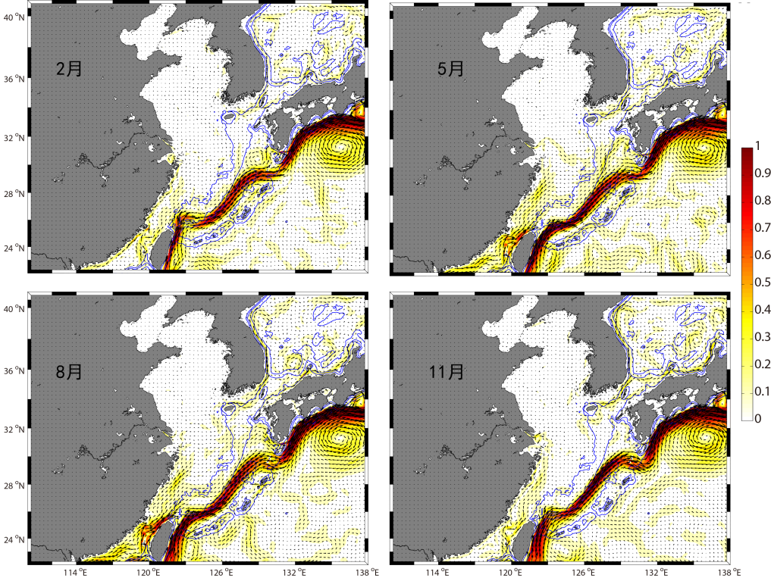
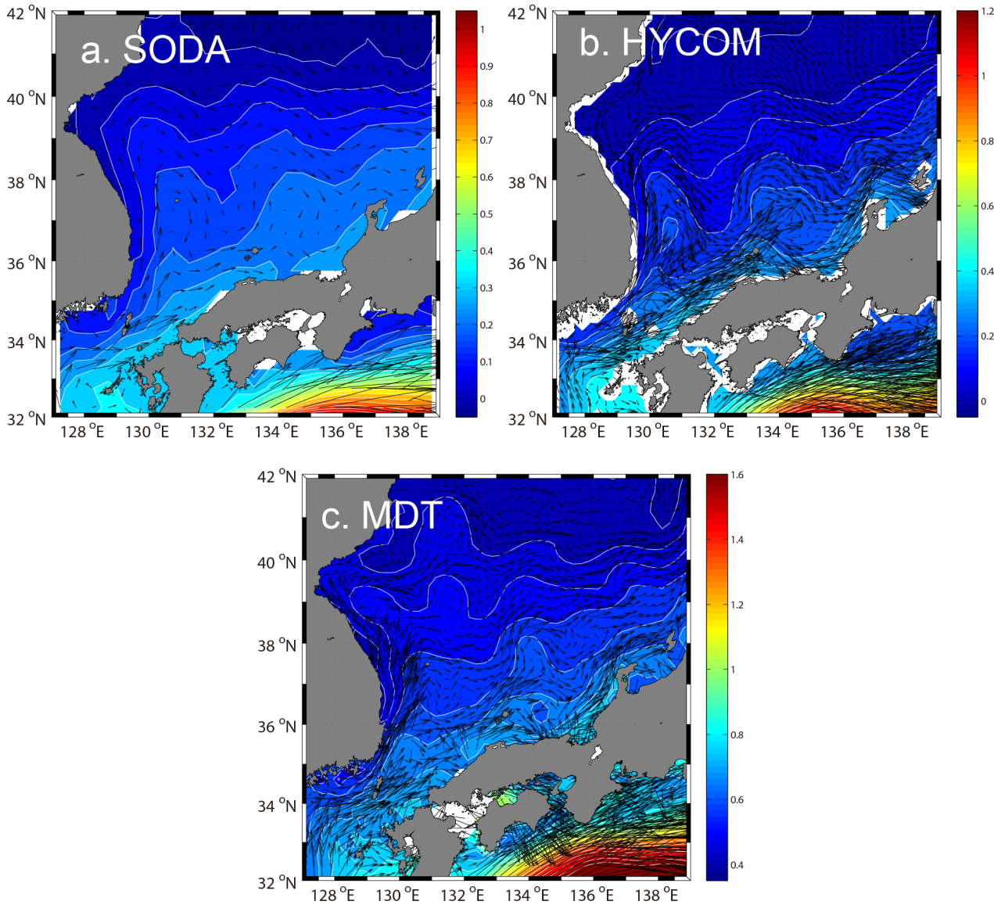
ROMS Model Setup (2): Data of Open Boudaries
SODA Boundary
HYCOM Boundary
Feb
May
Feb
May
Aug
Nov
Aug
Nov

Slide 9
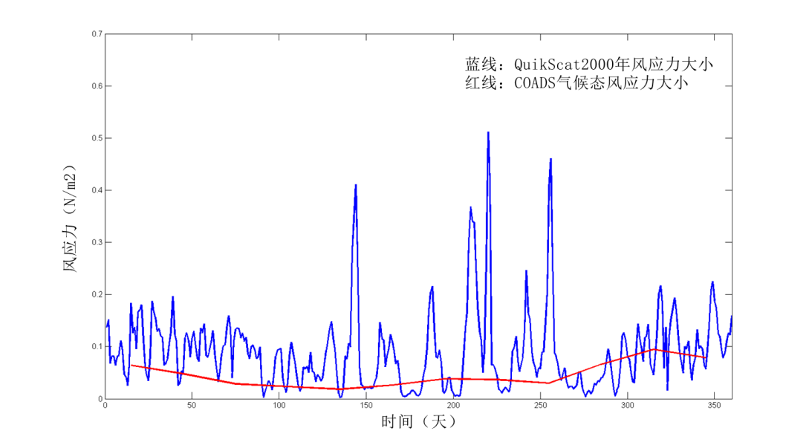
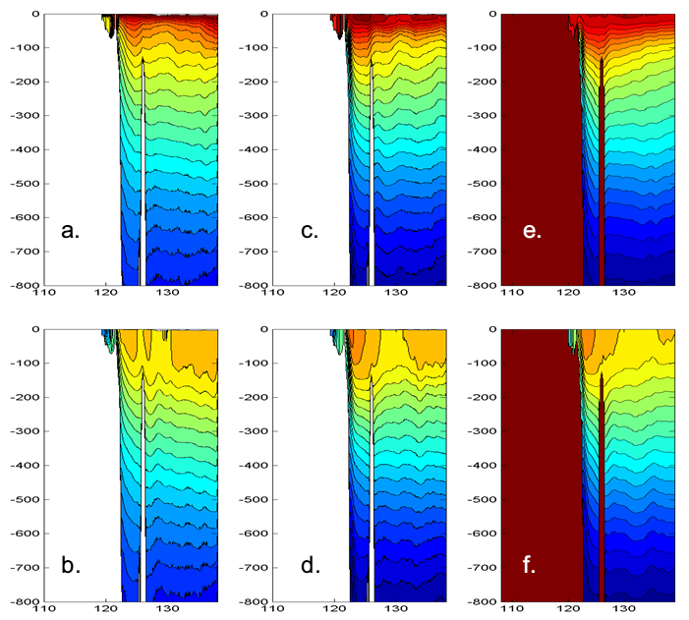
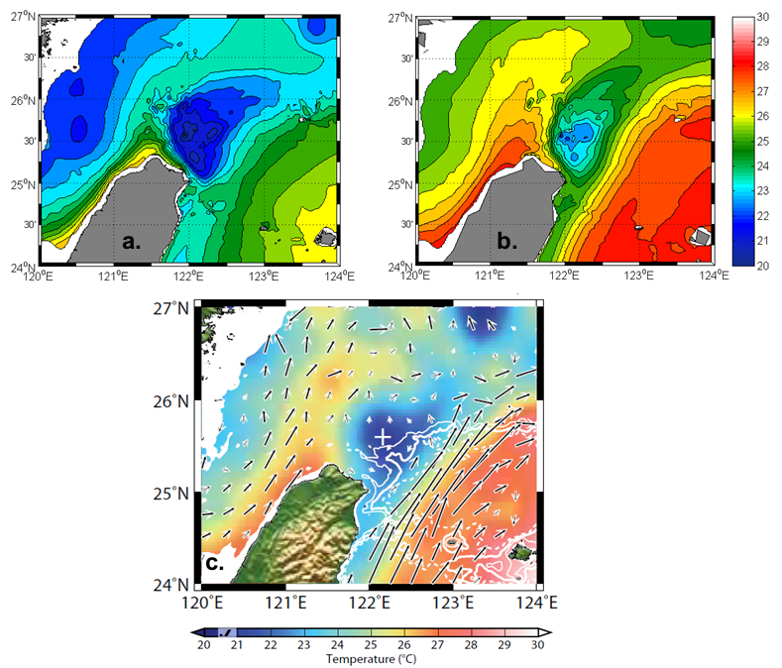
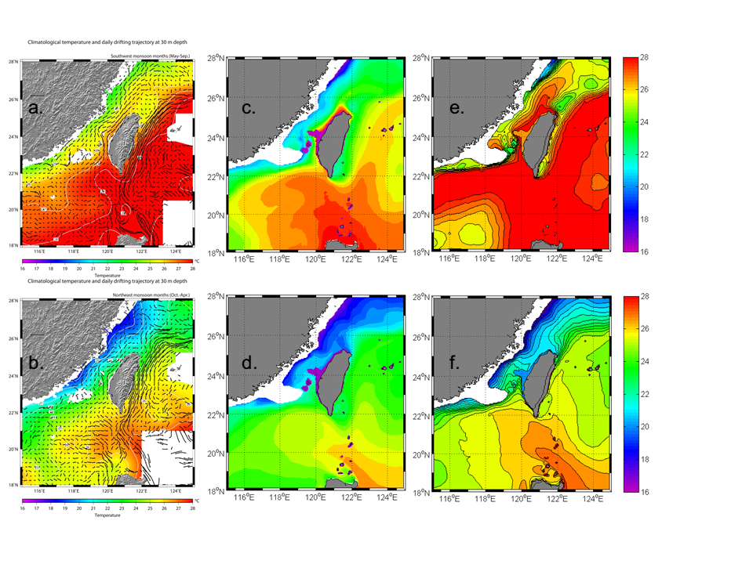
ROMS Model Setup (3): High-frequency wind stress forcing
Climatological wind
Daily wind
HYCOM Reanalysis data
quikSCAT (year 2000)
Climatological monthly mean
Wind stress (N/m^2)
Temperature along 25 N
Time (day)
Climatological wind
Daily wind
Climatological wind
Daily wind
Observation
Temperature at 50 m layer
Observation
Temperature at 50 m layer

Slide 10
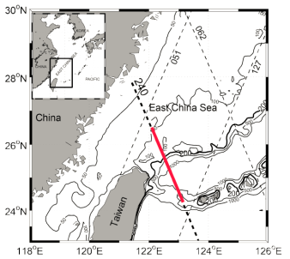
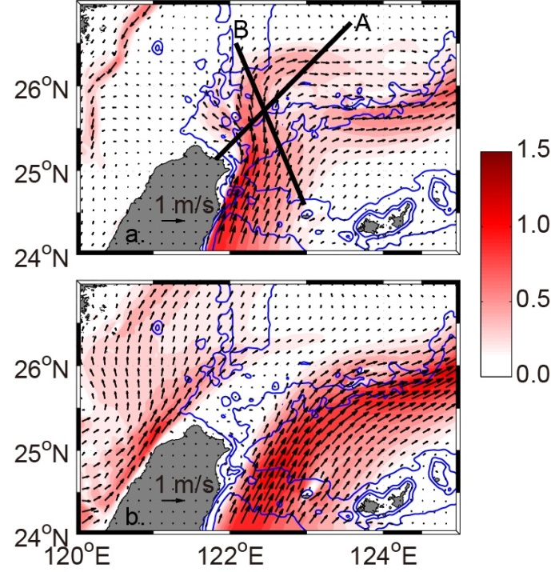
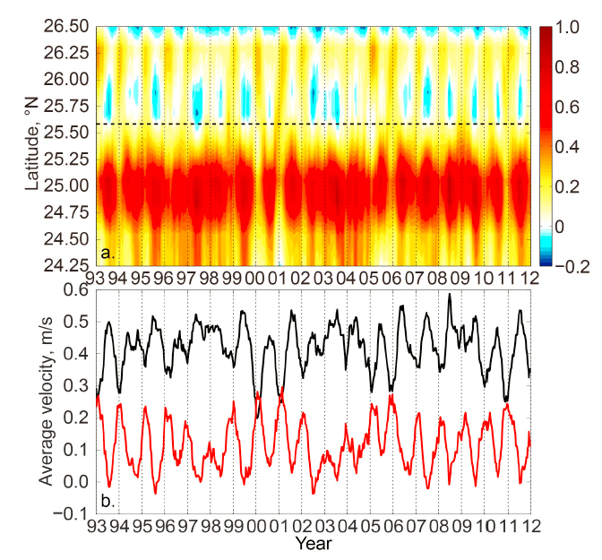
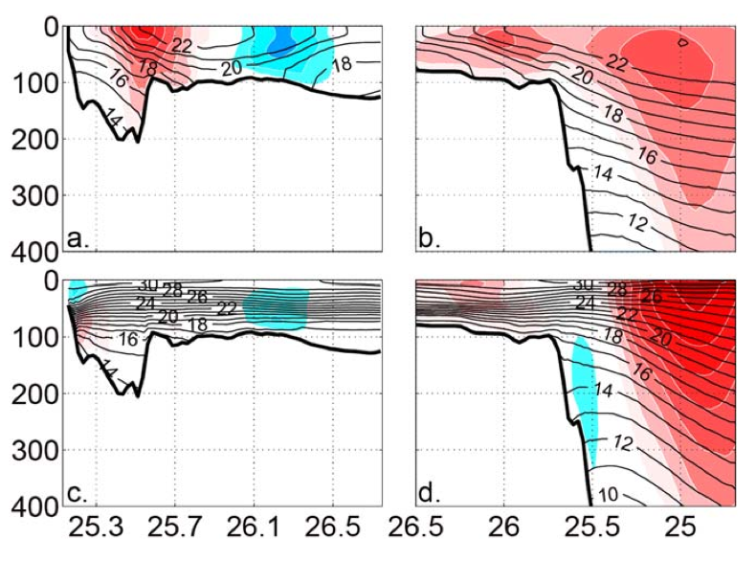
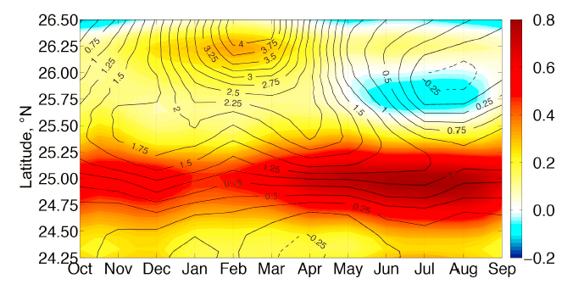
Result (1): Seasonal Pattern of Kuroshio intrusion
Jan
Geostrophic velocity along the track
Jul
Sec. A
Sec. B
Climatological mean of Geo Velocity
Jan
Jan
Jul
Jul
Liu et al., 2014

Slide 11
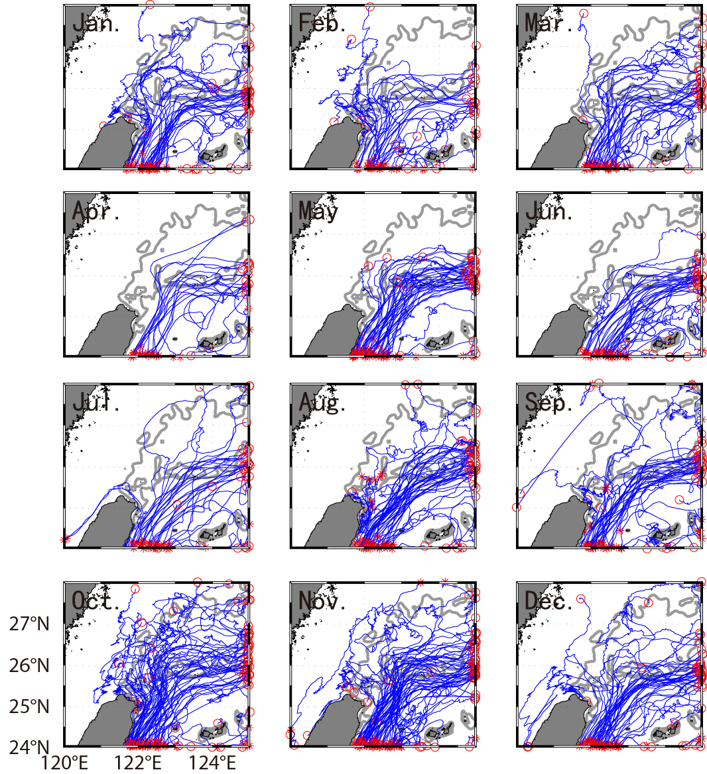
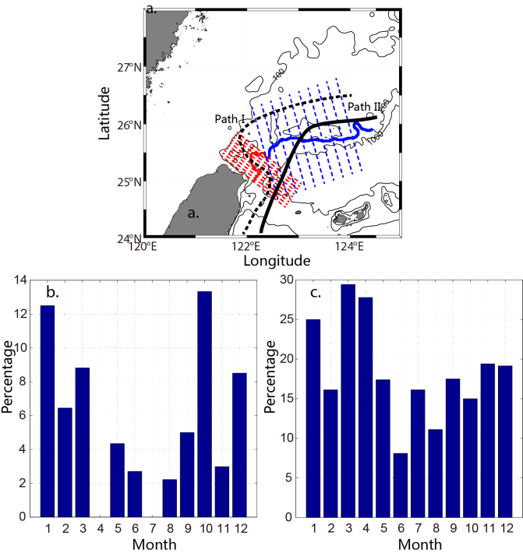
Result (2): Floating drifters
Argos drifters
Liu et al., 2016

Slide 12
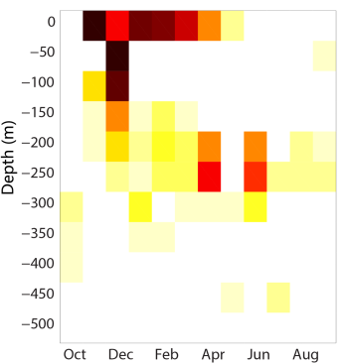
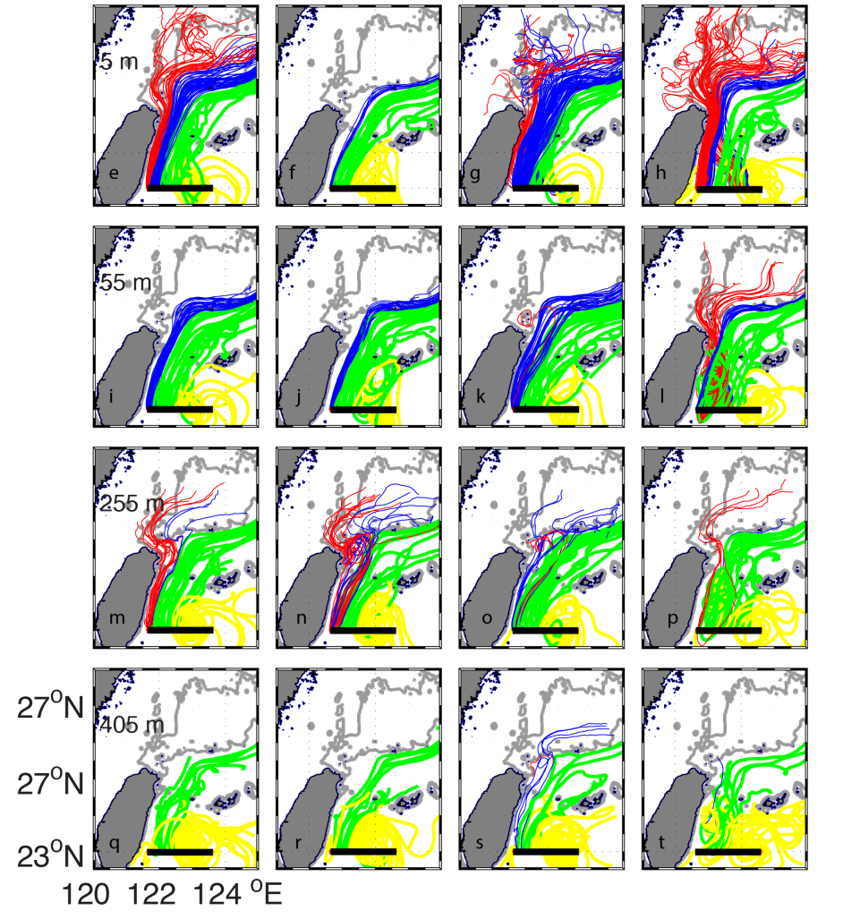
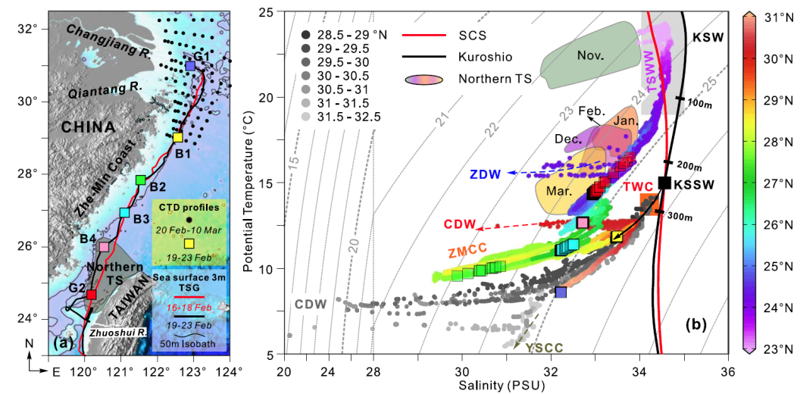
Result (2): Floating drifters
Model simulation of tracers
Spring
Summer
Autumn
Winter
Lian et al, 2016
Liu et al., 2016

Slide 13
Result (3): Interannual variability
Along-track Geo Velocity

Slide 14
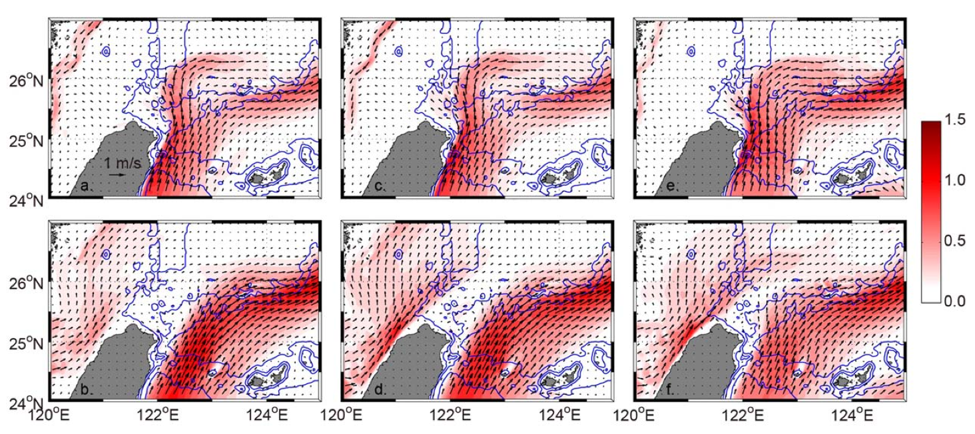
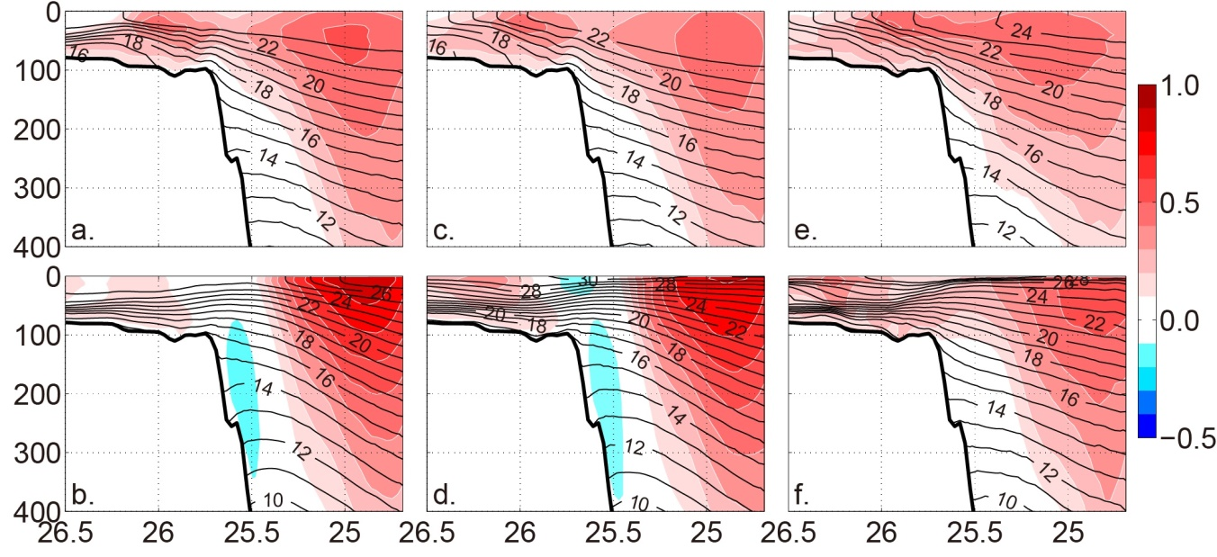
Result (3): Interannual variability
Wind
Heat Flux
Kuroshio Transport
 | Control | Test 1 | Test 2 | Test 3
Surface heat flux | S | A | S | S
Surface wind stress | S | S | A | S
Upstream transport | S | S | S | A
S: Seasonal varied
A: Annual mean

Slide 15
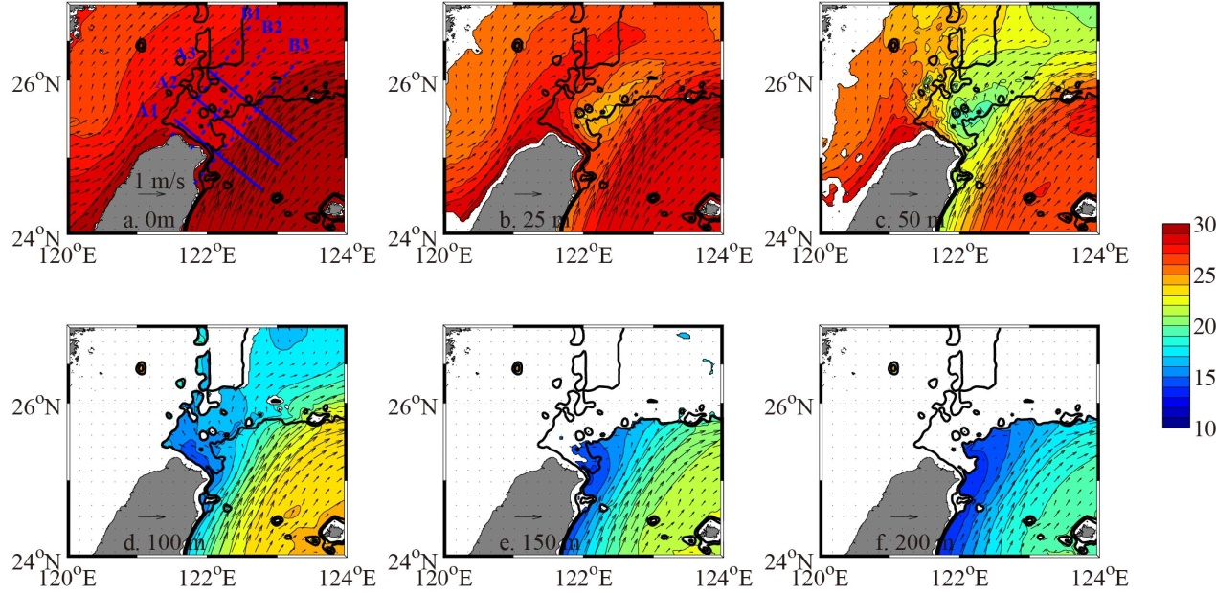
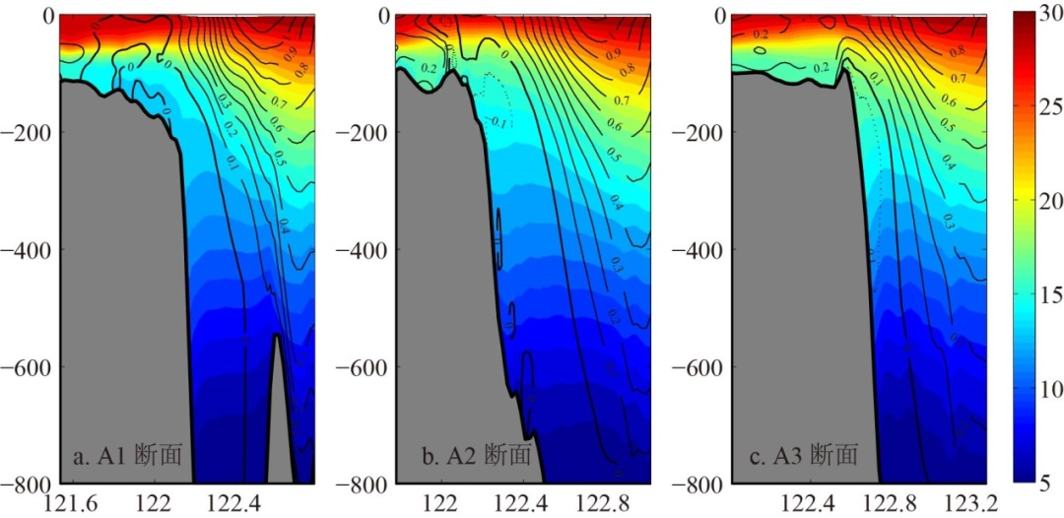
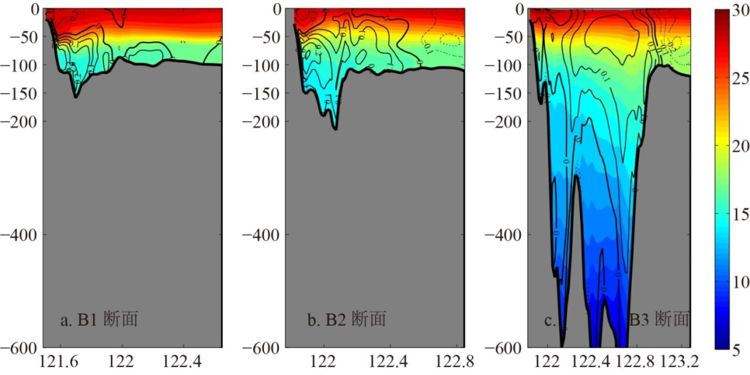
Result (4): Upwelling of subsurface water

Slide 16
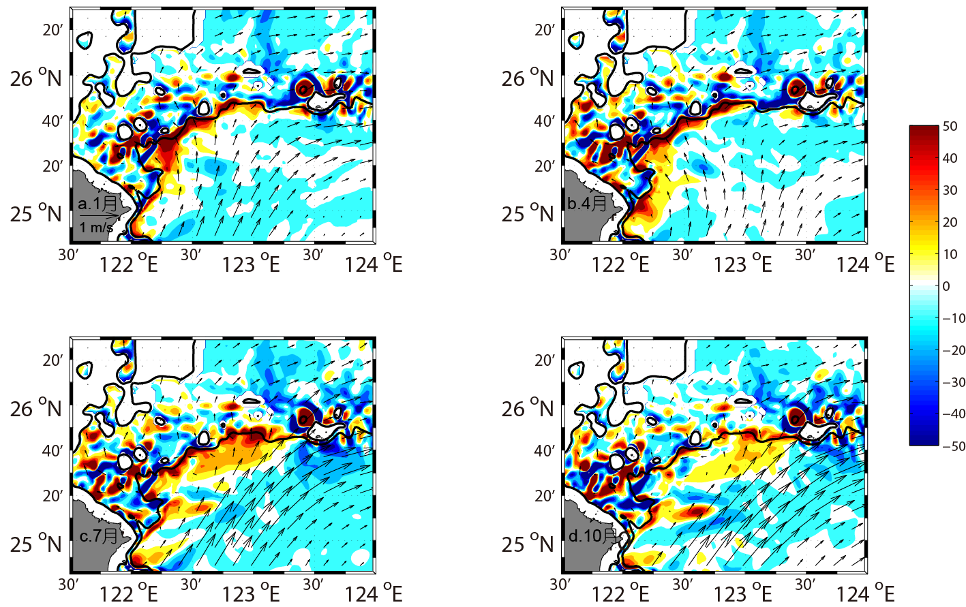
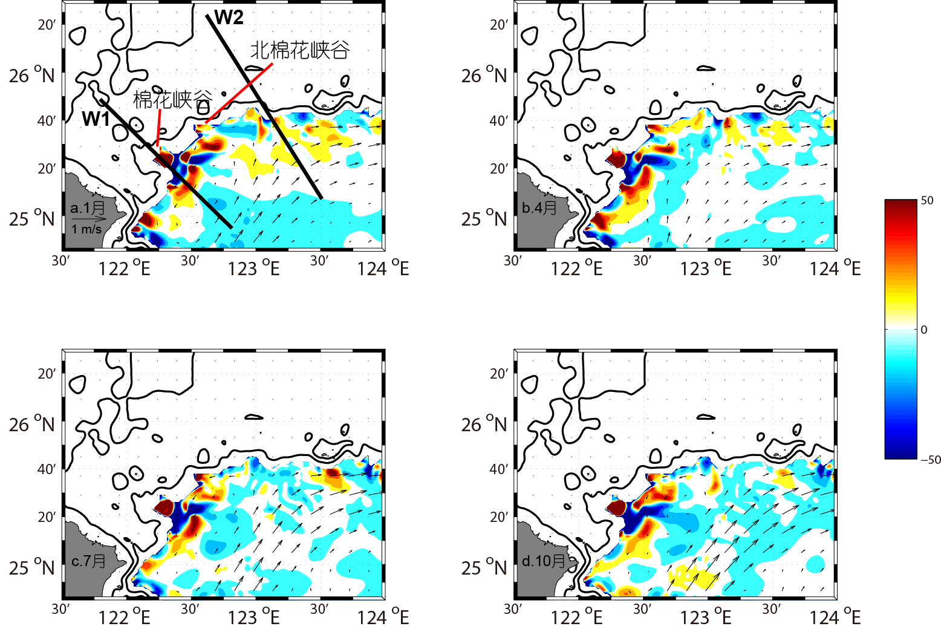
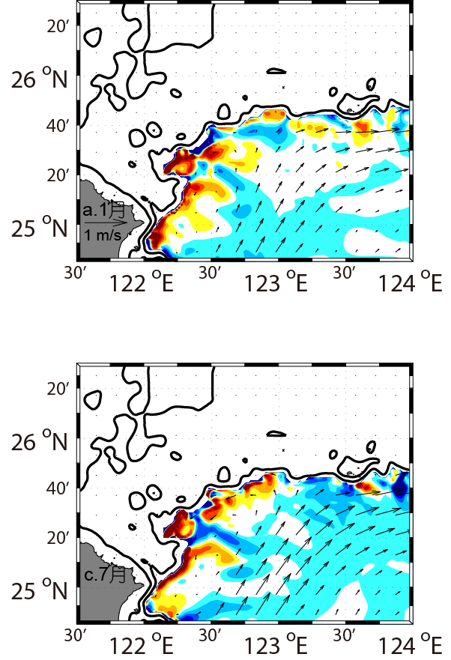
Result (4): Upwelling of subsurface water
100m
250m
400m
North M-H Canyon
M-H Canyon
Jan
Jan
Jan
Jul
Jul
Jul

Slide 17
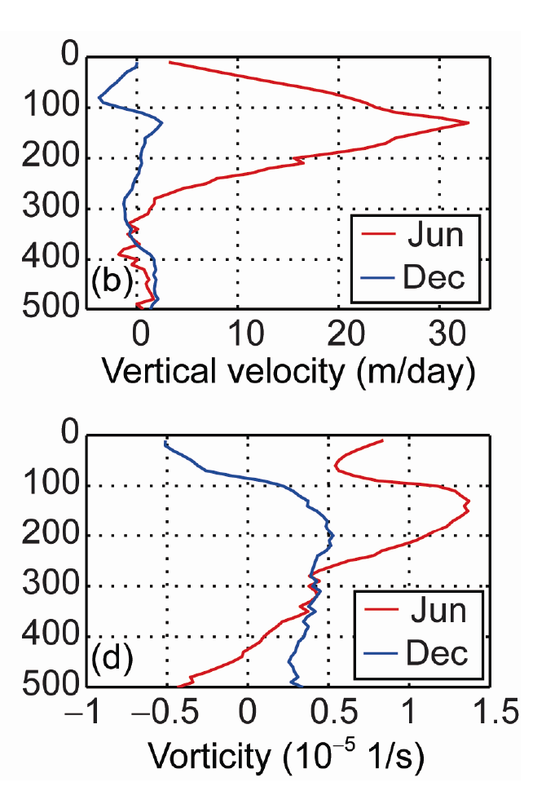
Result (4): Upwelling of subsurface water

Slide 18
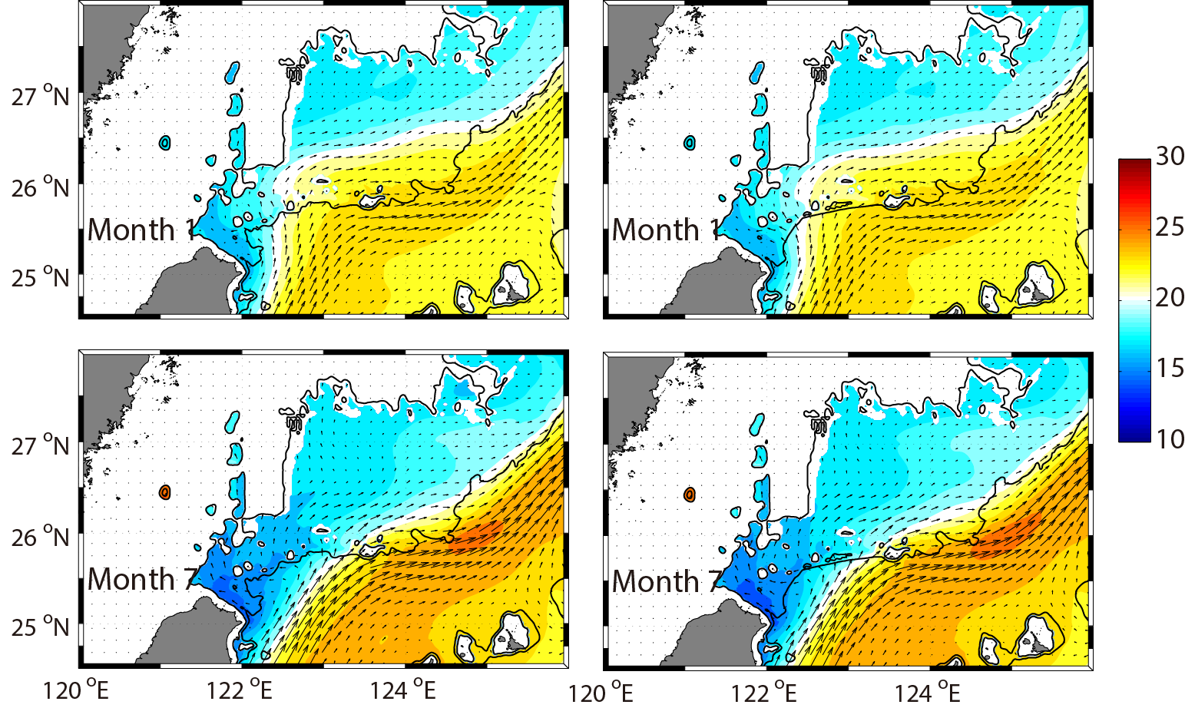
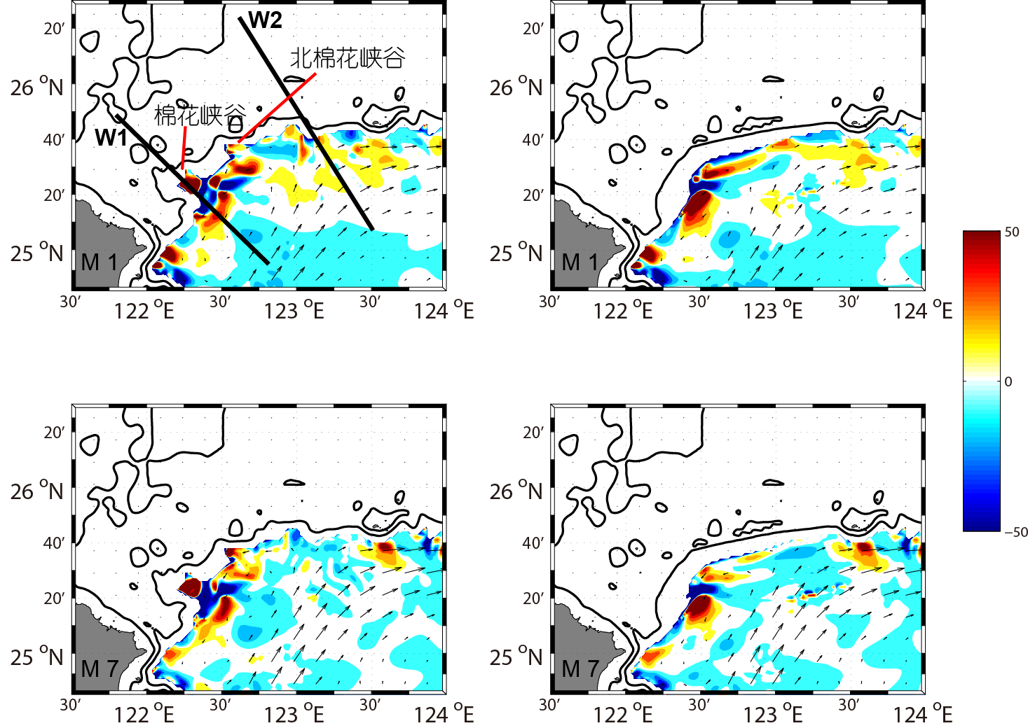
Result (4): Upwelling of subsurface water
Sensitivity test on the canyons near shelf break
Original
Canyon-smoothed
Original
Canyon-smoothed
Jan
Jan
M-H Canyon
North M-H Canyon
Jul
Jul
Canyons influence the strengthen, but not the structure.

Slide 19
Summary
A two-level nested ROMS model was applied to the China Seas and the Kuroshio intrusion northeast of Taiwan was investigated by model results.
The choice of different data on open boundary condition and wind stress influences the model results greatly.
Kuroshio intrusion shows seasonal and interannual variabilities.
Seasonal: a branch current in winter and subsurface upwelling in summer.
Interannual: Kuroshio transport is more important than local factors.
Cold dome forms due to the upwelling near the edge of shelf break. The convergence induced by vorticity of the current near the shelf break is the main mechanism. Canyons just influences the strengthen.

Slide 20
Thank you!
Email: xh_liu@sio.org.cn
Pubulications:
X. Liu, D. Chen, C. Dong, H. He, 2016, Variation of the Kuroshio intrusion pathways northeast of Taiwan using the Lagrangian method. Science China: Earth Sciences, 59(2), 268–280.
X. Liu, C. Dong, D. Chen, J. Su, 2014, The pattern and variability of winter Kuroshio intrusion northeast of Taiwan. Journal of Geophysical Research: Oceans, 119, 5380–5394, doi:10.1002/2014JC009879.

