Slide 1
The cold water source and the role of tides on Guangdong Coastal Upwelling in summer: a numerical model study
Kuang Fangfang, Pan Aijun, Zhang Junpeng
Ocean Dynamics Laboratory,
Third Institute of Oceanography,
State Oceanic Administration (TIOSOA)
Xiamen, China

Slide 2
Outline
Introduction
Model configuration
Model evaluation
The cold water source of upwelling
The role of tides in upwelling
Conclusion
Things to be done

Slide 3
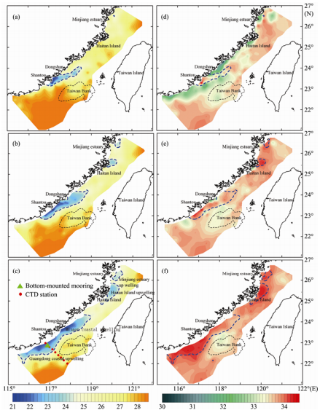
Introduction
a)T,10m
d)S,10m
The continental shelf zone in the northern South China Sea (SCS), is the location of one of the main seasonal upwelling regimes off the China coast.
Guangdong coastal upwelling.
It believed that the dominant driving force of NSCS coastal upwelling is the Asian southwest monsoon
b)T,20m
e)S,20m
c)T,30m
f)S,30m
Temperature and salinity at 10,20,30m,
June to August,2006(Pan,2011)
Notes:
Coastal upwelling is an important marine system which can
transport nutrient-rich water towards the ocean surface.

Slide 4
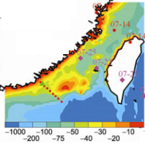
Introduction
On the basis of observations, Hong (Hong,1991) suggested that because there is no horizontal water supply at the same level, the water source for the summer Guangdong coastal upwelling is the subsurface water of the SCS, which ascends the continental slope in an onshore direction and is driven by the alongshore southwest monsoon
It is thus revealed that the topographical rise about 80–120 km offshore, emanating from the southwestward natural extension of the Taiwan Bank, cuts off direct on-shore upwelling of deep water in the SCS. As a result, cool, saline upwelling water can only come from the southwest subsurface water of the SCS (Gan,2009).
Bottom- mounted mooring
CTD station
B1
Section A
Water depth/m

Slide 5
Problem to be solved
Moreover, contributions from the “tidal pumping” effect invoked by interactions of tides, tidal current, and complex bathymetry remain unknown

Slide 6
Model configuration
ROMS model
The model domain covers the Northwest Paciﬁc with a resolution of 0.1º (~10km)
24 sigma levels with a higher resolution near the surface.
Open boundary condition and initial condition: SODA(0.5º×0.5º,monthly mean)
Tidal : TPXO8,8 constitutes
Air–sea interface: BULK_FLUX module using CFSR data(0.25º×0.25º,6 hourly)
Notes:
the temperature, salinity, surface
elevation and velocity, derived from a Paciﬁc Regional
Ocean Model System (Paciﬁc ROMS) (Wang and Chao
2004; Liu and Chai 2009), were set as the lateral boundary
and initial conditions. In addition, at the open boundary of
the sub-domain, this model includes tidal forcing com-
prising 16 tidal components

Slide 7
Model configuration
Spin-up: 2000-2011
Stand Run and No-tide Run:
Initialized using monthly mean values from spin-up, 2000-2006
with or without tides
Spin up
Stand Run
No-tide Run
Volume averaged kinetic energy(m²/s²)

Slide 8
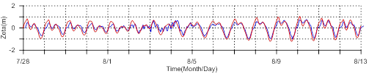
Model evaluation
Bottom- mounted mooring
CTD station
Time: 28/7/2006-13/8/2006
B1
Section A
Mooring
Water depth/m
Model
Water level(m) at station B1
neap tide
spring tide
Tide amplitude is 1~2m

Slide 9

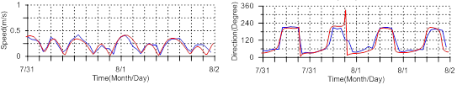
Model evaluation
Mooring
Current speed and direction at station B1
Model
Time: 31/7/2006-2/8/2006(neap tide)
a) speed: surface layer
c) direction: surface layer
b) speed: bottom layer
d) direction: bottom layer

Slide 10
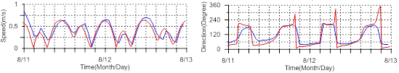
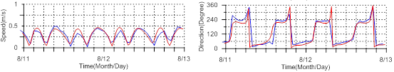
Model evaluation
Mooring
Current speed and direction at station B1
Model
Time: 11/8/2006-13/8/2006(spring tide)
a) speed: surface layer
c) direction: surface layer
b) speed: bottom layer
d) direction: bottom layer

Slide 11
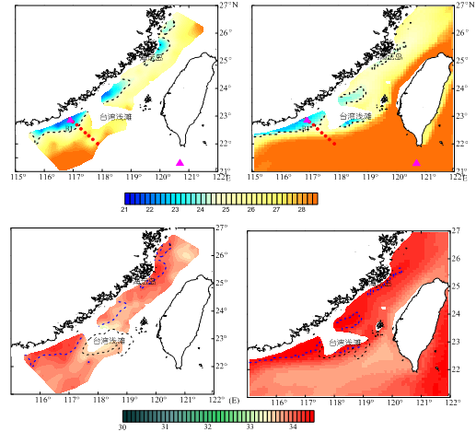
Model evaluation
Temperature and Salinity at 30m
Temp:
survey
c) Temp: model
Time: June-August 2006
b) Salt:
survey
d) Salt:
model
Dash line denote 24.5º isotherm

Slide 12
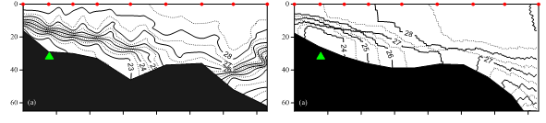
Model evaluation
Temperature at section A(11/8/2006)
a)survey
b)Model
Depth/m

Slide 13
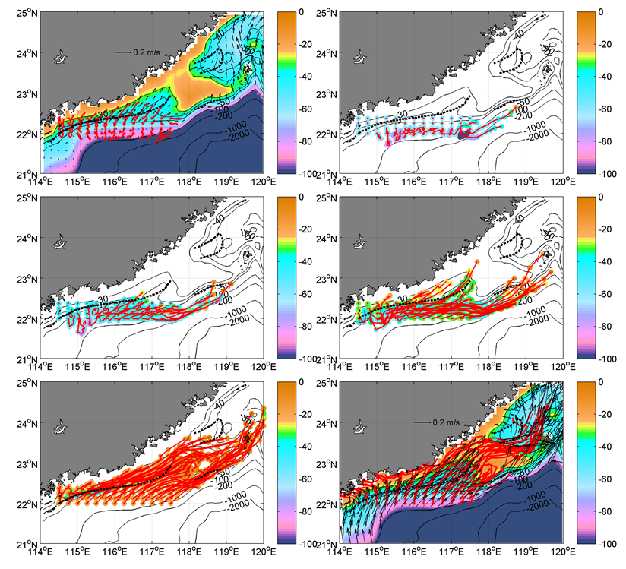
The cold water source
Drift trajectories, 1/8/2006-12/8/2006(12 days)
a bottom layer
b 60m layer
bottom layer, in the region where water depth more than 50m water are transported offshore while in the region where water depth less than 50m water move cross-isobath inshore and transported to the upwelling area;
in the 60m layer water mainly transported offshore;
in the 45m layer in the region of 116ºE～116.5ºE and in the 30m layer in the region of 115ºE～116ºE water move cross-isobath inshore and transported to the upwelling area;
water above 30m mainly move along-isobath and transported northeast.
In conclusion, the shoreward cross-shelf water in the southeast region(about 115ºE～116.5ºE) above 50m is the main origin of the cold water of Guangdong coastal upwelling system.
c 45m layer
d 30m layer
e 15m layer
f surface
In fig.a) and f),color denote water depth;
in fig.b-e,color denote float depth;
Black dash line denote 24.5º isotherm at 30m

Slide 14
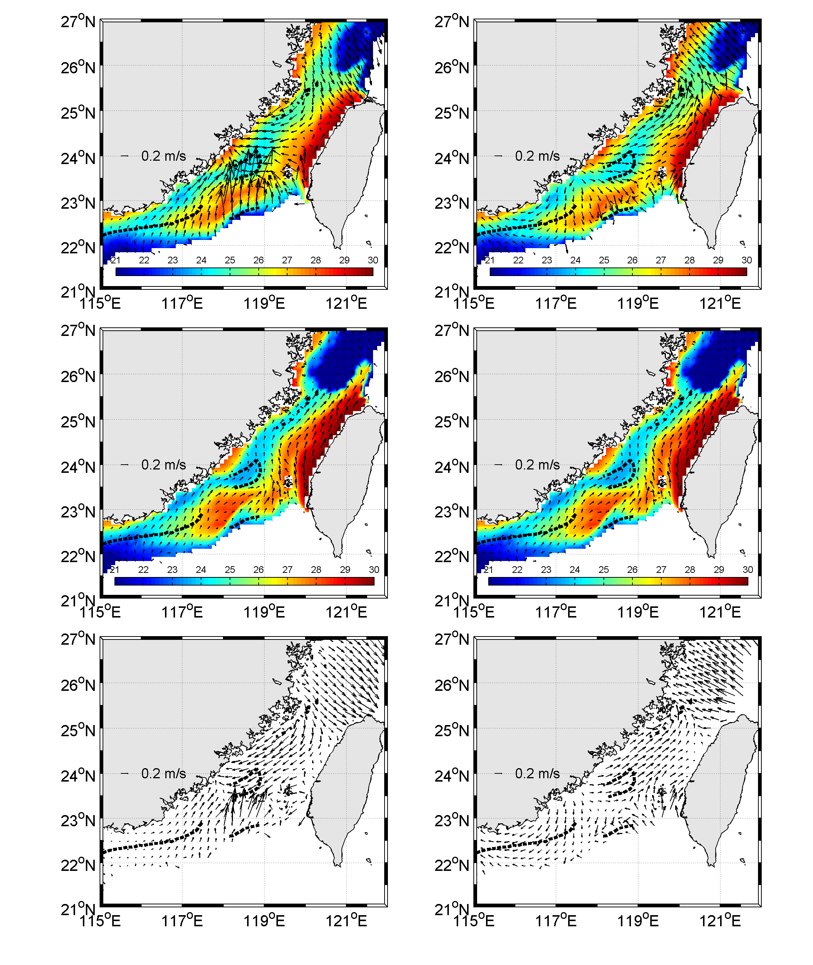
The role of tide
bottom temperature and velocity
Flood tide: 2006-8-11 16:00:00
Ebb tide: 2006-8-11 10:00:00
a) flood tide
Stand Run
b) ebb tide
Stand Run
the bottom temperature in the upwelling region is colder in the no-tide case than that
in the stand case
c) flood tide
No-tide Run
d) ebb tide
No-tide Run
Black dash line denote 24.5º isotherm at 30m

Slide 15
The role of tide
residual tidal current is southwest
the tidal processes weaken the transport of colder water from the northeast coastal current upstream
Tidal current
a. Flood tide b. ebb tide

Slide 16
Conclusion
the shoreward cross-shelf water in the southeast region(about 115ºE～116.5ºE) above 50m is the main origin of the cold water of Guangdong coastal upwelling system.
the tidal processes weaken the upwelling by weaken the transport of colder water from the coastal current upstream

Slide 17
Things to be done
10km resolution is too coarse for coastal applications
—>try nesting, sub-region and refined grids(3km)
Qualitative analysis
—> Quantitative analysis

Slide 18
Thank you!

