Slide 1
Limiters for 3rd order upwind advection scheme
Gary Brassington and Frank Colberg
Bureau of Meteorology
ROMS workshop, Hobart October 2016
Notes:
ROMS not a trivial choice for the Bureau
Performance has been quite credible.
First generation system and DA configurations for coastal
GBR is the toughest test to get started in Australia

Slide 2

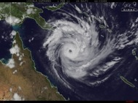
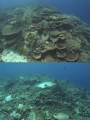
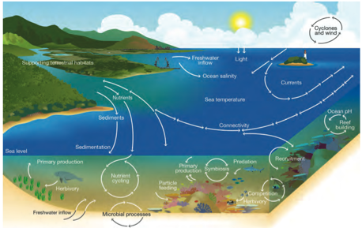

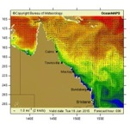
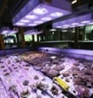
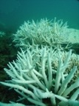
Water
quality
stress
Mechanical stress
pH
stress
Thermal
stress

Slide 3
Overview
  Scalar advection ROMS options:
    2nd/4th order centred
    3rd order upwinding (quick, efficient, workhorse)
    MPDATA
  3rd-order upwinding properties
    Stable, |c|<1 (implicit diffusion)
    Cost-efficient
    Not a symmetric algorithm, sign(u)
    Not shape preserving (smooth)
    ROMS implementation – no limiters
  River discharge
    Flooding events (tropics) – impulse problem

Slide 4
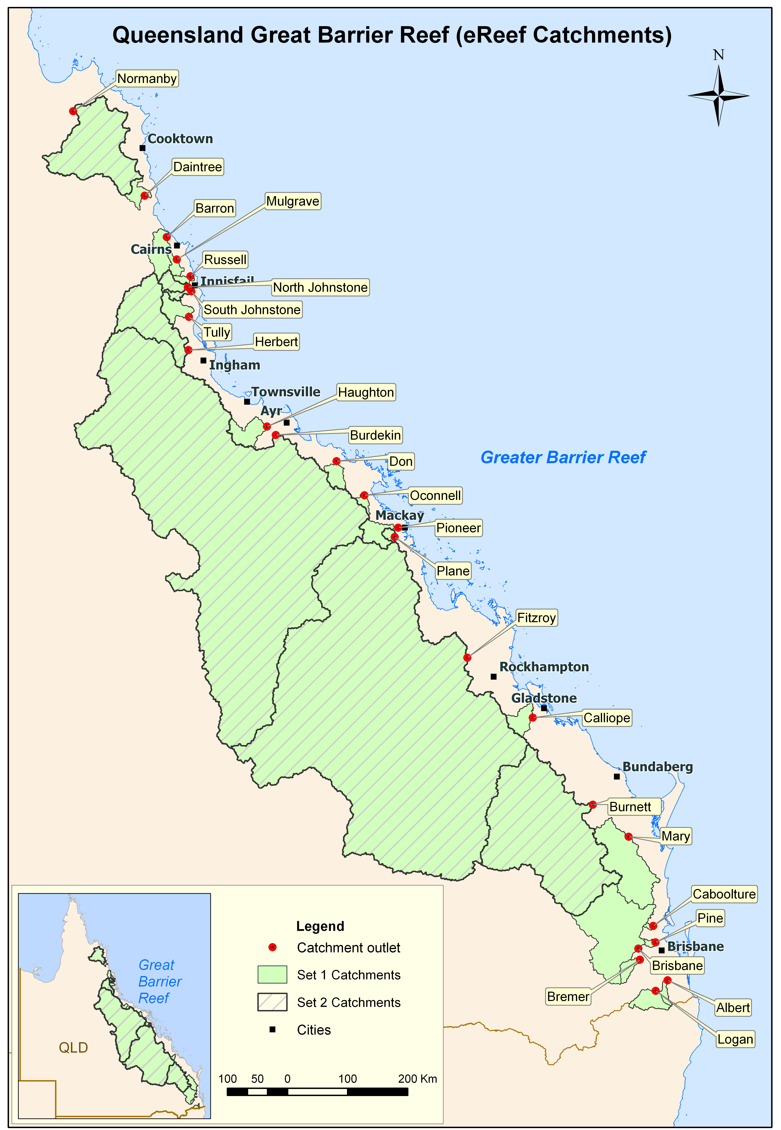
Queensland river catchments
Catchment sizes
Burdekin 129,700 km² (~Pennsylvania)
Fitzroy, 142,665 km² (~New York)

Slide 5
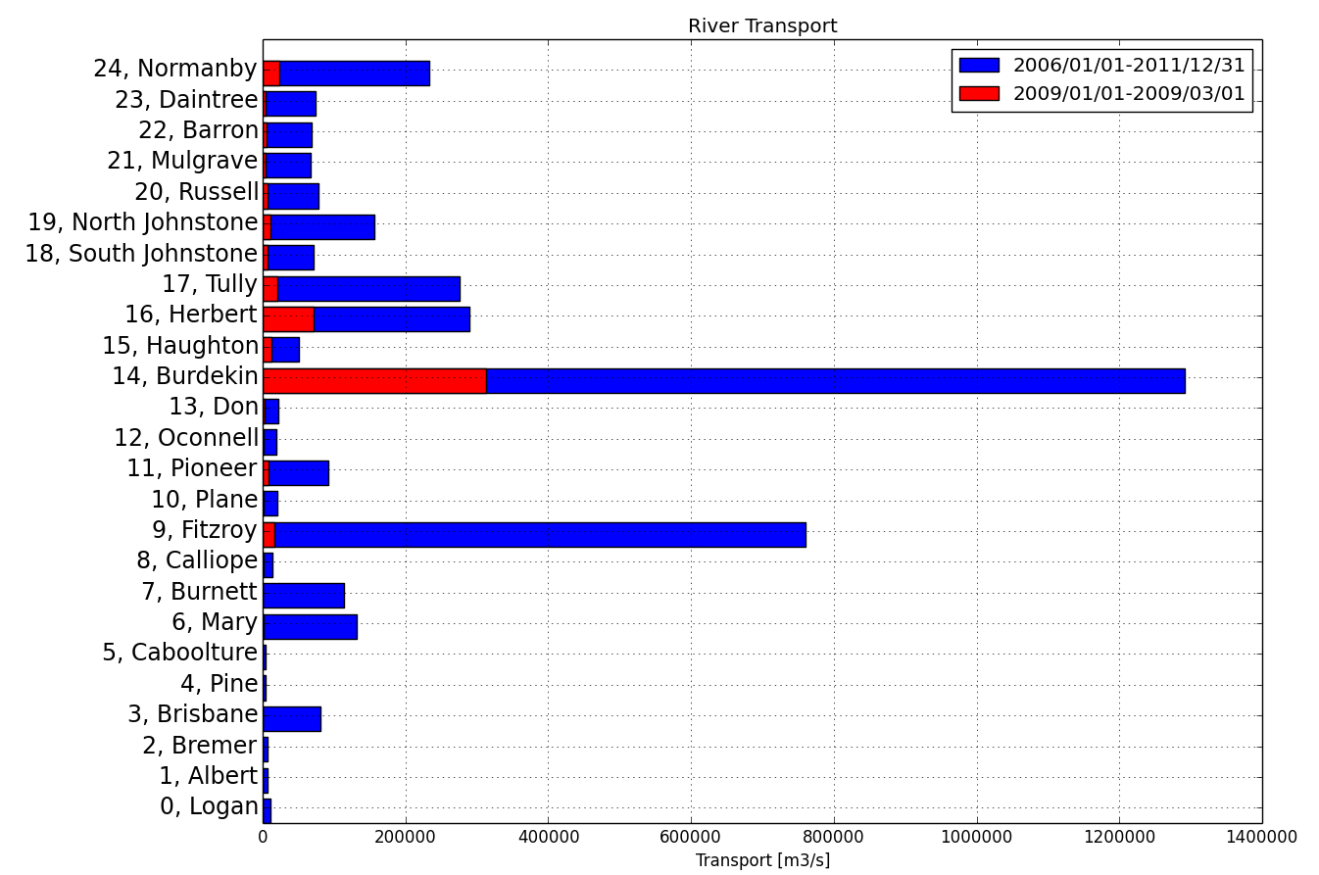
Queensland river discharge

Slide 6
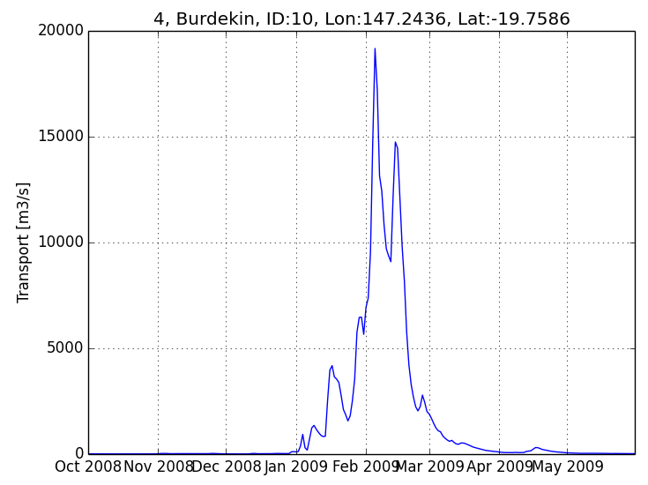
Burdekin flood 2009

Slide 7
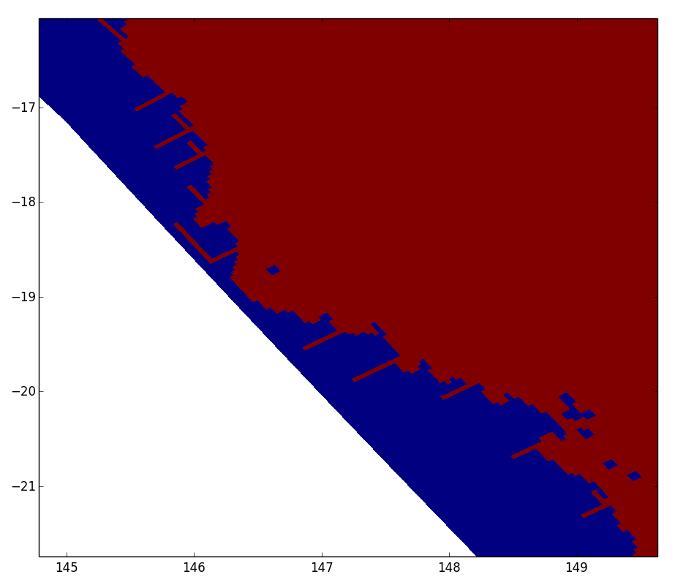
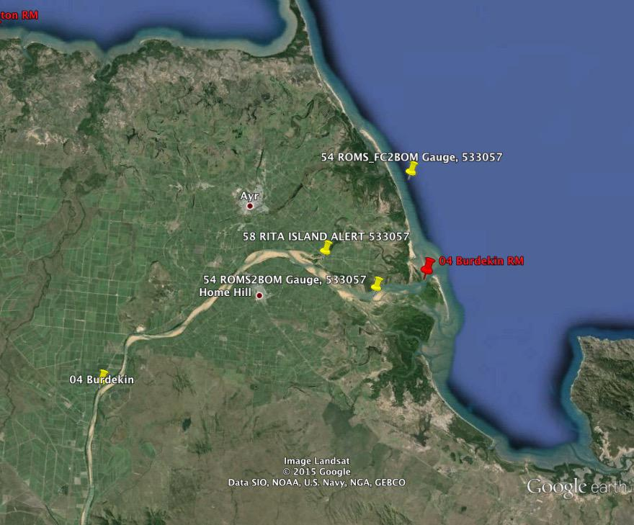
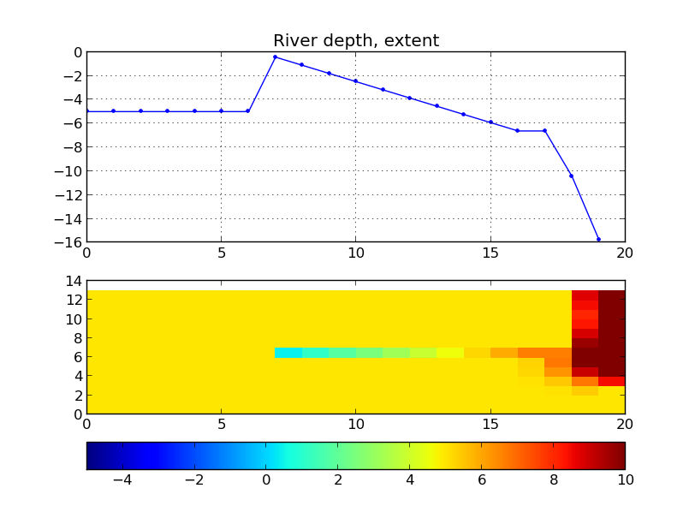
River channel - Burdekin
Methodology
  Explicit modelling of estuaries
  Depth preserve river volume
  Balance between model stability and (1)

Slide 8
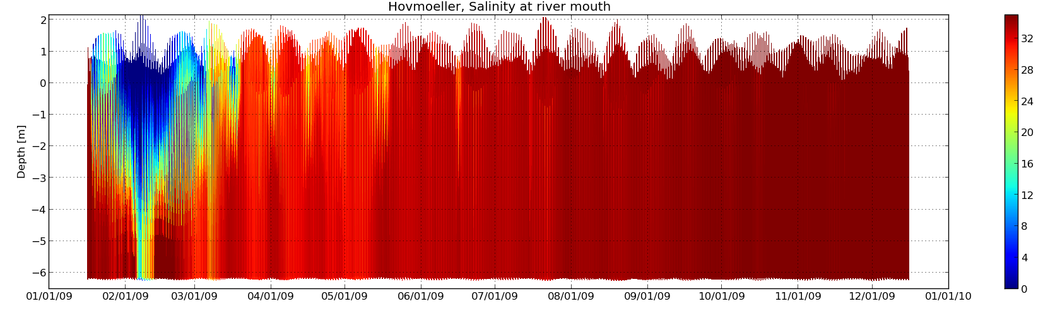
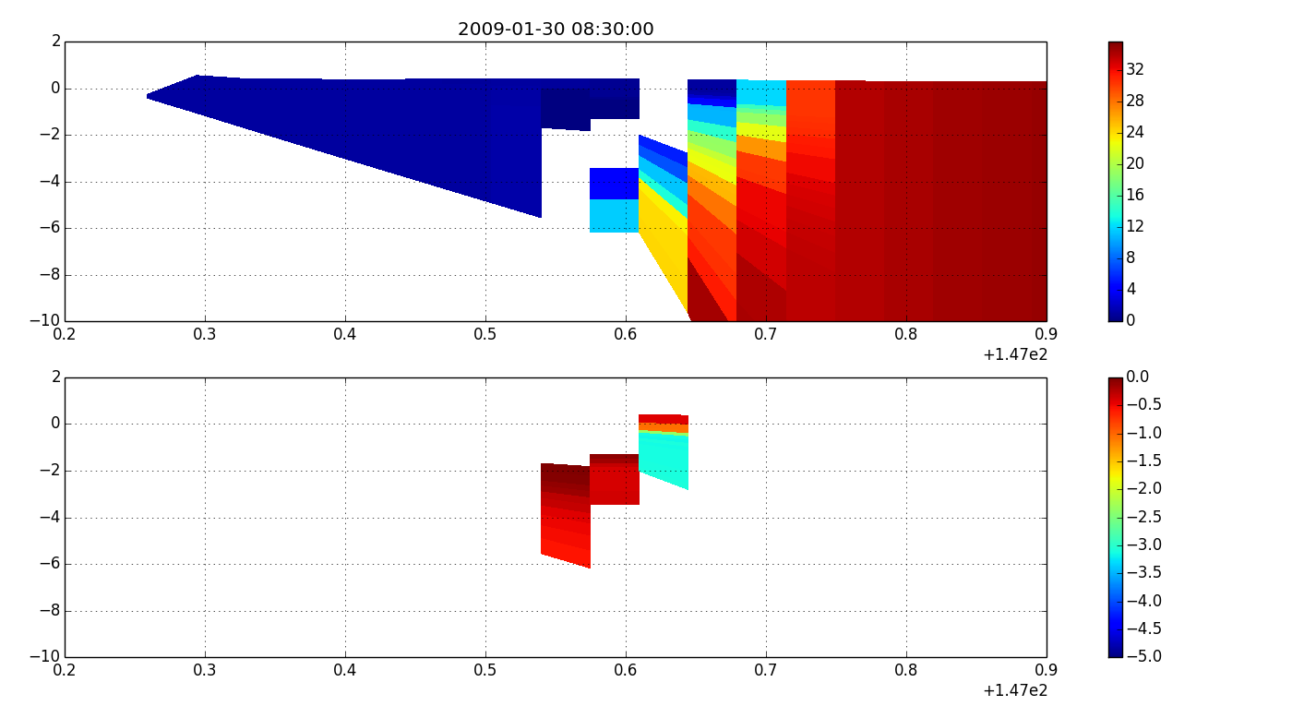
Example: Burdekin, negative salinity
SALINITY>0
SALINITY<0
Notes:
Example of river discharge event and how it affects the salinity distribution (vertically) at the river mouth
Why negative salinity ?
Large amount of freshwater → front
gravity current
discontinuity
Numerical schemes overshoots
Possibilities to overcome ?
ROMS is equipped with a variety of advection schemes 2,4, upwind, mpdata.
2,4 are more noisy
MPDATA – positive definite advection scheme - slower, less accurate
Upwind Limiter in tracer advection

Slide 9
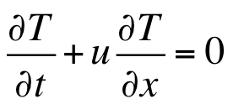
Scalar advection – 1D channel
t
t₂
t₁
t₀
x
x₀
x₀+ut₁
x₀+ut₂

Slide 10
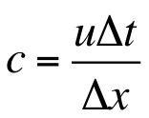
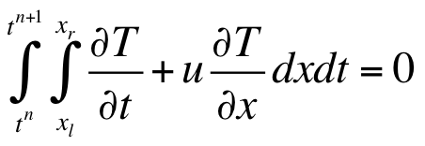

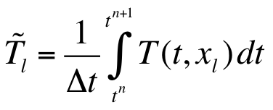
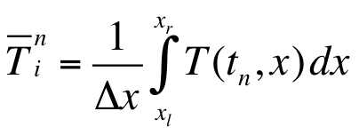
1D control-volume formulation

Slide 11
3rd-order Upstream discretisation
Integral variable
For u<0
u>0

Slide 12
RECAST IN QUICK FORMULATION
u>0
u<0

Slide 13
Monotonicity
Normalized variable
B. P. Leonard and S. Mokhtari. ULTRA-SHARP nonoscillatory convection schemes for high-speed steady multidimensional flow. Technical Memorandum TM-102568 ICOMP-90-12, NASA, April 1990

Slide 14
Normalised Variable Diagram
with
B. P. Leonard and S. Mokhtari. ULTRA-SHARP nonoscillatory convection schemes for high-speed steady multidimensional flow. Technical Memorandum TM-102568 ICOMP-90-12, NASA, April 1990

Slide 16
ULTRA-SHARP (Leonard and Mokhtari, 1990)
FX_EE(i,j)=T(i+1,j)*umask(i,j)
FX_E(i,j)=T(i,j)*umask(i,j)
FX_W(i,j)=T(i-1,j)*umask(i,j)
FX_WW(i,j)=T(i-2,j)*umask(i,j)
For u≥0
FX_limited = MEDIAN[FX_E, FX, MEDIAN[FX_W, FX_E, FX_WW+ α*(FX_W-FX_WW)] ]
For u<0
FX_limited = MEDIAN[FX_W, FX, MEDIAN[FX_E, FX_W, FX_EE+α*(FX_E-FX_EE)] ]
where FX is the estimate based on third-order upwinding.

Slide 17
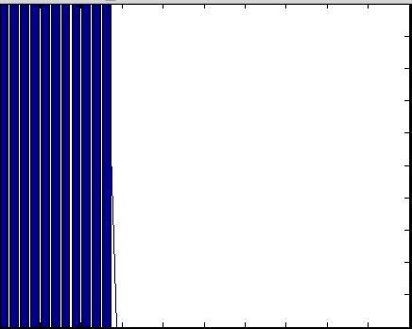
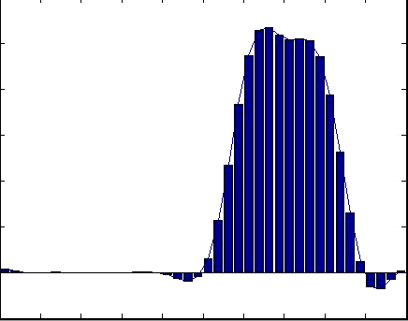
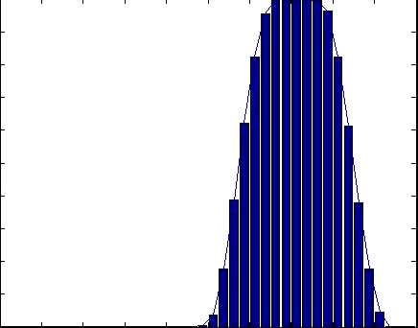
TOY EXAMPLE
UNLIMITED
LIMITED

Slide 18
ROMS original
T_LOOP1 :DO itrc=1,NT(ng)
K_LOOP: DO k=1,N(ng)
!
! Third-order, uptream-biased horizontal advective fluxes.
!
! Prepare the third-order upwinding
DO j=Jstr,Jend
DO i=Istrm1,Iendp2
FX(i,j)=t(i ,j,k,nstp,itrc)- &
& t(i-1,j,k,nstp,itrc)
FX(i,j)=FX(i,j)*umask(i,j)
END DO
END DO
!
DO j=Jstr,Jend
DO i=Istr-1,Iend+1
curv(i,j)=FX(i+1,j)-FX(i,j)
END DO
END DO

Slide 19
ROMS original
cff1=1.0_r8/6.0_r8
cff2=1.0_r8/3.0_r8
DO j=Jstr,Jend
DO i=Istr,Iend+1
FX(i,j)=Huon(i,j,k)*0.5_r8* &
& (t(i-1,j,k,nstp,itrc)+ &
& t(i ,j,k,nstp,itrc))- &
& cff1*(curv(i-1,j)*MAX(Huon(i,j,k),0.0_r8)+ &
& curv(i ,j)*MIN(Huon(i,j,k),0.0_r8))
END DO
END DO

Slide 20
ROMS with limiters – pre-step3D.f
! Prepare the limiting values East/West
IF (apply_upwinding_limiters) THEN
! Note that valid values need to span i-2:i+1 cells for each cell face
DO j=Jstr,Jend
DO i=Istr,Iend
FX_E(i,j)= t(i ,j,k,nstp,itrc)*umask(i,j)
FX_EE(i,j)= t(i+1 ,j,k,nstp,itrc)*umask(i,j)
FX_W(i,j)= t(i-1 ,j,k,nstp,itrc)*umask(i,j)
FX_WW(i,j)= t(i-2 ,j,k,nstp,itrc)*umask(i,j)
END DO
END DO
END IF

Slide 21
ROMS with limiters – pre-step3D.f
IF (apply_upwinding_limiters) THEN
cff1=1.0_r8/6.0_r8
cff2=1.0_r8/3.0_r8
DO j=Jstr,Jend
DO i=Istr,Iend+1
! Apply Huon after limiters
FX(i,j)=0.5_r8*(t(i-1,j,k,nstp,itrc)+t(i ,j,k,nstp,itrc))- &
cff1*(curv(i-1,j)*MAX(SIGN(1.0_r8,Huon(i,j,k)),0.0_r8)+ &
curv(i ,j)*MIN(SIGN(1.0_r8,Huon(i,j,k)),0.0_r8))
! apply limiters - compute median(a,b,c)=MAX(MIN(a,b),MIN(b,c), MIN(c,a))
! Postive limit
! FX_med_pos=median(FX_W,FX_E,FX_WW+alpha*(FX_W-FX_WW))
FX_tmp=FX_WW(i,j)+alpha_limiter*( FX_W(i,j)-FX_WW(i,j) )
FX_med_pos=MAX( MIN(FX_W(i,j),FX_E(i,j)), MIN(FX_E(i,j),FX_tmp), MIN(FX_tmp,FX_W(i,j) )
! FX_pos=median(FX_W,FX,FX_med_pos)
FX_pos=MAX(MIN(FX_W(i,j),FX(i,j)), MIN(FX(i,j),FX_med_pos), MIN(FX_med_pos,FX_W(i,j) )
! Negative limit

Slide 22
ROMS with limiters – pre-step3D.f
IF (apply_upwinding_limiters) THEN
: (cont’d)
! Negative limit
! FX_med_neg=median(FX_E,FX_W,FX_EE+alpha*(FX_E-FX_EE))
FX_tmp=FX_EE(i,j)+alpha_limiter*( FX_E(i,j)-FX_EE(i,j) )
FX_med_neg=MAX( MIN(FX_E(i,j),FX_W(i,j)), MIN(FX_W(i,j),FX_tmp), MIN(FX_tmp,FX_E(i,j) )
! FX_neg=median(FX_E,FX,FX_med_neg)
FX_neg=MAX(MIN(FX_E(i,j),FX(i,j)), MIN(FX(i,j),FX_med_neg), MIN(FX_med_neg,FX_E(i,j) )
FX(i,j)= MAX(Huon(i,j,k),0._kd)*FX_pos +
& MIN(Huon(i,j,k)),0._kd)*FX_neg
END DO
END DO
ELSE ! original code, no limiters

Slide 23
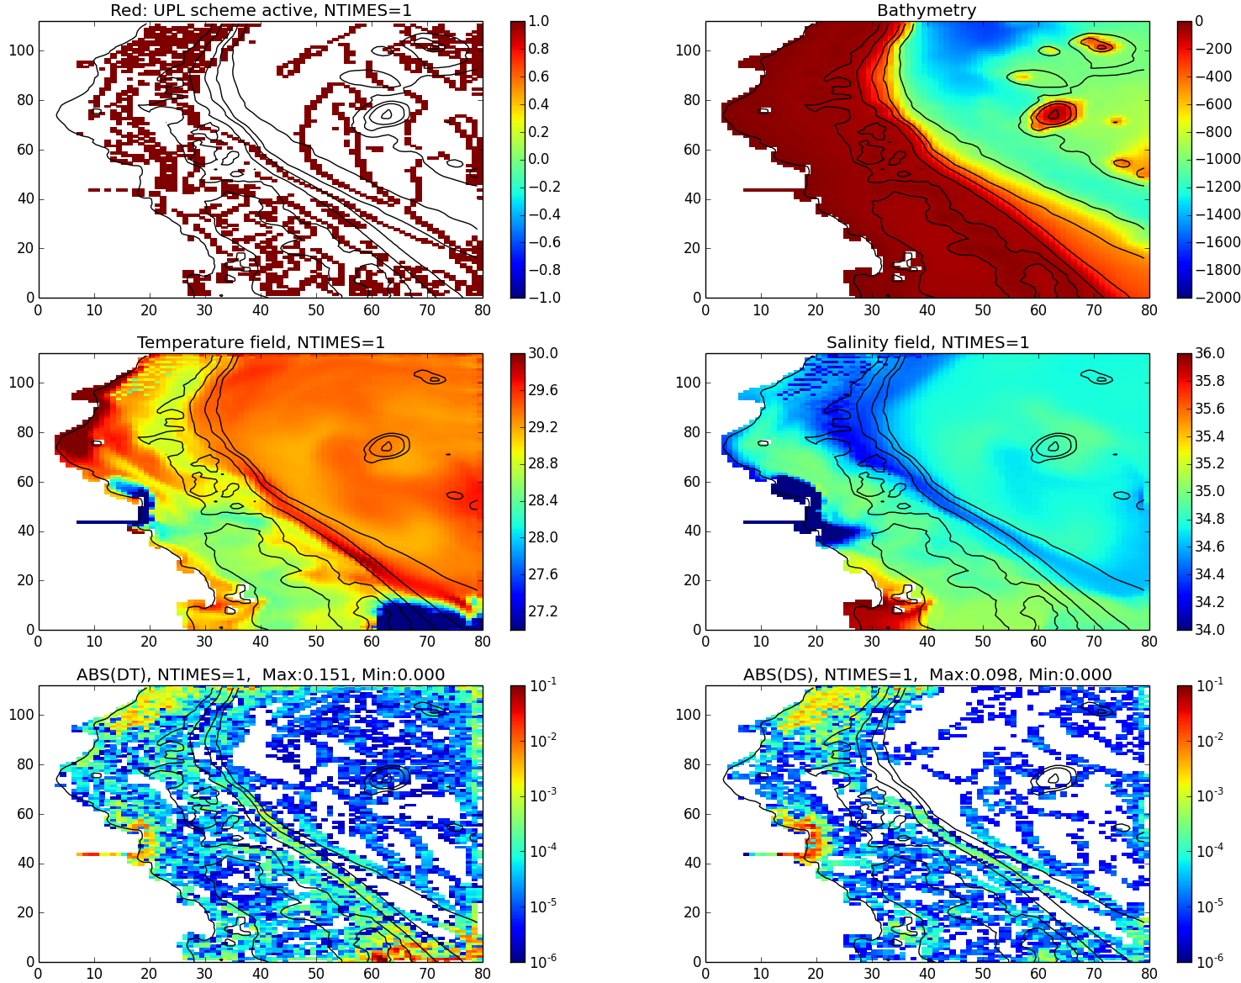
ROMS with limiters

Slide 24
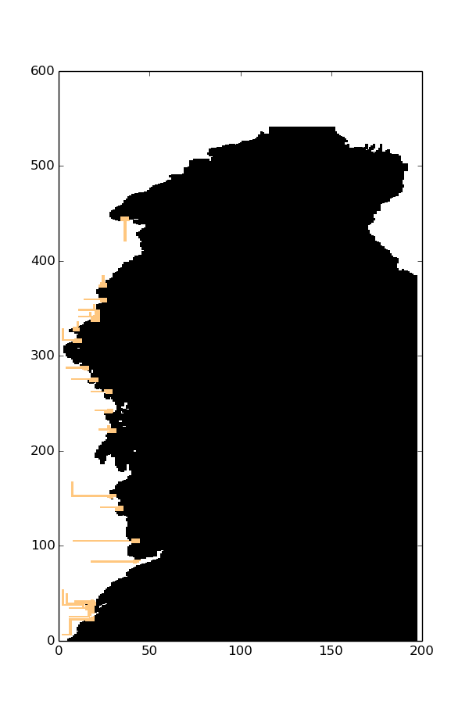
Upwinding limiters
#define UPWIND_LIMITER
#define UPL_MASK
Changes:
pre_step3d.F
step3d_t.F

Slide 25
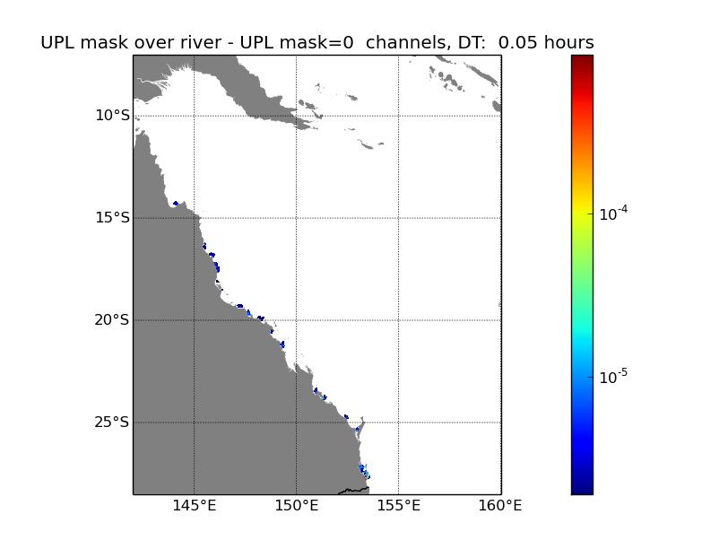

Slide 26
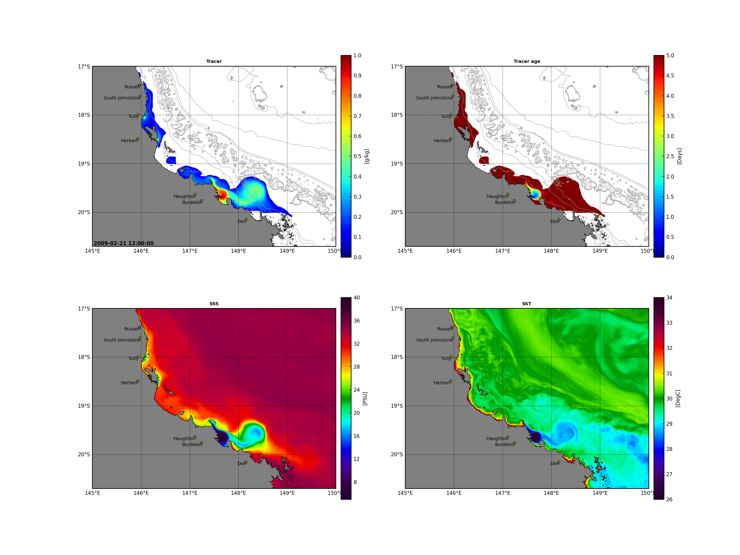
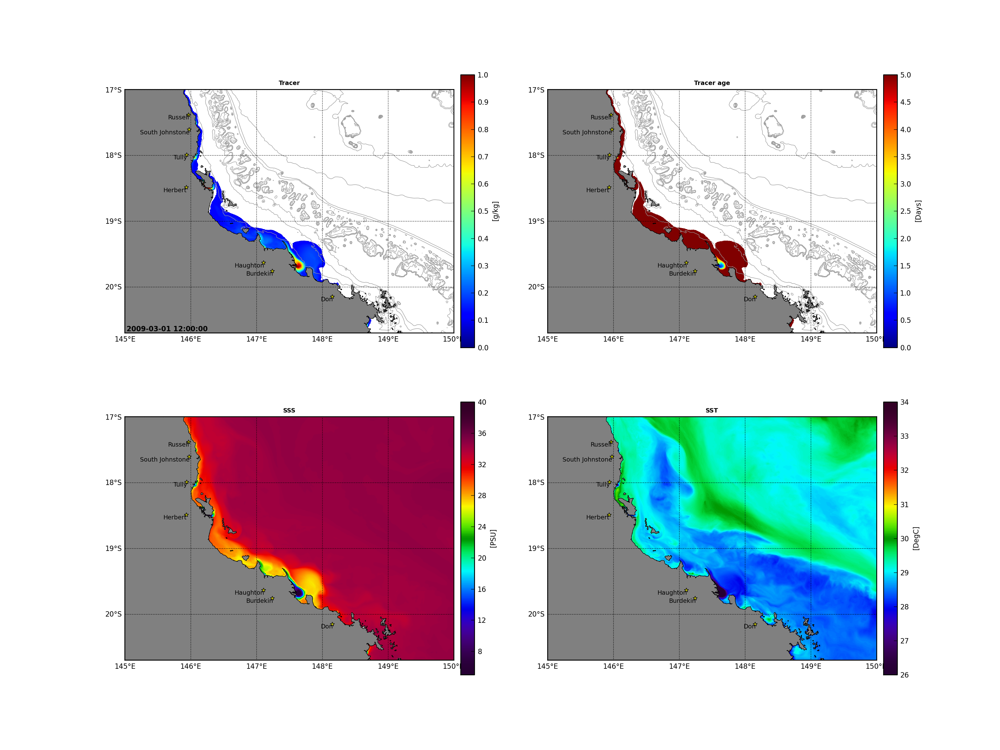
Burdekin flood 2009
16 FEB-22 FEB
23 FEB-1 MAR
Burdekin river plume - 2009

Slide 27
Summary
  3rd-order upwinding does not guarantee montonicity
  Limiters should be available
  ULTRA-SHARP strategy applied
  ROMS implementation
    LOGICAL OPTION
    Pre-step3D and step3d_t
  General 3D application larger response than expected
    Implementation?
    Fronts and grid scale noise
    Needs further diagnosis
  Backed off to apply to 2D channels
  Adjoint?

