Slide 1
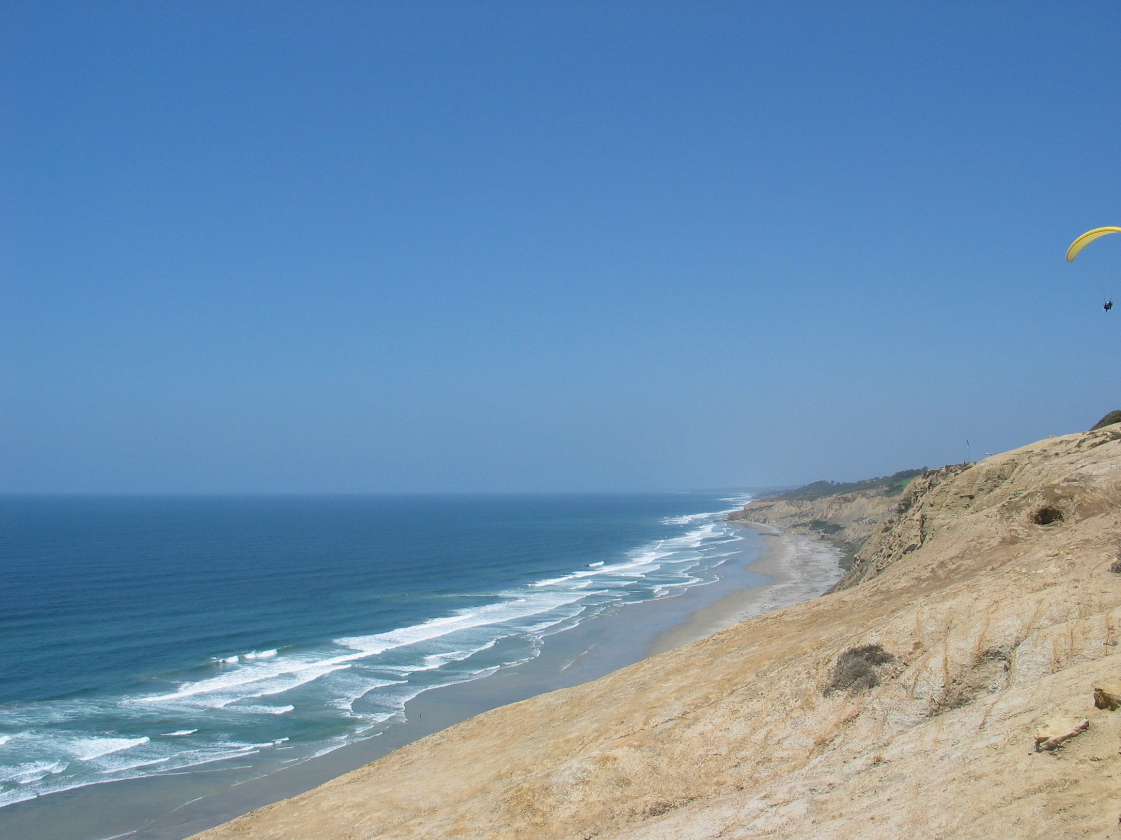

ROMS Algorithms: Coupling and Nesting
Hernan G. Arango
DMCS, Rutgers University
Institute for Marine and Antarctic Studies
Hobart, Tasmania, Australia
October 20, 2016

Slide 2
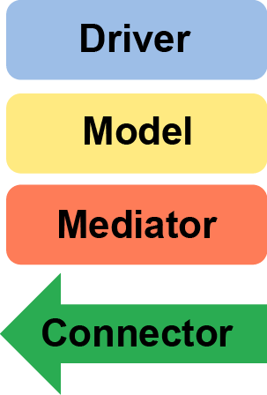
ESMF Coupling Revisited
Updating ROMS coupling interface to ESMF Library Version 7.0
Using the National Unified Operational Prediction Capability (NUOPC) Layer.
The NUOPC layer is a simplified infrastructure on top of the ESMF library that provides conventions and templates to facilitate the easy coupling between Earth System Models (ESMs).
The NUOPC layer consist of four generic components:
Controls Models, Mediators, and Connectors. Coordinates initialization and time-stepping.
Earth System Models: Atmosphere, Ocean, Sea Ice, Waves, etc.
Custom coupling code between models: Flux calculations, scaling, averaging, etc.
Connects pair of components: Model to/from Model, Model to/from Mediator. Computes transformations and re-griding.

Slide 3
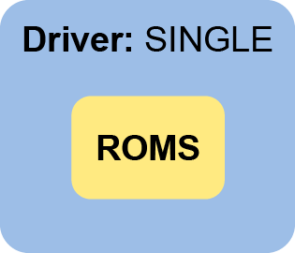
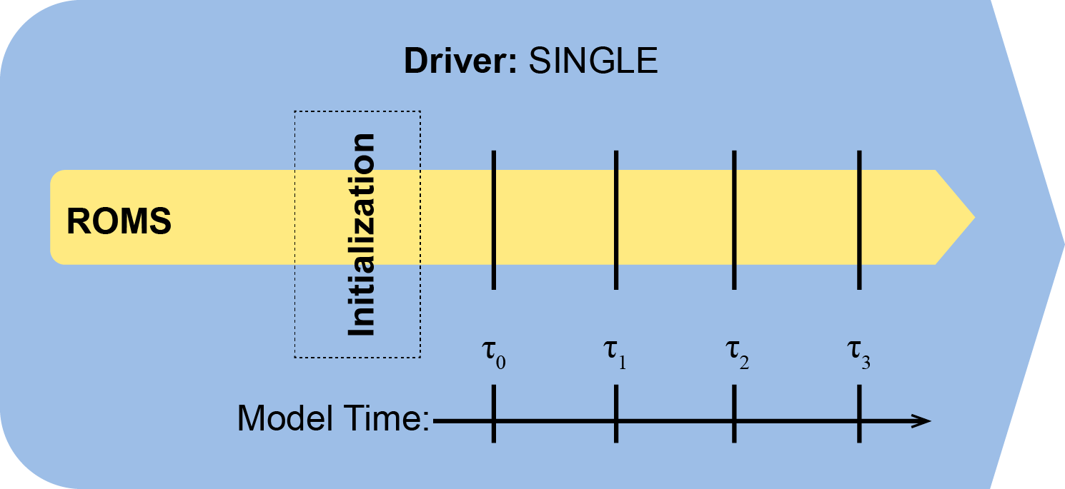
ESMF/NUOPC Single Model Prototype
A single model component (ROMS) is being called by the driver in regular intervals. There is no coupling.
master.F
esmf_coupler.h or
nuopc_coupler.h

Slide 4
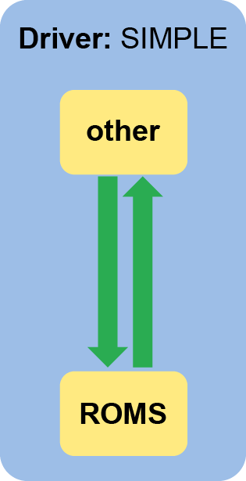
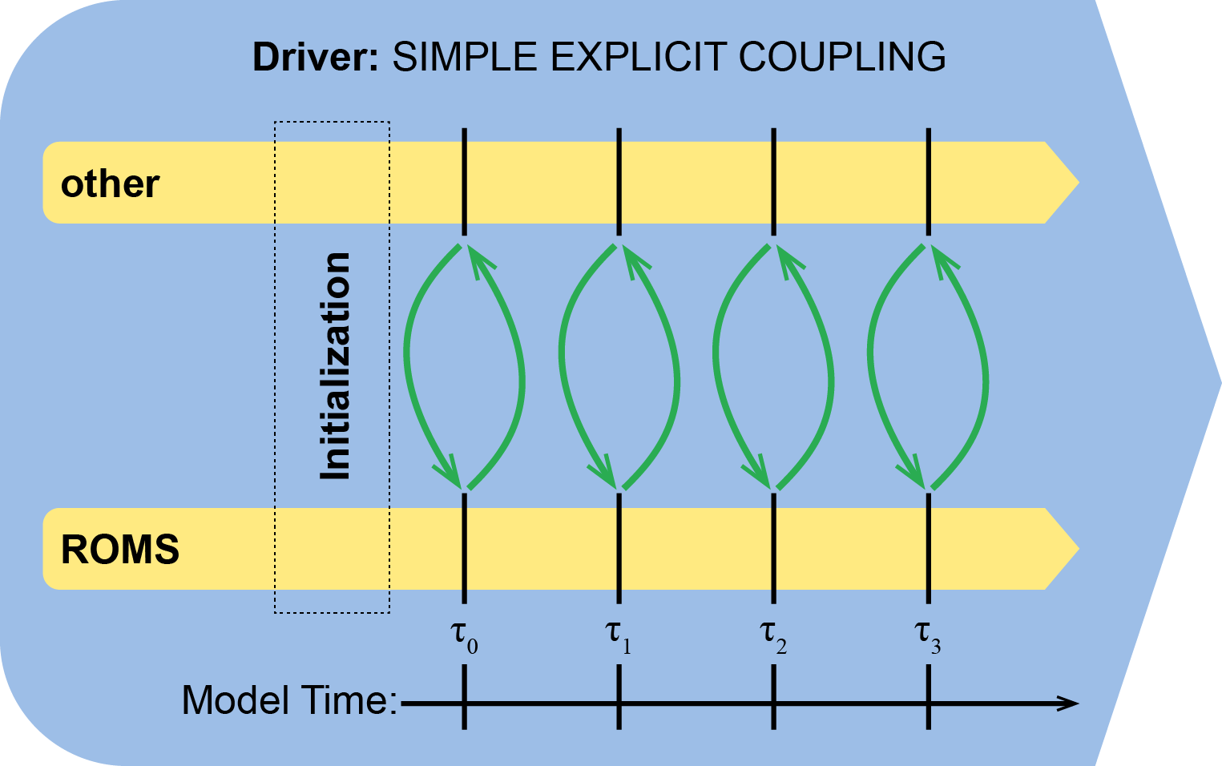
ESMF/NUOPC Simple Model Coupling Prototype
OTHER and ROMS fields are exchanged in both directions at the beginning of each coupling interval via the connector components. There is no Mediator.

Slide 5
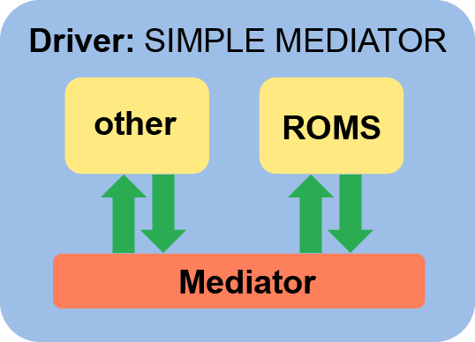
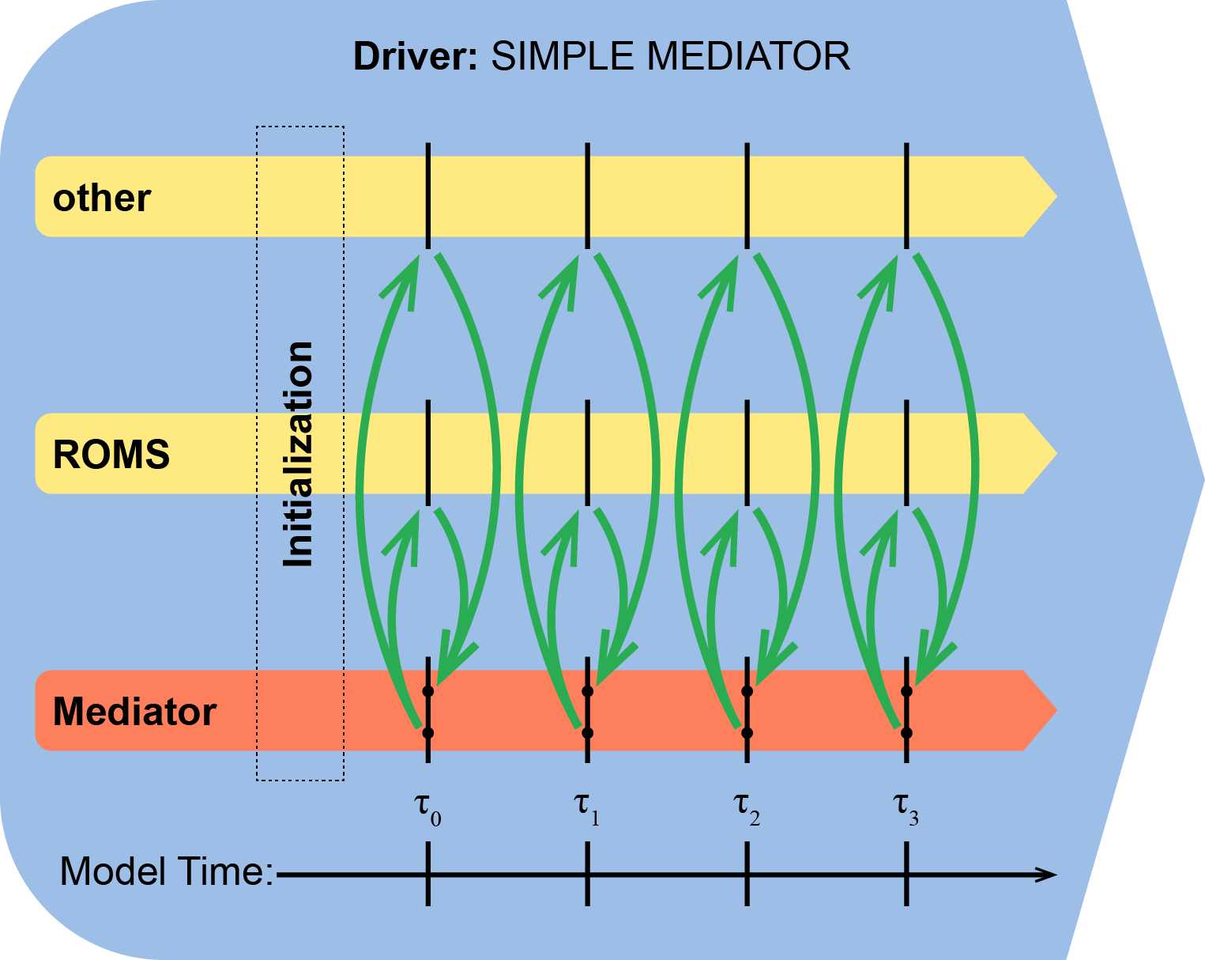
ESMF/NUOPC Coupling Through Mediator Prototype
Connector components transfer OTHER and ROMS fields to mediator at the beginning of the coupling interval
The Mediator processes input data and transfer back to model components: OTHER and ROMS

Slide 6
NRL Global Earth System Prediction Capability
(ESPC)
Atmos
Ocean
Sea
Ice
Wave
Mediator/Coupler (ESMF, NUOPC)
Data Atmos
Data Generic
Data Ocean

Slide 7
COAMPS-ROMS Coupled Infrastructure
Coupled
App
Driver
COAMPS
NUOPC Layer
ROMS
NUOPC Layer
Mediator/Coupler
(a2m, m2a, o2m, m2o)
COAMPS
Initialize
COAMPS
Run
COAMPS
Finalize
ROMS
Initialize
ROMS
Run
ROMS
Finalize

Slide 8
ROMS Single Standalone Infrastructure
ROMS
ESMF/NUOPC
Driver
ROMS
non-ESMF
Driver
(master.F,
ocean_control.F)
ROMS
NUOPC Layer
Component
ROMS
Initialize
ROMS
Run
ROMS
Finalize

Slide 9
ROMS Nesting is very unique:
Inspiration

Slide 10
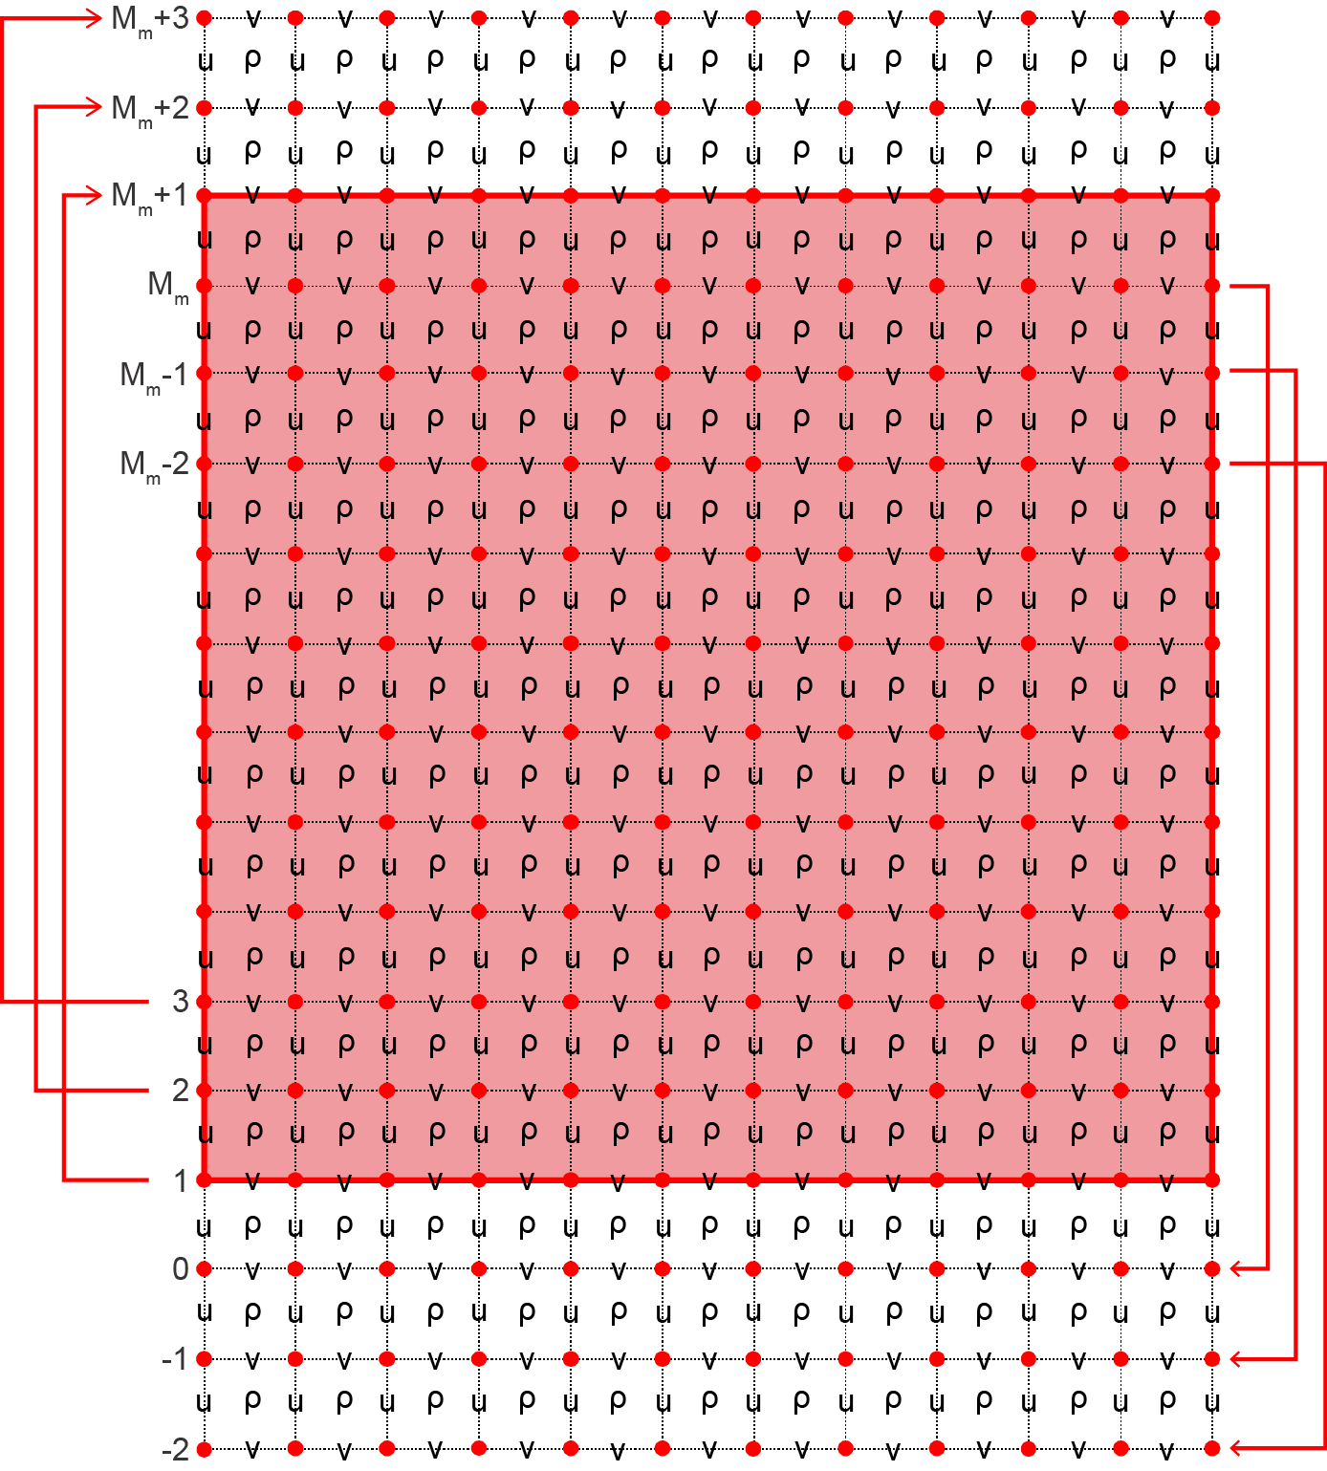
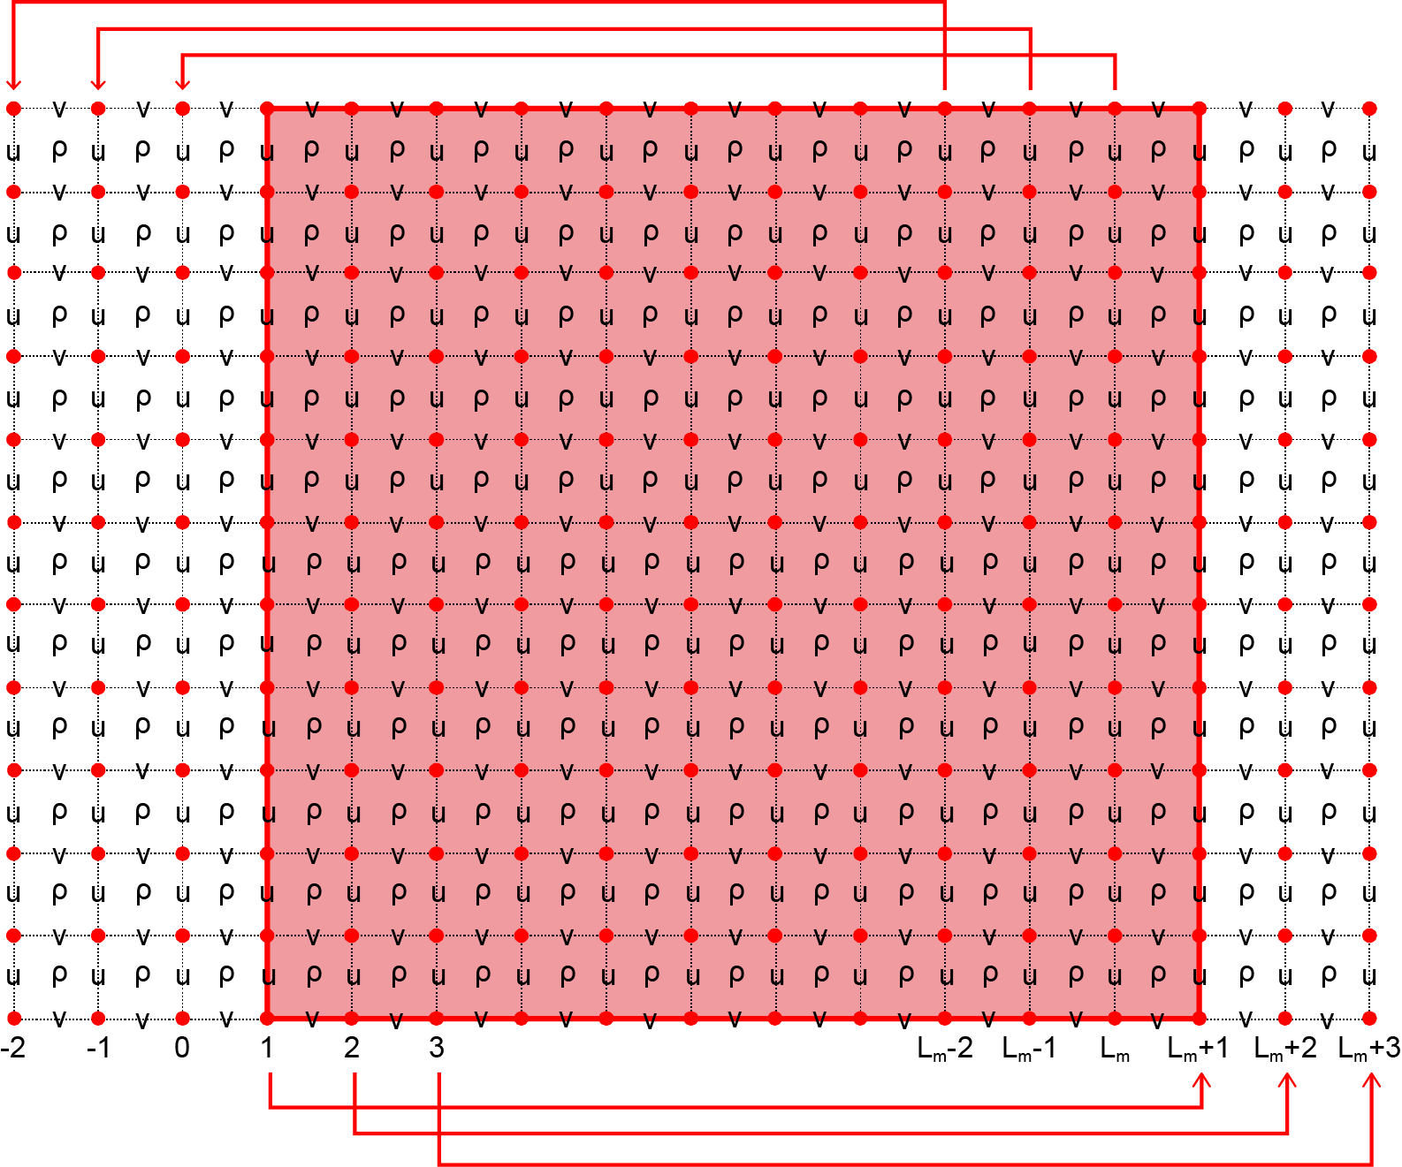
Nesting Inspiration
East-West Periodic
North-South Periodic

Slide 11
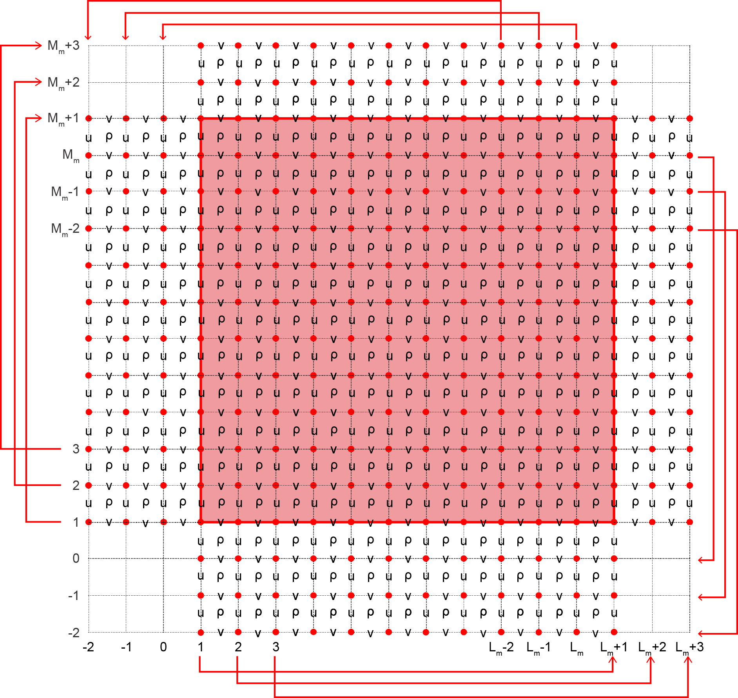
Nesting Inspiration
Double Periodic

Slide 12
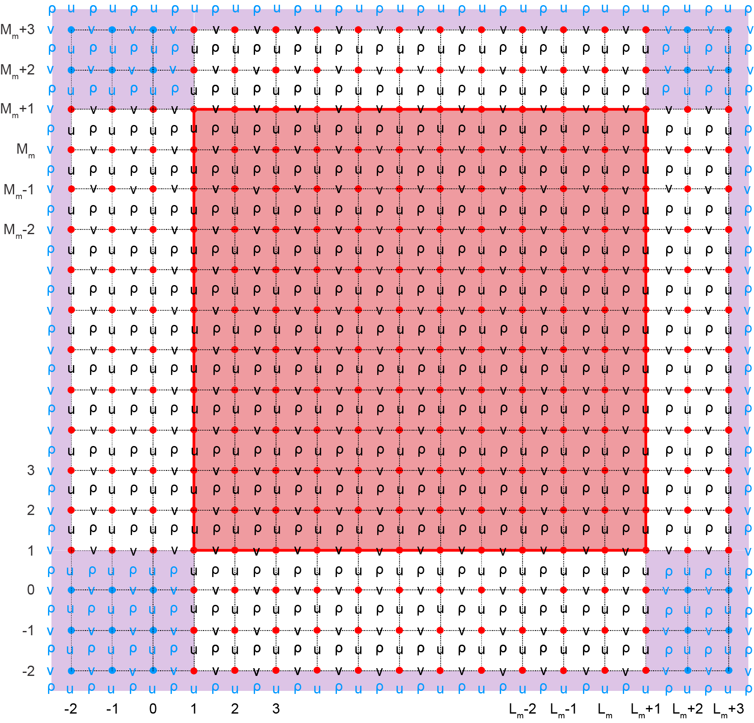
Nesting Inspiration
Double Periodic to Refinement

Slide 13
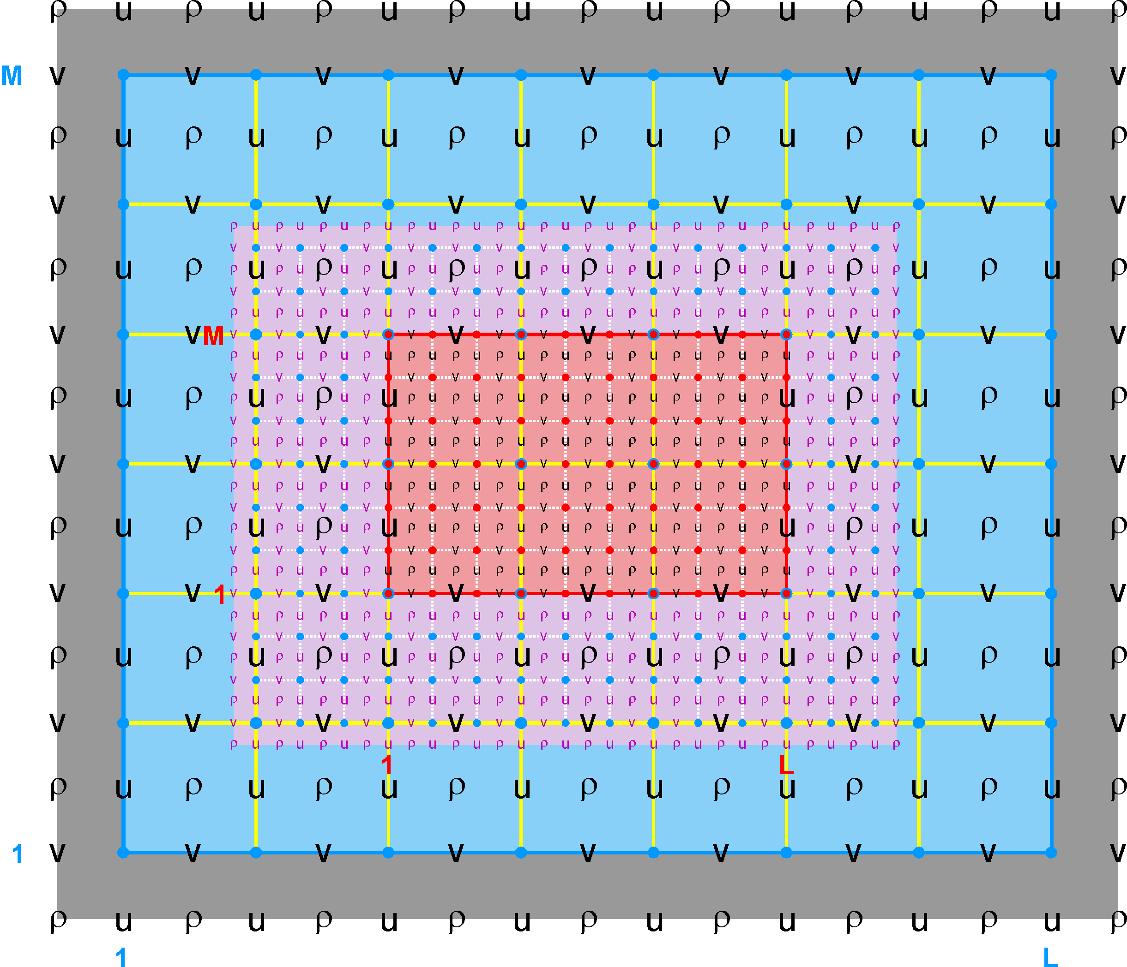
figure1.png
Ngrids = 2
NestLayers = 2
GridsInLayer = 1 1
Ncontact = 2
Donor Grid = blue
Receiver Grid = red
Ncontact=(Ngrids-1)*2

Slide 14
Nesting Strategy
The horizontal i- and j-ranges in the numerical kernel DO-loops are expanded to allow operations on various nested grid classes (refinement, mosaics, and composite) and nesting layers (refinement and composite combinations).
  This facilitates the computation of any horizontal operators (advection, diffusion, gradient, etc.) in the nesting overlap regions and avoids the need for cumbersome lateral boundary conditions on the model variables and their associated flux/gradient values. The advantage of this approach is that it is generic to any discrete horizontal operator. The overlap region is an extended section of the grid that overlays an adjacent grid.
  The strategy is to compute the full horizontal operator at the contact points between nested grids instead of specifying boundary conditions.

Slide 15
Nesting Strategy
Nowadays, the lateral boundary conditions are set with logical switches (LBC structure) that depend on the nested grid.
  This facilitates, in a generic way, the processing or not of lateral boundary conditions in applications with nested grids. In nesting applications, the values at the lateral boundary points are computed directly in the overlap region by the numerical kernel.
  The logical switches allow different lateral boundary conditions types between active (temperature and salinity) and passive (biology, sediment, inert, etc.) tracers.
  The lateral boundary condition switches for each state variable and boundary edge are now specified in ROMS input script file, ocean.in.

Slide 16
Nesting Strategy
The nesting calls appear only in the main time-stepping routines, main2d or main3d. The concept of nesting layers is introduced to allow applications with both composite grids and refinement grids. Several routines in module nesting_mod are used to process the information that it is required in the overlap region, what information needs to be exchanged from/to another grid, and when to exchange it.
  In mosaic and composed grids, the information is exchanged between each sub-time step call in main2d or main3d. For example, the data donor grid and the mosaic/composite grids need to sub-time step the 2D momentum equations before any of them start solving and coupling the 3D momentum equations.
  In refinement grids, the information at the contact points is processed at the end of the full time-step layer. The exchange between data donor and refinement grids is two-way.

Slide 17
Tile I- and J-Ranges
get_bounds.F
Istr = BOUNDS(ng) % Istr (tile)
IstrB = BOUNDS(ng) % IstrB (tile)
IstrM = BOUNDS(ng) % IstrM (tile)
IstrP = BOUNDS(ng) % IstrP (tile)
IstrR = BOUNDS(ng) % IstrR (tile)
IstrT = BOUNDS(ng) % IstrT (tile)
IstrU = BOUNDS(ng) % IstrU (tile)
Iend = BOUNDS(ng) % Iend (tile)
IendB = BOUNDS(ng) % IendB (tile)
IendP = BOUNDS(ng) % IendP (tile)
IendR = BOUNDS(ng) % IendR (tile)
IendT = BOUNDS(ng) % IendT (tile)
Jstr = BOUNDS(ng) % Jstr (tile)
JstrB = BOUNDS(ng) % JstrB (tile)
JstrM = BOUNDS(ng) % JstrM (tile)
JstrP = BOUNDS(ng) % JstrP (tile)
JstrR = BOUNDS(ng) % JstrR (tile)
JstrT = BOUNDS(ng) % JstrT (tile)
JstrV = BOUNDS(ng) % JstrV (tile)
Jend = BOUNDS(ng) % Jend (tile)
JendB = BOUNDS(ng) % JendB (tile)
JendP = BOUNDS(ng) % JendP (tile)
JendR = BOUNDS(ng) % JendR (tile)
JendT = BOUNDS(ng) % JendT (tile)
Istrm3 = BOUNDS(ng) % Istrm3 (tile) Istr-3
Istrm2 = BOUNDS(ng) % Istrm2 (tile) Istr-2
Istrm1 = BOUNDS(ng) % Istrm1 (tile) Istr-1
IstrUm2 = BOUNDS(ng) % IstrUm2 (tile) IstrU-2
IstrUm1 = BOUNDS(ng) % IstrUm1 (tile) IstrU-1
Iendp1 = BOUNDS(ng) % Iendp1 (tile) Iend+1
Iendp2 = BOUNDS(ng) % Iendp2 (tile) Iend+2
Iendp2i = BOUNDS(ng) % Iendp2i (tile) Iend+2 interior
Iendp3 = BOUNDS(ng) % Iendp3 (tile) Iend+3
Jstrm3 = BOUNDS(ng) % Jstrm3 (tile) Jstr-3
Jstrm2 = BOUNDS(ng) % Jstrm2 (tile) Jstr-2
Jstrm1 = BOUNDS(ng) % Jstrm1 (tile) Jstr-1
JstrVm2 = BOUNDS(ng) % JstrVm2 (tile) JstrV-2
JstrVm1 = BOUNDS(ng) % JstrVm1 (tile) JstrV-1
Jendp1 = BOUNDS(ng) % Jendp1 (tile) Jend+1
Jendp2 = BOUNDS(ng) % Jendp2 (tile) Jend+2
Jendp2i = BOUNDS(ng) % Jendp2i (tile) Jend+2 interior
Jendp3 = BOUNDS(ng) % Jendp3 (tile) Jend+3
Suffix:
R : tile RHO-points B : Boundary tile RHO- and V-points
U : tile U-points M : Boundary tile PSI- and U-points
V : tile V-points P : Nesting PSI-, U-, and V-points
T : Nesting RHO-points

Slide 18
Boundary Tile Indices
If not nesting grids, the additional boundary tile indices associated with nesting are set to:
IstrT = IstrR full range, starting I- direction (RHO-point)
IendT = IendR full range, ending I- direction (RHO-point)
JstrT = JstrR full range, starting J- direction (RHO-point)
JendT = JendR full range, ending J- direction (RHO-point)
IstrP = Istr full range, starting I- direction (PSI-, U-point)
IendP = Iend full range, ending I- direction (PSI-point)
JstrP = Jstr full range, starting J- direction (PSI-, V-point)
JendP = Jend full range, ending J- direction (PSI-point)
IstrB = Istr interior range, starting I- direction (RHO-, V-point)
IendB = Iend interior range, ending I- direction (RHO-, V-point)
JstrB = Jstr interior range, starting J- direction (RHO-, U-point)
JendB = Jend interior range, ending J- direction (RHO-, U-point)
IstrM = IstrU interior range, starting I- direction (PSI-, U-point)
JstrM = JstrV interior range, starting J- direction (PSI-, V-point)

Slide 19
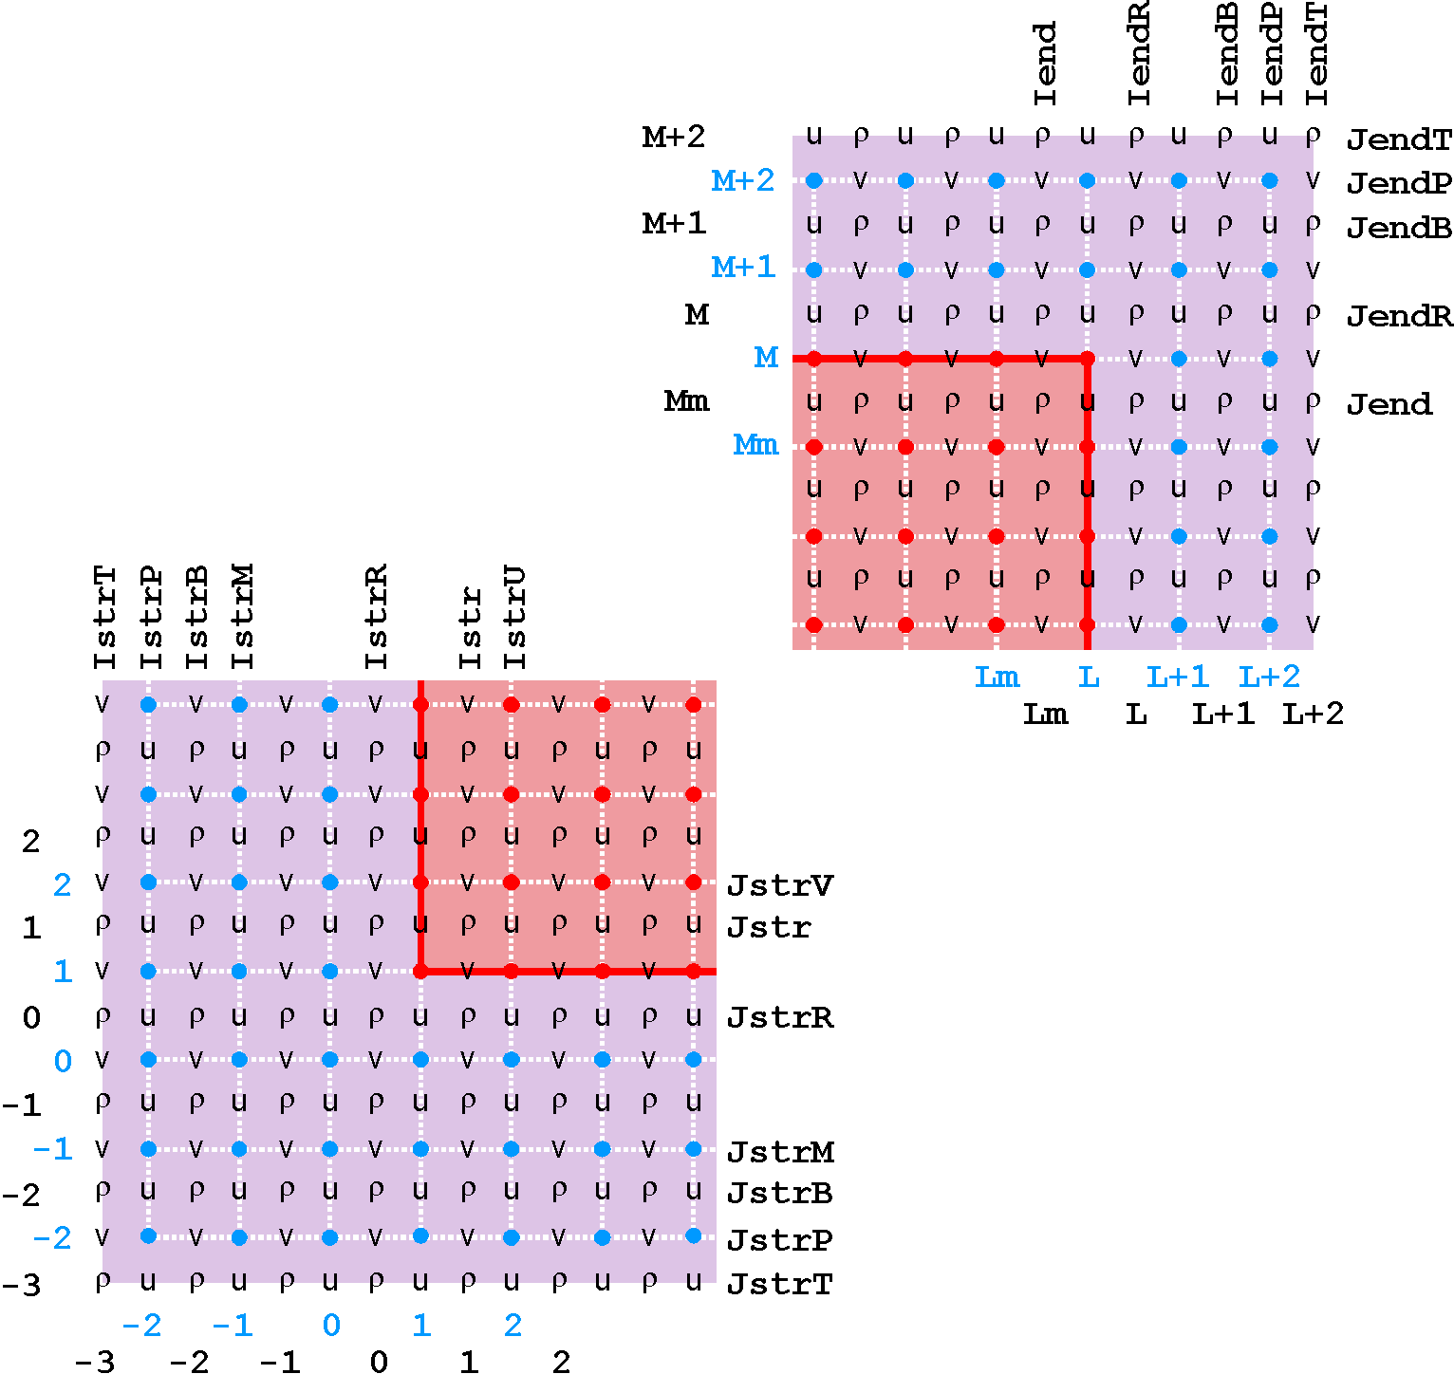
Boundary Tile Indices Locations

Slide 20
Lateral Boundary Conditions Structure
TYPE T_LBC
logical :: acquire process lateral boundary data
logical :: Chapman_explicit
logical :: Chapman_implicit
logical :: clamped
logical :: closed
logical :: Flather
logical :: gradient
logical :: nested
logical :: nudging
logical :: periodic
logical :: radiation
logical :: reduced
logical :: Shchepetkin
END TYPE T_LBC
TYPE (T_LBC), allocatable :: LBC(:,:,:)
For example, for free-surface gradient boundary conditions we have:
LBC(iwest, isFsur, ng) % gradient
LBC(ieast, isFsur, ng) % gradient
LBC(isouth, isFsur, ng) % gradient
LBC(inorth, isFsur, ng) % gradient

Slide 21
Lateral Boundary Conditions Code
For Example, in zetabc.F the western boundary conditions are:
IF ( DOMAIN (ng) % Western_Edge(tile) ) THEN
IF ( LBC (iwest, isFsur, ng) % radiation ) THEN
…
ELSE IF ( LBC (iwest, isFsur, ng) % Chapman_explicit ) THEN
…
ELSE IF ( LBC (iwest, isFsur, ng) % Chapman_implicit ) THEN
…
ELSE IF ( LBC (iwest, isFsur, ng) % clamped ) THEN
…
ELSE IF ( LBC (iwest, isFsur, ng) % gradient ) THEN
…
ELSE IF ( LBC (iwest, isFsur, ng) % closed ) THEN
DO j = Jstr, Jend
IF ( LBC_apply (ng) % west ( j ) ) THEN ! Allows both specified and
zeta ( Istr-1, j, kout ) = zeta ( Istr, j, kout ) ! nested conditions
END IF
END DO
END IF
END IF

Slide 22
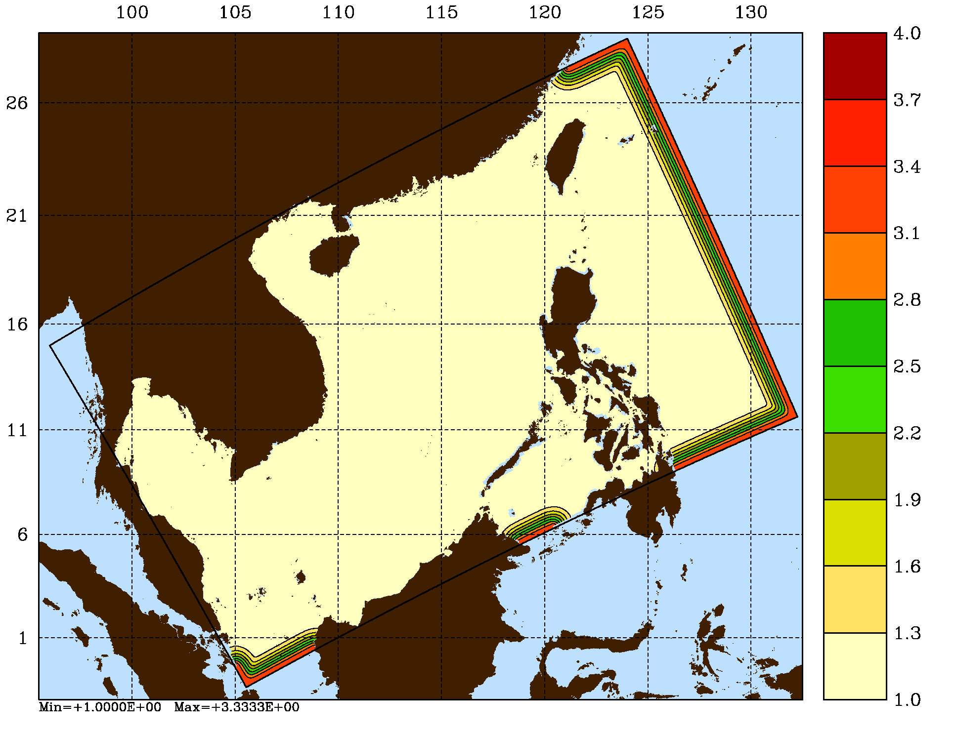
Viscosity and Diffusion Sponges
The horizontal viscosity is now computed as:
visc2_r(i,j) = visc_factor(i,j) * visc2_r(i,j)
visc4_r(i,j) = visc_factor(i,j) * visc4_r(i,j)
And the horizontal diffusion is now computed as:
diff2(i,j,itrc) = diff_factor(i,j) * diff2(i,j,itrc)
diff4(i,j,itrc) = diff_factor(i,j) * diff4(i,j,itrc)
The horizontal mixing coefficients (visc_factor and diff_factor) can be set with analytical functions using ANA_SPONGE or can be read from input GRID NetCDF file variables:
double visc_factor (eta_rho, xi_rho) ;
visc_factor:long_name = "horizontal viscosity sponge factor" ;
visc_factor:valid_min = 0. ;
visc_factor:coordinates = "lon_rho lat_rho" ;
double diff_factor (eta_rho, xi_rho) ;
diff_factor:long_name = "horizontal diffusivity sponge factor" ;
diff_factor:valid_min = 0. ;
diff_factor:coordinates = "lon_rho lat_rho" ;
The Matlab script add_sponge.m can be used to append sponge variables to the application GRID NetCDF file

Slide 23
Standard Input File: Rivers and Sponges
Logical switches (TRUE/FALSE) to activate horizontal momentum transport point Sources/Sinks (like river runoff transport) and mass point Sources/Sinks (like volume vertical influx), [1:Ngrids].
LuvSrc == 3*F ! horizontal momentum transport
LwSrc == 3*F ! volume vertical influx
Logical switches (TRUE/FALSE) to activate tracers point Sources/Sinks (like river runoff) and to specify which tracer variables to consider: [1:NAT+NPT,Ngrids]. See glossary below for details.
LtracerSrc == 2*F 2*F 2*F ! temperature, salinity, inert
Logical switches (TRUE/FALSE) to increase/decrease horizontal viscosity and/or diffusivity in specific areas of the application domain (like sponge areas) for the desired application grid.
LuvSponge == 3*F ! horizontal momentum
LtracerSponge == 2*F 2*F 2*F ! temperature, salinity, inert

Slide 24
Standard Input File: Climatology and Nudging
Logical switches (TRUE/FALSE) to read and process climatology fields. See glossary below for details.
LsshCLM == 3*F ! sea-surface height
Lm2CLM == 3*F ! 2D momentum
Lm3CLM == 3*F ! 3D momentum
LtracerCLM == 2*F 2*F 2*F ! temperature, salinity, inert
Logical switches (TRUE/FALSE) to nudge the desired climatology field(s). If not analytical climatology fields, users need to turn ON the logical switches above to process the fields from the climatology NetCDF file that are needed for nudging. See glossary below for details.
LnudgeM2CLM == 3*F ! 2D momentum
LnudgeM3CLM == 3*F ! 3D momentum
LnudgeTCLM == 2*F 2*F 2*F ! temperature, salinity, inert

Slide 25
Nudging Coefficients Metadata
The inverse (1/time) nudging coefficients can be set with analytical functions using ANA_NUDGCOEF or can be read from new input NUDNAME NetCDF file variables:
double M2_NudgeCoef (eta_rho, xi_rho) ;
M2_NudgeCoef:long_name = "2D momentum inverse nudging coefficients" ;
M2_NudgeCoef:units = "day-1" ;
M2_NudgeCoef:coordinates = "xi_rho eta_rho " ;
double M3_NudgeCoef (s_rho, eta_rho, xi_rho) ;
M3_NudgeCoef:long_name = "3D momentum inverse nudging coefficients" ;
M3_NudgeCoef:units = "day-1" ;
M3_NudgeCoef:coordinates = "xi_rho eta_rho s_rho " ;
double tracer_NudgeCoef (s_rho, eta_rho, xi_rho) ;
tracer_NudgeCoef:long_name = "generic tracer inverse nudging coefficients” ;
tracer_NudgeCoef:units = "day-1" ;
tracer_NudgeCoef:coordinates = "xi_rho eta_rho s_rho " ;
double temp_NudgeCoef (s_rho, eta_rho, xi_rho) ;
temp_NudgeCoef:long_name = "temp inverse nudging coefficients" ;
temp_NudgeCoef:units = "day-1" ;
temp_NudgeCoef:coordinates = "xi_rho eta_rho s_rho " ;
double salt_NudgeCoef (s_rho, eta_rho, xi_rho) ;
salt_NudgeCoef:long_name = "salt inverse nudging coefficients" ;
salt_NudgeCoef:units = "day-1" ;
salt_NudgeCoef:coordinates = "xi_rho eta_rho s_rho " ;

Slide 26
Nesting Configuration Types
Composite Grids Super-Class:
  Mosaic Grids Sub-Class
  Composite Overlap Grids Sub-Class
  Complex Estuary Composite Grids Sub-Class
  Partial Boundary Composite Grids Sub-Class
Refinement Grids Super-Class:
  Single Refinement Sub-Class
  Multiple Refinement Sub-Class
Composite and Refinement Combination Super-Class:
  Refinement and Partial Boundary Composite Sub-Class
  Complex Estuary Refinement-Composite Sub-Class

Slide 27
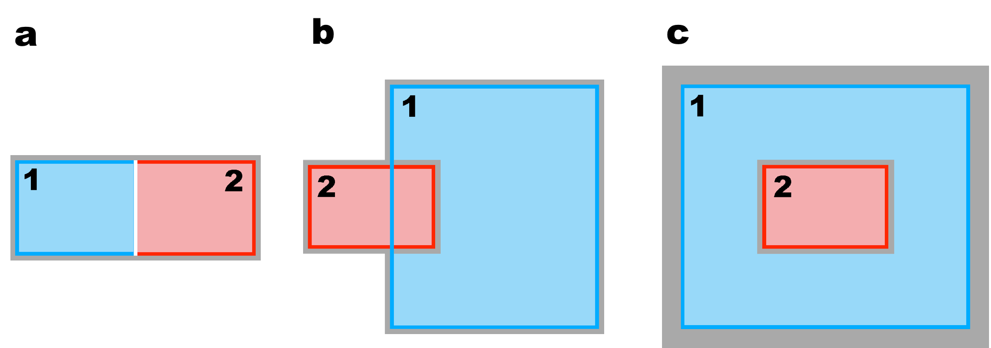
Nesting Classes
Mosaic
Composite
Refinement

Slide 28
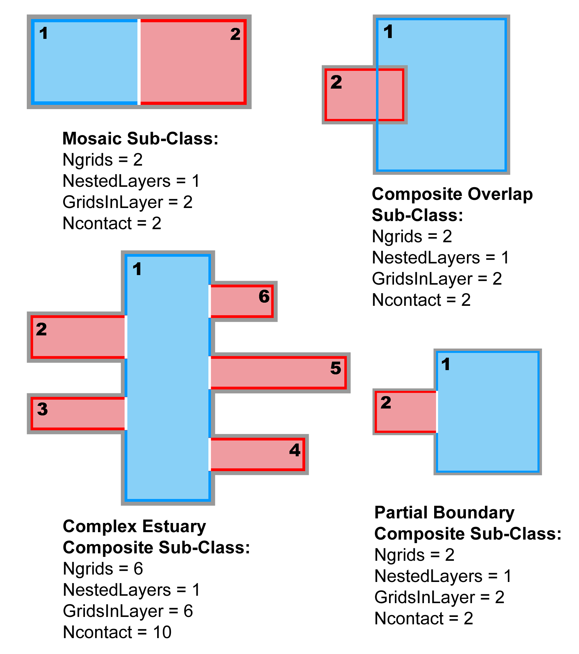
Composite Grid Sub-Classes

Slide 29
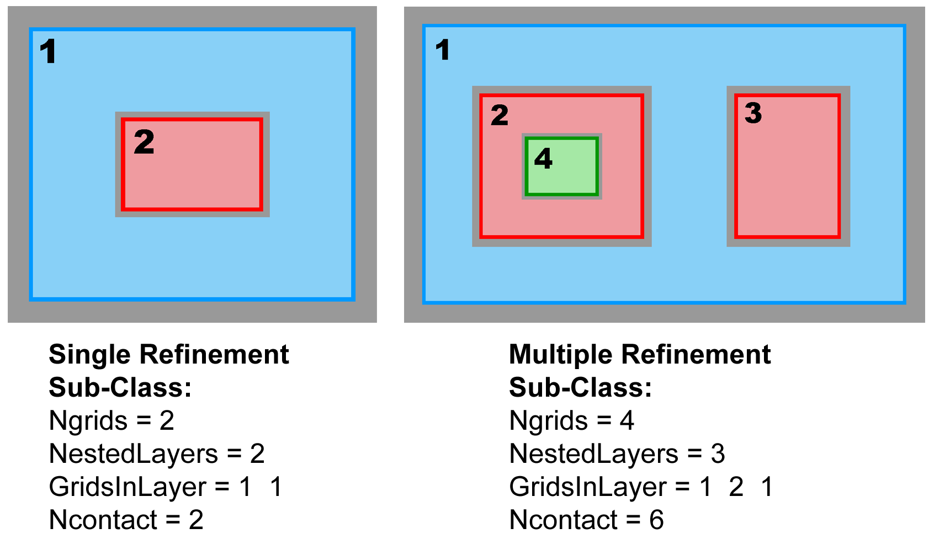
Refinement Grid Sub-Classes

Slide 30
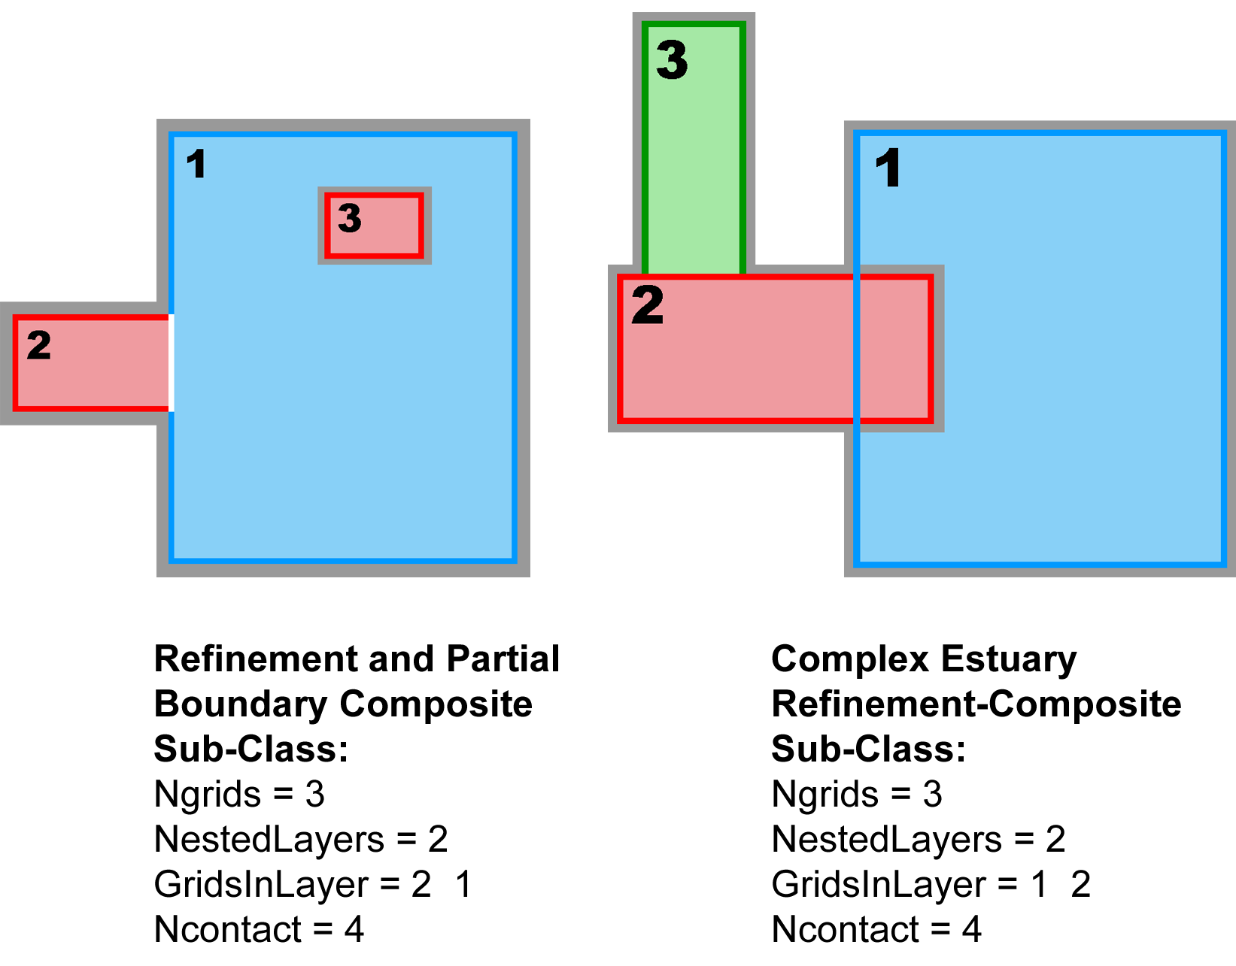
Composite-Refinement Grid Sub-Classes

Slide 31
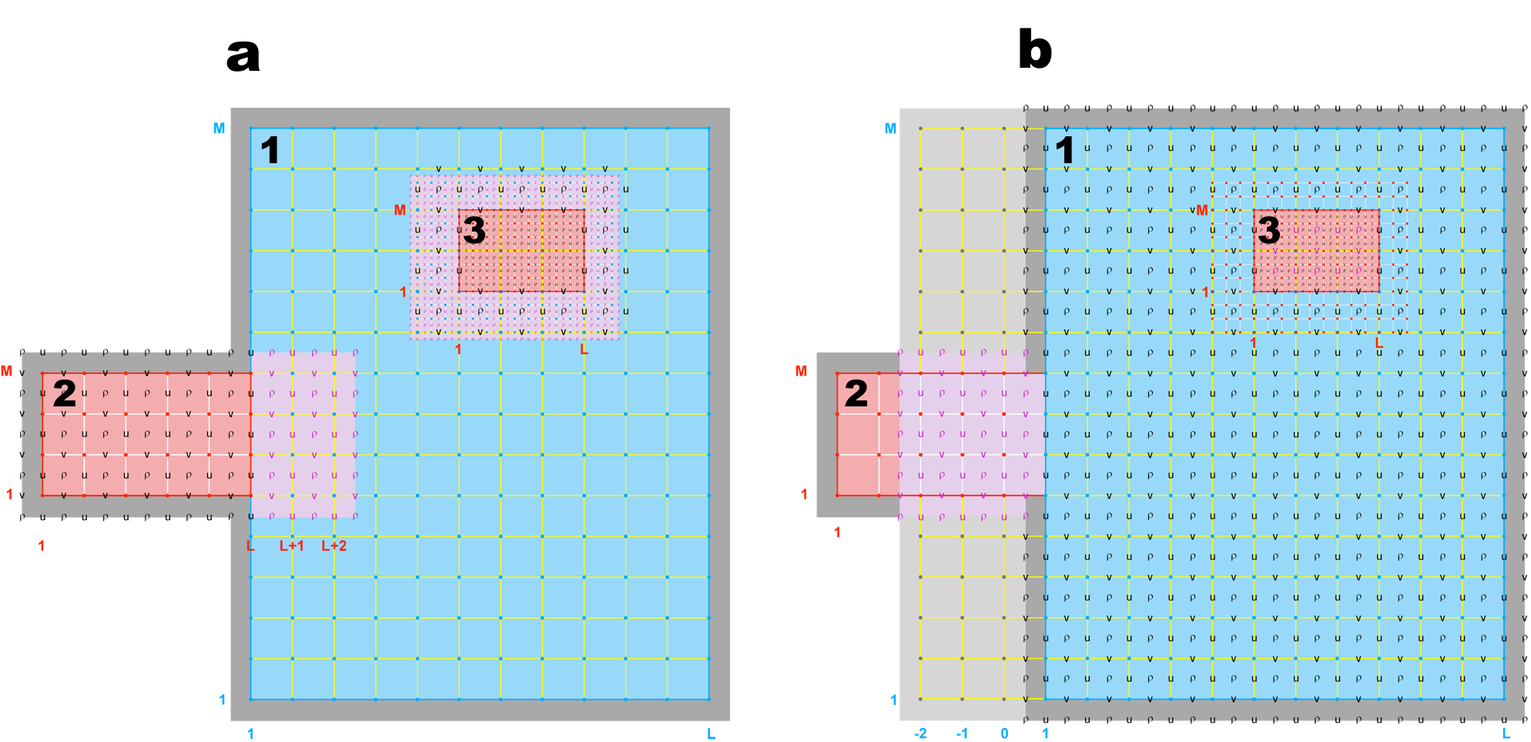
Contact Areas and Points
Refinement-Composite Sub-Class

Slide 32
Contact Areas and Points: Definitions
Contact Region (cr): Extended section of the nested grid that overlays an adjacent nested grid. It is the region where the exchange of data between nested grids takes place. Since ROMS nesting is two-way by default, there are Ncontact=(Ngrids-1)*2 contact regions, where Ngrids is the number of nested grids and Ncontact is the number of contact regions in a nested application. There is a duality in ROMS grid nesting: data donor in one contact region and data receiver in its conjugate contact region. Each contact region has a donor and a receiver grid.
Contact Points: Grid cells inside a contact region. Since ROMS governing equations are solved in an Arakawa C-grid, there are contact points at ρ-, Ψ-, u-, and v-points. However, the Ψ-points are only used to define the physical grid perimeters within a contact region. Since the C-grid stencil indices in ROMS are left-bottom ordered, there are always 4 ρ contact points at the left and bottom side of the contact region. On the other hand, there are 3 ρ contact points on the right and top side of the contact region.
Donor Grid (dg): Data source grid in a nesting contact region. In refinement, the donor grid is used either to interpolate data from coarse to fine grid or to average data from fine to coarse grid (two-way feedback).
Receiver Grid (rg): Data recipient grid in a nesting contact region. In refinement, the contact points of the finer receiver grid are interpolated using the coarser donor data from the grid cell containing the contact point. The interpolation can be linear or quadratic. In two-way nesting, when the coarse grid is the receiver grid the finer grid solution is averaged within the coarse cell. The coarse grid cell value is replaced with the finer grid averaged solution. This takes place in routine fine2coarse.
Nesting Layer: Nested grids time-step arrangement and order for the ROMS numerical kernel. It is directly related to the time-step size (dt) for each nested grid. The number of nested layers, NestLayers, is specified in standard input script (ocean.in) and should be equal to the different number of time-step size (dt).

Slide 33
Contact Regions and Contact Points

Slide 34
Contact Points Structure
integer :: Ncontact total number of contact regions
TYPE T_NGC
logical :: coincident coincident donor and receiver points, p=q=0
logical :: interpolate perform vertical interpolation
integer :: donor_grid data donor grid number
integer :: receiver_grid data receiver grid number
integer :: Npoints
integer, pointer :: Idg (:) donor grid, cell I-left index
integer, pointer :: Jdg (:) donor grid, cell J-bottom index
integer, pointer :: Kdg (: , :) donor grid, cell K-index
integer, pointer :: Irg (:) receiver grid, I-contact point
integer, pointer :: Jrg (:) receiver grid, J-contact point
real(r8), pointer :: Lweight (: , :) linear horizontal weights
real(r8), pointer :: LweightUmasked (: , :) linear horizontal unmasked weights (WET_DRY)
real(r8), pointer :: Qweight (: , :) quadratic horizontal weights
real(r8), pointer :: QweightUmasked (: , :) quadratic horizontal unmasked weights (WET_DRY)
real(r8), pointer :: Vweight(: , : , :) vertical weights
END TYPE T_NGC
TYPE (T_NGC), allocatable :: Rcontact (:) RHO-points
TYPE (T_NGC), allocatable :: Ucontact (:) U-points
TYPE (T_NGC), allocatable :: Vcontact (:) V-points

Slide 35
Contact Points Interpolation
Suffix: dg = donor grid
rg = receiver grid
8
7 Kdg
4
3 (Idg+1, Jdg+1, Kdg-1)
5
6
1- q
p
5
Jrg
1- p
q
4
3 Kdg-1
(Idg, Jdg, Kdg-1) 1
Irg
2
1
2
Lweight (1, :) = (1 - p) * (1 - q)
Lweight (2, :) = p * (1 - q)
Lweight (3, :) = p * q
Lweight (4, :) = (1 - p) * q
Value (Irg, Jrg) = Lweight (1,:) * F2d(Idg ,Jdg )+
Lweight (2,:) * F2d(Idg+1,Jdg )+
Lweight (3,:) * F2d(Idg+1,Jdg+1)+
Lweight (4,:) * F2d(Idg ,Jdg+1)
If coincident contact points between data donor and data receiver grids, p = q = 0.0,
Lweight (1, :) = 1.0 Value (Irg, Jrg) = Lweight (1, :) * F2d( Idg, Jdg )
Lweight (3, :) = 0.0
Lweight (4, :) = 0.0
Lweight (5, :) = 0.0

Slide 36
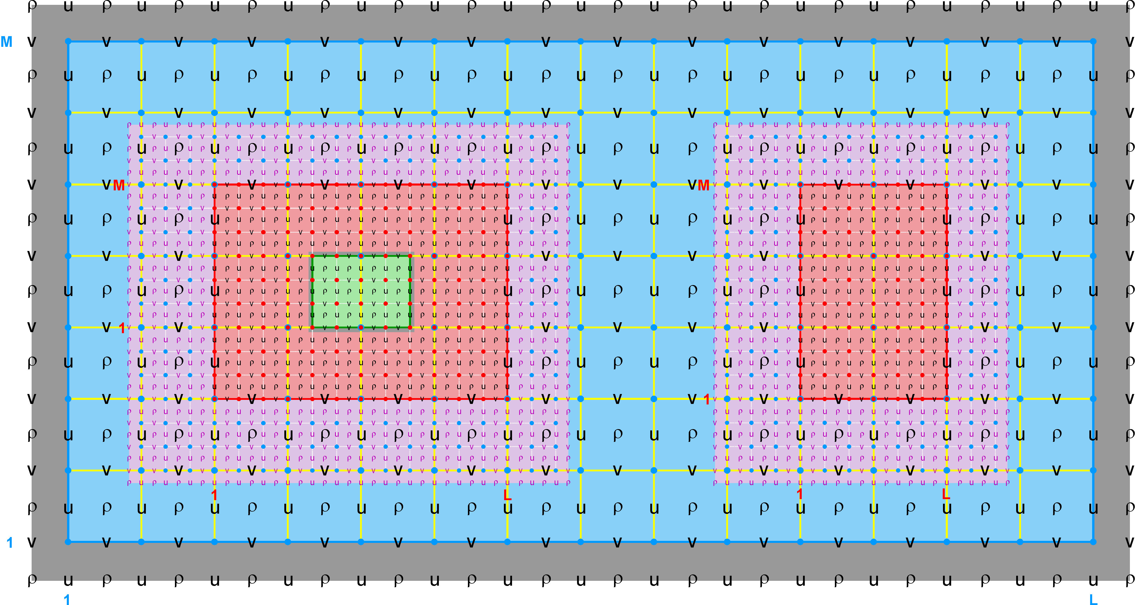
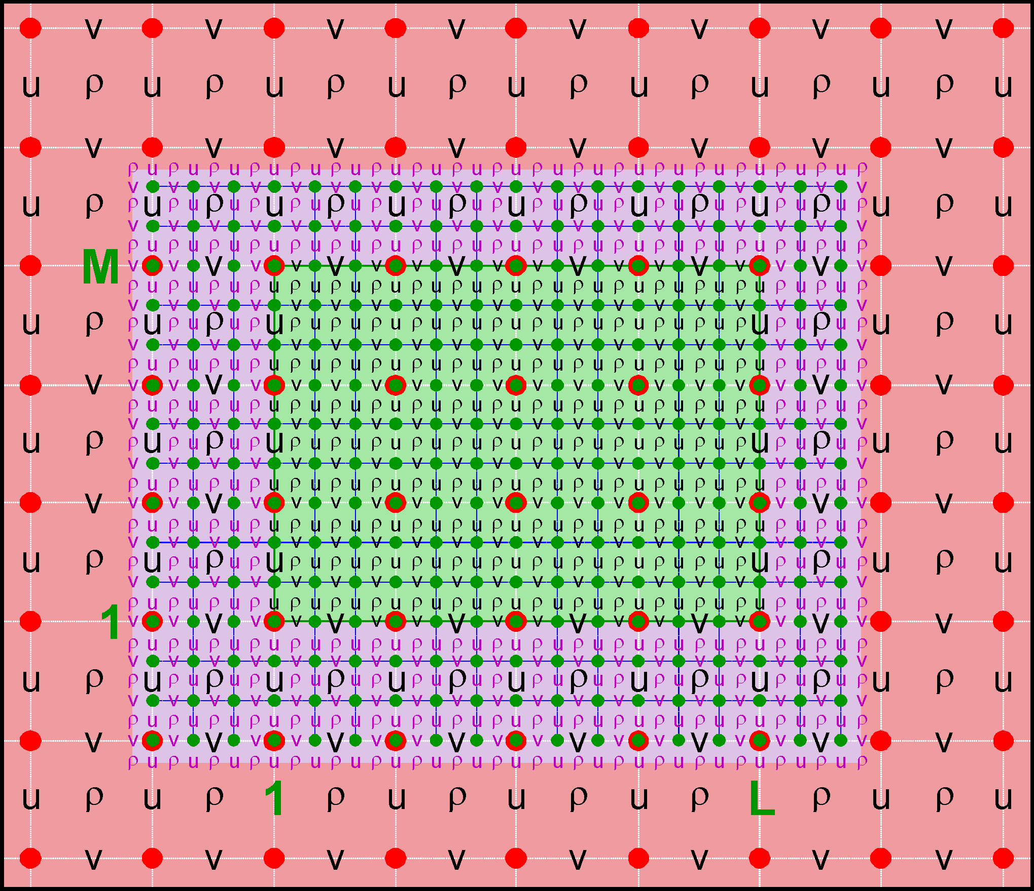
Nested Grids: Multi-Refinement Class
Ngrids = 4
NestLayers = 3
GridsInLayer = 1 2 1
Ncontact = 6
Donor Grid = blue
Receiver Grid = red
Ngrids = 4
NestLayers = 3
GridsInLayer = 1 2 1
Ncontact = 6
Donor Grid = red
Receiver Grid = green

Slide 37
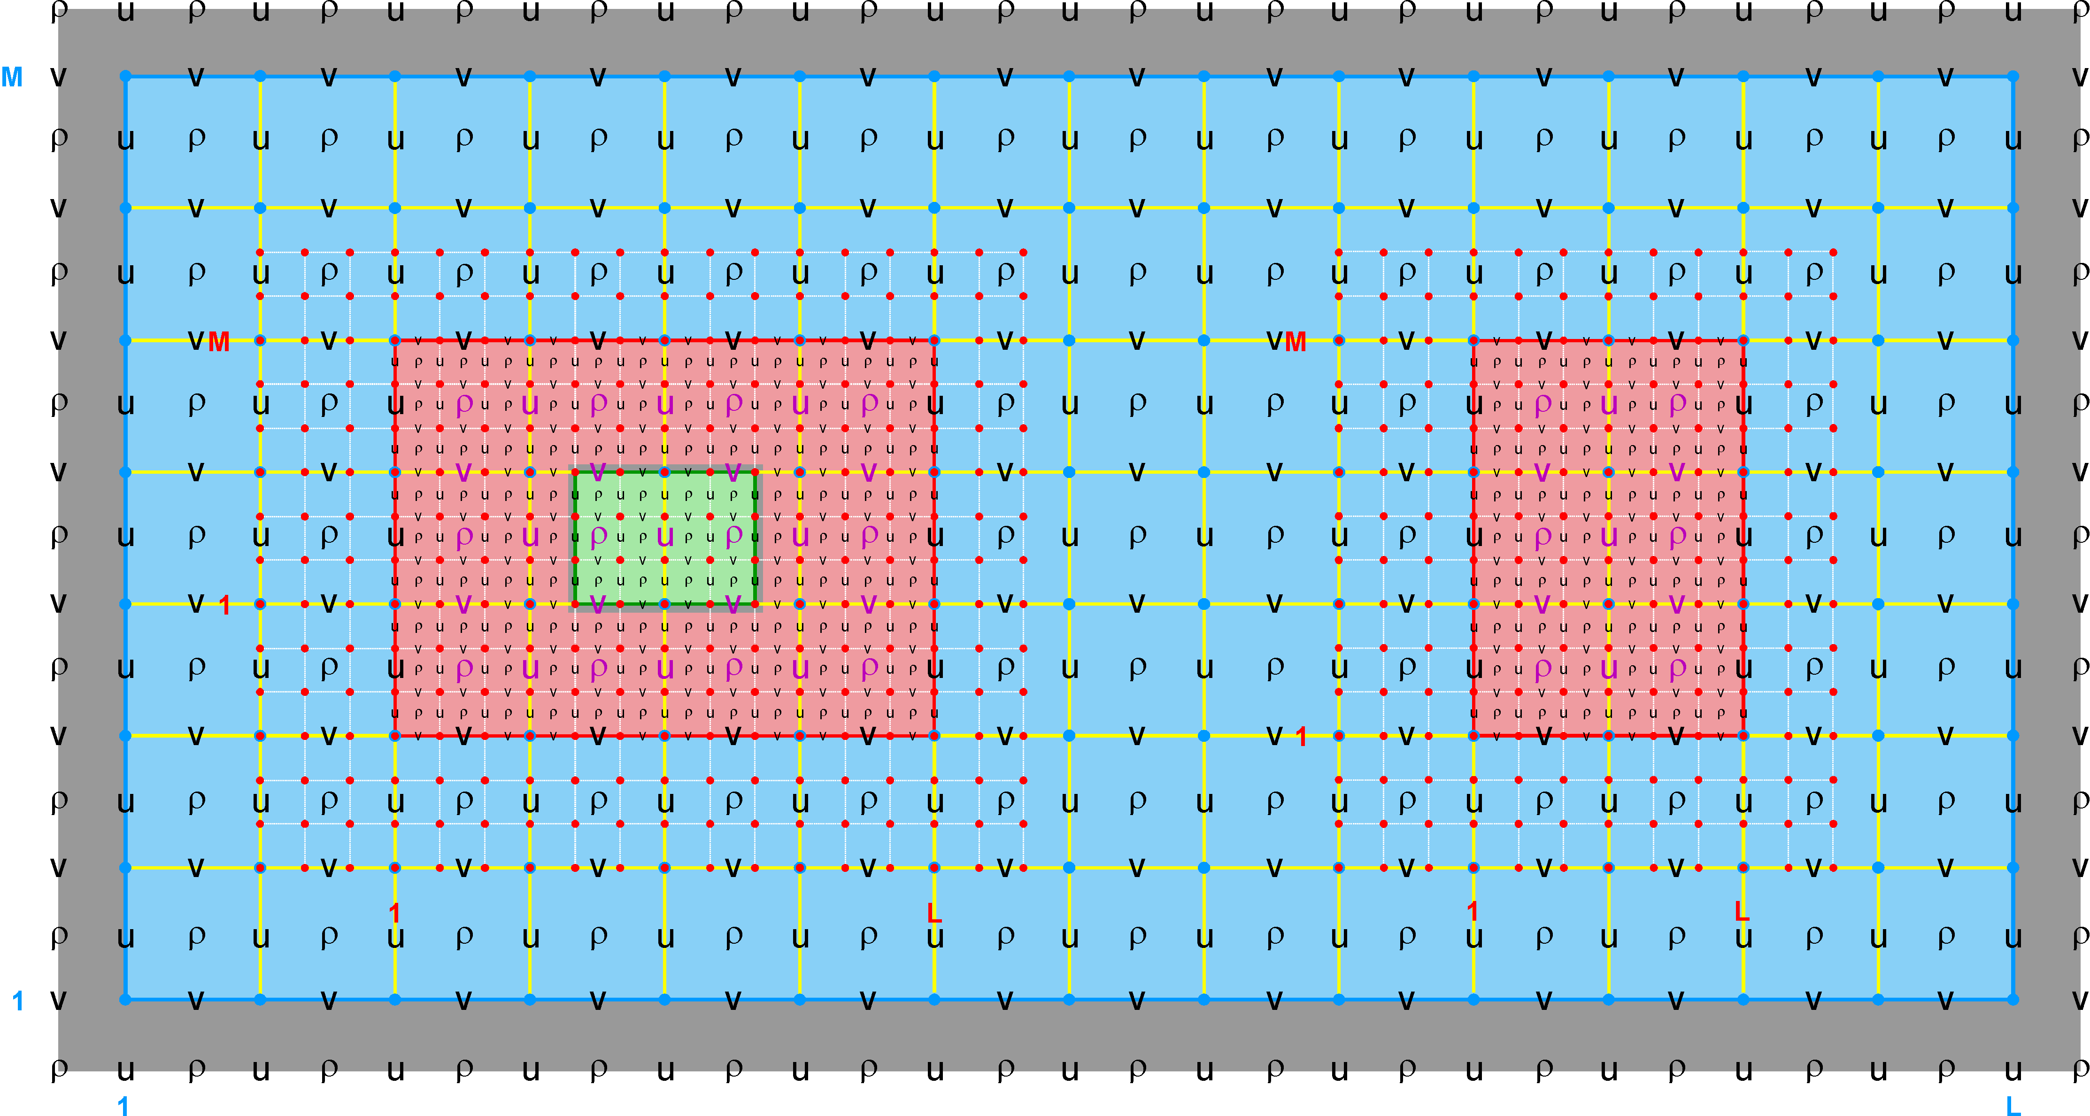
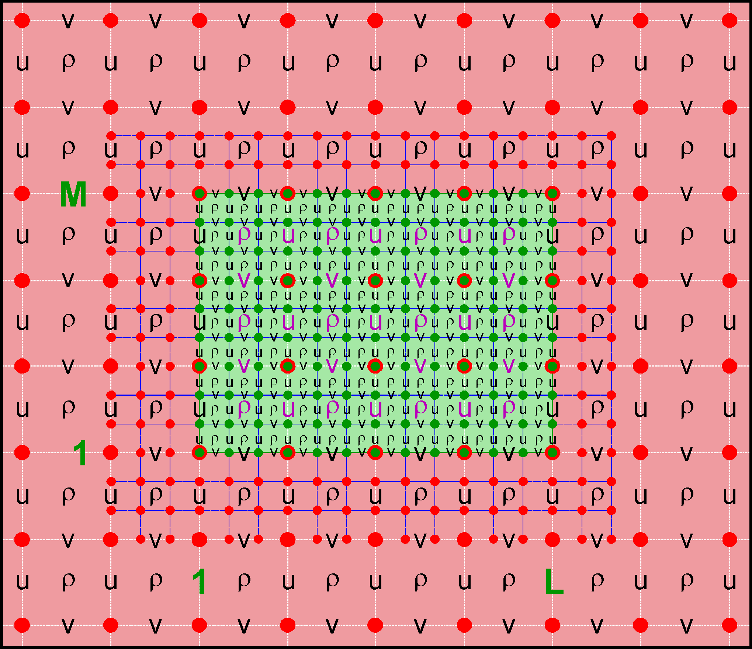
Nested Grids: Multi-Refinement Class
Ngrids = 4
NestLayers = 3
GridsInLayer = 1 2 1
Ncontact = 6
Donor Grid = red
Receiver Grid = blue
Ngrids = 4
NestLayers = 3
GridsInLayer = 1 2 1
Ncontact = 6
Donor Grid = green
Receiver Grid = red

Slide 38
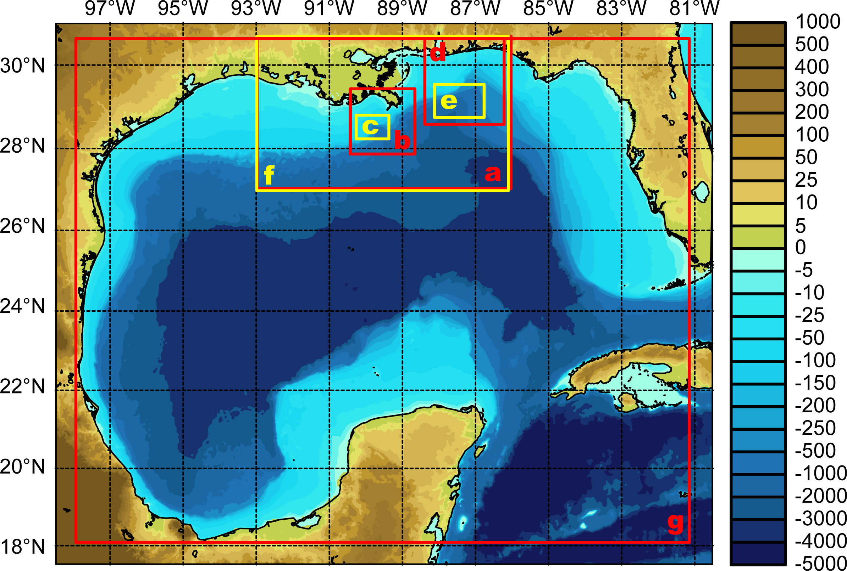
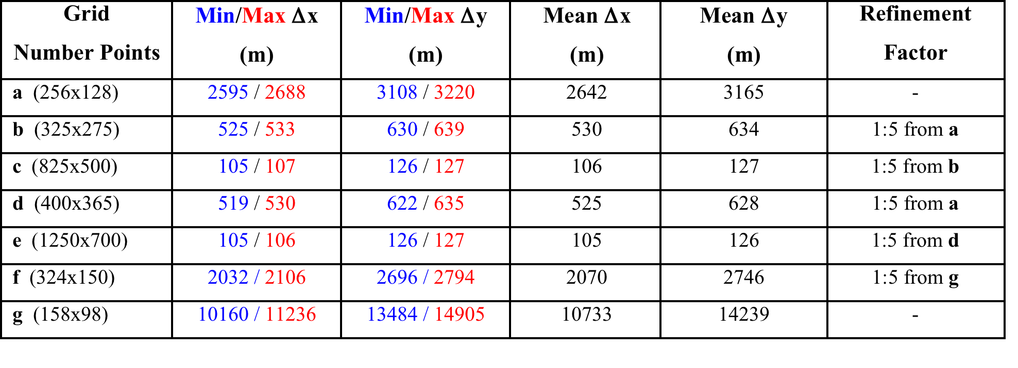
Realistic Nesting Configuration: Gulf of Mexico
(Multiple Refinement Sub-Class)

Slide 39
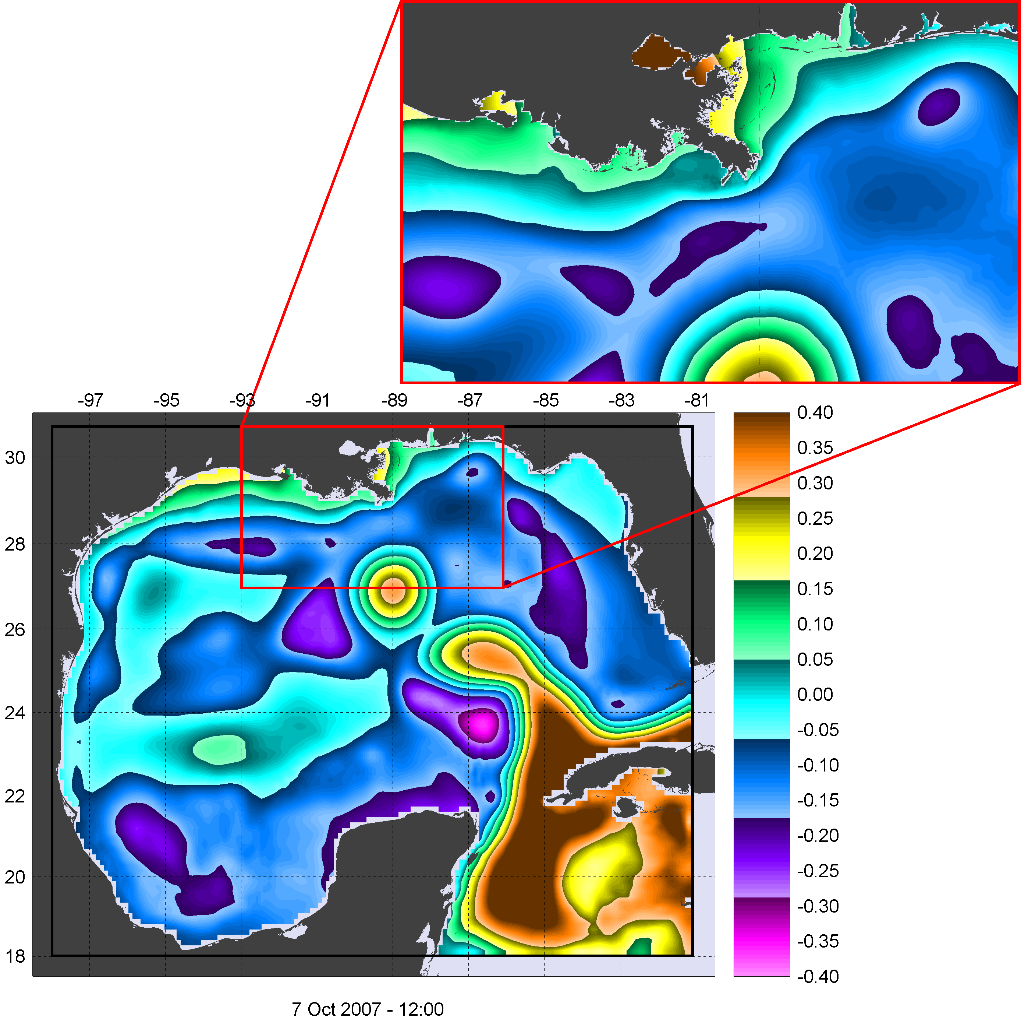
Realistic Nesting Configuration: Gulf of Mexico
(Multiple Refinement Sub-Class)

Slide 40
Realistic Nesting Configuration: US West Coast
(Telescoping Refinement Sub-Class)
Modeling of Monterey Canyon

Slide 41
Realistic Nesting Configuration: South China Sea
(Multiple Refinement Sub-Class)
Free-Surface

Slide 42
Realistic Nesting Configuration: South China Sea
(Multiple Refinement Sub-Class)
Temperature

Slide 43
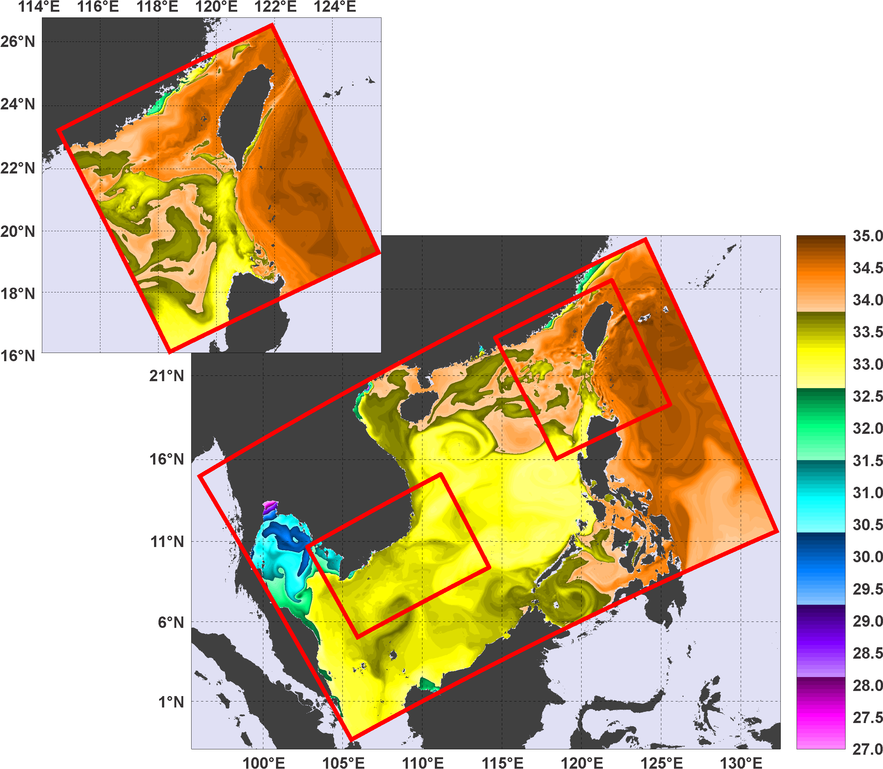
Realistic Nesting Configuration: South China Sea
(Multiple Refinement Sub-Class)
Salinity

Slide 44
Lake Jersey Test Case

Slide 45
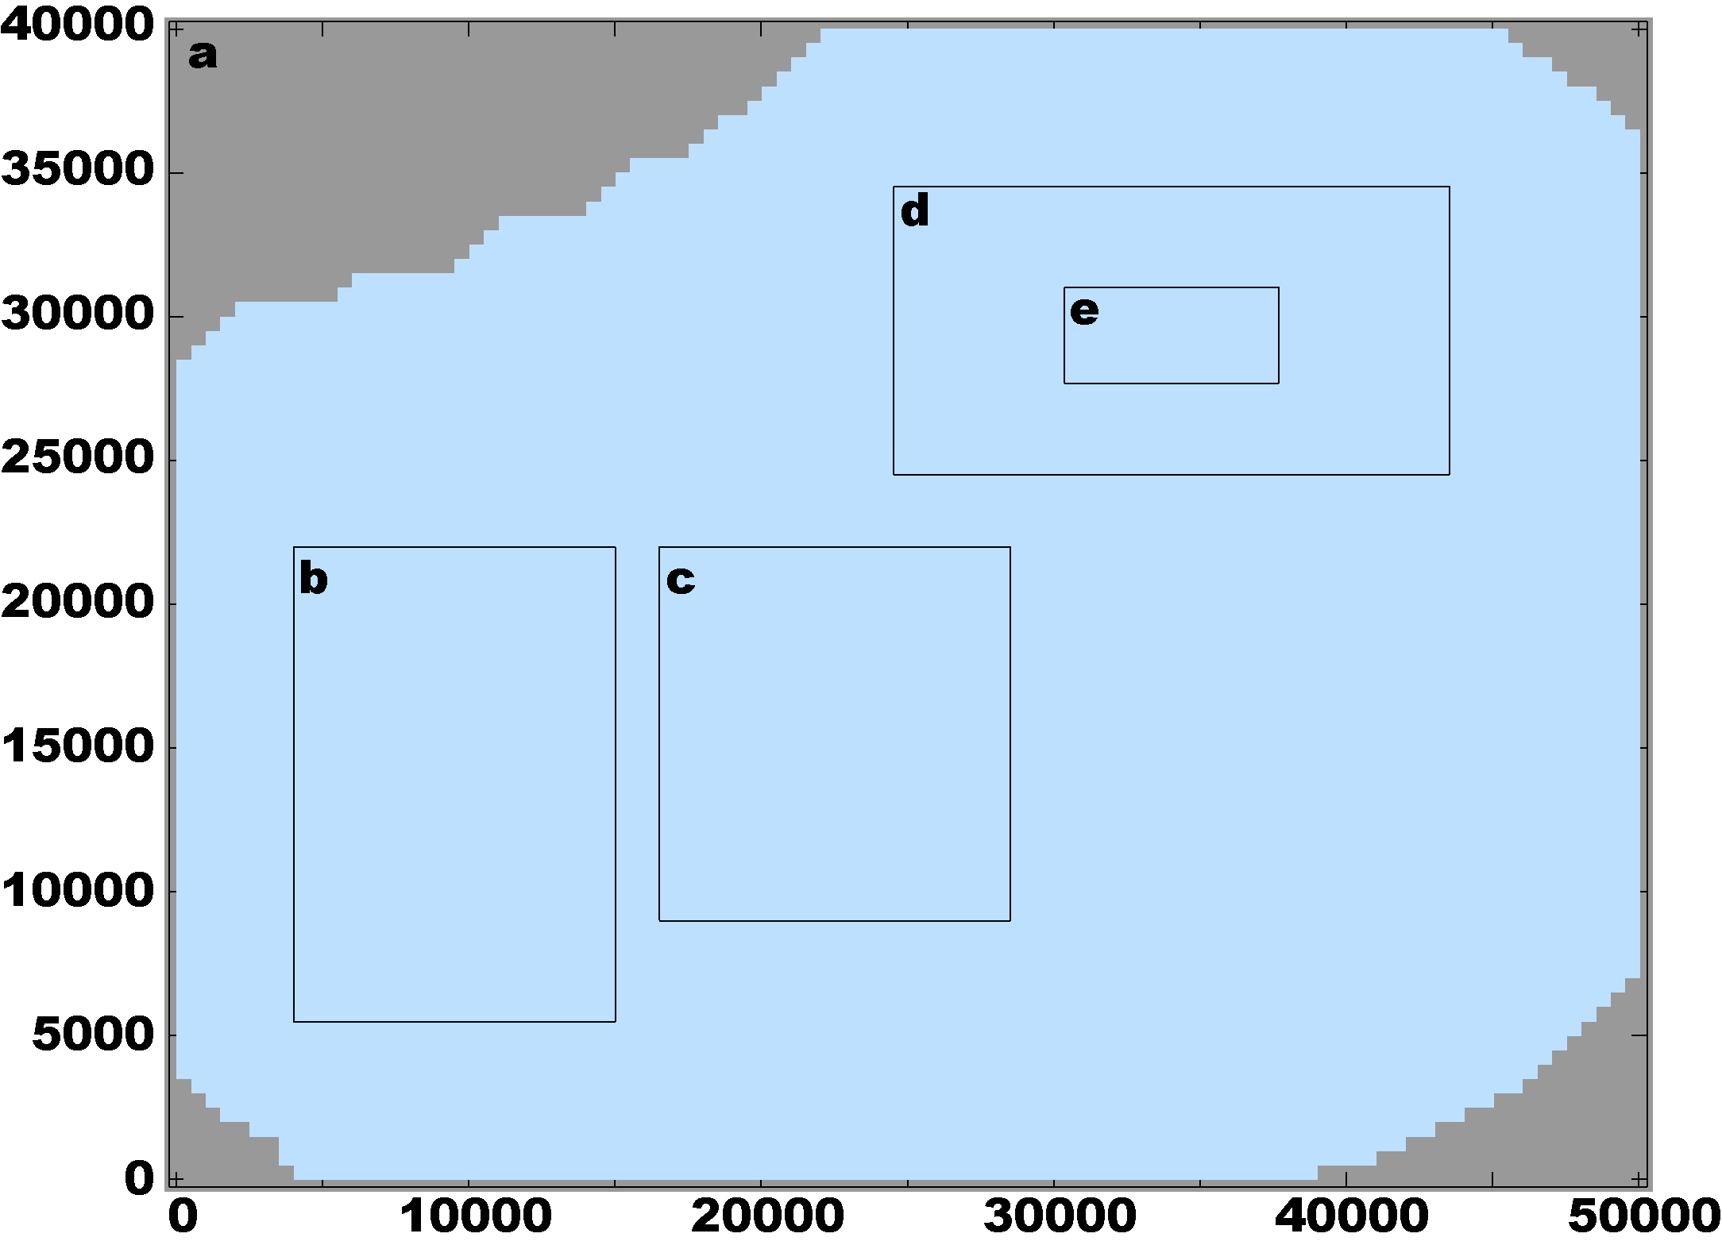
Lake Jersey
Lake Jersey Grid Information
Grid | Mesh Size | Refinement Factor | Parent Imin | Parent Imax | Parent Jmin | Parent Jmax | Δx Δy | Grid NetCDF File
a | 100x80x8 | - | - | - | - | - | 500.0 m | lake_jersey_grd_a.nc
b | 66x99x8 | 1:3 from a | 9 | 31 | 12 | 45 | 166.6 m | lake_jersey_grd_b.nc
c | 120x130x8 | 1:5 from a | 34 | 58 | 19 | 45 | 100.0 m | lake_jersey_grd_c.nc
d | 114x60x8 | 1:3 from a | 50 | 88 | 50 | 70 | 166.6 m | lake_jersey_grd_d.nc
e | 132x60x8 | 1:3 from d | 36 | 80 | 20 | 40 | 55.5 m | lake_jersey_grd_e.nc

Slide 46
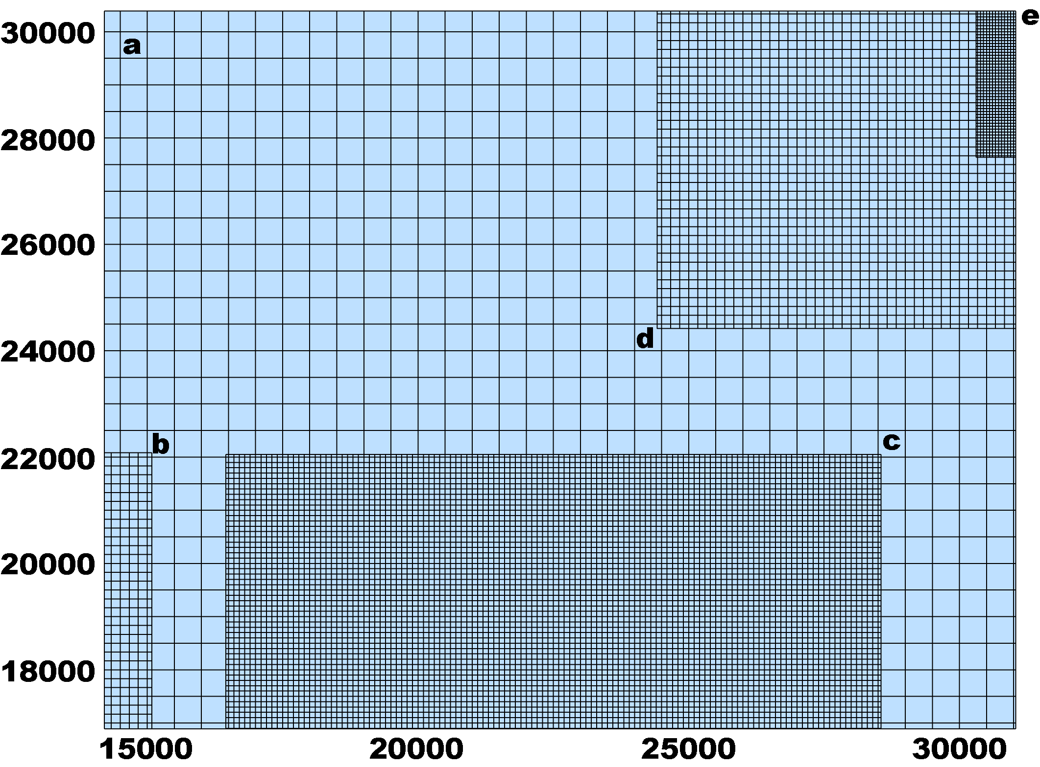
Lake Jersey

Slide 47
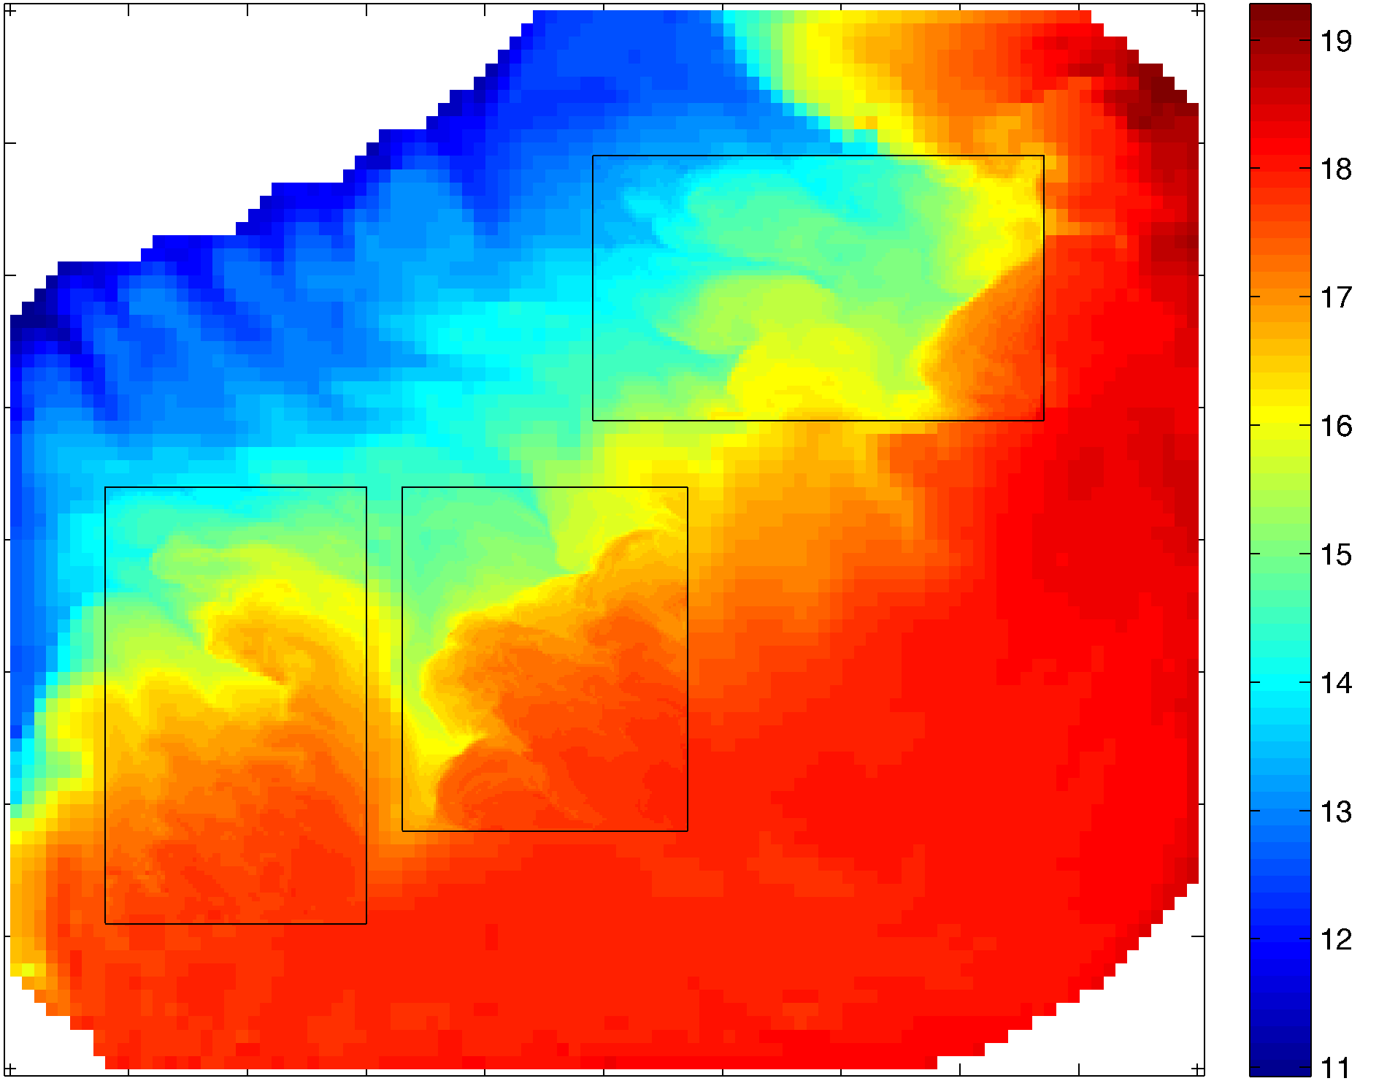

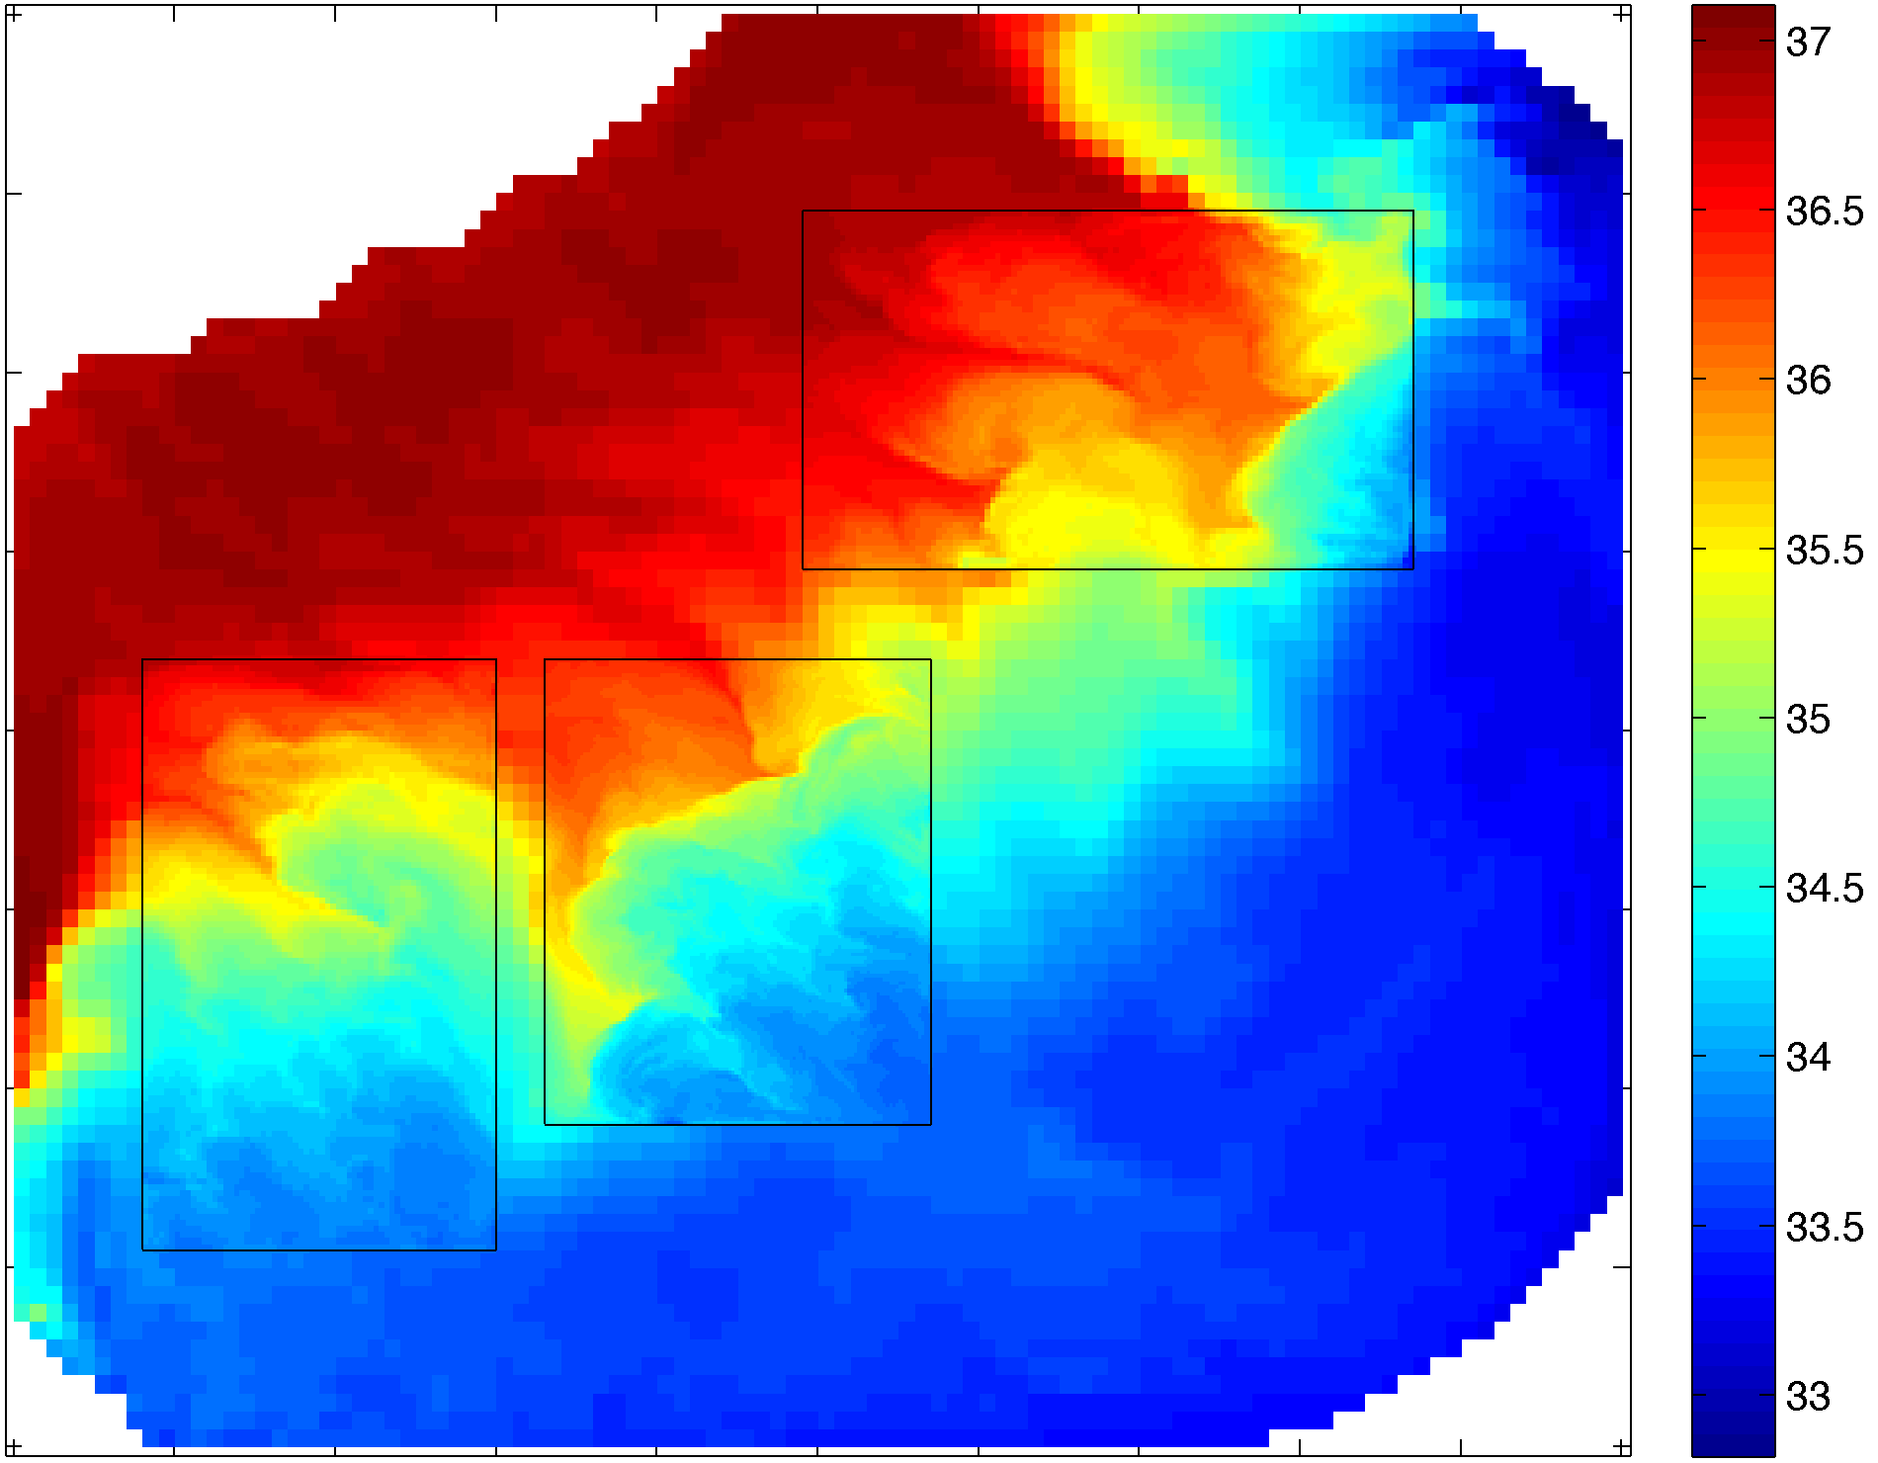
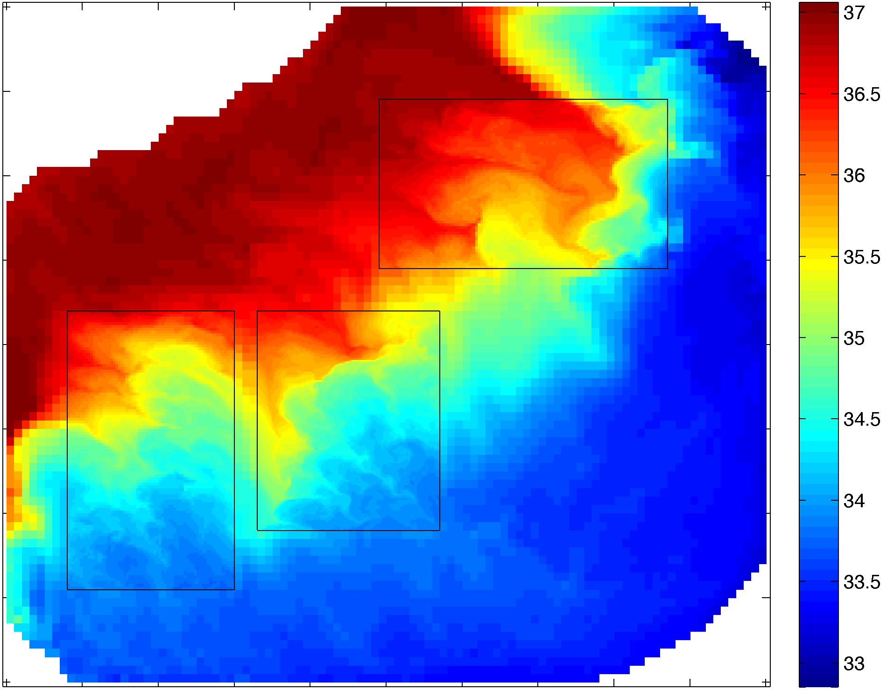
Lake Jersey: Case ABDC
One-Way
Two-Way
Temperature
Temperature
Salinity
Salinity

Slide 48
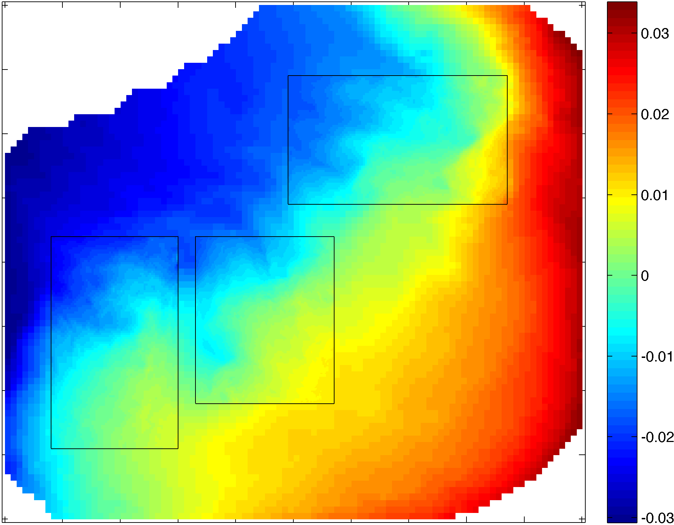

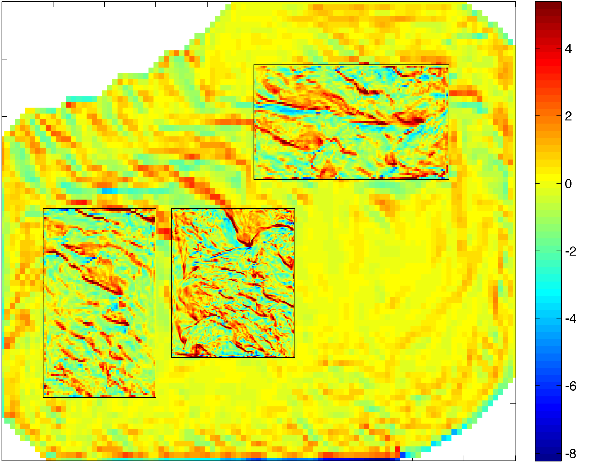
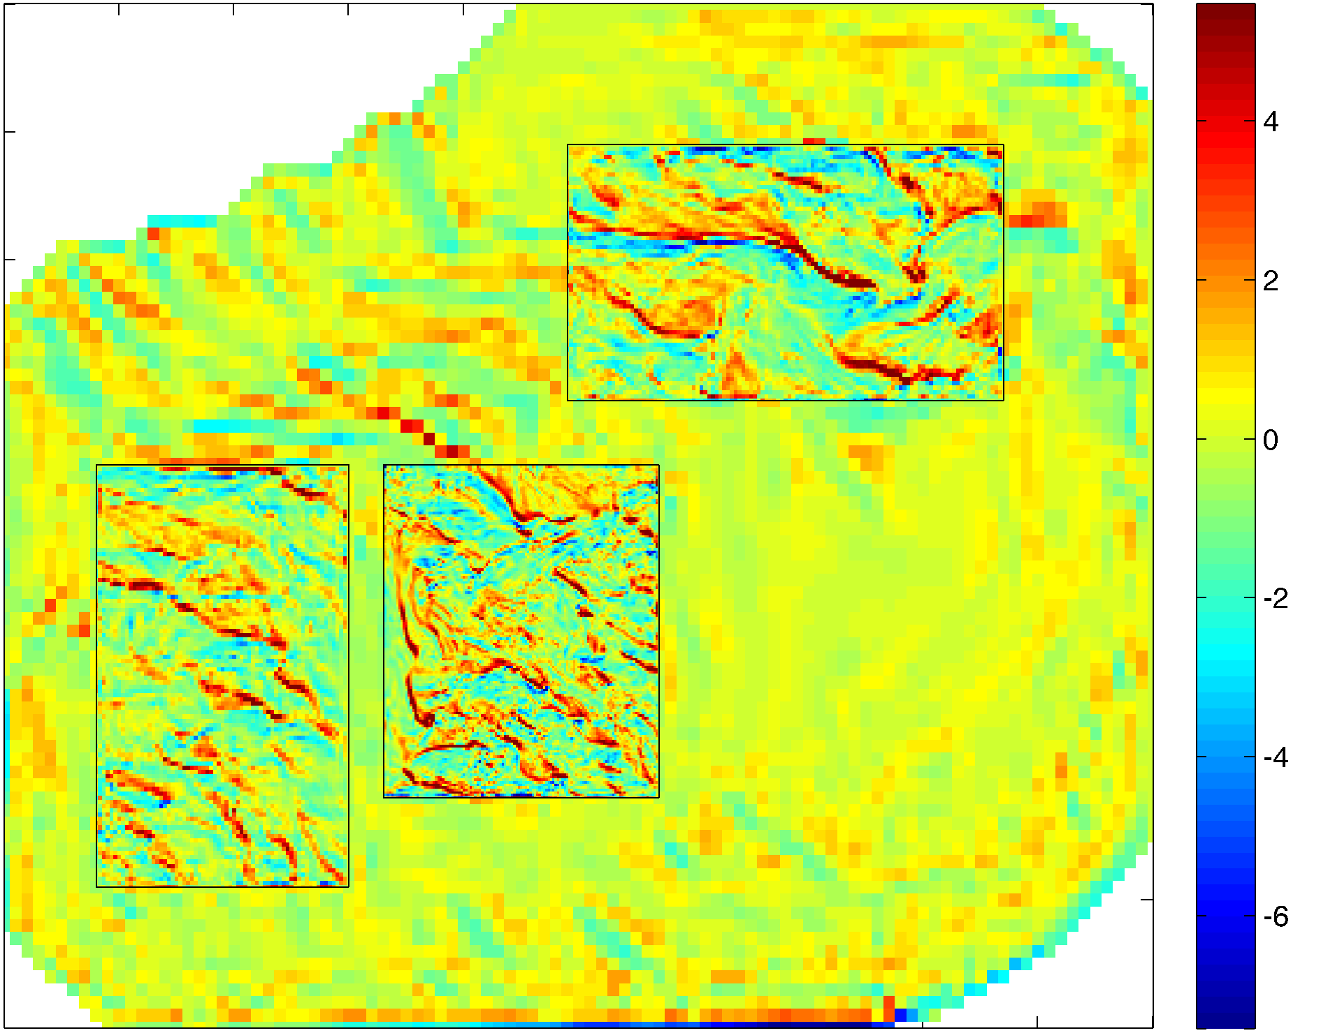
Lake Jersey: Case ABDC
One-Way
Two-Way
Free-Surface
Free-Surface
2D Relative Vorticity
X 10⁻⁴
2D Relative Vorticity
X 10⁻⁴

Slide 49

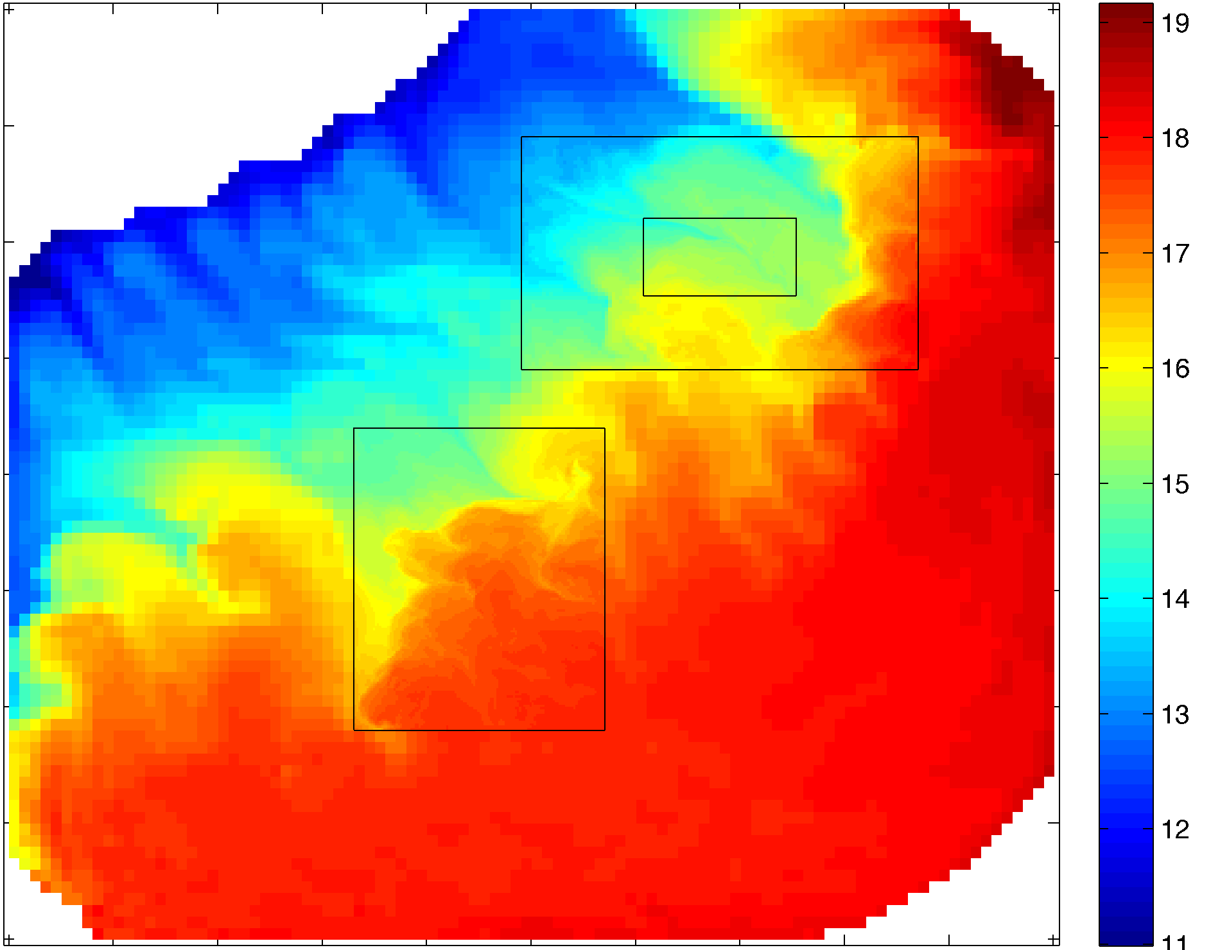

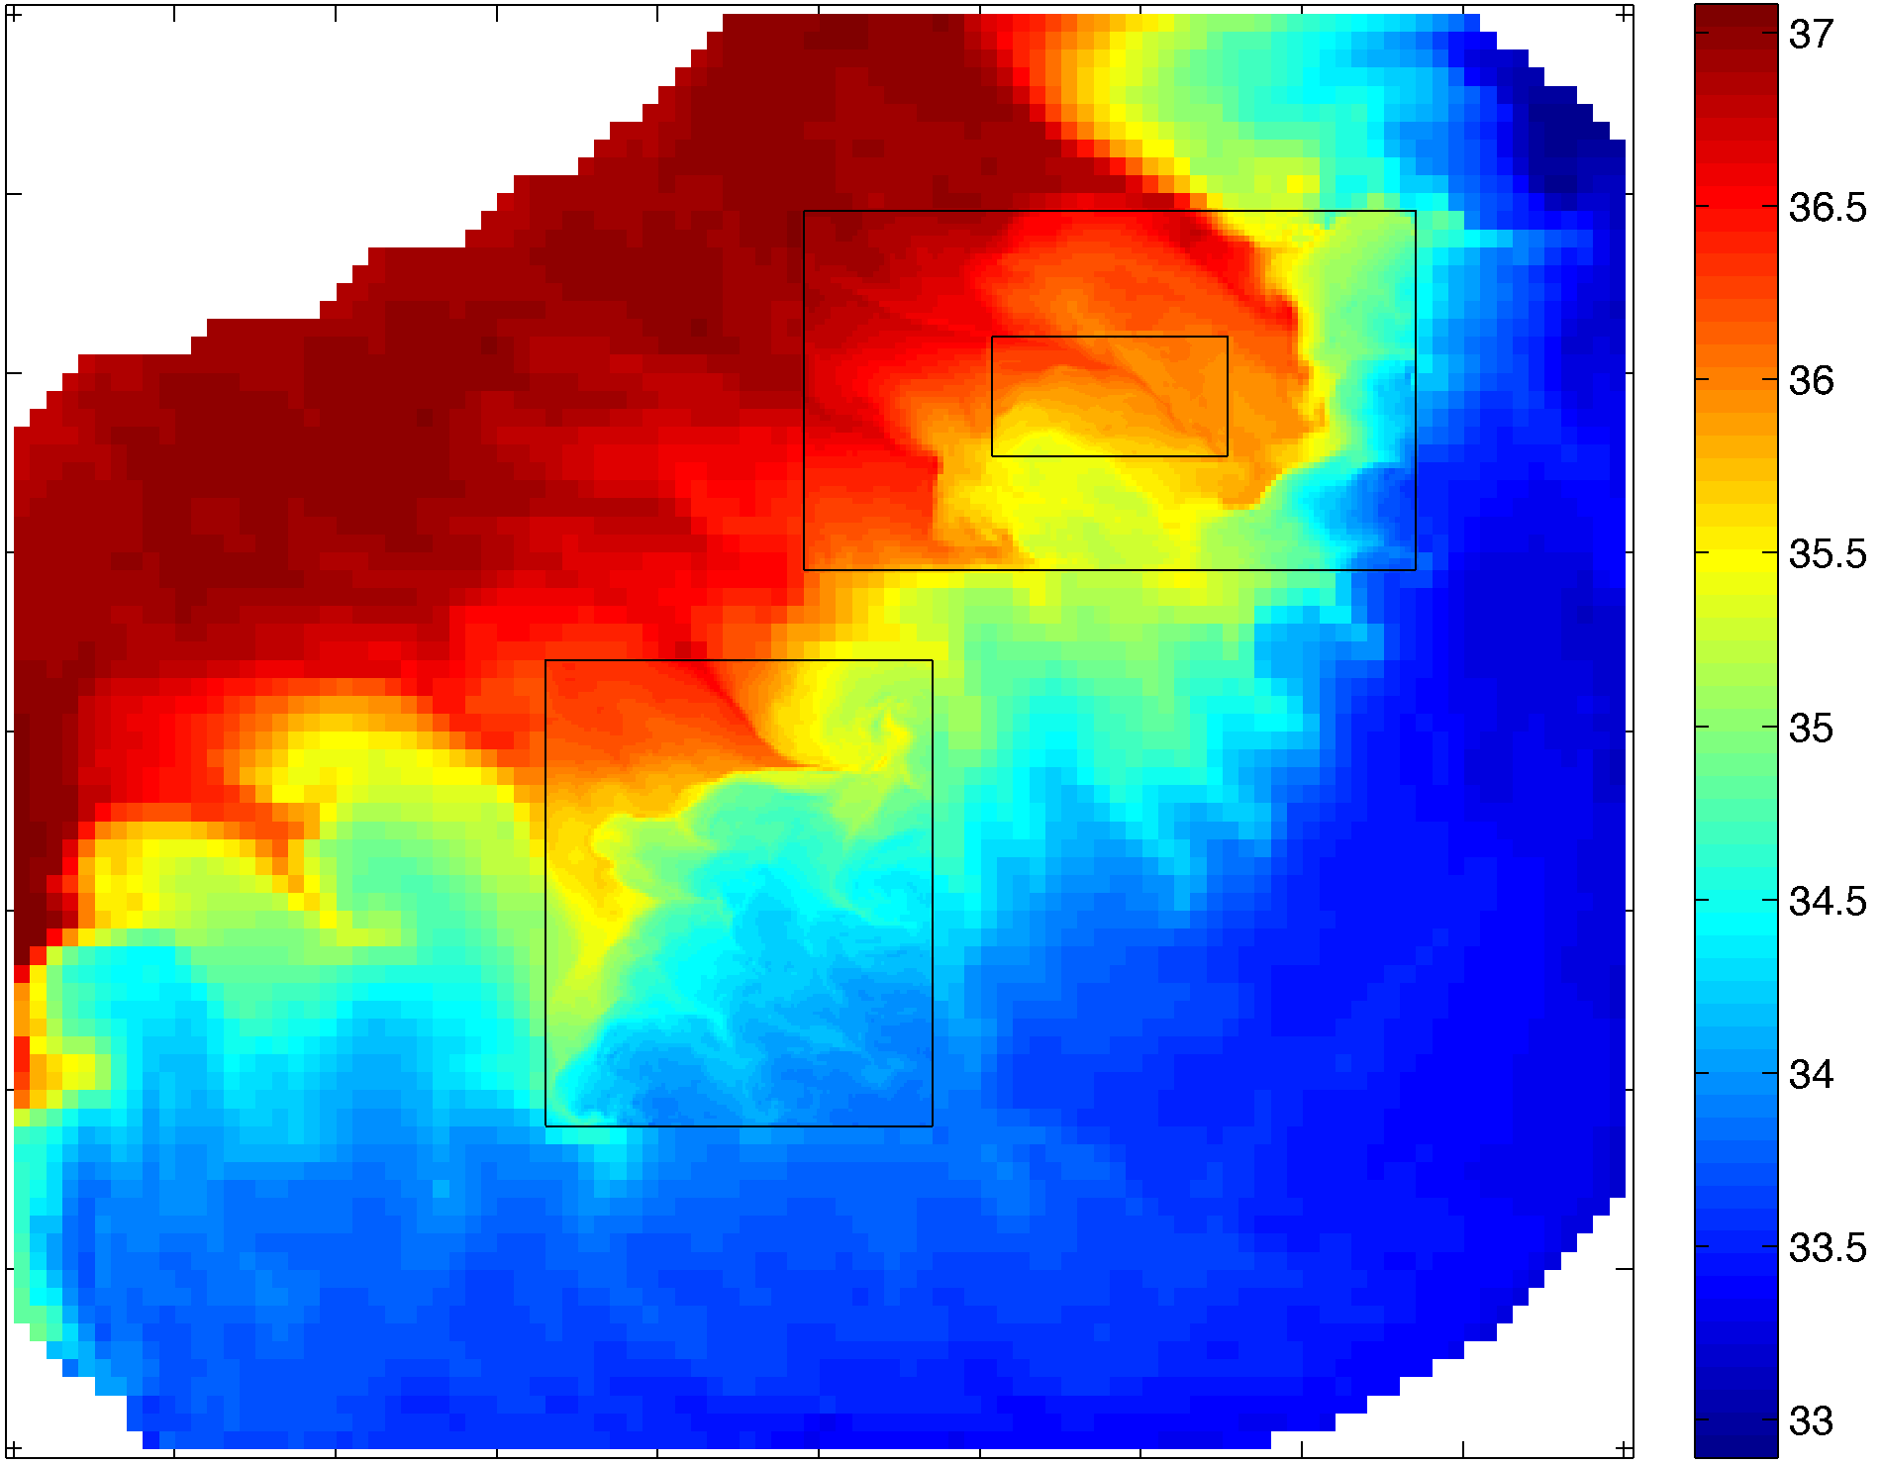
Lake Jersey: Case ACDE
One-Way
Two-Way
Temperature
Temperature
Salinity
Salinity

Slide 50
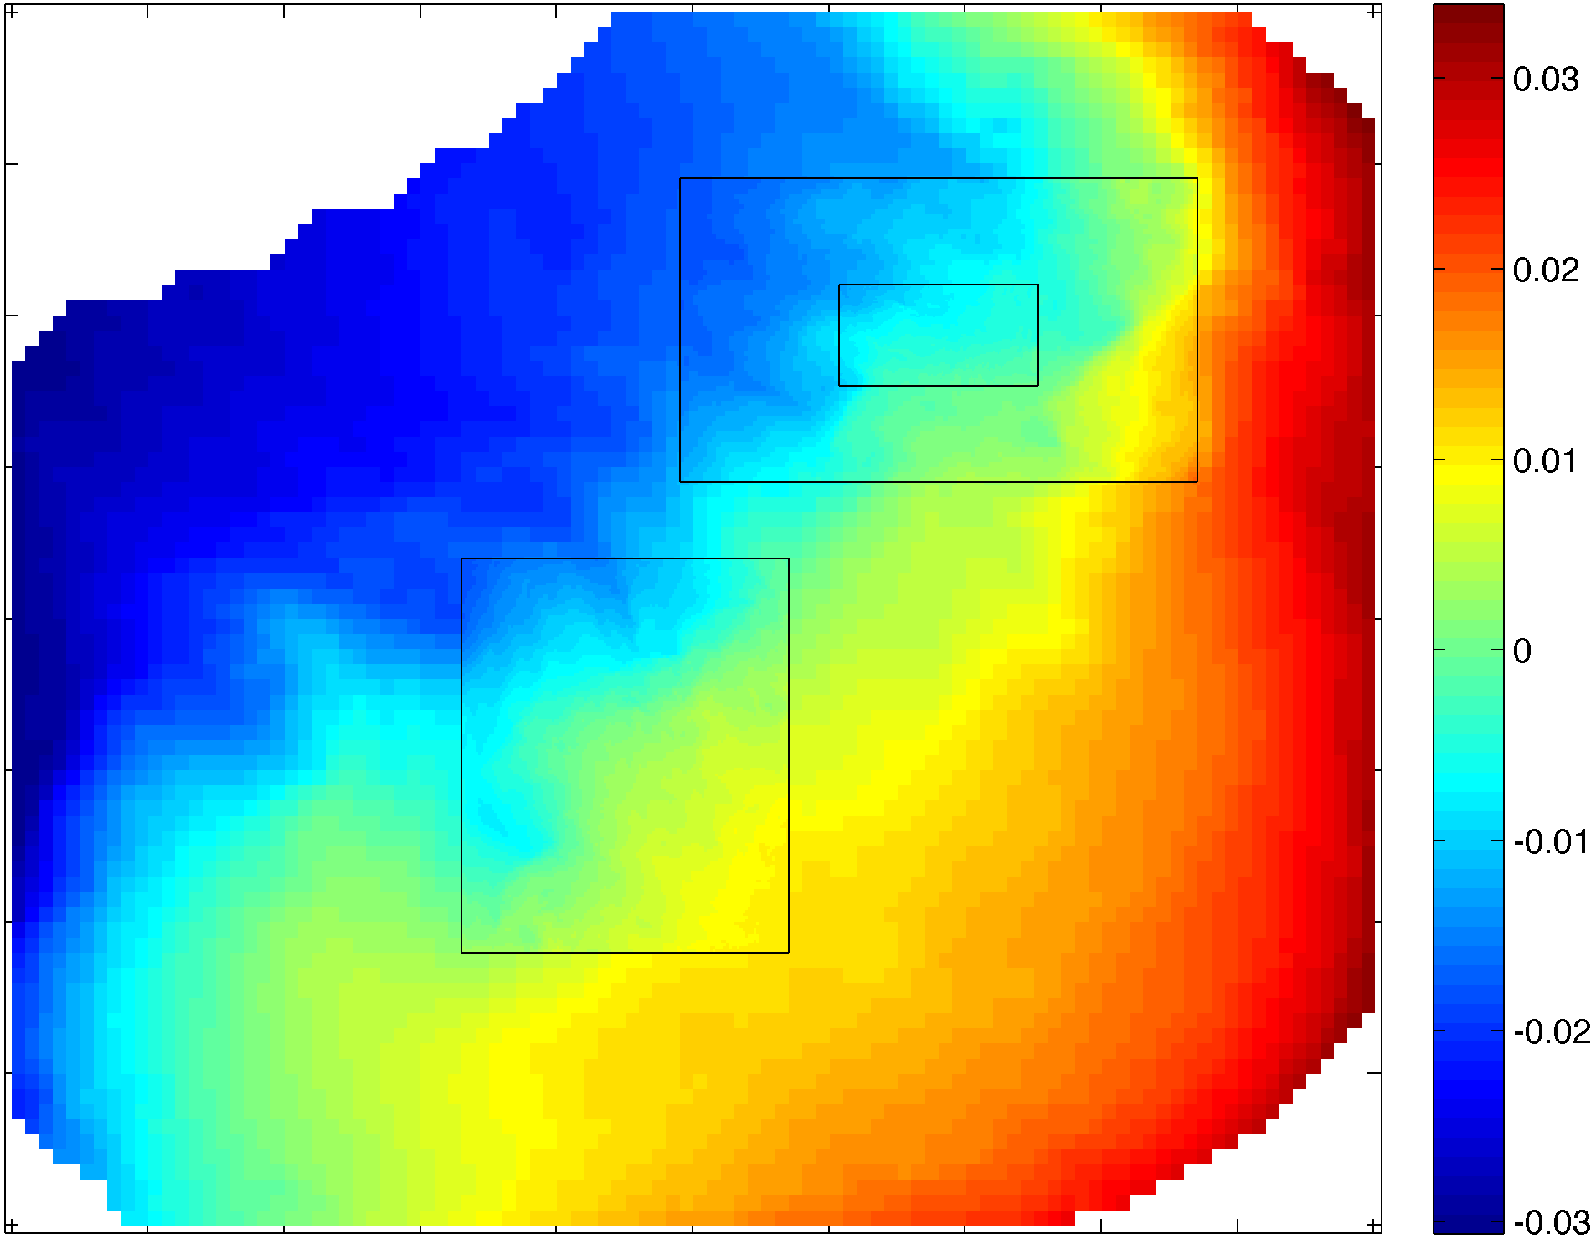

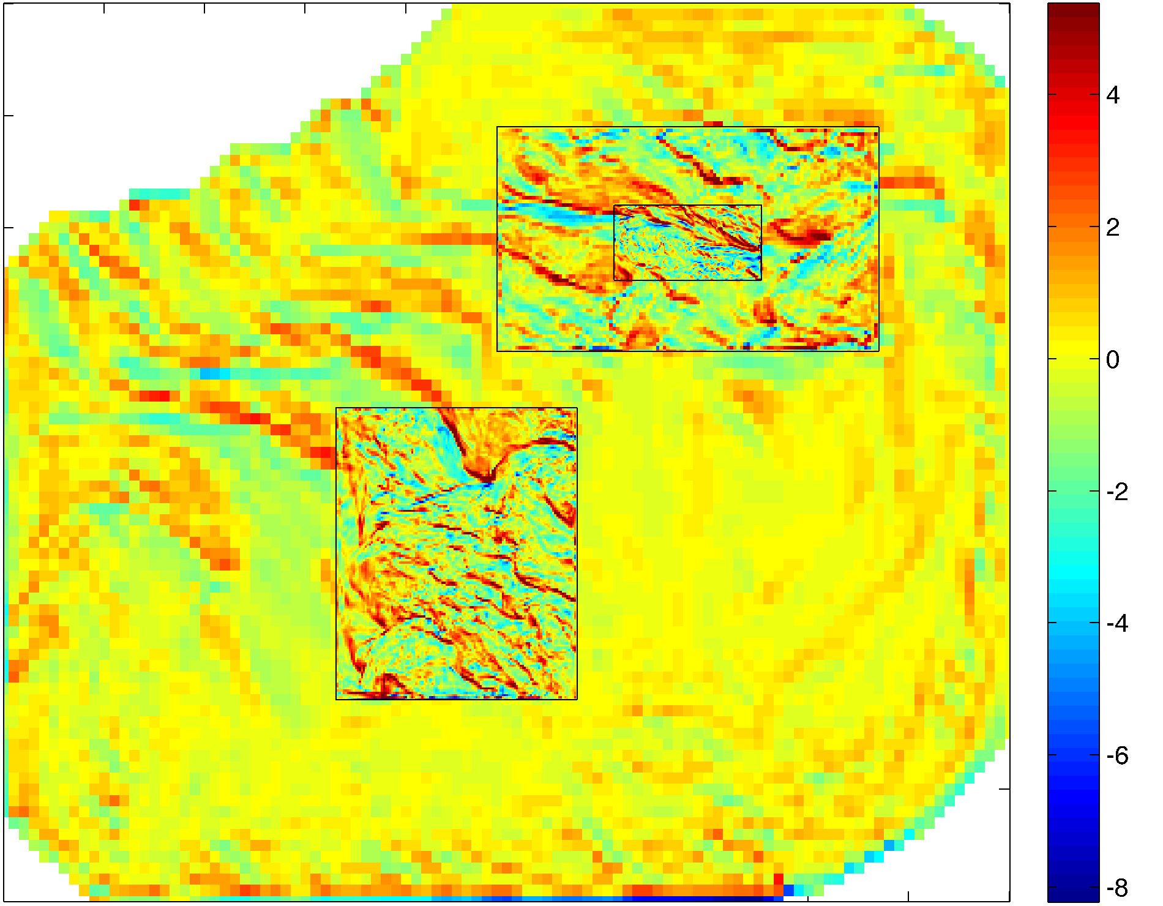
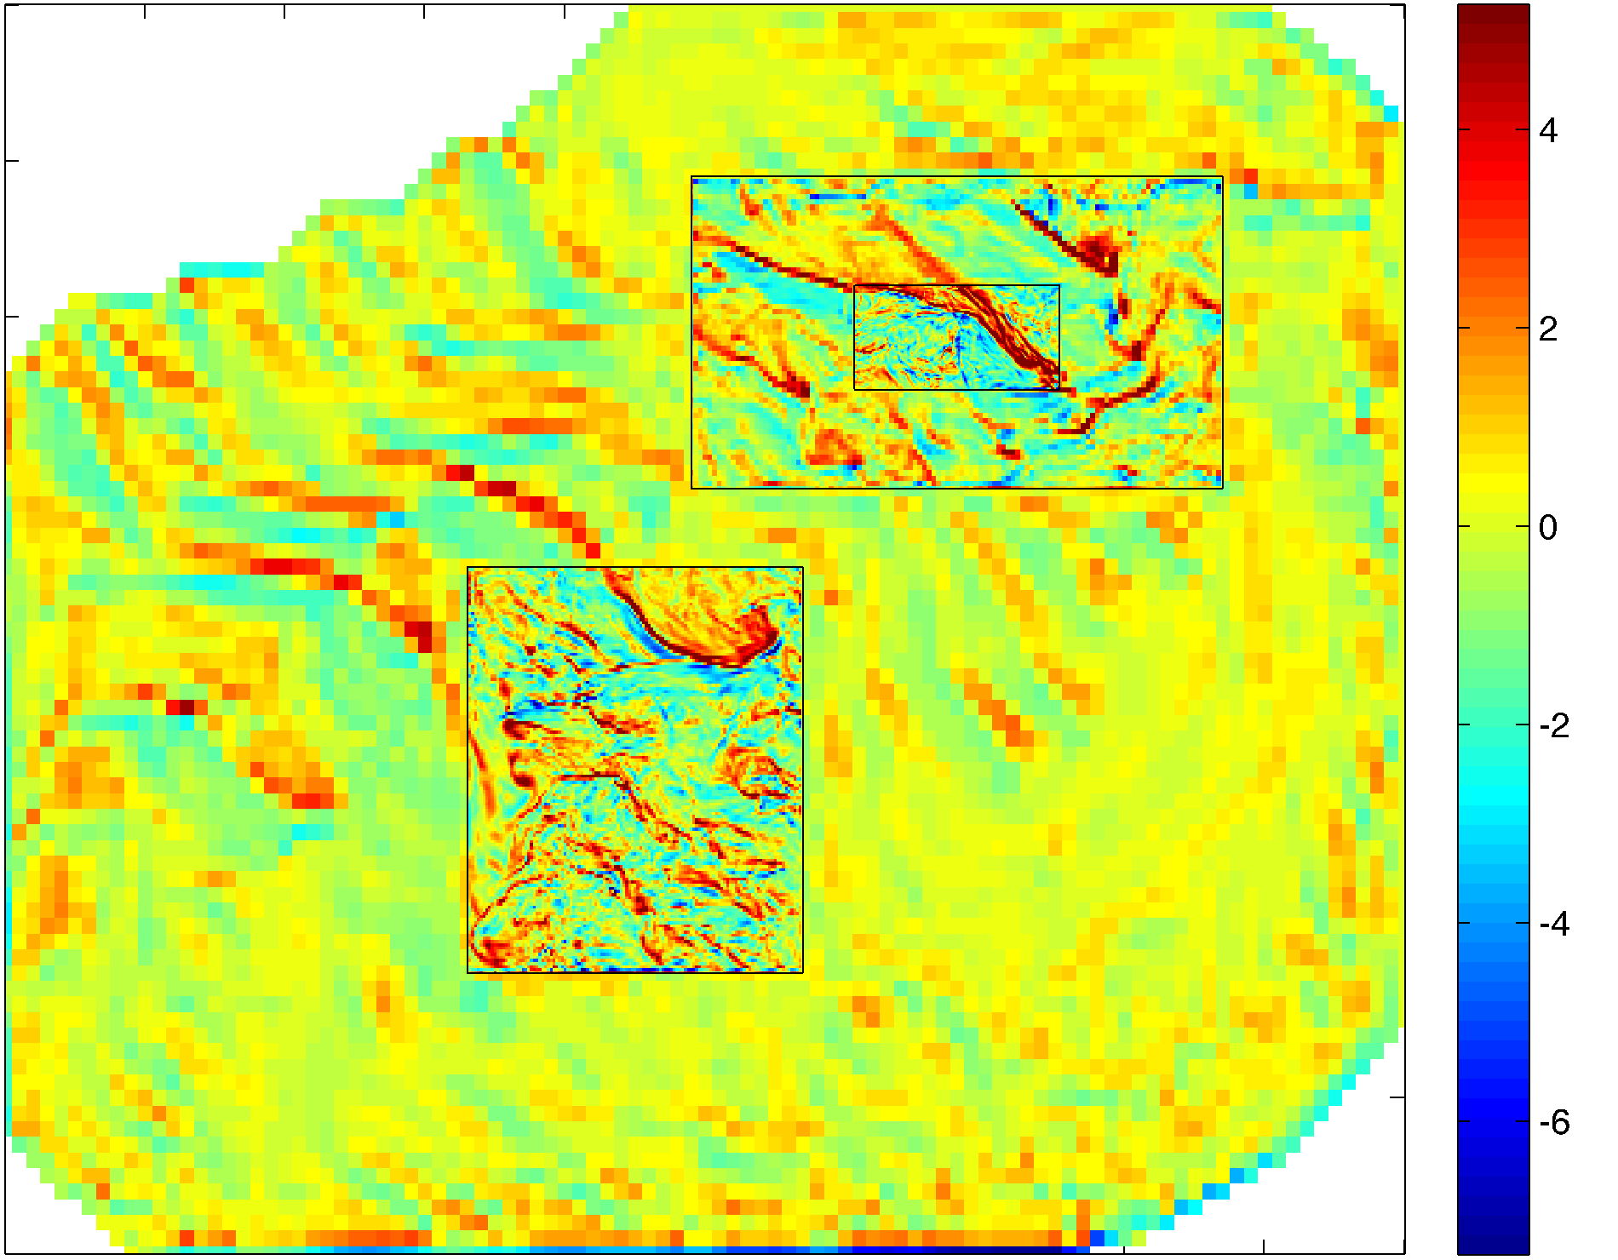
Lake Jersey: Case ACDE
One-Way
Two-Way
Free-Surface
Free-Surface
2D Relative Vorticity
X 10⁻⁴
2D Relative Vorticity
X 10⁻⁴

Slide 51
Mid-Atlantic Bight Grids
DOPPIO: 242x106 (~7 km)
USECOS: Chesapeake-Delaware grid (1:5 ratio): 202x167 (~1.4 km)
PIONEER (Hudson Canyon) grid (1:3 ratio): 204x216 (~2.3 km)
ARRAY (Pioneer Data Array) grid (1:3; 1:9 ratio): 210x195 (~1 km)

Slide 52
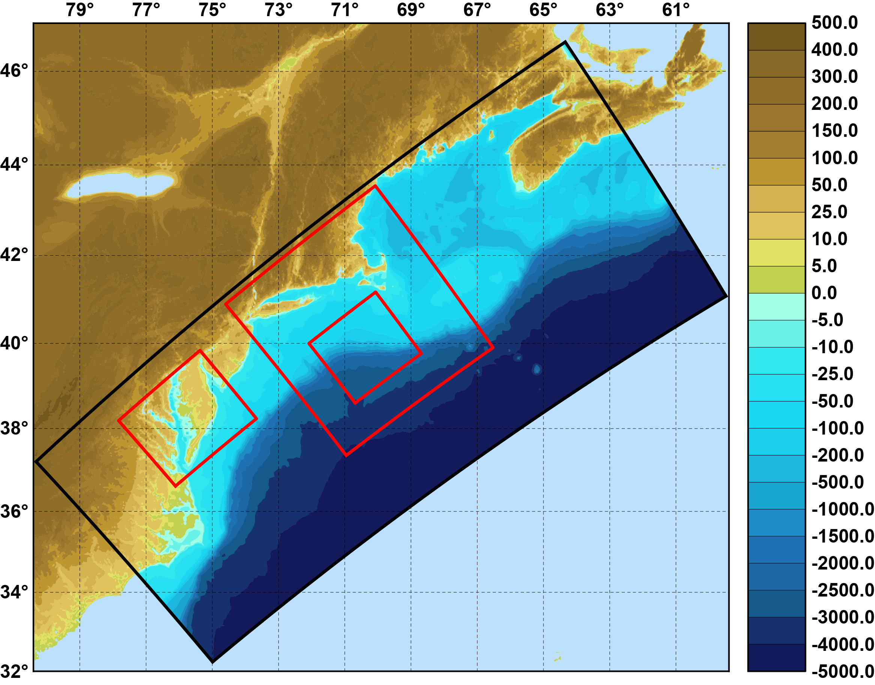
DOPPIO Refinement Grids
Bathymetry (m)

Slide 53
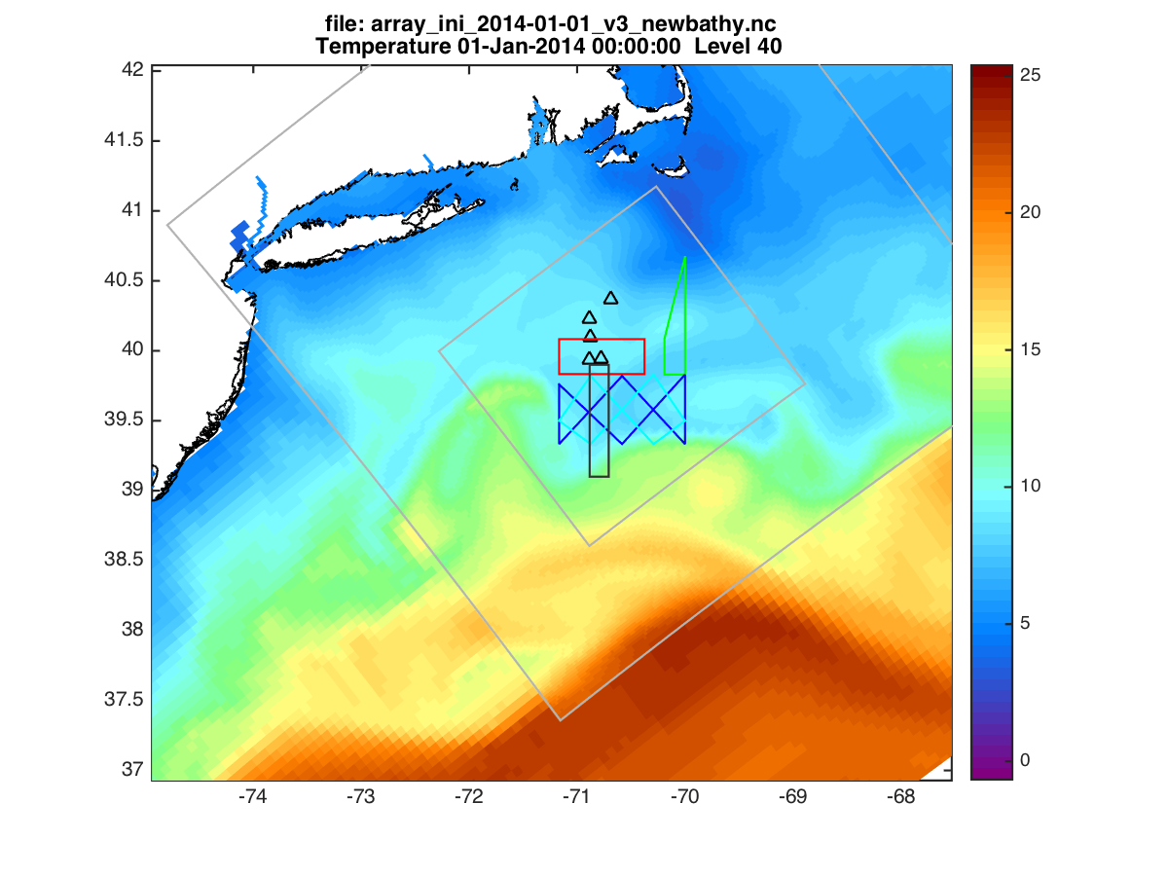
PIONEER Data Array Observations
Initial Surface Temperature (01-Jan-2014)

Slide 54
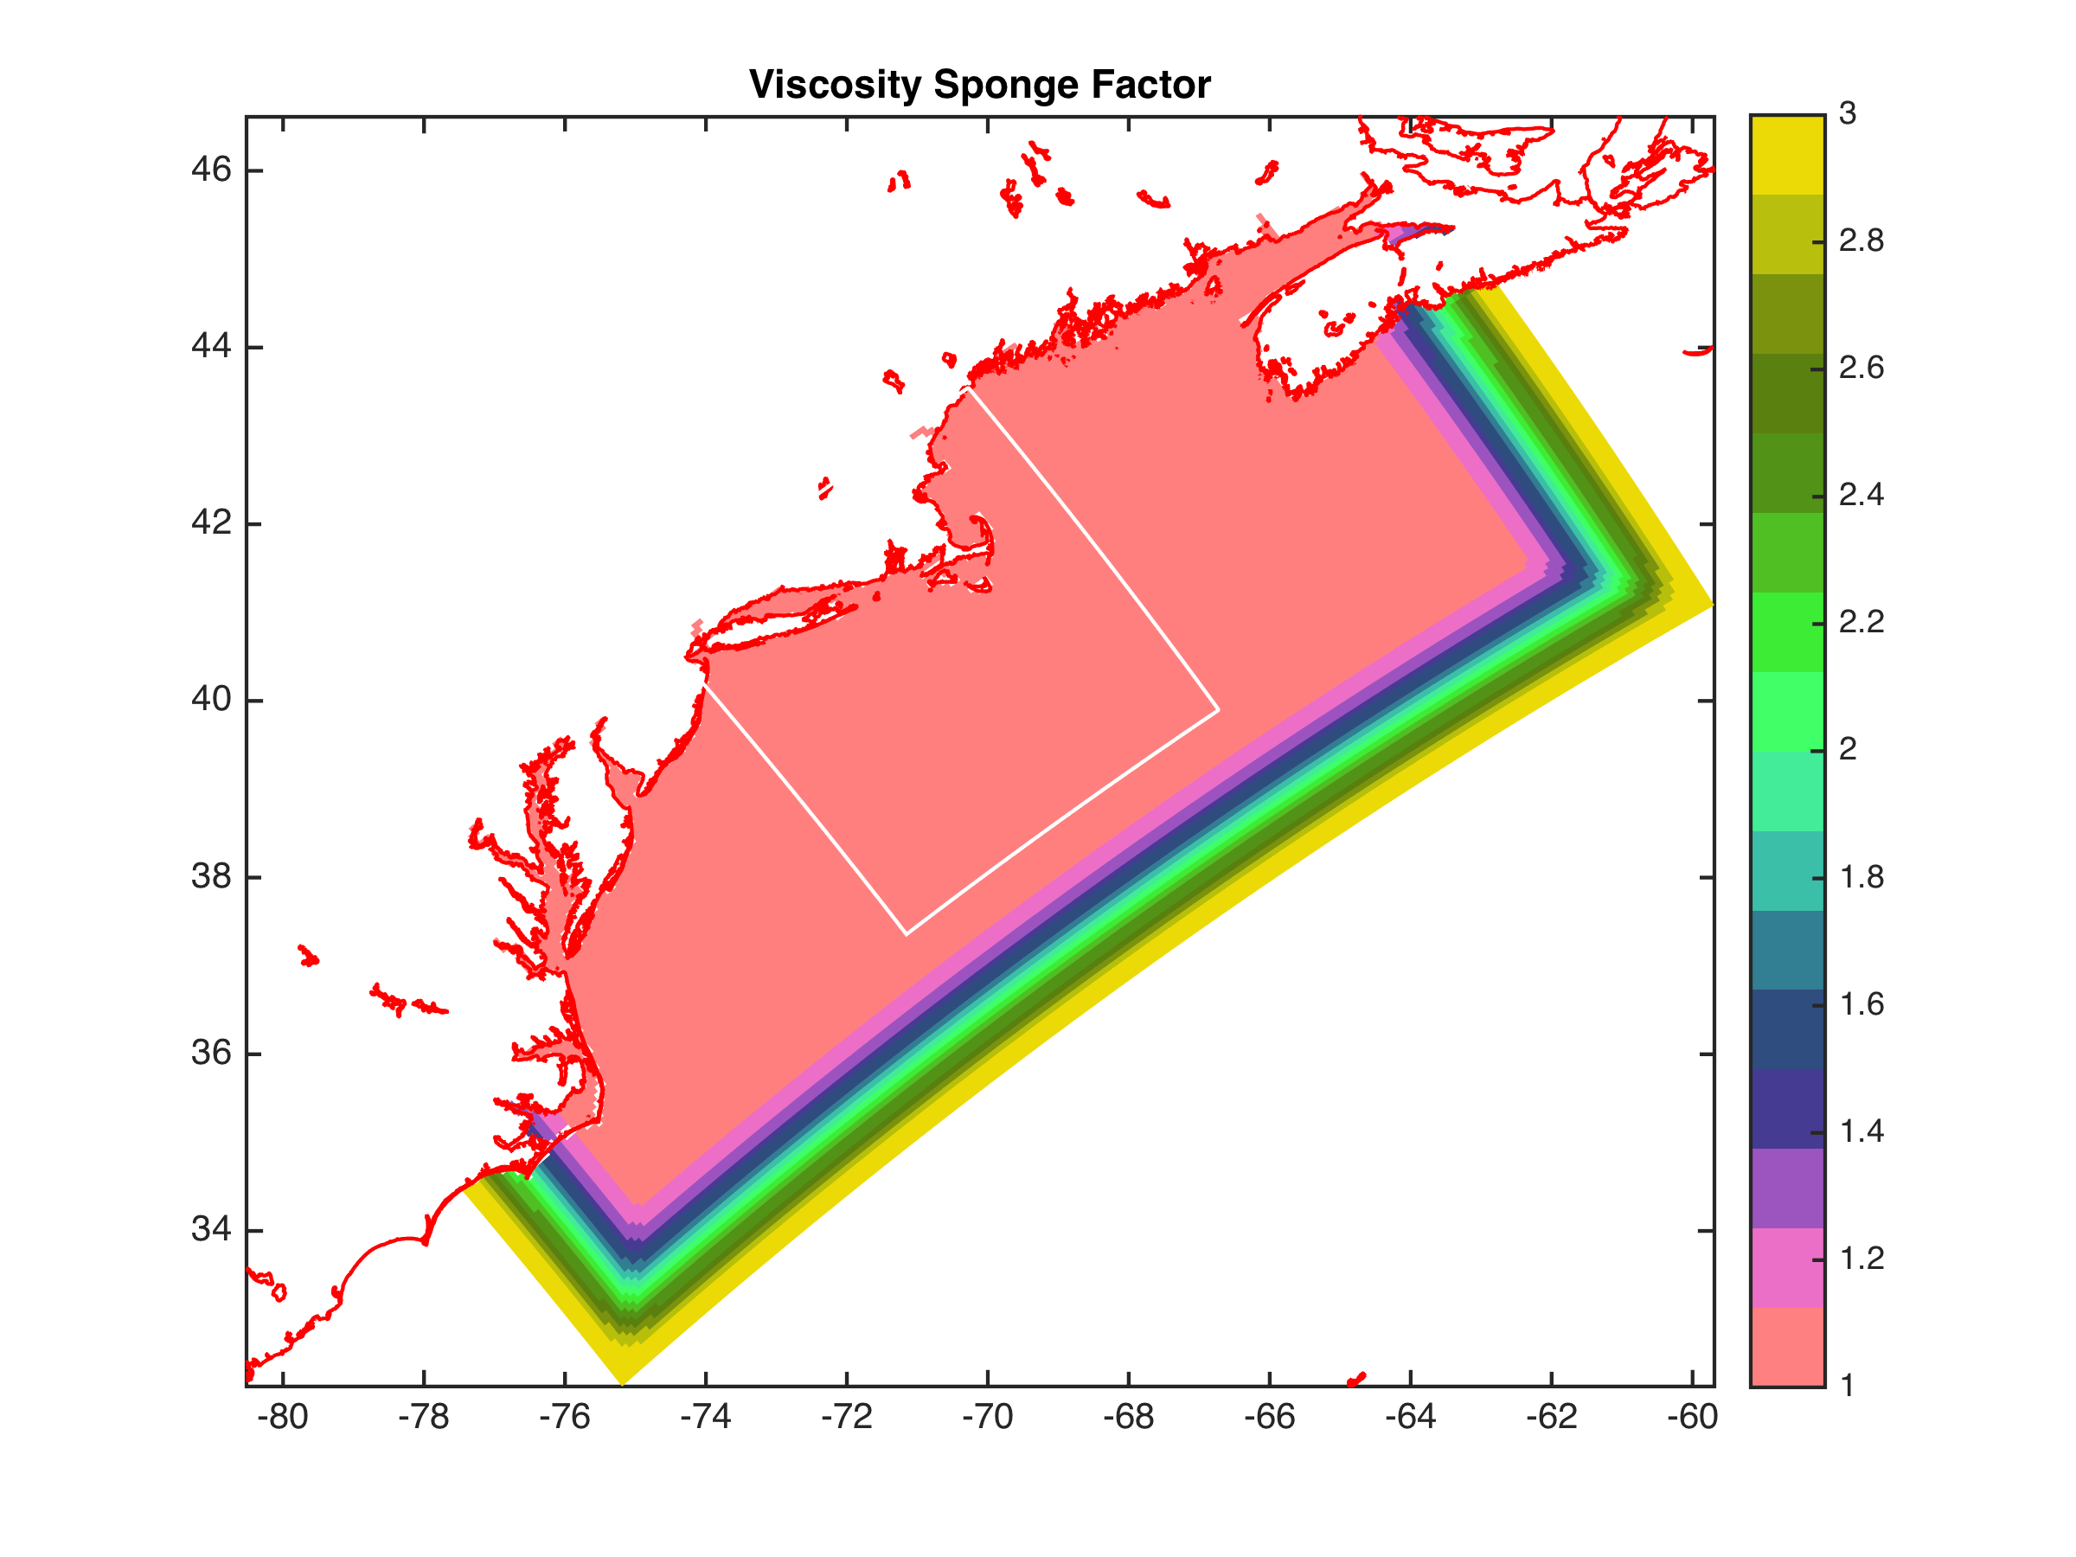

DOPPIO Sponge Areas
Same Reynolds Number for all Grids (U Δx/ν):
VISC2 == 90.0d0 30.0d0 10.0d0 (m2/s)
TNU2 == 2*27.0d0 2*9.0d0 2*3.0d0 (m2/s)
Time stepping (Δt):
DT == 180.0d0 90.0d0 45.0d0 (3/1.5/0.75 minute step)

Slide 55
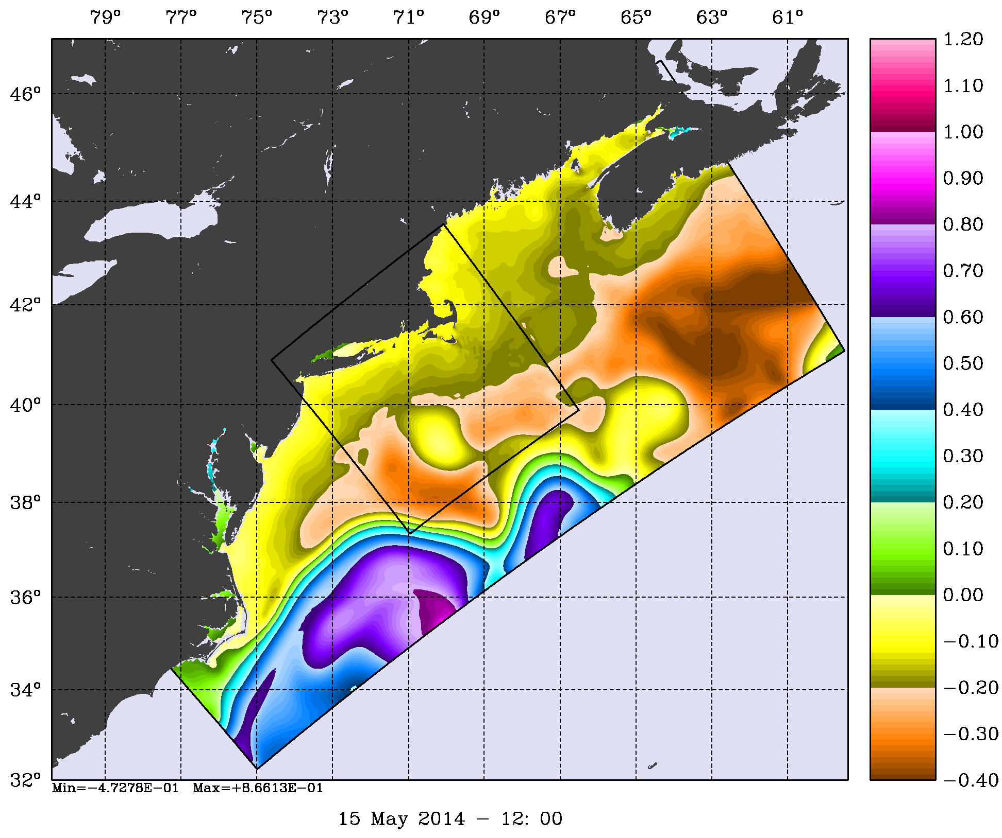
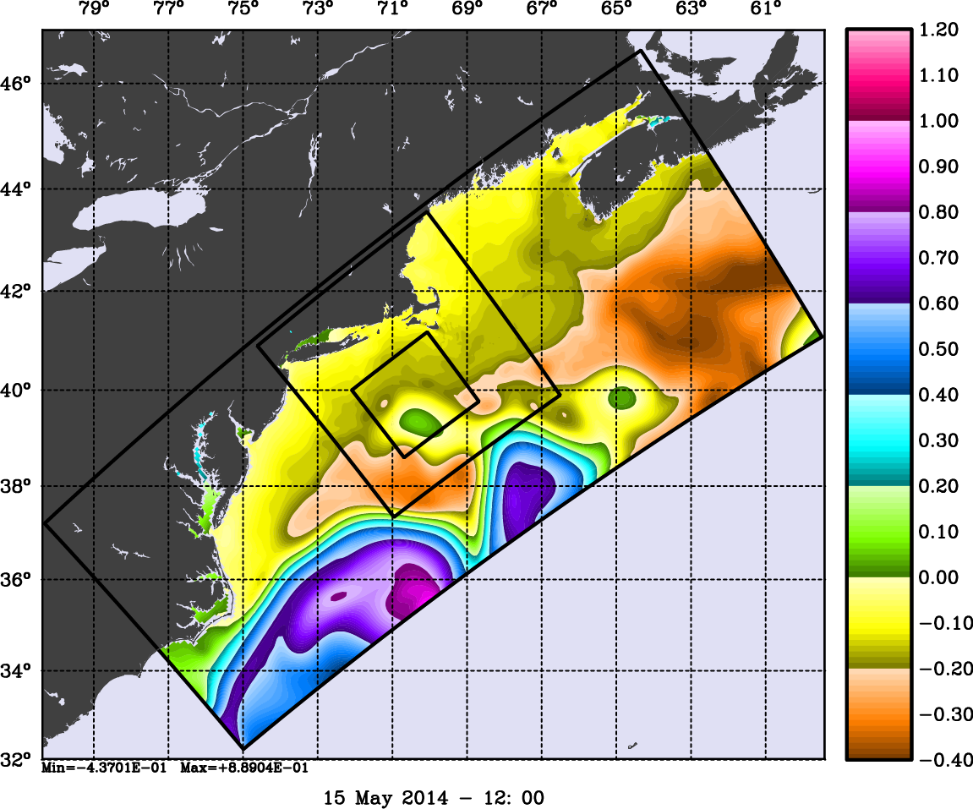
Two-Way DOPPIO-PIONEER-ARRAY
(1:3 Refinement)
Free-Surface (m)

Slide 56
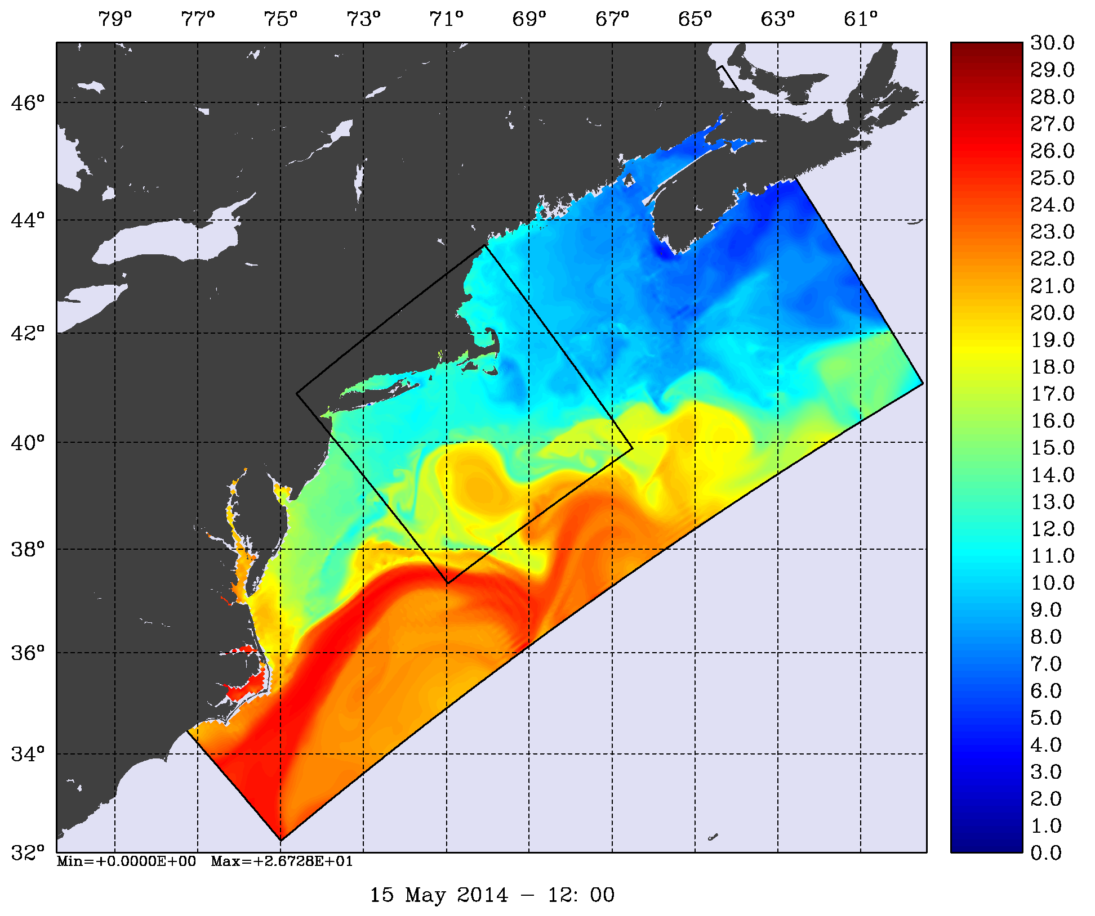
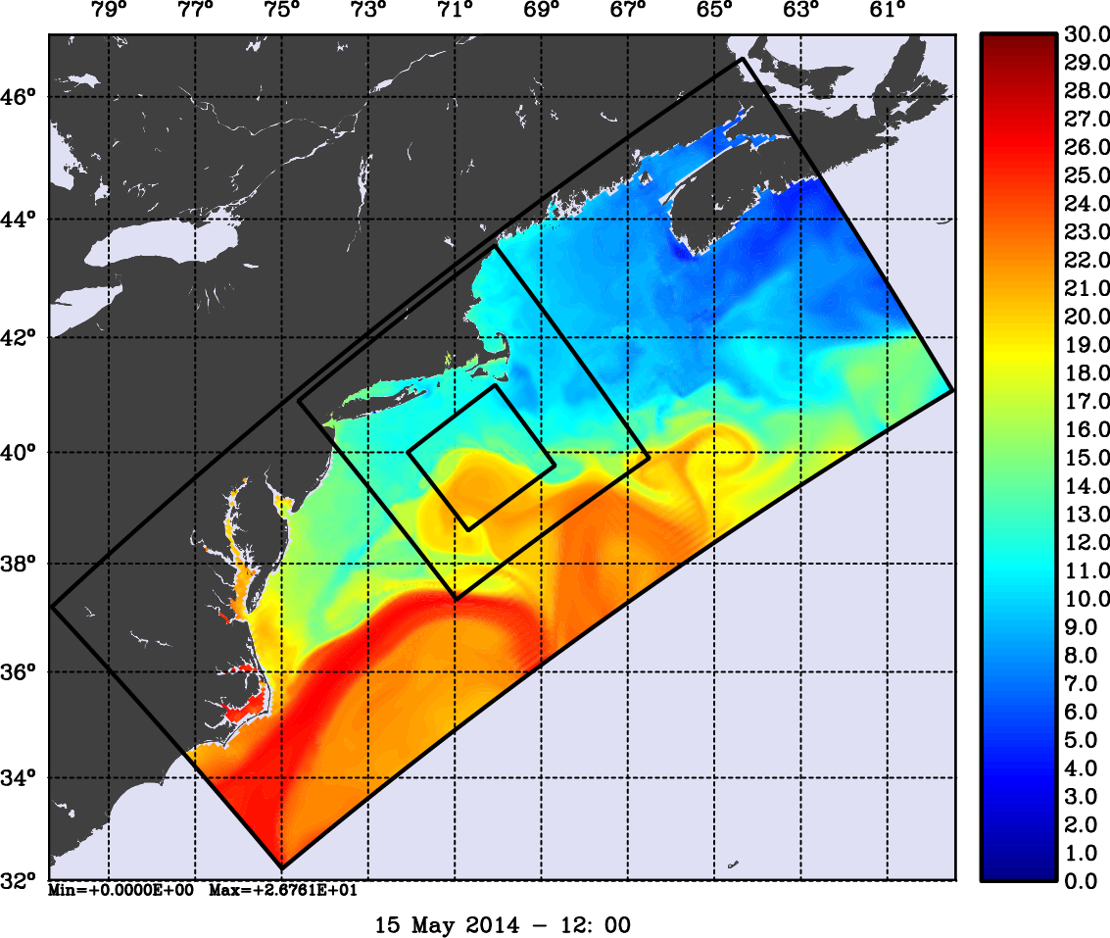
Two-Way DOPPIO-PIONEER-ARRAY
(1:3 Refinement)
Surface Temperature (Celsius)

Slide 57
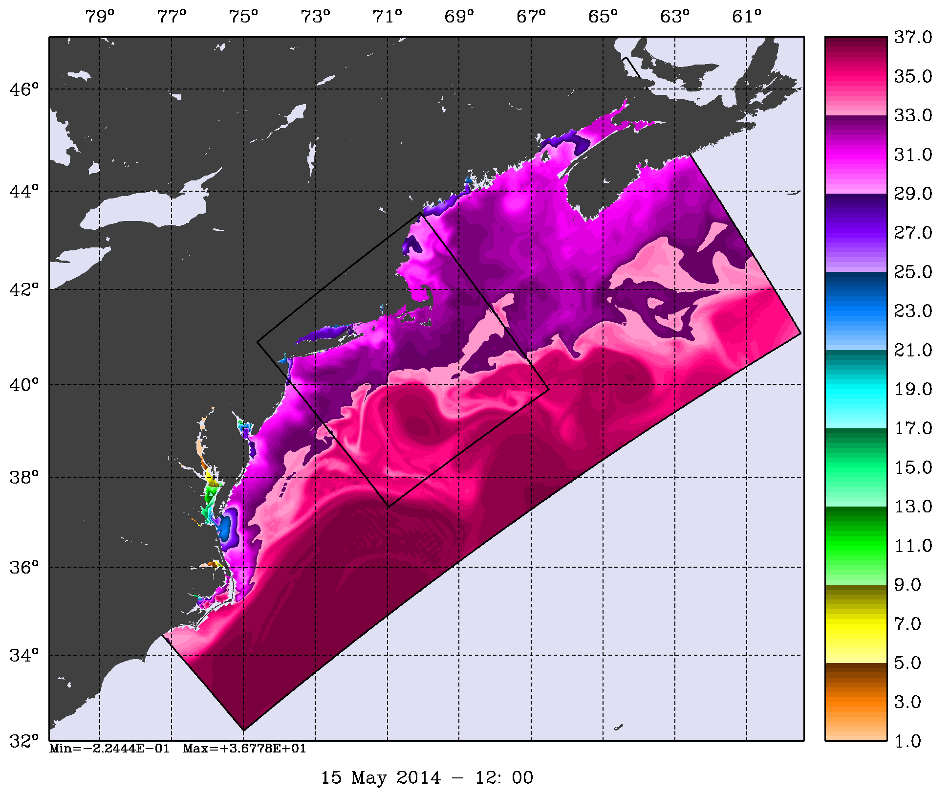
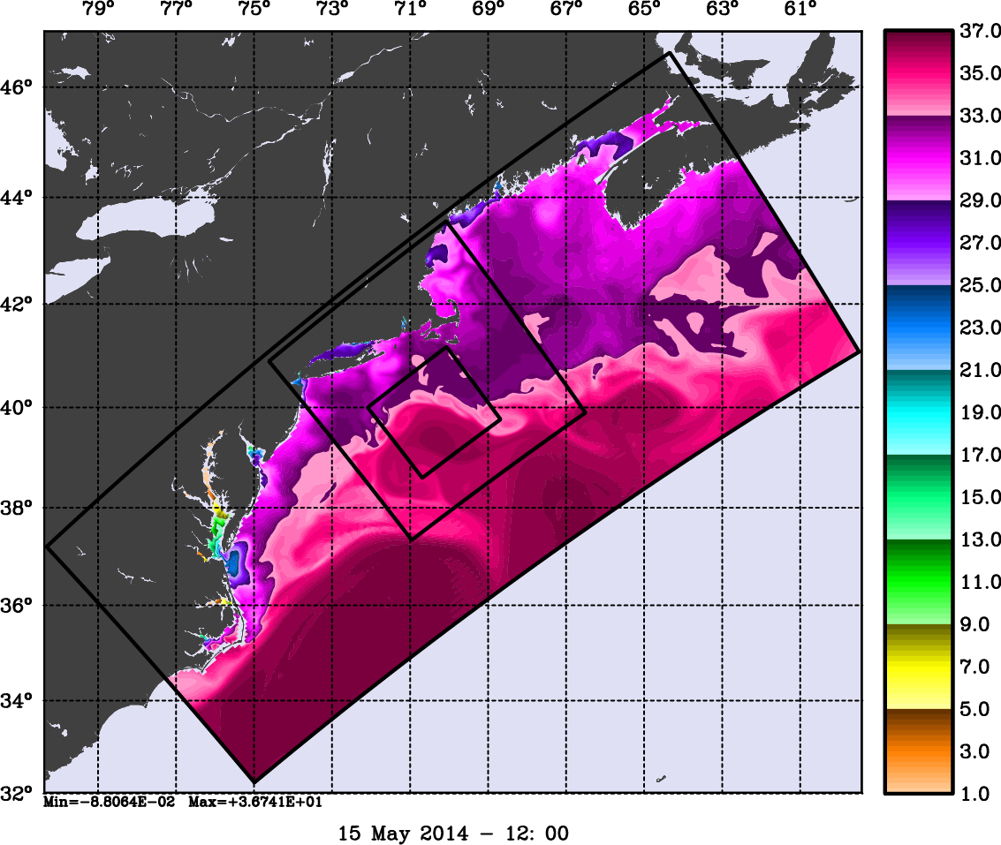
Two-Way DOPPIO-PIONEER-ARRAY
(1:3 Refinement)
Surface Salinity

Slide 58


Two-Way DOPPIO-PIONEER-ARRAY
(1:3 Refinement)
Surface Relative Vorticity (1/s)

Slide 59


Two-Way DOPPIO-USECOS
Chesapeake and Delaware Estuaries
(1:5 Refinement)
Free-Surface (m)
John Wilkin

Slide 60


Two-Way DOPPIO-USECOS
Chesapeake and Delaware Estuaries
(1:5 Refinement)
Surface Temperature (Celsius)
John Wilkin

Slide 61


Two-Way DOPPIO-USECOS
Chesapeake and Delaware Estuaries
(1:5 Refinement)
Surface Salinity
John Wilkin

Slide 62


Two-Way DOPPIO-USECOS
Chesapeake and Delaware Estuaries
(1:5 Refinement)
Surface Relative Vorticity (1/s)
John Wilkin

Slide 63

https://www.myroms.org/wiki/index.php/Matlab_Scripts

Slide 64

Heterogeneous Model Nesting
(One-Way Open boundary Conditions)

Slide 65
Nesting Remarks
ROMS nesting capabilities are unique and allow complex estuary and coastal configurations with unlimited number of composite and refined grids
Coincident composite and mosaic grids produce identical solutions when compared to one large continuous grid
Nowadays, both one-way and two-way nesting work well
Placement of nested grids is application dependent and subject to geometrical and dynamical constrains
The two-way exchange of information fine-to-coarse in grid refinement applications is expensive. We are exploring strategies to minimize computational cost.

Slide 66
Latest Releases
Replaced the SPLINES option: www.myroms.org/projects/src/ticket/681
Corrected tracer horizontal diffusion algorithms: www.myroms.org/projects/src/ticket/689
Added Red Tide Ecosystem Model (Gulf of Maine): www.myroms.org/projects/src/ticket/694
Added Ensemble Kalman filter (EnKF) using the Data Assimilation Research Testbed (DART) developed at NCAR:www.myroms.org/projects/src/ticket/697
Added Staggered Grid (SGRID) data model conventions: www.myroms.org/projects/src/ticket/701
Major Update to all 4D-Var algorithms: www.myroms.org/projects/src/ticket/702
Added Quicksave output NetCDF file: www.myroms.org/projects/src/ticket/704

Slide 67
Upcoming
Efficient two-way MPI-communications for the fine-to-coarse nesting step
Heterogeneous models nesting: one-way open boundary conditions (NetCDF files or ESMF/MCT coupling)
Multiple model coupling with ESMF (Earth System Modeling Framework, Version 7) including the NUOPC (National Unified Operational Prediction Capability) layer
Fully coupled ROMS and COAMPS dynamics via ESMF and NUOPC
Fully coupled ROMS and COAMPS data assimilation (EnKF and 4D-Var)
4D-Var data assimilation within nested grids
Overhaul of ROMS plotting package (NCAR GKS library) to include nesting grids
Release of ROMS 4.0

Slide 68
SPLINES Option
The SPLINES option was removed and replaced with following three options for more flexibility:
SPLINES_VDIFF: conservative, parabolic splines reconstruction for vertical diffusion on active and passive tracers (step3d_t.f).
SPLINES_VVISC: conservative, parabolic splines reconstruction for vertical diffusion on active and passive tracers (step3d_uv.f).
RI_SPLINES: conservative, parabolic splines reconstruction for vertical velocity shear used in the Richardson Number (gls_corstep.F and my25_corstep.F) and Bulk Richardson Number (lmd_bkpp.F, lmd_skpp.F, and lmd_vmis.F).
It was been reported that the SPLINES option violates the stress condition:
sustr = Akv * du/dz
svstr = Akv * dv/dz
Check www.myroms.org/projects/src/ticket/681

Slide 69




Realistic Nesting Configuration: US East Coast
(Complex Estuary Refinement-Composite Sub-Class)

Slide 70
Realistic Nesting Configuration: US East Coast
(Complex Estuary Refinement-Composite Sub-Class)
The coarser grid, ESPRESSO (130 x 82), has an average resolution of dx=7.5km, dy=5.8km. The nested grids (ρ-points mesh) are color coded for convenience to show the strategy used to better resolve the Delaware and Chesapeake Estuary Systems. The red and green are refinement grids whereas blue and magenta are composite grids. The refinement ratio is 1:7. An intermediate 1:7 refinement grid is created using Matlab script coarse2fine.m that included both the Delaware and Chesapeake Estuary Systems. Then, the Matlab script grid_extract.m is used to extract the Delaware Bay refinement grid (58 x 142) and Delaware River composite grid (42 x 55). Similarly, grid_extract.m is used to extract the Chesapeake Bay outer refinement grid (135 x 142) and Chesapeake Bay inner composite grid (233 x 212).

Slide 71

Contact Points: Quadratic Interpolation
R⁻ = 0.5 * p * (p-1) + α
Rº = (1-p²) - 2α
R⁺ = 0.5 * p * (p+1) + α
S⁻ = 0.5 * q * (q-1) + α
Sº = (1-q²) - 2α
S⁺ = 0.5 * q * (q+1) + α
The finer grid variable, F, is interpolated from the coarser grid variable, C, as:
F(Irg,Jrg) = S⁻ * [R⁻ * C(Idg-1,Jdg-1) + Rº * C(Idg,Jdg-1) + R⁺ * C(Idg+1,Jdg-1)]+
Sº * [R⁻ * C(Idg-1,Jdg ) + Rº * C(Idg,Jdg ) + R⁺ * C(Idg+1,Jdg )]+
S⁺ * [R⁻ * C(Idg-1,Jdg+1) + Rº * C(Idg,Jdg+1) + R⁺ * C(Idg+1,Jdg+1)]

Slide 72


Contact Points: Quadratic Interpolation
For conservation and reversibility, we need:
where r is the grid refinement factor. The reversibility condition is:
Then, the quadratic interpolation weights are:
Qweight (1, :) = R⁻ * S⁻
Qweight (2, :) = Rº * S⁻
Qweight (3, :) = R⁺ * S⁻
Qweight (4, :) = R⁻ * Sº
Qweight (5, :) = Rº * Sº
Qweight (6, :) = R⁺ * Sº
Qweight (7, :) = R⁻ * S⁺
Qweight (8, :) = Rº * S⁺
Qweight (9, :) = R⁺ * S⁺
Σ Qweight(1:9,:) = 1
Clark and Farley, 1984

