Slide 1
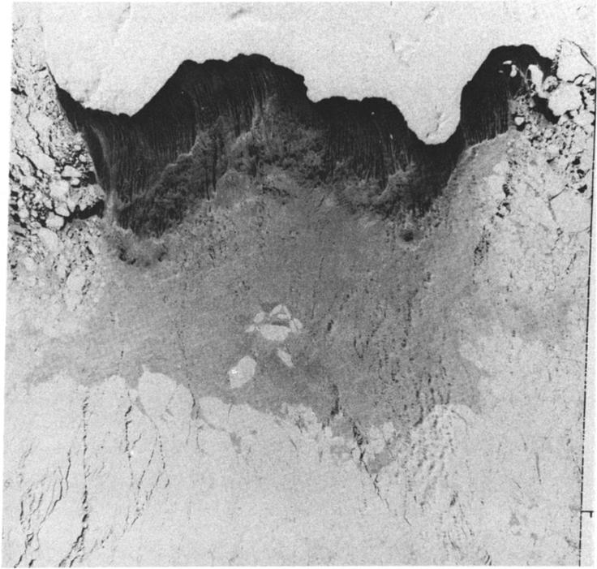
Dispersal of polynya dense water
on a sloping shelf
Weifeng (Gordon) Zhang
Collaborator: Claudia Cenedese
Woods Hole Oceanographic Institution
Woods Hole, Massachusetts, USA
ROMS Asia-Pacific Workshop
17-20 Oct 2016
(background image from Martin and Kauffman 1981)

Slide 2
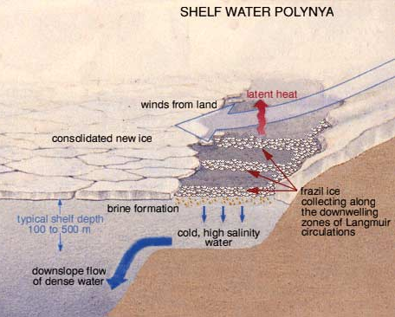
Physical processes in coastal polynyas
(Morales Maqueda et al, Review of Geophysics, 2004)

Slide 3
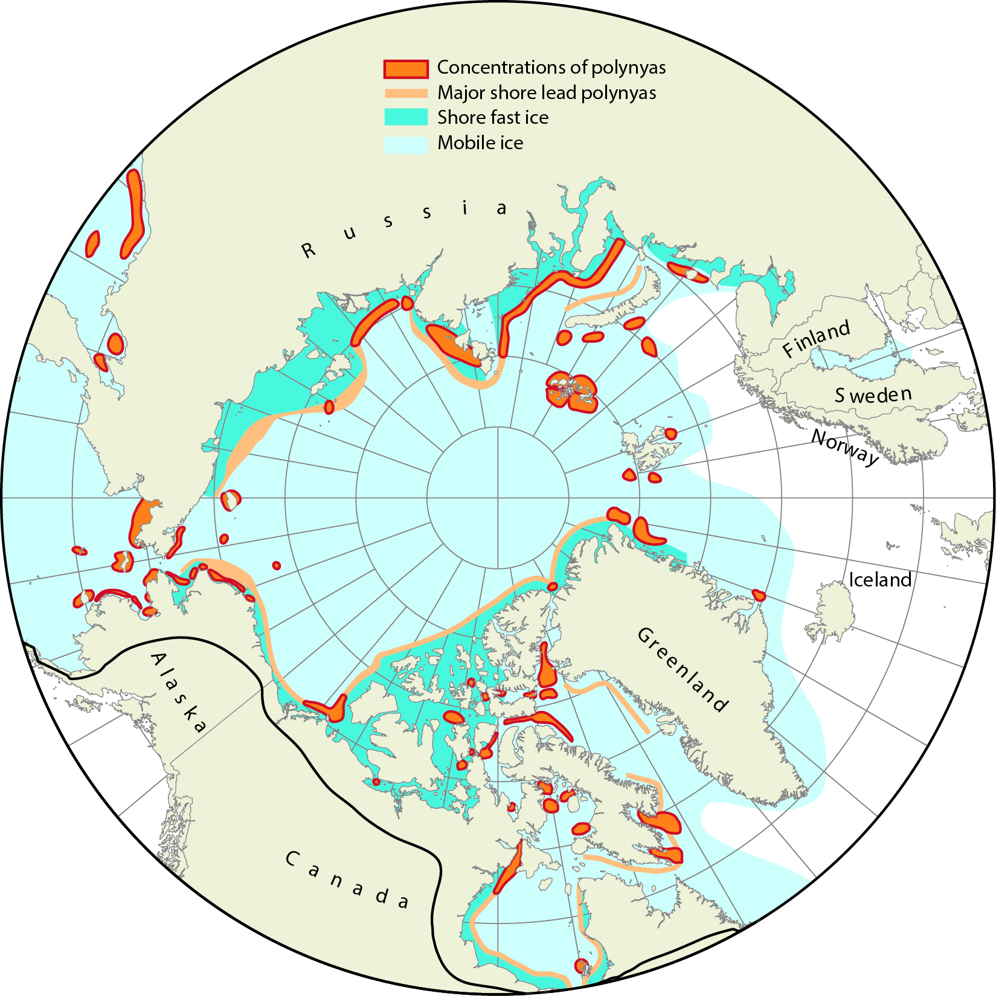
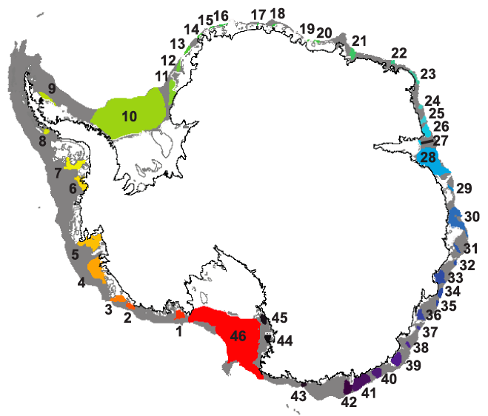
Coastal polynyas at both poles
(Barber and Masson, 2007)
(Arrigo et al, JGR, 2015)

Slide 4
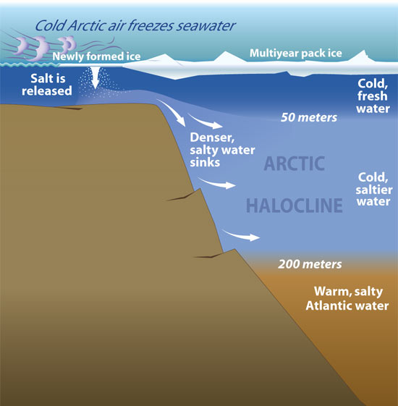
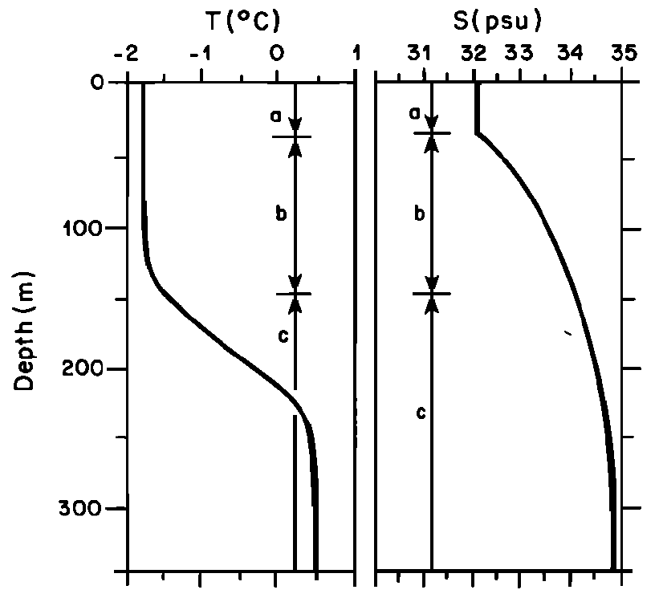
Why do we care about the dense water?
In the Arctic Ocean:
(http://www.whoi.edu/oceanus/viewArticle.do?id=9206)
(Cavalieri and Martin, 1994)
Major sources of the Arctic halocline water (e.g., Cavalieri and Martin, 1994)

Slide 5
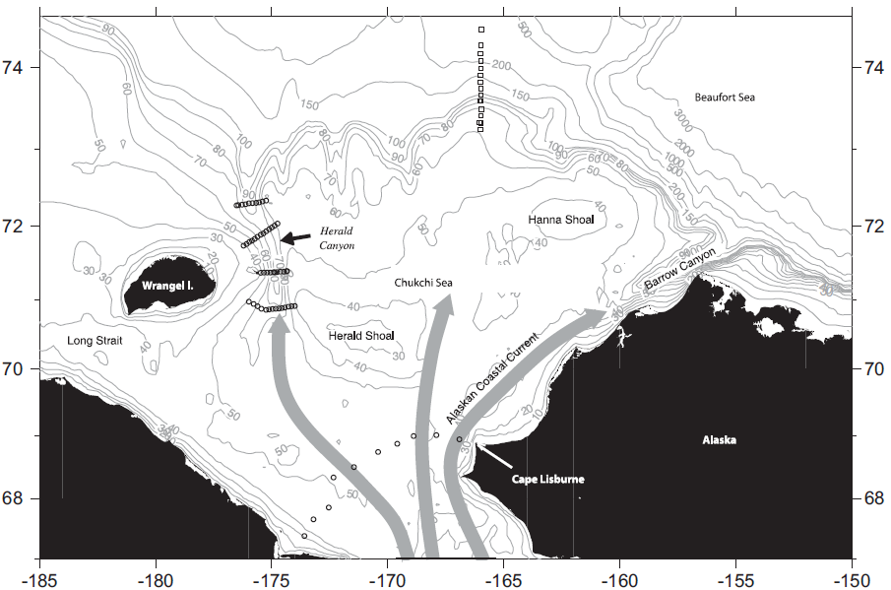
Transportation of the dense waters
(Pickart et al, 2010)
Issues:
How are the polynya dense waters transported across the continental shelf and how much?

Slide 6
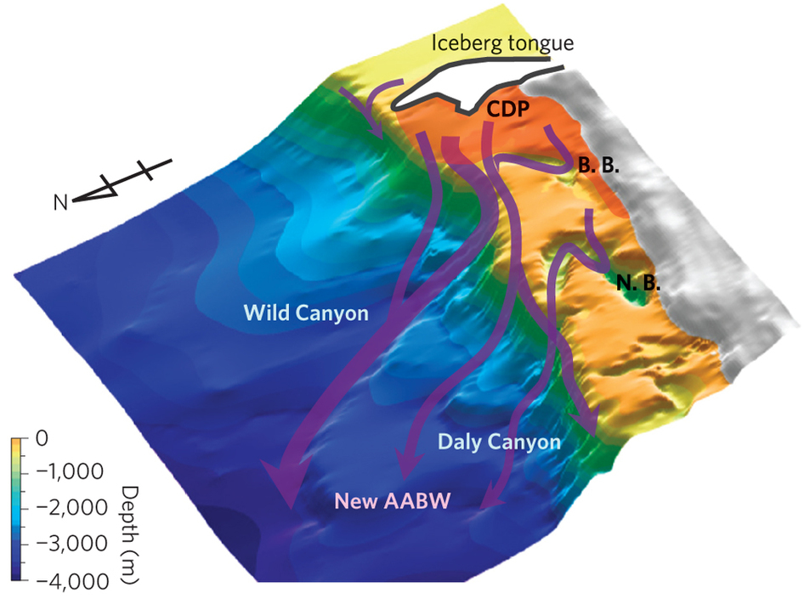
Why do we care about the dense water?
In the Antarctic region:
Cape Darnley Polynya
(Arrigo et al, JGR, 2015)
Primary sources of Antarctic Bottom Water
(Ohshima et al, Nature Geo, 2013)

Slide 7
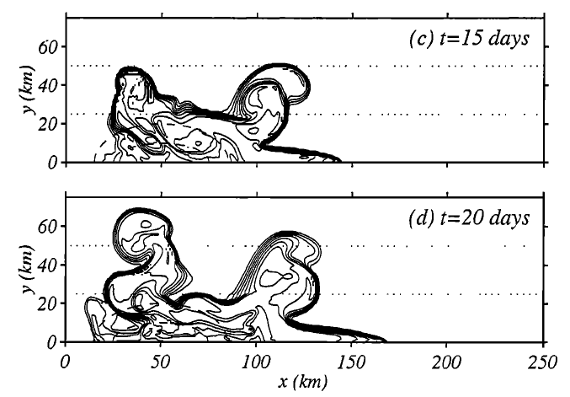
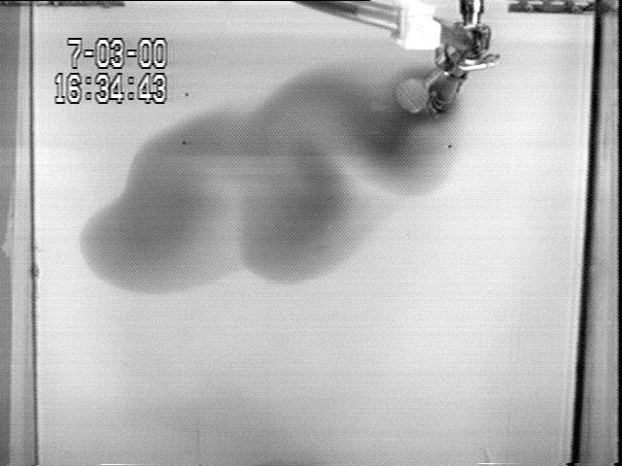
Dispersal of the dense water on a sloping bottom
Laboratory result
Numerical result (an idealized Arctic coastal polynya)
Bottom density anomaly
(Cenedese et al. 2004)
Polynya (downward salt flux)
(Chapman 2000)

Slide 8
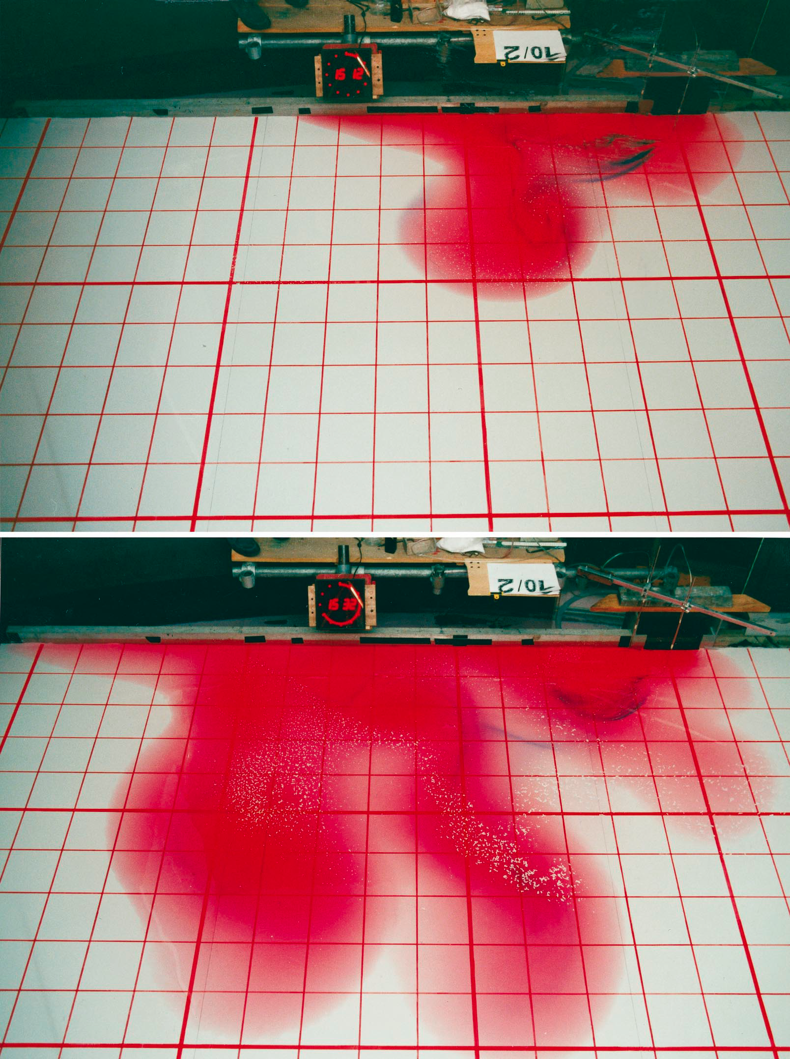
A coastal plume of the dense water?
Source of dense water
Laboratory result
Numerical result
Bottom density anomaly
After 15 inertial periods
(Cenedese et al. 2004)
After 45 inertial periods
(Etling et al, 2000)

Slide 9
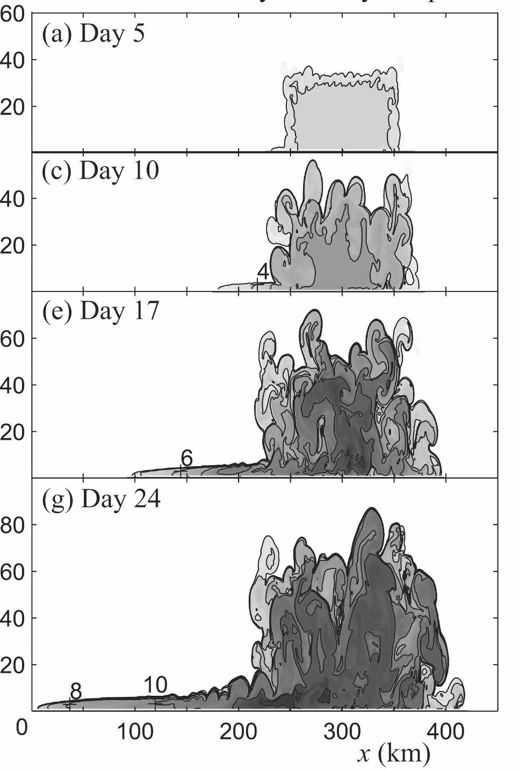
A coastal plume of the dense water?
An idealized ‘Antarctic’ polynya
Bottom salinity anomaly
f < 0
Flat bottom depth: 400 m
Unknowns:
dynamics of the coastal plume
the relative transport in the narrow coastal and broad offshore eddy plumes
(Wilchinsky and Feltham, JPO, 2012)

Slide 10
Idealized 3D models, numerical and laboratory
Plane view
Side view
Assumptions:
Uniform bottom slope
f-plane
No ambient current
No initial stratification
No surface momentum flux
Notes:
Throughout the talk, blue represents numerical experiments and green laboratory

Slide 11
Numerical set-up
ROMS
quadratic bottom drag
GLS turbulent closure k-kl scheme
L_{x} = 300km, L_{y} = 150 km
horizontal resolution: 500m
60 vertical layers
Control variables
Parameter | Symbol | Control Value
Bottom slope | α | 10⁻³
Surface buoyancy flux | Q | 4×10⁻⁷ m² s⁻³
Quadratic bottom drag coef. | C_{d} | 3×10⁻³
Coriolis parameter | f | 1.3×10⁻⁴ s⁻¹
Water depth at the coast | H_{c} | 30 m
Constant downward salt flux (negative buoyancy flux) in the “polynya” region

Slide 12
Laboratory set-up
Control variables
0.5 m X 0.5 m tank on a rotating table
Dyed dense water injected on the ‘coast’
Parameter | Symbol | Control Value
Bottom slope | α | 0.21
Reduced gravity | g' | 0.012 m s⁻²
Coriolis parameter | f | 4.0 s⁻¹
Volume flux | Q_{V} | 3.3×10⁻⁶ m³ s⁻¹
wall
(Cenedese and Adduce 2008)
Notes:
Although the mechanism of dense water generation is different than in a coastal polynya, the dense water source provides a more controllable setup in the laboratory
Notice that some of the control variables here are different from those in numerical experiments

Slide 13
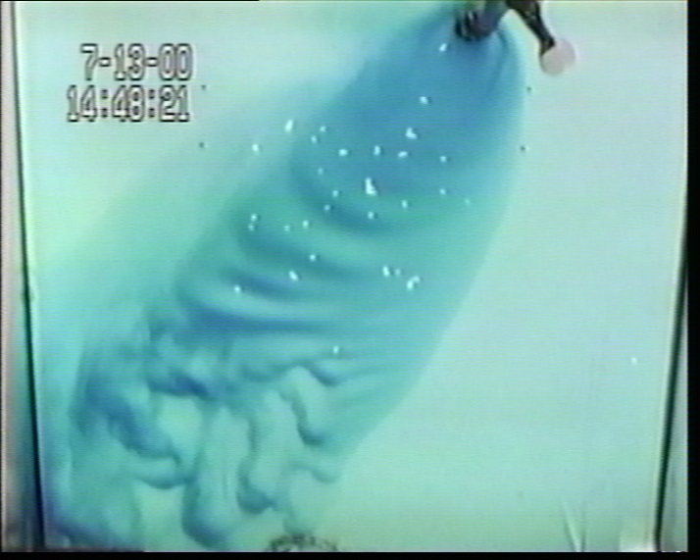
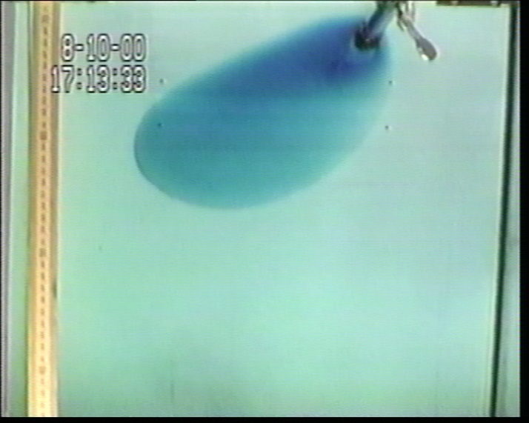
Dynamical regimes of gravity currents on a sloping bottom
Numerical control exp:
Fr = 0.09
Ek = 0.02
Laboratory control exp:
Fr = 0.09
Ek = 0.0002
Both in eddies regime
Fr ≥ 1
(Cenedese et al. 2004)
Wave-breaking regime
Fr < 1 & Ek > 0.1
Fr < 1 & Ek < 0.1
Laminar regime
Eddies regime

Slide 14
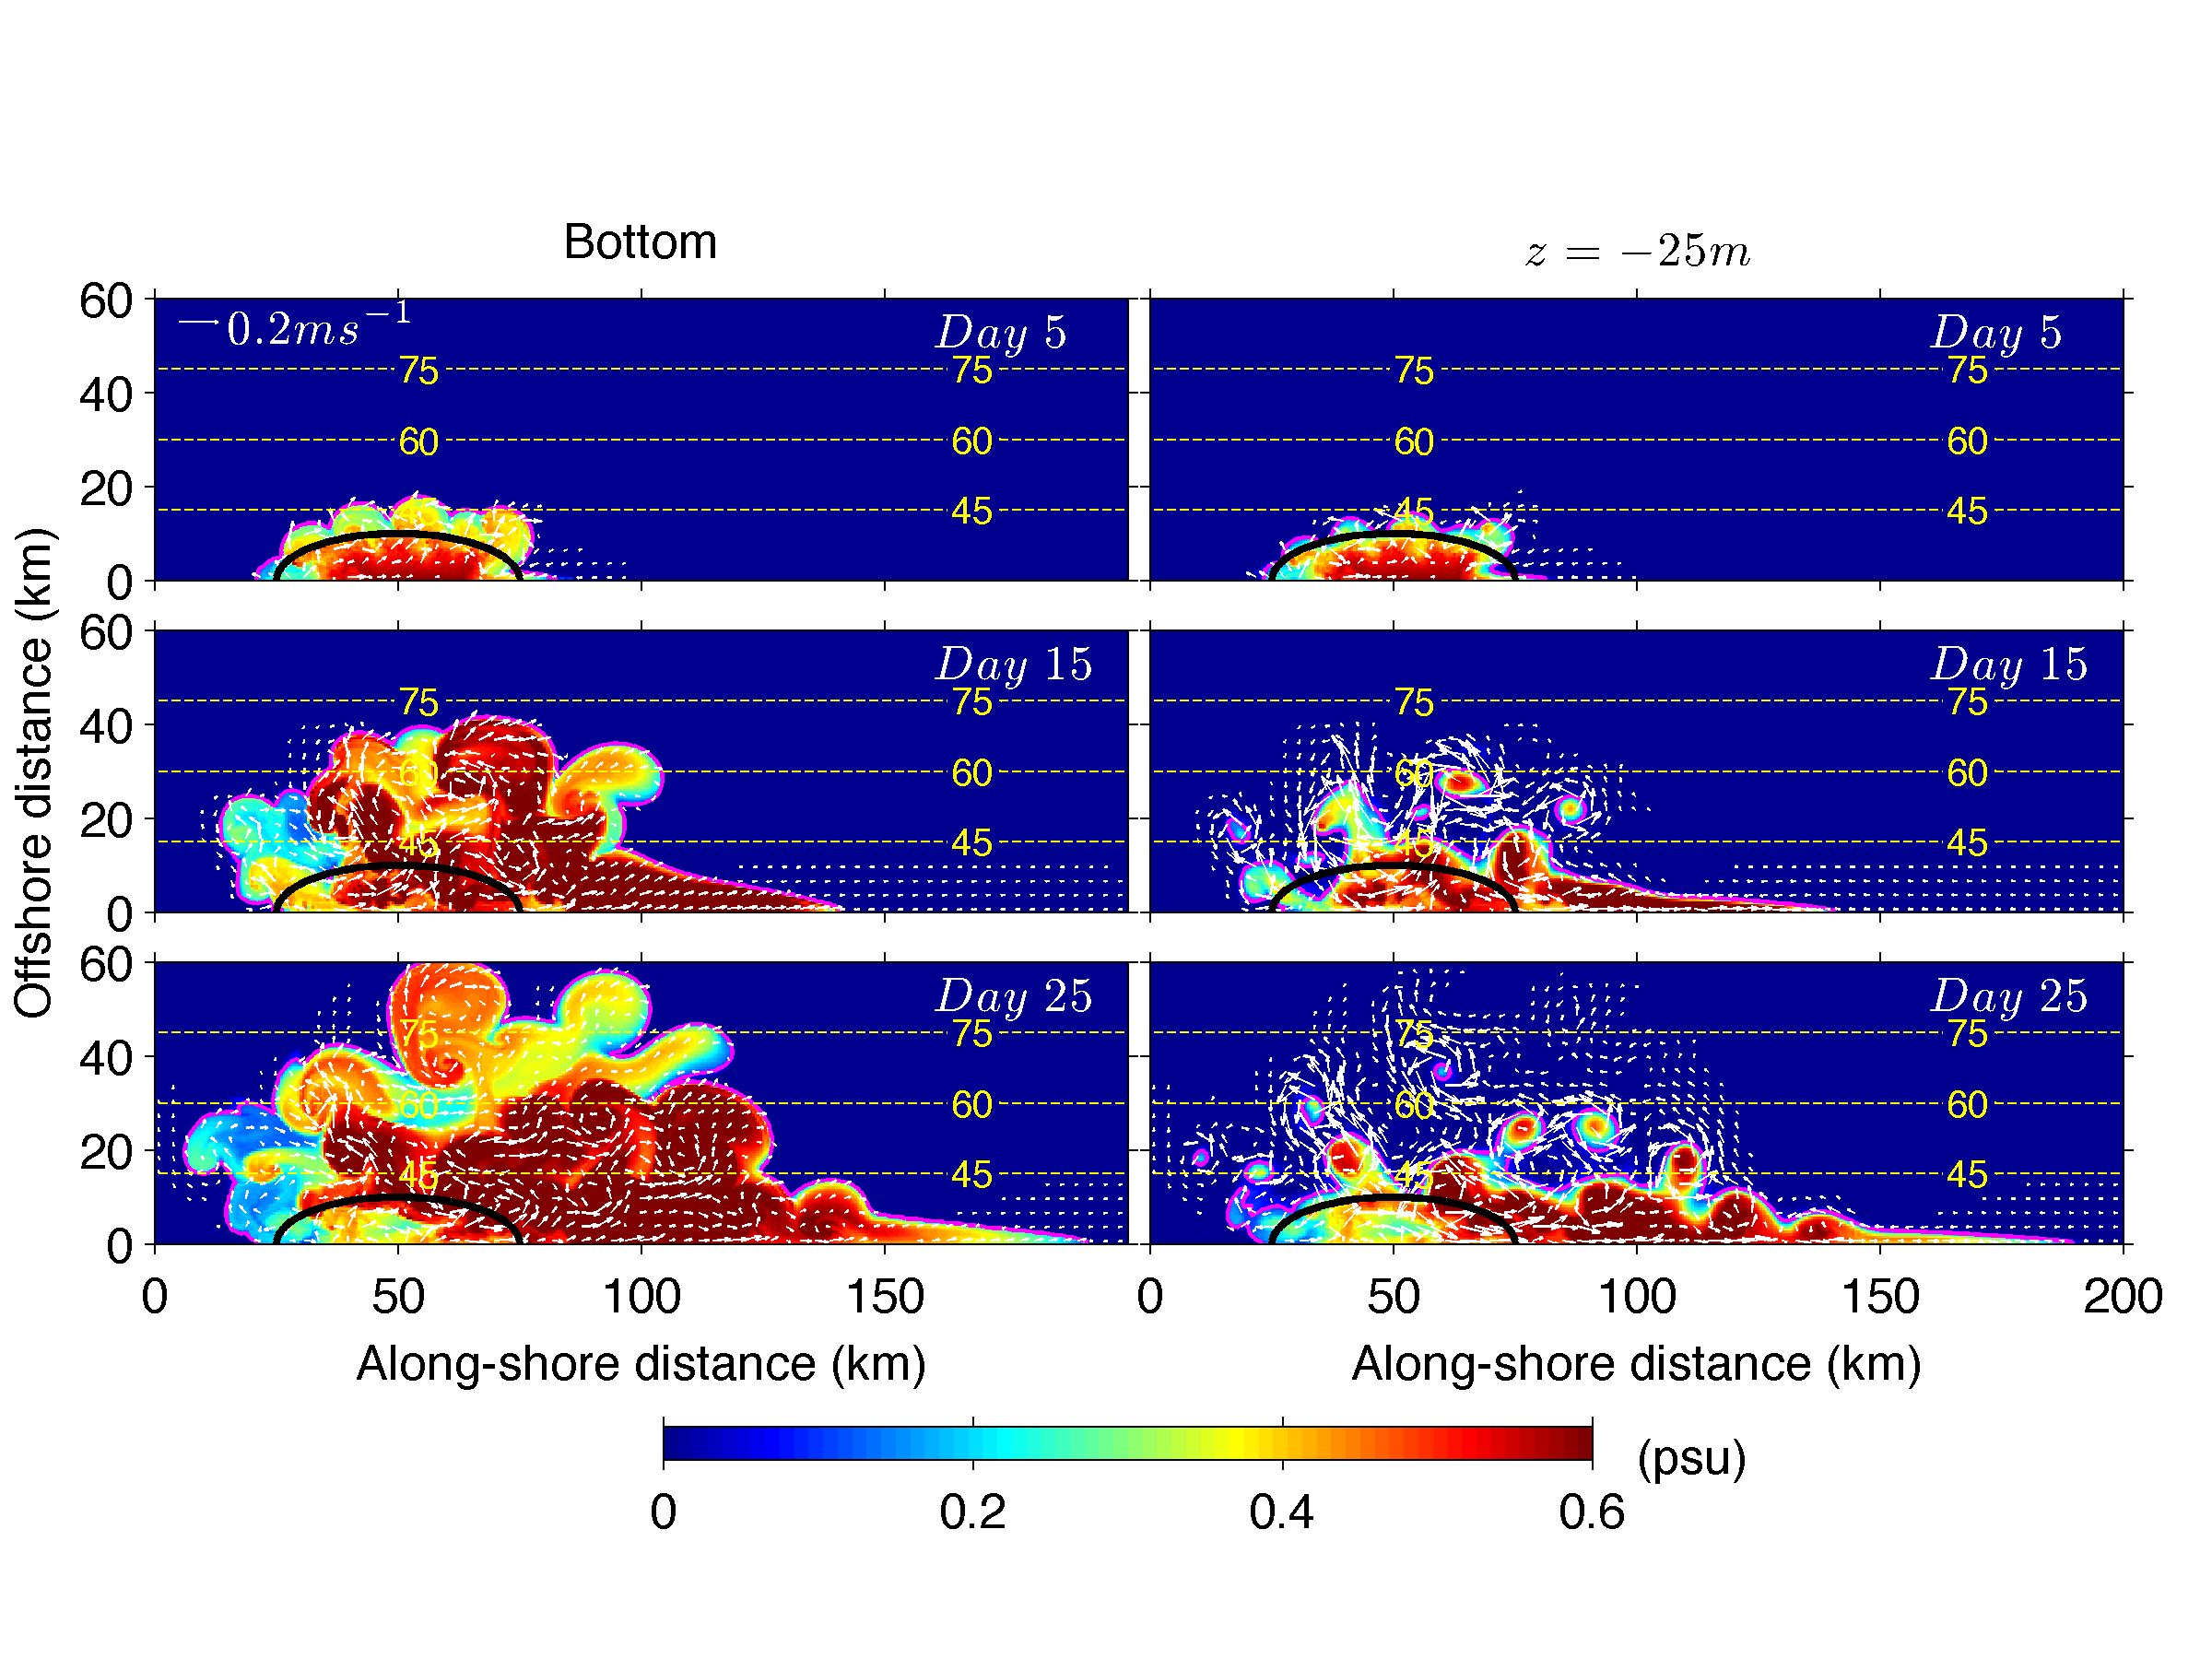
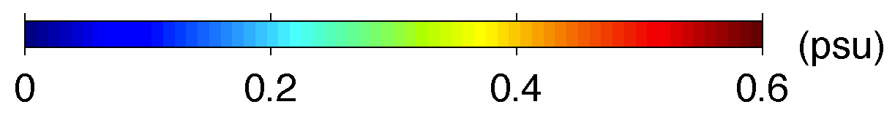
Time series of the control experiments
Modeled bottom salinity anomaly
Laboratory results
9T
24T
44T
Both experiments show two pathways:
a narrow coastal plume and a broad offshore plume

Slide 15
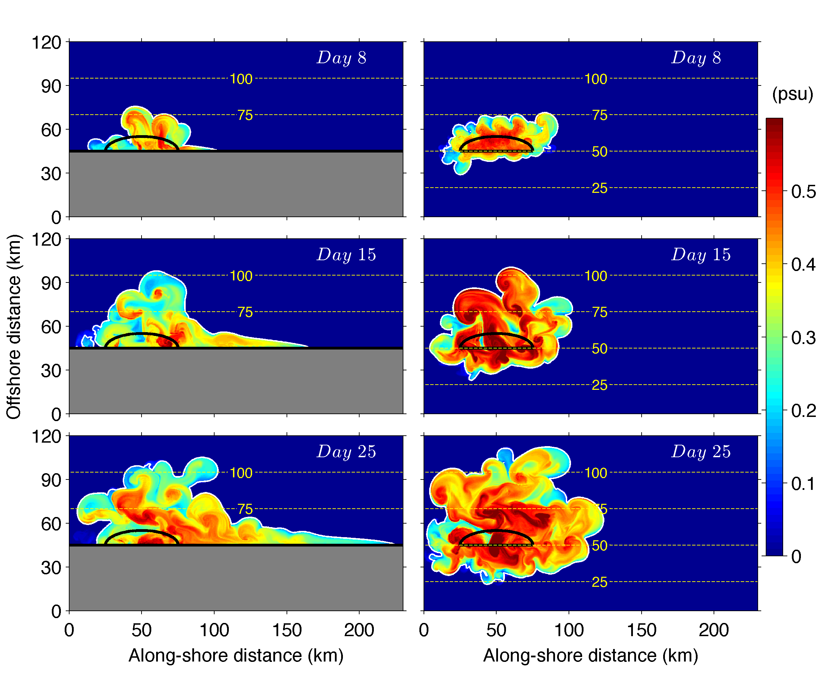
Influence of the coastal vertical wall: numerical
With wall
No wall

Slide 16
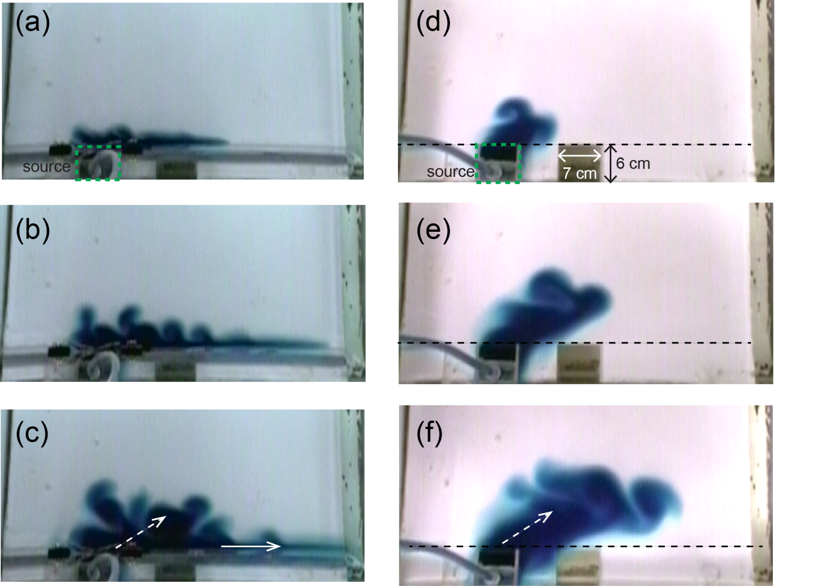
Influence of the coastal vertical wall: laboratory
With wall
No wall

Slide 17
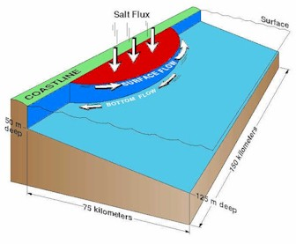
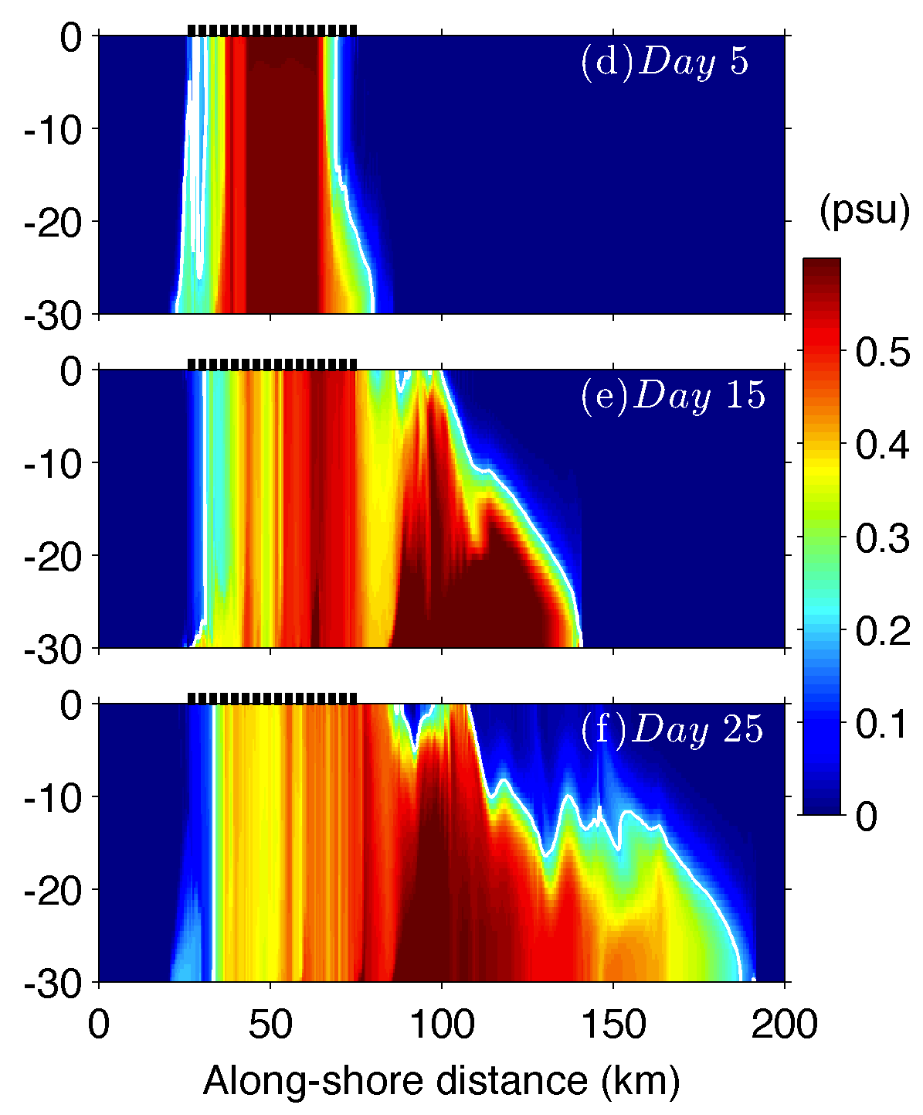
Generation of the coastal current
Along-coast vertical sections of modeled salinity anomaly
Depth (m)
(Chapman and Gawarkiewicz)
Horizontal density gradient generates a near-bottom anticyclonic jet through thermal-wind
The jet is stopped at the down-stream end by the wall and accumulates dense water there
Along-coast baroclinic pressure gradient drives the gravity current along the coast (similar to a lock-release gravity current)

Slide 18
Question for this talk:
What control the propagation speeds of the offshore and coastal plumes?
Methods:
Momentum balance-based scaling analyses
Numerical and laboratory sensitivity experiments

Slide 19
Velocity scaling for the offshore eddy plume
Because << 1, vertically integrated
horizontal momentum balance:
(speed of the long topographic Rossby wave)
H_{i}: total water depth
For numerical experiments, assuming and H_{i} ≈ H_{c}, we get
Because

Slide 20
Velocity scaling for the coastal current
A lock-release gravity current transitions from an initial inviscid state to a viscous state as it proceeds in distance (Linden and Simpson, 1986).
Along-shelf momentum balance for the bottom coastal current:
near field, inviscid
The distance separating the near and far fields:
far field, viscous
integrating over h_{c}
Assuming L ≈ |u_{c}|t,
Notes:
we assume ∂ρ/∂x to be independent of z and define L as the along-shore span of the baroclinic pressure gradient.

Slide 21
Scaled velocities
Numerical model
Laboratory Experiments
Offshore plume
Coastal plume
Control variables for sensitivity tests
α, H_{c}, f, Q, C_{d}
α, g’, f, Q_{V}

Slide 22
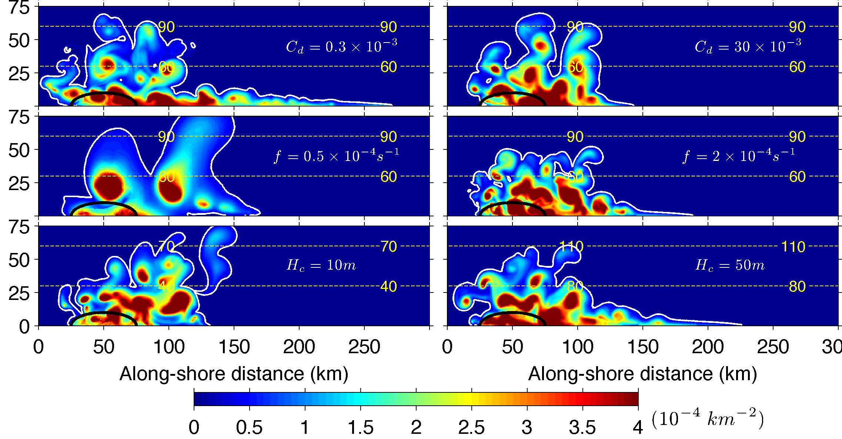
Vertically integrated salinity anomaly in the model at Day 25
C_{d}
f
H_{c}

Slide 23
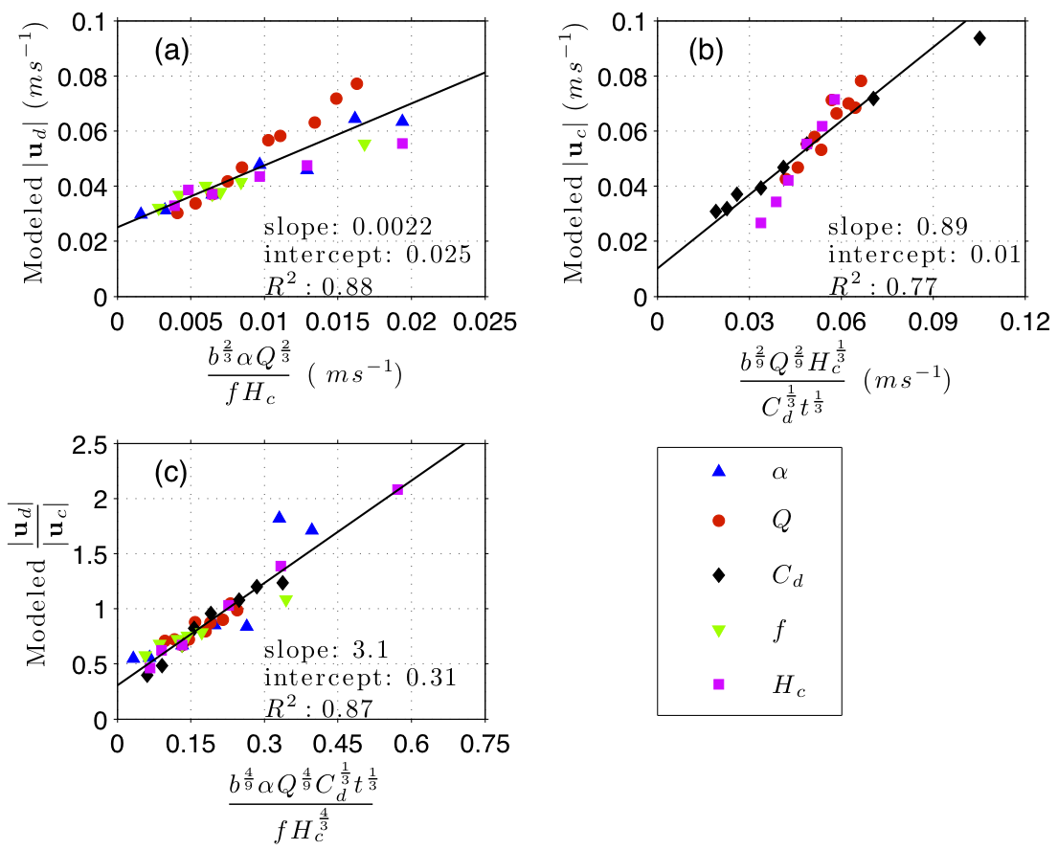
Numerical sensitivity analysis
Modeled offshore plume speed (m s⁻¹)
Modeled coastal plume speed (m s⁻¹)
Modeled speed ratio
Scaled velocity ratio

Slide 24
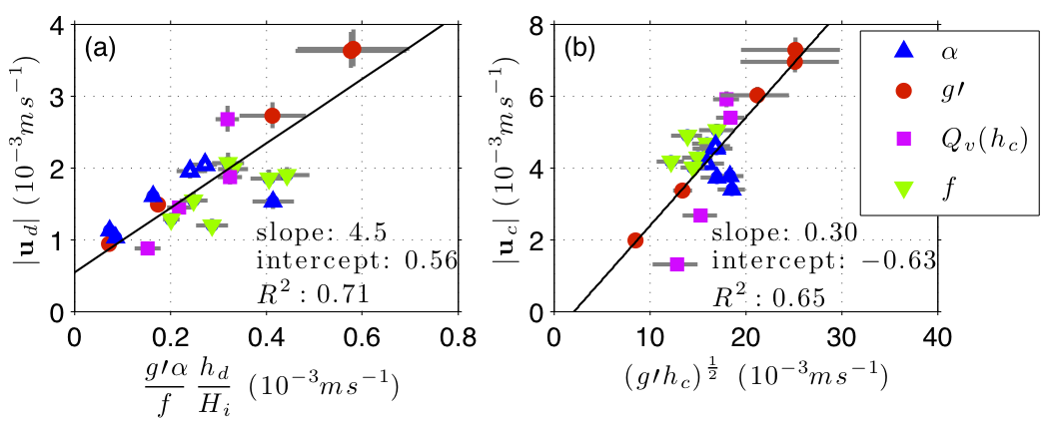
Laboratory sensitivity analysis
Measured offshore plume speed (mm s⁻¹)
Measured coastal plume speed (mm s⁻¹)
Velocity computed from the scaled formulae
Results of the numerical and laboratory sensitivity experiments are largely consistent with those of the velocity scaling analyses

Slide 25
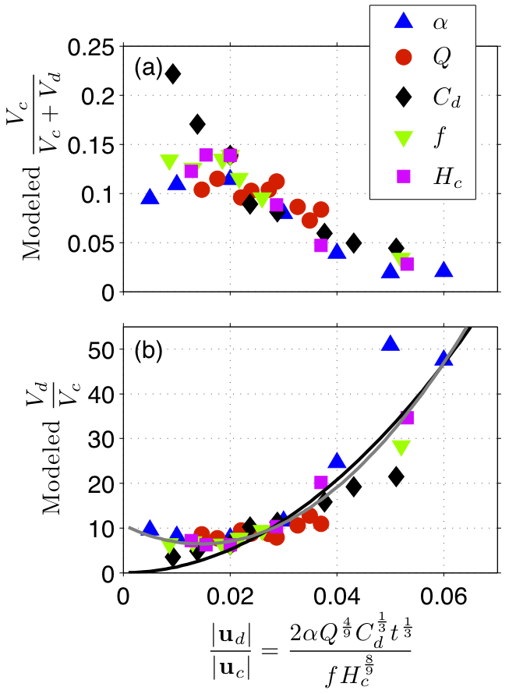
Volume transport in the plumes
Numerical result
The fraction of dense water entering the coastal plume is generally < 23%
The percentage depends highly on the scaled velocity ratio
The scaled velocity ratio may be useful for observational studies to estimate the amount of dense water formed in coastal polynyas
Fraction in the coastal plume
Transport ratio
Velocity ratio computed from the scaled formulae

Slide 26
Conclusions
Two separate bottom transport pathways of the polynya dense water:
  A broad offshore eddy plume
  A coastal plume (a gravity current along the coastal wall)
Scaled velocities in both pathways are consistent with the numerical and laboratory sensitivity experiments.
<23% of the dense water enters the coastal plume, and the percentage depends on the ratio of the offshore and coastal plume speeds, a potentially useful aspect for observations.

Slide 28
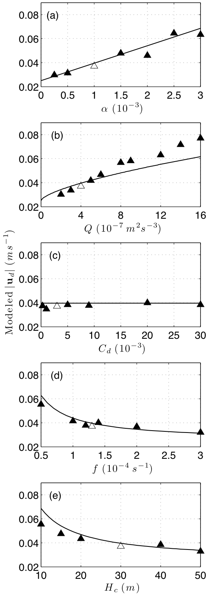
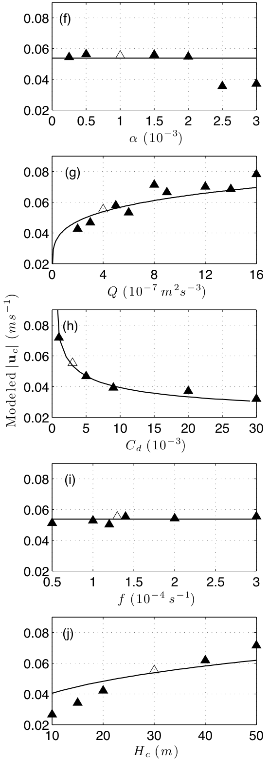
Numerical sensitivity experiments
Modeled velocities vs.
control parameters
Modeled offshore plume speed |u_{d}| (m s⁻¹)
Modeled coastal plume speed |u_{c}| (m s⁻¹)

Slide 29
Time series of salinity anomaly and horizontal velocity in the control simulation

Slide 30
Numerical sensitivity experiments
Parameter | Symbol | Unit | Control Value | Min. Value | Max. Value | Range of Fr_{d} | Range of Ek_{d} | Range of Fr_{c}
Bottom slope | α | 10⁻³ | 1 | 0.25 | 3 | 0.17~ 0.41 | 0.013~ 0.086 | 0.14~ 0.19
Surface buoyancy flux | Q | 10⁻⁷ m² s⁻³ | 4‡ | 2 | 16 | 0.22~ 0.26 | 0.025~ 0.13 | 0.14~ 0.19
Quadratic bottom drag | C_{d} | 10⁻³ | 3 | 0.3 | 30 | 0.22~ 0.26 | 0.0026~ 2.9 | 0.11~ 0.23
Coriolis parameter | f | 10⁻⁴ s⁻¹ | 1.3* | 0.5 | 3 | 0.15~ 0.37 | 0.0021~ 0.44 | 0.13~ 0.19
Water depth at the coast | H_{c} | m | 30§ | 10 | 50 | 0.21~ 0.27 | 0.020~ 0.067 | 0.099~0.20
* f = 1.3×10⁻⁴ s⁻¹ corresponds to the latitude of 63°N.
‡ Q = 4×10⁻⁷ is a typical surface buoyancy flux for coastal polynyas in the Chukchi Sea area (Winsor and Chapman 2002).
§ H_{c} = 30 m is a typical water depth at the seaward landfast ice edge off the north coast of Alaska in winter (Mahoney et al. 2007).

Slide 31
Laboratory sensitivity experiments
Parameter | Symbol | Unit | Control Value | Min. Value | Max. Value | Range of Fr_{d} | Range of Ek_{d} (×10⁻³) | Range of Fr_{c}
Bottom slope | α | - | 0.21 | 0.05 | 0.31 | 0.039~ 0.088 | 0.12~ 0.26 | 0.18~ 0.27
Reduced gravity | g' | m s⁻² | 0.012 | 0.001 | 0.051 | 0.063~ 0.10 | 0.050~ 0.78 | 0.23~ 0.35
Coriolis parameter | f | s⁻¹ | 4.0 | 2.0 | 4.0 | 0.083~ 0.090 | 0.17~ 0.43 | 0.26~ 0.30
Volume flux | Q_{V} | 10⁻⁶ m³ s⁻¹ | 3.3 | 0.92 | 5.3 | 0.049~ 0.11 | 0.11~ 0.62 | 0.10~ 0.33
Water depth at the coast* | h_{c0} | m | 0.043 | 0.025 | 0.099 | - | - | -
* h_{c0} is not an external control variable in the laboratory experiments, but closely related to Q_{V}.
Its control value and range are provided here for reference

