Slide 1

Data Assimilative Modeling in Coastal and Shelf Waters of the U.S. Mid-Atlantic Bight and Gulf of Maine
John Wilkin
Julia Levin, Javier Zavala-Garay, Hernan Arango
Marine and Coastal Sciences
Rutgers, The State University of New Jersey
New Brunswick, NJ, USA
jwilkin@rutgers.edu
http://marine.rutgers.edu/wilkin
Regional Ocean Modeling System
http://myroms.org
ROMS User Workshop, Hobart, Australia
17-20 October 2016

Slide 2
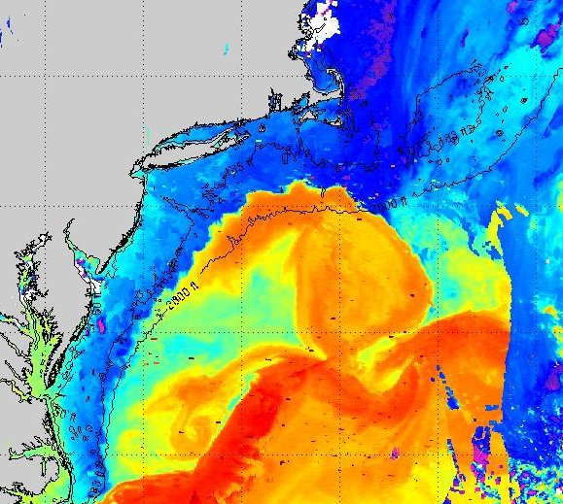
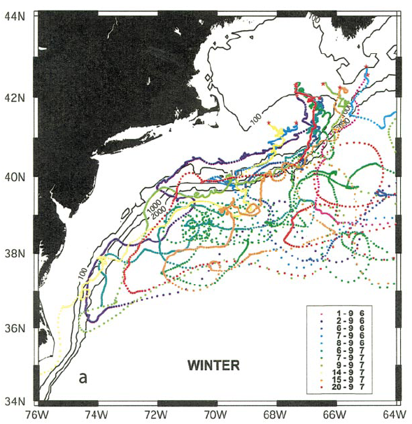
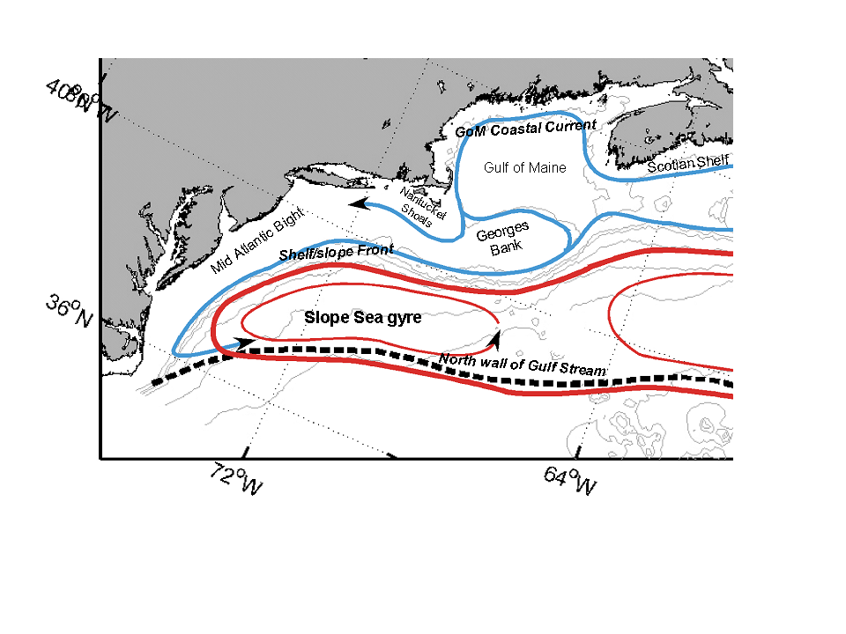
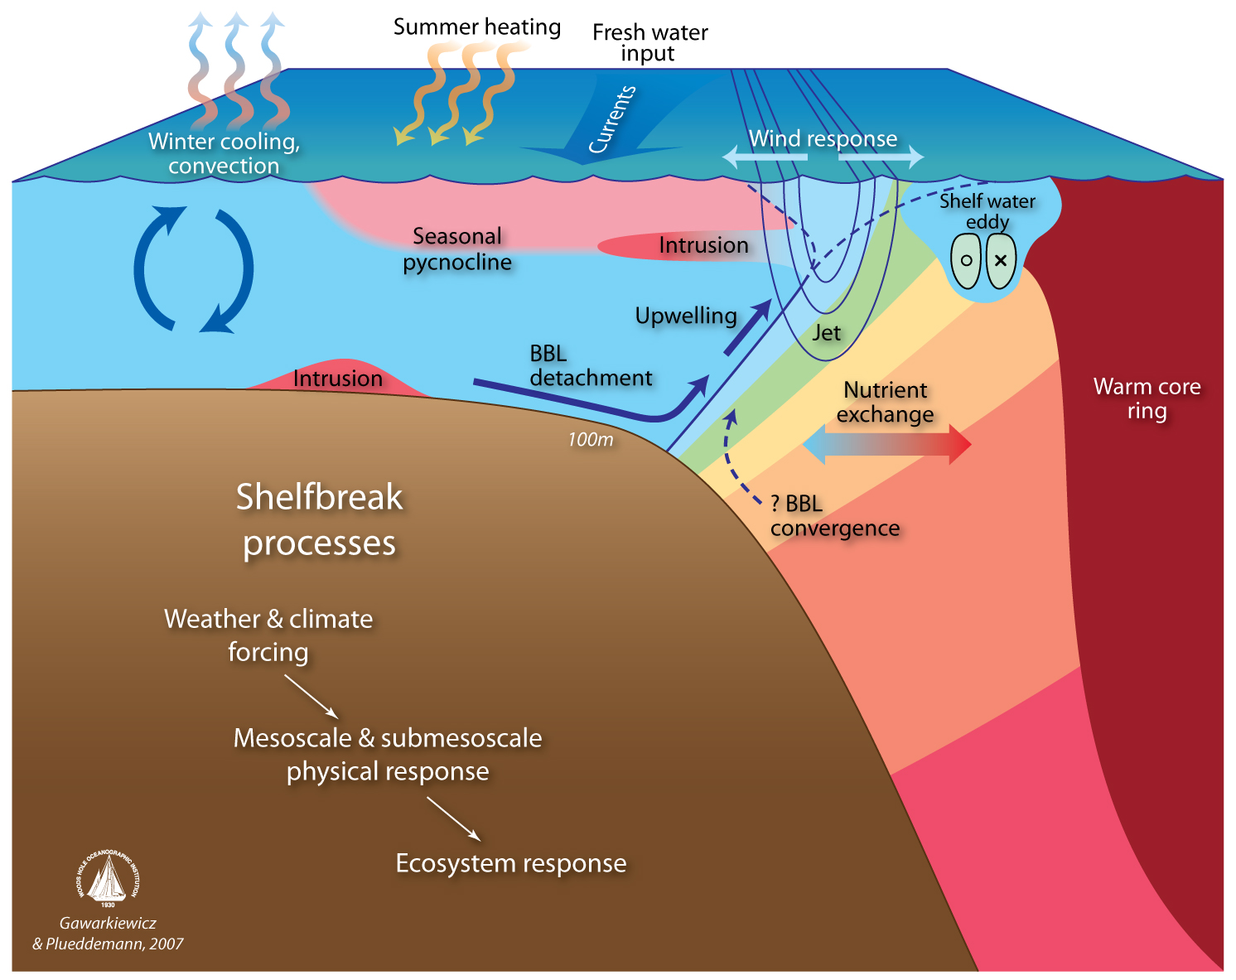
Circulation of
the Mid-Atlantic Bight
(MAB) and Gulf of Maine (GOM)
Dynamics of the MAB shelf-break front

Slide 3
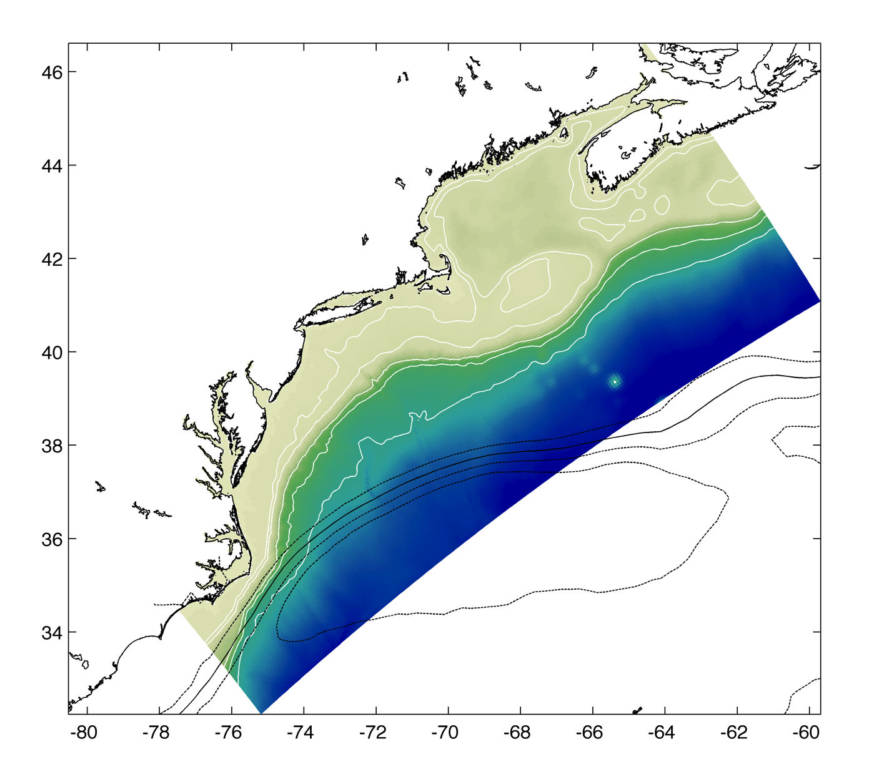


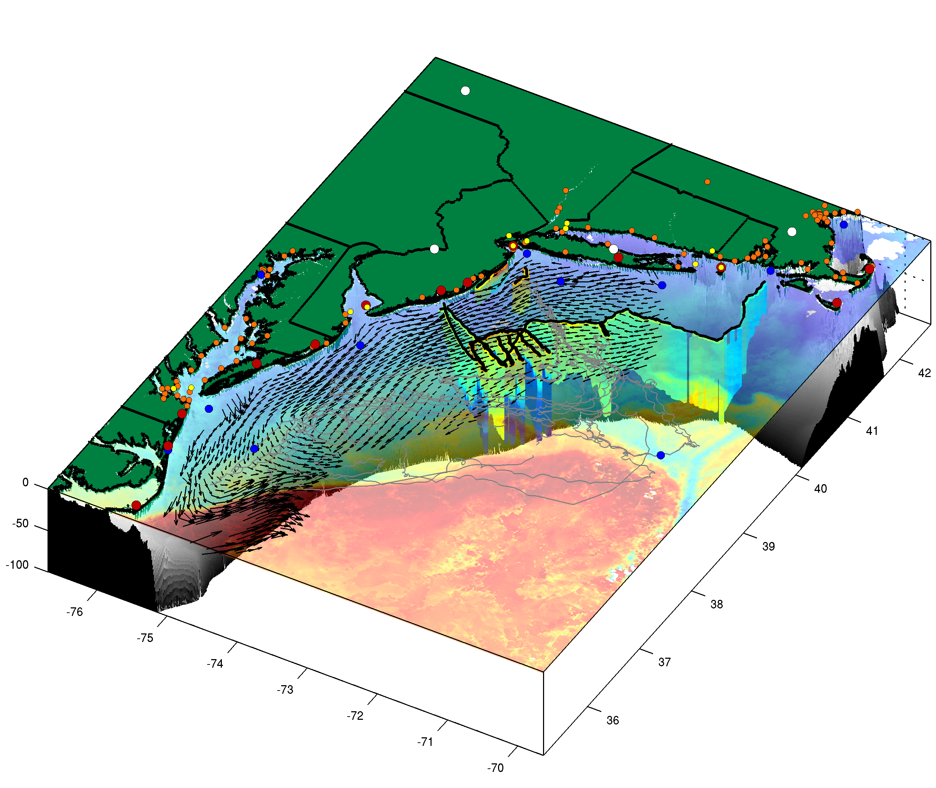
ESPreSSO* real-time and reanalysis ROMS system
Doppio**
real-time and reanalysis system
** it’s a double espresso
*Experimental System for Predicting Shelf and Slope Optics
http://maracoos.org
Mid-Atlantic Regional Association of Coastal Ocean Observing Systems
Notes:
Much better. More on this later.
Nested in NWA

Slide 4
Data streams Real-time Data source
Surface and boundary forcing:
72-hour forecast NAM 0Z cycle at 2 am EST NCEP NOMADS Grads DODS Server
USGS daily river flow available 11:00 EST waterdata.USGS.gov
MERCATOR 7-day forecast updated daily Mercator-ocean.fr
Assimilation data sets:
Regional CODAR hourly: 4-hour latency delay Rutgers TDS*
IOOS glider T,S (1 hour delay) Rutgers TDS and IOOS glider DAC
SST AVHRR passes 6-8 per day (2 hour delay) tds.maracoos.org (from U. Del.)
SST GOES, WindSat & AMSR-2 IR PFEG ERDDAP; NASA PO-DAAC
Jason-2, CryoSat, AltiKa along-track GDR RADS.tudelft.nl
SOOP XBT/CTD, Argo floats on GTS OSMC.noaa.gov using ERDDAP
XBT/CTD archive UK Met. Office
Gulf of Maine moorings NERACOOS
No …. NSF OOI Pioneer Array moorings and gliders
*THREDDS Data Server unidata.ucar.edu
Notes:
Reanalysis runs on data sets that are largely available in near real time.
Building a real-time (quasi-operational) and reanalysis system in coordination is the best way to go.
Greater potential to build user base – which can leverage support for both development branches

Slide 5
Data pre-processing flow for Doppio 4DVAR
RU CODAR de-tided (harmonic analysis) and binned to 5km
  variance within bin & OI combiner expected u_err (GDOP) used for QC
    >> ROMS tide added to de-tided CODAR – so tide phase error does not enter cost function
IOOS glider T,S averaged to ~5 km horiz. and 5 m vertical bins
Satellite SST: bin to 5 km resolution
  AVHRR 6-8 passes per day; 3-hour GOES composites; AMSR-E/2 SST
  Have previously used daily SST OI combination of microwave and IR
Altimetry along-track 5 km bins from RADS
  With coastal altimetry corrections can use to ~40 m isobath
  MDT from 4DVAR on climatological observations: 3D T,S, velocity (moorings, Oleander vessel ADCP, CODAR), mean τ^{wind}
  No Dynamic Atmosphere Correction (DAC)
  Add ROMS harmonic tide to SLA; repeat obs. +/- 2 hours
USGS daily river flow is projected by MCA to un-gauged watersheds
Open boundary data from MERCATOR adjusted to remove bias (using 4DVAR climatological analysis on MOCHA and velocity data sets)
Notes:
Canada rivers!

Slide 6
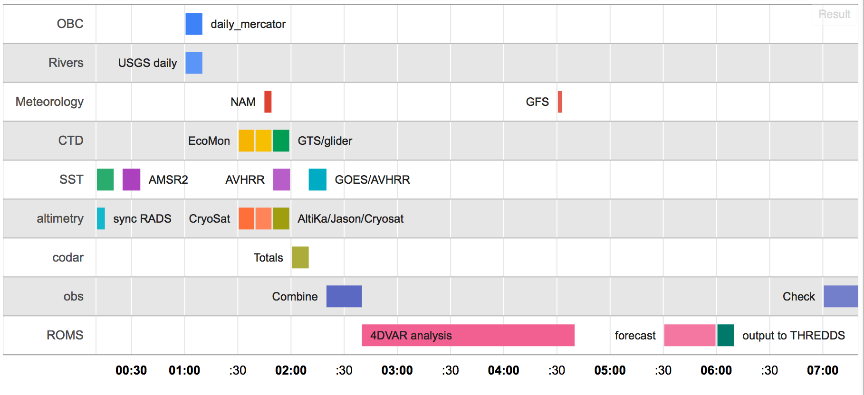
Data pre-processing flow for Doppio 4DAR real-time system
All times New York local (U.S. EST)

Slide 7
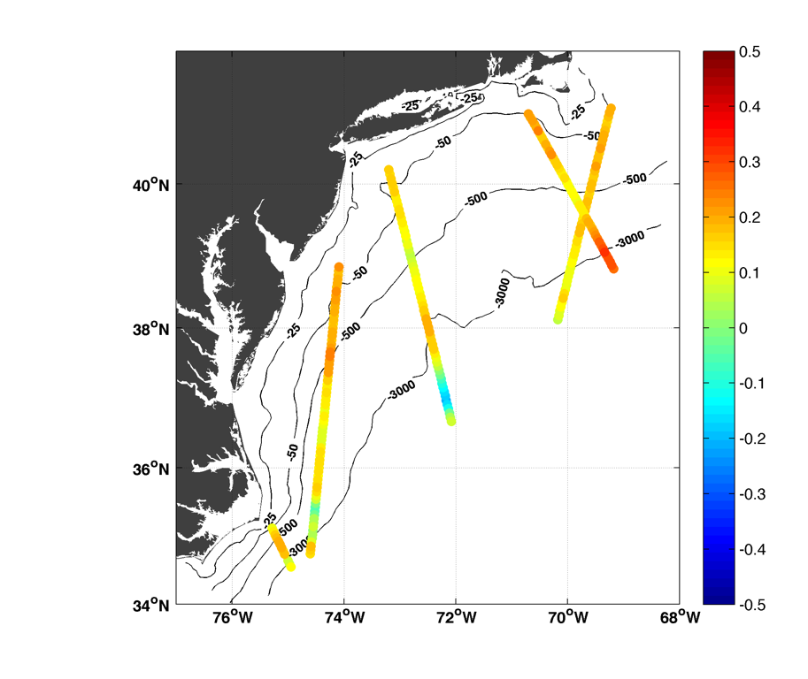
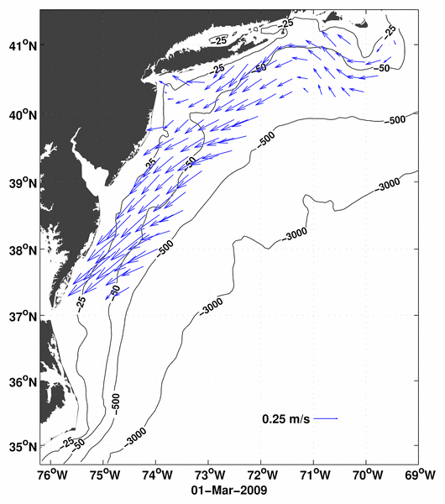
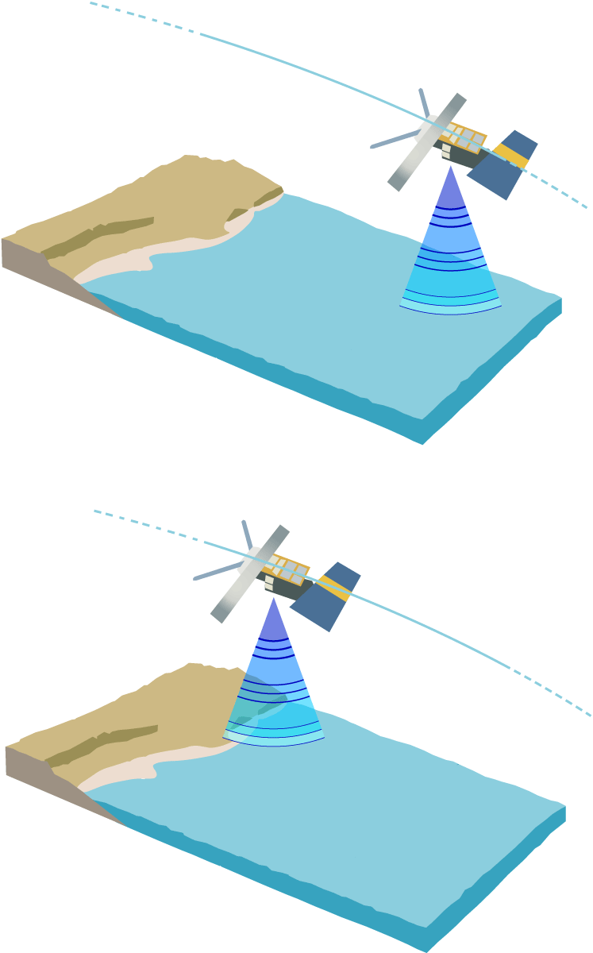
Jason
Oct 2
AltiKa
Oct 1
AltiKa
Oct 2
Jason
Oct 3
Cryosat
Oct 1
Example of CODAR data after quality control, binning and decimation to a set of independent observations.
Example of along-track altimeter sea level anomaly data during a single 3-day analysis window.

Slide 8
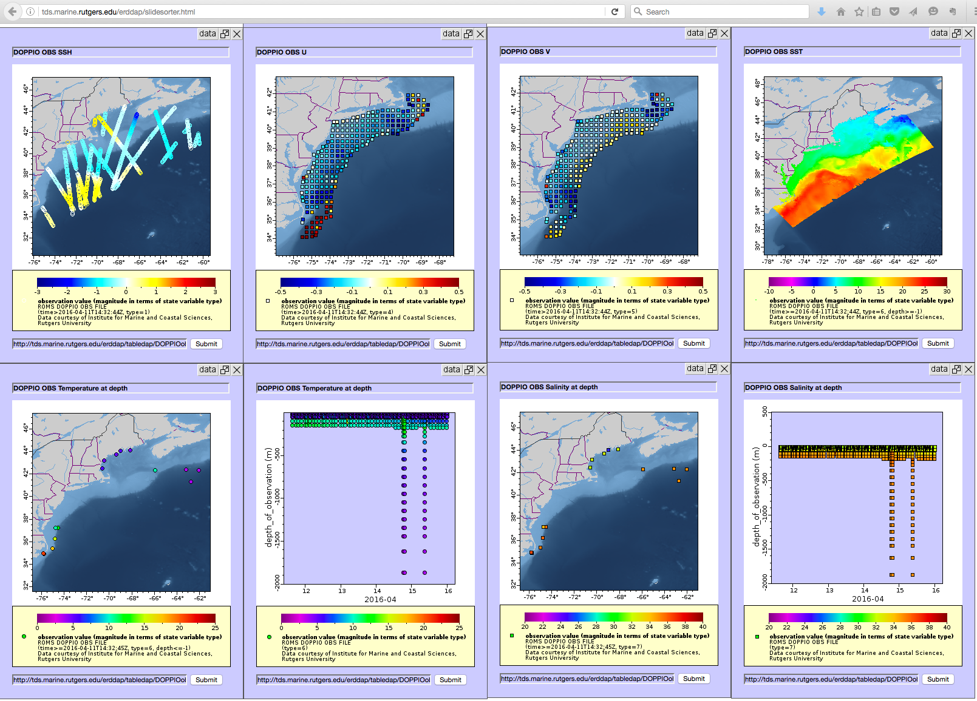

Slide 9
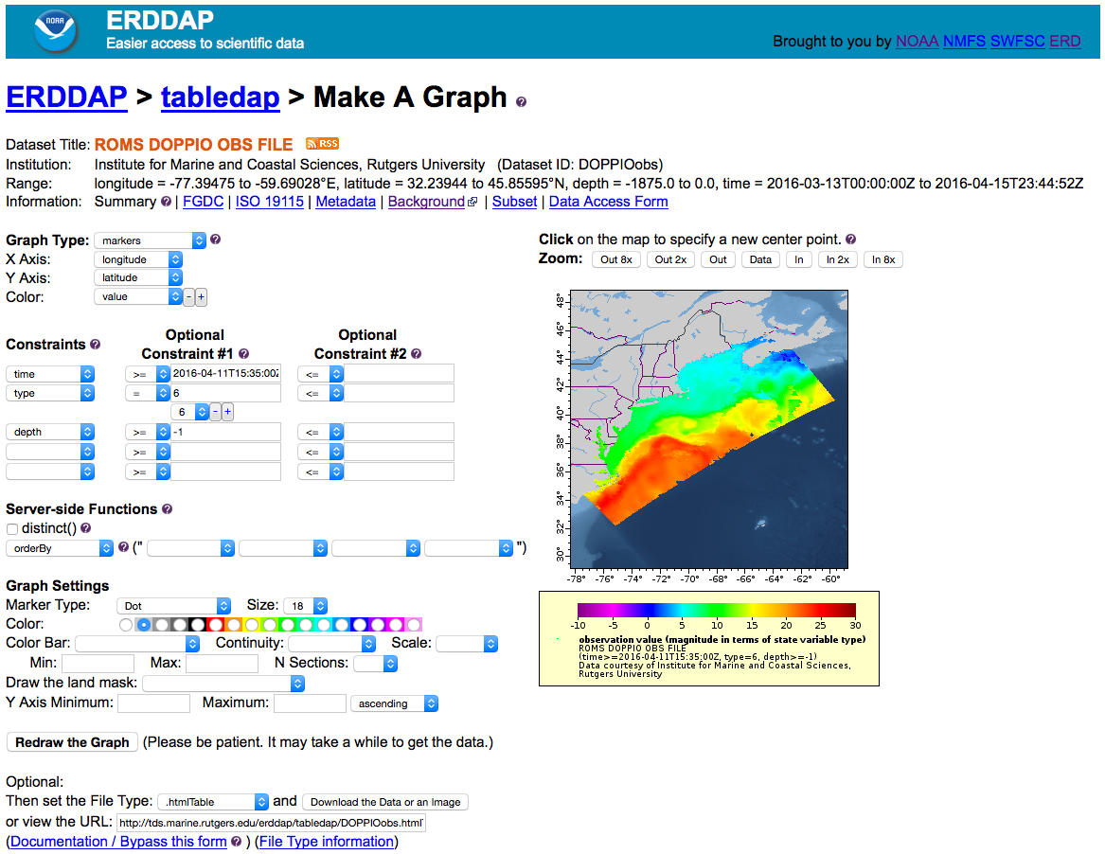

Slide 10
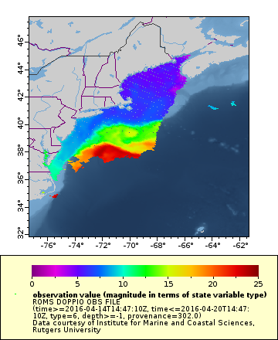
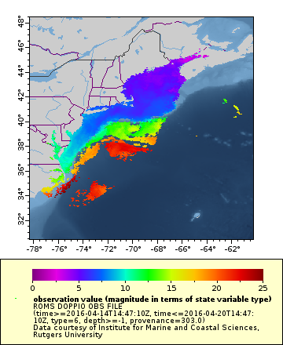
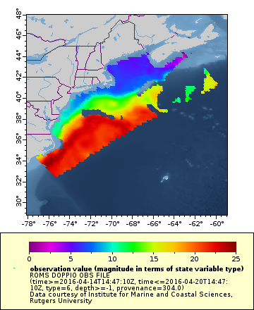
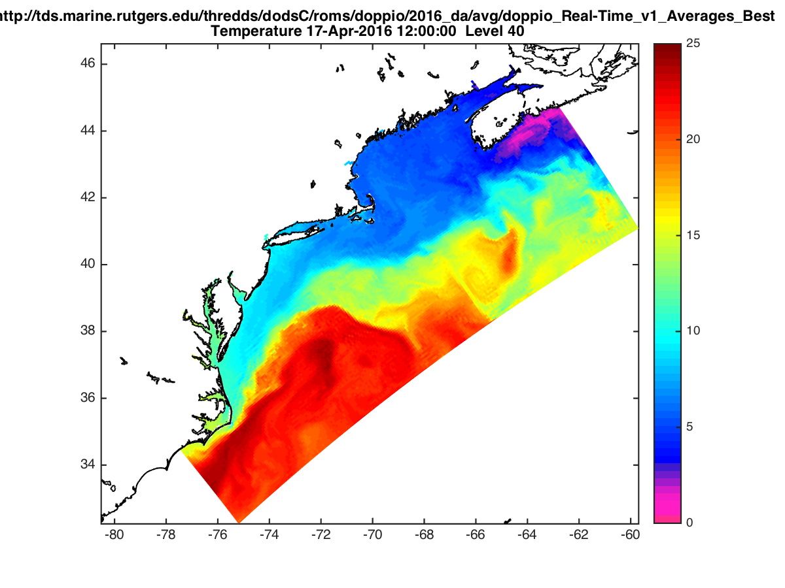

AVHRR
Geostationary
Microwave
Analysis on 20160417
Forecast from 20160412

Slide 11
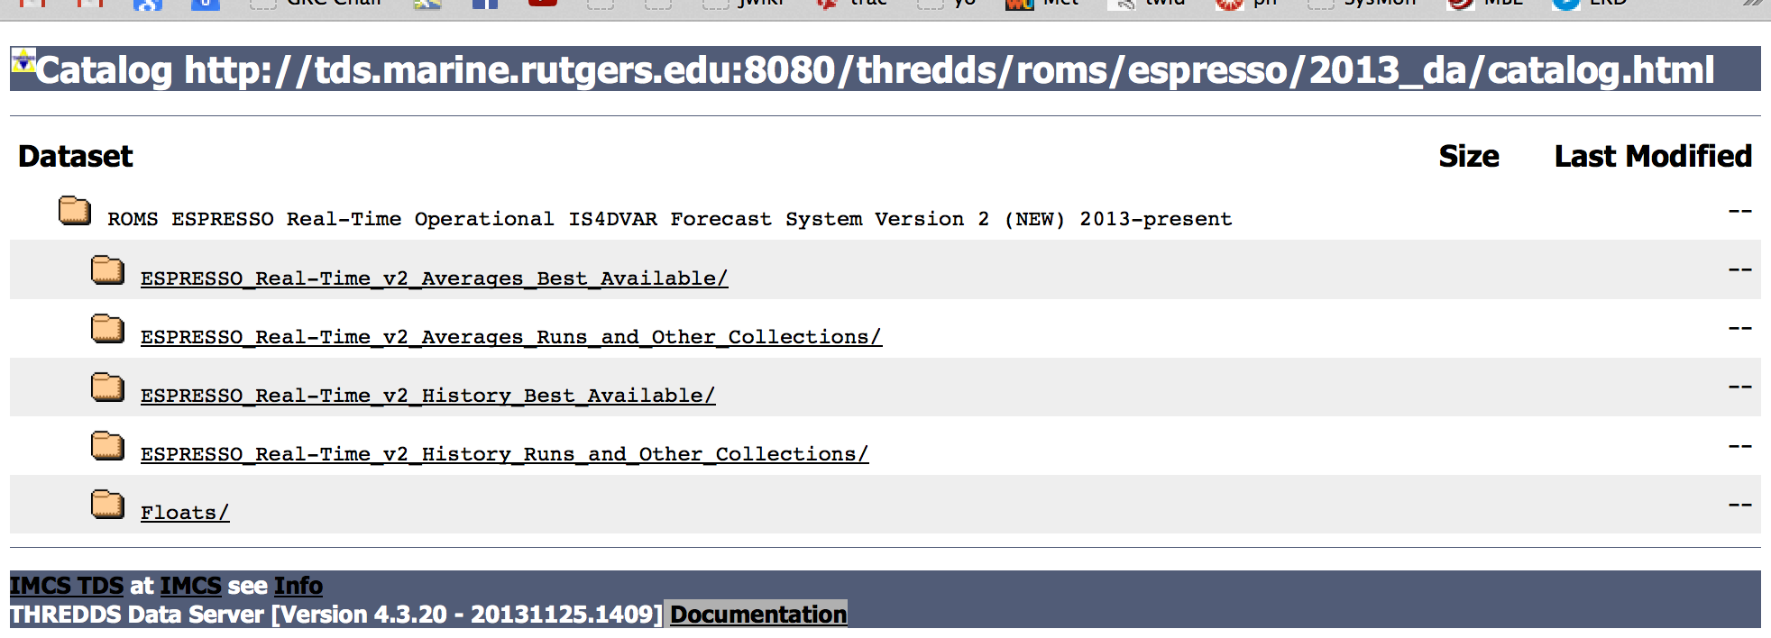
Output goes to THREDDS server Forecast Model Run Collection* (FMRC)
at tds.marine.rutgers.edu/thredds
*unidata.ucar.edu

Slide 12
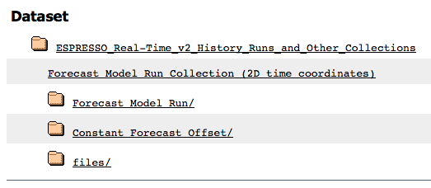
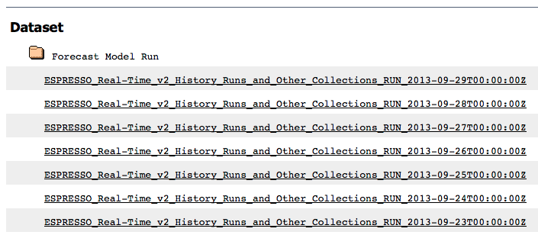
Forecast Model Run Collection (FMRC): Output from a single analysis and forecast

Slide 13
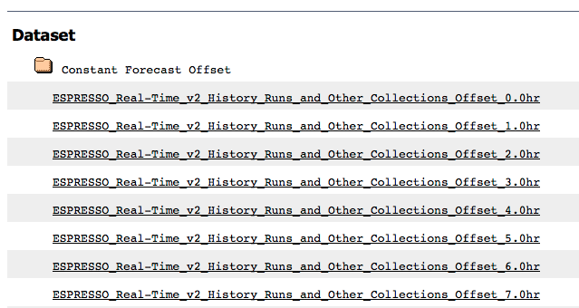
Constant Forecast Offset: Every realization of a given date from all forecasts

Slide 14
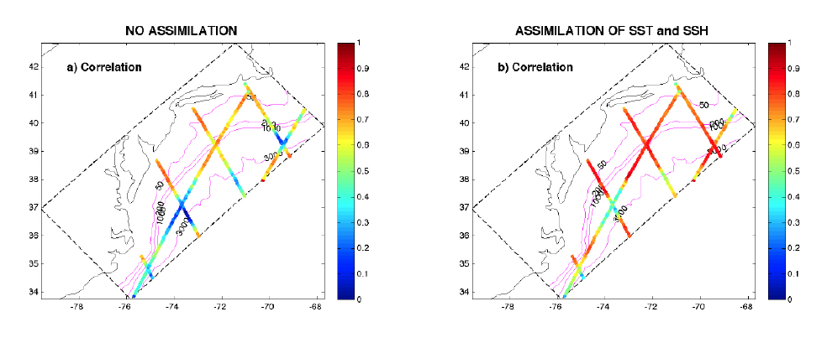
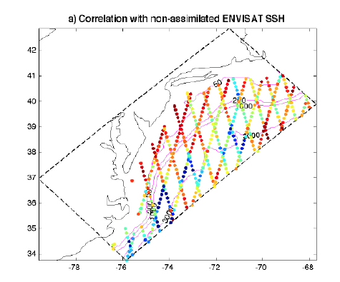
Analysis skill for SSH
Correlation after assimilation of
SSH and SST
ESPreSSO SSH variability correlation improves with assimilation, and predicts variance in withheld observations from ENVISAT
Correlation when no
assimilation
Correlation with ENVISAT SSH
not assimilated

Slide 15
Lagrangian forecast skill w.r.t.
U.S. Coast Guard (SLDMB) drifters
Observed
Forecast: with satellite data only
also with CODAR assimilation
satellite data only
with CODAR assimilation
satellite data only
with CODAR assimilation

Slide 16
Lagrangian forecast skill w.r.t.
U.S. Coast Guard (SLDMB) drifters
Observed
Forecast: with satellite data only
also with CODAR assimilation
Addition of HF-radar (CODAR) to assimilation system gives modest error reduction, but more significant reduction in uncertainty (error bars are 5% and 95%)
satellite data only
with CODAR assimilation
satellite data only
with CODAR assimilation
Median separation distance (error)
Separation normalized by distance traveled

Slide 17
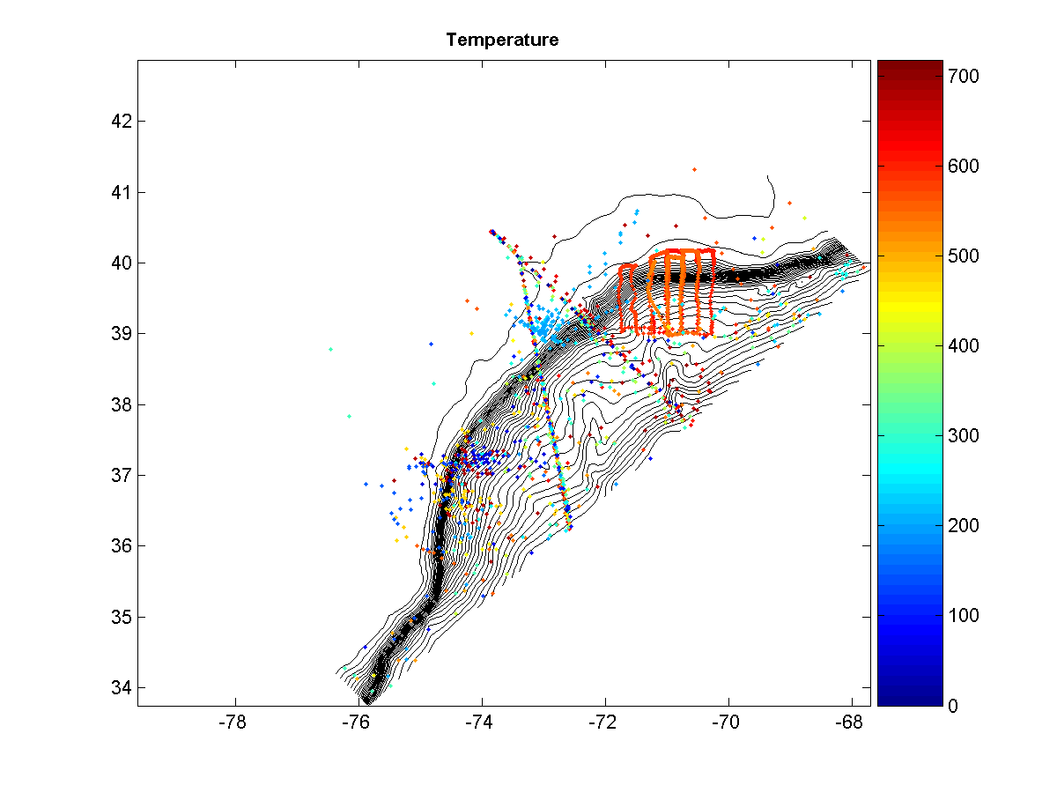
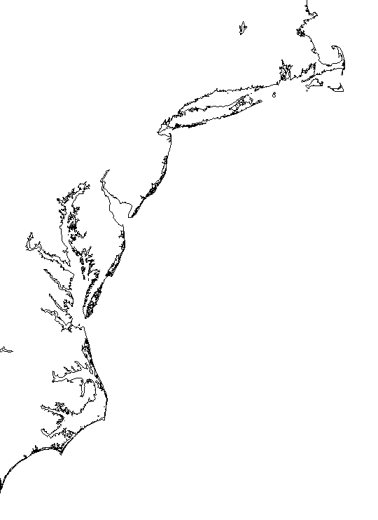
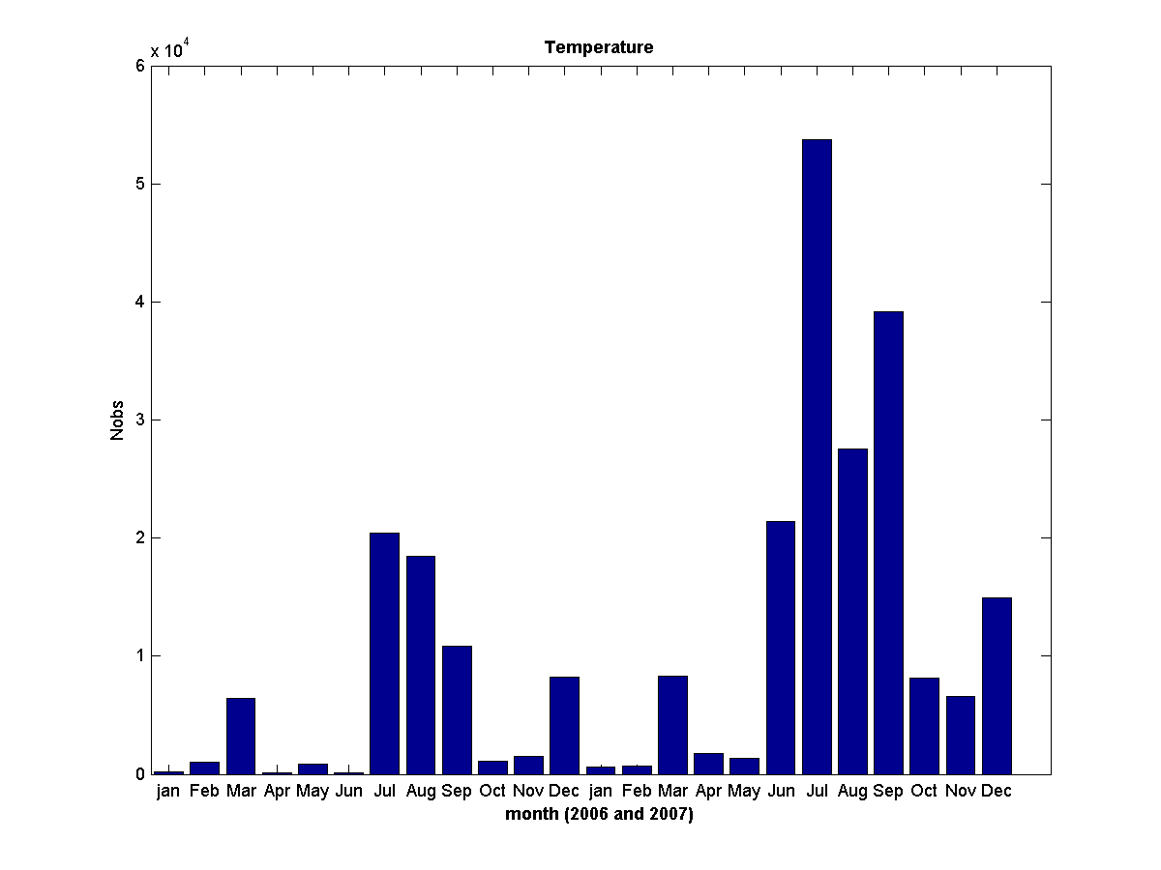
Sub-surface T/S analysis and forecast skill
In situ T and S observations are not assimilated so offer independent skill assessment
There is a sizeable archive of observatory data from CTD, gliders and XBTs for 2006 (SW06) and 2007
days since 01-Jan-2006
7

Slide 18
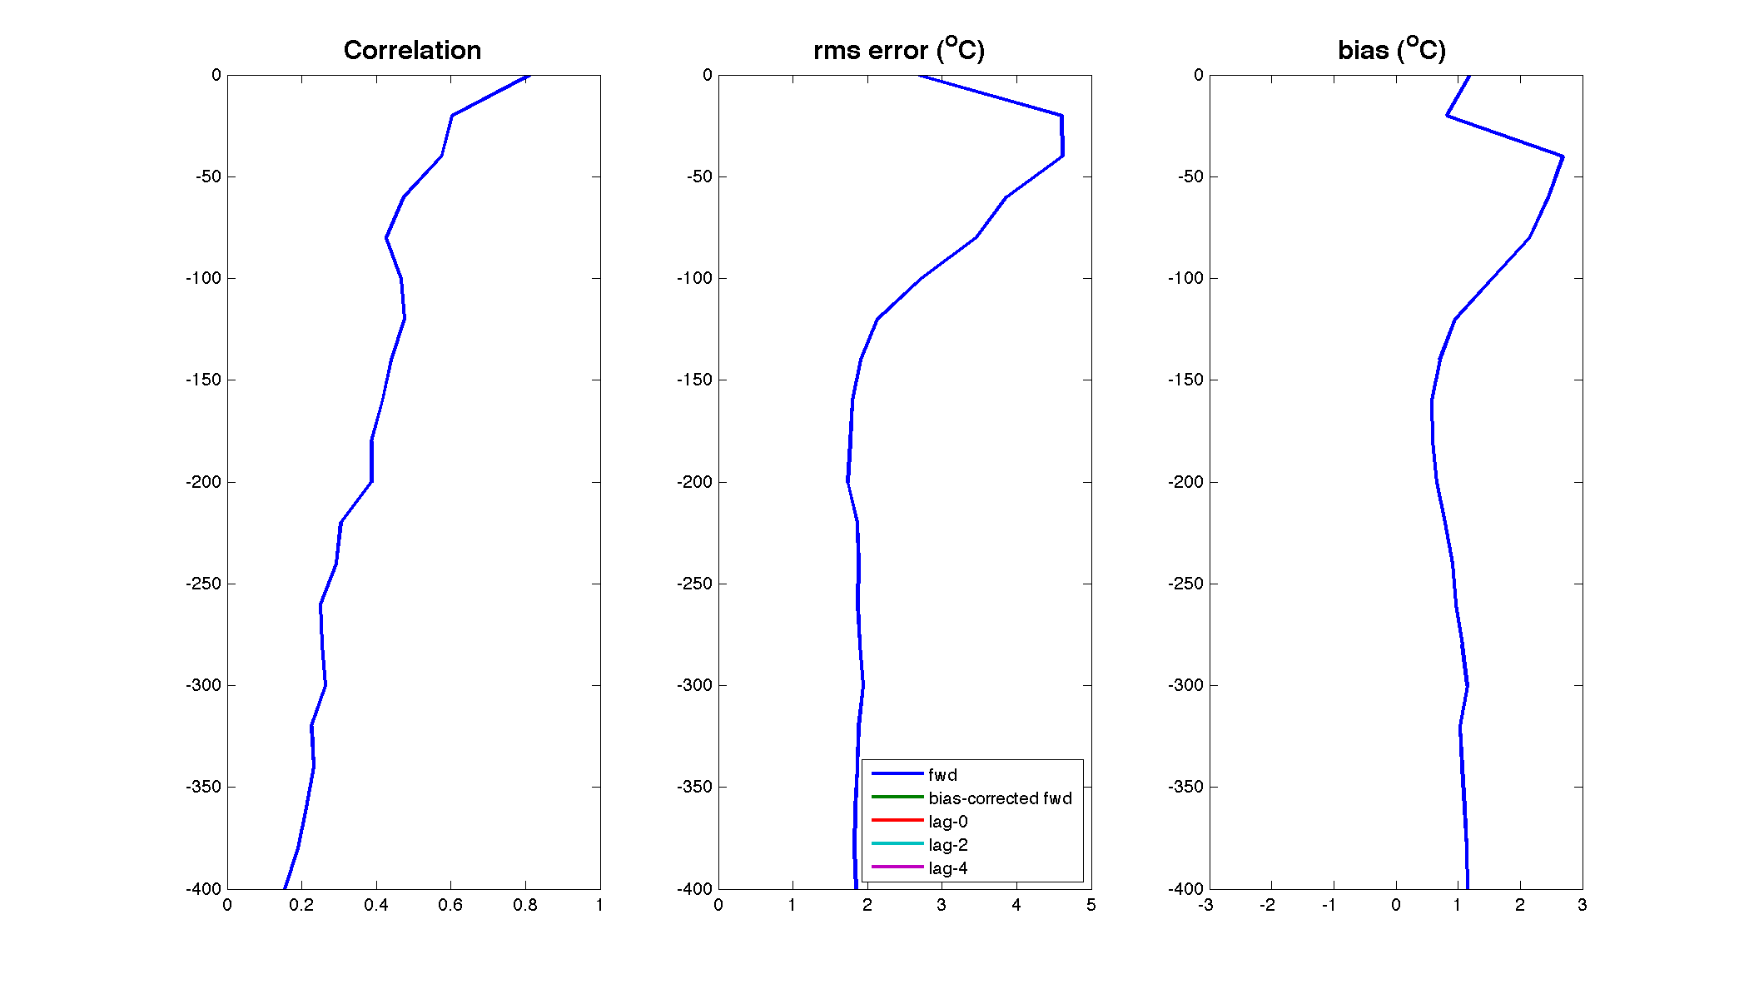
Analysis/forecast skill with respect to subsurface OBS that are NOT assimilated
Temperature
Forward model

Slide 19
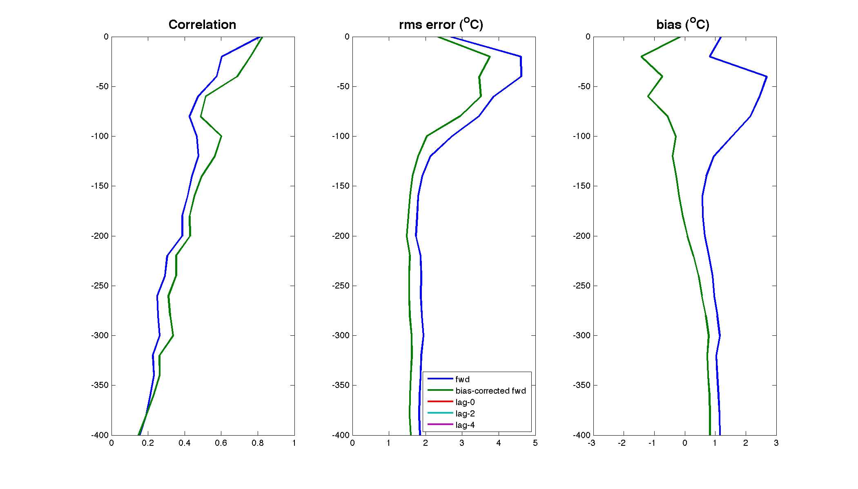
Analysis/forecast skill with respect to subsurface OBS that are NOT assimilated
Temperature
Forward model after bias removal

Slide 20
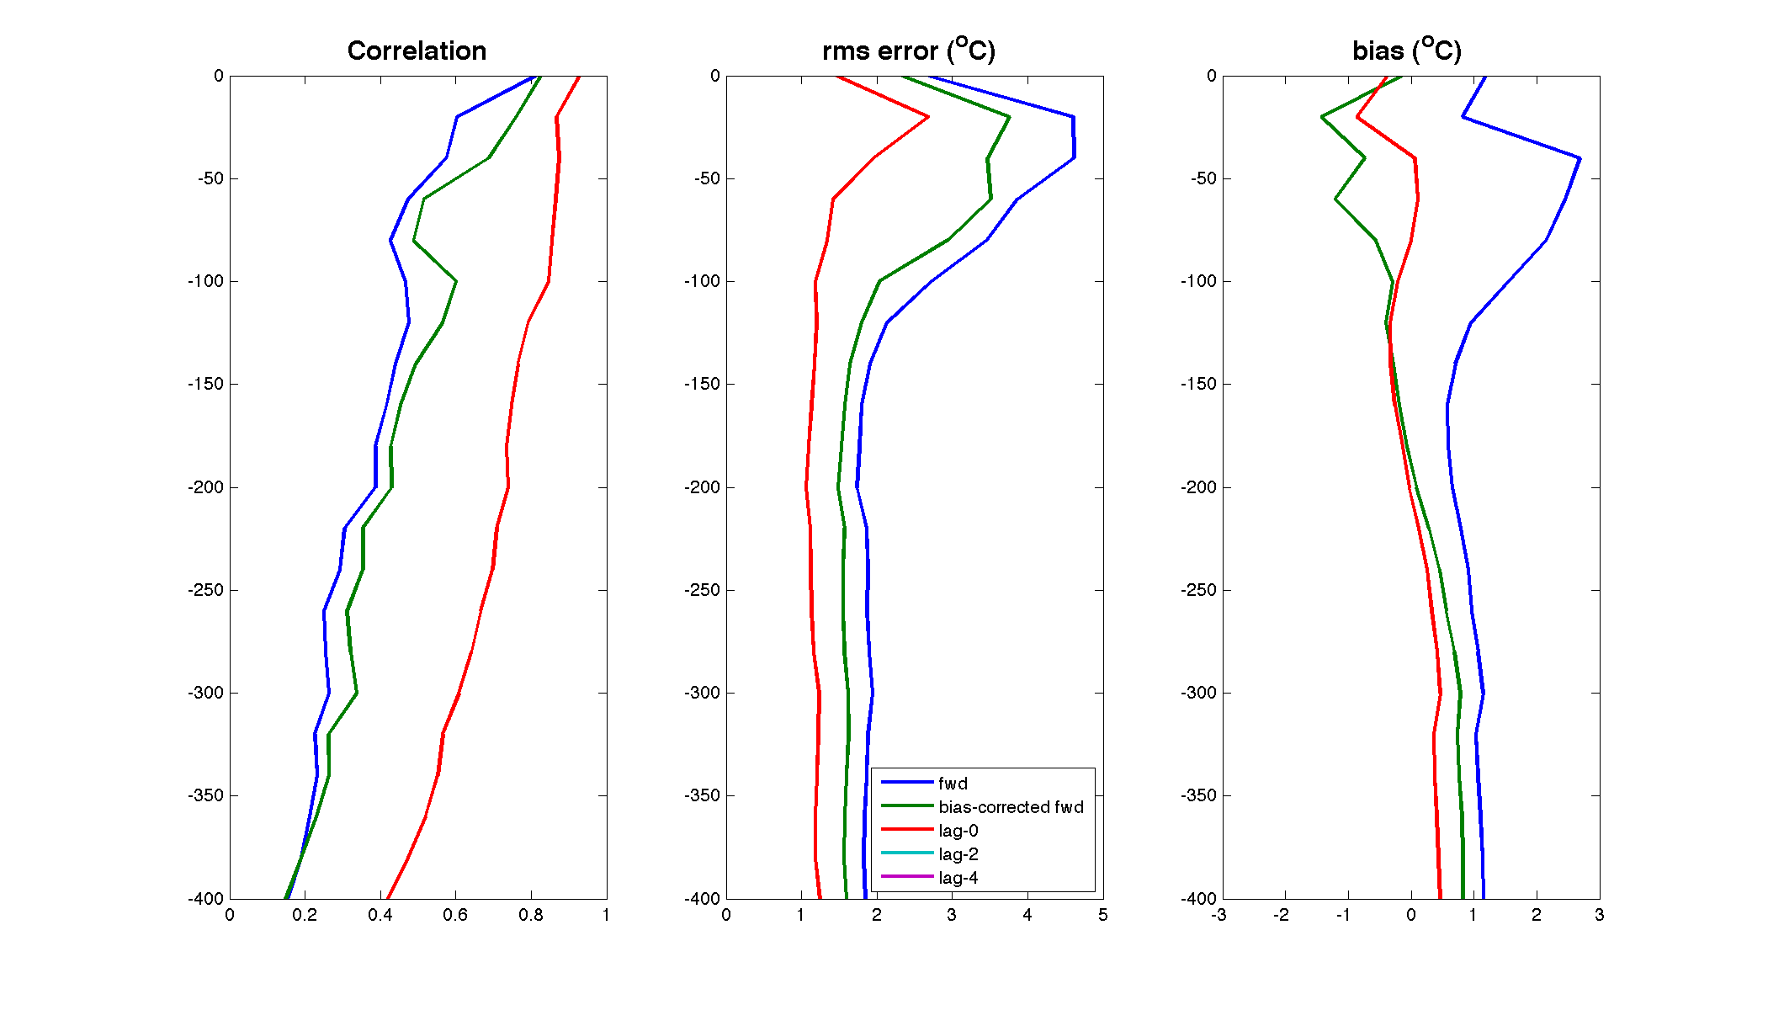
Analysis/forecast skill with respect to subsurface OBS that are NOT assimilated
Temperature
Data assimilation analysis/hindcast
8

Slide 21
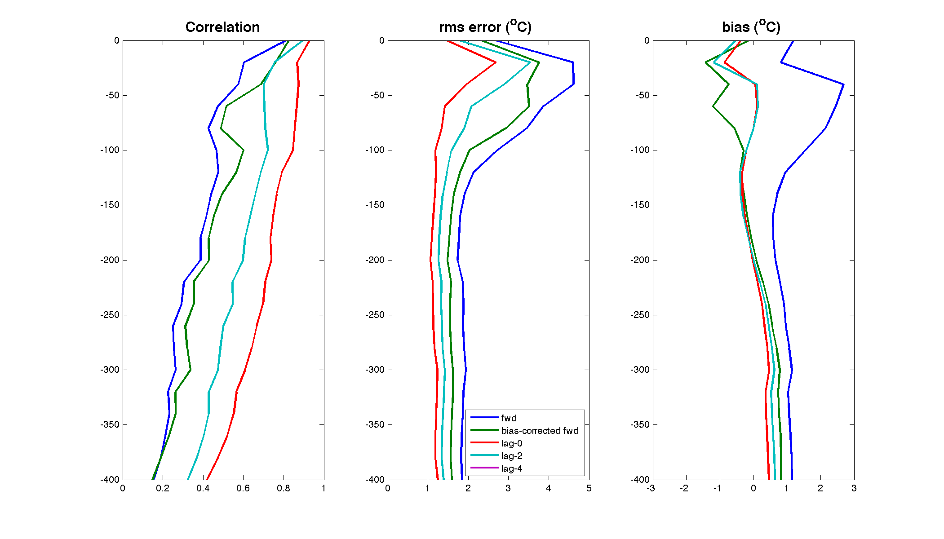
Analysis/forecast skill with respect to subsurface OBS that are NOT assimilated
Temperature
2-day forecast

Slide 22
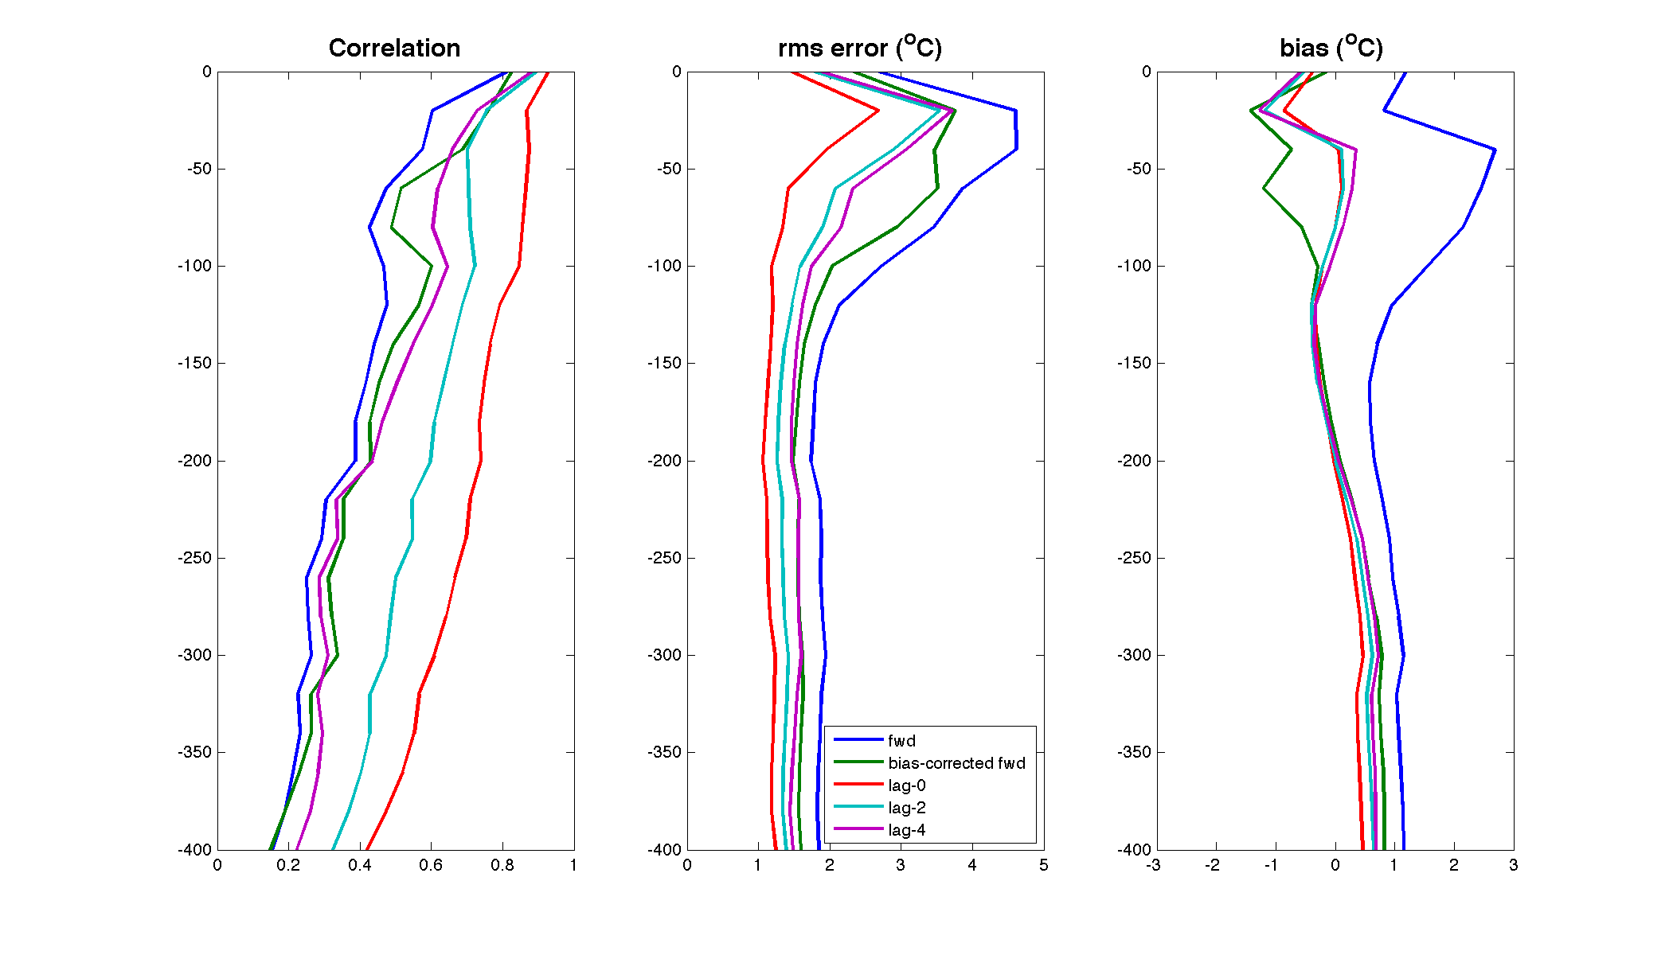
Analysis/forecast skill with respect to subsurface OBS that are NOT assimilated
Temperature
4-day forecast
9

Slide 23
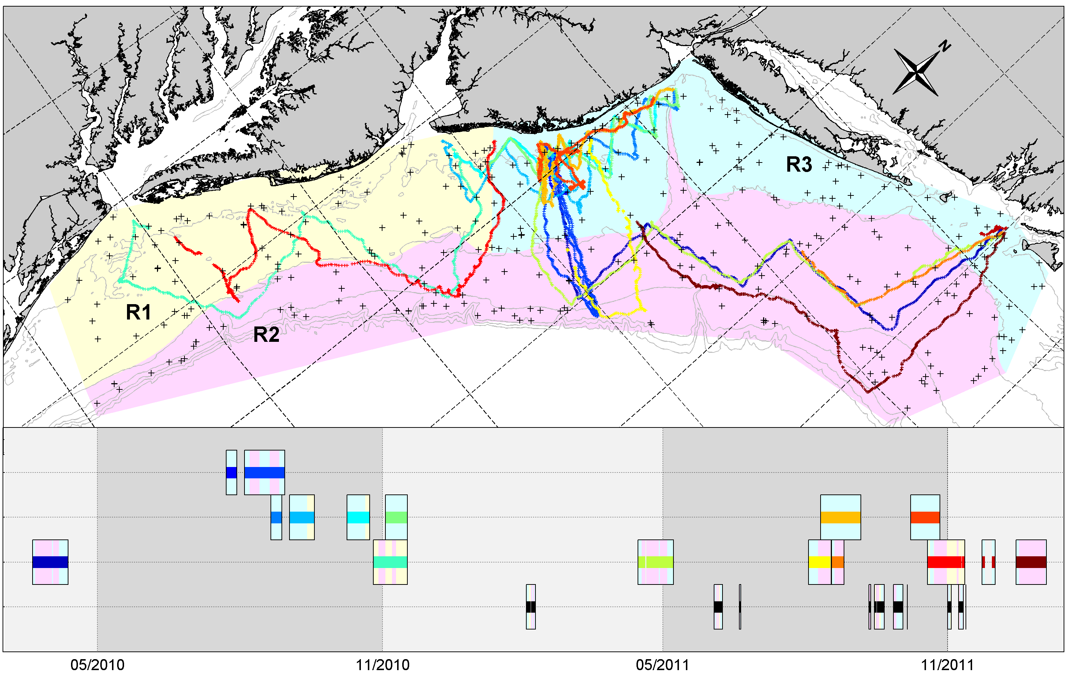
Multi-model skill assessment: 7 real time models of the Mid-Atlantic Bight
Comparison to MARACOOS gliders and NMFS CTD surveys in 2010-2011
RUEL
ENV
MAB
EcoMon
summer
winter
summer
Notes:
AUGV tracks (colored lines) and ECOMON CTD stations (+ symbols) in 2010-2011. Geographic sub-regions R1, R2 and R3 are shown by color shading. Timeline panel shows dates of observations grouped by project: Rutgers University Endurance Line (RUEL), New Jersey state environmental agencies (ENV), long range MARACOOS deployments (MAB), and NMFS stock assessment voyages (ECOMON). For each box on the timeline the central line color corresponds to a map track, and the background color the sub-region in which the vehicle was operating at that time. Dark and light grey shading on timeline indicates summer and winter, respectively.

Slide 24
Multi-model Skill Assessment
using Coastal Ocean Observing System Data
All analyses – with “DA”
  global: HYCOM, Mercator, NCOM
  regional: ESPreSSO, NYHOPS, UMassHOPS, COAWST
  climatology: MOCHA
Model | THREDDS URL | Resolution in MAB | Output interval | Surface forcing | Tides | Rivers | Assimilation method | Data
HYCOM | http://tds.hycom.org/thredds/dodsC/ glb_analysis.html | 7 km 10 z-levels in h<100m | Daily snapshots | NOGAPS | No | Monthly climatology | MVOI | SSH, SST, T/S profiles
NCOM | http://edac-dap.northerngulfinstitute.org/ thredds/dodsC/ncom_reg1_agg/NCOM_Region_1_Aggregation_best.ncd.html | 11 km 19 TF-levels in h<100m | 3-hour snapshots | NOGAPS | Yes | Monthly climatology | Weighted sum | SSH, SST, T/S profiles
MERCATOR | Register at myocean.eu. Python script motu-client.py used to access data set PSY2V4R2 | 7 km 12 z-levels in h<100m | Daily average | ECMWF | No | Monthly climatology | SEEK filter | SSH, SST, T/S profiles
NYHOPS | http://colossus.dl.stevens-tech.edu:8080/ thredds/dodsC/fmrc/NYBight/NYHOPS_ Forecast_Collection_for_the_New_York_Bight_best.ncd.html | 4 km 10 TF-levels | 10-min averages | NCEP NAM | Yes | Hydrologic forecast and point sources | None | N/A
ESPreSSO | http://tds.marine.rutgers.edu/thredds/ dodsC/roms/espresso/2009_da/his.html | 5 km 36 TF-levels | 3-hour snapshots | NCEP NAM | Yes | Daily observed | 4D-VAR | SSH, SST, CODAR
UMassHOPS | http://aqua.smast.umassd.edu:8080/thredds/ dodsC/pe_shelf_ass/fmrc/HOPS_PE_SHELF_ASS_Forecast_Model_Run_Collection_best.ncd.html | 15 km 16 TF-levels | Daily average | NCEP GFS | No | None | Feature model OI | SSH, SST
COAWST | http://geoport.whoi.edu/thredds/dodsC/ coawst_2_2/fmrc/coawst_2_2_best.ncd.html | 5 km 16 TF-levels | 2-hour snapshots | NCEP NAM | Yes | None | None | N/A
MOCHA climatology | http://tds.marine.rutgers.edu/thredds/ dodsC/other/climatology/mocha | 5 km 50 z-levels in h<100m | Monthly | N/A | N/A | N/A | Weighted least squares | T/S profiles

Slide 25
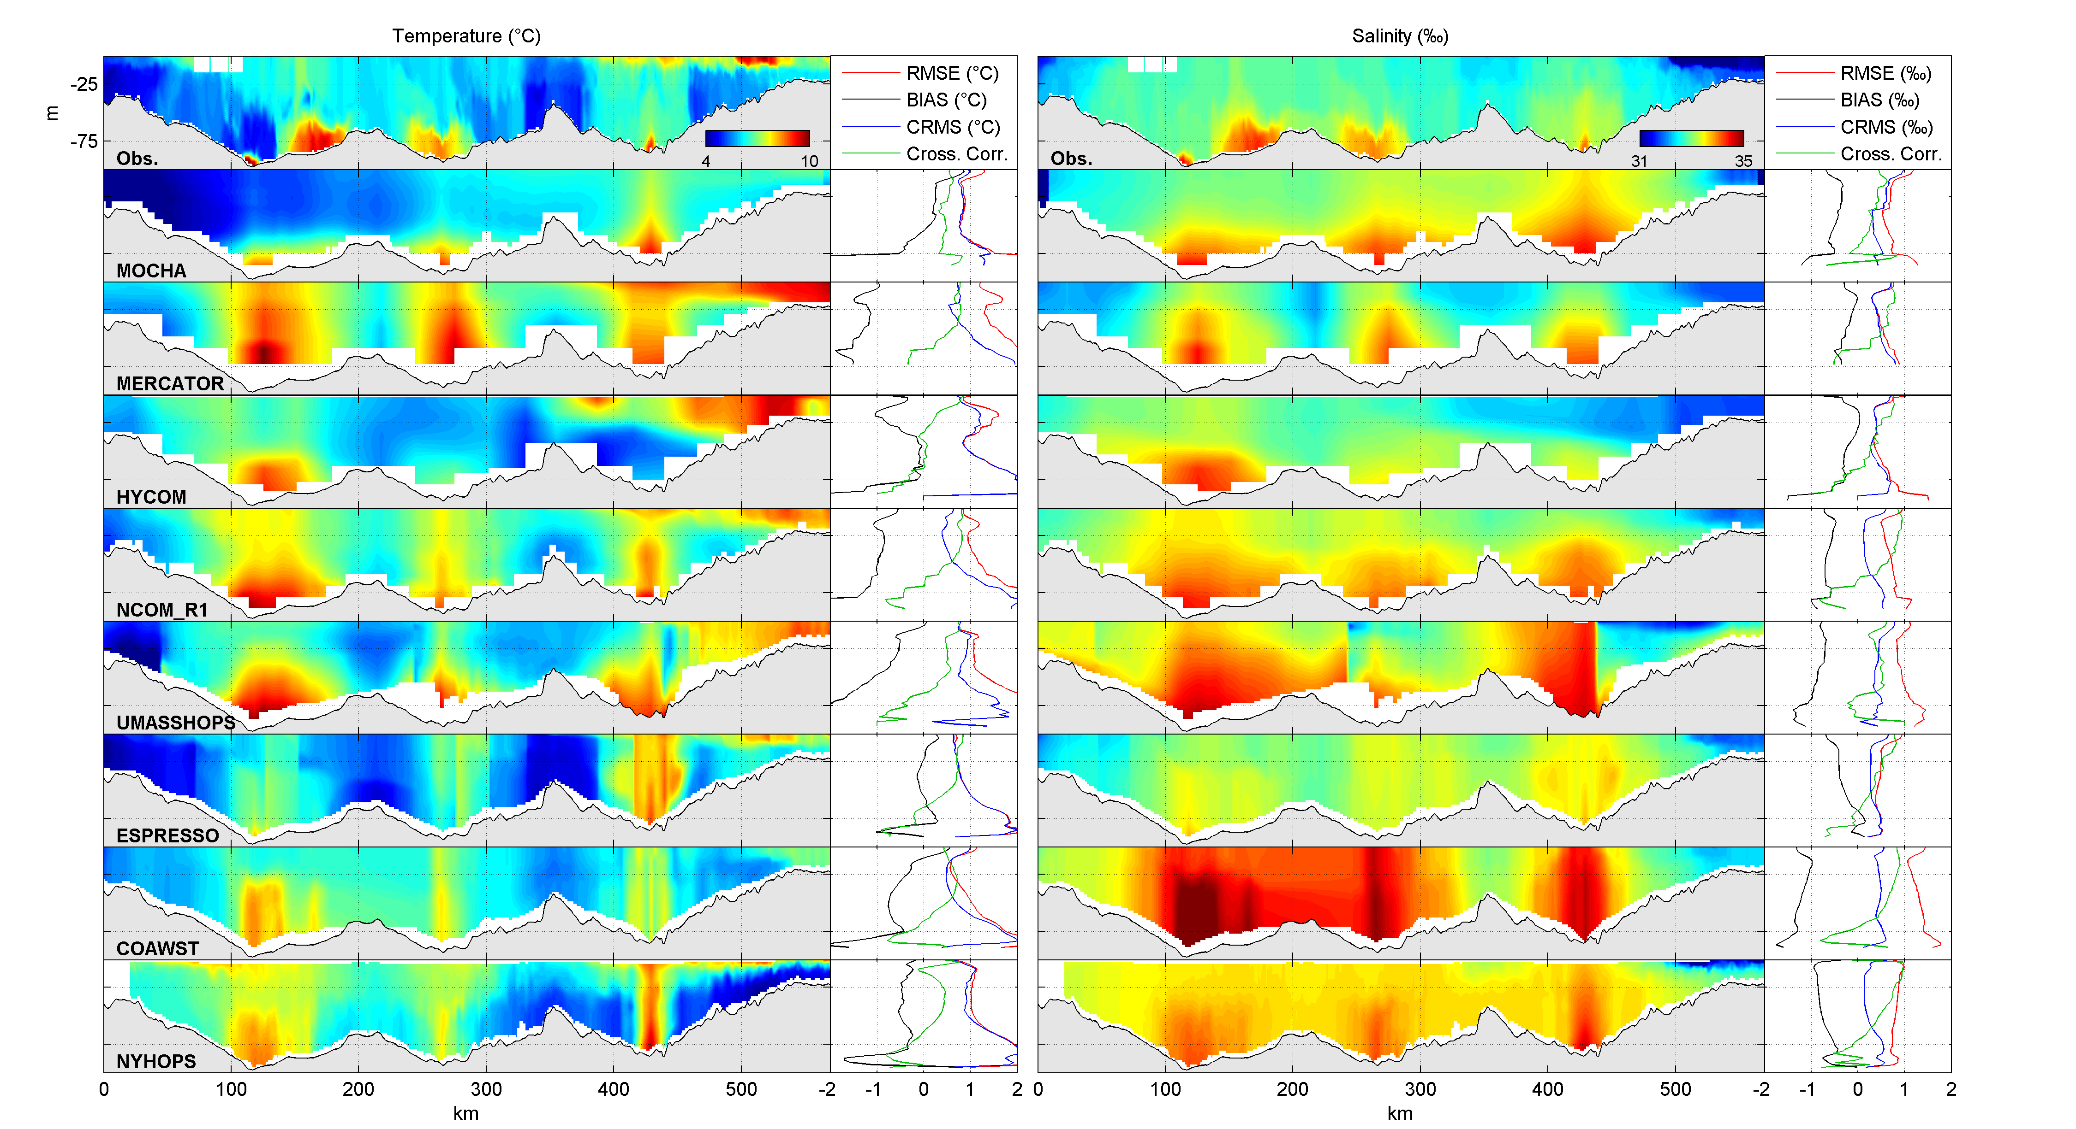
MAB March 2010
Notes:
Temperature (left) and salinity (right) versus along-track distance and depth for the MAB AUGV deployment of 04/2010 (see Fig. 1 for trajectory). Top row: reduced resolution observation set obtained following binning described in text. Other rows: Individual model results interpolated to the AUGV track at binned observation times. Model labels are as defined in Table 1. Summary line plots show root mean squared error (RMSE), mean bias (MB), centered root mean squared error (CRMS) and cross-correlation (R) versus depth for each model compared to this set of observations.

Slide 26
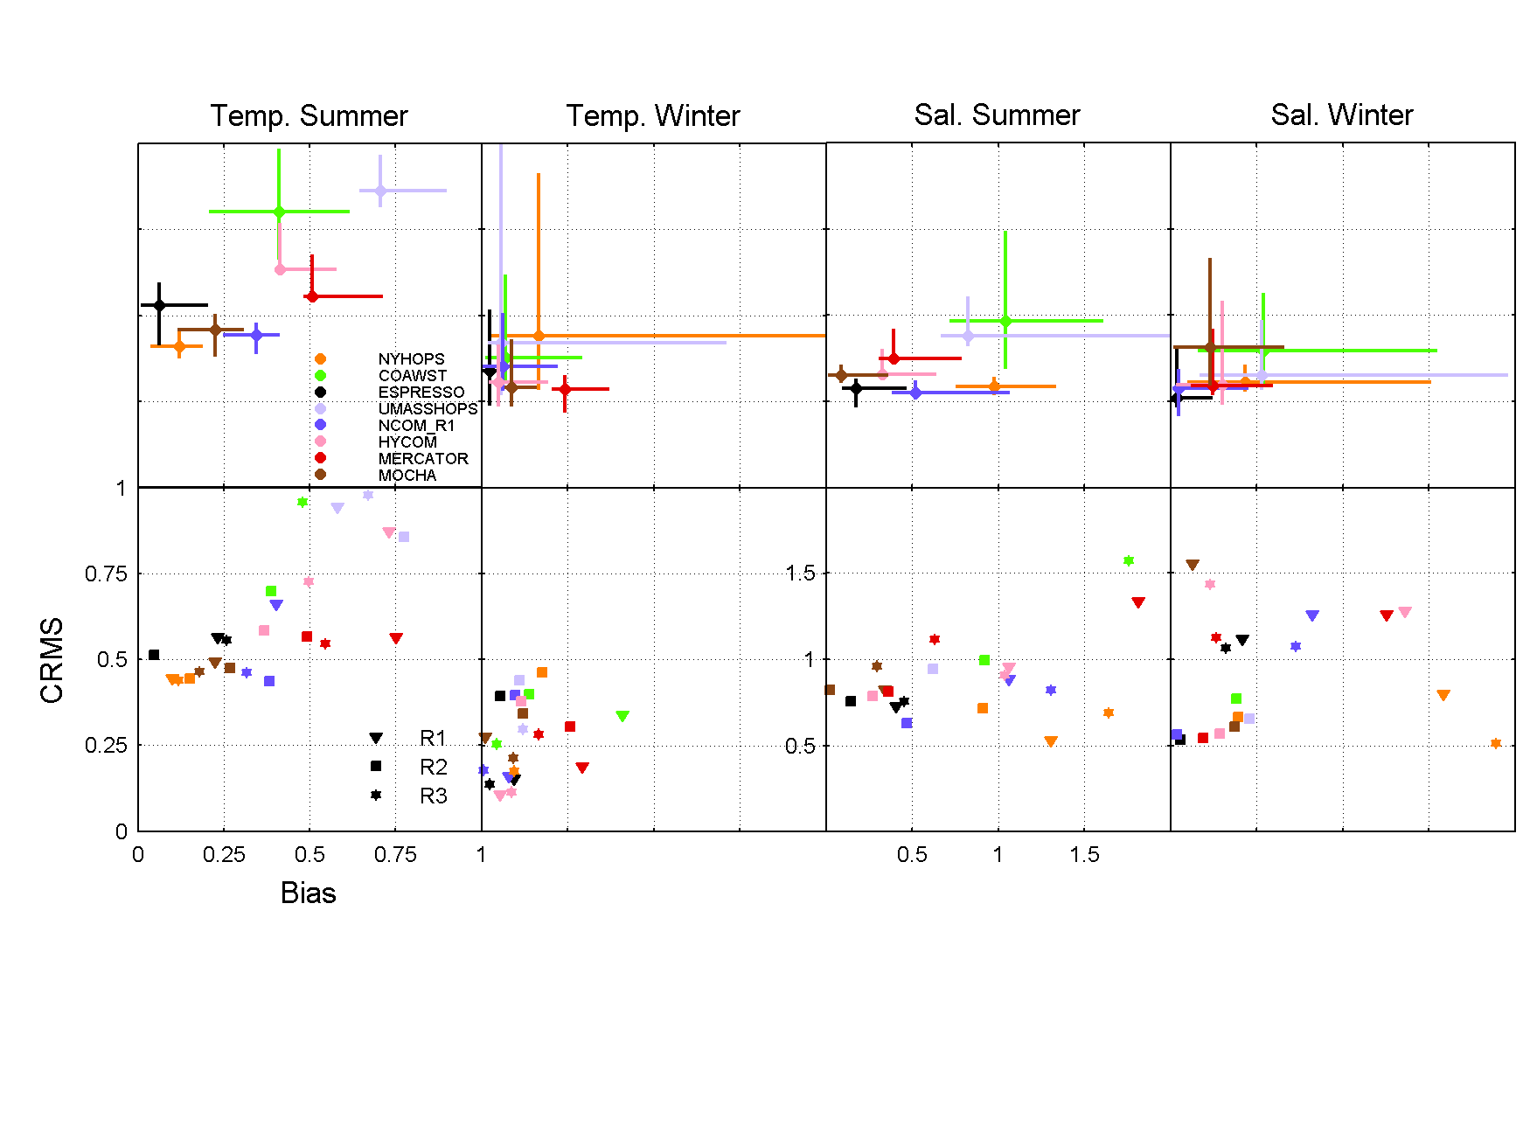
Multi-model skill assessment
Ensemble Mean BIAS (x-axis) and Centered RMS error (y-axis)
Distance from origin is Root Mean Squared Error (RMSE)
Error bars are 95% conf.
1
0.75
0.5
0.25
0
Centered RMS error
0 0.25 0.5 0.75 1
Mean BIAS
7

Slide 27
Multi-model skill assessment
Ensemble Mean BIAS (x-axis) and Centered RMS error (y-axis)
Distance from origin is Root Mean Squared Error (RMSE)
Error bars are 95% conf.
1
0.75
0.5
0.25
0
Centered RMS error
0 0.25 0.5 0.75 1
Mean BIAS
7

Slide 28
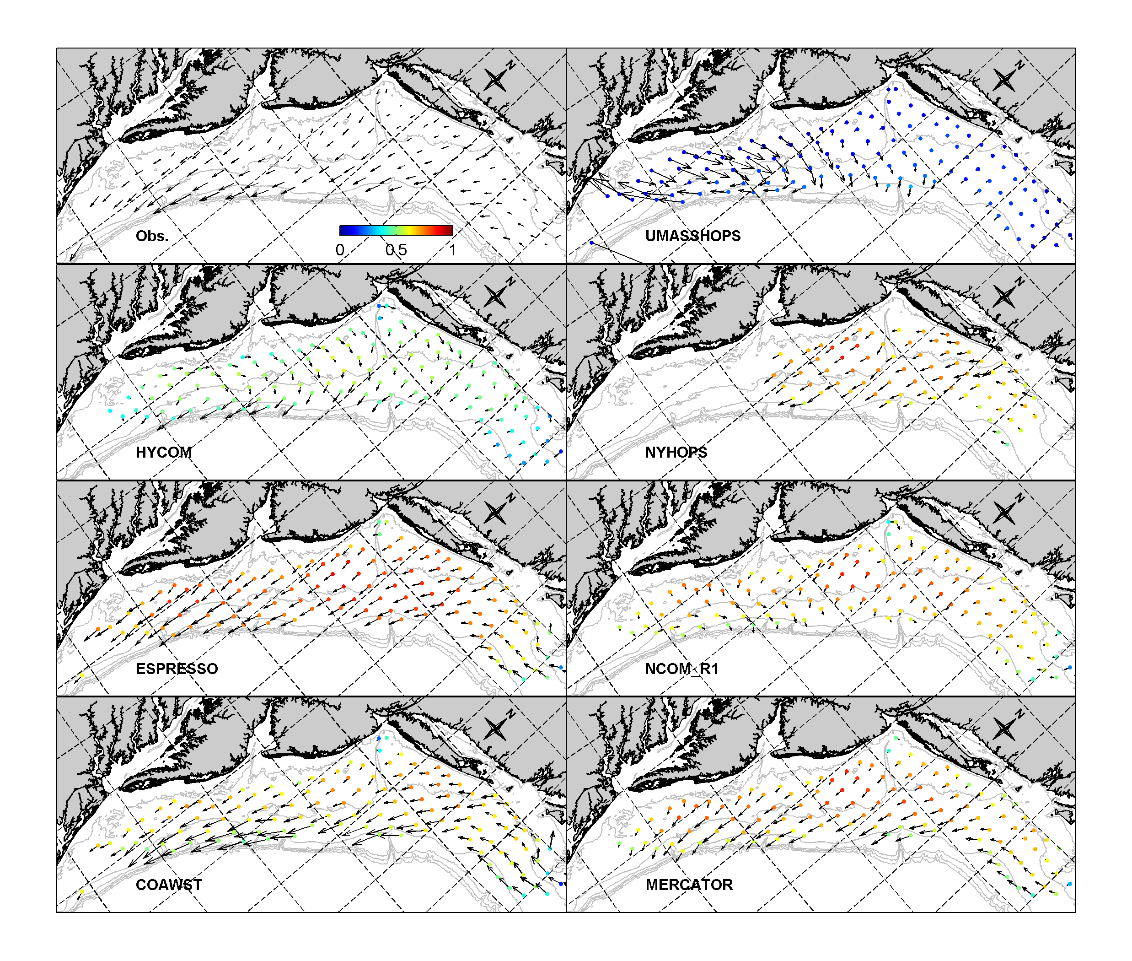
Skill assessment
Vectors: 2-year mean surface current compared to CODAR
Color: Magnitude of vector complex correlation (for daily variability)
Notes:
ESPreSSO assimilates CODAR
COAWST assimilation=nudging
Next, GODAE models …

Slide 29
Skill assessment
Vectors: 2-year mean surface current compared to CODAR
Color: Magnitude of vector complex correlation (for daily variability)
What next?
Observation impact

Slide 30
Bias removal
Some details …
Removing bias from boundary conditions and data is crucial
4D-Var will not converge if it cannot reconcile model and data error
Co-variances embodied in the Adjoint and Tangent Linear physics are incorrect if the background state is biased
Open Boundary Conditions
(T and S) from HYCOM are adjusted by matching mean to regional climatology (MOCHA)
Open boundary sea level and velocity, and regional Mean Dynamic Topography (MDT) are computed using 4D-Var with annual mean observations (climatology)

Slide 31
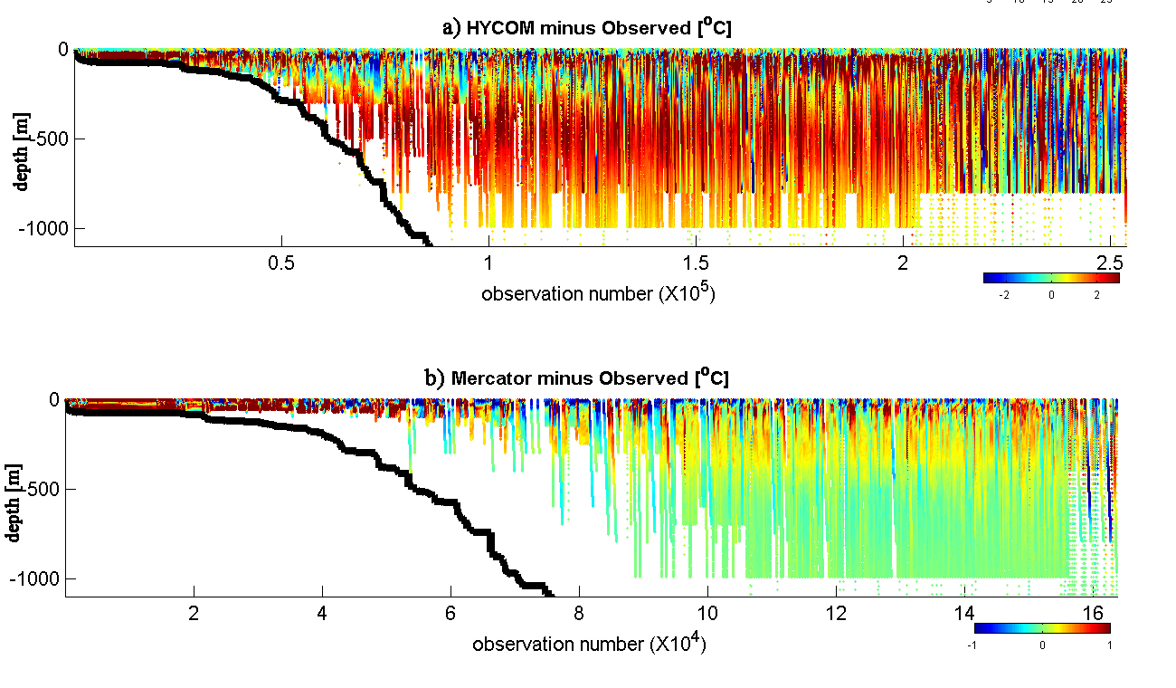
Bias in global data assimilating models compared to a regional climatology:
Bias is problematic for down-scaling
HYCOM minus Observed ºC
Data (obs. number) sorted by ocean depth in model domain
-2 0 2 ºC
MERCATOR minus Observed ºC
-1 0 1 ºC
Notes:
Downscaling is hampered by bias in large scale analysis fields.

Slide 32
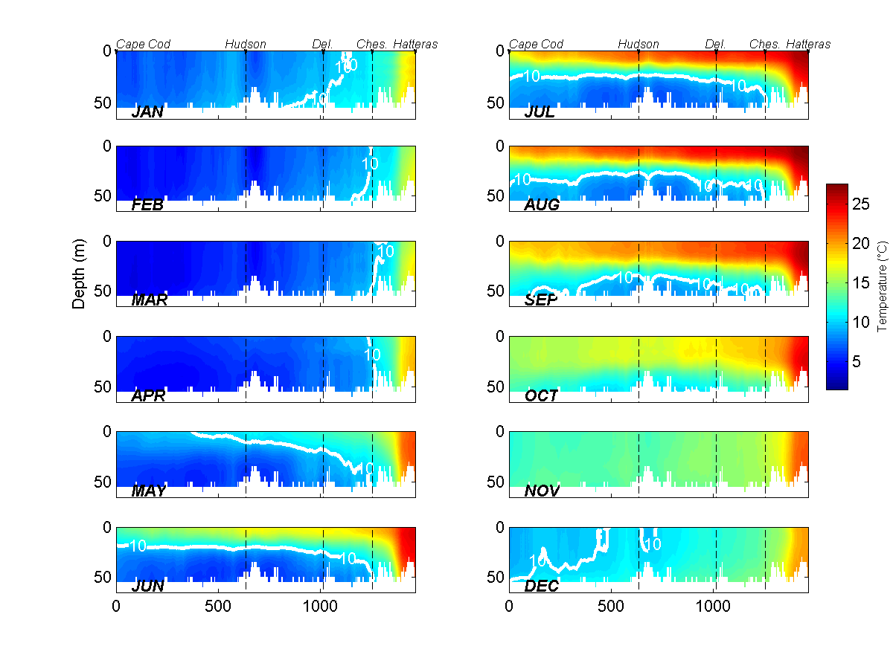
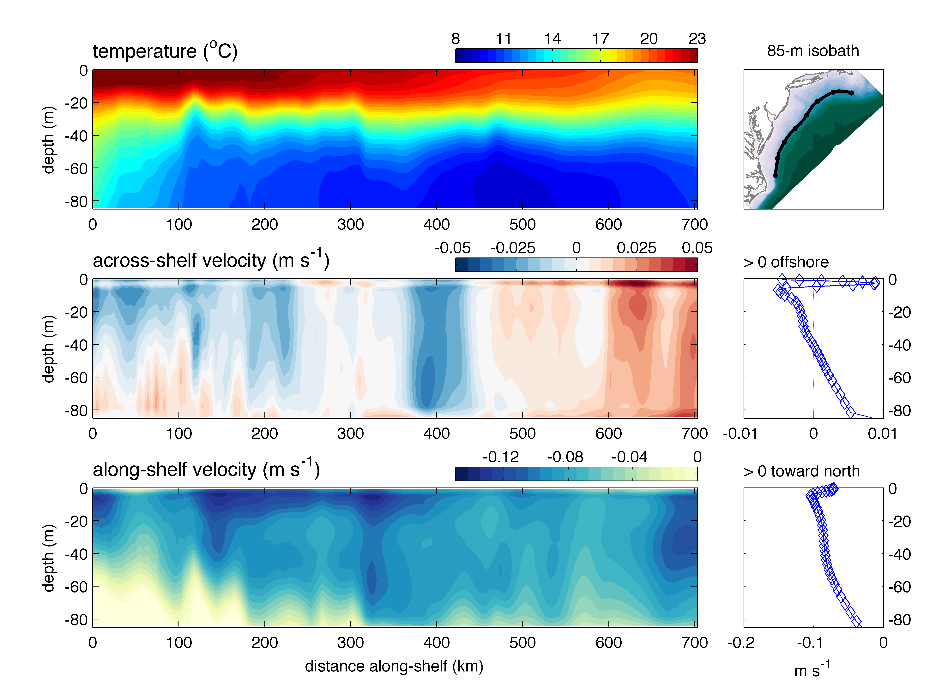
4DVAR analysis of mean climatological
ocean state
Combine …
High-res regional T/S
climatology (MOCHA)
with …

Slide 33
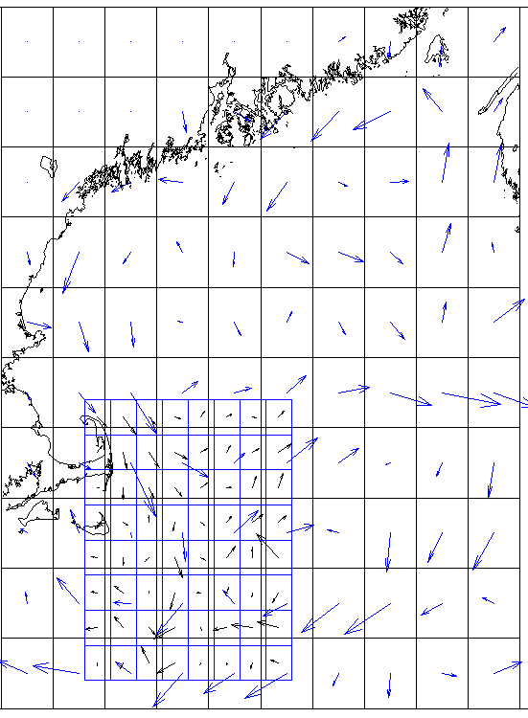
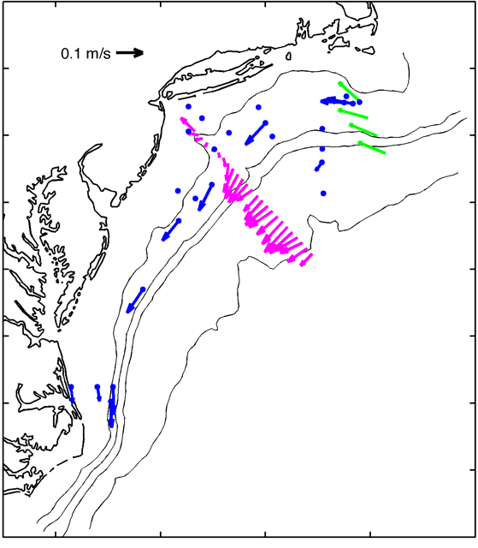
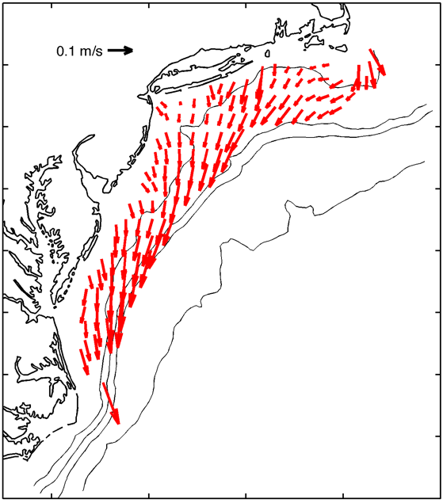
4DVAR analysis of mean climatological
ocean state
velocity obs. from … surface drifters
moorings (blue, green)
and ship ADCP (magenta) ) CODAR (red)
… to get ... >>

Slide 34
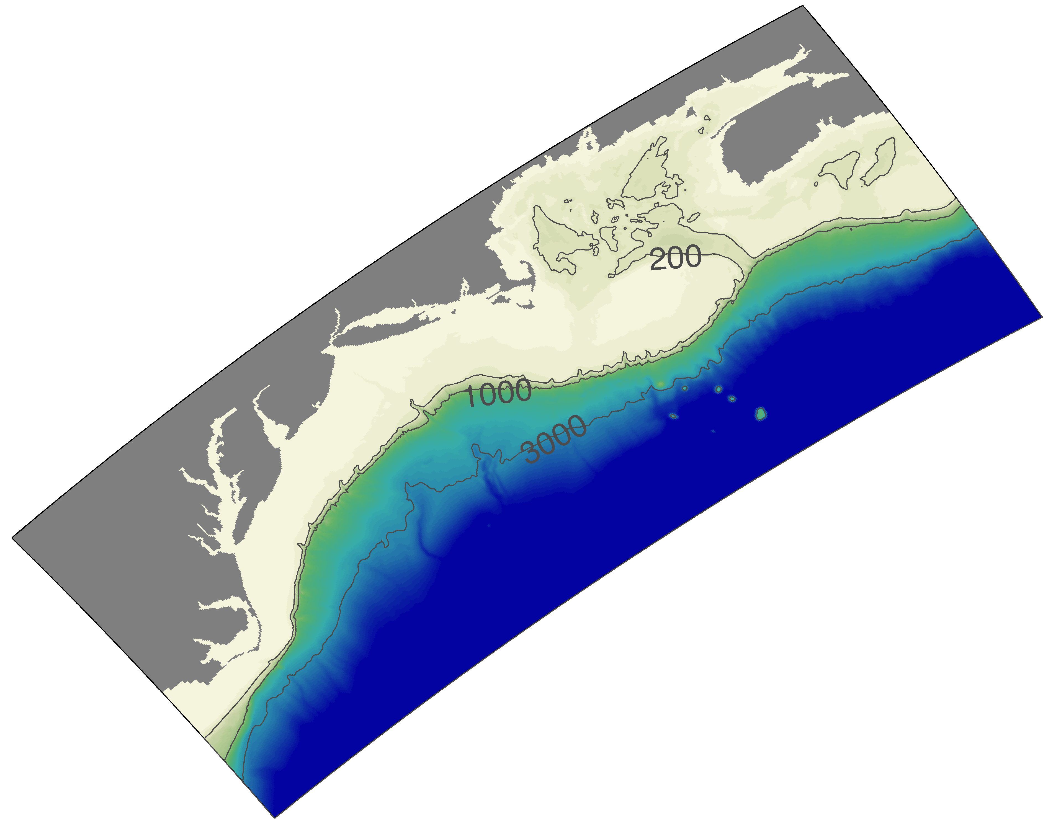
4DVAR analysis of mean climatological
ocean state
… a dynamically and kinematically adjusted MDT, and seasonal T,S,u,v for
OBC bias removal
Mean Dynamic Topography (MDT) in meters from ROMS
climatological 4DVAR

Slide 36
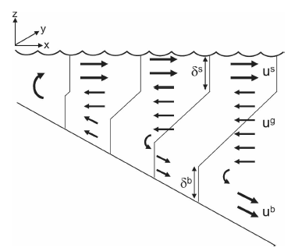
Lentz (JPO, 2008)
100 m

Slide 37
Summary
Rutgers ROMS ESPreSSO and Doppio 4DVAR use all available data from a modern coastal ocean observing system
  Satellite SSH and SST, HF-radar, gliders, Argo, GTS XBT/CTD
  More and diverse data is better
  Pre-processing for QC; tides in altimetry; binning to independent obs.
  OBC bias removal essential: use mean state from 4DVAR-based climatology
  Data ingest and output exploits web services (OPeNDAP/THREDDS) and interoperability of data conventions (CDM, CF-conventions, NetCDF/HDF)
Useful skill for real-time applications
  4 days for temperature and salinity; 1-2 days for velocity
Output of full model solution to THREDDS/FMRC Forecast Model Run Collection
  Surface currents to U.S. Coast Guard; Bottom temperatures to NOAA Fisheries
Development path
  Observation Impact analysis using variational tools
  Nesting (with 4DVAR)
  Representer-based observing system design/operation (for OOI Pioneer)
ROMS User Workshop, Hobart, Australia
17-20 October 2016

