Slide 1
The mean flow through Cook Strait, New Zealand, is 0.4 Sv!
Mark Hadfield & Craig Stevens
National Institute of Water & Atmospheric Research, Wellington, NZ

Slide 2
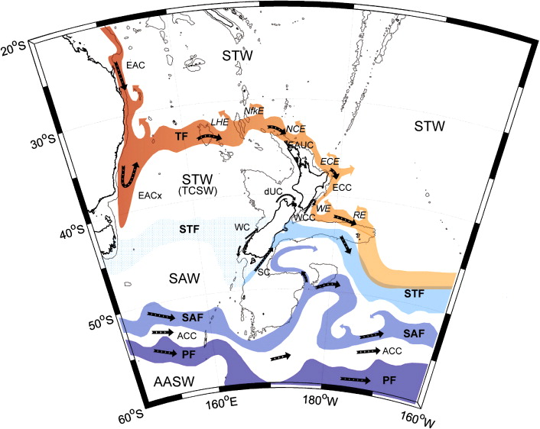

The surface circulation around New Zealand
The d’Urville Current
Published in: Stephen M Chiswell; Helen C Bostock; Philip JH Sutton; Michael JM Williams; New Zealand Journal of Marine and Freshwater Research 2015, 49, 286-317. DOI: 10.1080/00288330.2014.992918 © 2015 The Royal Society of New Zealand

Slide 3
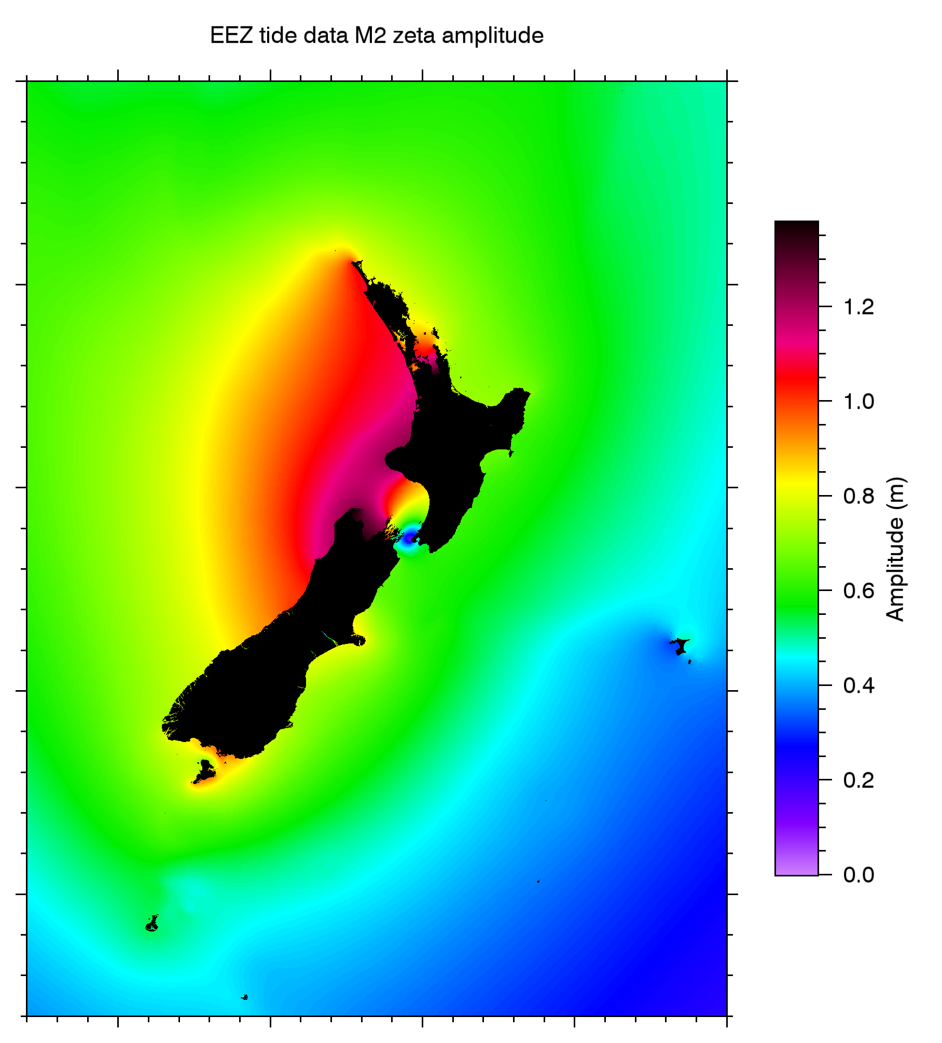
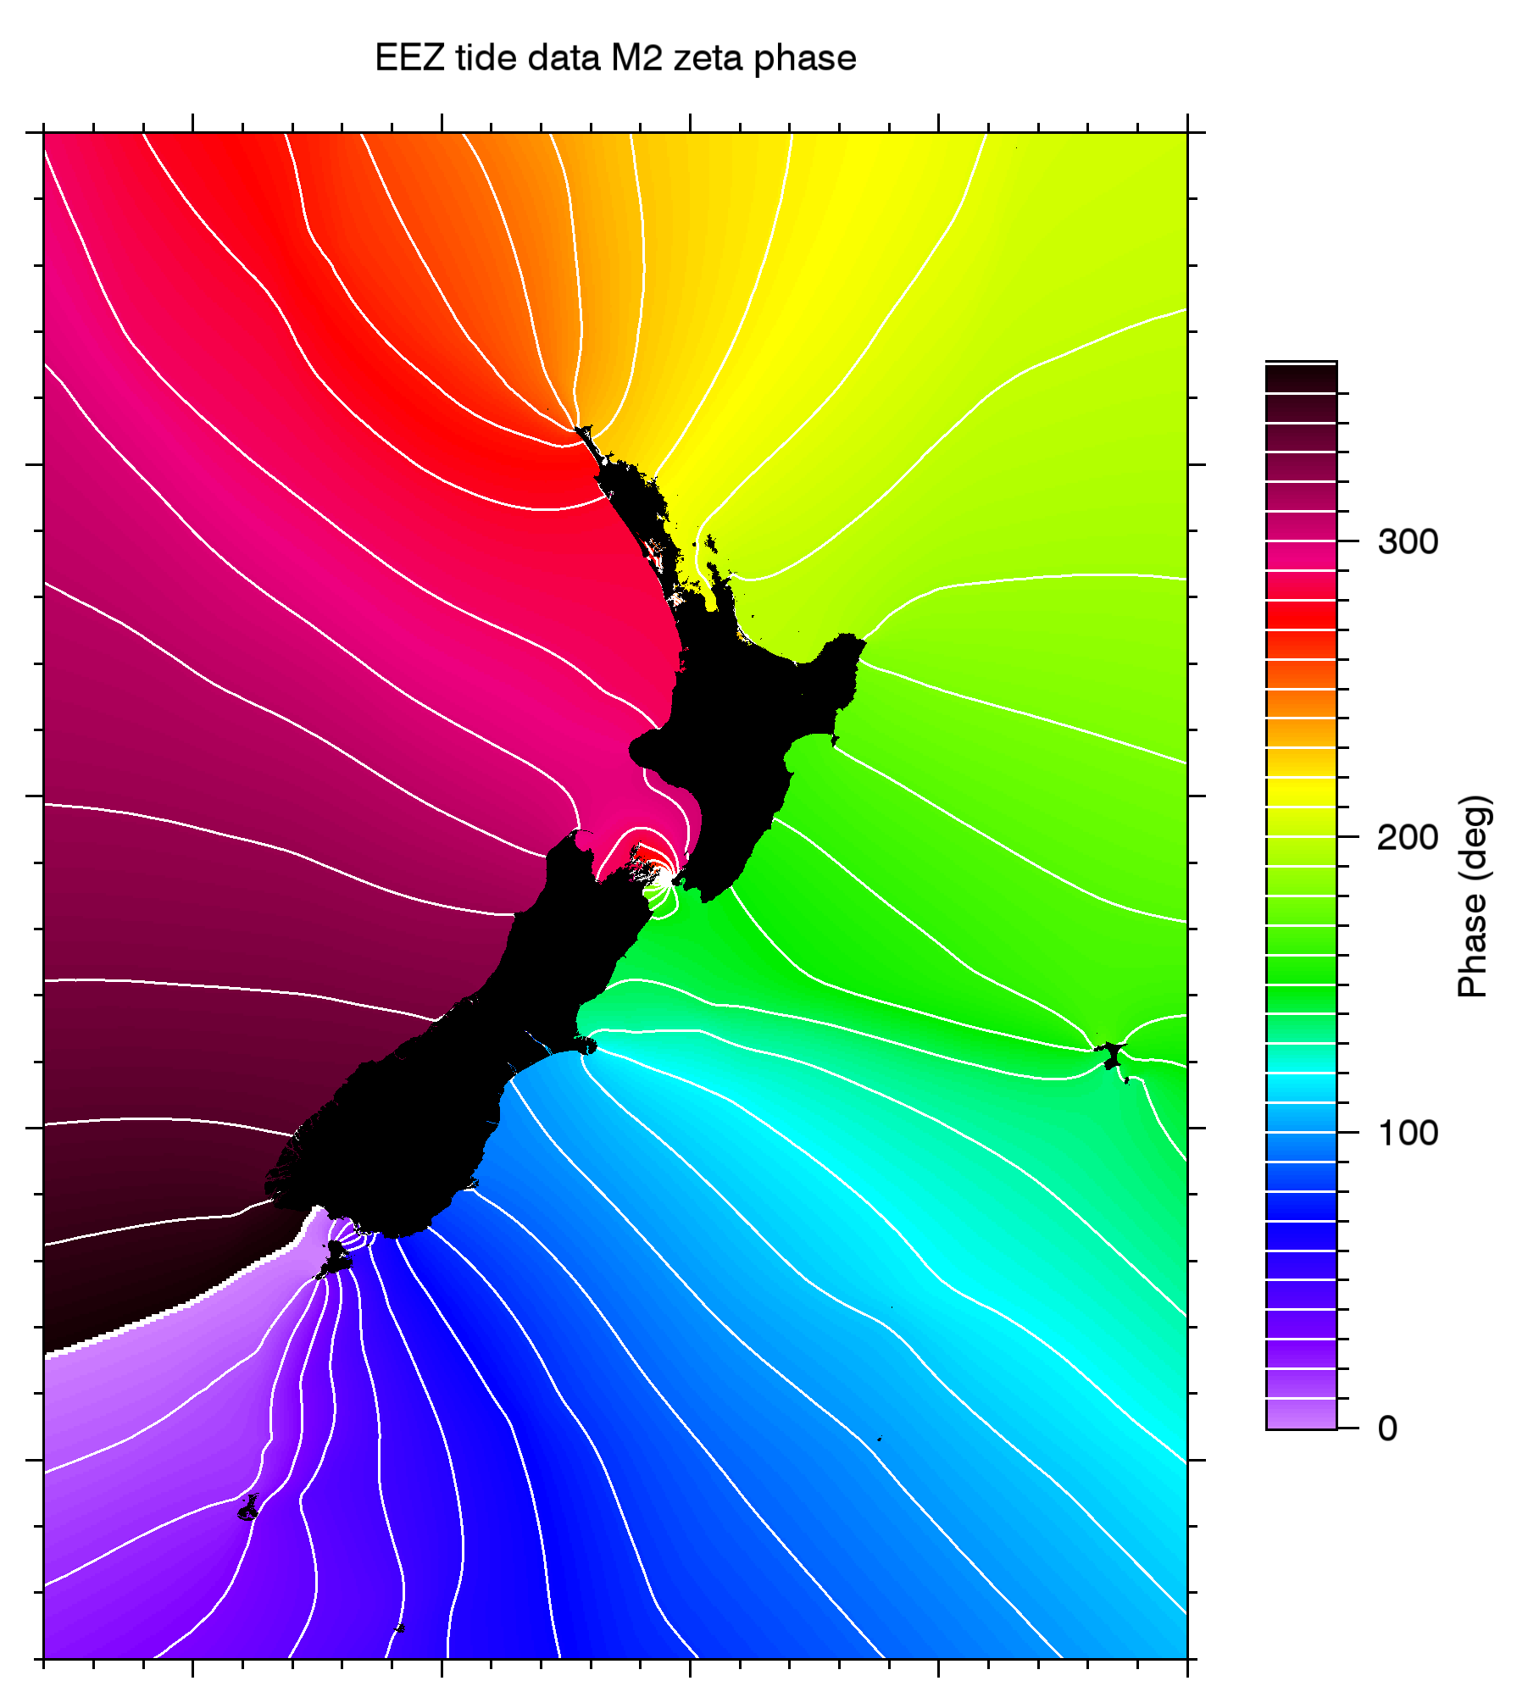
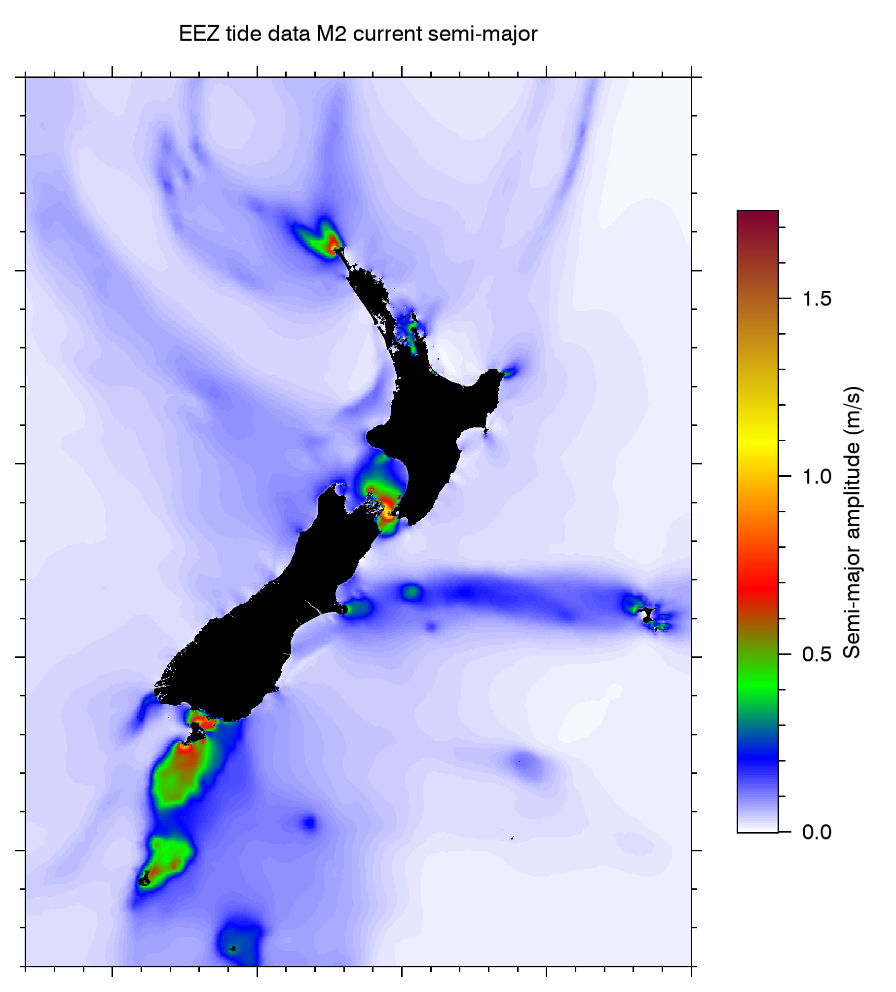

The M2 tide around New Zealand
$$∆\text{phase}=150°$$

Slide 4
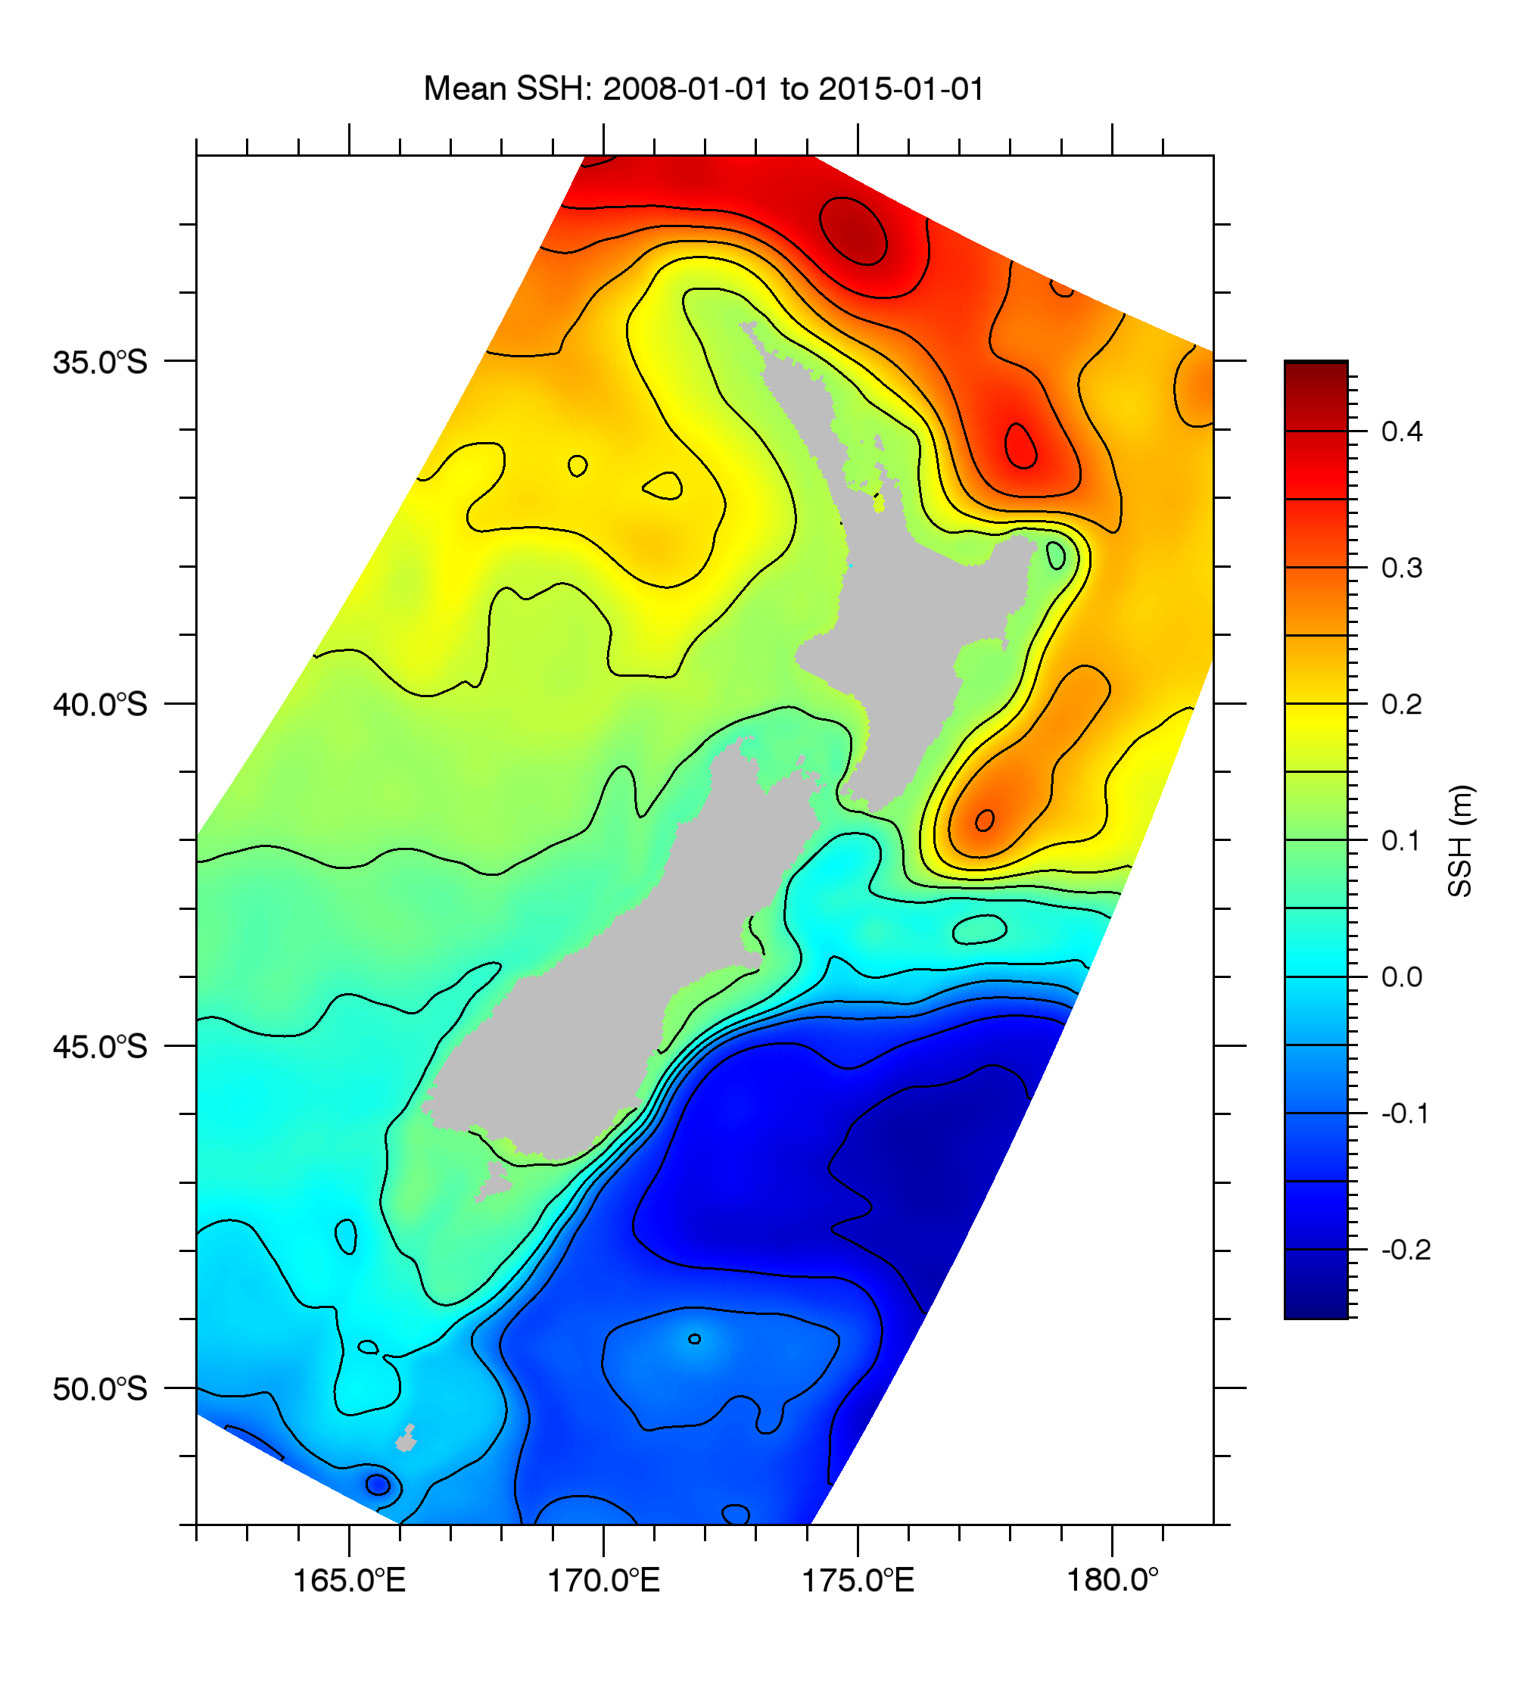

Mean sea surface height from a 7-year ROMS simulation at 5 km resolution
$$∆η≈0.1\text{m}$$

Slide 5
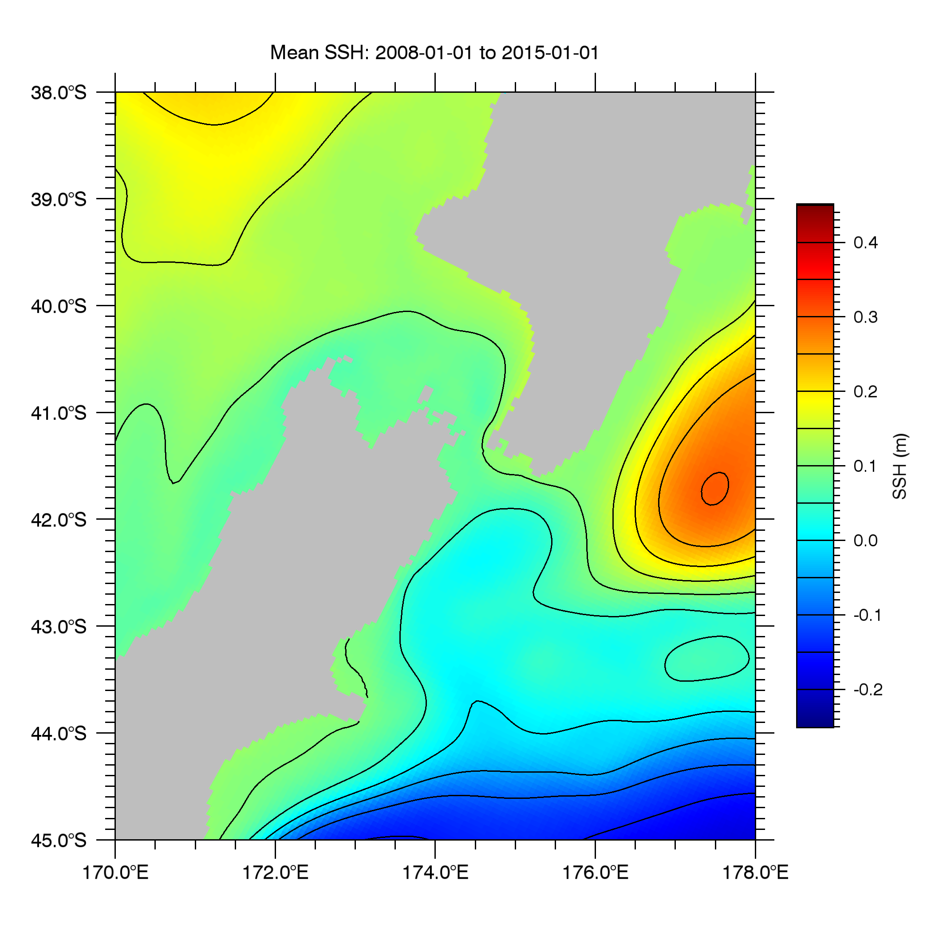
Estimated volume flux through Cook Strait: #1
Wairarapa Coastal Current 1.6 Sv
Chiswell (2000):
The Wairarapa Coastal Current transports ~ 1.6 Sv.
Water mass analysis shows about half comes via Cook Strait and the other half via the northern extension of the Southland Current.
Therefore the mean transport through Cook Strait is ~ 0.8 Sv.
d’Urville Current 0.8 Sv
Southland Current (northern extension) 0.8 Sv
Chiswell, S.M. (2000) The Wairarapa Coastal Current. New Zealand Journal of Marine and Freshwater Research, 34: 303–315. 10.1080/00288330.2000.9516934

Slide 6
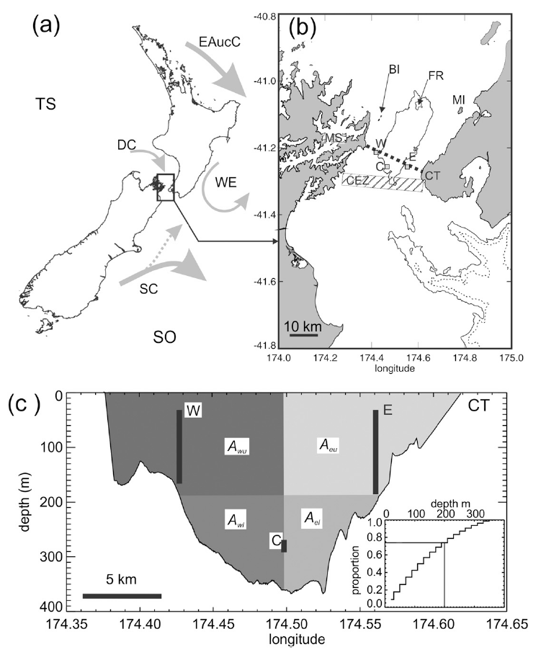
Estimated volume flux through Cook Strait: #2
Stevens (2014):
ADCPs at W and E sites: 634 days in 2 deployments;
Point current meter at 250m depth at C site: 50 days;
The cross section was divided into blocks with transports calculated from the velocity data;
Mean transport estimated as 0.25 Sv (mean)
Stevens, C. (2014) Residual flows in Cook Strait, a large tidally dominated Strait. Journal of Physical Oceanography, 44: 1654–1670. doi:10.1175/JPO-D-13-041.1

Slide 7
So we have two estimates of the mean volume flux through Cook Strait:
0.8 Sv, based on water mass analysis in the Wairarapa Coastal Current (Chiswell, 2000)
0.25 Sv, based on measurements from two ADCPs for almost two years (Stevens, 2014)
Which is closer to the truth? Can a hydrodynamic model help us decide?

Slide 8
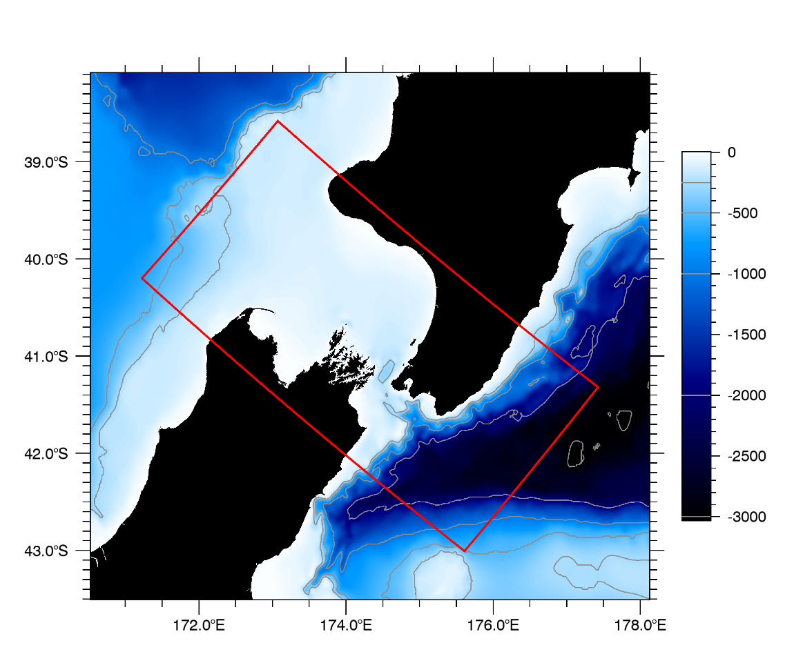
Cook Strait ROMS simulations
ROMS was run on a domain covering Cook Strait (1 km resolution, 20 levels), with the usual forcings:
Tidal height and velocity (13 constituents) at the boundary;
Surface stress from a mesoscale atmospheric model at 12 km resolution;
Surface heat and freshwater fluxes from NCEP Reanalysis with SST nudging towards OI 1/4°;
Riverine freshwater input (120 rivers) at annual mean values.
Simulations were run for a 3-year period with lateral boundary data (temperature, salinity, SSH, velocity) from three sources:
Bluelink Reanalysis (global, 1/10°, data-assimilating);
HYCOM (global, 1/10°, data-assimilating);
New Zealand region ROMS run (5 km) with HYCOM boundary data and surface stress from the 12 km atmospheric model.

Slide 9
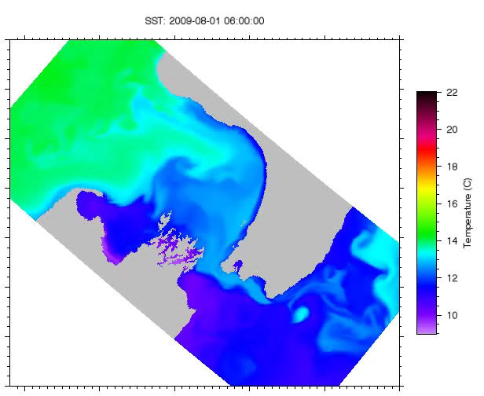
SST animation

Slide 10
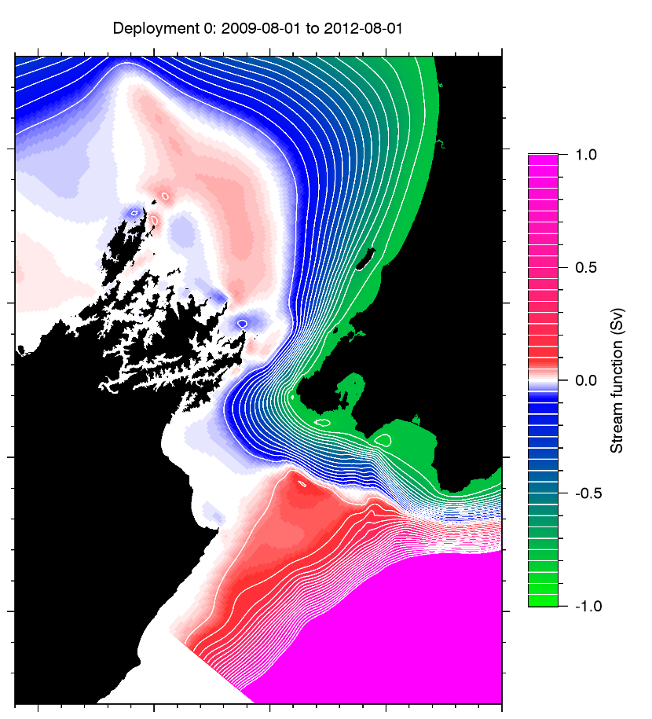
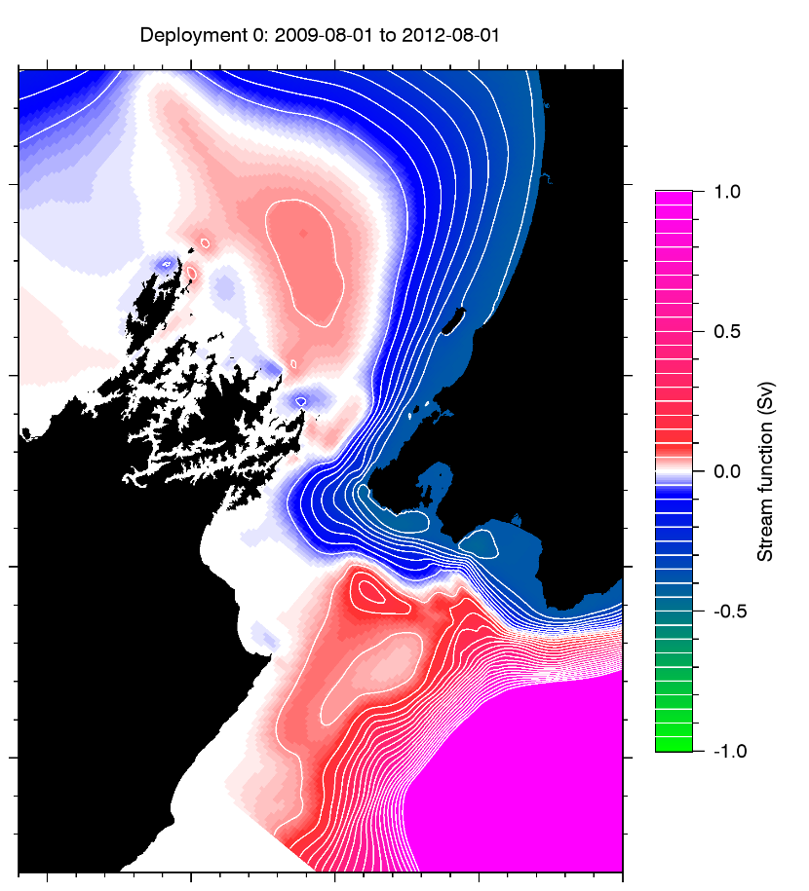
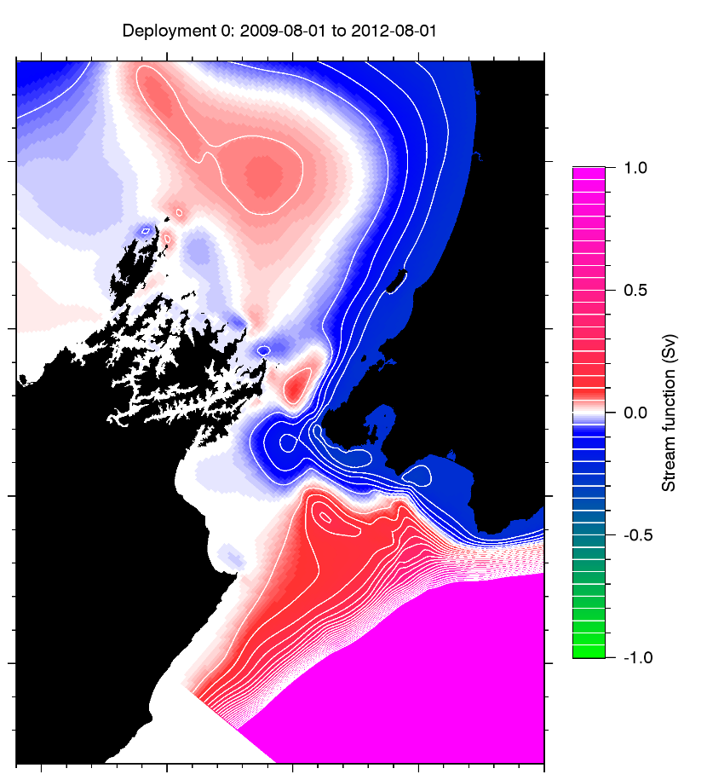
Model stream function and transport, 3-year mean
HYCOM: 0.76 Sv
BRAN: 0.39 Sv
NZ ROMS: 0.23 Sv

Slide 11
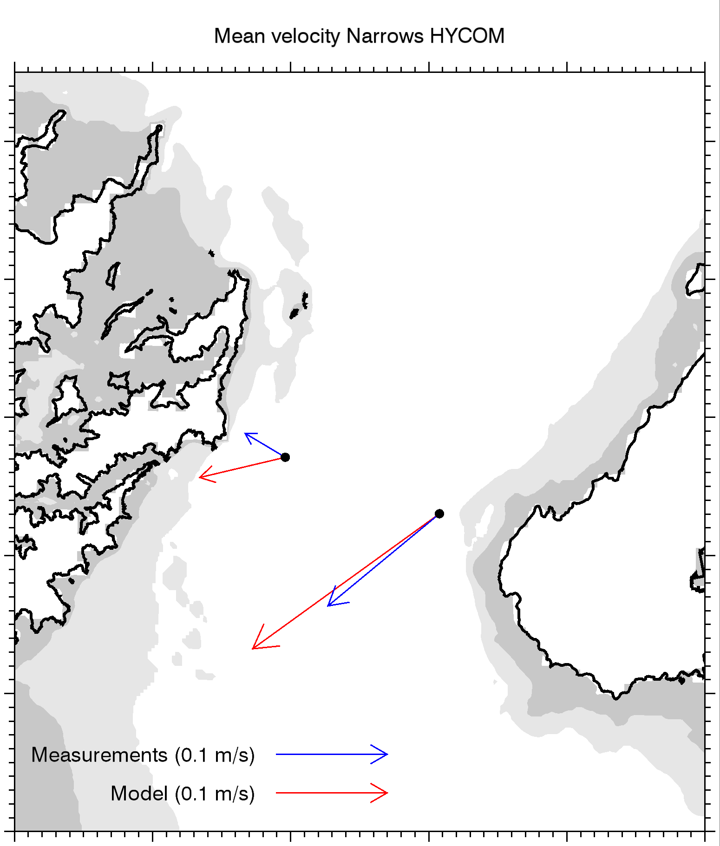
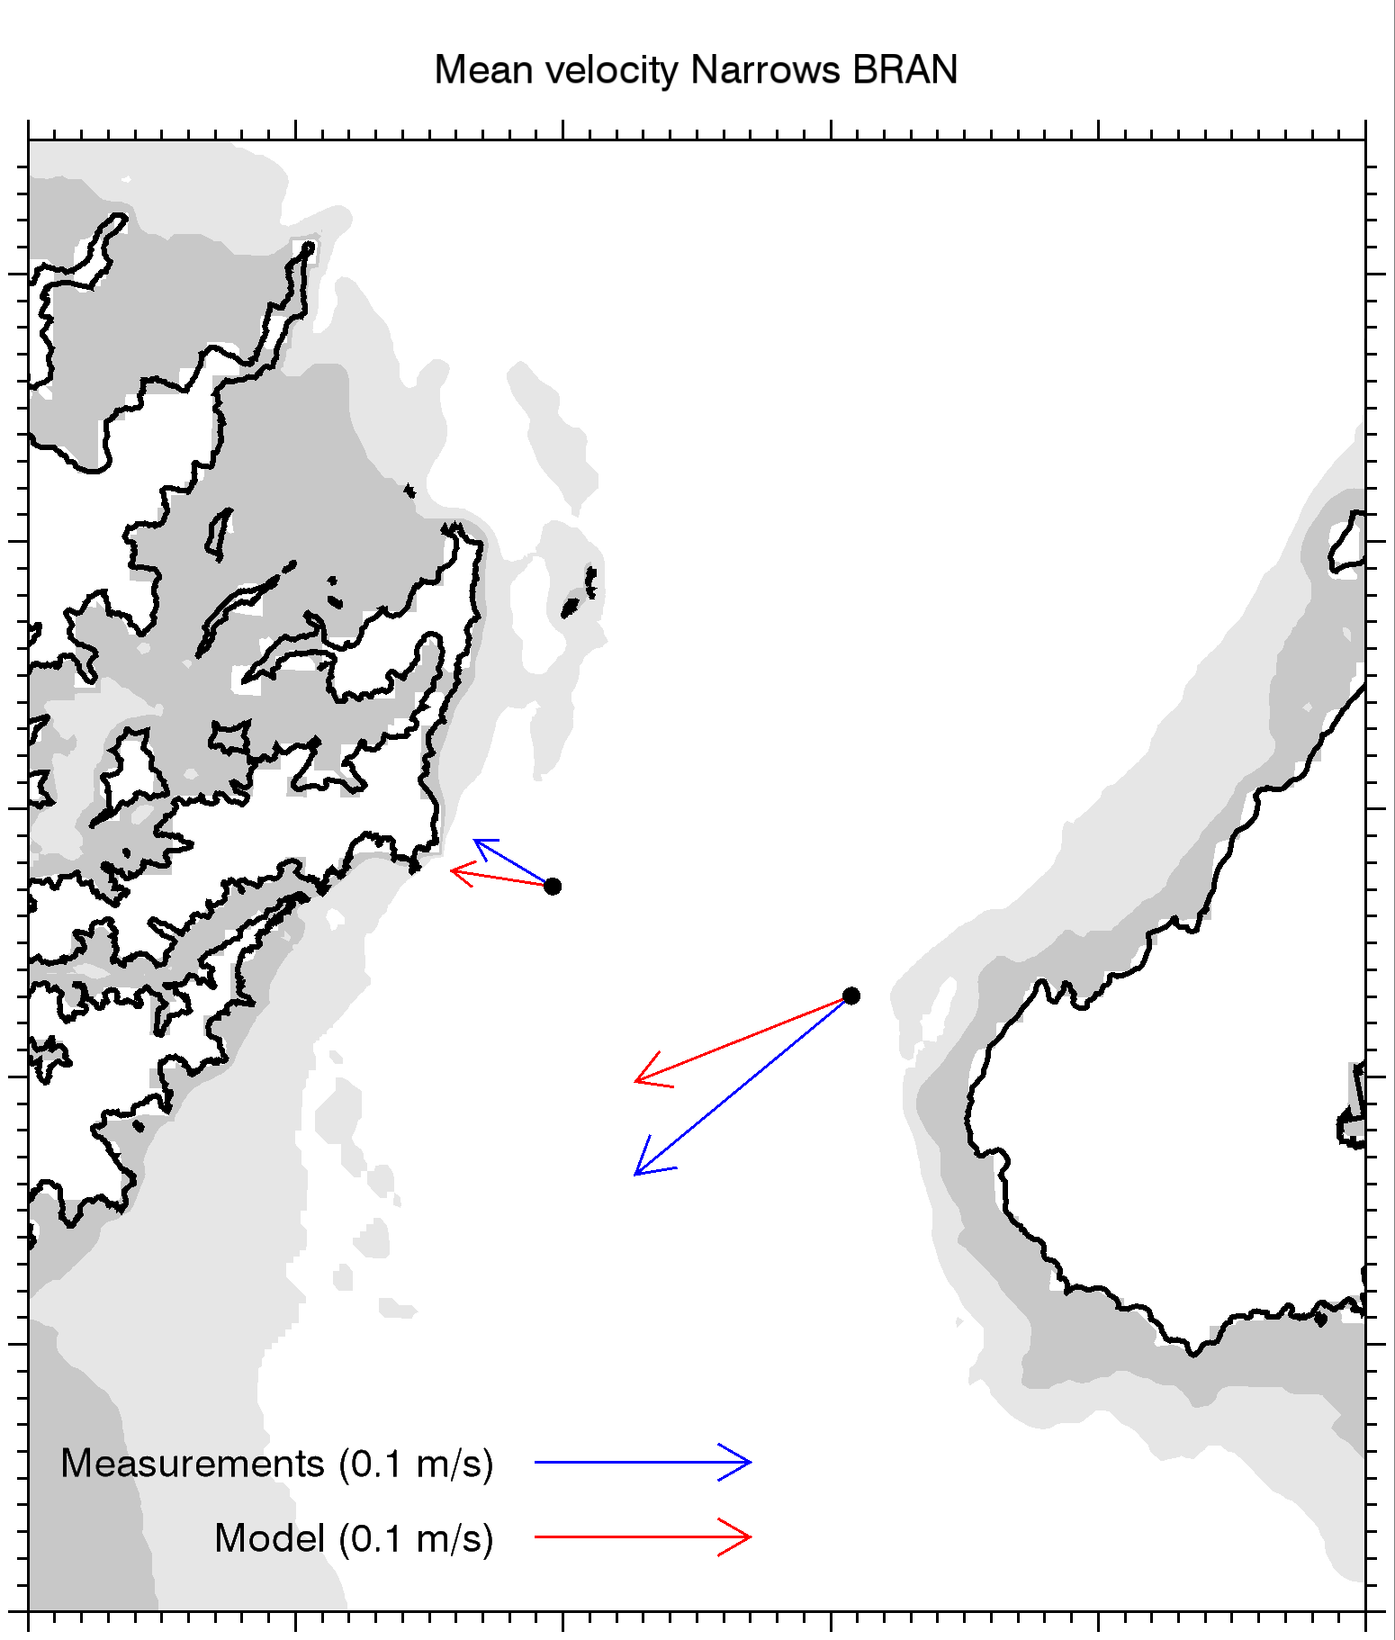

Mean velocity comparison: models vs ADCP

Slide 12
Mean velocity comparison: models vs ADCP
Use mismatch to adjust transport estimate
HYCOM:
0.76 – 0.25 = 0.51 Sv
BRAN:
0.39 + 0.04 = 0.43 Sv
NZ ROMS:
0.23 + 0.08 = 0.31 Sv

Slide 13
Conclusion 1:
The (multi-year) mean transport though Cook Strait is 0.4 Sv, (standard error ~ 0.1 Sv). This is smaller than Chiswell’s 0.8 Sv and a little larger than Stevens’ 0.25 Sv.

Slide 14
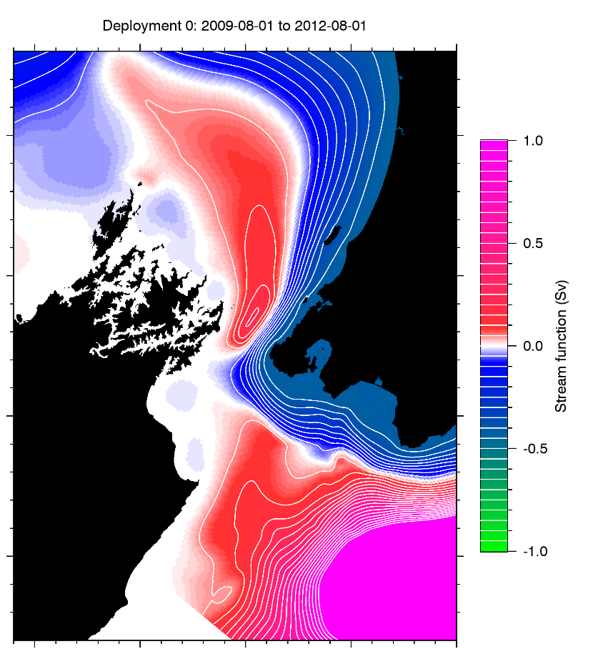
Effect of tides 1
BRAN: 0.39 Sv
BRAN (no tides): 0.40 Sv

Slide 15
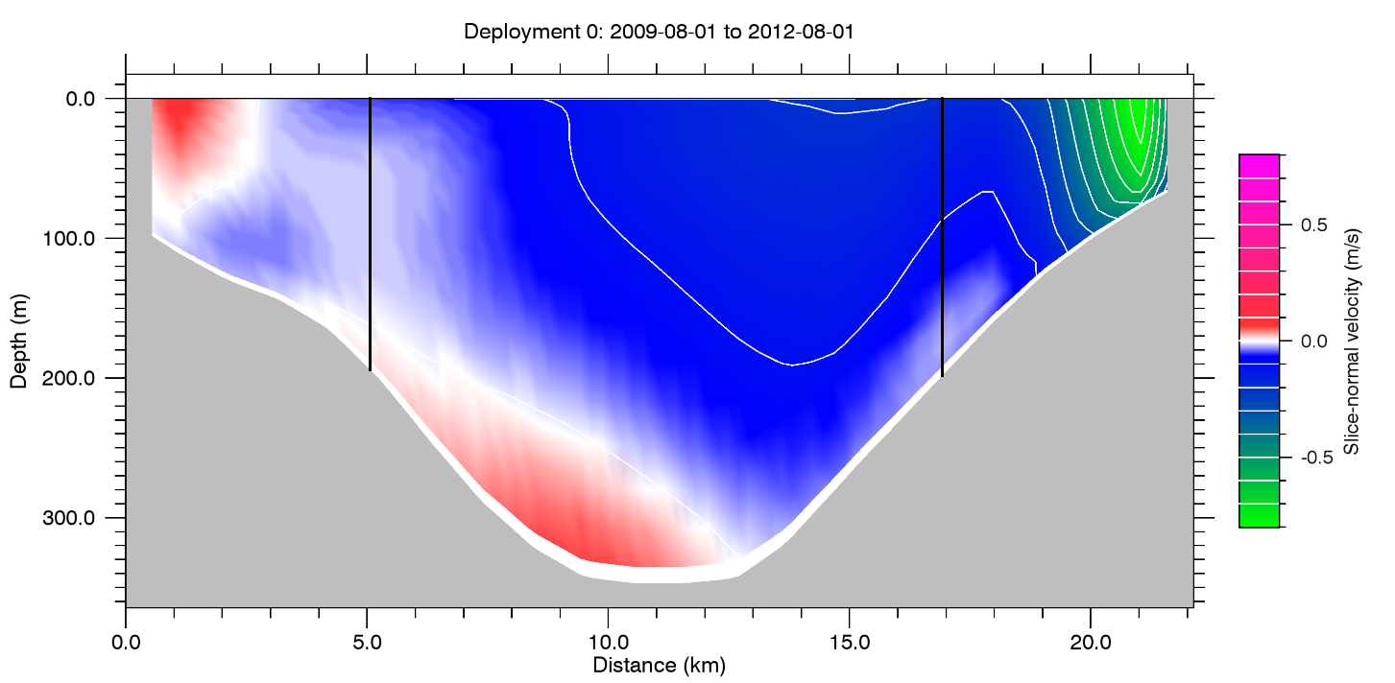
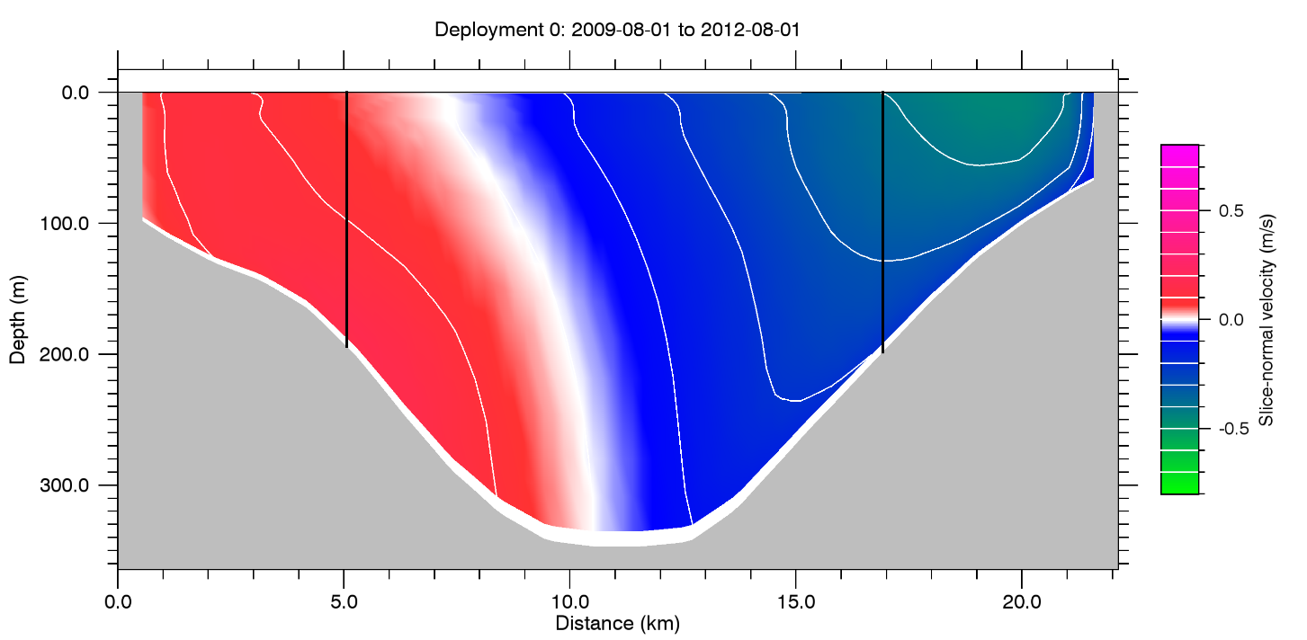
Effect of tides 2
BRAN: 0.39 Sv
BRAN (no tides): 0.40 Sv

Slide 16
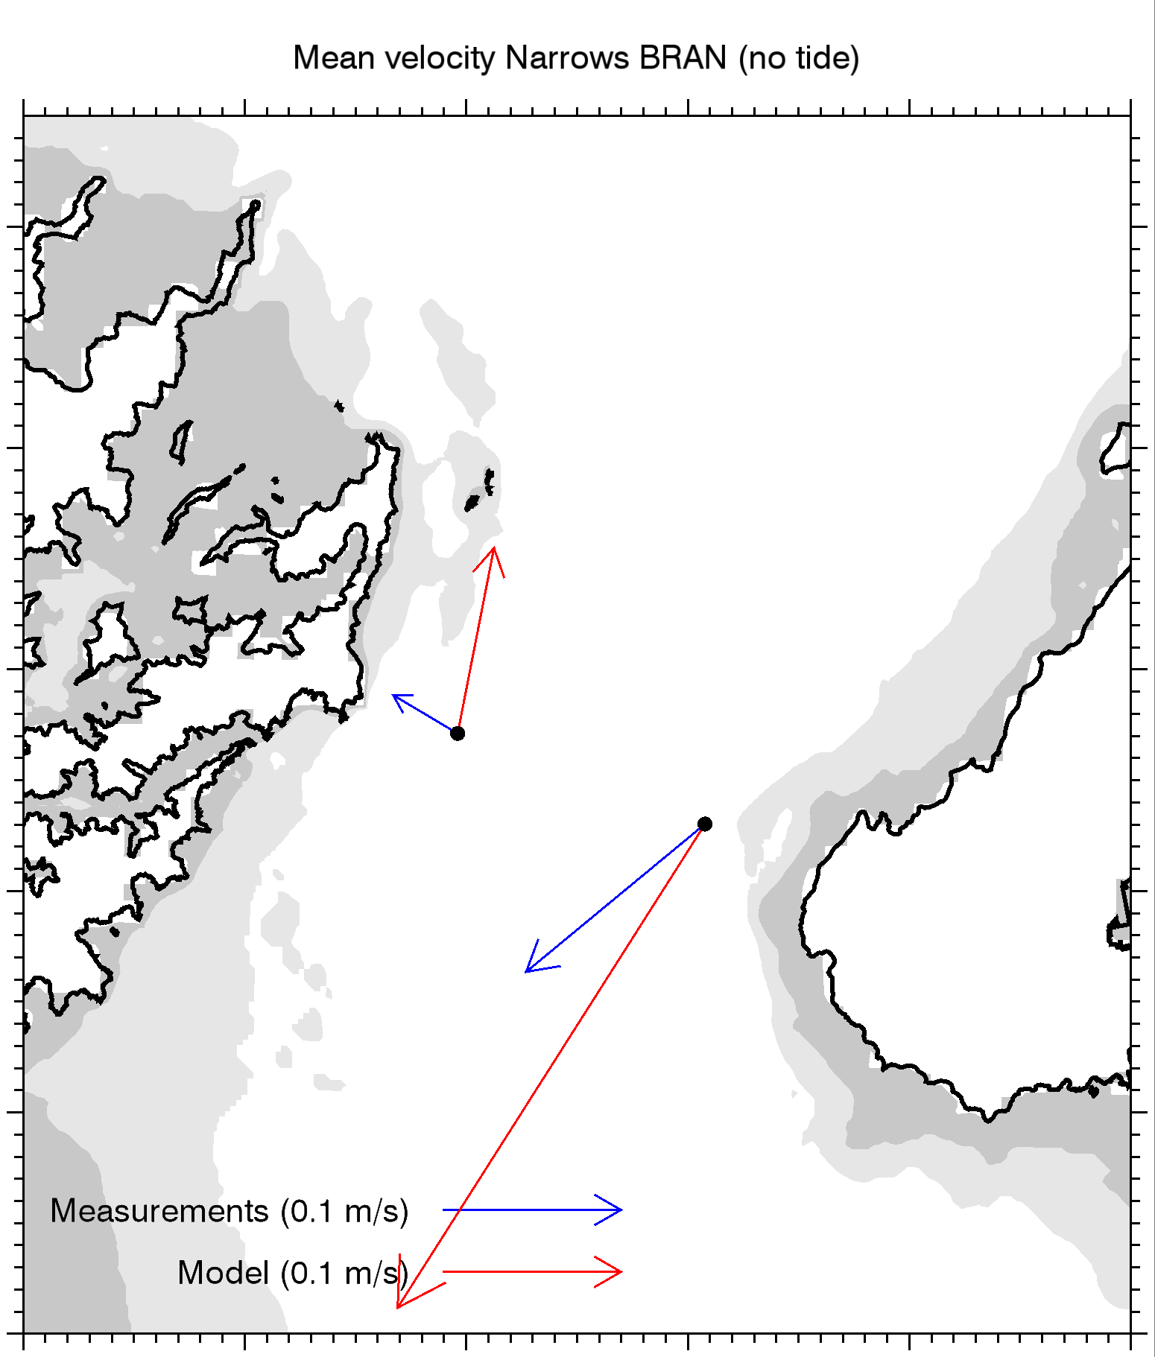
Effect of tides 3

Slide 17
Conclusion 2:
Stevens’ estimate of 0.25 Sv (based largely on two ADCPs) is biased low because both current meters are affected by local mean eddies, generated by tidal rectification. The eastern current meter, in particular, is in the northwards limb of an eddy, so is not representative of the eastern half of the channel.

Slide 18
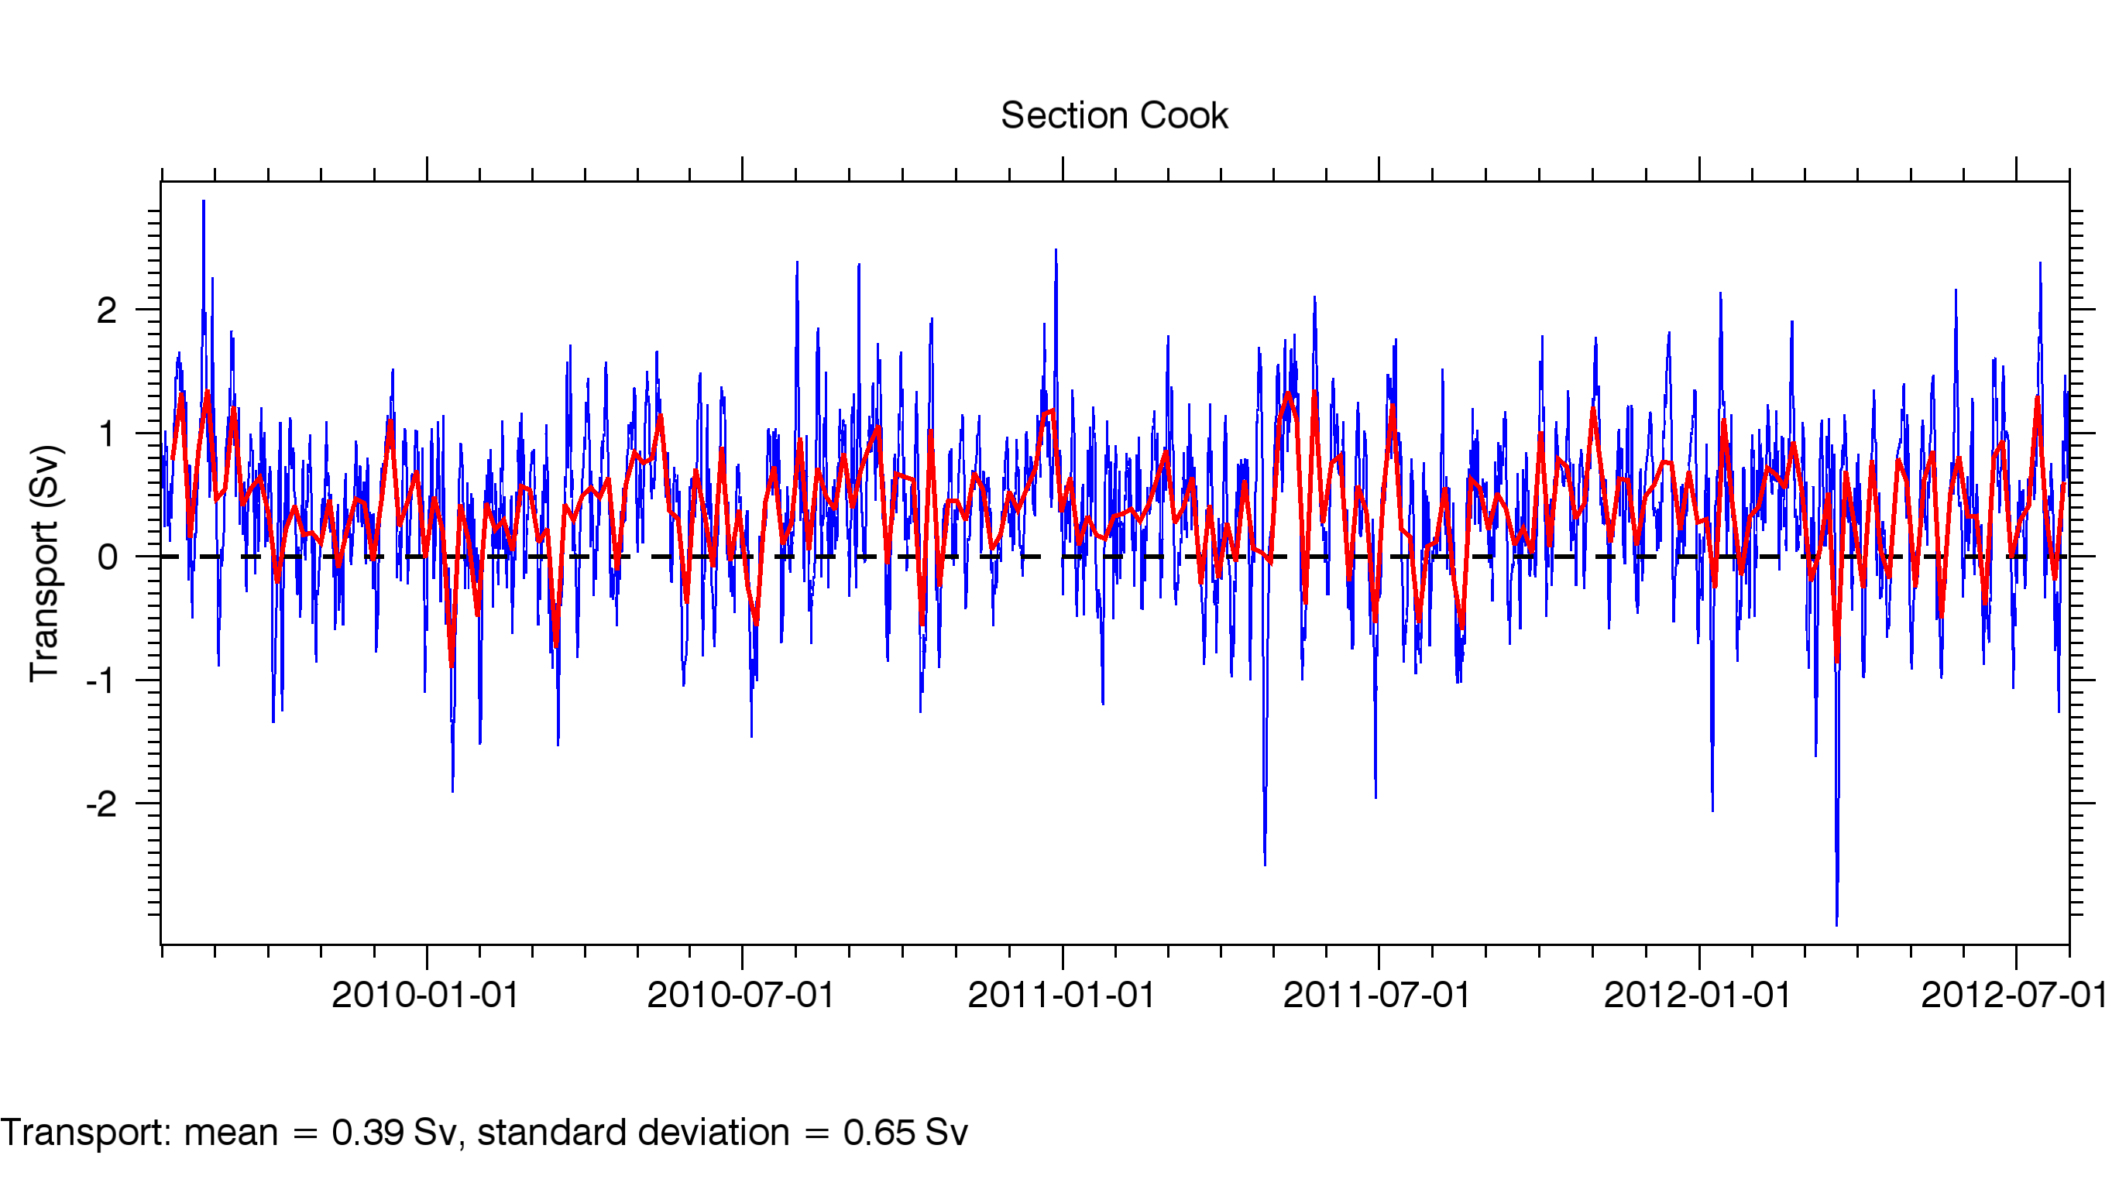
Temporal variation

Slide 19
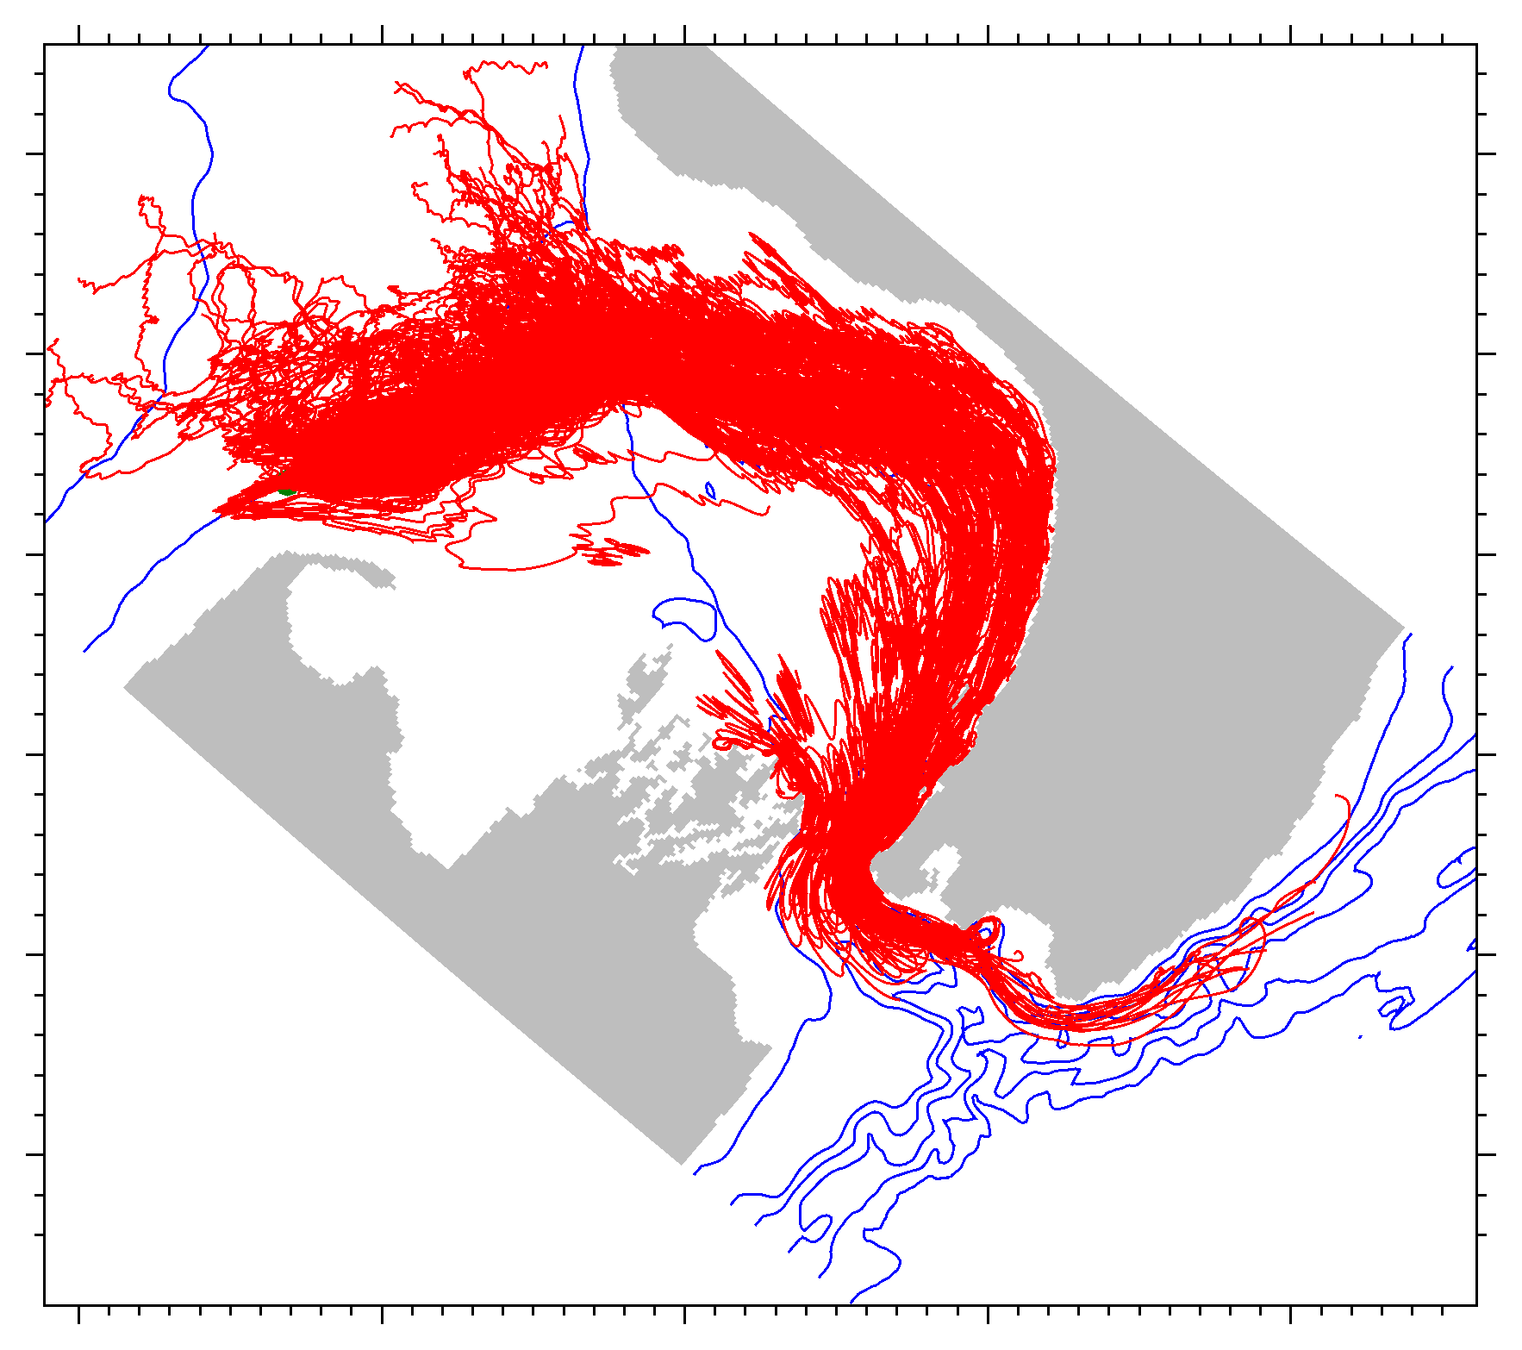
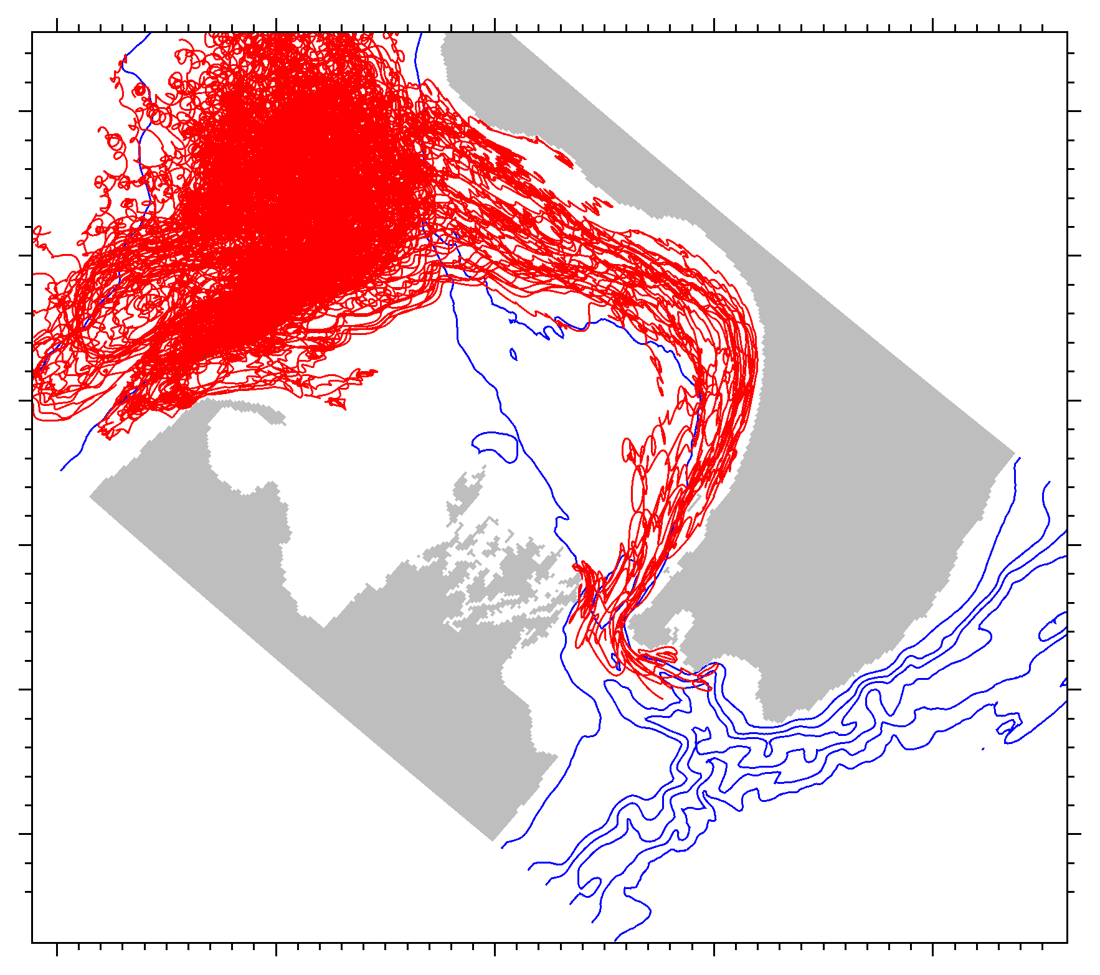
Float trajectories: a source in the d’Urville Current entrance
20-day trajectories
2009-10-19 to 2009-11-28
2010-03-18 to 2010-04-27

Slide 20
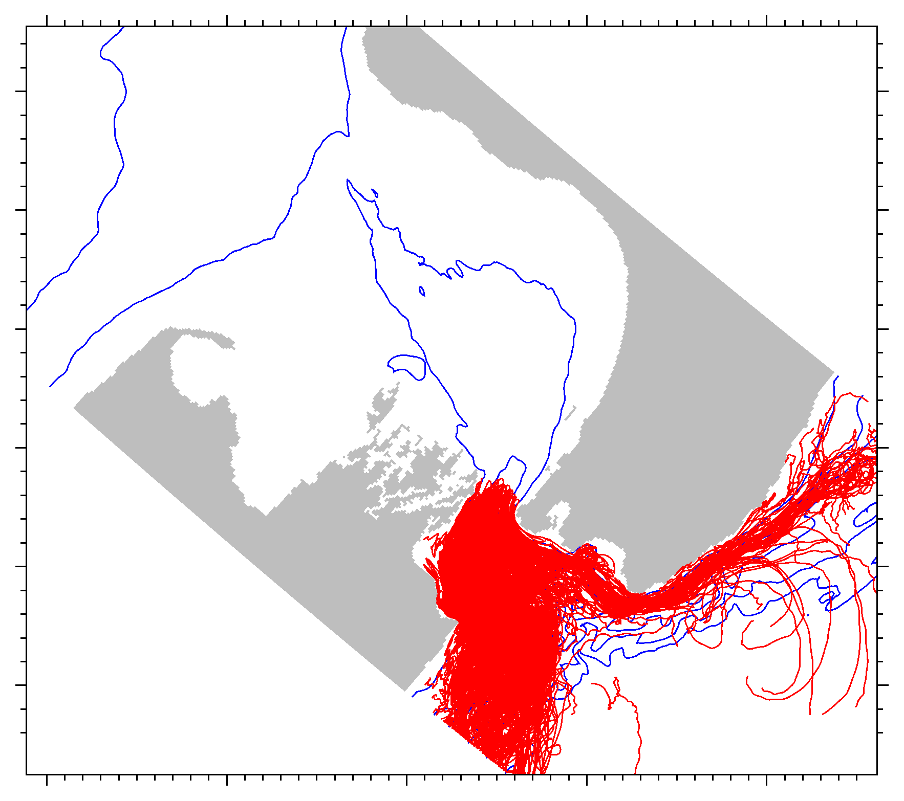
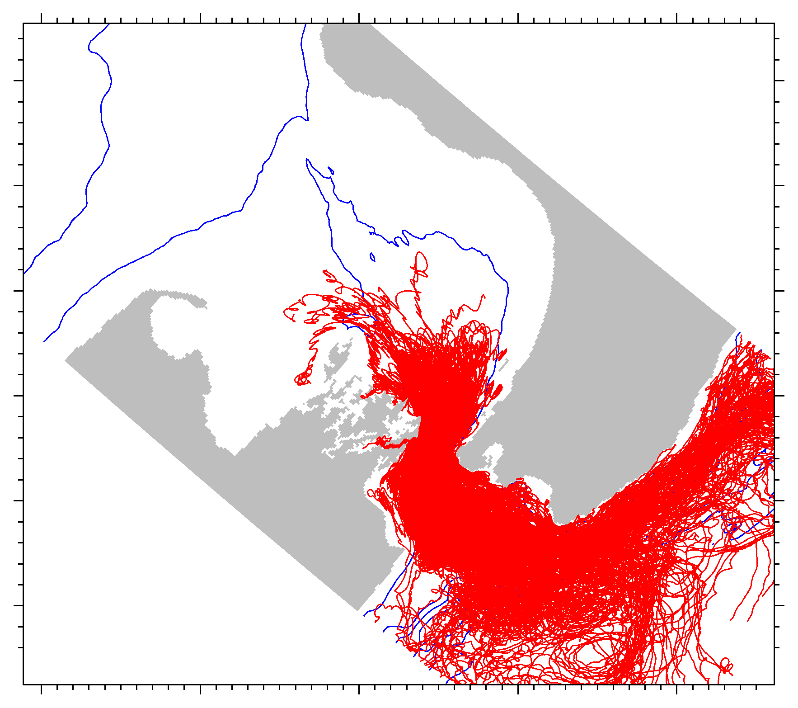
Float trajectories: a source near the southeast end of Cook Strait
20-day trajectories
2009-10-19 to 2009-11-28
2010-03-18 to 2010-04-27

Slide 21
Conclusion 3:
Temporal variation in the volume flux through Cook Strait is largely wind-driven (though I haven’t showed that here) and on the scale of 5–30 days is comparable to the mean. This has a significant effect on the movement of water and nutrients through the system.

