Slide 1
Seasonal and interannual variability in the East Sea ecosystem: effects of nutrient transport through the Korea Strait
2014 ROMS/TOMS User Workshop
Rovinj, Croatia, 26-29 May
Chan Joo Jang, and Yuri Oh
Korea Institute of Ocean Science & Technology
Notes:
I’m Chan Joo Jang. Today I will show some preliminary results how N transport through the Korea Strait between Korean and Japan afftect East Sea or Japan Sea Ecosystem using ROMS coupled with simple NPZD type ecosystem model.

Slide 2
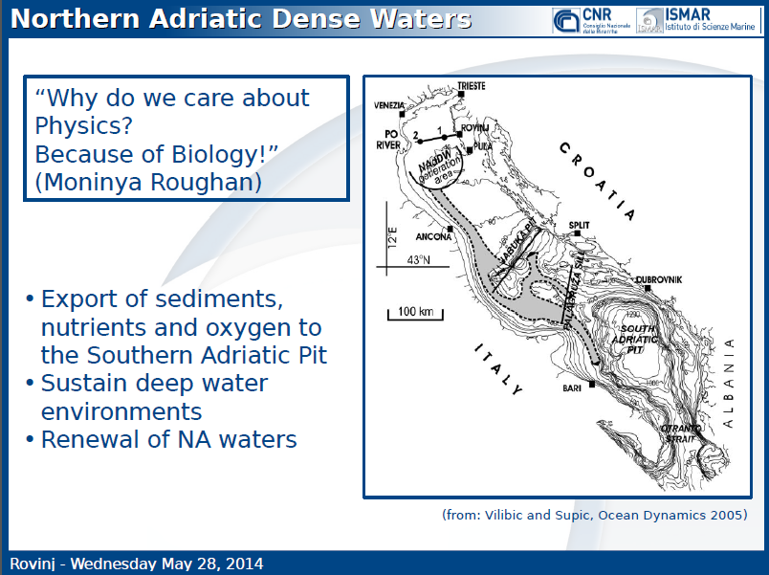
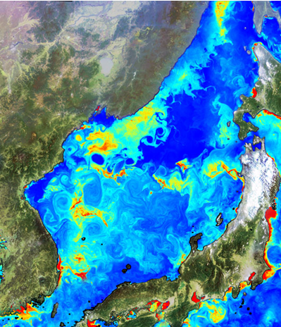
2012.4-5 composite
GOCI CHL
“Why do we care about Biology as physical oceanographers?
Because of Physics!”
Courtesy: Francesco

Slide 3
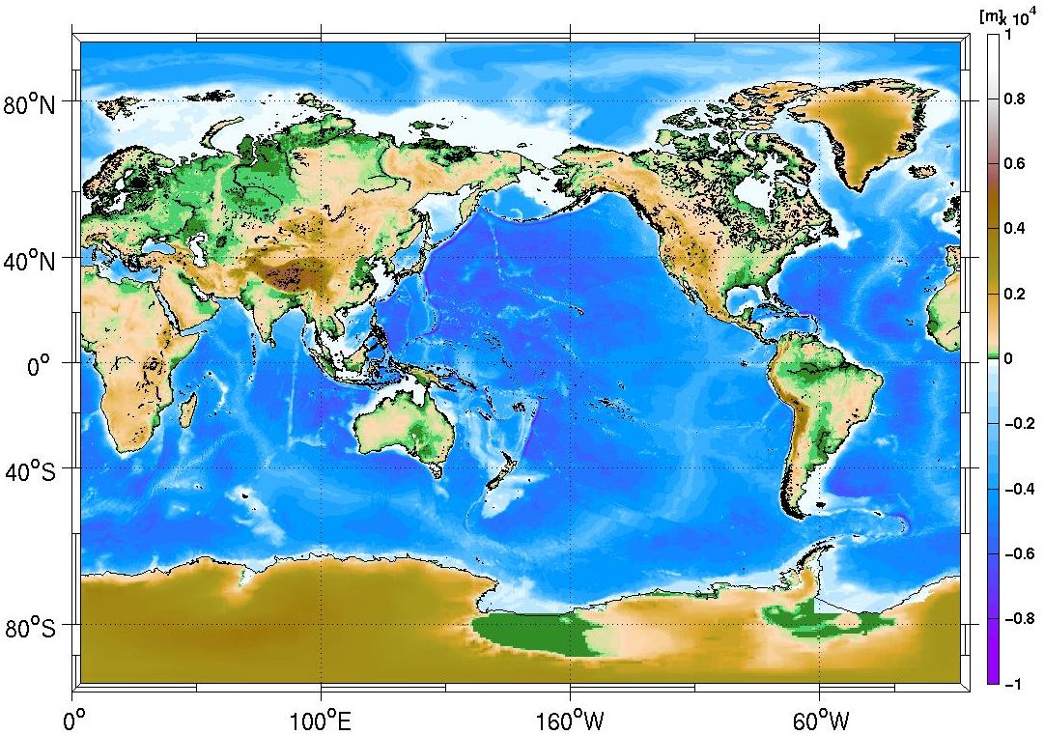
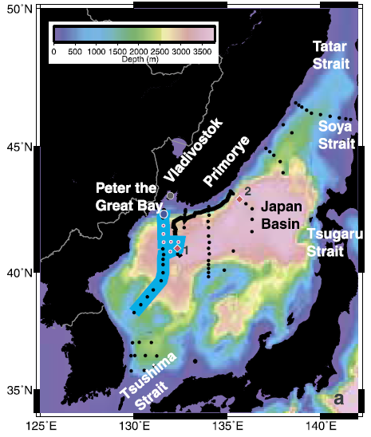
The East Sea (Japan Sea)
Talley et al 2002
Korea

Slide 4
Cascading sites around the world…
Courtesy: Sandro Carniel
From Ivanov et al., PIO (2004) & Durrieu de Madron et al., PIO (2005))
not so many, but powerful drivers of the overall circulation, heat/salt /carbon transfer, and relevant for climate
dynamics

Slide 5
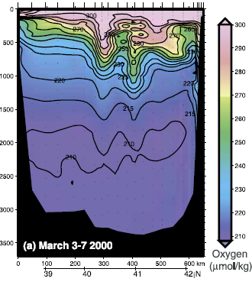
Deep Convection
Talley et al 2002
Korea
Notes:
Feb 28-Mar 15, 2000

Slide 6
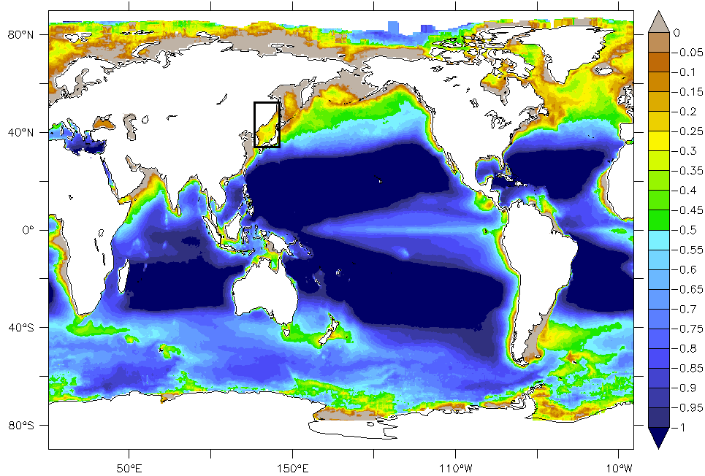
Long-Term Mean Chlorophyll-a
EKWC: East Korean Warm Current
JB: Japan Basin
KS: Korea Strait
LC: Liman Current
NB: Nearshore Branch
NKCC: North Korea Cold Current
OB: Offshore Branch
SPF: Subpolar Front
SS: Soya Strait
TS: Tsugarn Strait
UB: Ulleung Basin
YB: Yamato Basin
YR: Yamato Rise
Log (CHL)
mg m⁻³
East Sea (Japan Sea)
SS
LC
JB
SPF
TS
NKCC
YR
YB
NB
EKWC
UB
OB
KS
Notes:
What you see here is a long-term annual-mean Satellite-driven Chlorophyll distribution, showing the East Sea here is a relatively high productive marginal seas between Korea, Japan & Russia. If you zoom in the East Sea, you can find some interesting features. One is relatively high CHL along the subpolar front. This high CHL is probably supported by relatively shallow winter-time mixed layer that provide better light condition for phytoplankton growth. Another important feature is a high CHL or productivity in this southwestern East Sea region. There are no major rivers affectiong this region, so a natural question here is why the southwestern East Sea is much more productive than other area? There are two most convincing explanations.
The East Sea is a semi-enclosed marginal sea in the northwestern Pacific with 1350 meters depth averagely and 3700 meters as a maximum depth. Here is a distribution of climatological mean chlorophyll-a concentration. The southwestern part of the East Sea is much productive. Why is the southwestern East Sea much productive? Because of upwelling? or nutrient transport through the Korea Strait?

Slide 7
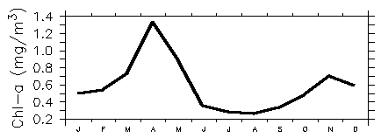
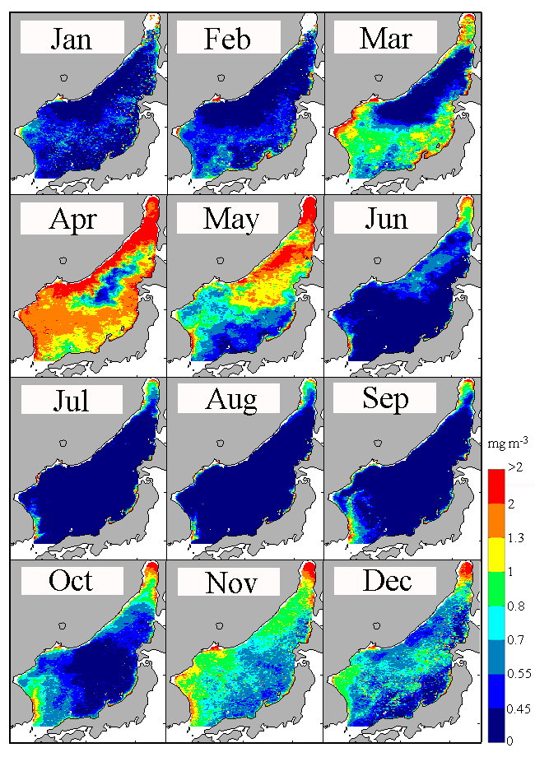
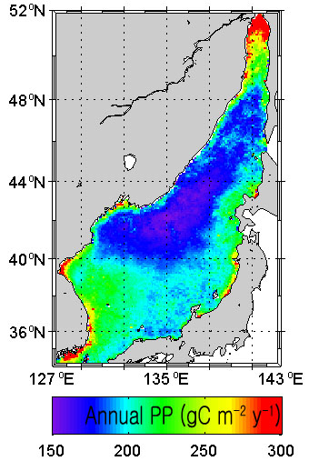
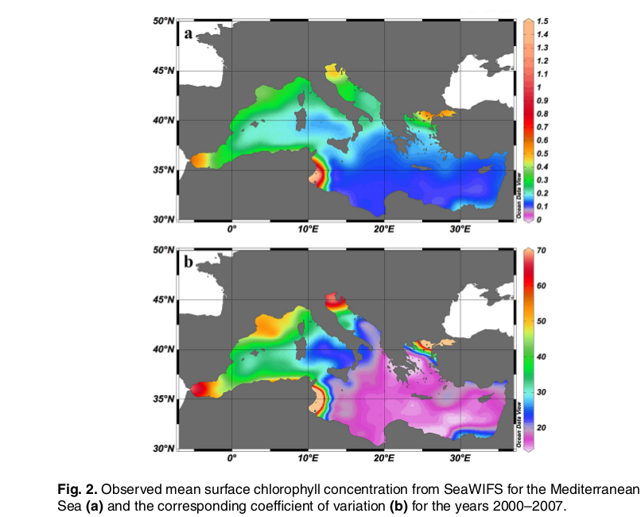
CHL variability
Yoon et al (2013)
Gallisai et al. 2012 (Biogeosciences Discussions)

Slide 8
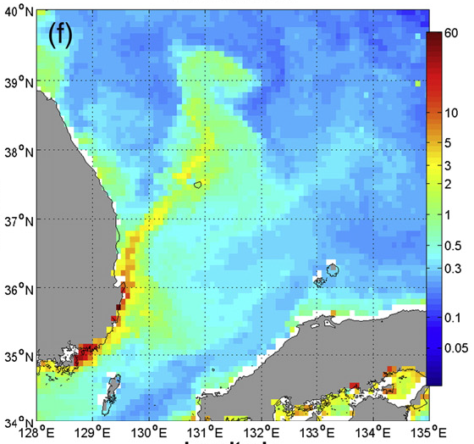
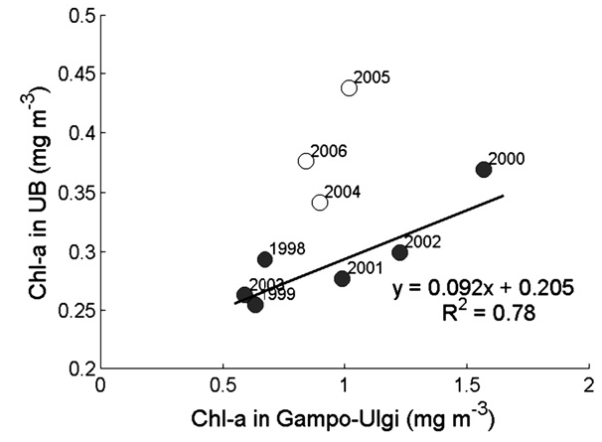
1. Coastal Upwelling
(You & Park, 2009)
KOREA
Japan
Notes:
One of them is the coastal upwelling along the Korea coast. Here is CHL distribution showing very high values along the coast maintained by upwelling that brings nutrients into the surface from the deep. This upwelling is particularly strong in summertime due to monsoonal southerly wind. This high CHL is evident not only near the coast, but also in the open sea including the Ulleung Basin here. So if you compare CHl in the upwelling area with UB CHL, you can find very good linear relationship in two regions suggesting the upwelling support not only high productivity along the coast, but also offshore region. So the coastal upwelling can contribute to maintaining the higher productivity in the southwestern East Sea.

Slide 9
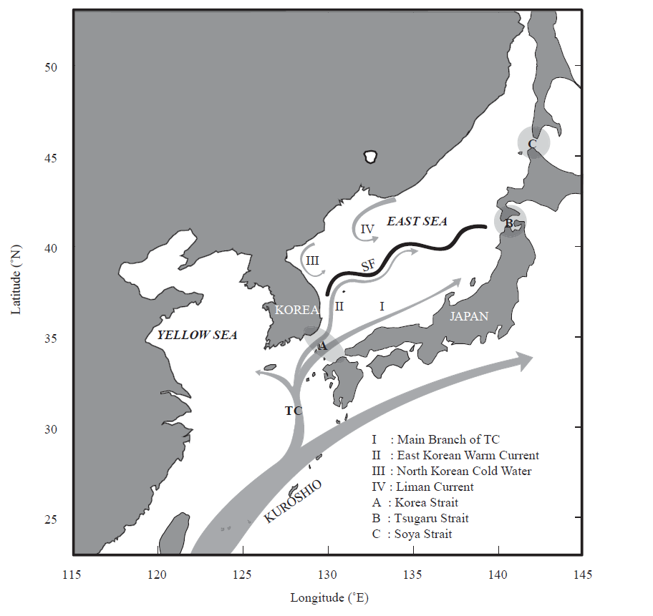
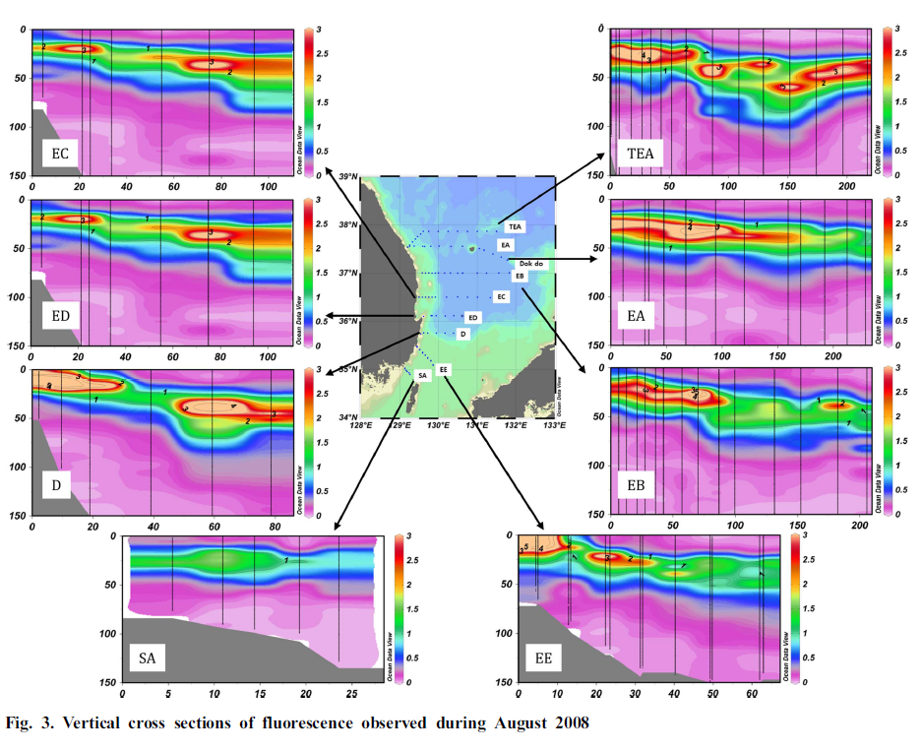
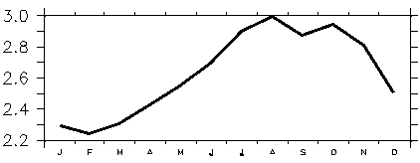
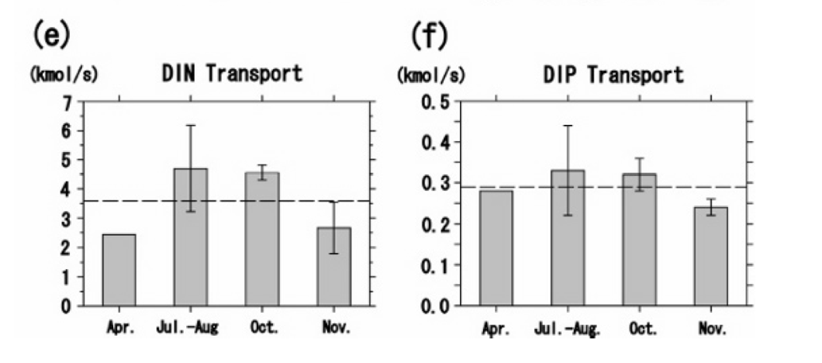
2. Nutrient transport through the KS
Vertical cross sections of fluorescence (Aug 2008)
Yoo and Kim (2004)
SCM (subsurface chlorophyll maximum layer)
SV
Nutrient transport through the KS
Roh et al. (2012)
Total 3.59 kmol/s
Total 0.29 kmol/s
▲ The Tsushima intermediate water with high nutrient may contribute to maintaining the SCM.
◀ The annual mean fluxes of DIN and DIP transported through the KS are relatively large compare to other nutrient sources.
DIN : Dissolved inorganic Nitrogen
DIP : Dissolved inorganic phosphorus
Morimoto et al. (2009)
Notes:
The other plausible mechanism is nutrient supply through the Korea Strait between Korea & Japan, here. Before going further, for those who may not familiar with seas around Korea, I will briefly explain surface current system for seas around Korea. The Kuroshio current branches in the west of the Kushyu, Japan and flows through the Korea Strait here, forming Tsushima warm current. The Tsushima warm current again split into two braches. One is the nearshore branch along the Japanese coast, and the other is the East Korean Warm Current along the Korean coast. In the northern East Sea, there is a cold current called North Korea Cold Current flows southward and meets the EKWC forming the subpolar front and flows out to the North Pacific through the Tsugaru Strait.
The nutrient supplied through the Korea Strait has been believed to have an negligible effect on the nutrient budget and biological productivity in the East Sea. However, recent studies based on observation argue that it may be not true.
In other word, the nutrient transport through the Korea Strait may contribute to the East Sea ecosystem.
For example, Roh et al. (2012) reported that subsurface chlorophyll maximum layer, SCM, exists in most of the East Sea and lasts for at least a half-year (from early May to late October).
They also reported that the Tsushima intermediate water supplies nutrient consistently to the SCM in Ulleung basin and so it makes the SCM maintained there for a long time.
Morimoto et al. (2009) reported that the annual mean fluxes of Dissolved Inorganic Nitrogen and Phosphorus transported through the East Channel of the Korea Strait are relatively large compared to those of the Changjiang (how high?) and the Taiwan Strait.
Considering these things, in this study we have investigated how the nutrient transport through the Korea Strait affect the low trophic ecosystem in the East Sea.
======================================================
The Tsushima current (TC) branched from the Kuroshio supplies heat, water and materials such as nutrient through the Korea Strait to the East Sea.
The nutrient supplied through the Korea Strait would have a large effect on the nutrient budget and biological productivity in the East Sea
Roh et al. (2012) reported the subsurface chlorophyll maximum layer, which is called SCM, exists in most of the East Sea and last for at least a half-year(from the early May to late October).
They also reported that the Tsushima intermediate water supplies nutrient consistently to the SCM in the Ulleung basin and so it makes the SCM maintained there for a long time.
Morimoto et al. (2009) reported that Dissolved Inorganic Nitrogen and Phosphorus of 3.59 kmol/s[three point five nine kilomol per second] and 0.29 kmol/s[zero point two nine kilomol per second] on the annual mean, respectively are transported through the East Channel of the Korea Strait, which are relatively large compared to those through the Changjiang and the Taiwan Strait.
Considering these things, in this study we have investigated how the nutrient transport through the Korea Strait affect the low trophic ecosystem in the East Sea.
쿠로시오에서 분기하는 대한해협을 통해 대마난류는 열과 해수, 영양염과 같은 물질들을 동해로 공급한다.
대한해협을 통해 공급된 영양염은 동해 영양염 수지와 생물학적 생산성에 큰 영향을 줄 것이다.
노 등(2012)은 아표층 클로로필 최대층이 5월초부터 10월말까지의 기간동안 적어도 반년 정도 동해 전역에 존재한다고 보고하였다.
영양염이 적은 표층수 아래로 영양염이 풍부한 대만난류 중층수 유입되어 울릉분지의 아표층 클로로필 최대층에 지속적으로 영양염이 공급되며, 이로 인해 긴 시간동안 아표층 클로로필 최대층이 유지될 수 있다고 보고하였다.
Morimoto 등(2009)은 대한해협 동수로로 수송되는 연평균 용존무기질소(DIN)과 용존무기인(DIP)이 각각 3.59 kmol/s와 0.29 kmol/s로, 이 양은 양자강과 대만해협을 통한 수송량보다 상대적으로 크다고 보고하였다.
따라서 본 연구는 이와같은 대한해협을 통한 영양염의 중요성을 인지하고 대한해협 영양염 수송량이 동해 하위 영양단계 생태계에 미치는 영향을 조사하였다.

Slide 10
Objective
To investigate how the nutrient transport through the Korea Strait affect the ecosystem in the East Sea (considering higher primary production in the southern basin)
Notes:
While effects of the coastal upwelling appear to be rather clear and have been investigated extensively, the effects of the nutrient transport through the KS appear to be rather complex and controversial. So to investigate how the nutrient transport through the Korea Strait affect the ecosystem in the East Sea
We used a numerical model because there are not enough observational nutrient data.

Slide 11
Numerical experiments
Methodology:
3D circulation-biological coupled model
Hypothesis:
Nutrient transport through the KS contributes to the ES ecosystem, mainly to southwestern area.
Two numerical experiments with different nutrient transports:
  Seasonally varying nutrient flux
  No nutrient flux
Notes:
Using a 3 dimensional biological circulation model, we have conducted two numerical experiments.
We presumed that nutrient transport through the Korea Strait contributes to seasonal variation of the East Sea ecosystem.
We designed the two numerical experiments with different nutrient transport conditions.
One has seasonally varying nutrient flux through the Korea Strait as a lateral boundary condition, and the other one has no nutrient flux.
본 연구는 3차원 순환 생태 접합모형을 이용하여 다음과 같은 두 가지 수치실험을 실시하였다.
대한해협을 통한 영양염 수송이 동해 생태계 계절변화에 기여한다는 가설을 세우고,
영양염 수송 조건을 달리한 두 가지 실험을 계획하였다.
첫 번째 실험은 영양염이 계절변화하면서 수송되는 조건의 실험이고,
두 번째는 영양염 수송이 없는 조건의 실험이다.

Slide 12
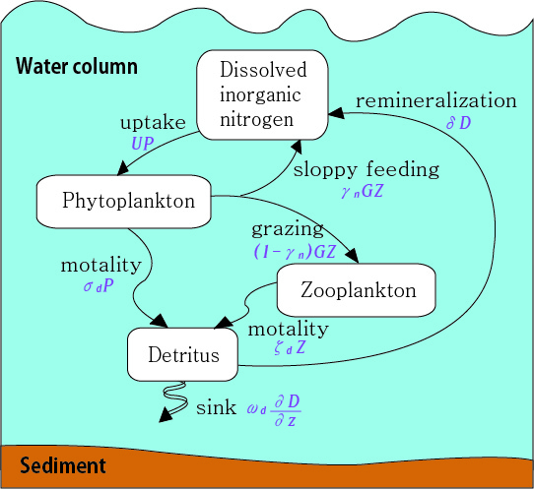
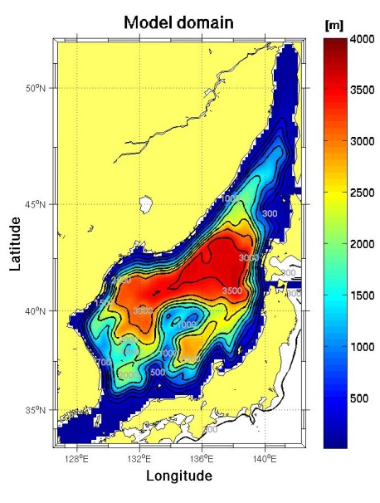
3D circulation - biological coupled model
ROMS
Low trophic biological model
NPZD model
+
1. domain:
126.5˚E-142.5˚E, 33˚N-52˚N
2. Topography : ETOPO5
3. Horizontal resolution: 1/6˚
Powell et al. (2006)
4. Vertical layers: 30 layers
N cycle,
7 biochemical processes
5. forcing: ERA40 (bulk formula)
6. Integration: 10 years
 | Circulation model
Initial condition | Circulation only-model Spin-up (10 years)
Boundary condition (at KS) | T, S : observation 2D-U,V : Kim (1996) 3D-U,V : observation
Biological model Seasonally varying N flux | no N flux
N : WOA2005 P, Z, D : 1.0 mmolN/m3
N : WOA2009 P : 50% of seaWiFS (roms_agrif) Z, D : 20% of seaWiFS | No N flux (bry value = inner value)
Notes:
The 3 dimensional biological–circulation coupled model used in this study is coupled a 3 dimensional circulation model, ROMS and a low trophic biological model.
The biological model consists of four compartments such as Nutrient, phytoplankton, zooplankton and detritus. It is called NPZD model for convenience.
And It is based on a Nitrogen cycle, which circulates each of the 4 compartments by 7 biogeochemical processes.
The model domain is shown on the right.
The model has one-sixth of a degree resolution horizontally and 30 vertical layers.
We used ECMWF reanalysis data as the surface forcing and intergrated for 10 years.
Initial and lateral boundary conditions were given like these.
Initial concentration of nutrient was given by the vertical profile of the nutrient data from World Ocean Atlas 2005.
Initial concentration of phytoplankton, zooplankton and detritus were set at 1.0 mmol N/m3.
In case of seasonally varying nutrient flux, the south lateral boundary condition for nutrient was given by the nutrient data from WOA2009
and for phytoplankton were given with the value which was estimated using a ratio of chlorophyll and phytoplankton derived from previous simulations. For zooplankton and detritus were set in a similar way.
In case of no nutrient flux, the four compartment fluxes at the south boundary were set to zero
본 연구에서 사용한 수치 실험의 기본 설정에 대해 언급하자면,
ROMS를 이용하여 3차원 순환모형과 하위 영양단계 생태 모형이 접합된 모형을 구동하였다.
하위 영양단계 생태모형은 영양염, 식물플랑크톤, 동물플랑크톤과 유기쇄설물 4가지 요소로 구성되어 있다. 편의상 NPZD 모형으로 이름한다.
질소순환에 기반한 모형이며, 7가지 생지화학 과정을 통해 질소가 계를 순환한다.
오른쪽은 모형영역에 대한 그림이다.
수평 해상도는 1/6도이고 연직으로 30개층이다. 대기강제력으로 ecmwf자료를 사용하였으며, 10년 적분 실시하였다.
초기 경계조건은 다음과 같은 조건을 주었다.
생태 모형의 영양염 초기조건은 WOA 영양염 연직 프로파일 자료를 이용하여 모형 전 영역에 동일하게 주었으며, 식물플랑크톤, 동물플랑크톤, 유기쇄설물의 초기조건 모두 1 mmolN/m3 로 설정하였다.
실험 1인 계절변화하는 영양염이 수송되는 조건의 실험에서는 NPZD의 남쪽 경계조건으로 각각 WOA2009, 50%, 20% and 20% of seaWiFS 자료를 이용하였다.
실험 2인 영양염 수송이 없는 조건의 실험은 영양염, 식물플랑크톤, 동물플랑크톤, 유기쇄설물의 수송을 모두 0으로 주었다.

Slide 13
Coastal upwelling
(You & Park, 2009)
Korea
Japan

Slide 14
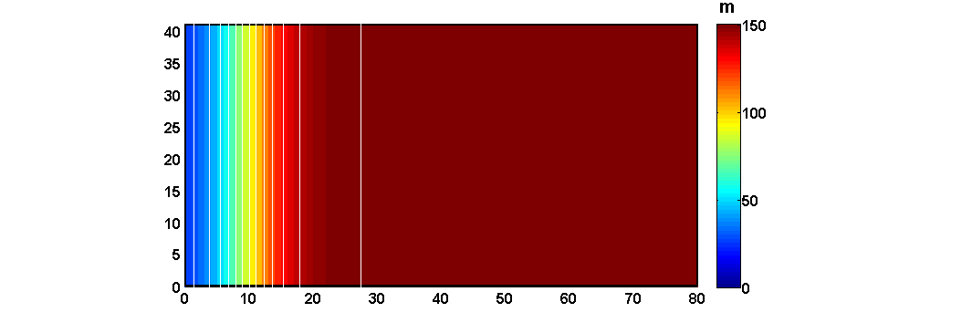
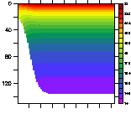
Idealized Ecosystem model for coastal upwelling
grid:41x80x16(41km x 80km x 150m)
IC: T- 22ºC at 0m, 14ºC at the bottom, S-uniform(35psu)
Wind stress: southly (0.02, 0.05, 0.1 Pa)
OBC: Radiation
Wind = 0.02, 0.05, 0.1 Pa
Notes:
표층 열속 및 담수속=0, 위 그림: 수심, 아래 그림: 연직 수온 분포

Slide 15
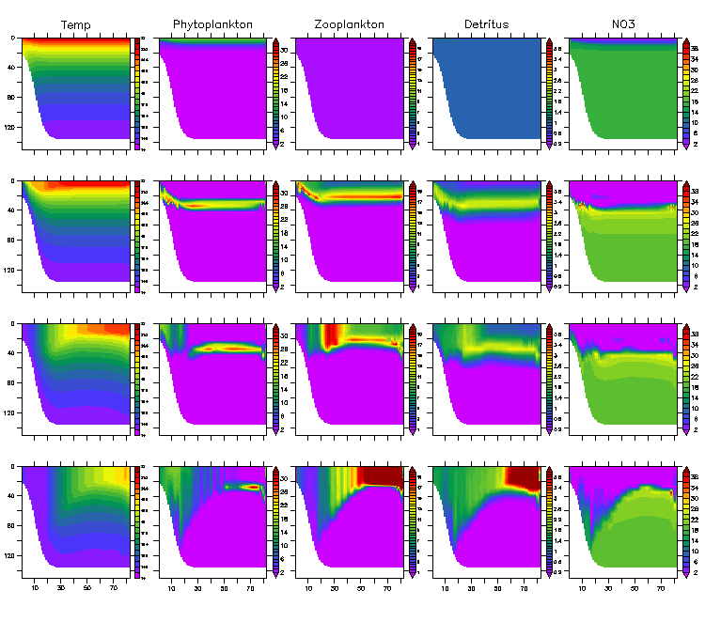
Upwelling Case (Day 20) wind change effects
T
P
Z
D
DIN
IC
0.02 Pa
0.1 Pa
Notes:
Radiation 조건을 준 경우는 오른쪽으로 갈수록 수온약층 등이 깊어지는 현상이 거의 없음 → 현실적

Slide 16
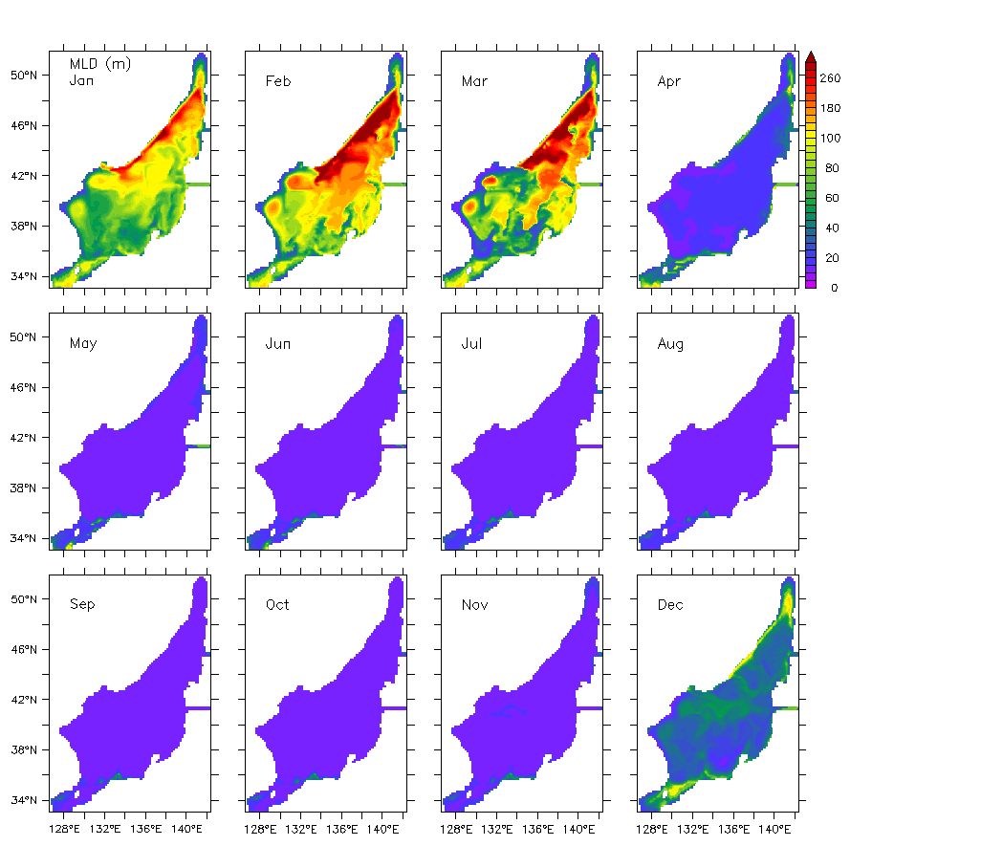
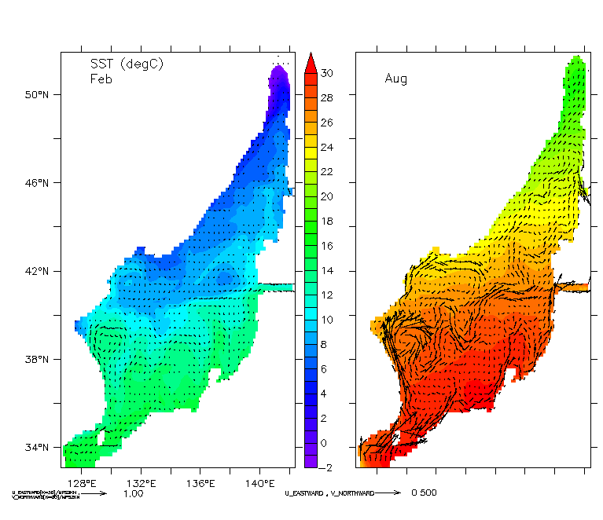

Model Validation I
Model SST (℃ ) & surface current (m/s)
Model MLD (m)
0.5 m/s
Feb
Aug
Notes:
Before I show you the result of experiments, I’m going to show the spin-up results.
The left panels show the simulated sea surface temperature and surface current in February and August. The model simulated the main current system in the East Sea such as East Korea Warm Current, Nearshore branch, and so on.
On the right, the panels show the simulated mixed layer depth distribution. In winter, mld was formed deep especially in the northern East Sea while in summer mld was low.
실험결과를 보이기 앞서, 모형 검증을 위해 스핀업 결과를 살펴보면,
왼쪽 그림은 2월과 8월의 해면수온과 표층 해류의 모사 결과이다. 해면 수온과 표층 해류 패턴이 동한난류가 이안하여 동진 사행하는 패턴, 일본 연안류 패턴 등과 같은 주요 해류시스템이 재현되고 있다.
이 그림은 혼합층 깊이 분포의 결과로, 겨울철 표층 냉각과 강한 바람에 의해 혼합층이 깊어지는 현상과 여름철에 얕아지는 현상이 재현되고 있습니다.
The model overestimates surface sea temperature in winter and summer about 1 Celsius degree in all of the East Sea but simulates a horizontal distribution of it reasonably well. (이 내용을 언급하려면 관측그림을 함께 보여줘야함.)

Slide 17
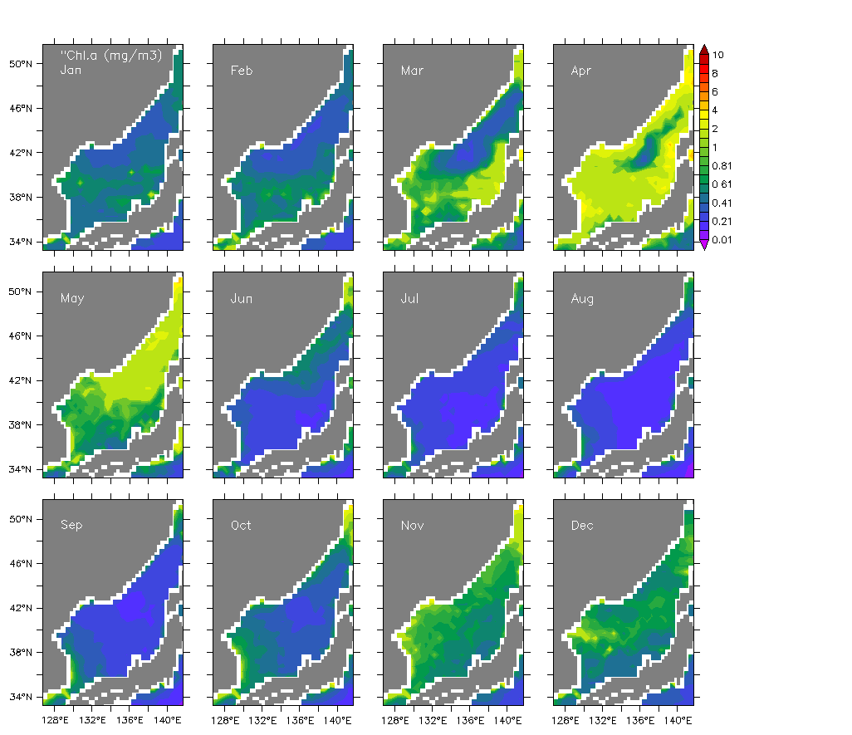
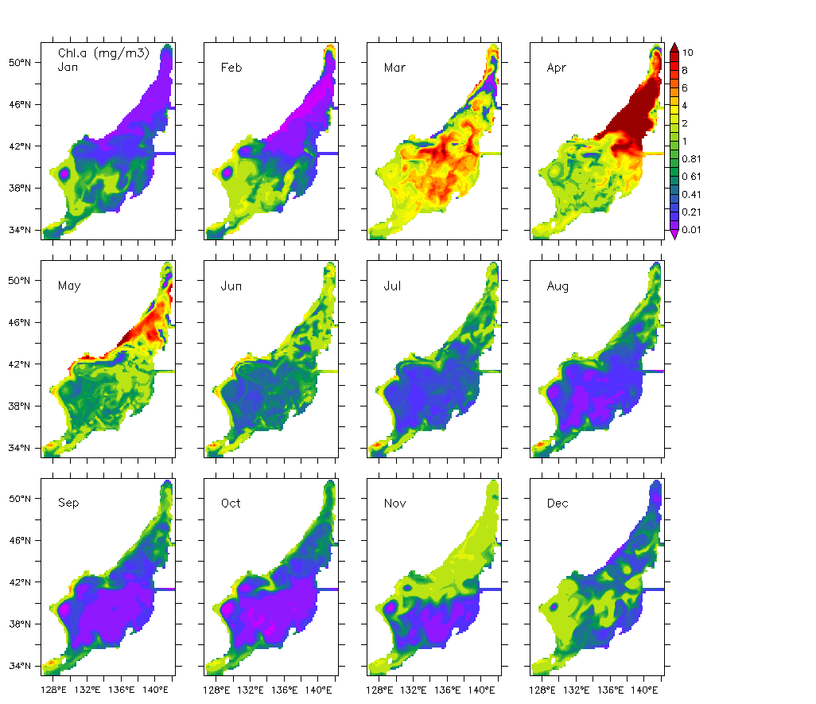
Model Validation II
Chlorophyll-a concentration (mg/m3)
Spring bloom
Spring bloom
Fall bloom
Fall bloom
SeaWiFS+MODIS (1998-2012)
Model
Notes:
These figures show Chl.a concentration distribution from Jan to Dec.
simulated results is on the left and the observed results from a satellite is on the right.
the bimodal seasonal blooms in spring and fall were shown in the surface layer.
또한, 1월부터 12월의 클로로필a 농도 분포를 살펴보면, 왼쪽은 모형 결과이고 오른쪽은 위성이미지입니다.
봄철과 가을철에 나타나는 두 개의 번성이 보실 수 있습니다.

Slide 18
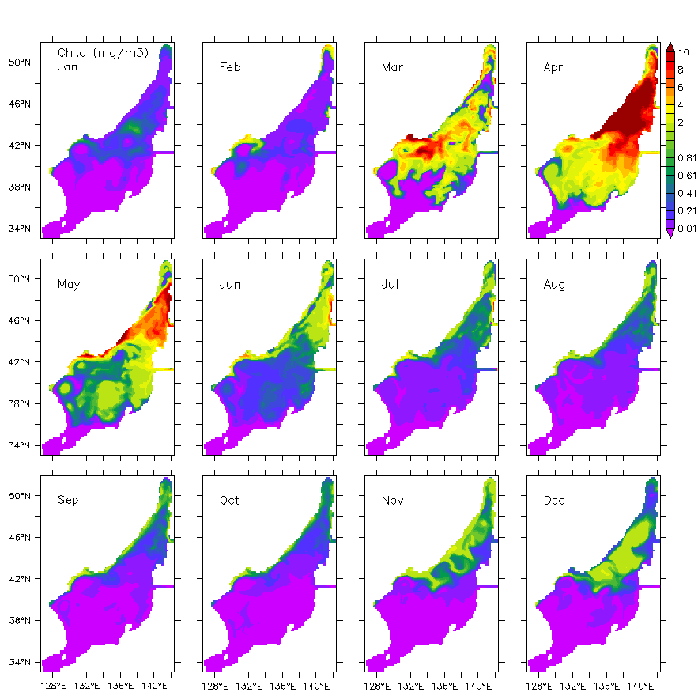
Experiment Results
Chlorophyll-a
Exp 1) Seasonally varying flux
Exp 2) No flux
Notes:
Let’s move on to the experiment results.
These are chlorophyll-a concentration,
the seasonally varying nutrient flux case is on the left and the no nutrient flux case is on the right.
In the southern East Sea, the spring and fall blooms appear in the first case but not in the latter case.
In the northern East Sea, however, there seems no distinct difference in the bimodal seasonal blooms between the cases.
This suggests that the nutrient transport through the Korea strait plays an important role in determining the chl.a distribution in the southern East Sea, but not in the northern East Sea.
수치실험 결과입니다.
왼쪽 그림은 계절 변화하는 영양염이 수송되는 경우의 실험결과이고 오른쪽은 영양염 수송이 없는 경우의 실험결과입니다.
수송이 없을 경우, 동해 남부해역의 봄 번성과 가을번성이 나타나지 않음을 확인할 수 있습니다.
그러나, 동해 북부해역의 봄 번성, 가을 번성은 두 실험 결과에 두드러진 차이가 나타나지 않습니다.
이는 대한해협을 통한 영양염 수송이 동해 북부해역보다 남부해역에 중대한 영향을 미친다는 걸 나타냅니다.

Slide 19
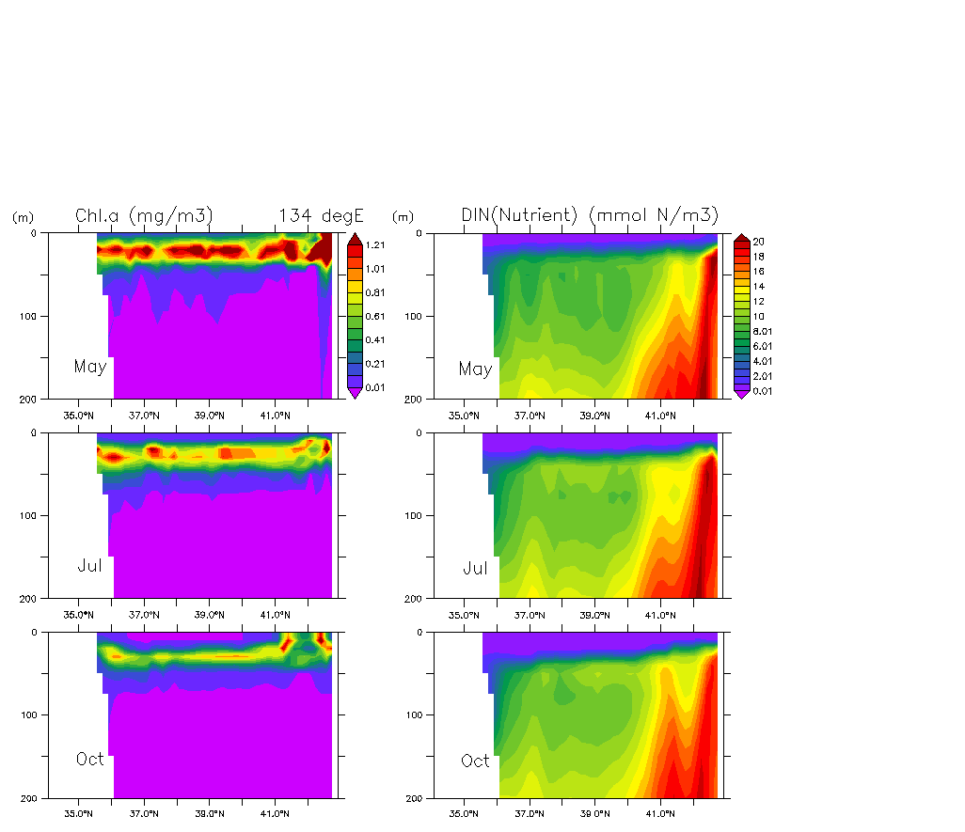
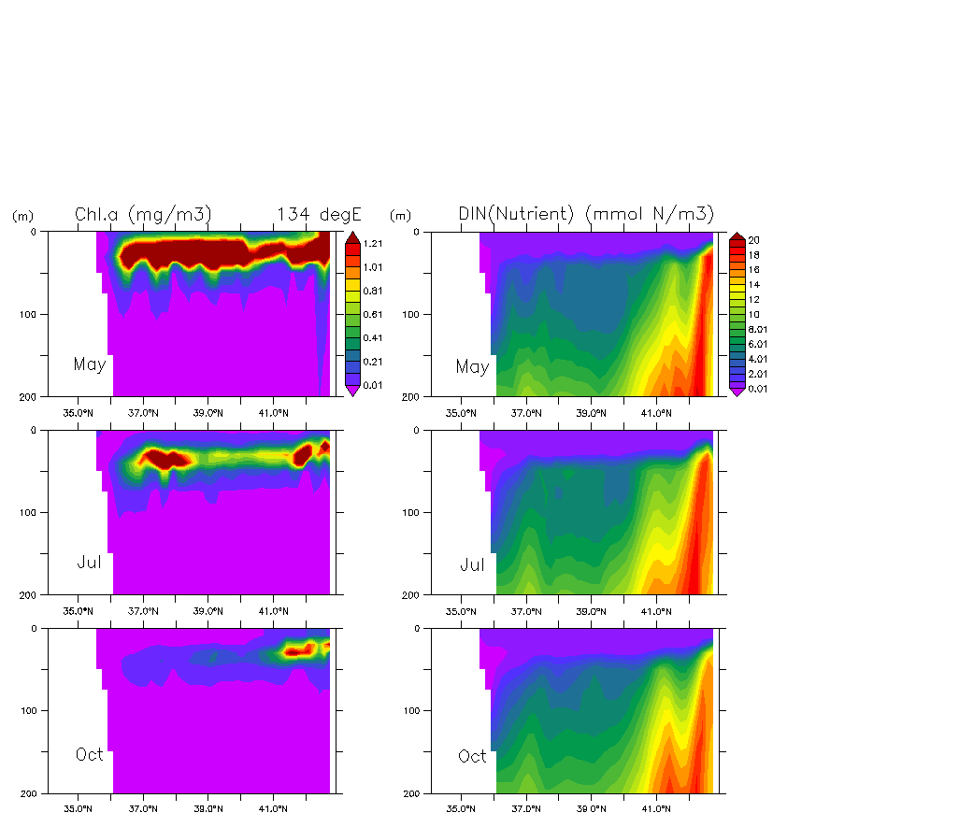
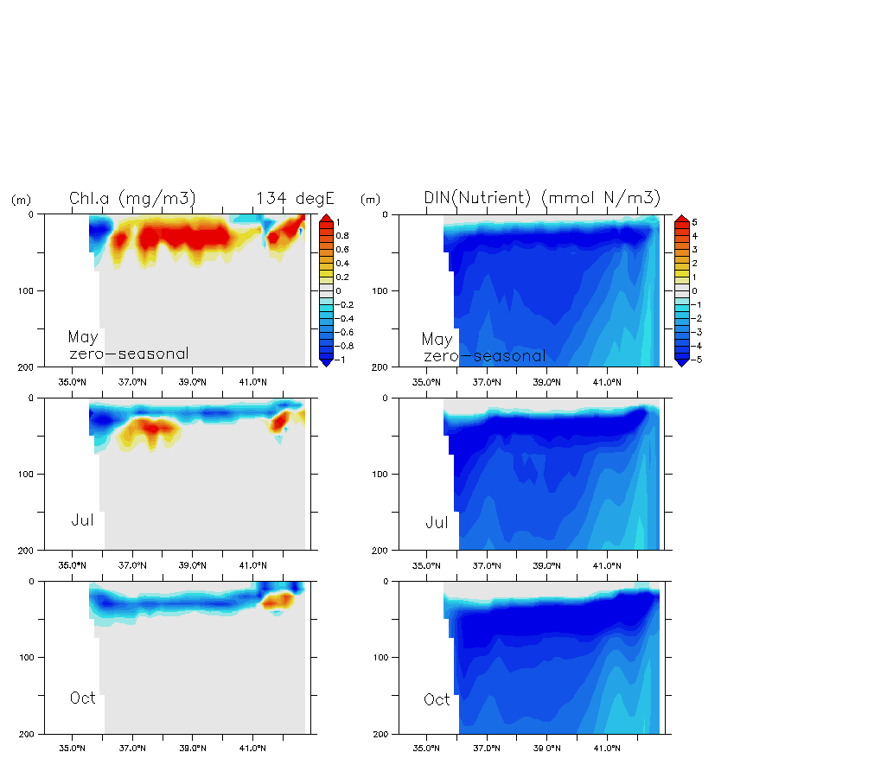
Experiment Results
134 °E Chlorophyll-a & nutrient
134 °E
Exp 1) Seasonally varying flux
Exp 2) No flux
Exp 2) - Exp1)
4-5
mmol N/m3
1-2
mmol N/m3
Chlorophyll-a
nutrient
Chlorophyll-a
nutrient
nutrient
Notes:
Here it shows you the vertical distribution of chla and nutrient along the 134 degrees East during Summer and early Fall.
In the case of no nutrient flux, the subsurface chlorophyll maximum layer does not appear in the southern East Sea. The nutrient concentration is low in the corresponding area.
The difference in nutrient concentration between the two case are 4-5 mmol N/m3 in the southern waters and is 1-2 mmol N/m3 in the northern waters.
You can see it is larger in the southern water than in the northern water.
동경 134도의 클로로필a와 영양염 연직 분포도 입니다.
영양염 수송이 없을 시, 아표층 클로로필 최대층이 동해 남부해역에서 나타나지 않습니다. 해당 해역의 영양염도 낮습니다.
두 실험 간의 영양염 차이가 동해 남부해역에서 동해 북부해역보다 크게 나타납니다.
영양염 수송이 없을 경우의 영양염 농도는 계절변화하는 영양염 수송이 있는 경우의 영양염 농도보다 아극전선이 형성되는 북위 39도 기준으로 그 이남 해역에서는 4-5 mmol N/m3, 이북 해역에서는 1-2 mmol N/m3 정도 낮게 나타납니다.

Slide 20
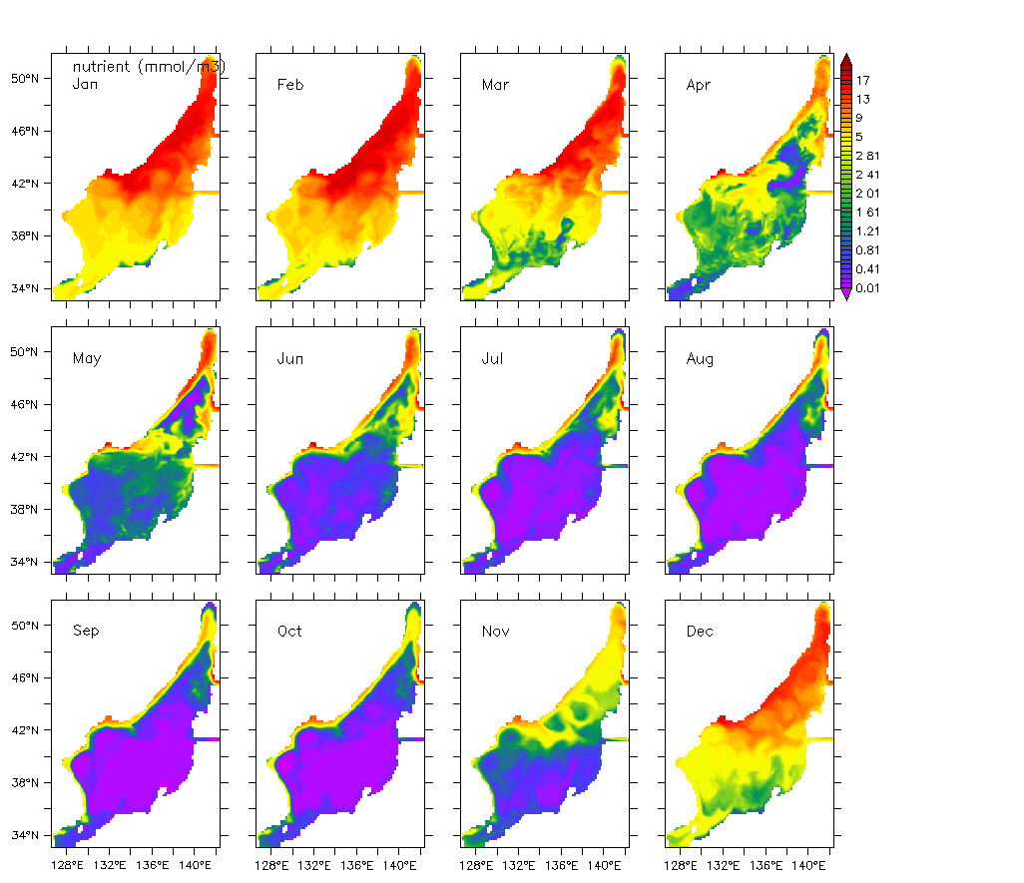
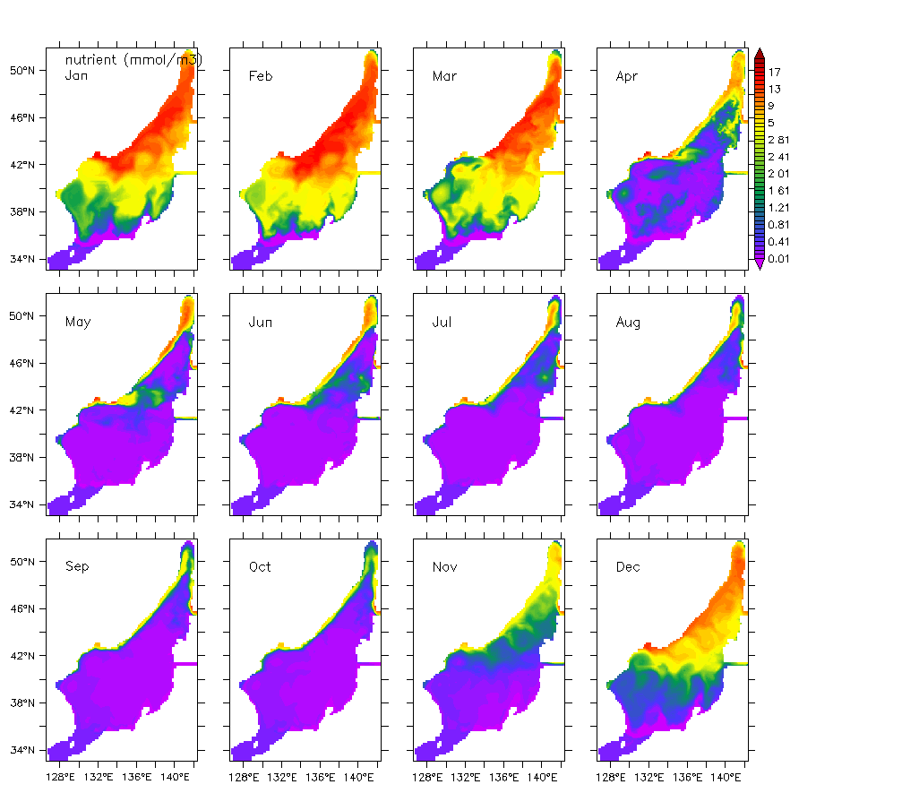
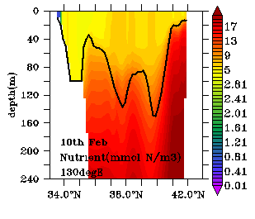
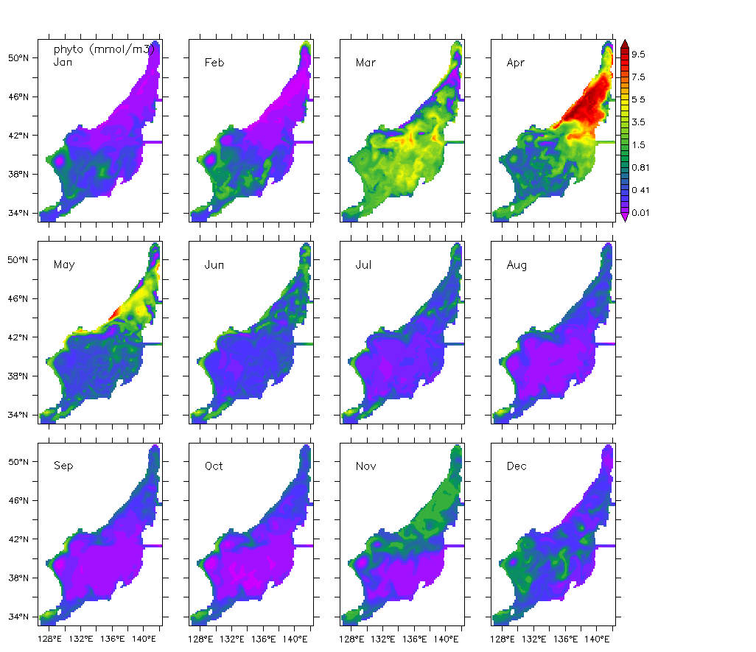
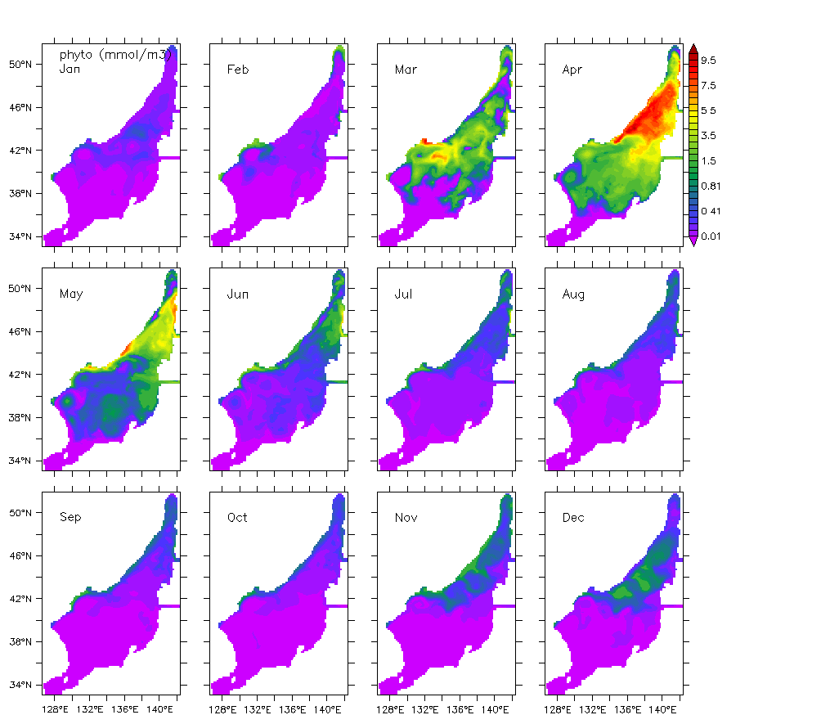
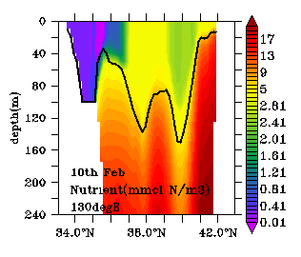
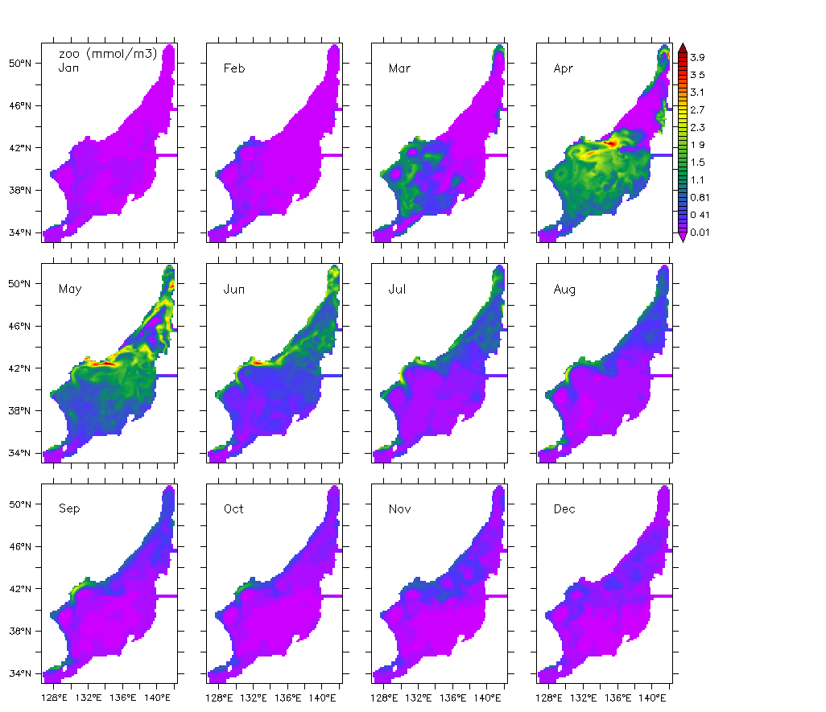
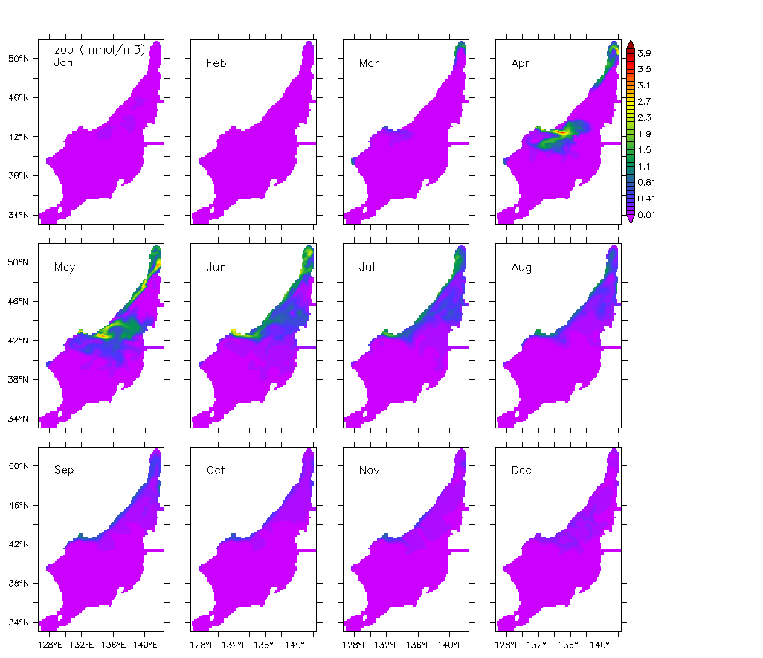
Experiment Results
Nutrient & phytoplankton & Zooplankton
Exp 1) Seasonally
varying
Exp 2) No flux
Exp 1) Seasonally
varying
Exp 2) No flux
Exp 1) Seasonally varying flux
130°E
130°E
Apr
Apr
Nov
Nov
Nutrient
MLD
Apr
Apr
Nov
Nov
Phyto P
Exp 2) No flux
Apr
Apr
Nov
Nov
Zoo P
Notes:
As you can see from the figures, in case of no nutrient flux,
surface nutrient concentration is low in the southern East Sea in winter.
And this can cause a suppression of phytoplankton bloom in spring,
and accordingly zooplankton concentration becomes low.
A similar result is shown in fall.
In case of no nutrient flux,
surface nutrient concentration is low in the southern East Sea,
phytoplankton bloom does not appear and thus, zooplankton concentration becomes low.
On the right, the figure represents a vertical distribution of nutrient along 130 degrees East in Feb.
Solid black lines indicate the mixed layer depth.
When there is no nutrient transport through the Korea Strait, the nutrient concentration is low
throughout the whole mixed layer in the southern East Sea.
We can think the reason for this is
the water inflow with a low concentration of nutrient in this region.
대한해협 영양염 수송이 없는 경우, 겨울철 동해 남부해역 표층 영양염 농도가 낮은 결과를 보입니다.
이로 인해 봄철에 식물플랑크톤이 번성하지 못하고, 동물식물플랑크톤 생체량도 낮은 농도를 보입니다.
또한, 가을철 역시 동해 남부해역의 표층 영양염 농도가 낮아 식물플랑크톤의 가을 번성이 나타나지 않고, 동물플랑크톤 생체량도 낮습니다.
오른쪽 그림은 두 실험의 2월 달 동경 130도 영양염 연직 단면도입니다. 검은색 선은 혼합층 깊이를 나타내는데,
영양염 수송이 없을 때, 동해 남부해역에서 혼합층 깊이까지 낮은 영양염 농도를 보입니다.
동해 남부해역에 영양염 농도가 낮게 나는 기작으로 농도가 낮은 해수의 유입을 생각해볼 수 있습니다.

Slide 21
Conclusion
The Nutrient transport through the Korea Strait contributes to higher primary production in the southern East Sea.
When there was no nutrient flux through the Korea Strait, the southern East Sea shows (within limited model resolution & simple NPZD model) :
  Spring bloom considerably weakened
  Fall bloom almost disappeared
  The Subsurface Chlorophyll Maximum layer was not distinct
But, the northern basin shows insignificant changes.
Notes:
To summarize, this study applied the 3-D biological-circulation coupled model to the East Sea to estimate the effect of nutrient transport through the Korea Strait.
When there was no nutrient flux through the Korea Strait,
changes on seasonal variation in low trophic ecosystem
in the southern East Sea appear as follows:
Spring bloom dwindled
Fall bloom almost disappeared
The Subsurface Chlorophyll Maximum layer was unrealistic and was not distinct.
Zooplankton was declined.
However, the seasonal variation in the northern East Sea is not significantly different
between seasonally varying nutrient transport and no nutrient transport case.
As a future study, we plan to conduct experiment to remove advection of biological
variables for estimating an effect of advection on the East Sea ecosystem.
요약하자면, 본 연구는 대한해협 영양염 수송이 영향을 파악하기 위해 3차원 순환 생태계 접합 모형을 동해에 적용하였습니다.
대한해협을 통해 영양염 수송이 없다면, 동해 하위영양단계 생태계 계절변화

Slide 22
Challenges & Limitations
Resolution-1/6 deg (10 km)
  EKWC overshooting
  UWE, upwelling
NPZD
  Only one compartment of PP & ZP
  T dependency (photosynthesis, grazing etc.) ignored
  BC & parameters poorly known
Notes:
This can be supported by the previous results of Yoo and Kim.
They reported the suppression of spring bloom in 1997 using chlorophyll satellite image.
They explained for the reason
that the nutrient-poor surface layer of the TC was flowing thick
and so the influx of nutrient from the lower layer was blocked.
본 연구의 대한해협 영양염 수송이 없는 경우의 실험 결과 중 동해 남부해역의 영양염이 낮게 나타나는 이유가 저농도의 해수가 유입으로 인해 표층의 영양염이 제거된 결과로 본다면,
이는 Yoo and Kim이 2004년 논문에서 제시한 결과와 어느 정도 일관된 결과라 생각할 수 있습니다.
Yoo and Kim은 클로로필 위성자료를 이용해 1997년 동해 남부해역의 봄 번성이 억제된 것을 밝히고, 이 같은 이유는 저영양염인 대마난류 표층수가 두껍게 유입되어 저층으로부터 영양염 유입이 차단되었기 때문이라고 하였습니다.

Slide 23
Future Work
Nutrient budget analysis
Experiments with yearly- varying nutrient transport through the KS (with climatological forcing)

Slide 24
HVALA
Thank you

Slide 25
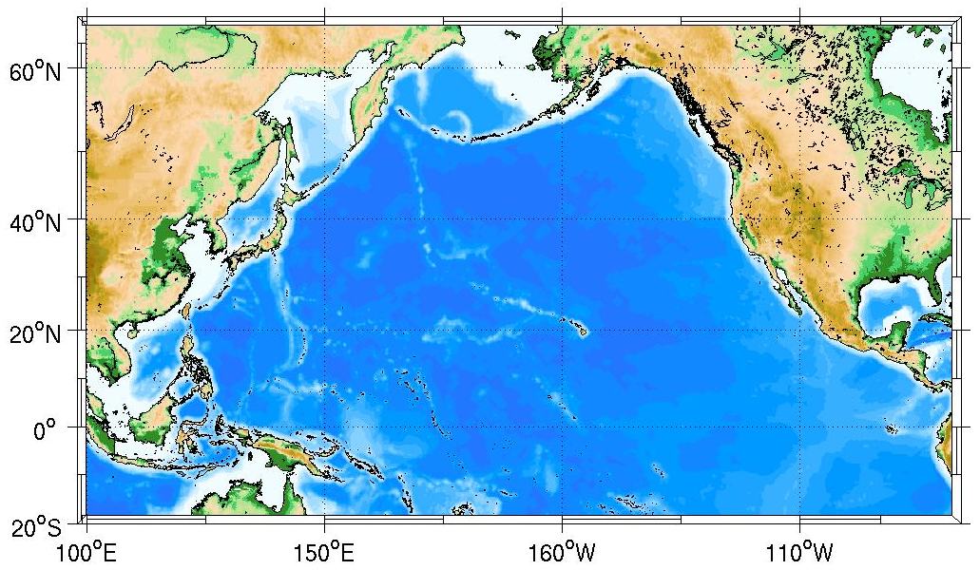
RCM nesting for Climate Change Projection
North Pacific(Ocean only) → Western N. Pacific (ocean only) → East Sea (Coupled Model)
1/24 x 1/24 deg.
1/12 x 1/12 deg.
1/6 x 1/6 deg.
Notes:
A nesting approach shown in here. The outermost domain covers the whole North Pacific Ocean with 1/6 horizontal resolution based on ROMS ocean model, which provides open boundary conditions for the second domain covering western N. Pacific with 1/12 horizontal resolution. This western NP model will provide water OBC to the innermost domain with 1/24 horizontal resolution.

Slide 26
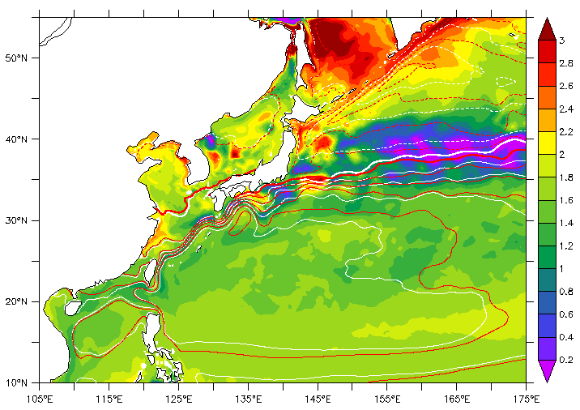
Projected Ocean Warming winter (2081~2100 – 1981~2000)
Ocean projection with a GCM(CanESM2) atmospheric forcing
(pseudo global warming)
Color shading: SST change
Contours: SSH (red-future)
Relative smaller warming: southward shift of Kuroshio
Notes:
Ocean projection with a GCM(CanESM) atmospheric forcing Shading : 겨울철(1~3월 평균) SST 미래변화, red contour : 겨울철 평균 미래 ssh, white contour : 겨울철 평균 현재 ssh

Slide 27
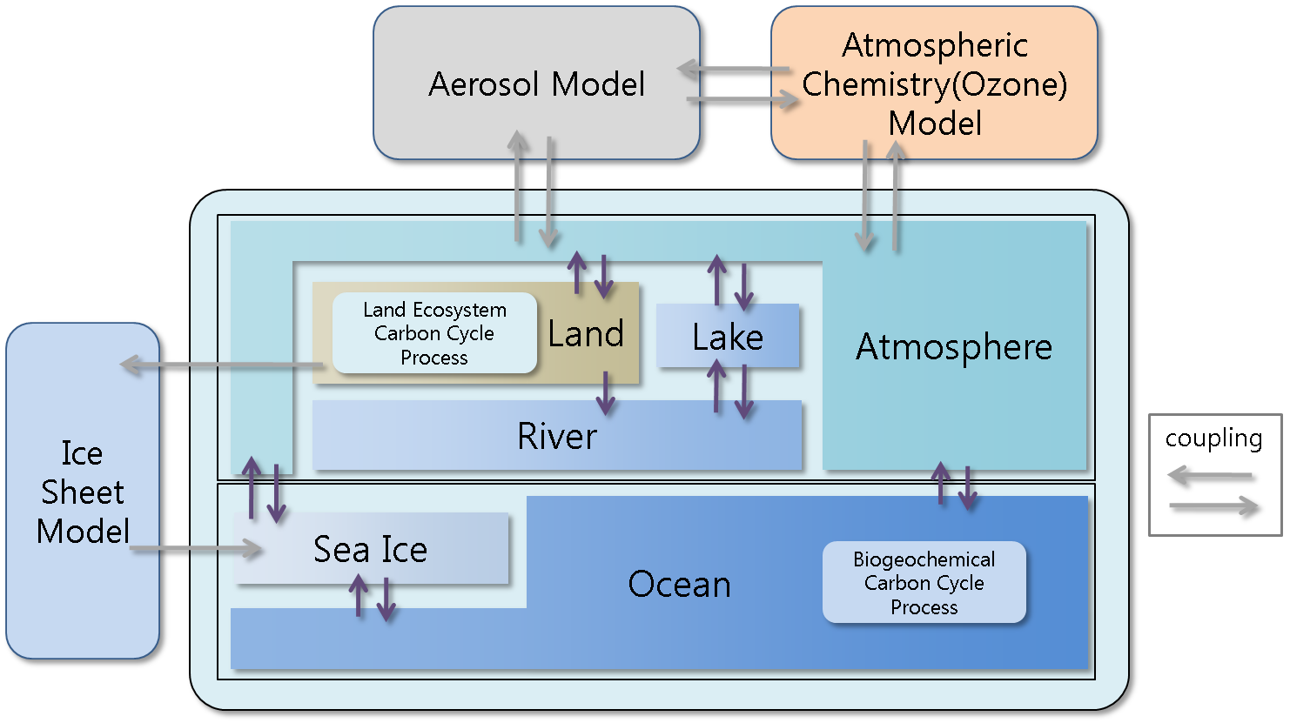
Integrated RCM

Slide 28
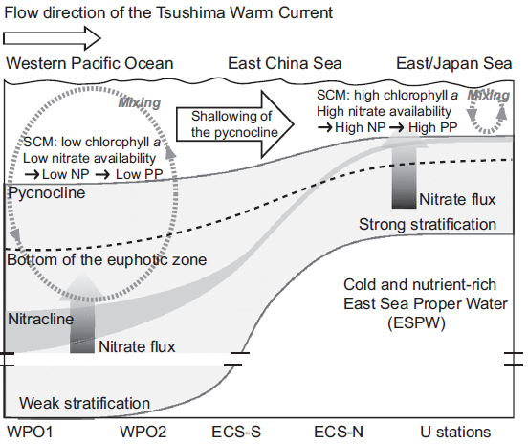
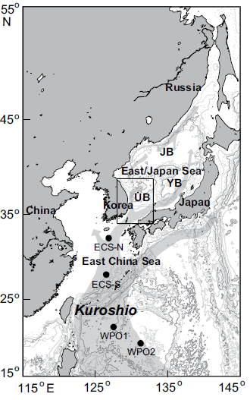
Nutrient Supply through the Korea Strait
(Kawk et al 2013)
Euphotic depth
Nitracline
Notes:
Pycnocline? 영구수온약층? 그렇다면 영구수온약층 아래는 동해자체 생성소멸하고 존재하는 물이고, 대마난류수는 아님
왜 Nitracline은 동해로 갈수록 왜 급격히 얕아지는지? 각 항의 수심은? Euphotic depth는 표층 관련 1% 줄어드는 깊이.

