Slide 1
Sub-surface and near-bottom thermohaline circulation of a shallow sea during a Dense Water production event:
a case study from the northern Adriatic Sea.
Alvise Benetazzo, Andrea Bergamasco,
Davide Bonaldo, Francesco M. Falcieri, Mauro Sclavo and
Sandro Carniel
CNR-ISMAR, Venice, Italy

Slide 2
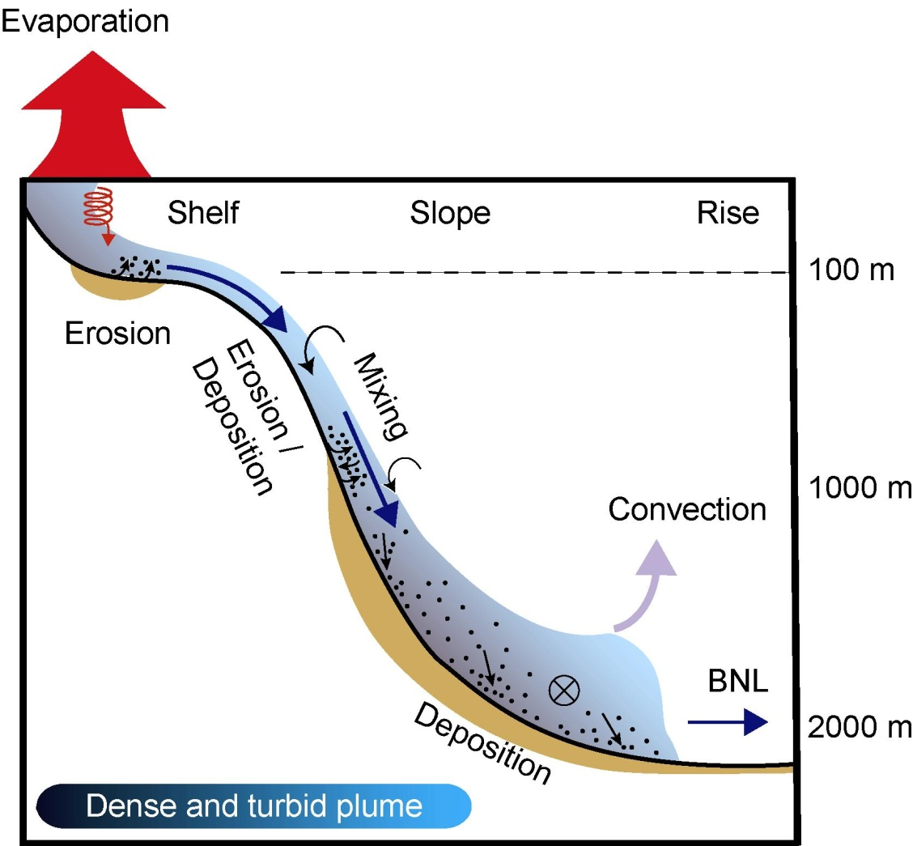
Did you say “Dense Shelf Water”?
Heat and Moisture fluxes
(brine rejection durng sea-ice formation)
Cascading: a type of buoyancy driven current, in which dense water formed by cooling, evaporation or freezing in the surface layer over the continental shelf descends down the continental slope to greater depths…
… link between small scale processes and global phenomena (BUT climate models do not capture the small scale processes and need to be “fed in” correctly…)
Hydraulic control
Ambient Water
Entrainments
Neutral buoyancy
INLs
Shear Instabilities
Bottom
Friction
Geostrophic
Eddies
Adapted from Puig (2009)

Slide 3
Cascading sites around the world…
From Ivanov et al., PIO (2004) & Durrieu de Madron et al., PIO (2005)
not so many, but powerful drivers of the overall circulation, heat/salt /carbon transfer, and relevant for climate dynamics

Slide 4
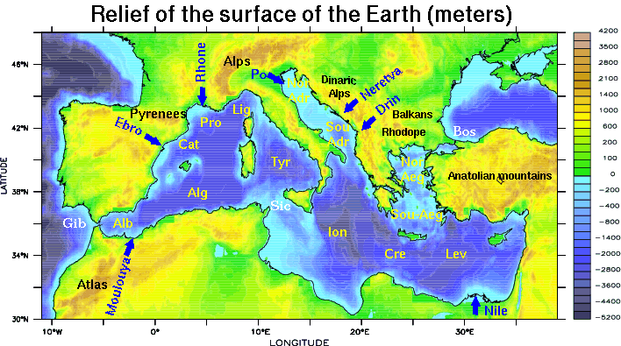
…and in our backyard…
Mistral
Bora
Tramontane
Etesians
Dense water formation regions in the Mediterranean Sea

Slide 6
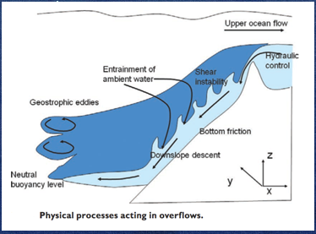
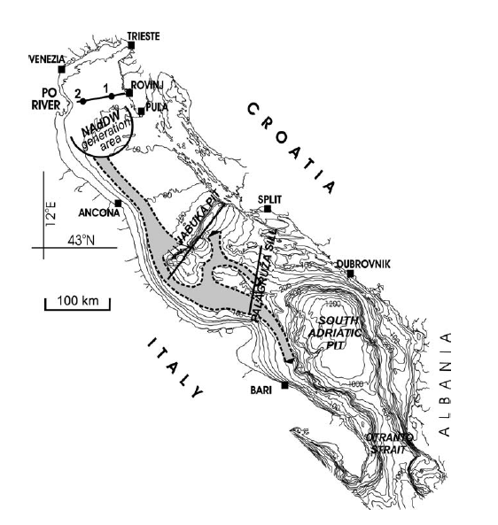
General strategy behind
WHY
DSW, or DW, are formed in the Northern Adriatic during cold periods associated to strong winds, triggered by local T and S conditions.
We call them also NAdDW (North Adriatic Dense Waters)
DW move southward and sink in those regions by cascading events. Responsible of the sediment transport along the SAM
Pathways and volumes are still largely unknown, but control heat and sediment export off-shelf
HOW
MODEL: using a system at high resolution, 2-way coupled wave-current-sediment, 1-way coupled atmosphere (see poster for 2-way AOW!)
DATA: tower. buoys, dedicated cruises (“ODW campaigns”)
Notes:
xxxs.

Slide 7
The 2012 event
In Winter 2012 a CAO episode spanned 15 consecutive days
(January 29 to February 13): a mass of cold air descended from NE to the NA with strong winds and cool air (at “AA” U₁₀ was 13.4 m/s on average and 35.1 m/s at most, air T dropped below 6°C, with a minimum record of -4.2 °C)
A severe wave condition was a consequence of such atmospheric event: maximum observed sea state had H_{s} 3.20 m, with 1.97 m in average.
The CAO event was characterized by an unusual duration!
General features of CAO effects on the Adriatic Sea described by
Mihanović, Vilibic, Carniel et al. (Ocean Science 2013) and Raicich et al. (JGR 2013). Recently by Janekovic et al. (JGR 2014).

Slide 8
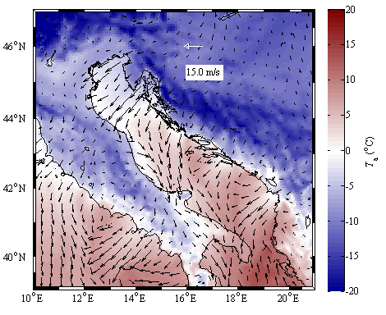
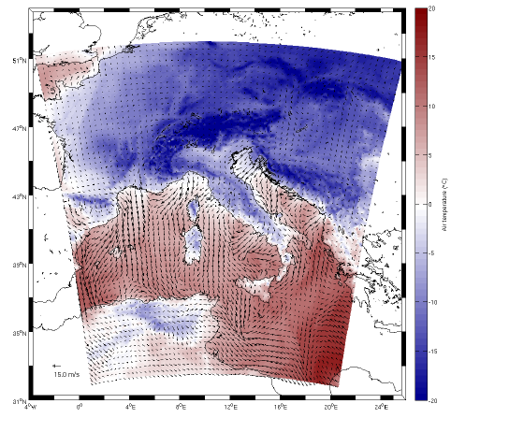
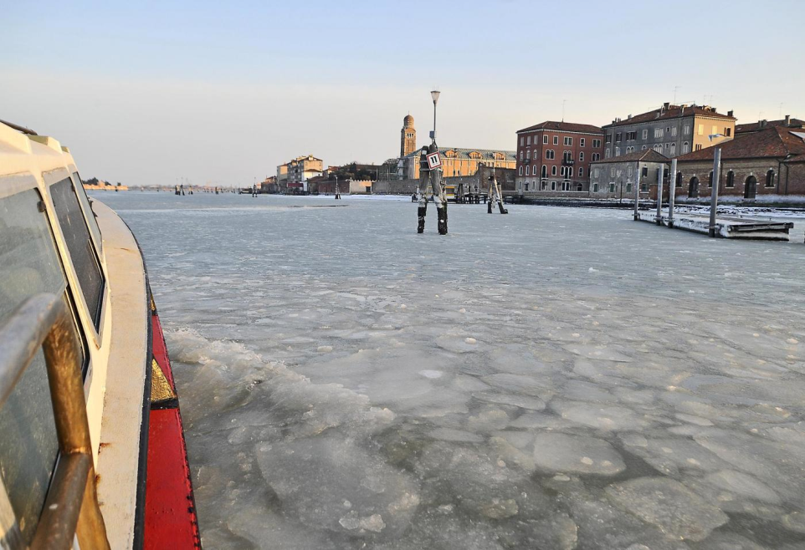
February 2012 Cold Air Outbreak event
frozen Venice lagoon
COSMO model (7 km)
ground Air T & 10m-wind
snapshot (Feb 2, 00:00 UTC)
Notes:
Breve descrizione evento: From mid January 2012 and lasting for approximately 30 consecutive days, pulses of northeastern Bora winds blew across NA Gulf of Trieste and Kvarner Bay gave rise to observed air temperature at AA below 9.3°C (Figure 6), with a 30-day average of 1.9 °C and a minimum record of -4.2 °C. Daily averaged air temperatures ranged between -2.1 °C and 8.1 °C. The CAO episode itself spanned 15 consecutive days from January 29 to February 13 during which a vast mass of cold air descended from North-East brought to the NA both high winds (at AA observed wind speed U₁₀ was 13.4 m/s on average and 35.1 m/s at most, see Figure 7) and cool weather (at AA air temperature dropped below 6°C). General features of CAO effect on the Adriatic Sea have already been described by Mihanović et al. (2013) and Raicich et al. (2013). A severe wave condition was a consequence of such persistent atmospheric event: maximum observed sea state had H_{s} of about 3.20 m, with 1.97 m in average. A wave storm analysis (Boccotti, 2000) at AA based on the 15-year average value of H_{s} (calculated equals to 0.45 m by Barbariol et al., 2013) showed that the CAO event was characterized by an unusual duration of more than 10 days.

Slide 9
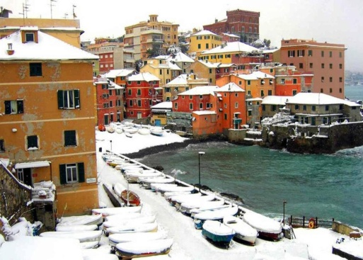
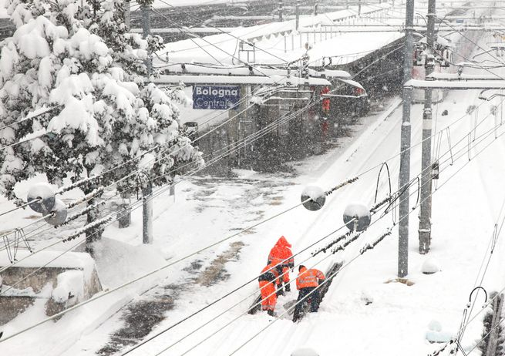
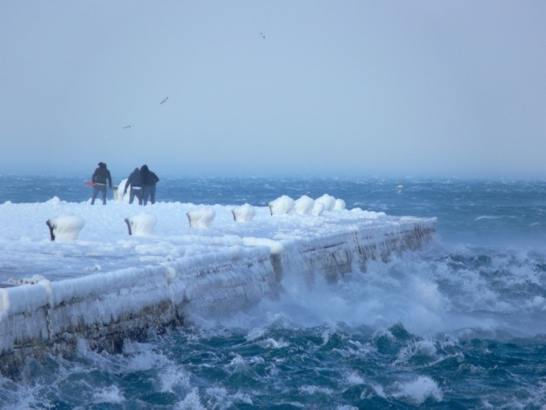
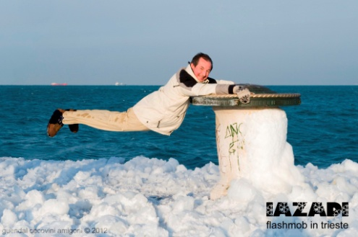
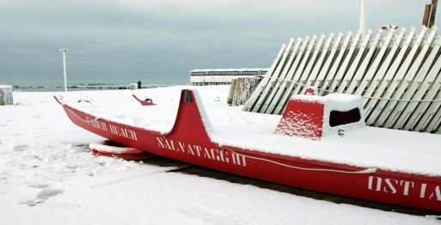
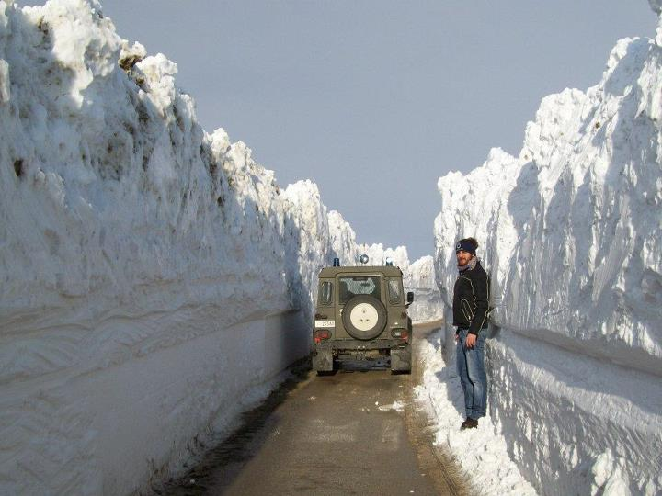
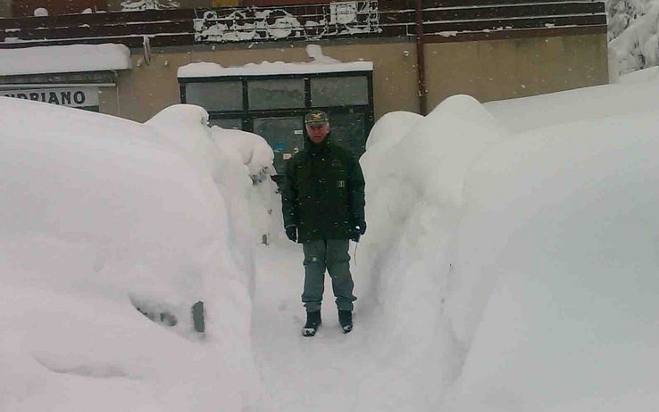
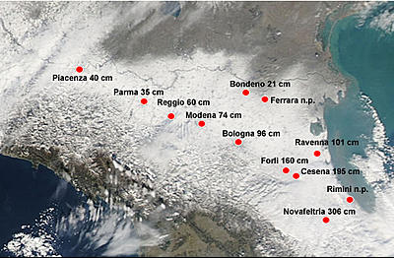
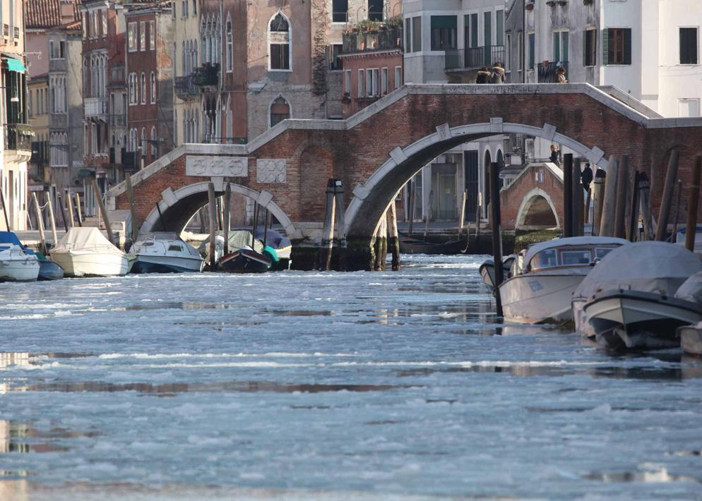
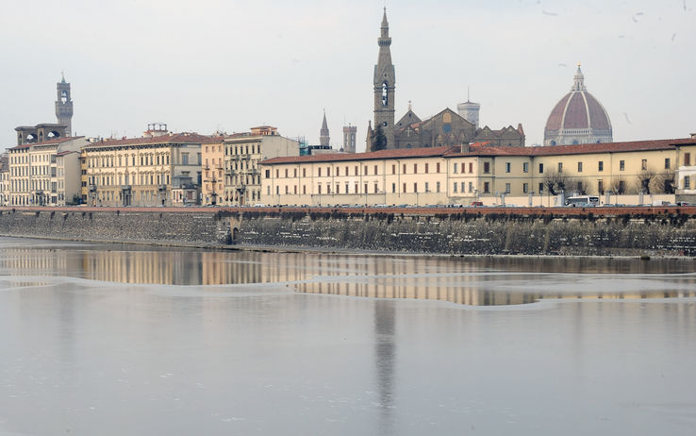
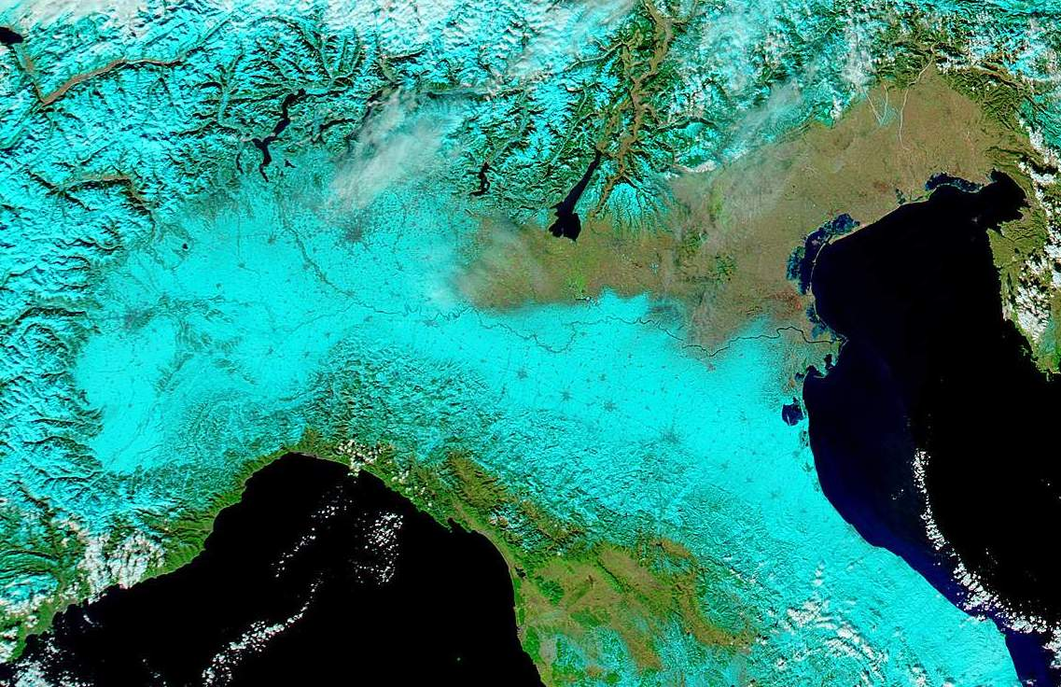
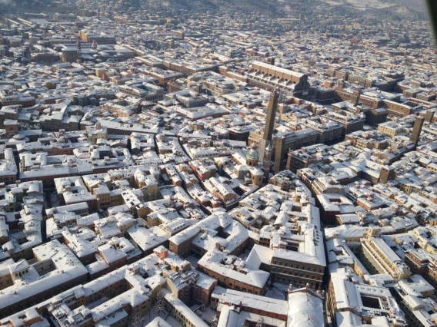
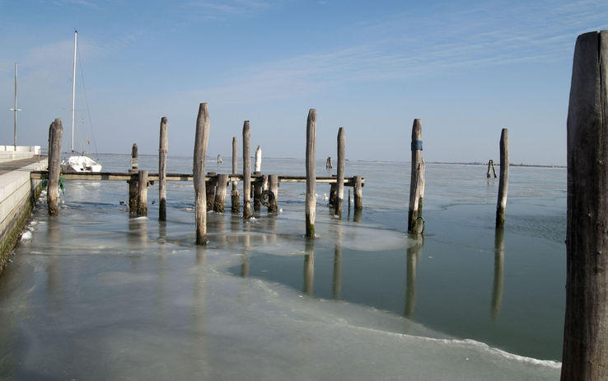
Bologna
Trieste
Genova
Romagna coast
Trieste
Venice
Rimini Inland
Ancona
Venice
Florence
Venice
Cold wave in N Italy
Bologna
Notes:
B

Slide 10
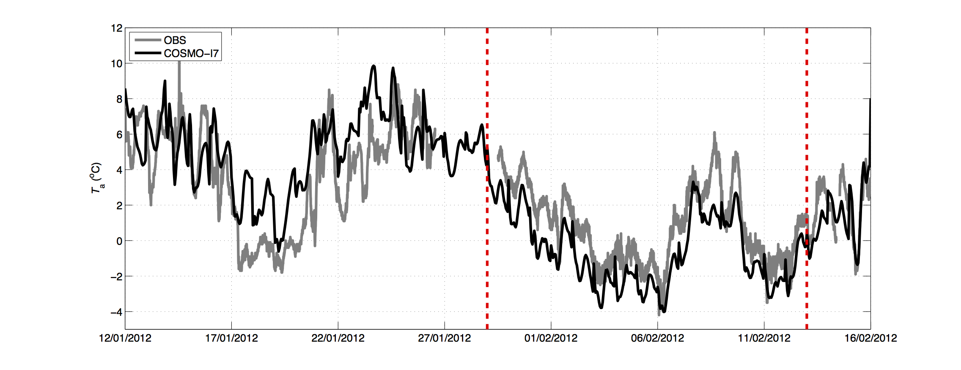
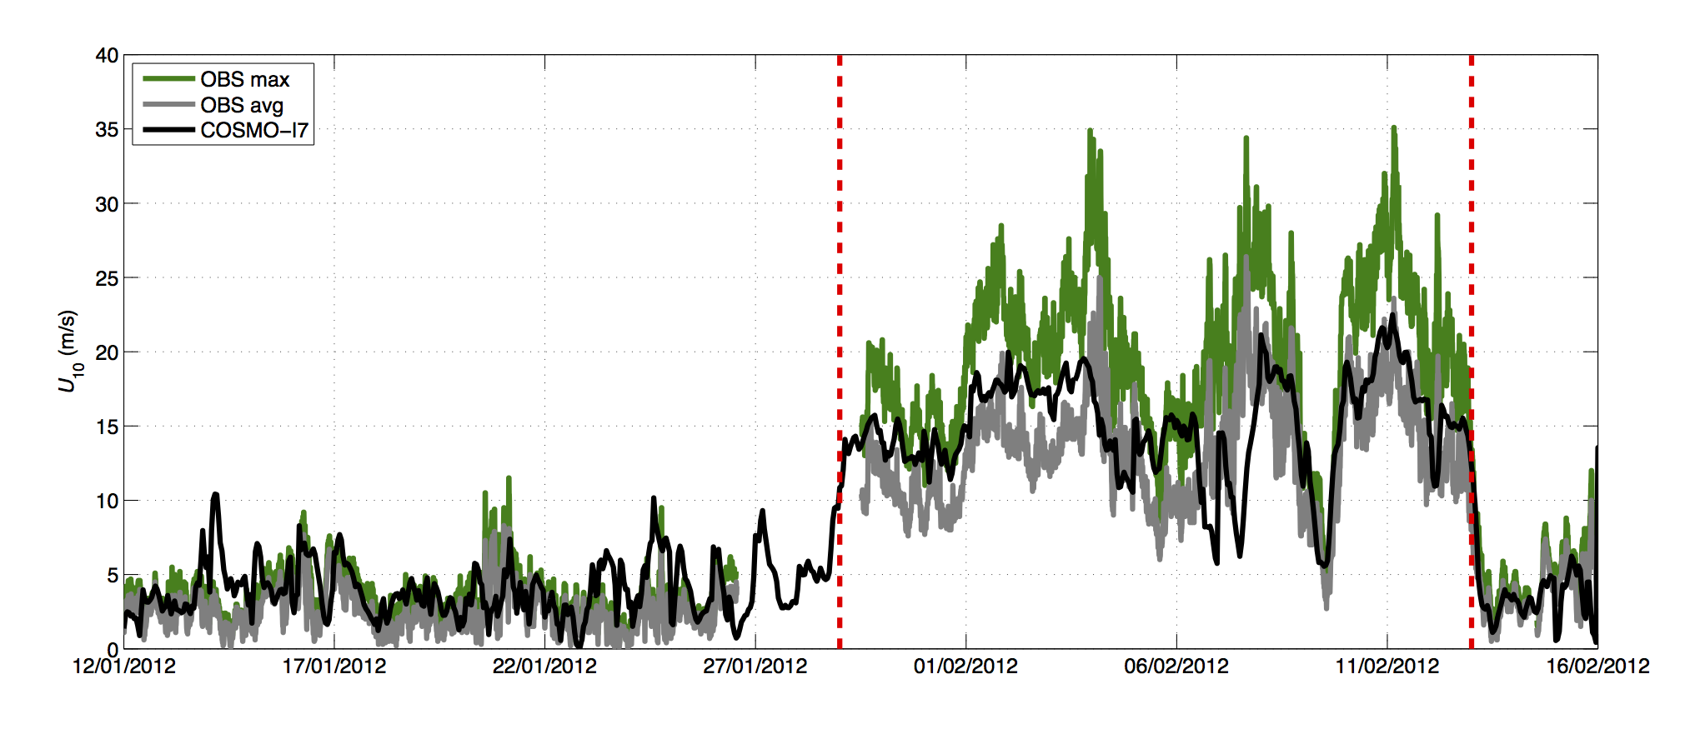
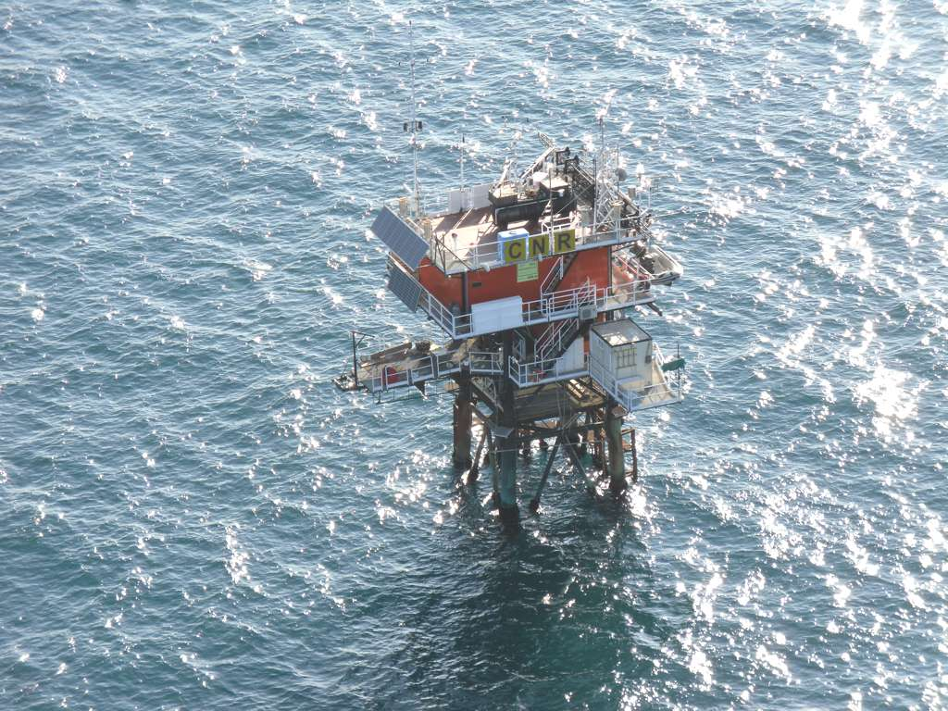
Atmospheric conditions at “AA” tower
Available model output and observations during CAO
Air temperature
(2 m)
Acqua Alta Tower
(“AA”) – 17 m depth
Wind speed
Notes:
Magari fare precedere da foto PTF

Slide 11
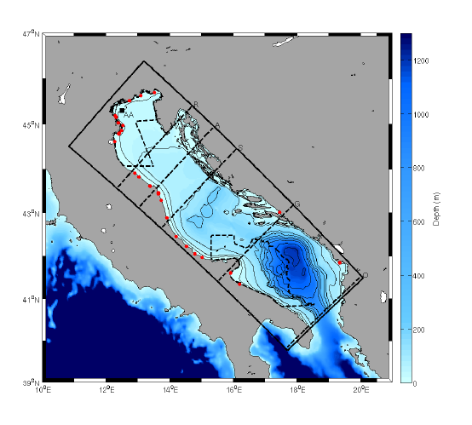
Modeling Approach
An integrated and coupled modeling system of the Adriatic Sea
NAdDW production and spreading simulated by a 3-D coupled wave-ocean-sediment numerical model, eddy-permitting, high-resolution grid (1.0 x 1.0 km²). 30 levels, Nov 2011-June 2012.
Coupled-Ocean-Atmosphere-Wave-Sediment-Transport system
ROMS-SWAN-SEDIMENTS
In this talk:
2WC run: ocean-wave coupled (1800 s ½ COSMO forcing time step)
UNC run: ocean and wave uncoupled.
Notes:
Wave effects are including using different mechanisms…
UNC= z0 using Charnock formula, then used in the GLS to reproduce ocean surface roughness
2WC=
a) at the air/sea, z0 using Taylor-Yelland (2001) (prop. to sea wave stepness)
b) In th GLS, waves contribute to surface roughness
c) Then as a wave-force, following the VF formalism, separating conservative terms (including Stokes-Coriolis terms) and non-cons terms
On the other hand, currents are sent to the Wave model as in Kirby and Chen 1989 (weighted depth-averaged velocity)
Short waves= feel the current nearby the surface
Long waves= feel the currents down to a larger depth

Slide 12
Modeling Approach
Atmospheric forcings provided by the meteorological model COSMO-I7 (one-way 7.0 x 7.0 km² horizontal resolution)
Observational dataset
-oceanographic platform "Acqua Alta" (AA) in the northern Adriatic,
-"Operation Dense Waters" (ODW2012) cruises in the southern Adriatic,
-instrumented moorings deployed in the Bari Canyon (South Adriatic Sea).
Among the things to be recalled, we fostered the collaboration with our marine geologists colleagues, who were carrying out a survey off the Adriatic using new technologies (e.g. HR MultiBeam). This produced a NEW ADRIATIC BATHYMETRY
Notes:
Riformulare e mettere su due slides.

Slide 13
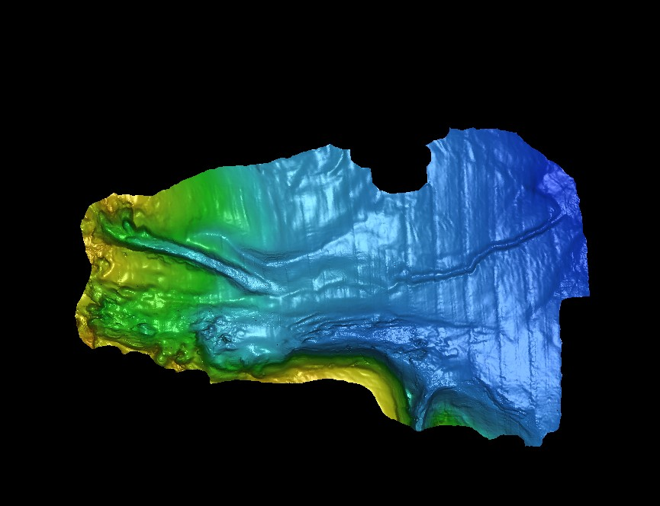
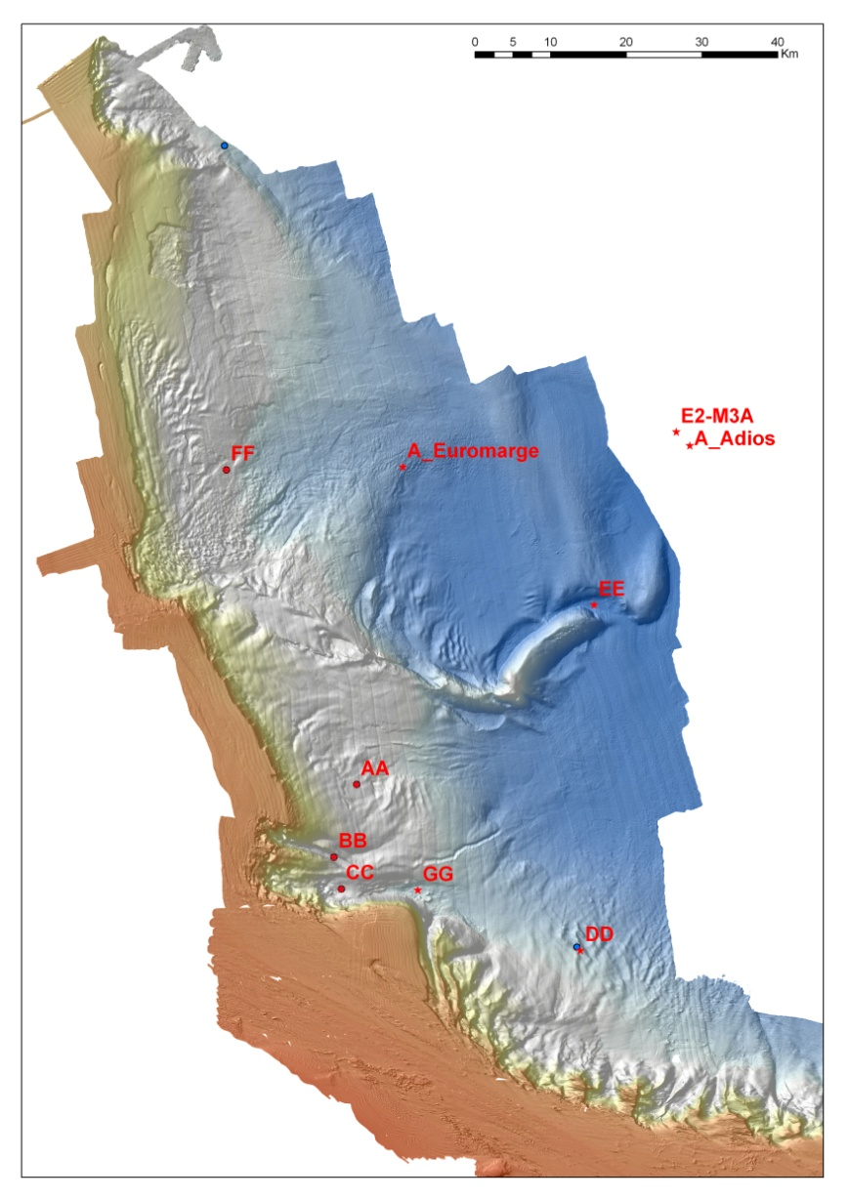
A new picture of the bottom areas
Bari Canyon
System
b
c
10 Km

Slide 14
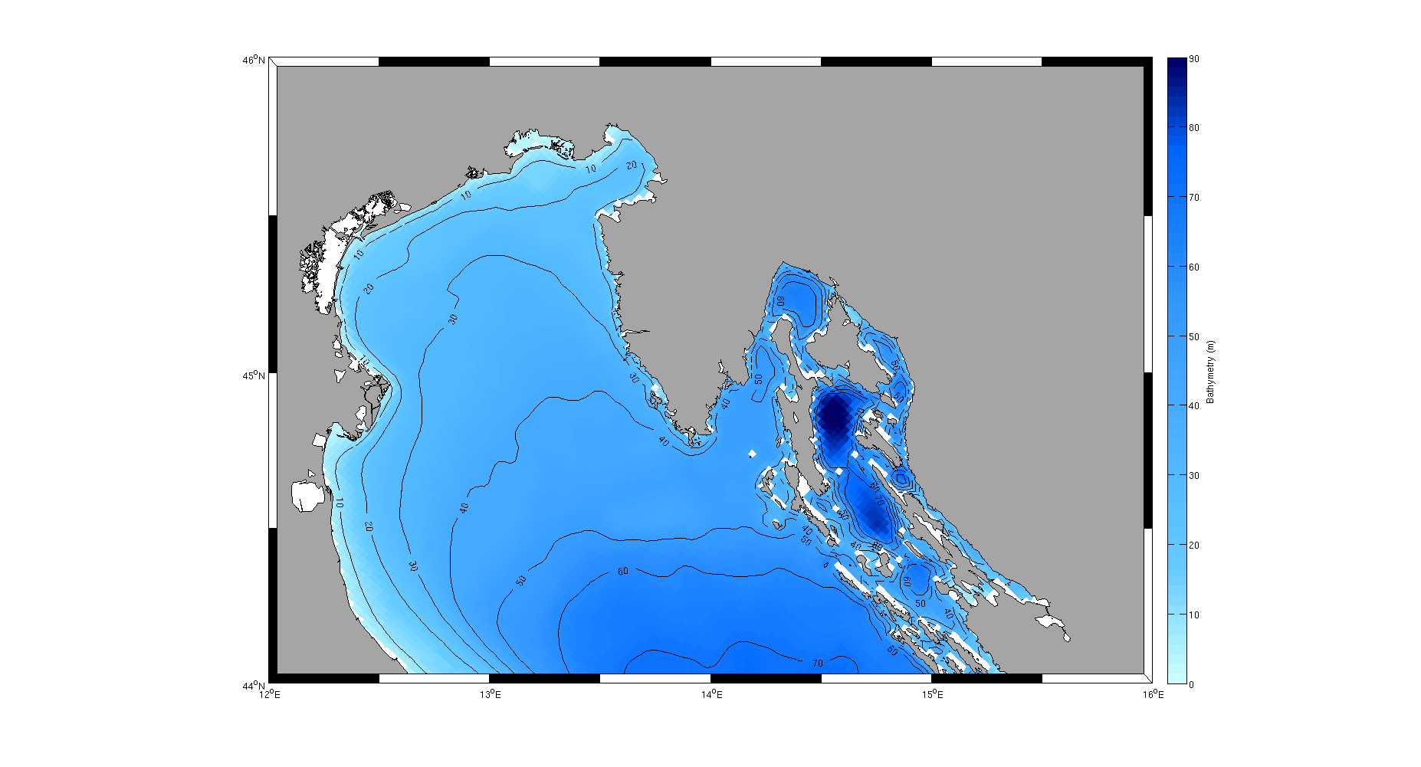
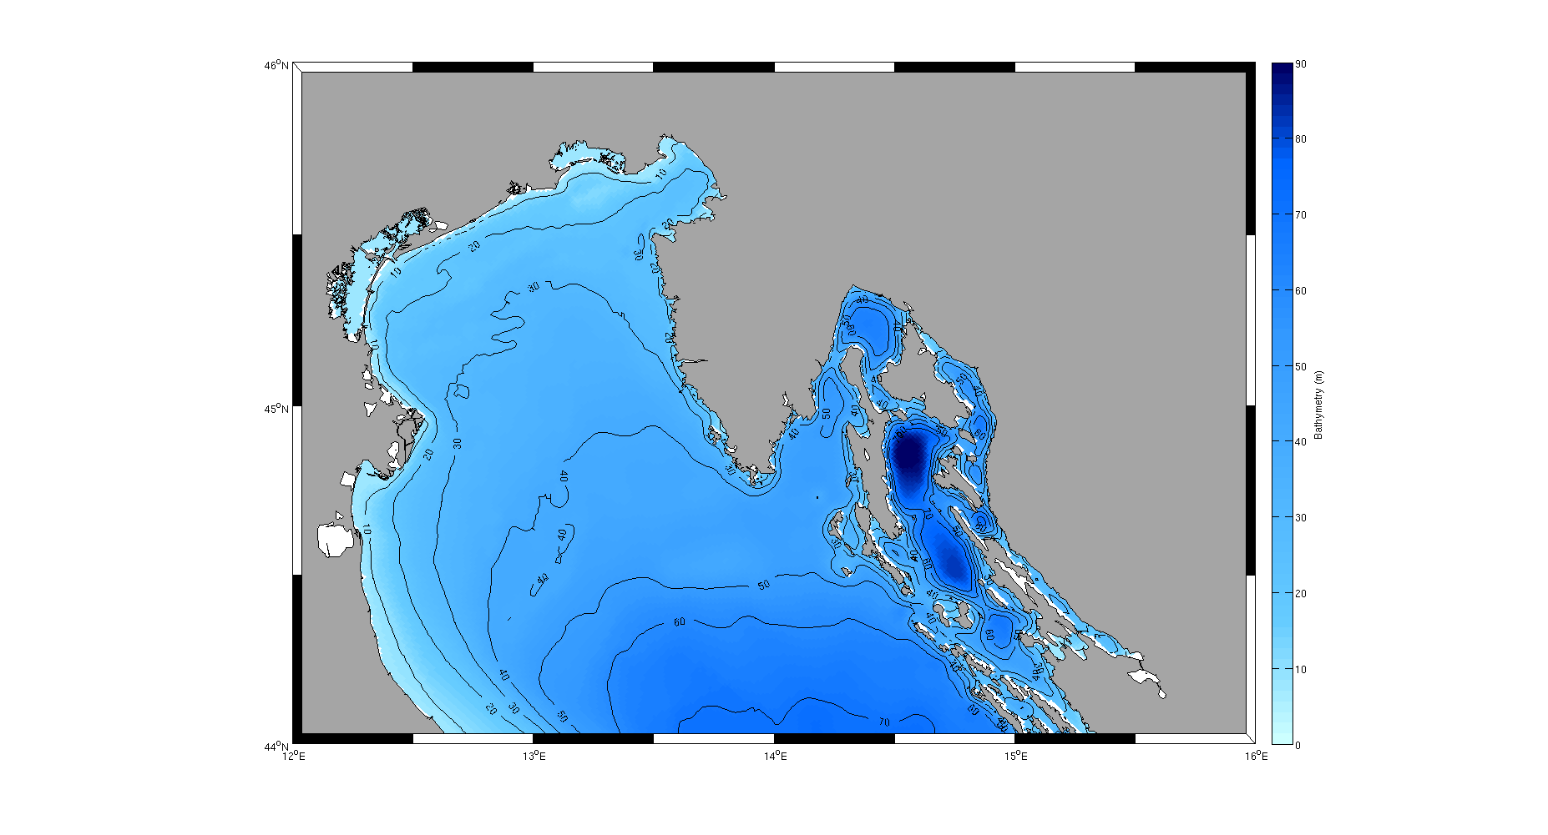
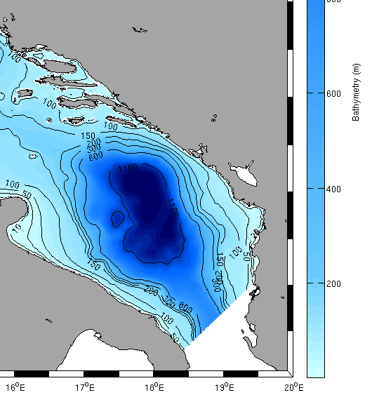

New data for a new bathymetry
Old bathymetry 2 km
Notes:
Riformulare e mettere su due slides.

Slide 15
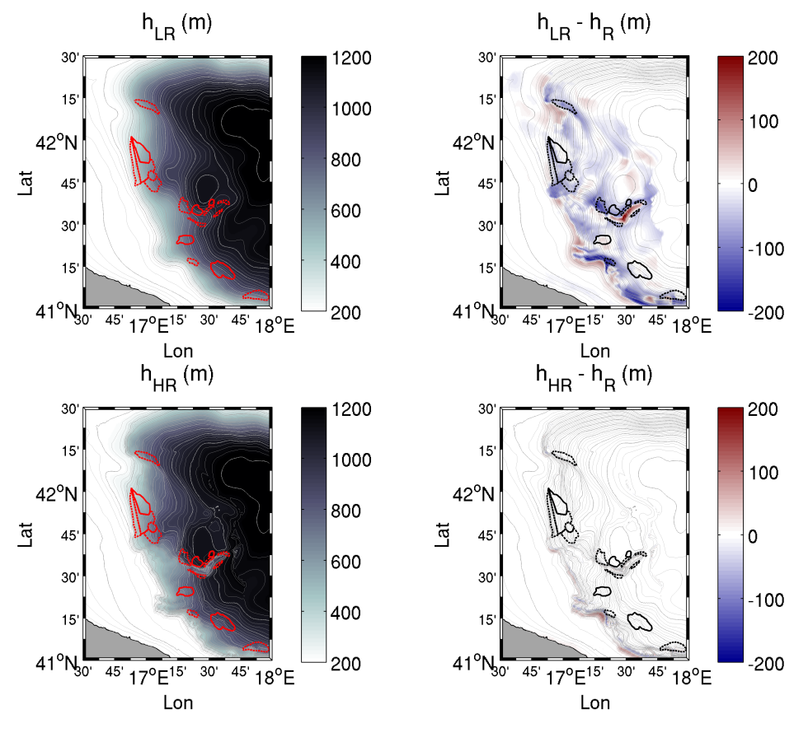
New bathymetry (these results: 1 km)
Notes:
Riformulare e mettere su due slides.

Slide 16
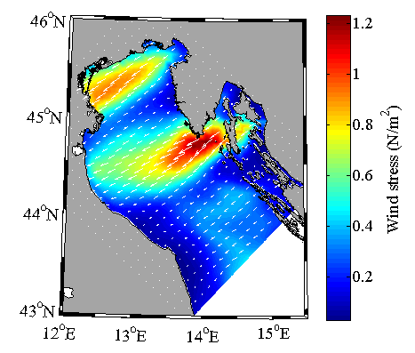
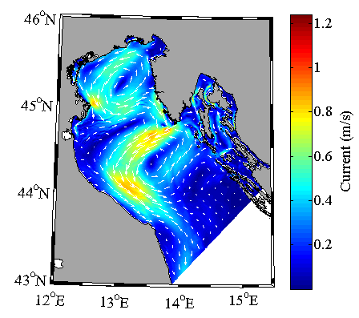
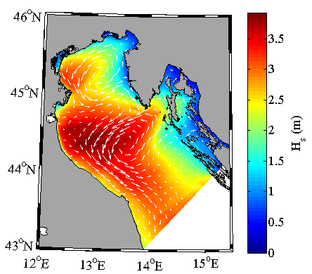
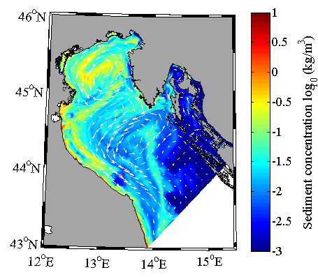
Modeling Approach
ATMOSPHERE
UV_{wind}, P_{atm}, RH, T_{air}, cloud, rain, evap, SWrad, LWrad, LH, HFX, UV_{stress}
UV_{wind}
H_{wave}, L_{wave}, D_{wave},
Tp_{surf}, Tm_{bott}, Q_{b}, Diss, UV_{bot}
UV_{s}, h, Zeta, Z₀
OCEAN
Currents
WAVES
Bottom stress
Bottom stress
SEDIMENTS (BIOLOGY…)

Slide 17
Modeling Approach
Several recent efforts using this coupled approach...
WCI: effects on the wave-field
Benetazzo, Sclavo Bergamasco, Carniel, 2013. Ocean Modeling, 70
WCI: effects on suspended sediments
Sclavo, Carniel, Bergamasco, Falcieri et al., 2013. J. Coast. Res., 65
Effects of DSW on southern margin reshaping
Bonaldo, Bergamasco, Falcieri, Trincardi and Carniel , 2014 (submitted Marine Geology)
Effects of DSW on sediment fluxes in the Southern margin
Carniel, Benetazzo, Falcieri et al., 2014 (submitted Marine Geology)
In this talk, we will refer to
Benetazzo, Bergamasco, Falcieri and Carniel 2014. The response of the Adriatic Sea to an intense CAO: basin renewal, dense water masses, near-bottom dynamics, and effects of ocean-wave coupling. (in revision, Progress in Oceanography)
Notes:
Riformulare e mettere su due slides.

Slide 19
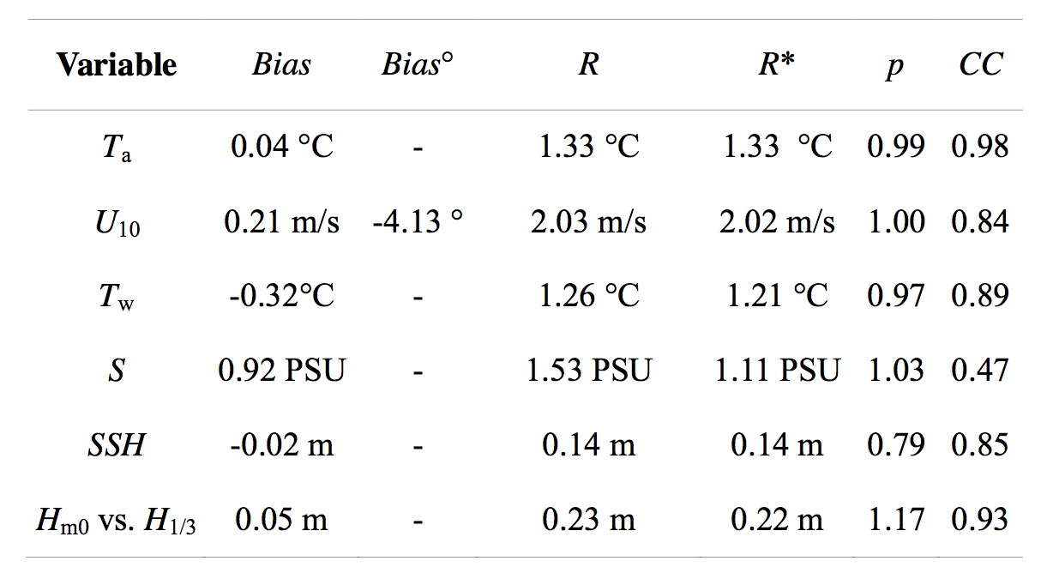
Model performances (“Acqua Alta”)
Nov 2011-Jun 2012
= modeled T air and U10 are very good w.r.t. Data
= generally, COSMO slightly “colder and faster”
=T&S data suffer from an “endemic” bias due to I.C. (2000 initialization, models adopted...)
= waves are well reproduced
Notes:
Results from 2WC run
R=root-mean-square difference (R and R*, where the latter refers to de-averaged data). As R is affected by a BIAS that masks the meaning of R (which says how two series look like), we removed the BIAS to check, once unbiased, whether model outputs flucuate similarly to observations
Tair e U10 are very good performing w.r.t. existing models
Generally conditions: COSMO was slightly colder and winds slighty fastert
T/S: suffer from an endemic bias due to 2000 initialization
SSH is OK. Sottolineo che abbiamo marea
Onde: OK

Slide 20
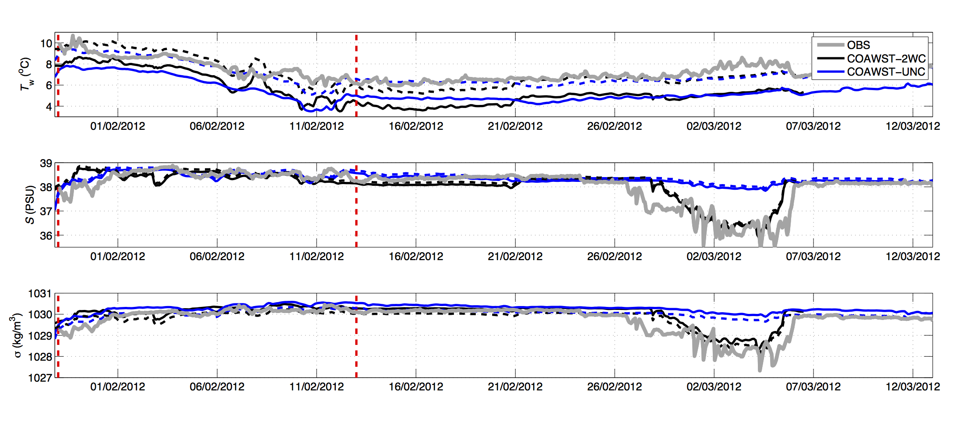
Hydrology data at “AA”
model results
-2.9 m obs
Notes:
Scriviamo le quote dei sensori in PTF: -2.9 m
---=unbiased

Slide 21
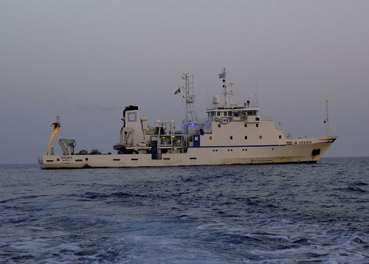
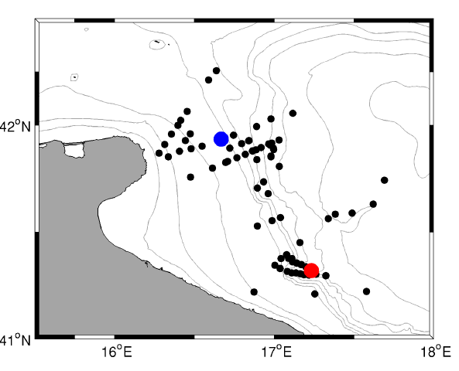
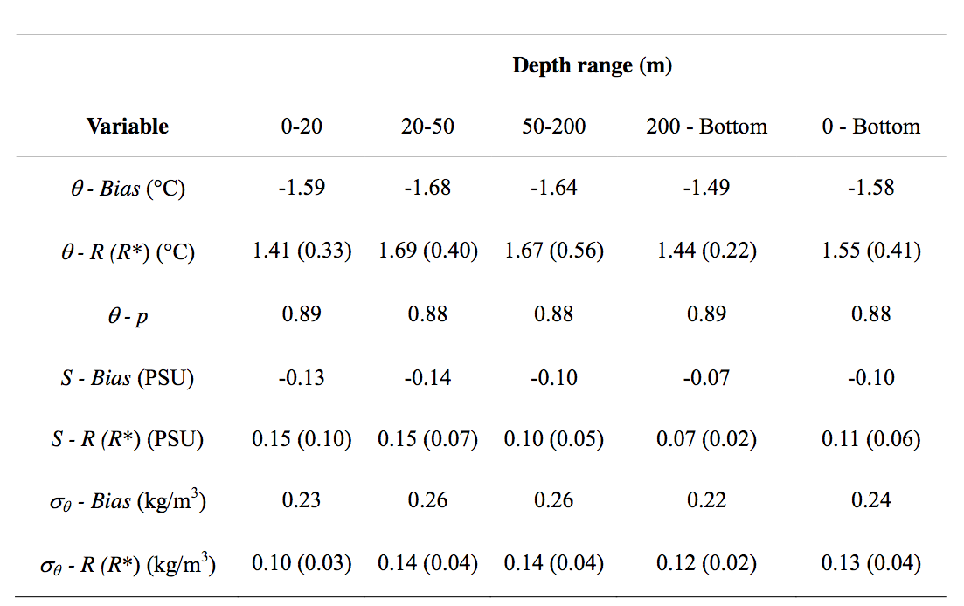
Model performances (CTD “Urania”)
March 23-April 20, 2012
=2 months after the CAO, T is underestimated (density higher than obs).
Notes:
Sempre da 2WC model
Necessity of using unbias results

Slide 22
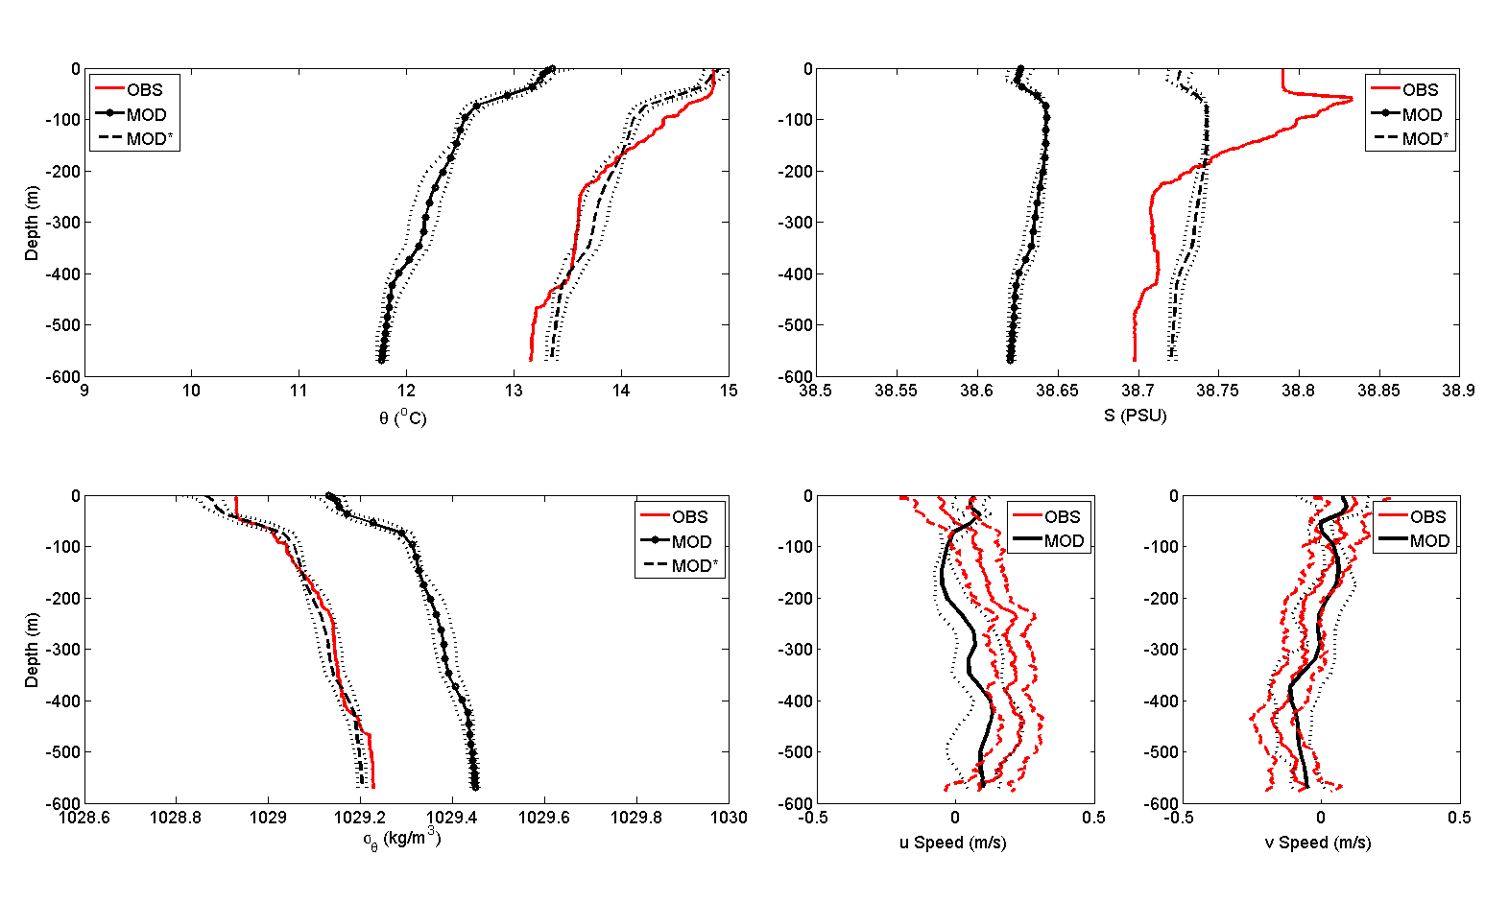
Model performances (CTD+ADCP)
-1.6°C, -0.10 PSU, 0.2 kg/m3
Notes:
Baied/unbiased. Unbiased is doing fine (except maybe for S).
No bias computed for velocities!

Slide 23
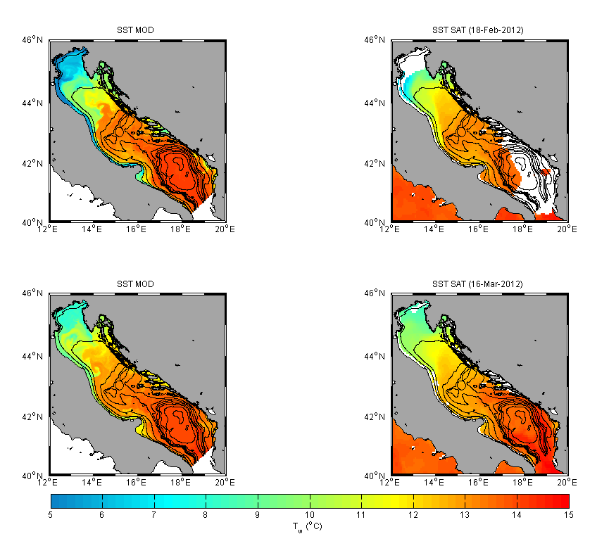
Qualit. comparison on DW formation area
SST (Model snapshot VS multi-image merging from satellite)
Notes:
This is UNBIASED
Citare satellite e passaggi effettuati. Periodo? Multi-satellite merging (Buongiorno Nardelli, B., Tronconi, C., Pisano, A., Santoleri, R., 2013. High and Ultra-High resolution processing of satellite Sea Surface Temperature data over Southern European Seas in the framework of MyOcean project. Remote Sens. Environ. 129, 1–16.) Sea Surface Temperature (SST) comparison between COAWST-2WC (unbiased) output (left column) and remotely sensed (right column). Maps at 00:00 UTC on February 18 (Top) and on March 16, 2012 (Bottom).

Slide 24
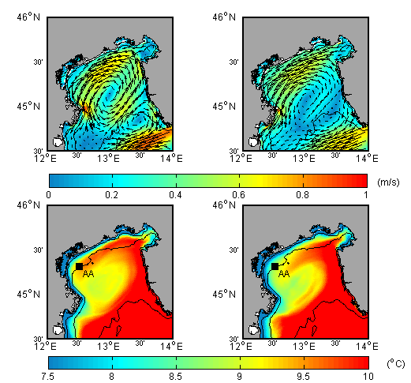
2WC and UNC difference
Wave Effects on Current speed and T fields (Jan 29 - Feb 07, 2012)
2WC
UNC
Effects of 2WC may be direct on increasing/decreasing surface velocity, but also on distributing local “blobs” w.r.t. coastal region.
This is a very important feature presented also by Sclavo et al. 2013 on the SSC
Notes:
Mettere periodi e livelli a cui si riferiscono le immagini medie Weekly mean average sea surface current speed (top) and temperature (bottom). Reference period: January 29 - February 07, 2012. Left panel: COAWST-2WC (unbiased); right panel COAWST-UNC (unbiased).
Diff 2WC e UNC….

Slide 25
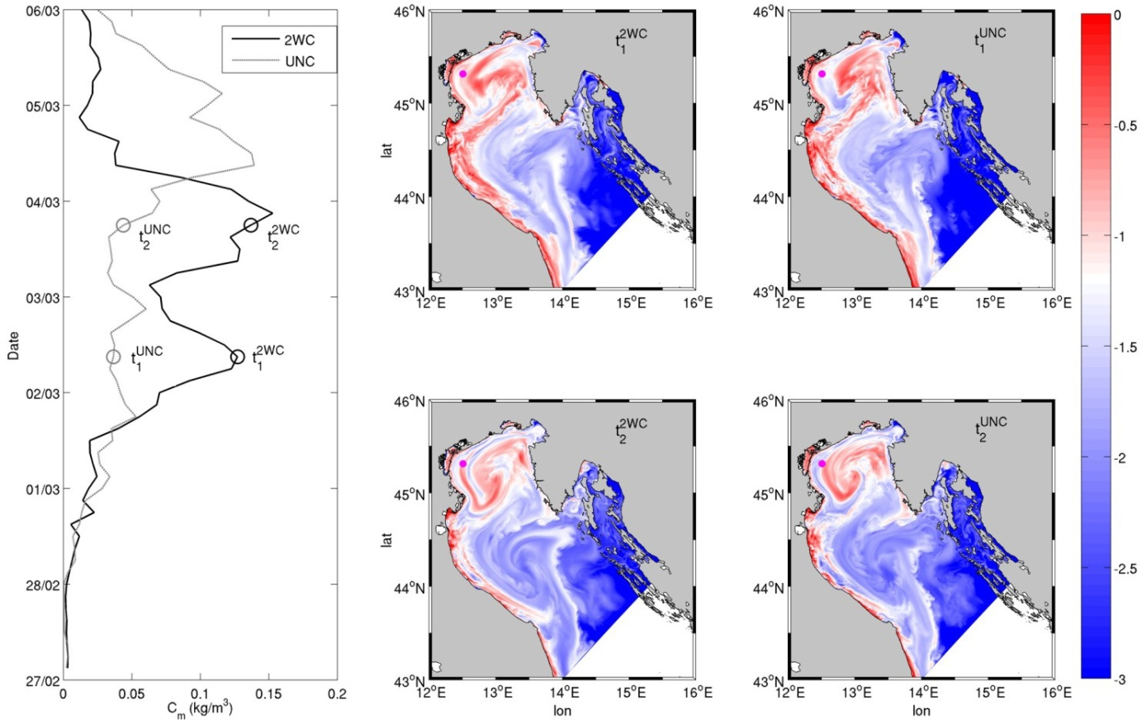
2WC and UNC difference
WCI effects on Suspended Sediments
t₃
t₂
t₁
WCI: 2 max at “AA”
NO WCI: 1 max, different timing
© DHI

Slide 26
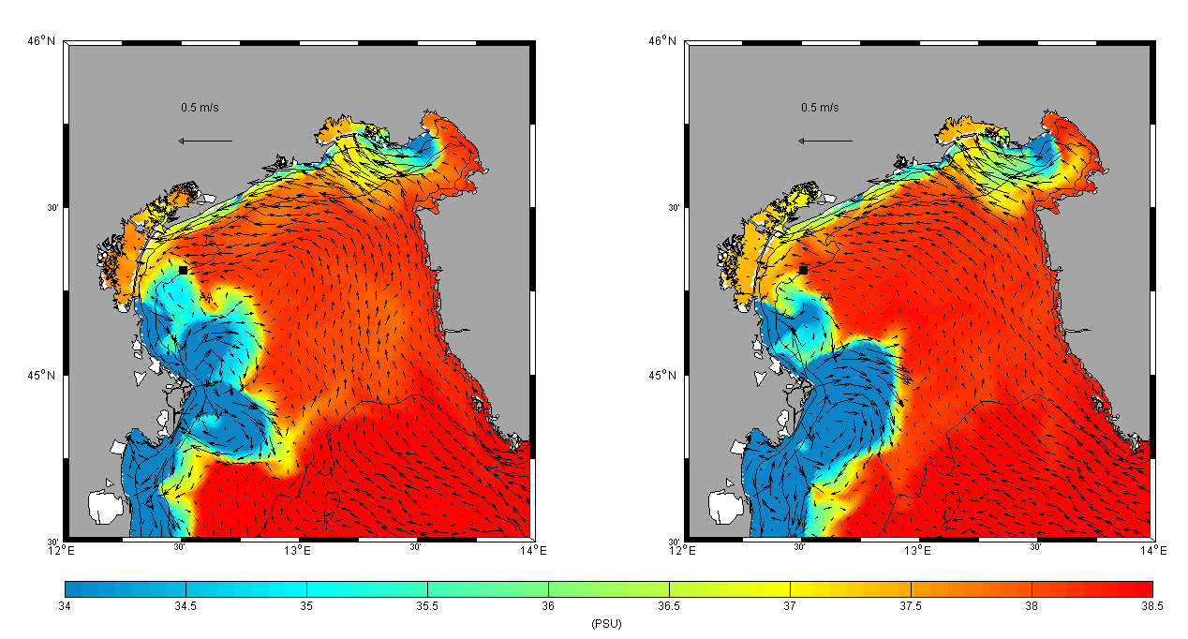
Interesting features: plume bifurcation
Wave Effects on River plume (SSS on Mar 05, 02:00 UTC)
2WC
UNC
See also F. Falcieri talk, tomorrow
Notes:
Sea surface salinity at 02:00 UTC on March 05, 2012. Left panel: COAWST-2WC (unbiased); right panel COAWST-UNC (unbiased).
Link talk Falcieri (che userà UNC)

Slide 27
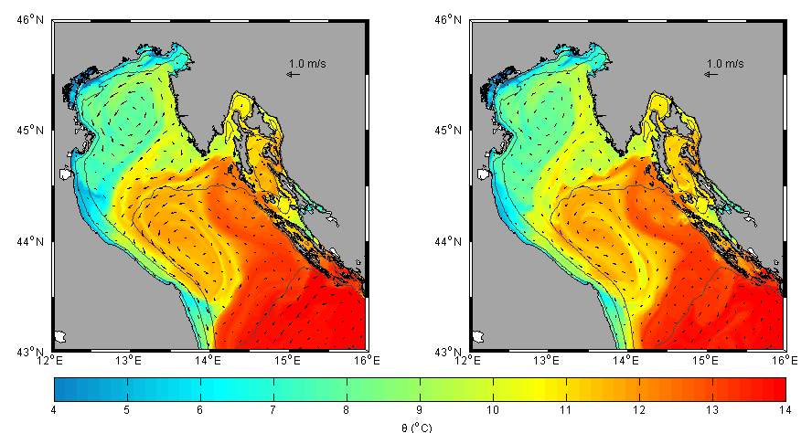
2WC result example
Water Temperature (Surface and Bottom) - 2012 Feb 6, 00:00 UTC
2WC
2WC
Notes:
Dire periodo a cui si riferisce media visualizzata: Surface (left panel) and bottom (right panel) layers of potential water temperature and ocean currents at 00:00 UTC on February 6, 2012. Results from COAWST-2WC (unbiased). For graphical purposes, current vector arrows are decimated by a factor of 12. Isobaths 10, 20, 50, and 100 m are superimposed as fine dashed lines.

Slide 28
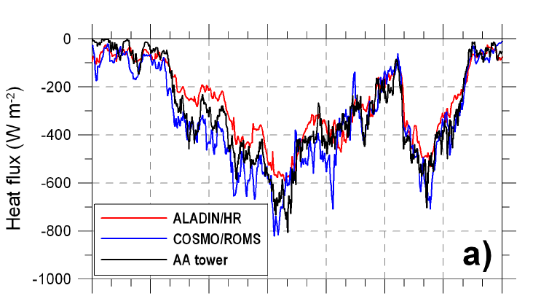
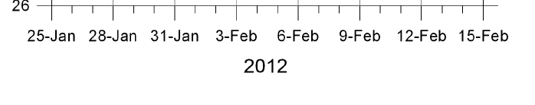
Turbulent Fluxes comparison at “AA”
Notes:
Ricordare formule utilizzate per stima flussi: COARE
We can present here 2WC and UNC results. Results that well compare with the Mihanovic et al. Paper results, where other estimated were presented (including “AA” data)

Slide 29
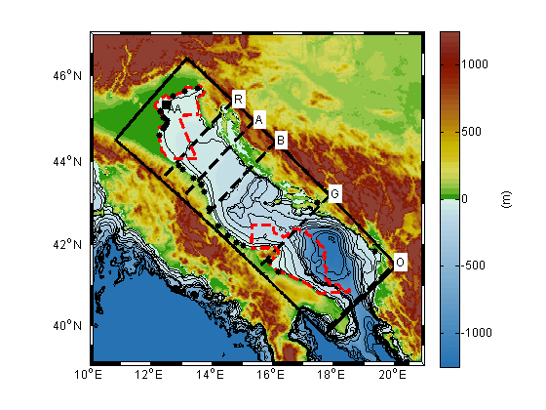
Control sections
Notes:
…

Slide 30
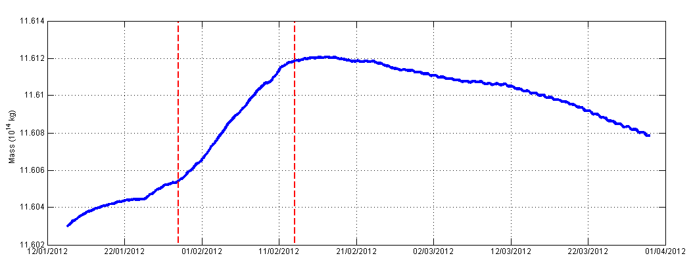
When did we have the max new DWs?
Adriatic Sea total Mass north of Section A (using 2WC results)
Since CAO onset, mass grows approx. linearly
(1.5 kg/m²/day loss of buoyancy)
After, gain of buoyancy 0.3 kg/m²/day
Notes:
Come è stata calcolata la curva? Tutto Adriatico? Solo NA? Time series of the Adriatic Sea total mass north of section A (see Figure 1). The two vertical dashed red lines mark the CAO extent. Output results from COAWST-2WC (unbiased). Newly formed water masses have been firstly identified (Figure 12) by computing the Adriatic Sea total mass northern than transect A. Since the CAO onset, Adriatic mass has grown approximately linearly during the cooling event, experiencing a loss of buoyancy of about 1.51 kg/m²/day (corresponding to 4.3x10¹⁰ kg/day and a mass variation of 0.06 % through the entire CAO). From CAO’s cessation NA mass has remained almost unchanged for 3 days, then it began to gain buoyancy, slightly decreasing its mass at a rate of -0.32 kg/m²/day.

Slide 31
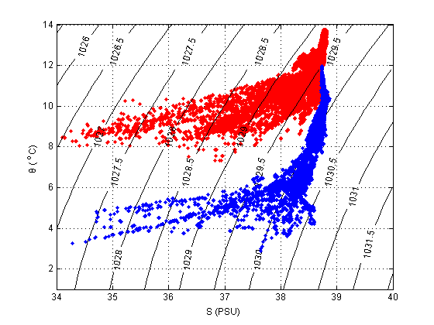
New water masses characteristics
North Adriatic area - TS diagram (before and after the CAO)
blue: a colder and saltier water (evaporation)
Haline contribution: ~ 25%
→ we track 1030.0
Notes:
Mettere immagine NA con linea di chiusura della sezione usata per calcolo Potential Temperature-Salinity diagram of simulated water masses northern than section A (see Figure 1) at 00:00 UTC on January 29, (red) and February 13 (blue). Output results from COAWST-2WC (unbiased).

Slide 32

A vertical view of the Italian DW vein
NAdDW Volumes (Feb 18, 14:00 UTC)
Notes:
Periodo a cui si riferisce immagine? Potential density at cross section B (see Figure 1). Example of NAdDW vein at 14:00 UTC on February 18, 2012. Black contour line identifies the 1029.8 kg/m³ potential density. For graphical purposes, the vertical dimension is magnified.
Ricordare che useremo approccio di calcolo acqua densa a aprtire dal fondo per acque “near bottom vein” in continuità

Slide 33

Residence time for different thresholds (2WC)
# days since Jan 29 when near-bottom water pot. dens. > than...
No direct info about the thickness of the vein here...
But note that HOW to compute these volumes matters!
Notes:
Queste densità cono dopo bias correction? Esatto! Residence time: number of days since January 29, 2012 such that near-bottom water potential density has exceeded the thresholds 1030.0 kg/m³ (left panel) and 1029.8 kg/m³ (right panel). Results from COAWST-2WC (unbiased).
Qui non dice nulla dello SPESSORE MEDIO DELLA VENA però!!!!!

Slide 34


Residence time for different thresholds (2WC)
# days since Jan 29 when near-bottom water pot. dens. > than...
Notes:
Non trovo acqua >29.2 nella SAP. Ma al Gargano la trovo, fino alla 29.4. Ad Otranto non trovo 29.4.
Nella SAP il 29.4 non c’è. Evidentemente si è diluito… diventando 29.2?

Slide 35

DW volume transports: time series
...tidal modulation rather evident
(stronger at N and on lighter waters)
About 1 Sv transport (during CAO, 2/3 of NA water was exchanged)
Notes:
Volume di acqua densa a soglie differenti
Si vedono chiaramente le modulazioni mareali a nord
Si vedono di più a nord e di più su acqua light
Ca. 1 Sv (durante evento i 2/3 dell’acqua NA sopra Ancona se ne è andata)

Slide 36

Tidal effects on DW volumes
Cumulative transp. Volumes: Section A
---= no tide
Notes:
NAdDW cumulate transport volume across Section A. Results from COAWST-UNC (continuous line) and COAWST-UNC_NoTide (dashed line).
Link talk precedente… tidal effect!!!
---= no tide
(questa volta, UNC run! Era l’unico che avevamo….)

Slide 37

DW volume transports: power spectrum
...again tidal modulation rather evident
Notes:
Spettri inerziale, semidiurna, diurna e flusso medio

Slide 38
DW volume in the South: arrival times
OBS and 2WC model results along channel B (Bari canyon system, 600 m)
Max density= 2-3 weeks after CAO
First “flash-stroke” faster (30 cm/s). Then slower (8 cm/s)
...time offset between model and data...bathymetry 1 km???
Notes:
Anche questa è corretta dal bias? Time series of observed (OBS) and modeled (MOD) water potential density along channel B of Bari canyon. Results from COAWST-2WC (unbiased).
Down canyon Bari. Max density= 2-3 weeks after the CAO. The first “flash-stroke” is much faster (30 cm/s) than the following average velocity (8 cm/s)
Slightly different timing between models and obs!

Slide 39

DW volumes at different transects: 2WC and UNC
We Integrate the time series of slide 23 into volumes at Sections
----- = UNC run
From N to S: the very dense water decreases
1029.6 increases until “A” (generated between “R” and “A”)
Large difference in “G” and “O” between UNC and 2WC (geostrophic adj. better preserved... why? Entrainment? Threshold?)
Notes:
Due righe su compatibilità/caveat con paper nuovo Janekovic et al 2014 (ricircolo, modo di calcolare volumi, etc.)
Le Time series mostrate prime, ora integrate ---= uncoupled
da N a S, l’acqua più nera diminuisce perché si modifica! La 1029.6 cresce fino ad A, perché tra R e A se ne forma…
Nelle sez. G e O abbiamo grande differenza tra UNC e 2WC perché dipende dalla velocità con cui arriva… acqua veloce: cade con meno facilità? (2WC, linea continua)
Vedi slide succ.

Slide 40
Bathymetry relevance
near-bottom current
(Feb 1 – May 31 mean)
Notes:
Magnitude and direction of near-bottom current speed difference between COAWST-2WC and COAWST-UNC. Four-month (January 29 - May 28, 2012) average. Velocity vectors are scaled to unit length.
E infatti, ecco la differenza tra 2WC e UNC!

Slide 41

Wave effects: from N to S Adriatic
near-bottom current difference 2WC-UNC
(Jan 29 – May 28 mean)
Notes:
Magnitude and direction of near-bottom current speed difference between COAWST-2WC and COAWST-UNC. Four-month (January 29 - May 28, 2012) average. Velocity vectors are scaled to unit length.
E infatti, ecco la differenza tra 2WC e UNC!

Slide 42

A useful “DW roadmap”
Density Anomaly: how it changes and along which paths travels from North to South Adriatic Sea (Feb-Jun)
Notes:
Ensemble of residence time maps; areas are selected belonging to a density class, provided that residence time is > 25% of the maximum for that class.
Utile per fare un manualetto pratico di come si modifica l’acqua densa da N a S. Inutile cercare alcune tip. di acqua nella fossa, devi tener conto di questi “delta” che spiegano i vari entrainment o mixing e aiutano a trovare l’acqua corrispondente!
Inoltre indica i path preferenziali di queste masse…

Slide 43
Take-home messages
during February 2012, NAdDW production area occupied most of the basin > 43.5 °N from where it started to flow southerly
in the NA, DWs partially recirculated during the CAO event (that lasted about 15 days) and more than 50% of NA water volume is exported southward by denser waters
Water’s export is driven by two mechanisms:
During the first days of CAO, strong and cold winds generate a jet of relatively fast (about 0.3 m/s) and dense waters that reaches the SA, with evidences measured in the Bari canyon system.
After CAO’s cessation, NAdDW slowly flows southerly up to emptying the production basin.

Slide 44
Take-home messages
By following near-bottom vein of DWs, we have computed the residence time of masses exceeding a prescribed potential density threshold.
By selecting different thresholds, weakening of DW signal has been followed and sequential pathways of NAdDW identified (water density vein smoothly weakens along its propagation as a result of dilution and mixing with the surrounding ambient waters)
Results integrate the map presented by Vilibić and Supić (2005), with the main differences that a broader production basin and an adjustment towards Italian coast of the DW vein of Jabuka origin was depicted (see “DW” roadmap).

Slide 45
Take-home messages
Volumes transported show that DW fluxes are triggered by tidal effects, with strong instantaneous modulation.
Further analysis would give insight on how kinetic and potential energies of NAdDW vein may be cyclically modified by tides.
2WC/UNC: in the NAdDW production area, the effects of wave forces that are removed from RANS equations modify intensity of ocean circulation (about 15% of the current speed and 10% of the average heat budget)
This can imply modified NAdDW volumes flowing to the SA and tracers features at both sub-basin and local scale, close to river mouths.

Slide 46
Take-home message
NAdDW splitting is present in the Central Adriatic, where two veins of underflow are identified: one on the Italian coast and another spilling from Jabuka pit. These veins partially merge in the area between Gargano peninsula and Palagruza sill.
Dilution of DWs along their paths is such that, close to the SAP (where DW can eventually cascade), DWs are identified with a difference of 0.8 kg/m³ compared to northern masses.
Possible tele-connection between circulation conditions in the NA (where DW are produced) and the amount of DW that reach the southern basin (about 600 km apart) and contribute to the SAP water renewal are to be further investigated

Slide 47
Acknowledgements
…after a new bathymetry (freely available)
…after new data on eastern basin rivers
…time to get a new T&S sea-truth initial conditions!
CNR-ISMAR is calling for a joint cruise in the Adriatic-Ionian basin in late 2015
A “basin wide” efffort on-board R/V URANIA (CNR) and R/V ITALICA (OGS) where we welcome international colleagues

Slide 48
Acknowledgements
The Authors gratefully acknowledge the funding from the Italian Ministry of Research FIRB RBFR08D825 grant (Project ‘‘DECALOGO’’).
ODW2012 campaign was partially supported by Flagship Project RITMARE − The Italian Research for the Sea –coordinated by the Italian National Research Council and funded by the Italian Ministry of Education, University and Research within the National Research Program 2011 – 2013.
We wish to acknowledge the ARPA-EMR for providing COSMO-I7 meteorological forcings. Data from Vida were provided by the National Institute of Biology, Marine Biology Station, Piran, Slovenia.

