Slide 1
ROMS 4D-Var: Past, Present & Future
Andy Moore
UC Santa Cruz

Slide 2
Overview
Past: A review of the current system.
Present: New features coming soon.
Future: Planned new features and
developments.

Slide 3
The Past….

Slide 4
Acknowledgements
Hernan Arango – Rutgers University
Art Miller – Scripps
Bruce Cornuelle – Scripps
Emanuelle Di Lorenzo – GA Tech
Brian Powell – University of Hawaii
Javier Zavala-Garay - Rutgers University
Julia Levin - Rutgers University
John Wilkin - Rutgers University
Chris Edwards – UC Santa Cruz
Hajoon Song – MIT
Anthony Weaver – CERFACS
Selime Gürol – CERFACS/ECMWF
Polly Smith – University of Reading
Emilie Neveu – Savoie University

Slide 5
Acknowledgements
Hernan Arango – Rutgers University
Art Miller – Scripps
Bruce Cornuelle – Scripps
Emanuelle Di Lorenzo – GA Tech
Doug Nielson - Scripps

Slide 6
“In the beginning…” Genesis 1.1
Acknowledgements
Hernan Arango – Rutgers University
Art Miller – Scripps
Bruce Cornuelle – Scripps
Emanuelle Di Lorenzo – GA Tech
Doug Nielson - Scripps

Slide 7
“In the beginning…” Genesis 1.1

Slide 8
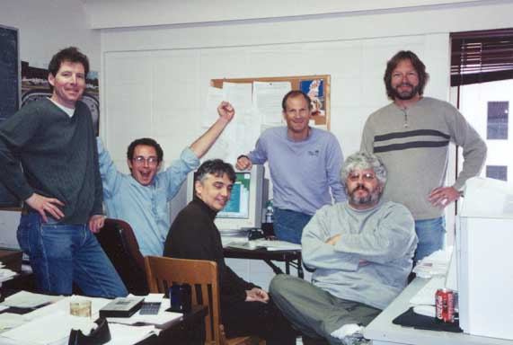
“In the beginning…” Genesis 1.1
No grey hair!!!

Slide 9
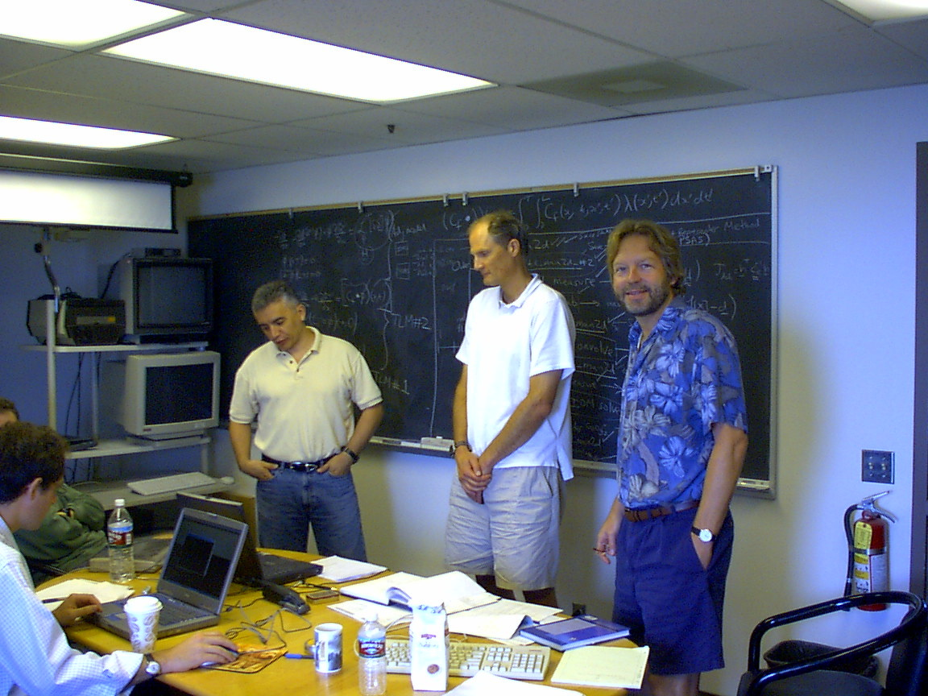

Slide 10
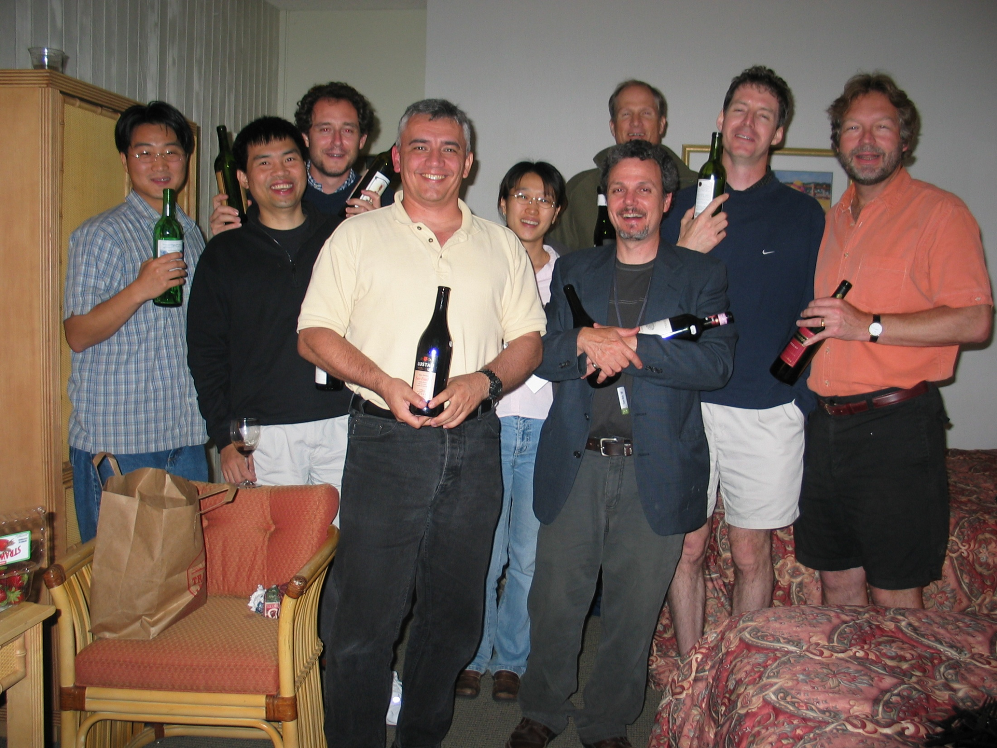

Slide 11
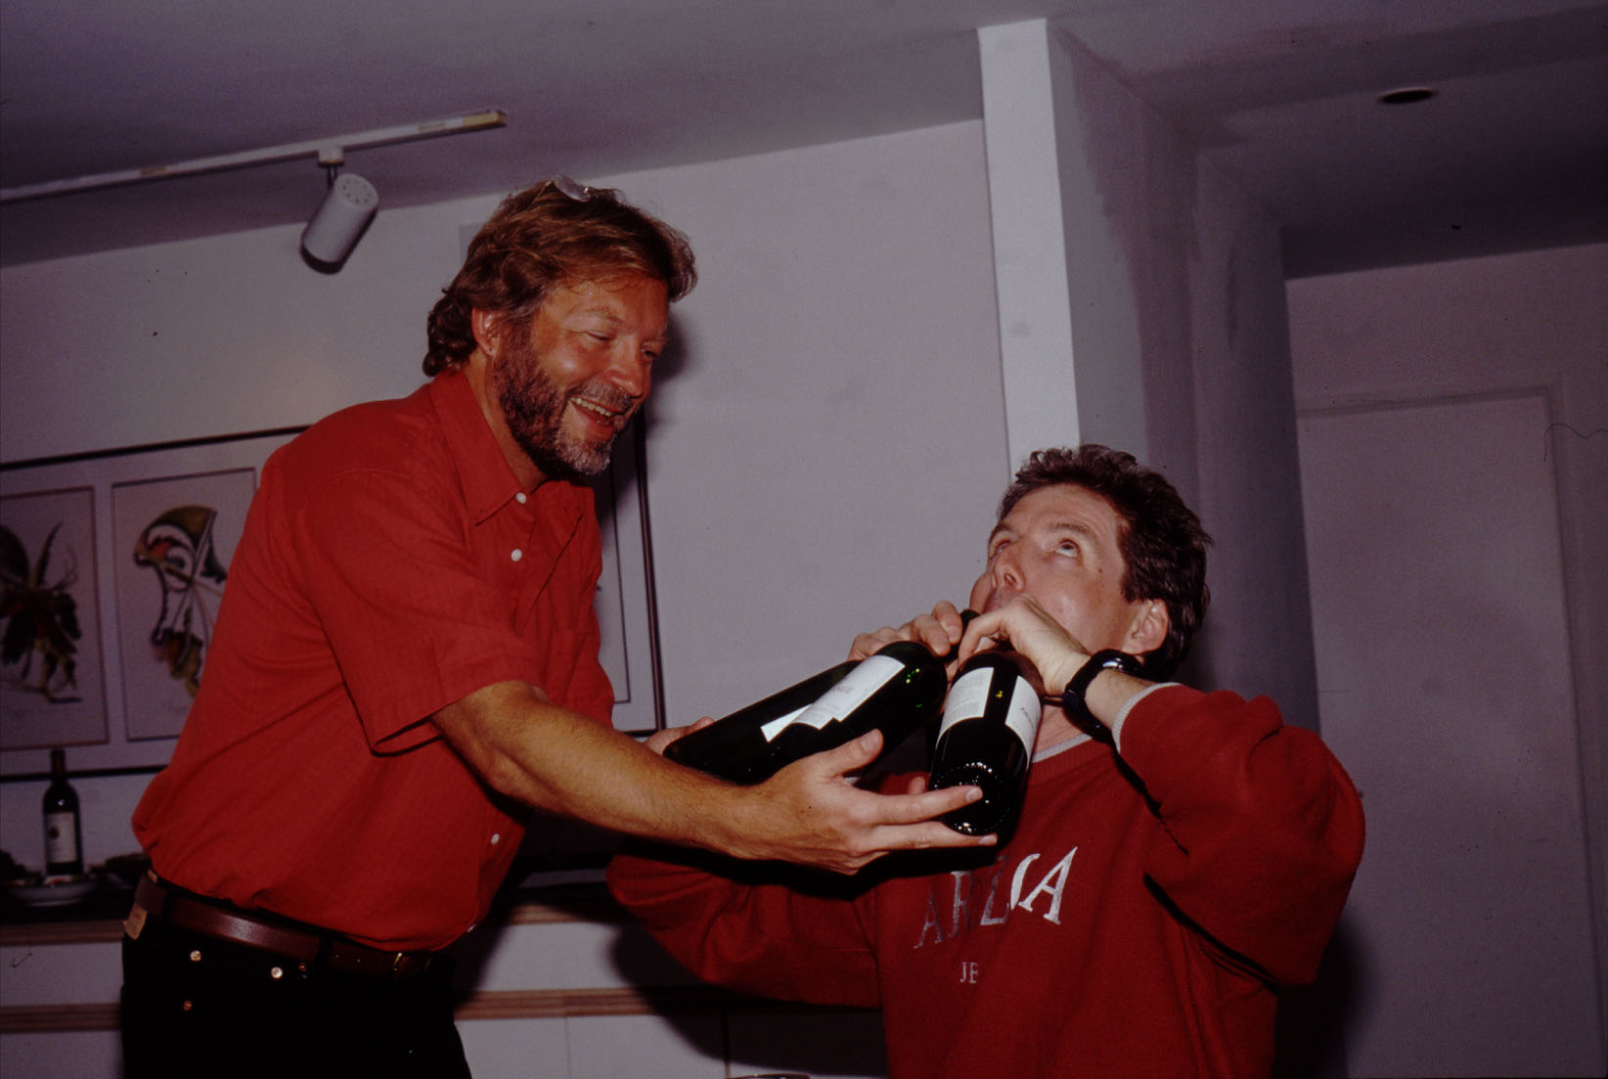

Slide 12
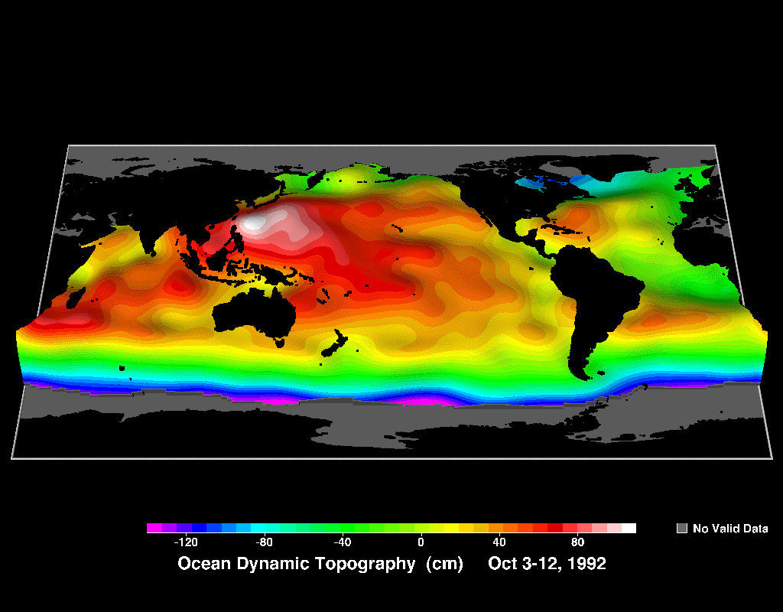
Regions where ROMS 4D-Var has been used

Slide 13
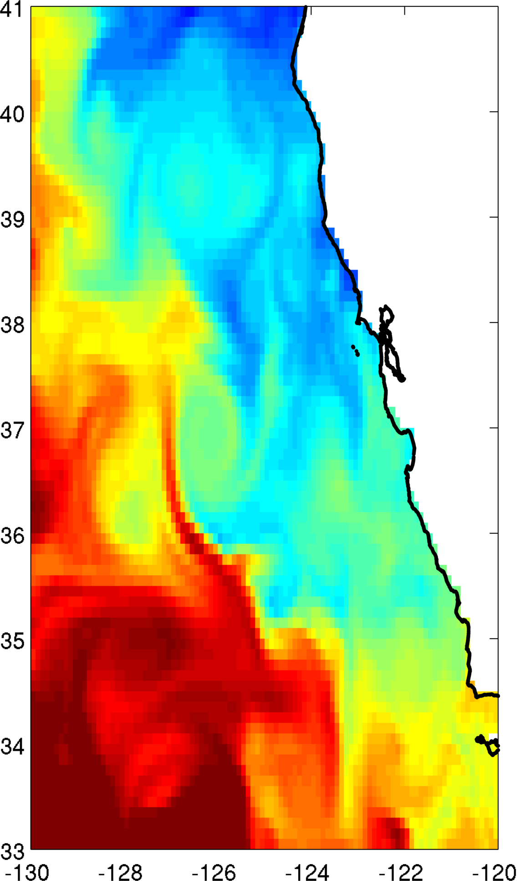
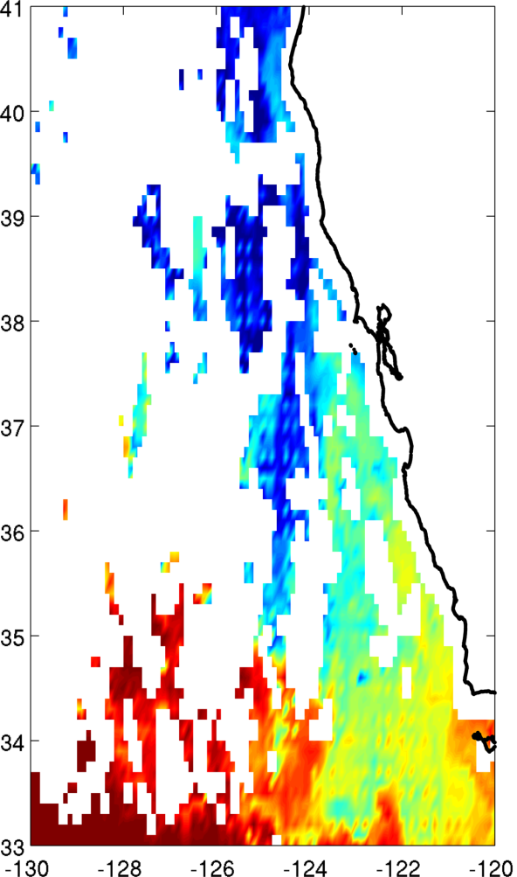
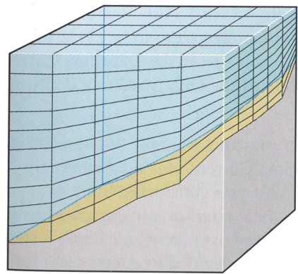
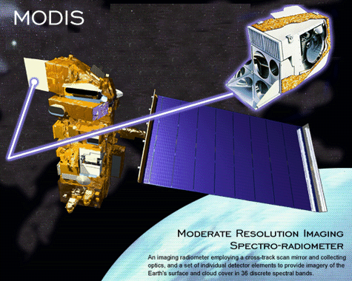
Data Assimilation
Model
Observations
f_{b}(t), B_{f}
+
Prior
b_{b}(t), B_{b}
ROMS
x_{b}(0), B_{x}
A complete picture but
subject to errors and
uncertainties
Incomplete picture of
the real ocean
Bayes’ Theorem
Data Assimilation
Posterior
Notes:
Extend the scenario where there are many observations, arranged in the vector y, with error covariance R.
The background now comes from a model with error covariance B.
Instead of obs at a single time, we consider obs from a finite time window.
And we seek an analysis that obeys the model equations to some degree; the model solution is controlled by initial and boundary conditions.

Slide 14
Data Assimilation
Model
Observations
f_{b}(t), B_{f}
+
Prior
b_{b}(t), B_{b}
ROMS
x_{b}(0), B_{x}
The control vector:
Prior error covariance:
Notes:
Extend the scenario where there are many observations, arranged in the vector y, with error covariance R.
The background now comes from a model with error covariance B.
Instead of obs at a single time, we consider obs from a finite time window.
And we seek an analysis that obeys the model equations to some degree; the model solution is controlled by initial and boundary conditions.

Slide 15
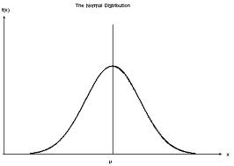
Maximum Likelihood Estimate & 4D-Var
Probability
Maximize P(z|y) by
minimizing J using
variational calculus
The cost function:
Prior
Prior
error
cov.
Obs
Obs
operator
Obs
error
cov.

Slide 16
Notation & Nomenclature
Prior
control
vector
Innovation
vector
State
vector
Control
vector
Observation
vector
η(t) = Correction for model error
η(t)=0 : Strong constraint
η(t)≠0 : Weak constraint
Observation
operator

Slide 17
4D-Var Cost Function
Control vector
Observation vector
Cost function minimum identified using truncated
Gauss-Newton method via inner- and outer-loops:
Tangent linear ROMS sampled at obs points
(generalized observation operator)

Slide 18
Solution
Optimal estimate:
Gain matrix – primal form:
Okay for strong constraint, prohibitive for weak constraint.
Gain matrix – dual form:
Okay for strong constraint and weak constraint.

Slide 19
Solution
Traditionally, primal form used by solving:
Okay for strong constraint, prohibitive for weak constraint.
The dual form is appropriate for strong and weak
constraint:

Slide 20
The Lanczos Formulation of CG
ROMS offers both primal and dual options
In both J is minimized using Lanczos formulation of CG
General
form:
Approx
solution:
Primal:
Tridiagonal
matrix:
Orthonormal
matrix:
Lanczos vectors: one per
inner-loop
Dual:
Primal
Dual

Slide 21
ROMS 4D-Var
Incremental (linearized about a prior) (Courtier et al, 1994)
Primal & dual formulations (Courtier 1997)
Primal – Incremental 4-Var (I4D-Var)
Dual – PSAS (4D-PSAS) & indirect representer
(R4D-Var) (Da Silva et al, 1995; Egbert et al, 1994)
Strong and weak (dual only) constraint
Preconditioned, Lanczos formulation of conjugate gradient (Lorenc, 2003; Tshimanga et al, 2008; Fisher, 1997)
2nd-level preconditioning for multiple outer-loops
Diffusion operator model for prior covariances (Derber & Bouttier, 1999; Weaver & Courtier, 2001)
Multivariate balance for prior covariance (Weaver et al, 2005)
Physical and ecosystem components
Parallel (MPI)
Moore et al (2011a,b,c, PiO); www.myroms.org

Slide 22
ROMS 4D-Var Diagnostic Tools
Observation impact (Langland and Baker, 2004)
Observation sensitivity – adjoint of 4D-Var (OSSE)
(Gelaro et al, 2004)
Singular value decomposition (Barkmeijer et al, 1998)
Expected errors (Moore et al., 2012)

Slide 23
Observation Impacts
The impact of individual obs on the analysis or
forecast can be quantified using:
Primal
Dual
Conveniently computed from 4D-Var output

Slide 24
Observation Sensitivity
Treat 4D-Var as a function:
Quantifies sensitivity of
analysis to changes in obs
Adjoint of 4D-Var
Adjoint of 4D-Var also yields estimates of expected
errors in functions of state.

Slide 25
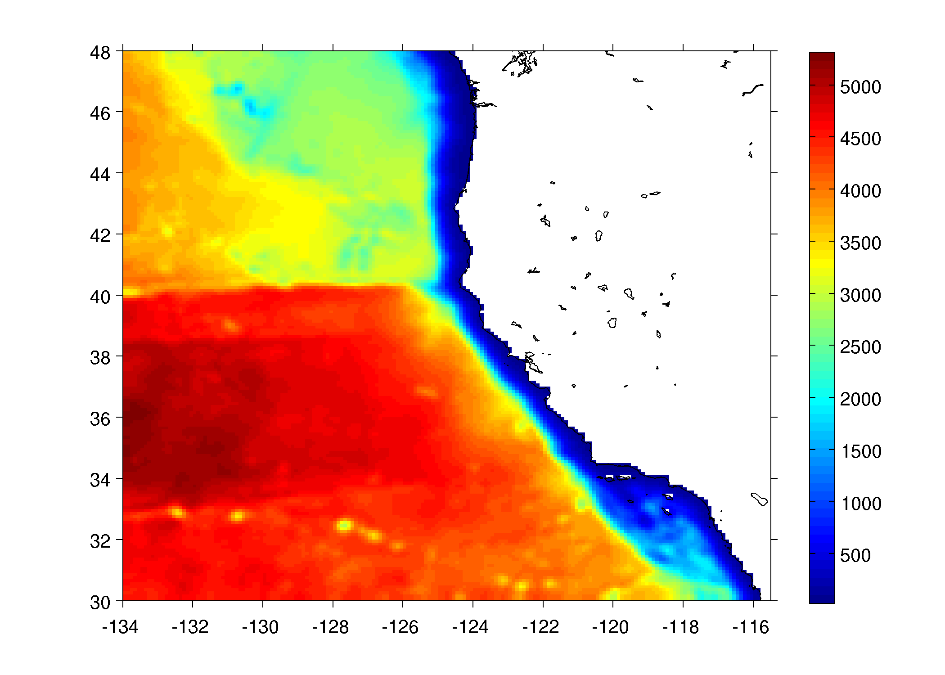
Impact of the Observations on Alongshore
Transport

Slide 26
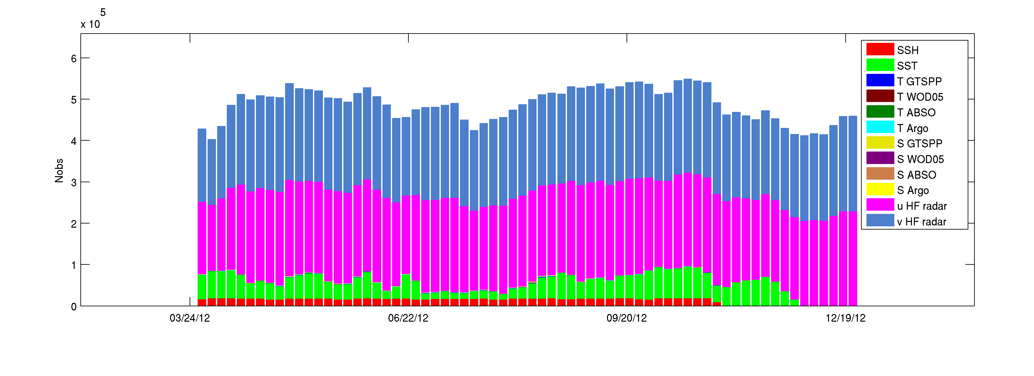
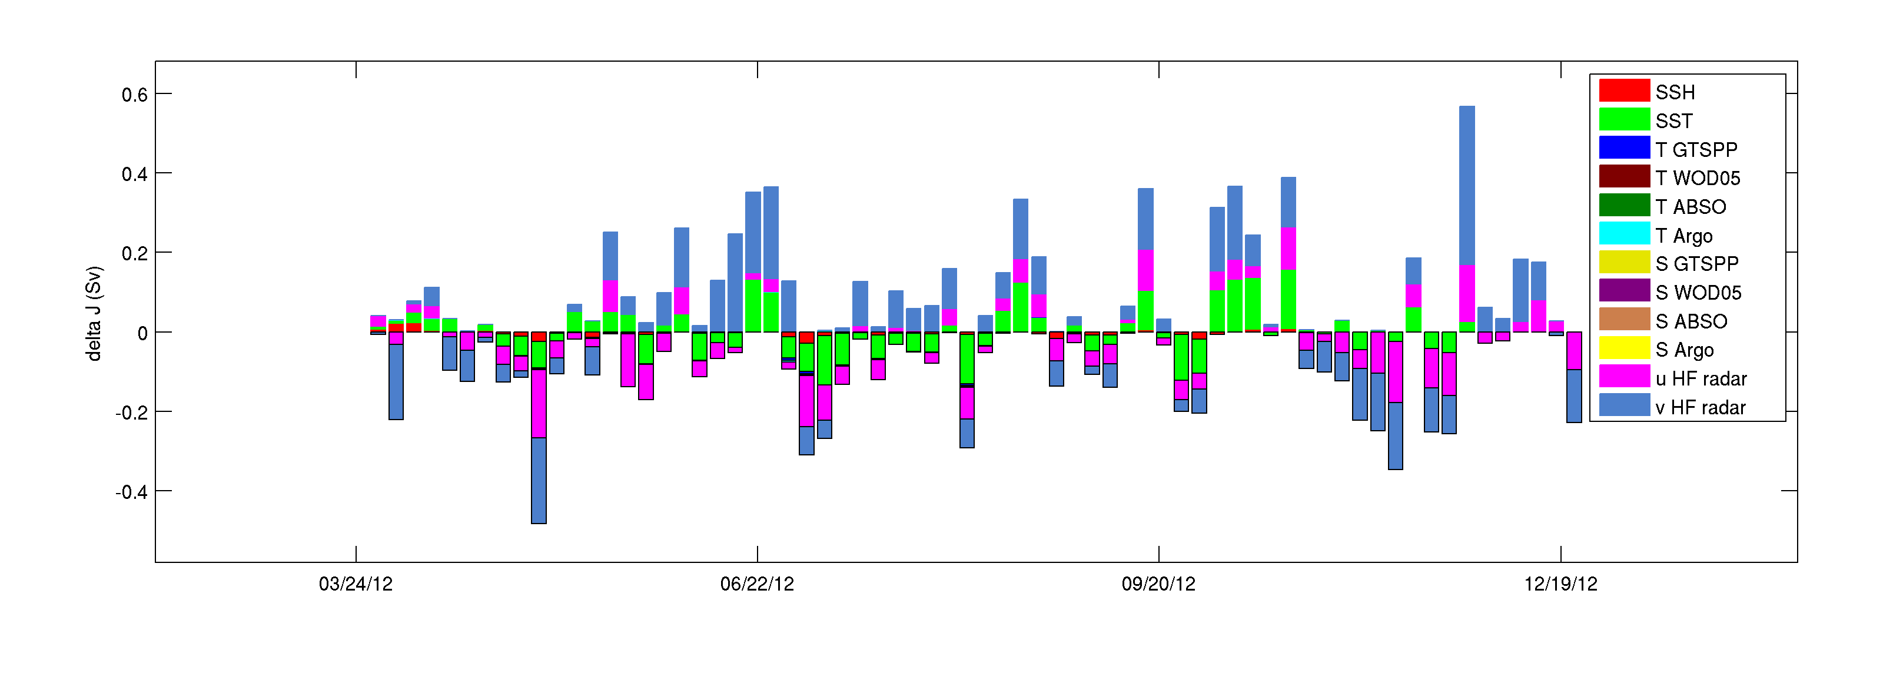
Total number of obs
March 2012
Dec 2012
Observation Impact
March 2012
Dec 2012
Ann Kristen Sperrevik (NMO)

Slide 27
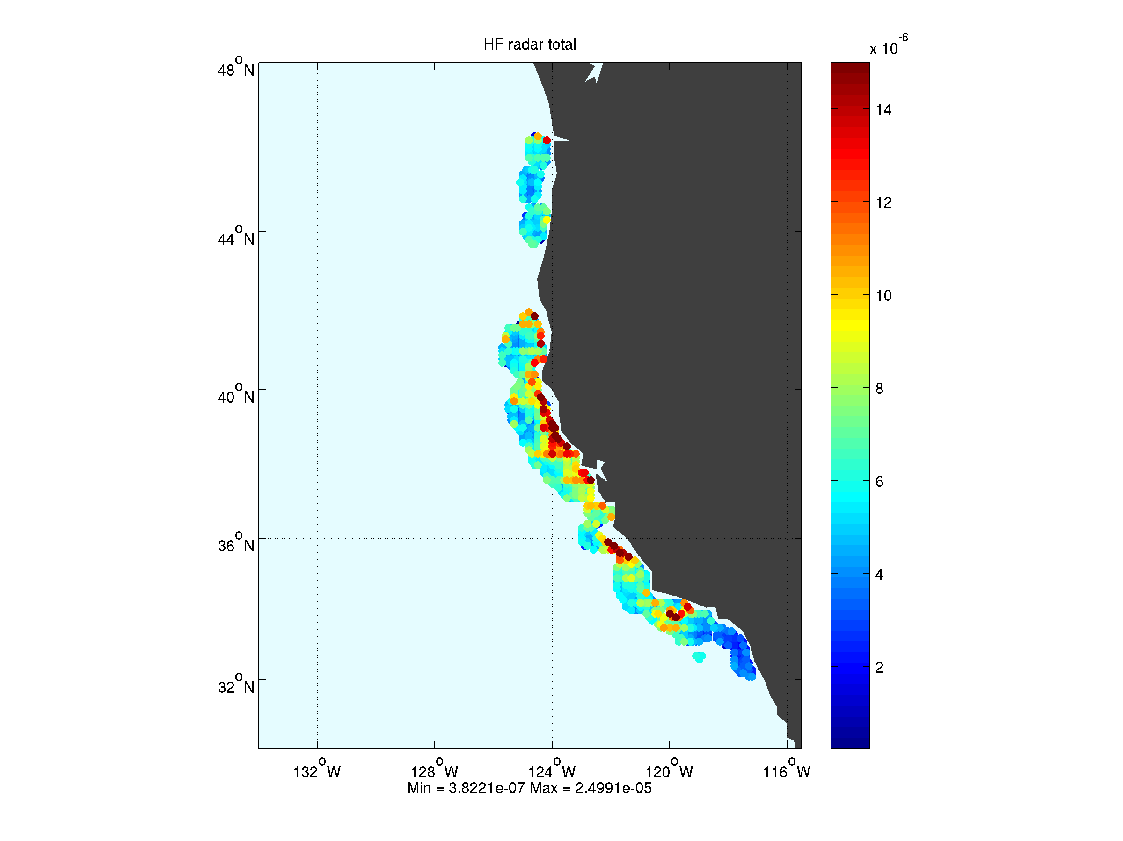
Impact of HF radar on 37N transport

Slide 28
Impact of HF radar on 37N transport

Slide 29
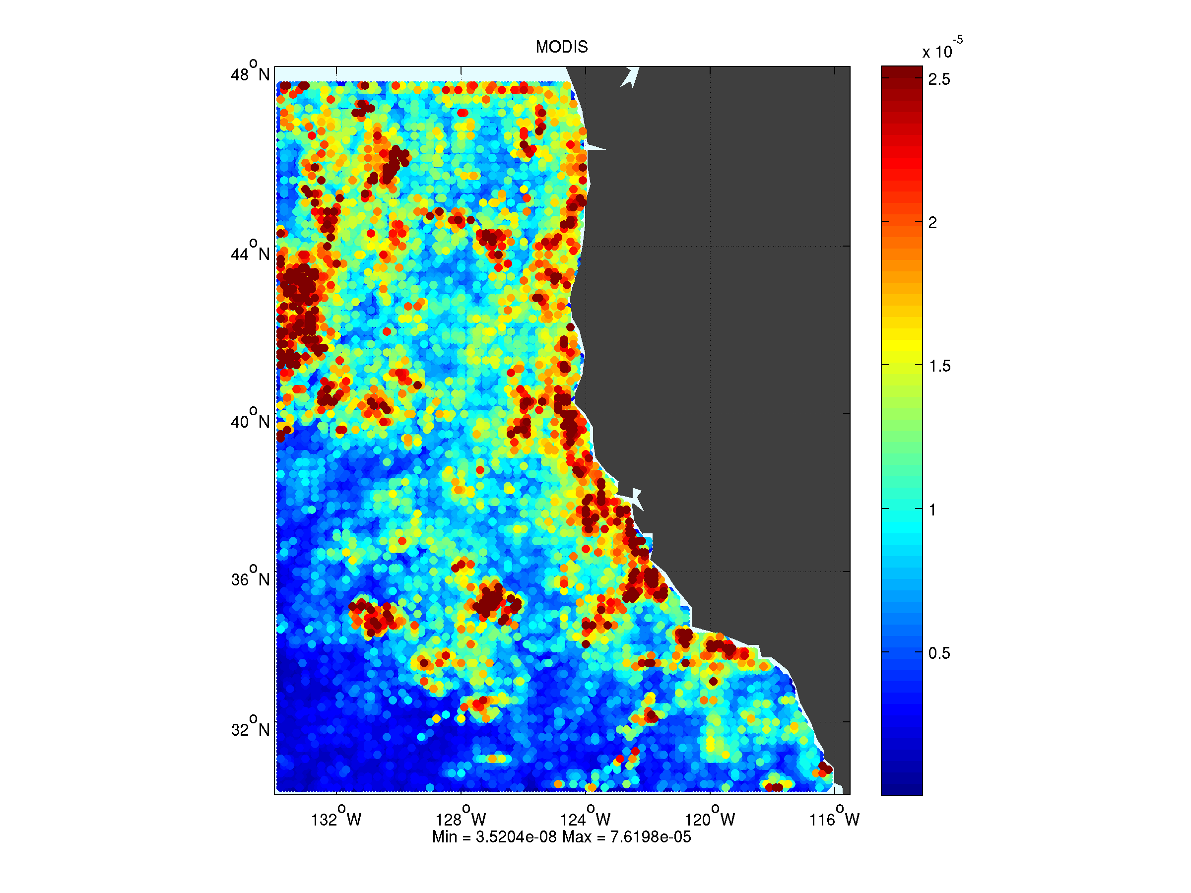
Impact of MODIS SST on 37N transport

Slide 30
The Present….

Slide 31
New stuff not in the svn yet

Slide 32
New stuff not in the svn yet
Augmented B-Lanczos formulation

Slide 33
4D-Var Convergence Issues
Primal preconditioned by B has good convergence
properties:
Preconditioned Hessian
Dual preconditioned by R⁻¹ has poor convergence
properties:
Preconditioned stabilized
representer matrix
Can be partly alleviated using the Minimum Residual
Method (El Akkraoui et al, 2008; El Akkraoui and Gauthier, 2010)
Restricted preconditioned CG ensures that dual
4D-Var converges at same rate as B-preconditioned
Primal 4D-Var (Gratton and Tschimanga, 2009)

Slide 34
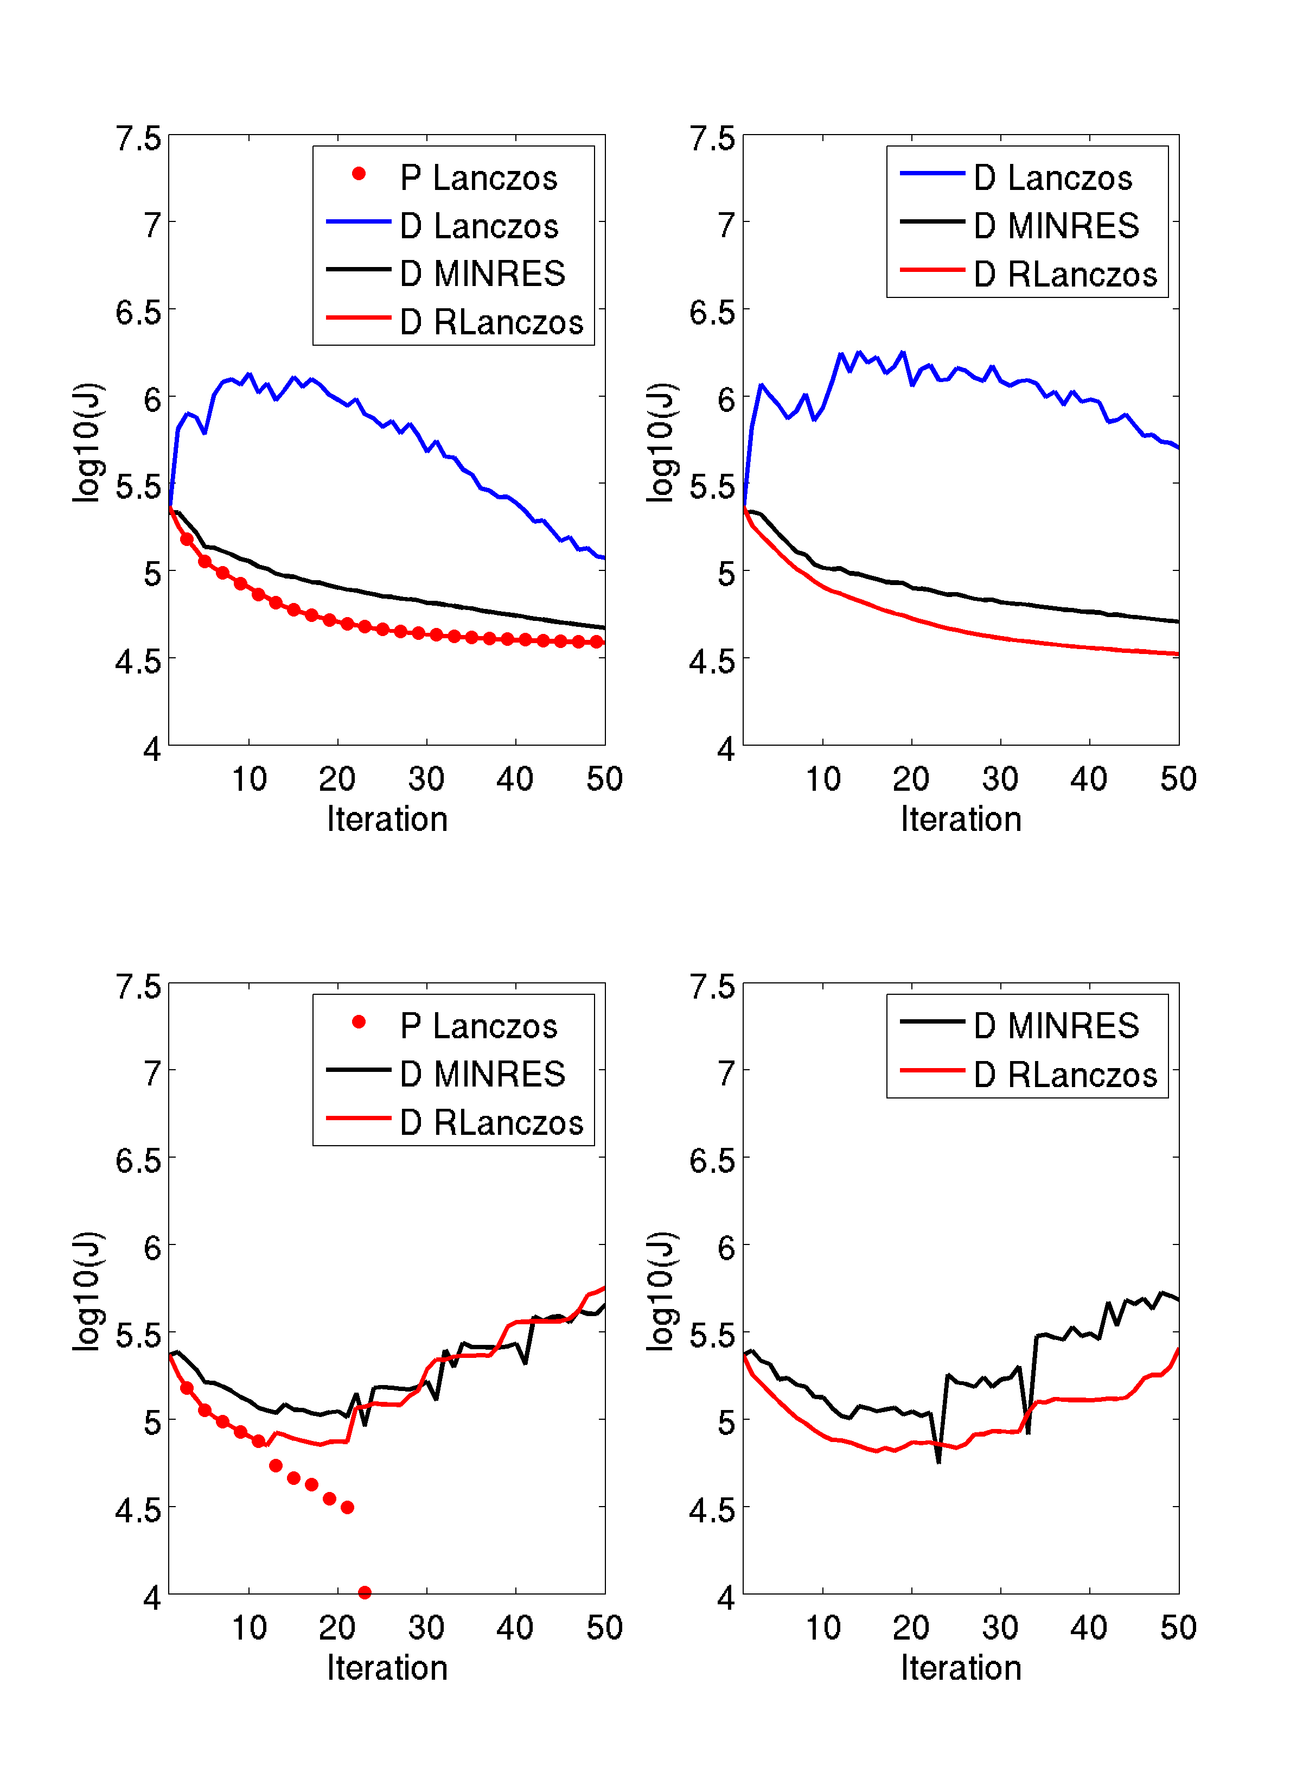
Restricted Preconditioned Conjugate Gradient
(Gürol et al, 2013, QJRMS)
Strong Constraint
Weak Constraint

Slide 35
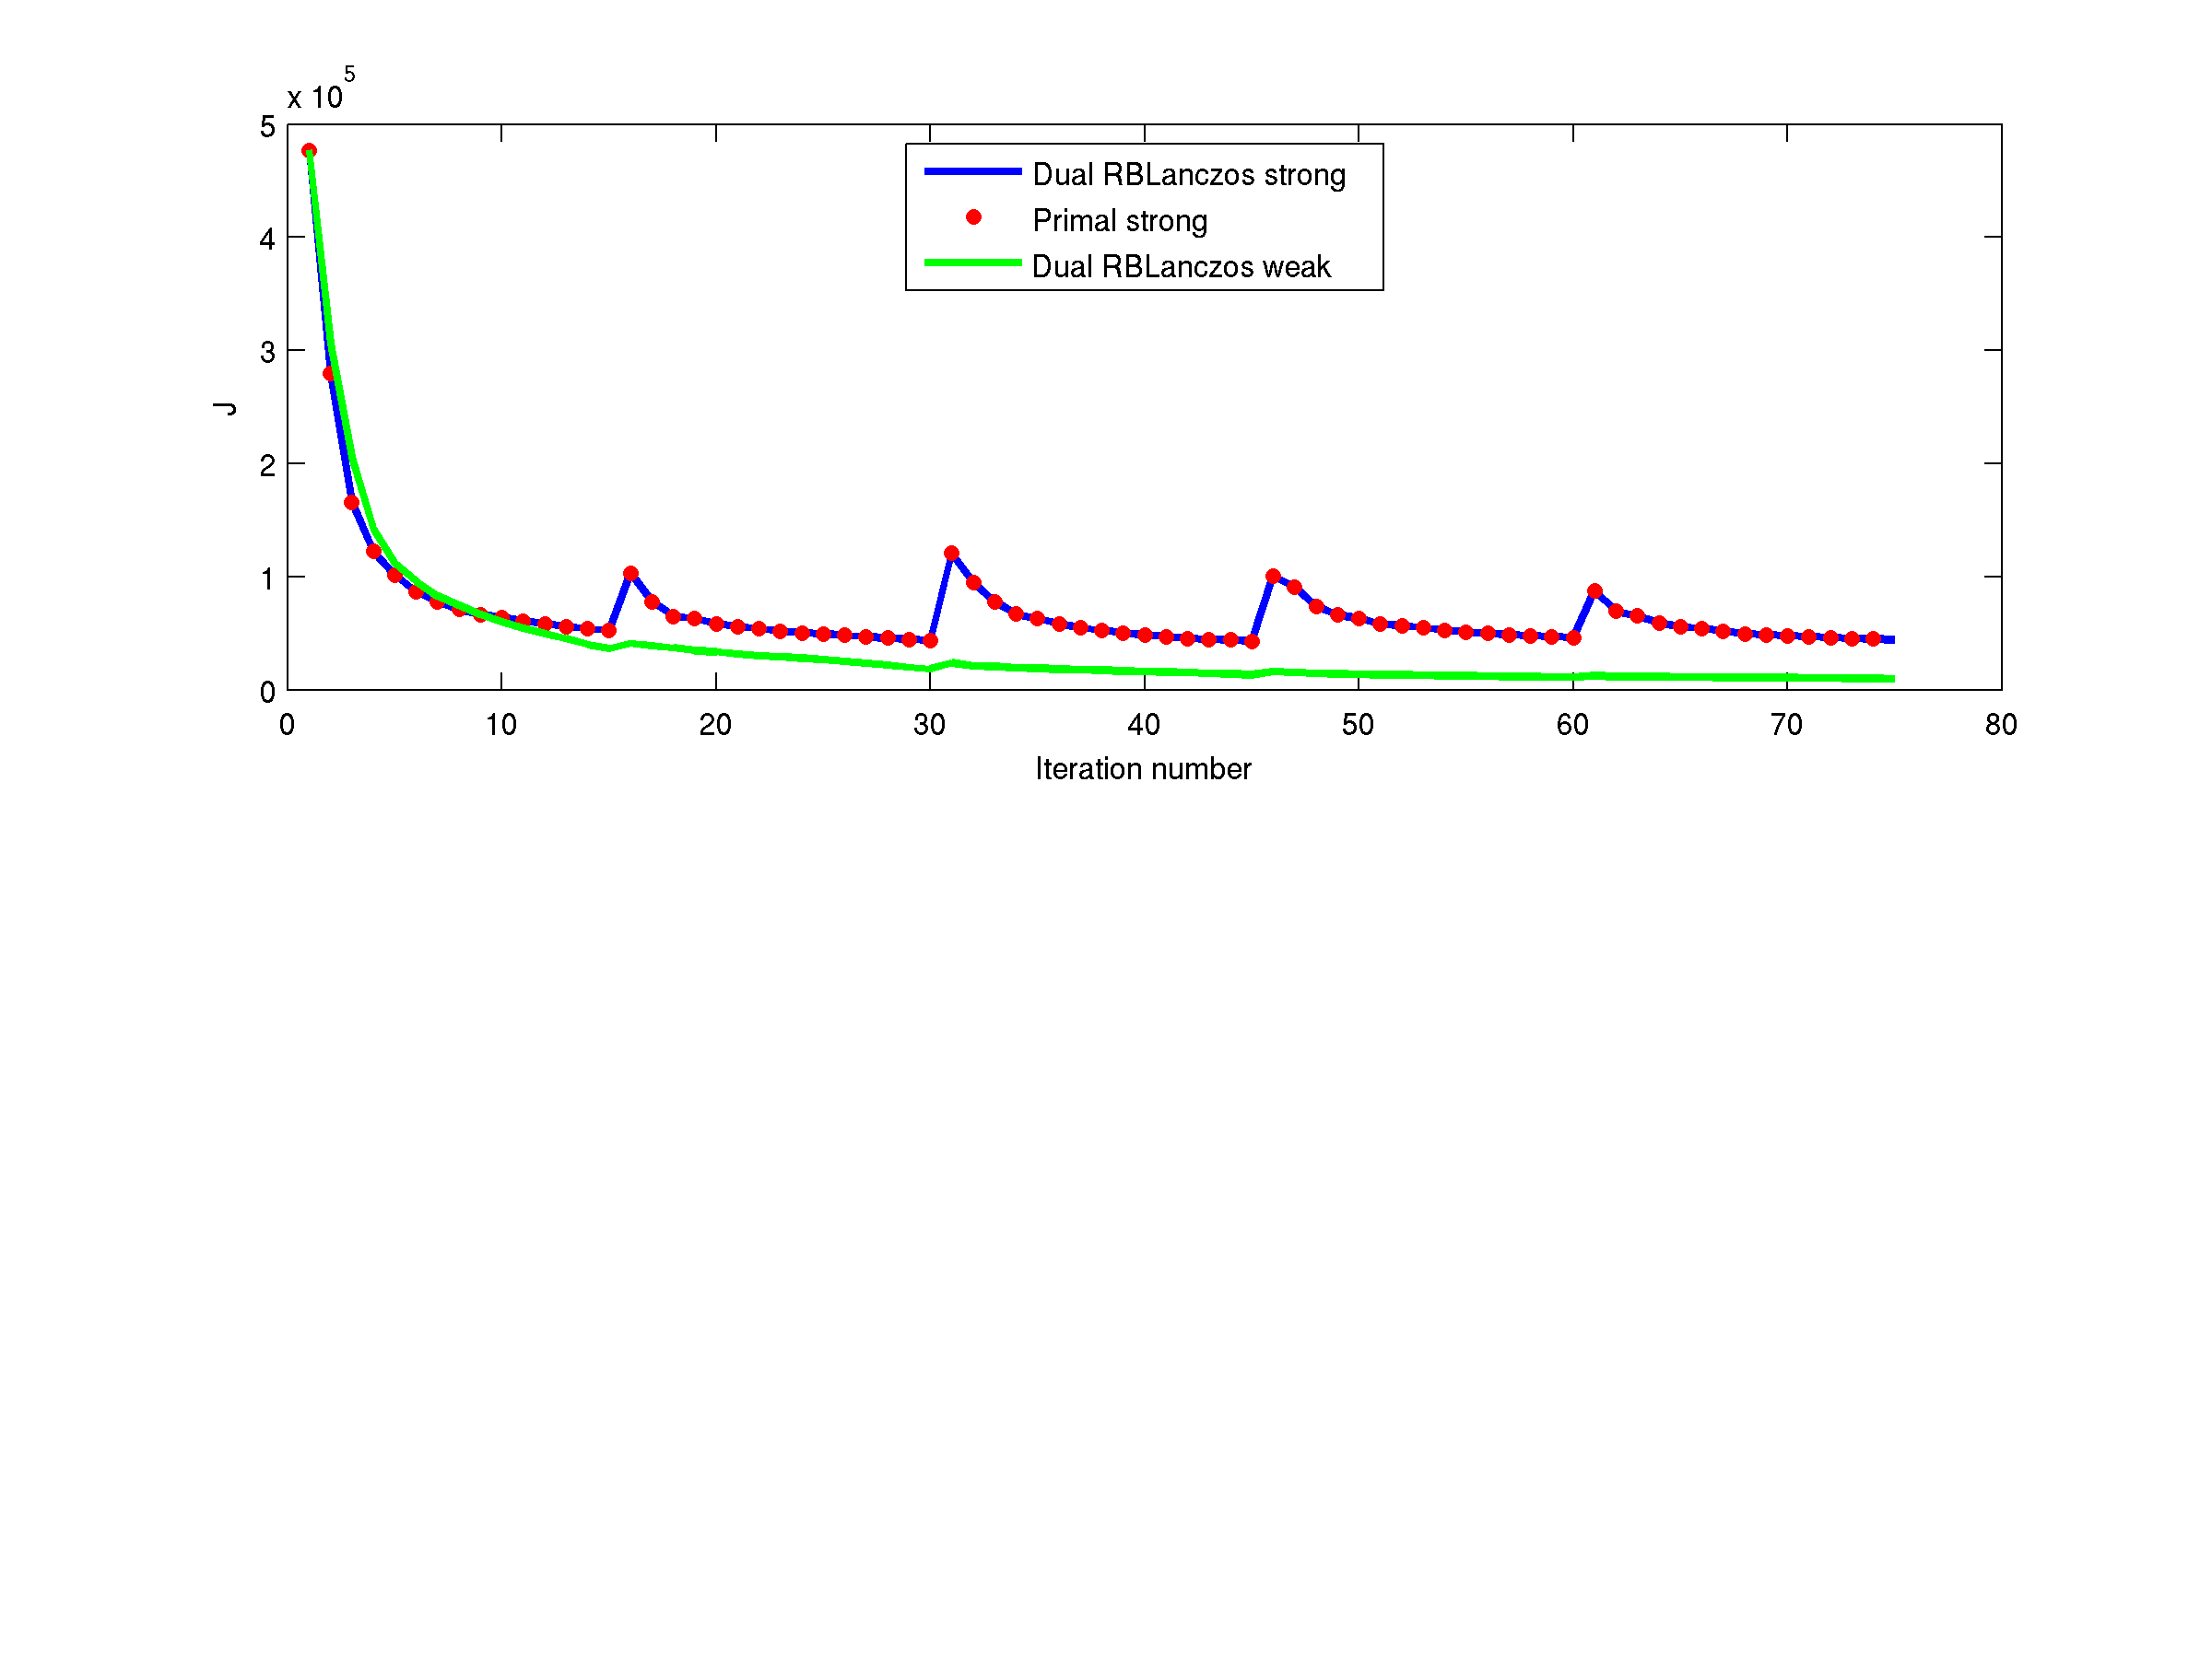
Augmented Restricted B-Lanczos
For multiple outer-loops:

Slide 36
New stuff not in the svn yet
Augmented B-Lanczos formulation
Background quality control

Slide 37
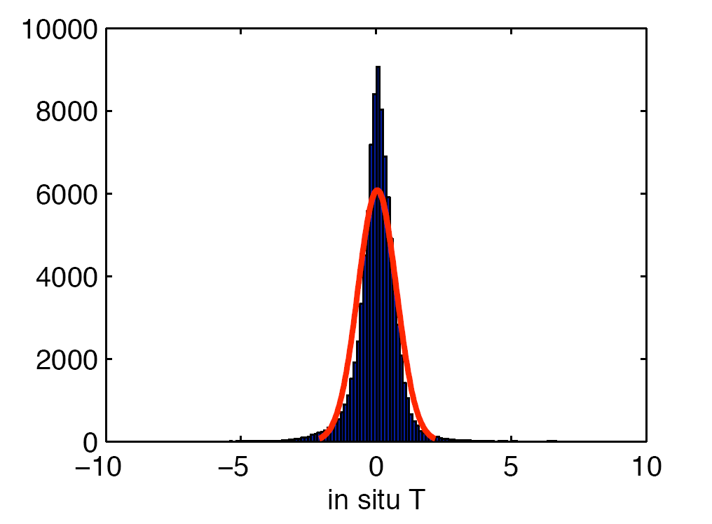
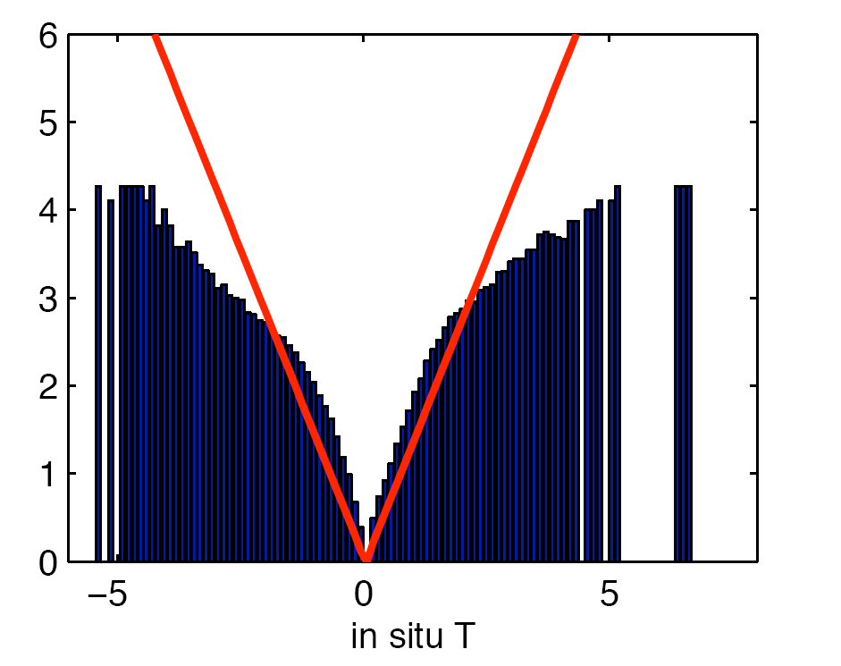
Background Quality Control
(Andersson and Järvinen, 1999)
PDF of in situ T innovations
Transformed PDF of in situ T innovations

Slide 38
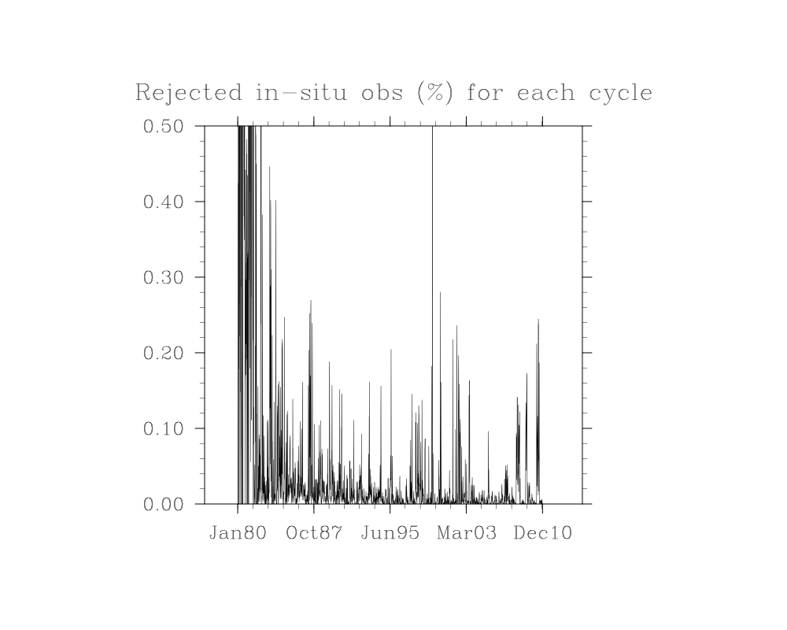

Slide 39
New stuff not in the svn yet
Augmented B-Lanczos formulation
Background quality control
Biogeochemical modules:
- TL and AD of NEMURO
- log-normal 4D-Var
Hajoon Song

Slide 40
Ocean Tracers: Log-normal or otherwise?
Campbell (1995) – in situ ocean Chlorophyll, northern hemisphere

Slide 41
Assimilation of biological variables
NPZ model
Differs from physical variables in statistics.
  Gaussian vs skewed non-Gaussian
We use lognormal transformation
Maintains positive definite variables and reduces rms errors over Gaussian approach
Song et al. (2013)

Slide 42
Lognormal 4DVAR (L4DVAR) Example
PDF of biological variables is often closer to lognormal than Gaussian.
Positive-definite property is preserved in L4DVAR.
Model twin experiment. Initial surface phytoplankton concentration (log scale).
Negative values in black.
Truth
Prior
L4DVAR
Posterior
G4DVAR
Posterior
Notes:
PDF of biological variables is often closer to lognormal than Gaussian.
Positive-definite property is preserved in L4DVAR.

Slide 43
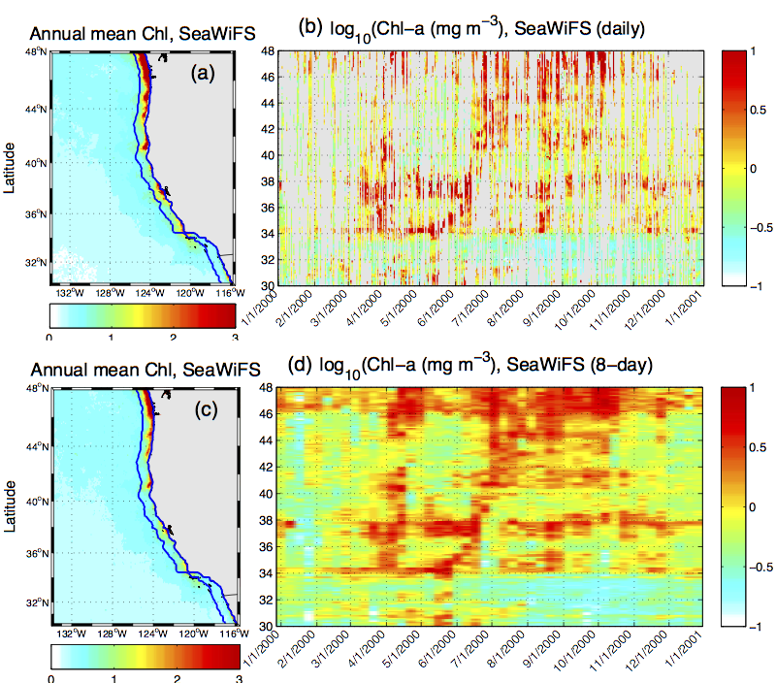
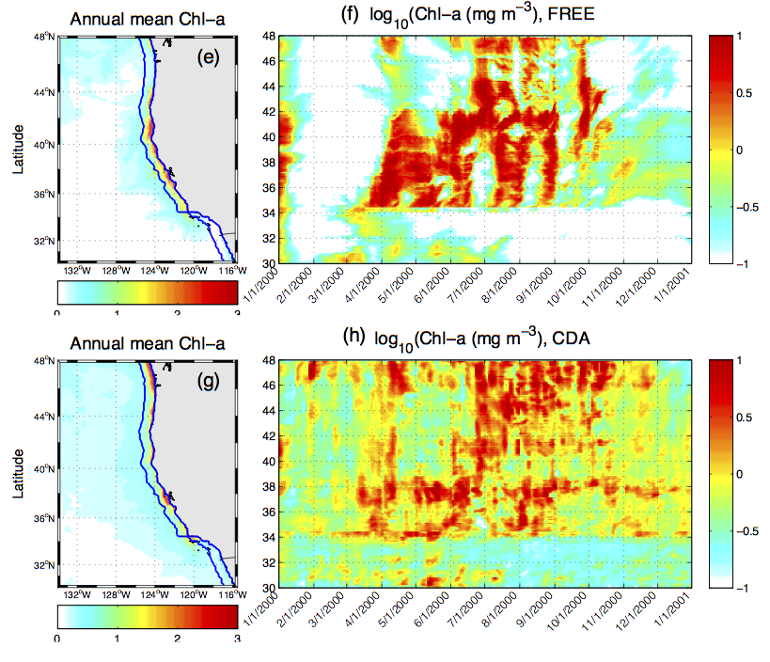
Biological Assimilation, an example
1 year (2000) SeaWiFS ocean color assimilation
NPZD model
Being implemented in near-realtime system
Gray color indicates cloud cover
1-Day SeaWiFS
Model –No Assimilation
8-Day SeaWiFS
Model –With Assimilation
Song et al. (in prep)

Slide 44
New stuff not in the svn yet
Augmented B-Lanczos formulation
Background quality control
Biogeochemical modules:
- TL and AD of NEMURO
- log-normal 4D-Var
Correlations on z-levels
Improved mixed layer formulation in balance operator
Time correlations in Q

Slide 45
Recent Bug Fixes
Normalization coefficients for B
Open boundary adjustments in 4D-Var

Slide 46
The Future….

Slide 47
Planned Developments

Slide 48
Planned Developments
Digital filter – J_{c} to suppress initialization shock (Gauthier & Thépaut, 2001)

Slide 49
Planned Developments
Digital filter – J_{c} to suppress initialization shock (Gauthier & Thépaut, 2001)
Non-diagonal R

Slide 50
Planned Developments
Digital filter – J_{c} to suppress initialization shock (Gauthier & Thépaut, 2001)
Non-diagonal R
Bias-corrected 4D-Var (Dee, 2005)

Slide 51
Planned Developments
Digital filter – J_{c} to suppress initialization shock (Gauthier & Thépaut, 2001)
Non-diagonal R
Bias-corrected 4D-Var (Dee, 2005)
Time correlations in B

Slide 52
Planned Developments
Digital filter – J_{c} to suppress initialization shock (Gauthier & Thépaut, 2001)
Non-diagonal R
Bias-corrected 4D-Var (Dee, 2005)
Time correlations in B
Correlations rotated along isopycnals using diffusion tensor (Weaver & Courtier, 2001)

Slide 53
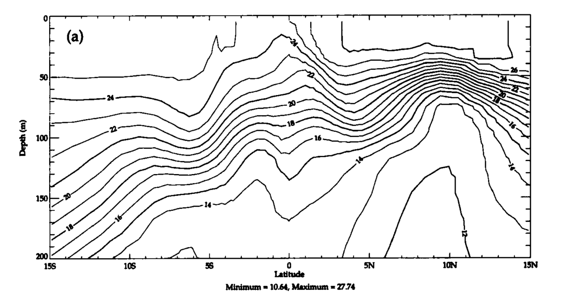
SEC
NECC
NEC
Equatorial Pacific
Temperature
0m
EUC
100m
NEC=N. Eq. Curr.
SEC=S. Eq. Curr
NECC=N. Eq. Counter
Curr.
EUC=Eq. Under Curr.
200m
0m
Observation
100m
Diffusion eqn with a
diffusion tensor.
200m
Weaver and Courtier (2001)
(3D-Var & 4D-Var)
15S
EQ
15N

Slide 54
Planned Developments
Digital filter – J_{c} to suppress initialization shock (Gauthier & Thépaut, 2001)
Non-diagonal R
Bias-corrected 4D-Var (Dee, 2005)
Time correlations in B
Correlations rotated along isopycnals using diffusion tensor (Weaver & Courtier, 2001)
Combine 4D-Var and EnKF (hybrid B)

Slide 55
Planned Developments
Digital filter – J_{c} to suppress initialization shock (Gauthier & Thépaut, 2001)
Non-diagonal R
Bias-corrected 4D-Var (Dee, 2005)
Time correlations in B
Correlations rotated along isopycnals using diffusion tensor (Weaver & Courtier, 2001)
Combine 4D-Var and EnKF (hybrid B)
TL and AD of parameters

Slide 56
Planned Developments
Digital filter – J_{c} to suppress initialization shock (Gauthier & Thépaut, 2001)
Non-diagonal R
Bias-corrected 4D-Var (Dee, 2005)
Time correlations in B
Correlations rotated along isopycnals using diffusion tensor (Weaver & Courtier, 2001)
Combine 4D-Var and EnKF (hybrid B)
TL and AD of parameters
Nested 4D-Var

Slide 57
Planned Developments
Digital filter – J_{c} to suppress initialization shock (Gauthier & Thépaut, 2001)
Non-diagonal R
Bias-corrected 4D-Var (Dee, 2005)
Time correlations in B
Correlations rotated along isopycnals using diffusion tensor (Weaver & Courtier, 2001)
Combine 4D-Var and EnKF (hybrid B)
TL and AD of parameters
Nested 4D-Var
POD for biogeochemistry

Slide 58
Biogeochemical Tracer Equation
Sources of P
Sinks of P
(Following Pelc, 2013)

Slide 59
Planned Developments
Digital filter – J_{c} to suppress initialization shock (Gauthier & Thépaut, 2001)
Non-diagonal R
Bias-corrected 4D-Var (Dee, 2005)
Time correlations in B
Correlations rotated along isopycnals using diffusion tensor (Weaver & Courtier, 2001)
Combine 4D-Var and EnKF (hybrid B)
TL and AD of parameters
Nested 4D-Var
POD for biogeochemistry
TL and AD of sea-ice model

