Slide 1
Forecasting Forecast Error
Andy Moore & Kevin Smith
UC Santa Cruz
Hernan Arango
Rutgers University

Slide 2
How can we predict forecast error ?
Ensemble
methods
0
t
Issues with ensemble methods:
- how to choose the perturbations?
- how large should the ensemble be?
- localization and covariance inflation?

Slide 3
Forecast EOFS and SVD
Ehrendorfer and Tribbia (1997)
Barkmeijer et al (1998)
EOFs=
left singular
vectors of Q
π
y=right singular
vectors of Q
y
4D-Var
-τ
0
t
Analysis
Forecast
Tangent linear approx:
(M=Tangent linear model)
Forecast error cov:
Equivalent to SVD of:
Forecast EOFs:

Slide 4
The Inverse Analysis Error Covariance, (Eª)⁻¹
Inverse
Analysis
error
covariance
Prior
Error
Cov.
Adjoint
of ROMS
at obs pts
Obs
Error
Cov.
Tangent
of ROMS
at obs pts
Hessian matrix
Hessian matrix
Factorization of
Hessian based on
4D-Var search
directions
A reduced rank approx
m = the number search directions
= number of 4D-Var inner-loops

Slide 5
Forecast EOFS and SVD
Barkmeijer et al (1998)
EOFs=
left singular
vectors of Q
π
y=Hessian
Singular
vectors
y
4D-Var
-τ
0
t
Analysis
Forecast
Tangent linear approx:
(M=Tangent linear model)
Forecast error cov:
Equivalent to SVD of:
Forecast EOFs:

Slide 6
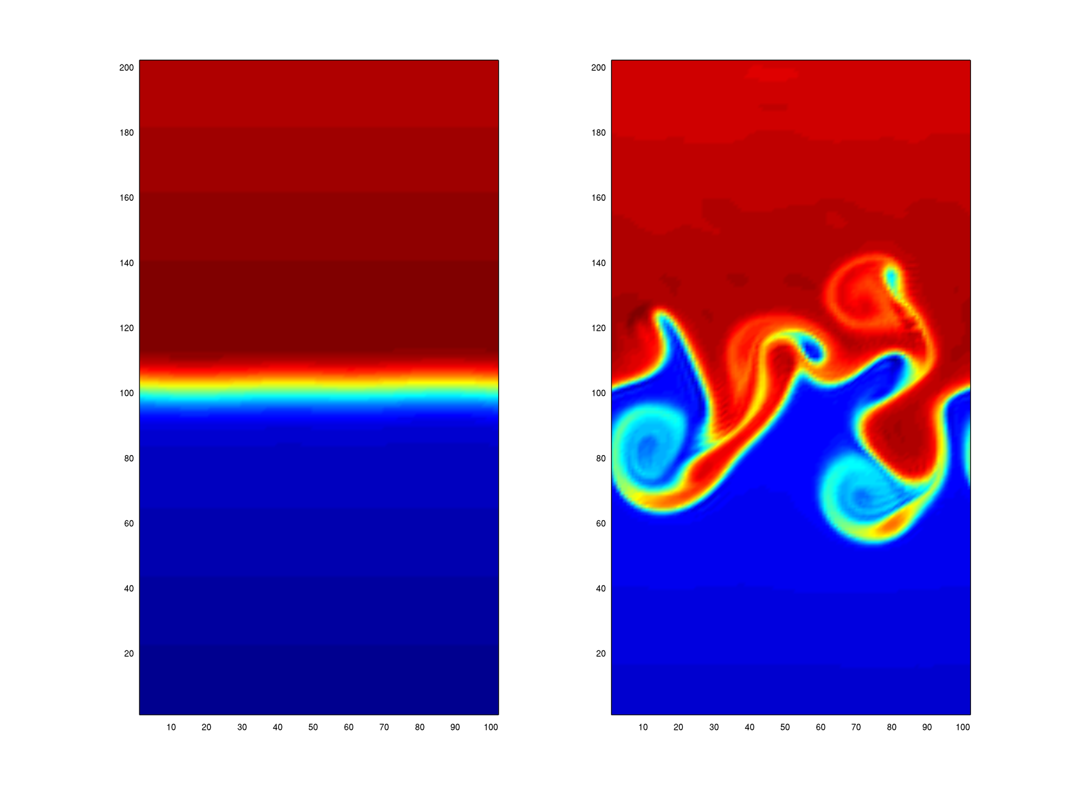
SH Baroclinically Unstable Jet
ROMS:
10km resolution
20 σ-levels
4000 m deep
2000km
Δx=10km, f=-10⁻⁴, β=1.6×10⁻¹¹
1000km

Slide 7
ROMS Identical Twin Set-up
4D-Var
-τ
0
t
Analysis
Forecast
Sequential
2 day 4D-Var cycles
Obs of T, 0-1000m
Obs spacing ds=1, 3 or 6
Sampled once per day
Obs error=0.3C
Strong constraint
15 inner-loops
1-3 outer-loops
2-30 day duration

Slide 8
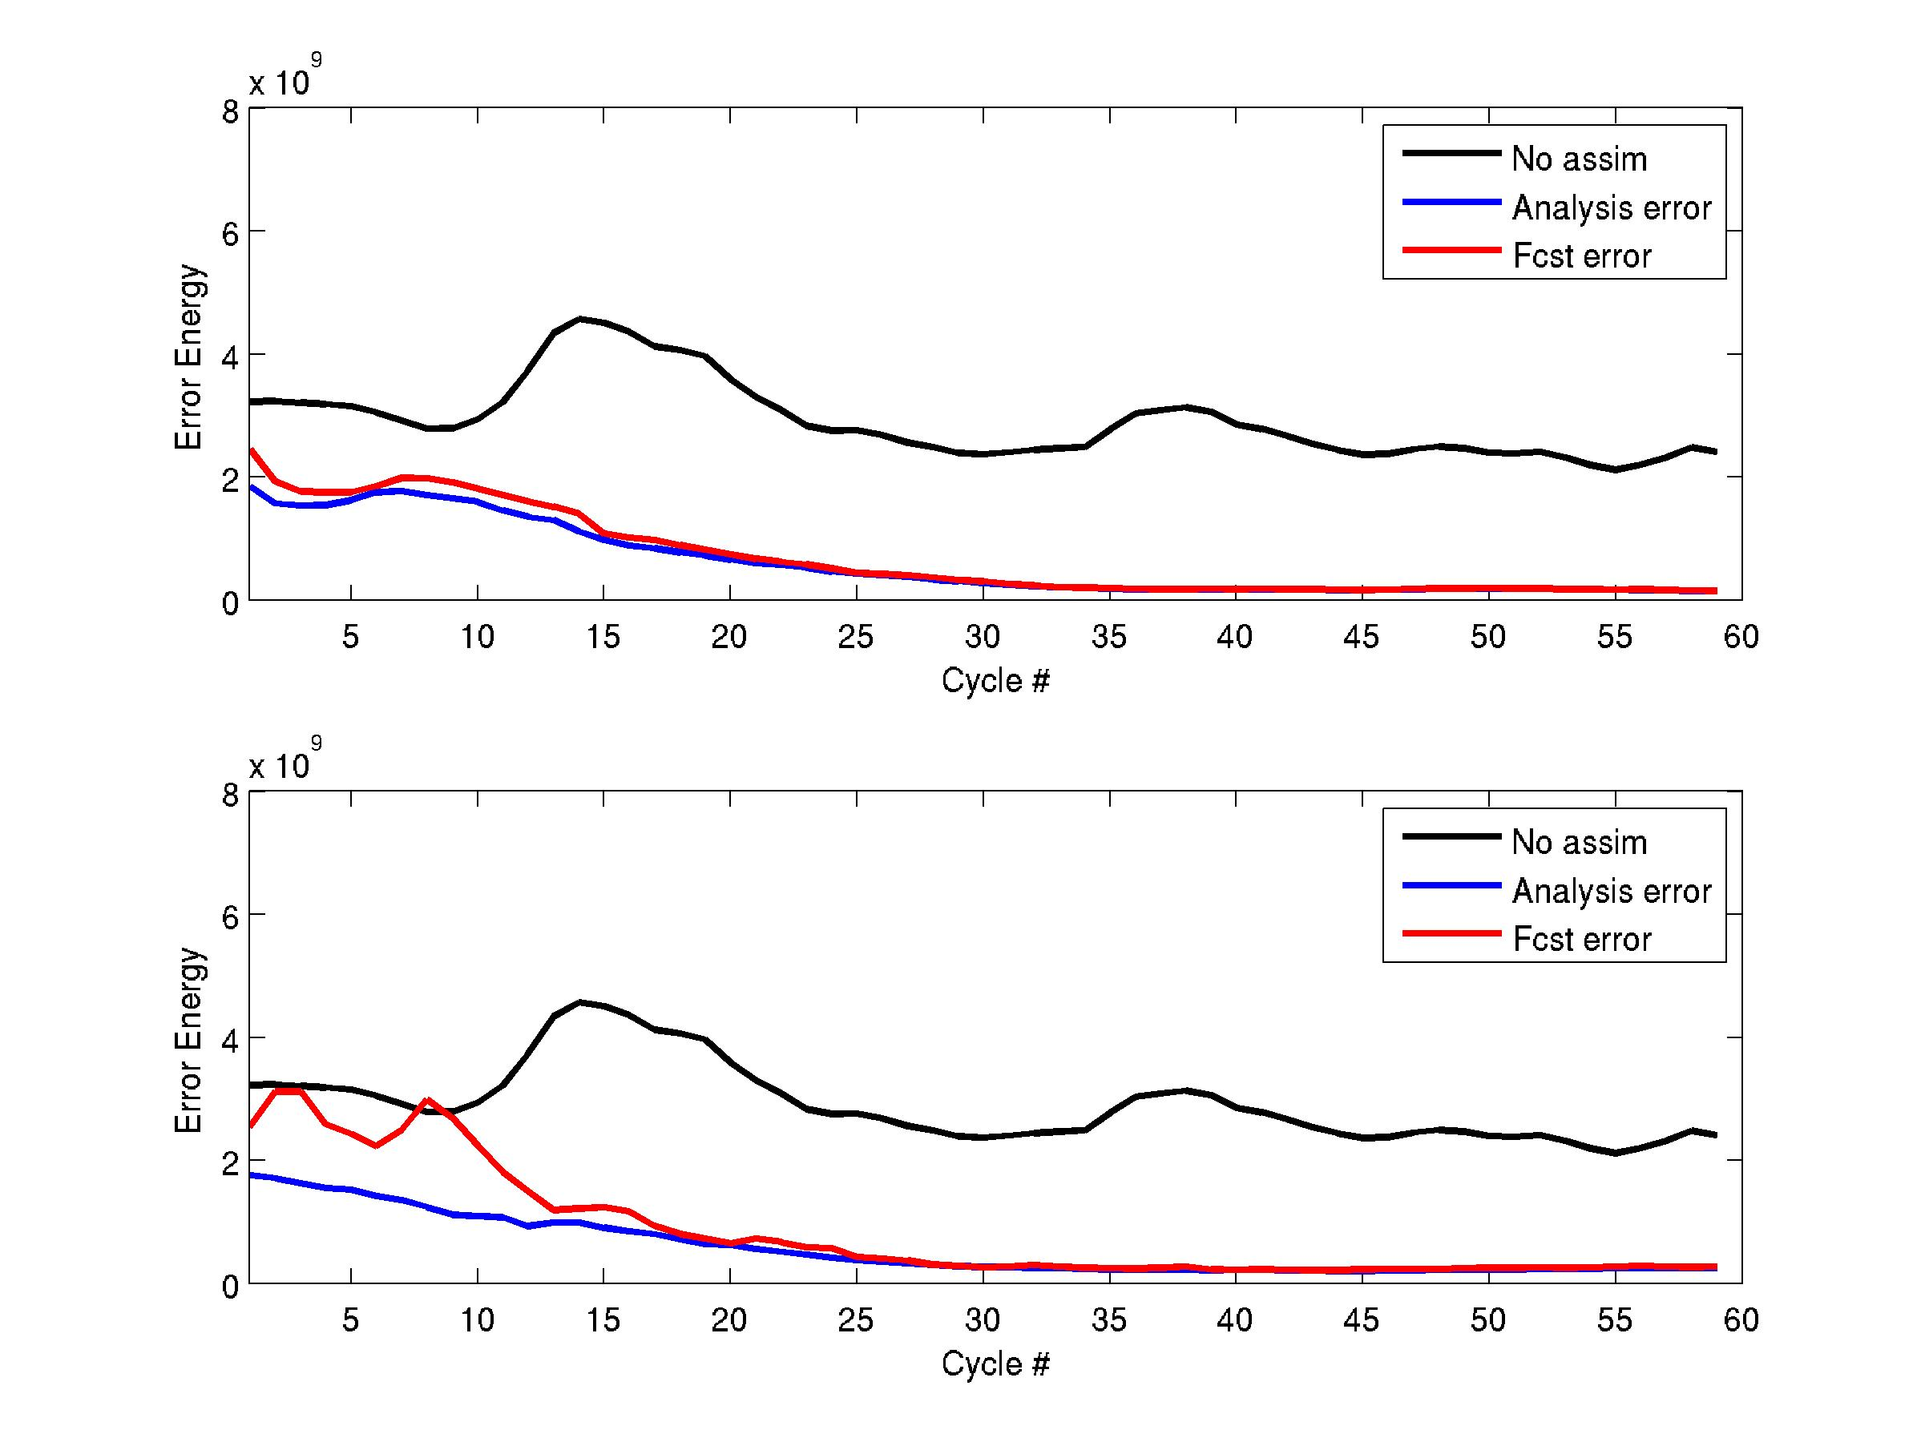
ds=1, 2 day analysis cycle, 2 day forecast
ds=6, 2 day analysis cycle, 6 day forecast
Time

Slide 9
Geometric Interpretation
EOFs
(λ_{i},π_{i})
Another likely
forecast
4D-Var
Reference
forecast
-τ
0
t
Analysis
Forecast
Mean squared distance
between green and red

Slide 10
Is F Consistent with the Truth?
(λ_{i},π_{i})
True state
of the system
4D-Var
Reference
forecast
-τ
0
t
Analysis
Forecast
Compare
with

Slide 11
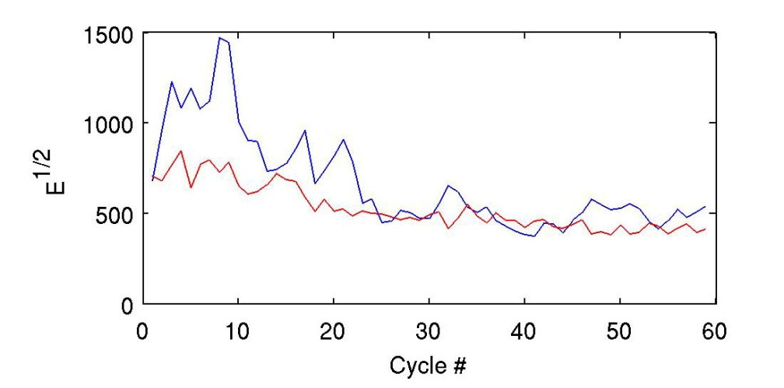
Reliability of F
6 day forecast
(True error)^{1/2}
(Total EOF var)^{1/2}
6 day
forecast
t=0
t=6 d
Initial time
unit norm
hyper-sphere
Final time
hyper-ellipse
defined by EOFs

Slide 12
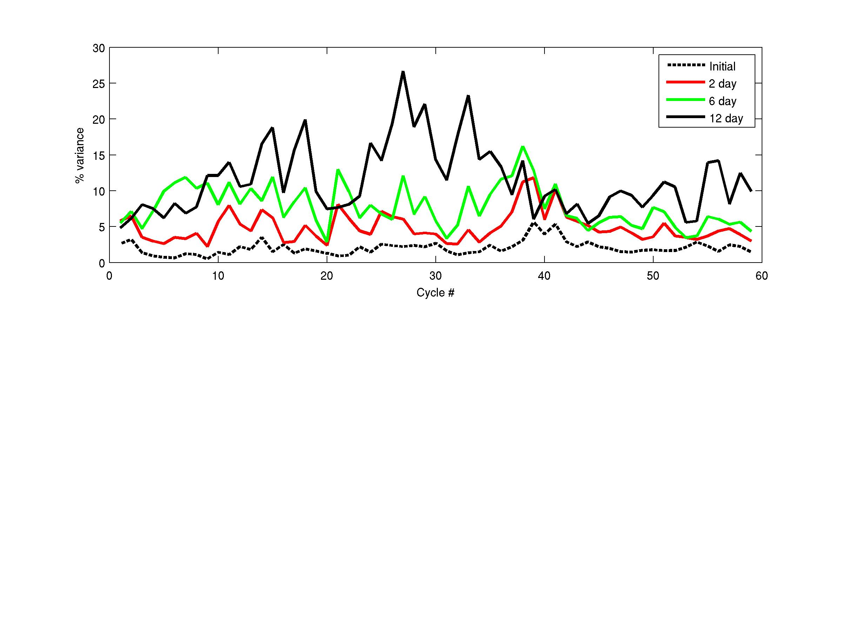
Fraction of TRUE Error Explained by EOFs
Projection of analysis error on HSVs
Projection of 2 day forecast error on EOFs
Projection of 6 day forecast error on EOFs
Projection of 12 day forecast error on EOFs

Slide 13
Fraction of TRUE Error Explained by EOFs
Unknown
Subspace
~90%
Known EOF
Subspace
Determined
by B
~10%

Slide 14
Unknown
Subspace 2
Space NOT spanned by B
Forecast error
Known EOF
Subspace 1
Analysis:
Space
spanned by B

Slide 15
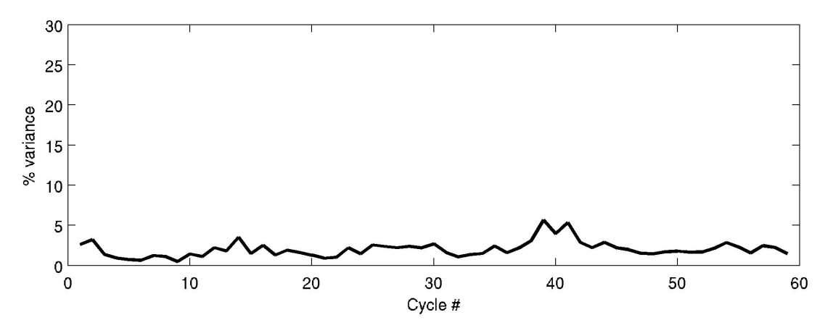
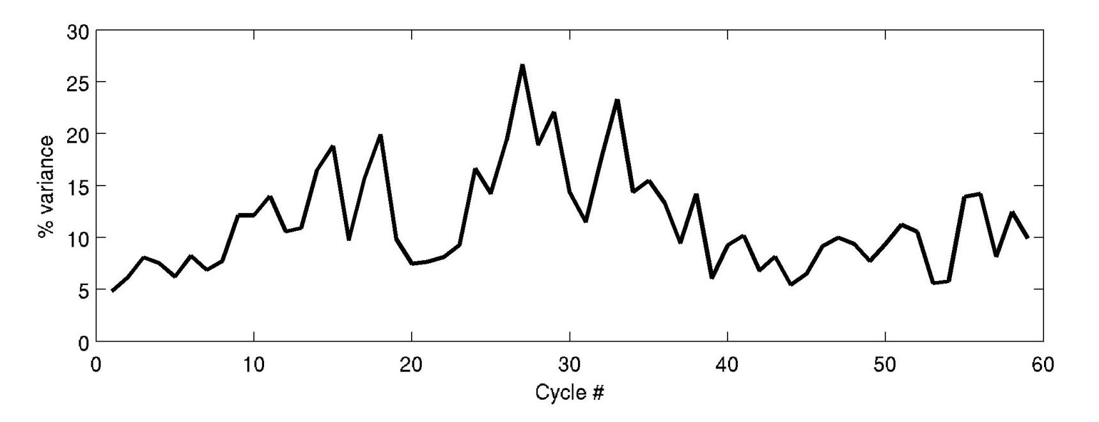
Space NOT spanned by B
Unknown
Subspace 2
Unknown
Subspace 2
Fraction of initial forecast
error explained by HSVs
Forecast error
Analysis error
Known EOF
Subspace 1
Known HSV
Subspace 1
Fraction of final forecast
error explained by EOFs
4D-Var Analysis:
Space
spanned by B

Slide 16
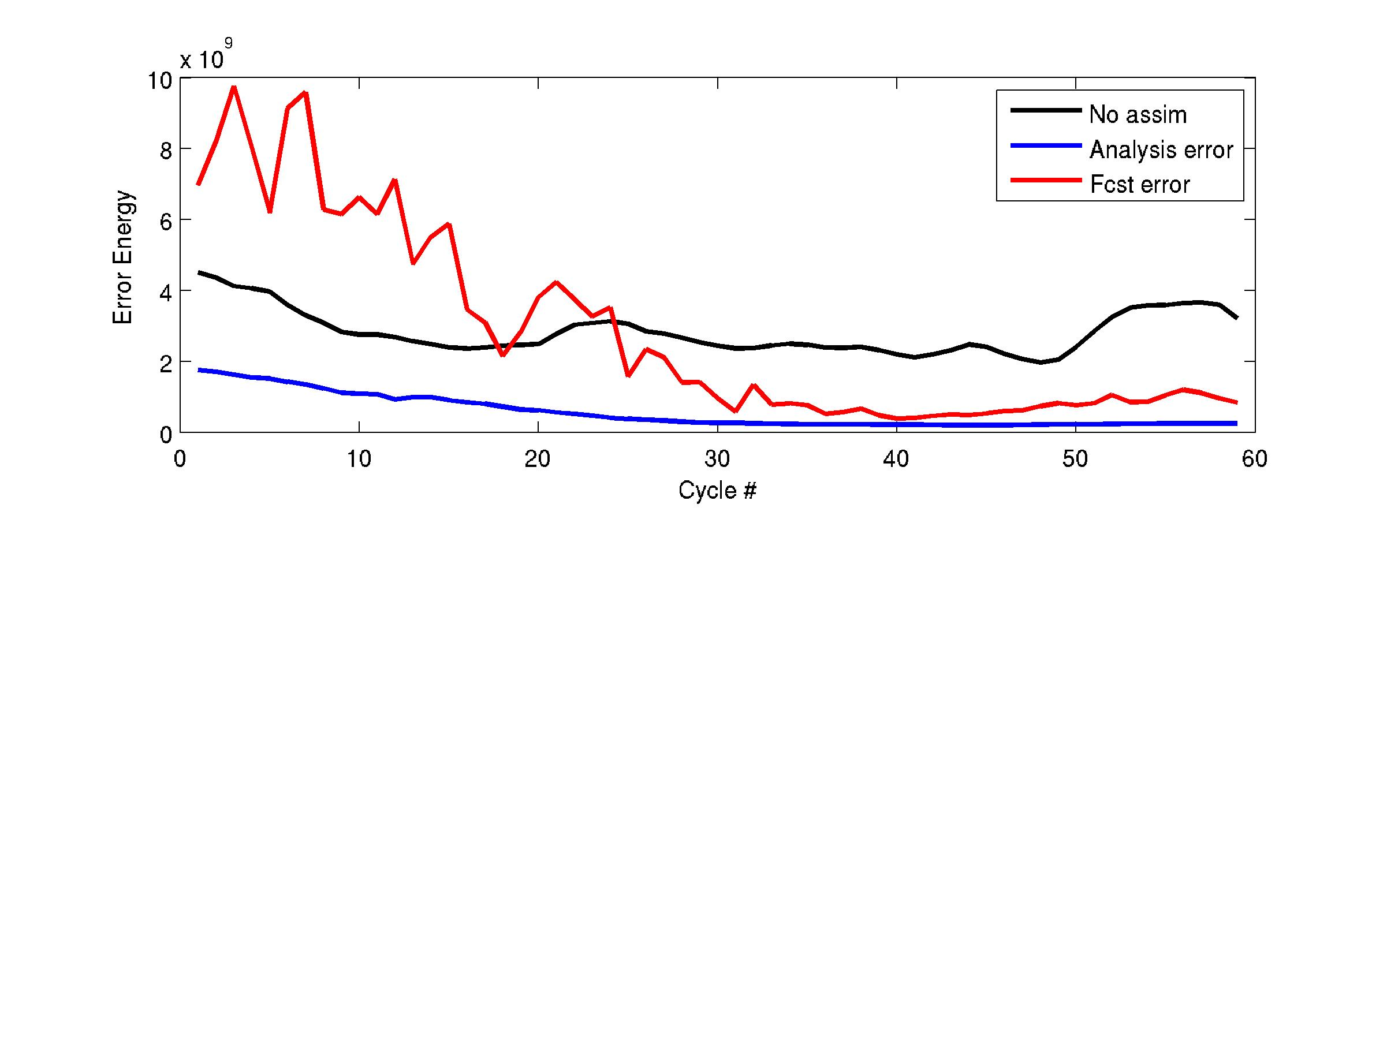
30 day forecasts, ds=6
2 outer-loops, 15 inner-loops
Good TL approx
% explained by HSVs
(Total EOF var)^{1/2}
% explained by EOFs
(True error)^{1/2}

Slide 17
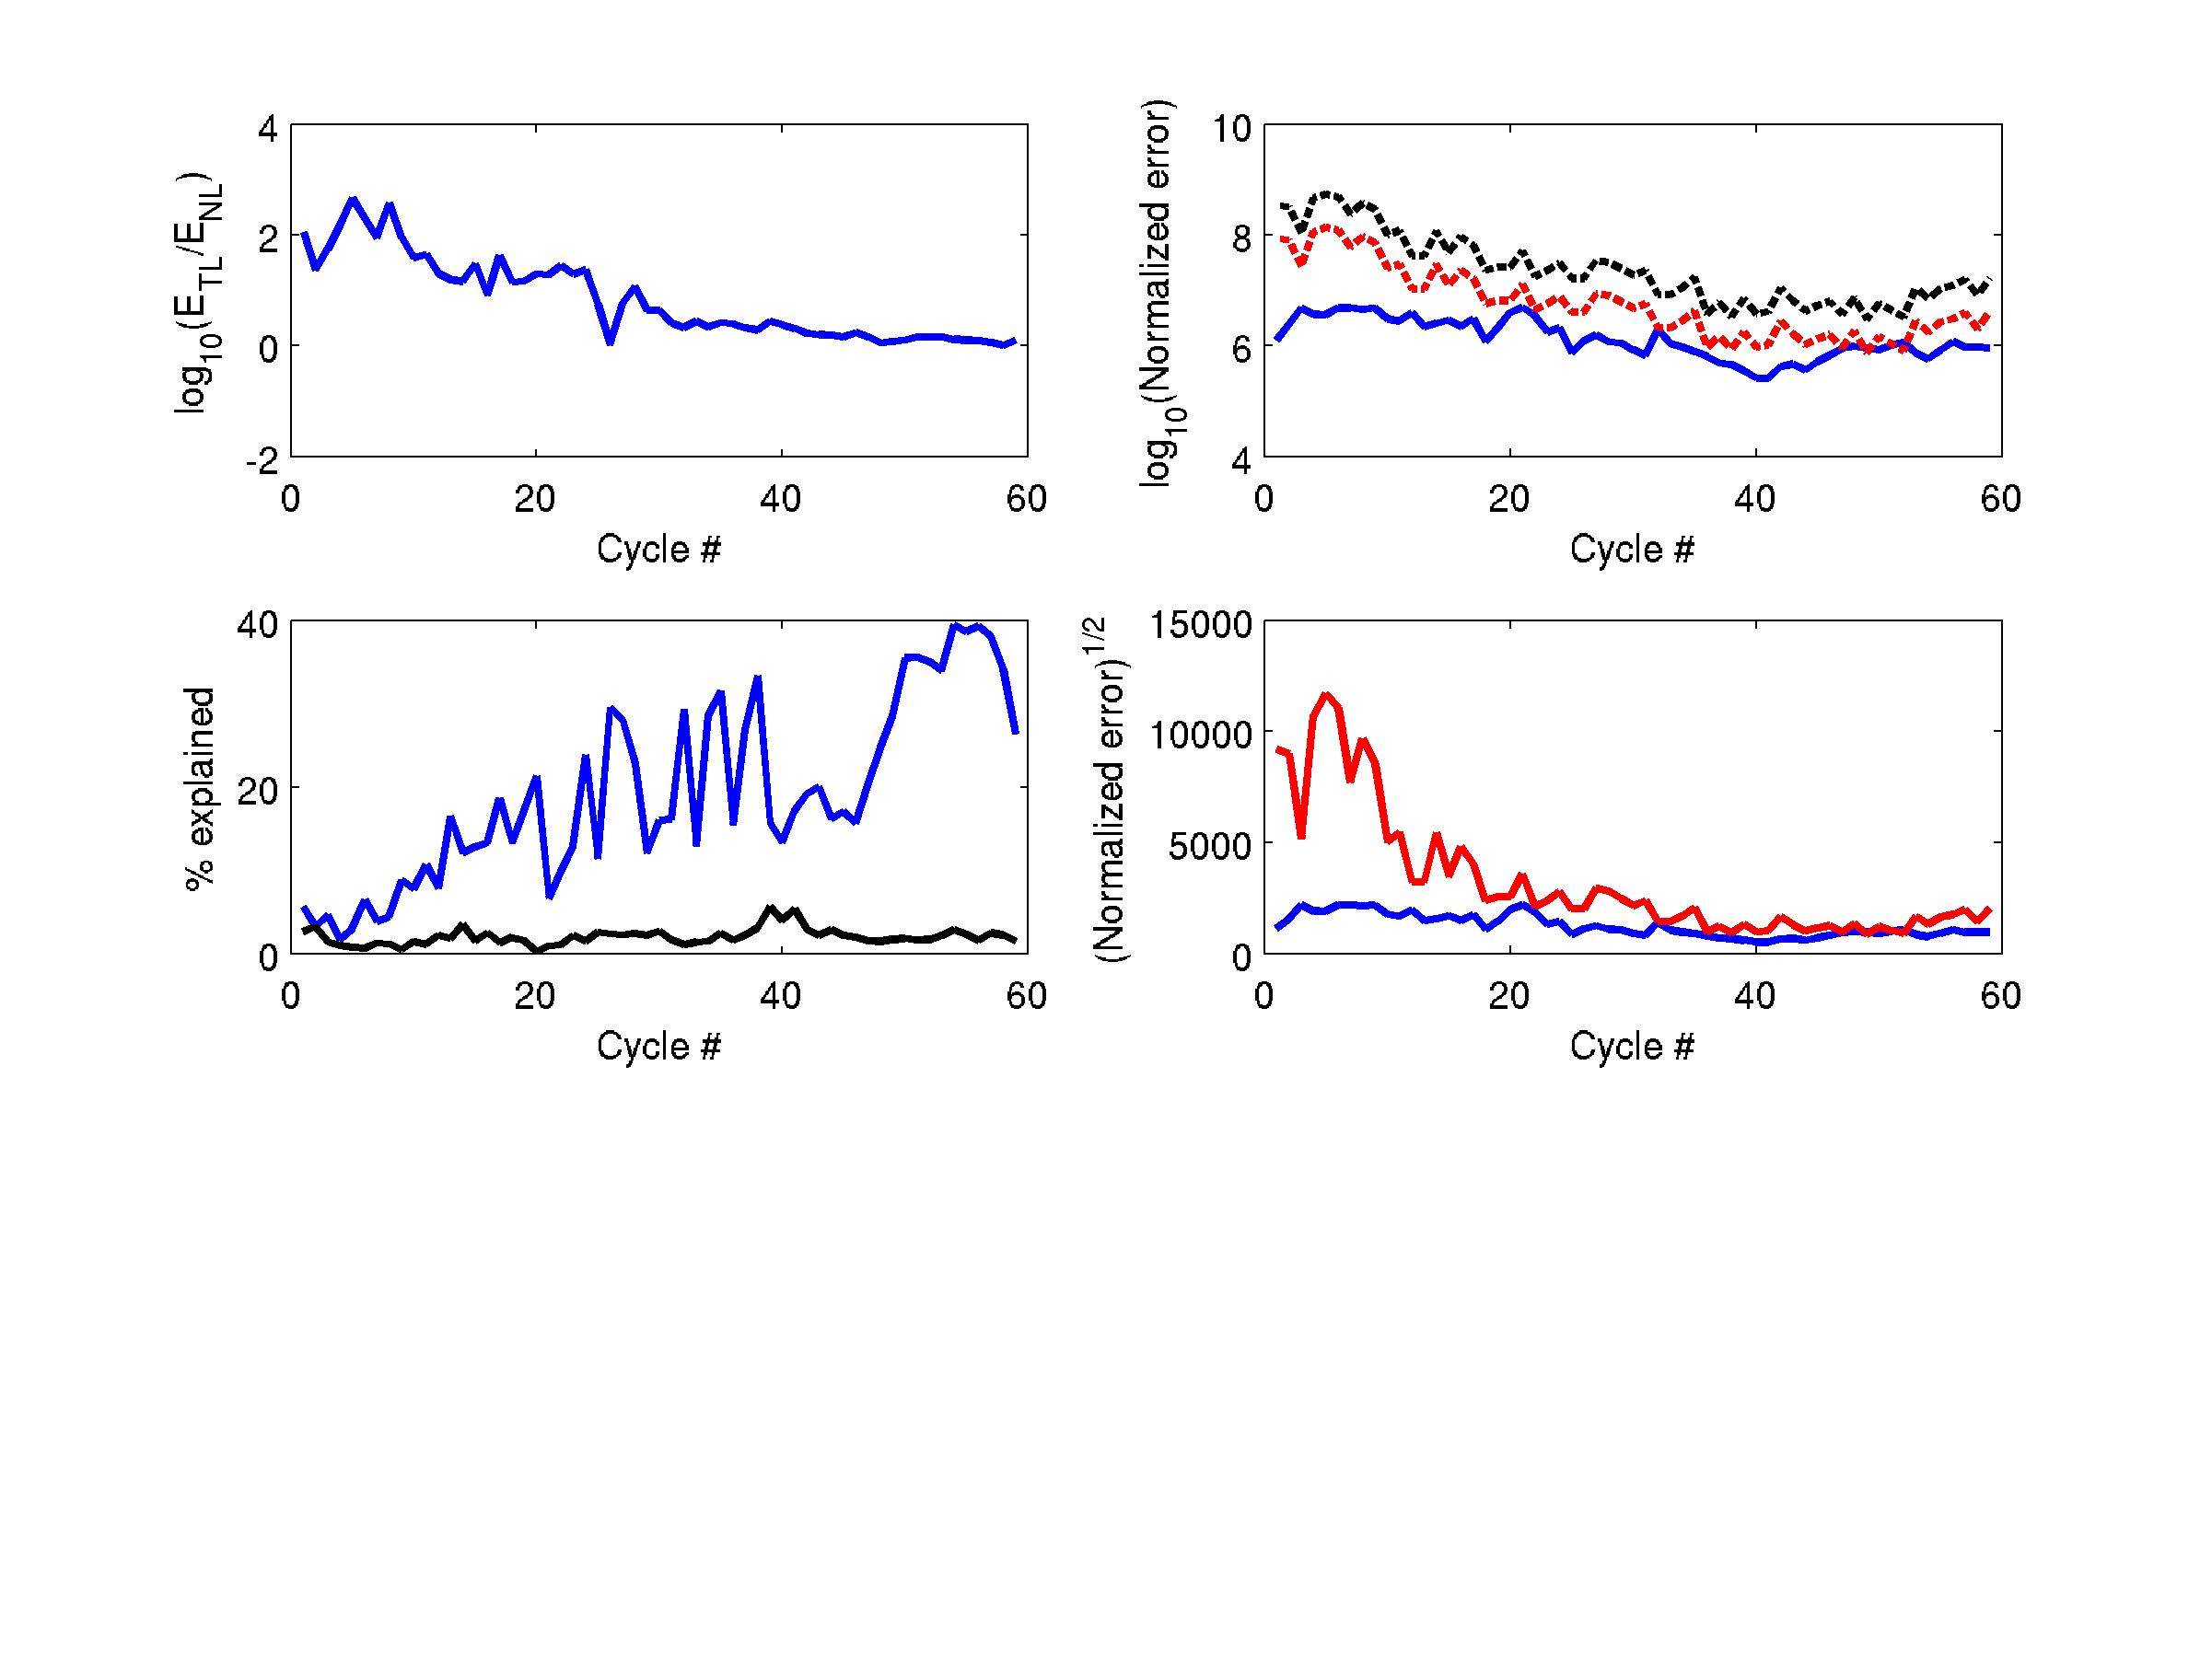
30 day forecasts

Slide 18
Can we predict the forecast error?

Slide 19
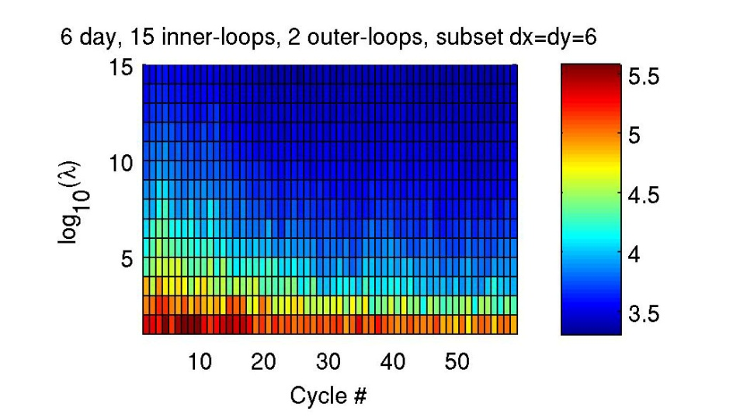
Eigenvalue #
log₁₀ λ

Slide 20
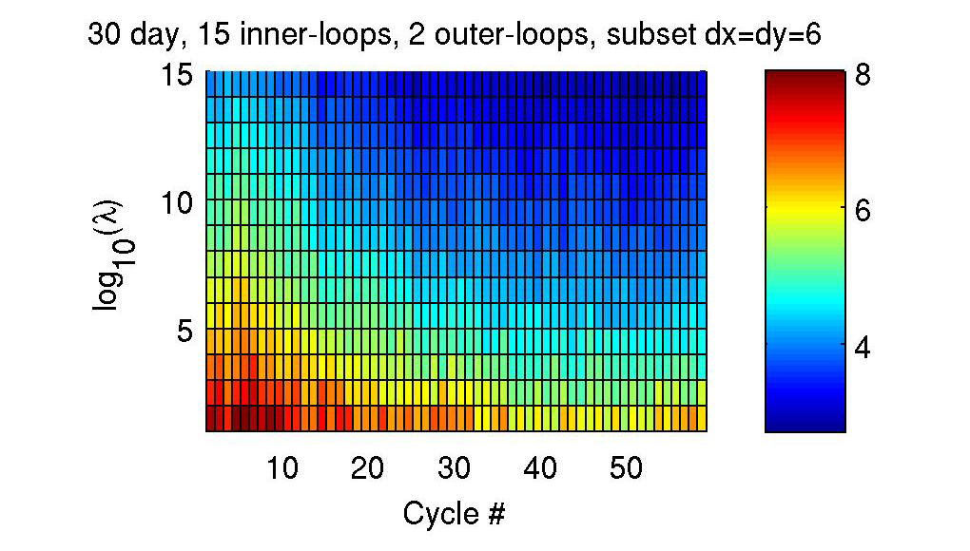
Eigenvalue #
log₁₀ λ

Slide 21
Eccentricity of the
Marginal
Covariance Ellipses

Slide 22
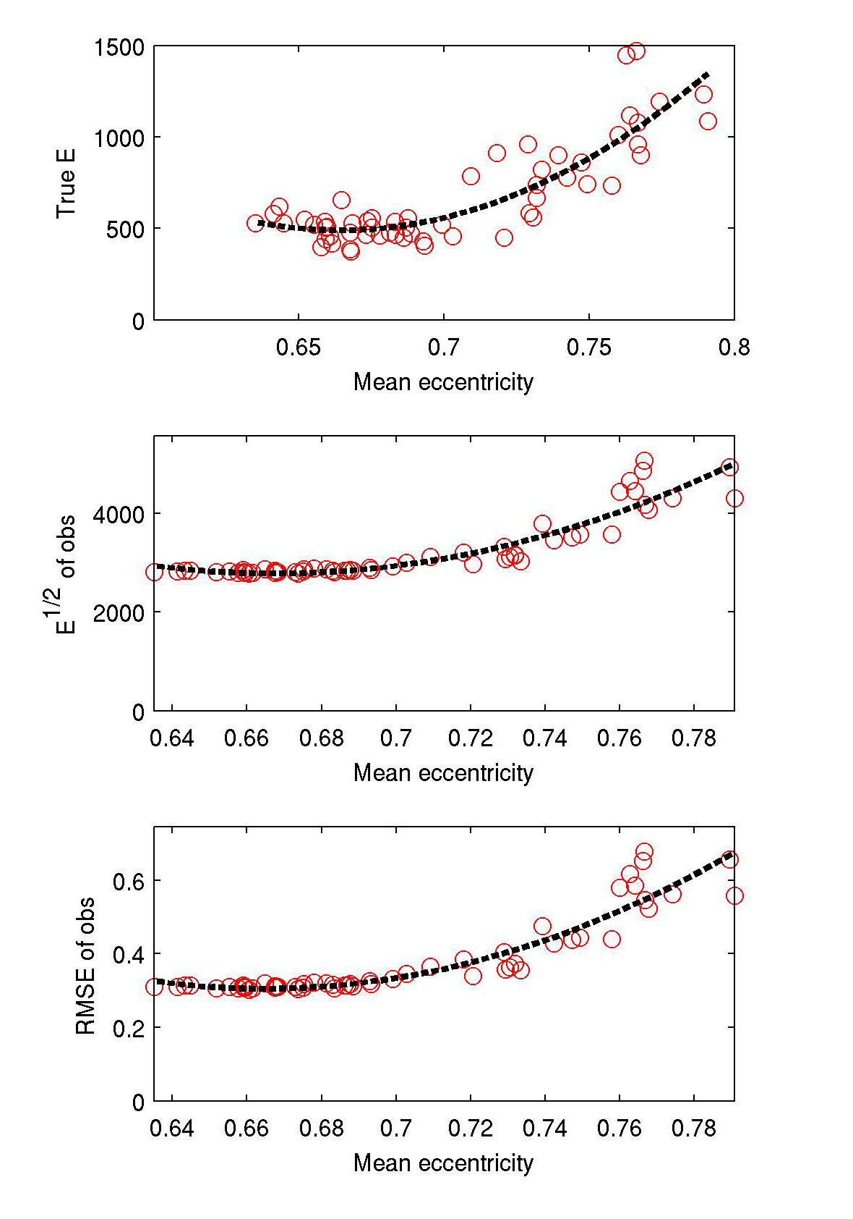
Mean Eccentricity as a Predictor
6 day forecasts, ds=6
k=2, m=15

Slide 23
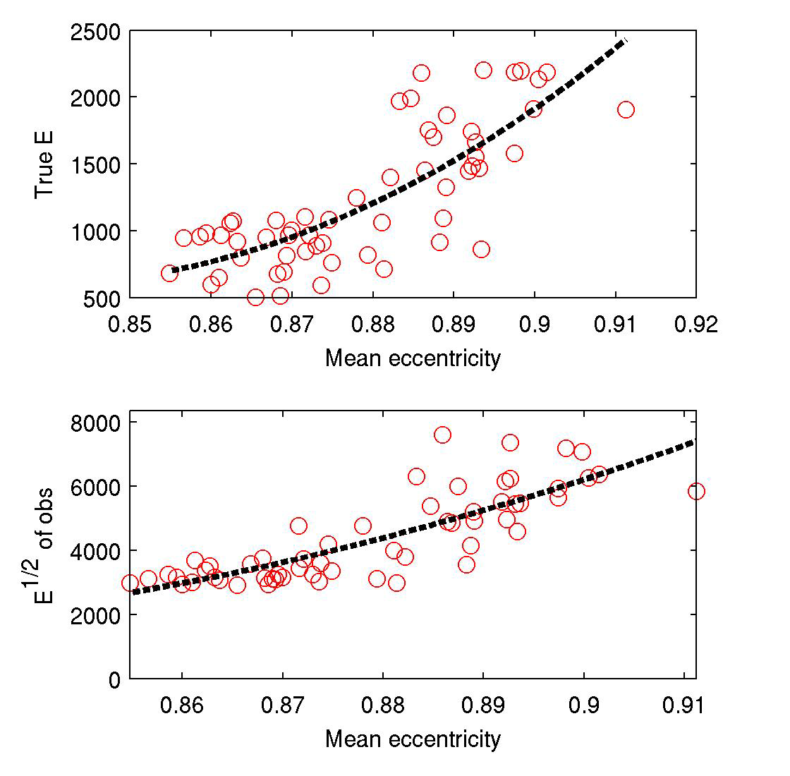
Mean Eccentricity as a Predictor
30 day forecasts, ds=6
k=2, m=15

Slide 24
Limit of Gaussian Assumption?
Linear
Gaussian
Linear or
Non-linear?
?

Slide 25
SVD vs Traditional Ensemble Methods
The cost of SVD ~ cost of a 50 member ensemble
SVD more elegant and less ad hoc than ensemble
SVD intimately linked to 4D-Var analysis
SVD does not require localization due to limited
ensemble size.
Extensions needed for SVD to account for errors in:
- surface forcing
- open boundary conditions
- ocean dynamics (weak constraint)

