Slide 1






The ROW Coupled System
(ROMS-AGRIF / OASIS3-MCT / WRF)
G. Cambon ª, S. Illig ª, P. Marchesiello ª, K. Goubanova ª, S. Le Gentil ^{b}, C. Messager ^{b}, Y. Yamashita ^{b}, S. Masson ^{c}, G. Samson ^{c,} B. Dewitte ª
ª : LEGOS, Toulouse, France
^{b} : LPO, Brest, France
^{c} : LOCEAN, Paris, France

Slide 2
General motivations
Study the detailed patterns of mesoscale air-sea interaction (Chelton et al 2010, Small et al 2008, …)
2. Coupled ocean-atmosphere approach needed to produce realistic high resolution atmospheric forcing.
Cross-shore profiles from a two-dimensional model of an eastern boundary current upwelling regime run with full-physics coupling (black lines) and in an uncoupled configuration (blue lines).
    From Chelton et al, 2010
Modified from
Perlin et al, 2007
3. Use of the online nesting capabilities available in ROMS and WRF

Slide 3

ROMS_AGRIF
ROMS_AGRIF is a branch of ROMS developed in France by IRD and INRIA and based at LEGOS, Toulouse.
Its main particularity is the AGRIF online nesting capability (Penven et al, 2006, Debreu et al, 2012) :
http://www.romsagrif.org
This French branch of ROMS is developed to respond to the objectives of IRD in terms of support to developing countries.
In this community experiment, the model code is developed in parallel with a powerful pre- and post- processing set of tools: the ROMSTOOLS matlab toolbox (Penven et al, 2008).

Slide 4
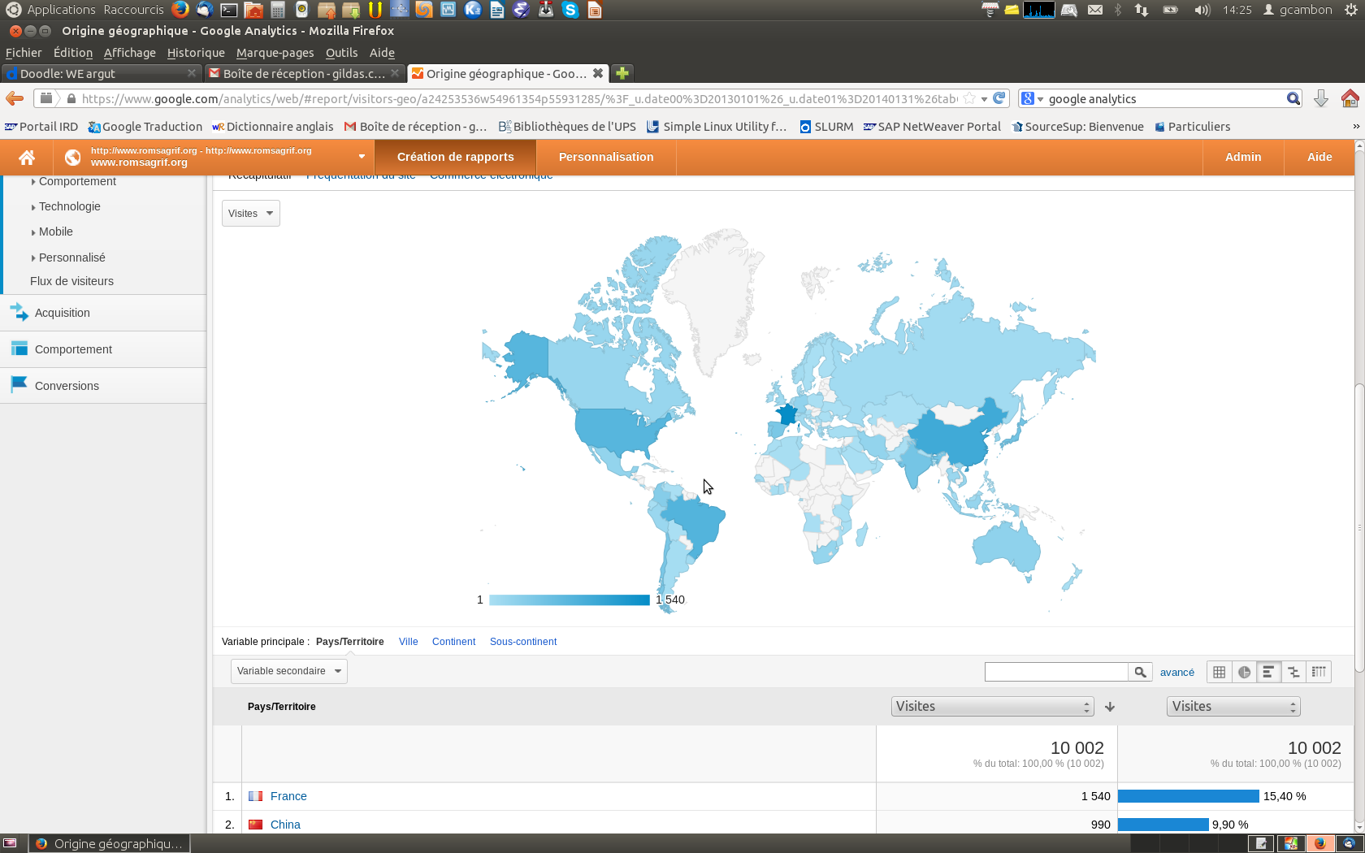
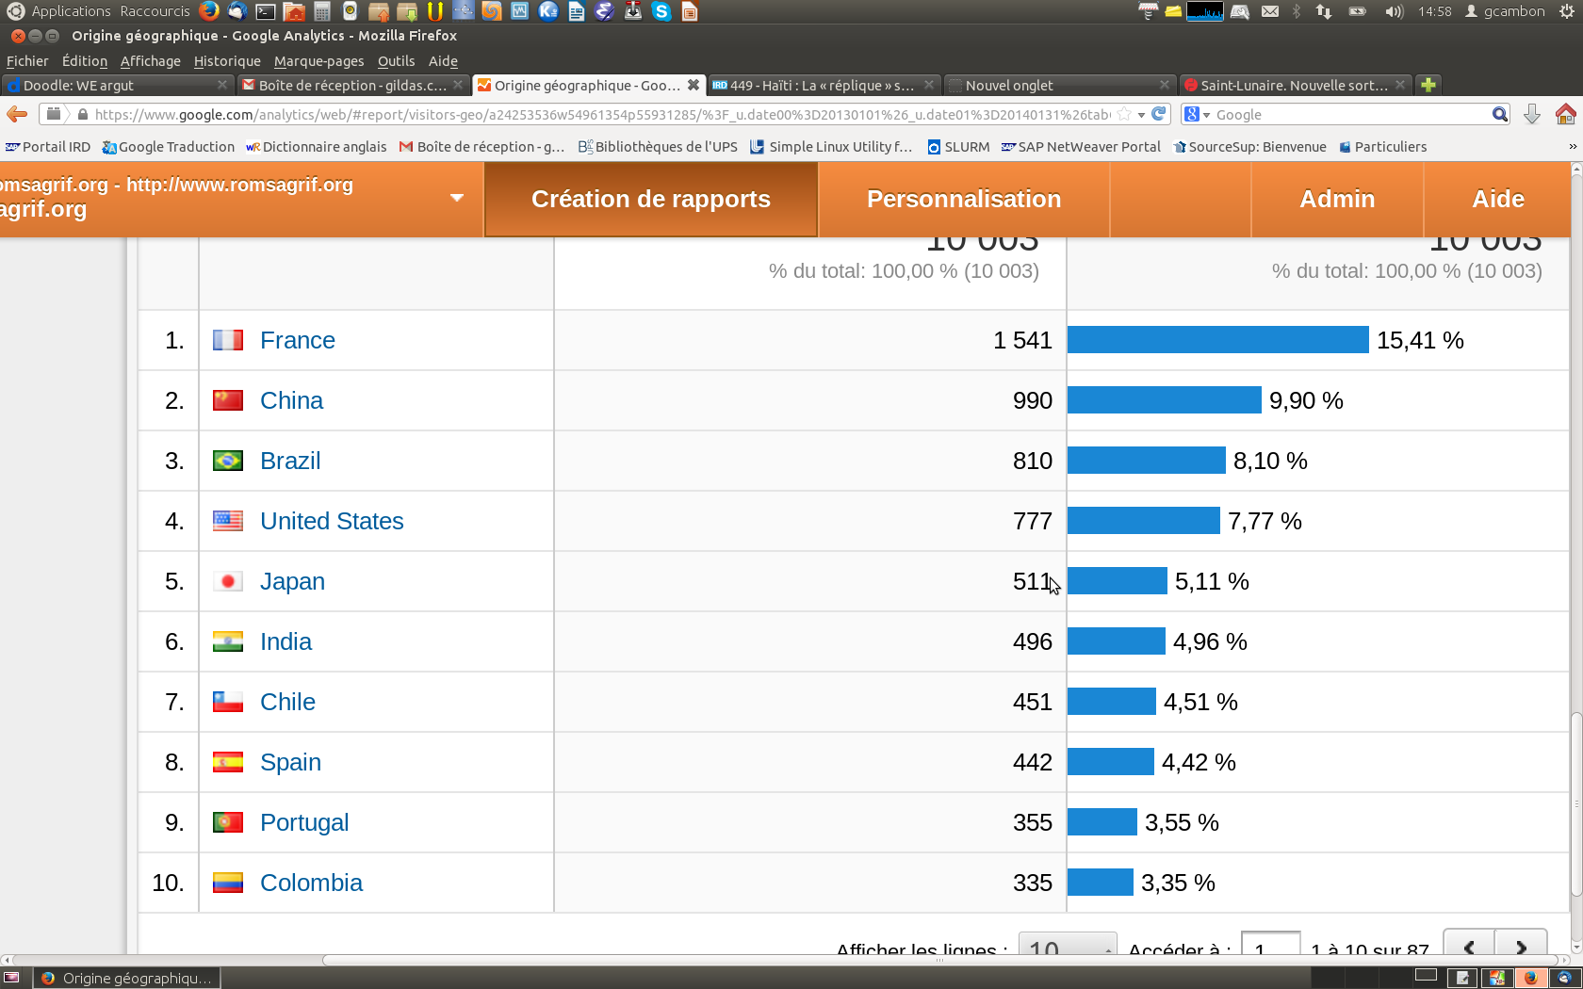
ROMS-AGRIF : A large community
About 1000 registered users
SVN development forge : ~ 120 beta-testers

Slide 5
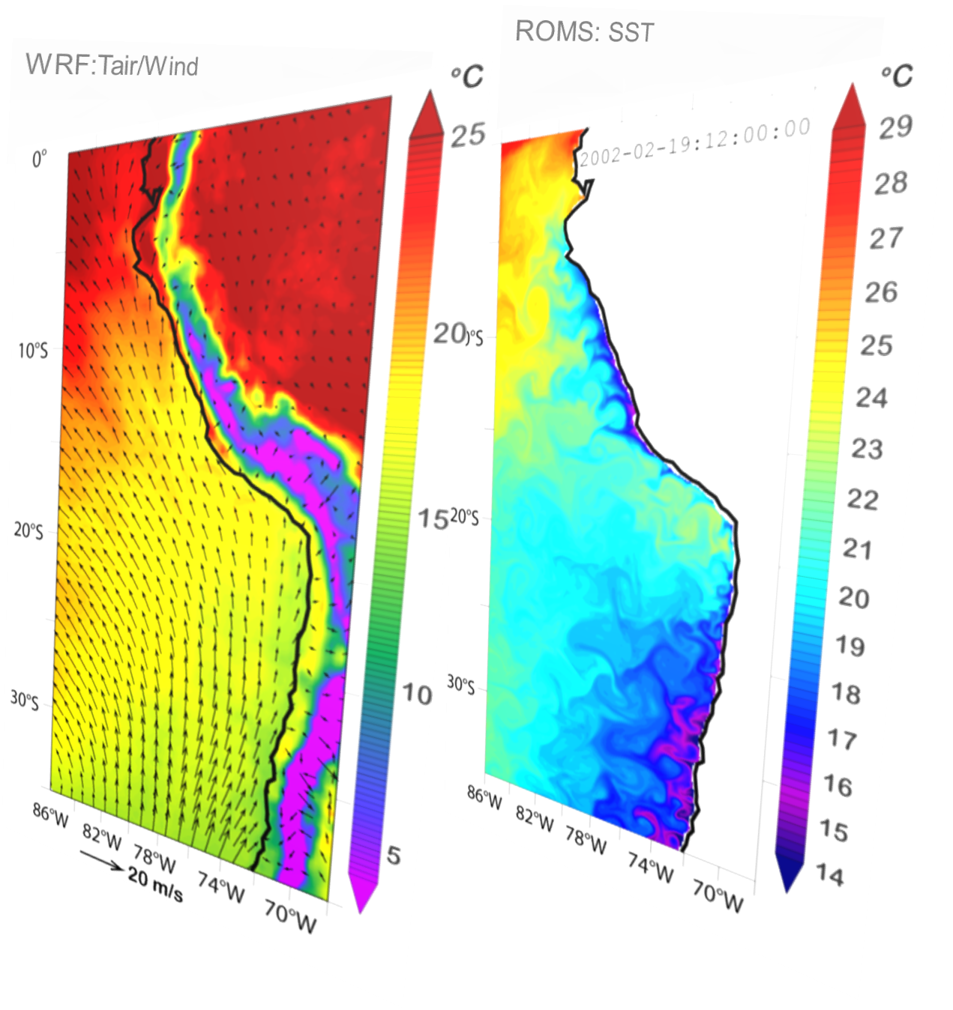
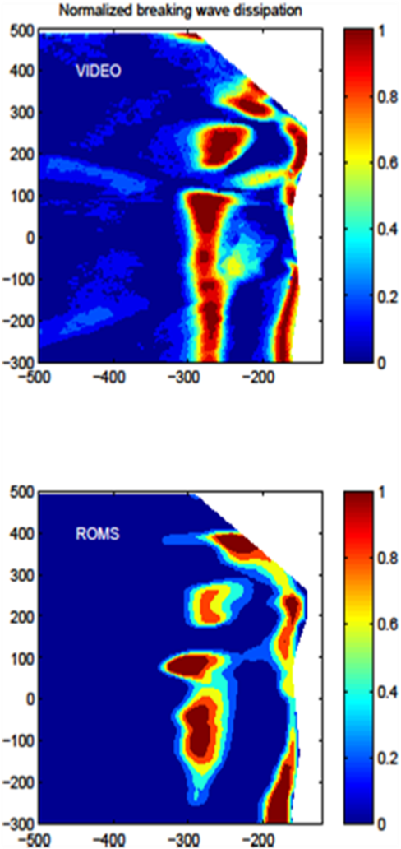
ROMS_AGRIF last functionalities
Last functionalities
Release v3.1, February 2014
[See poster]
  2-way nesting
  Ocean-Atmosphere coupling
  Wave-currents coupling
  GLS vertical mixing closure scheme
  Biogeochemical model BioEBUS
  Bilaplacian isopycnal diffusion (RSUPS3)
  Monotonic Tracer advection scheme (WENO5)
  Runoff forcing
Ocean-atmosphere coupling
Wave-current
interactions

Slide 6
Outline
The various coupling approaches
OASIS3-MCT generic coupler
The ROW coupled system
Application : A coupled nested simulation over the Peruvian Upwelling
Conclusions and Perspectives

Slide 7
The various coupling approaches
1- The Integrated Approach
Split code into elemental units
  at least init/run/finalize
Write or use coupling units
  Adapt data structure and calling interface
  Use the framework to build a hierarchical merged code
prog1_u1
program prog1
…
end prog1
coupling
prog1_u2
prog1_u3
prog1_u1
prog2_u1
coupling
program prog2
…
end prog2
prog2_u2
prog2_u1
prog1_u2
prog1_u3
prog2_u2
efficient
sequential and concurrent components
use of generic utilities (parallelization, regridding, time management, etc.)
easy
existing codes
From S. Valcke, CERFACS

Slide 8
The various coupling approaches
2 : The “Coupling Library” approach
coupling
configuration
program prog1
…
call cpl_send (data1, …)
end
program prog2
…
call cpl_recv (data2, …)
end
coupler
coupler
existing codes
use of generic transformations/regridding
concurrent coupling (parallelism)
efficient
multi-executable: more difficult to debug ; harder to manage for the OS
Use of the OASIS3-MCT generic coupler
  https://verc.enes.org/oasis , Cerfacs, France, Toulouse
From S. Valcke, CERFACS

Slide 9
Outline
The various coupling approaches
OASIS3-MCT generic coupler
The ROW coupled system
Application : A coupled nested simulation over the Peruvian Upwelling
Conclusions and Perspectives

Slide 10
OASIS3-MCT coupling : a large community of user
  About 35 modelling groups world-wide
ROW coupled system

Slide 11
Coupling with OASIS3-MCT
Communication and regridding library are used to exchange data between independent models with minimal level of interference in the codes
  Non-intrusive , flexible and generic coupling approach
  Written in F90 and C; open source license (LGPL)
  External configuration through namelist-like file
  https://verc.enes.org/oasis
Initialization: call oasis_init(...)
Grid definition: call oasis_write_grid (...)
Local partition definition: call oasis_def_partition (...)
Coupling field exchange: in model time stepping loop
  call oasis_put (…, time, var_array. …)
  call oasis_get (…, time, var_array, …)
  user external configuration: => define source / target model
      => tune the coupling frequency
      => select the transformations and regridding
Application Prog Interface
From S. Valcke, CERFACS
Notes:
Initialization phase:
OASIS3-MCT is initialized and local communicator for internal parallel computation in each model is created.
Definition phase:
The grid, partition, and exchanged variables are defined.
Exchange phase:
The exchange of the array between the model are operated, at the frequency coupling.
Finalization phase:
OASIS3-MCT coupling is finalized

Slide 12
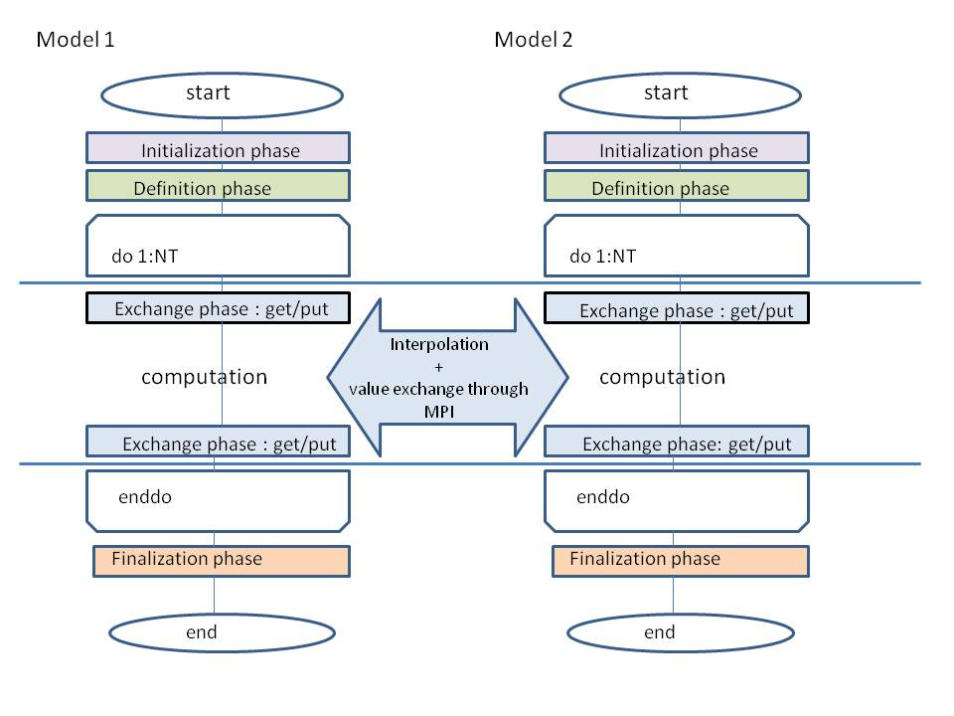
Coupling with OASIS3-MCT
Initialization phase:
OASIS3-MCT is initialized and local communicator for internal parallel computation in each model is created.
Definition phase:
The grid, partition and exchanged variables are defined.
Exchange phase:
The exchange of the arrays between the models are operated at the coupling frequency.
Finalization phase:
OASIS3-MCT coupling is finalized

Slide 13
Outline
The various coupling approaches
OASIS3-MCT generic coupler
The ROW coupled system
Applications : A coupled nested simulation over the Peruvian Upwelling
Conclusions and Perspectives

Slide 14
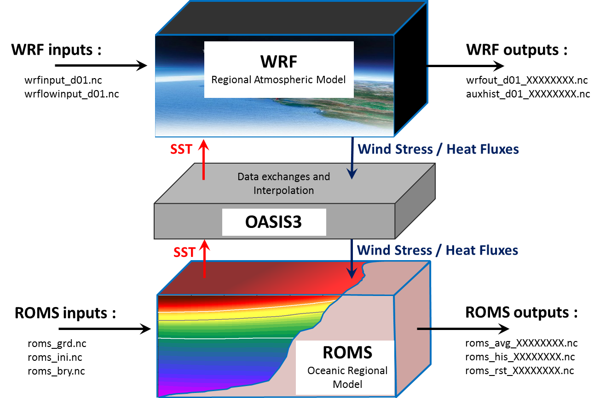
The ROW coupled system
First, OASIS3-MCT implementation in WRF done by in LOCEAN (Paris) in order to couple WRF and NEMO ocean model (Samson et al, 2014, Journal of Advances in Modeling Earth Systems, submitted)
Then, we developed the OASIS3-MCT implementation in ROMS-AGRIF
Notes:
In recent years, large efforts were devoted to develop ocean-atmosphere coupling.
For computational efficiency and extended capabilities (e.g., nesting), coupling of ROMS_AGRIF with the atmospheric model WRF is now implemented using the OASIS3-MCT generic coupler. We choose this approach to be coherent with the WRF community and because it provides a non-intrusive solution to couple independent codes.

Slide 15
ROW System compilation
OASIS3-MCT libraries compilation : The compilation of OASIS3-MCT is clearly described in the OASIS3-MCT User Guide (1)
ROMS_AGRIF coupled compilation
Define OA_COUPLING cpp_key in cppdefs.h
Lauch ./jobcomp.bash compilation script with correct link to oasis3-mct library
WRF coupled compilation
Modifed configure.wrf
compile em_real
… … # ESMFINCLUDEGOESHERE ########################################################################### #### add for OASIS ### PRISM_ROOT_DIR = $(HOME)/COUPLAGE/OASIS3/compile_oa3-mct_v2.0 CHAN = MPI1 LIBPSMILE = $(PRISM_ROOT_DIR)/lib/libpsmile.$(CHAN).a $(PRISM_ROOT_DIR)/lib/libscrip.a $(PRISM_ROOT_DIR)/lib/libmct.a $(PRISM_ROOT_DIR)/lib/libmpeu.a PSMILE_INCDIR = -I$(PRISM_ROOT_DIR)/build/lib/psmile.$(CHAN) -I$(PRISM_ROOT_DIR)/build/lib/mct LIBWRFLIB = libwrflib.a $(LIBPSMILE) ### end for OASIS ### … … LDFLAGS = $(OMP) $(FCFLAGS) $(LDFLAGS_LOCAL) ### add for OASIS ### OASISFLAGS = -Dkey_cpp_coupler -Dkey_cpp_coupler_mct -Dkey_cpp_nemo ### end for OASIS ### … … LDFLAGS = $(OMP) $(FCFLAGS) $(LDFLAGS_LOCAL) ### add for OASIS ### OASISFLAGS = -Dkey_cpp_coupler -Dkey_cpp_coupler_mct -Dkey_cpp_nemo ### end for OASIS ### LDFLAGS = $(OMP) $(FCFLAGS) $(LDFLAGS_LOCAL) CPPFLAGS = $(ARCHFLAGS) $(ENVCOMPDEFS) -I$(LIBINCLUDE) $(TRADFLAG) $(OASISFLAGS) # add pour OASIS
# # set MPI directories if needed # MPIF90="/usr/local/bin/mpif90" MPILIB="-L/usr/local/lib -lmpi" MPIINC="-I/usr/local/include" # # set OASIS-MCT (or OASIS3) directories if needed # PRISM_ROOT_DIR=../../oasis3-mct/compile_oa3-mct # # END OF USER'S MODIFICATIONS

Slide 16
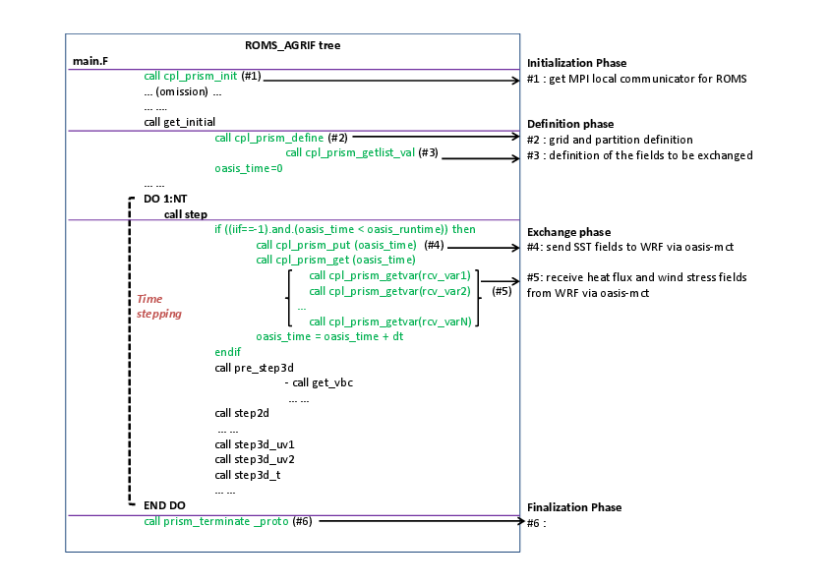
ROMS-AGRIF code modifications

Slide 17
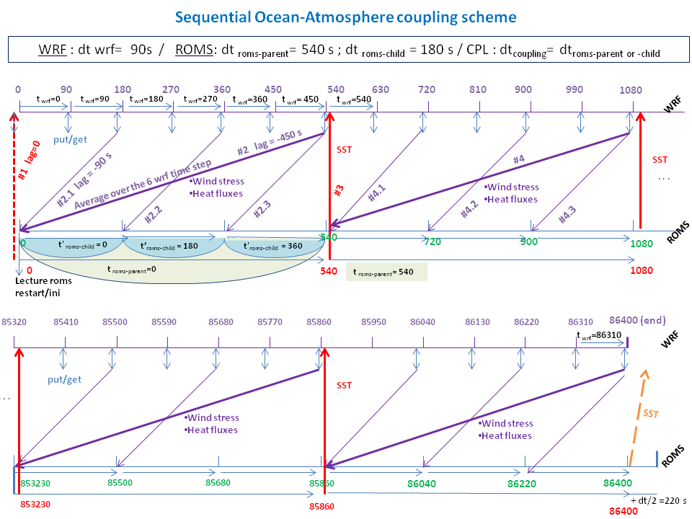
Coupling sequency example
2 ROMS nested grid / 1 WRF grid

Slide 18
Namcouple example : ROMS to WRF SST exchange
#
###############################################################################
$STRINGS > Beginning fields exchange set-up <
###############################################################################
#
# OCEAN --->>> ATMOS
# --------------------
###############################################################################
# Field 1 : Weighted sea surface temperature (o->a 1)
#
SRMSSTV0 | A_WRFSST | 1 | 540 | 1 | sstoc.nc | EXPOUT
SST sent from ROMS | SST received from WRF | CF-convention code | roms coupling frequency in s | Number of OASIS time+space transformation | WRF restart file | type of output
Suffix 0 refer to ROMS grid #0 | Prefix A refer to WRF grid #0
73 60 73 60 rrn0 wrp0 LAG=0
[xind_fin_roms–xind_deb_roms+1=73] ; [yind_fin_roms–yind_deb_roms+1=60]
[xind_fin_wrf–xind_deb_wrf+1=73] ; [yind_fin_wrf -yind_deb_wrf+1=60]
R 0 R 0
SCRIPR
BILINEAR LR SCALAR LATLON 1
Oasis operation:
  2D spatial interpolation (remapping) SCRIPR
BILINEAR LR SCALAR LATLON 1 => [SCRIPR] 2-D spatial interpolation : select bilinear interpolation option [BILINEAR]
#
############################################################################
Notes:
Coupling parameters are defined through the namecouple.
Exchanged fields definition
For each fields exchanges, definition of :
Type of time transformation and 2D space interpolation on exchanged field definition
Mask definition
Coupling frequency
Nested grid level
Lag definition….
high flexibility for the coupling !

Slide 19
Namecouple examples : WRF to ROMS Solar Heat Flux and EMP exchanges
############################################################################
# (Parent WRF - Parent ROMS)
# ATMOSPHERE --->>> OCEAN
# -------------------------
############################################################################
#
# Field 1 : solar heat flux on ocean (a->o flx 2)
#
A_WRFQSR RRMSRFL0 7 540 2 flxat.nc EXPOUT
73 60 73 60 wrp0 rrp0 LAG=-450
[xind_fin_wrf–xind_deb_wrf+1=73] [yind_fin_wrf -yind_deb_wrf+1=60]
[xind_fin_roms–xind_deb_roms+1=73] [yind_fin_roms–yind_deb_roms+1=60]
R 0 R 0
LOCTRANS SCRIPR
Oasis operation:
  Time transformation LOCTRANS
  2D spatial interpolation (remapping) SCRIPR
AVERAGE => [LOCTRANS] Time transformation : select averaging option [AVERAGE]
BILINEAR LR SCALAR LATLON 1 => [SCRIPR] 2-D spatial interpolation : select bilinear interpolation option [BILINEAR]
#
###########################################################################
# Field 2 : emp = emp_oce = evap_oce - ( rain_oce + snow_oce ) (a->o flx 9)
#
AWRFEVPR RRMEVPR0 29 540 2 flxat.nc EXPOUT
73 60 73 60 wrp0 rrp0 LAG=-450
R 0 R 0
LOCTRANS SCRIPR
AVERAGE
BILINEAR LR SCALAR LATLON 1
#

Slide 20
OASIS3-MCT auxiliary files creation
To manage grid exchanges and interpolations, OASIS3-MCT require 3 auxiliary data files:
  grids.nc : contain grid dimension of each coupled model
  masks.nc : contain mask information “ “
  areas.nc : cells surface information “ “
In ROW, automated scripts to create these files : script_make_all_files_uv.sh
It manages :
  the "u", "v" and "rho" grid placement
  the native or processed mask
  the nested grid level

Slide 21
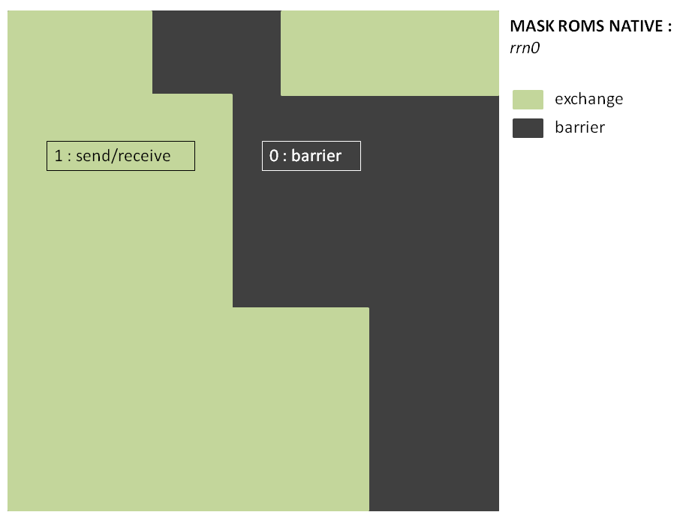
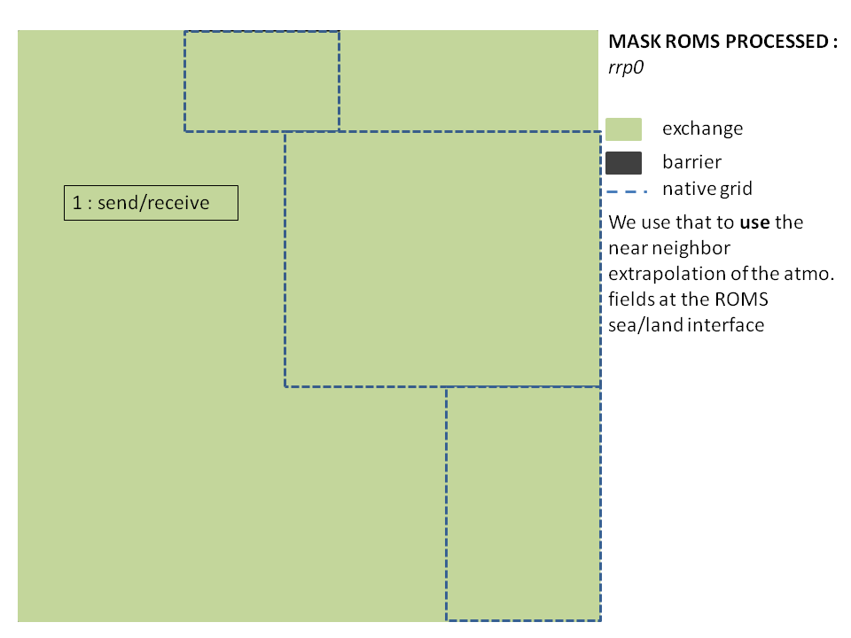
    About ROMS mask processing

Slide 22

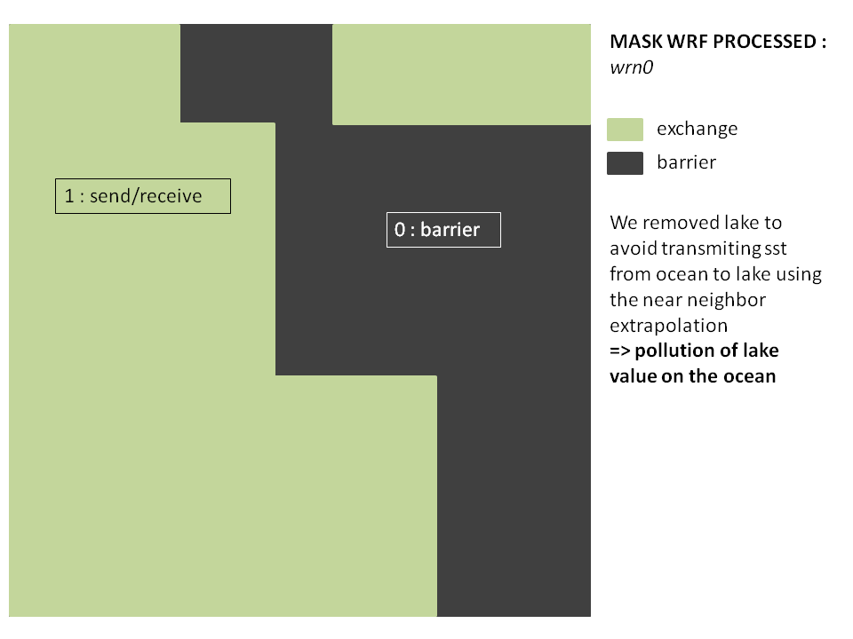
About WRF mask processing
MASK WRF NATIVE
Heat fluxes and wind stress exchanges (WRF to ROMS) : WRF processed grid to ROMS processed grid
SST exchange (ROMS to WRF) : ROMS native grid to WRF processed grid

Slide 23
To resume …
  Non-intrusive coupling approach
  Fully compatible with WRF’s oasis3-mct implementation (next release 3.6)
  Easy compilation step for ROMS and WRF in coupled mode
  High flexibility through the OASIS3-MCT : Easy coupling parameter definition through namelist-like file (namcouple)
  Implementation manage WRF and ROMS 1-way and 2-way online nesting functionalities
  A set of automated tools dedicated to the coupling files (grids, masking, interpolation weights, … ) processing
  Dedicated to interannual simulation (not presented)

Slide 24
Outline
The various coupling approaches
OASIS3-MCT generic coupler
The ROW coupled system
Application : A coupled nested simulation over the Peruvian Upwelling
Conclusions and Perspectives

Slide 25
Application : A coupled nested simulation over the Peruvian Upwelling region
Scientific objectives :
  Effect of oceanic versus atmospheric forcing resolution on the Peruvian upwelling system
Modeling tools :
  Use of a coupled model to have the most realistic atmospheric forcing near the coast
  Use of nesting capability in both ocean (ROMS-AGRIF) and atmospheric model (WRF) to increase resolution near the coast, in the upwelling region
Numerical set-up:
  1/12° and 1/36° oceanic grid
  1/6 and 1/18 atmospheric grid
  Hourly coupling frequency
  Simulation period : January 2000 Illig et al, in prep

Slide 26
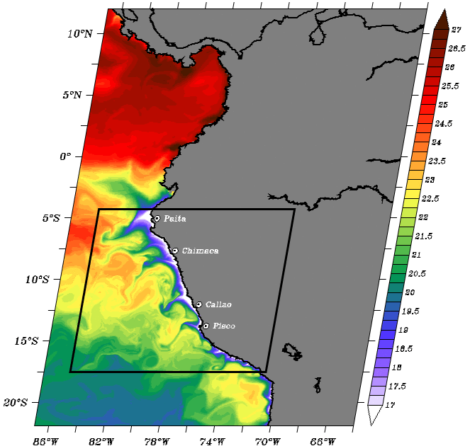

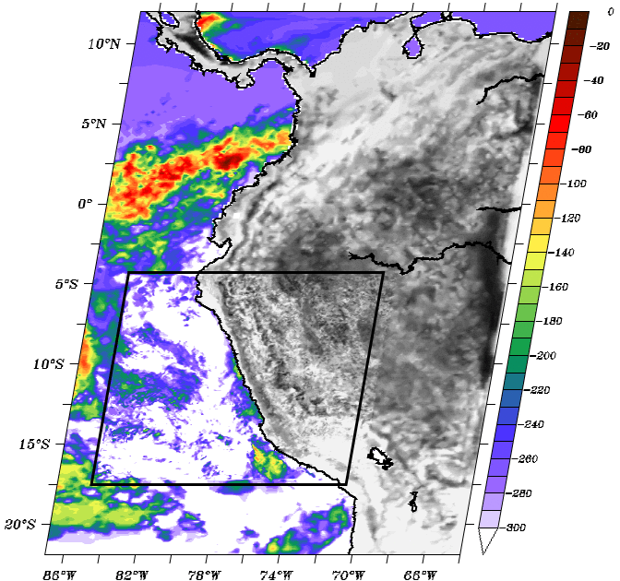
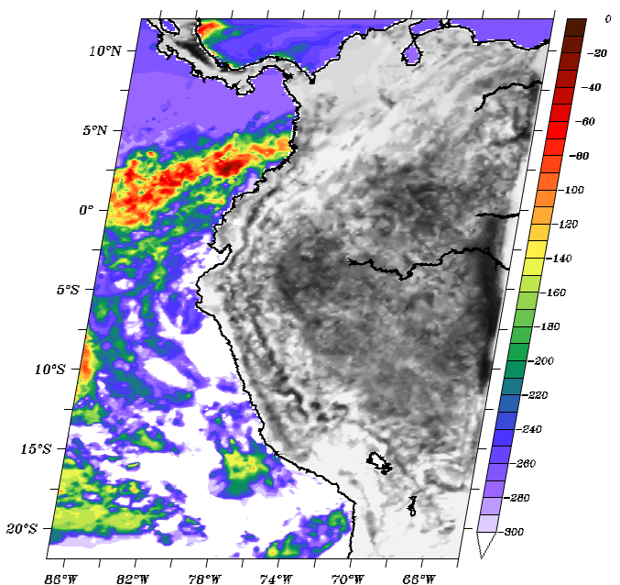
Preliminary results
ROMS: SST (°C)
WRF : 1 - Solar heat flux (W/m2)
1/6°
1/12°
1/6°
1/12°
1/36°
1/18°
Figures : S. Illig
Coupling

Slide 27
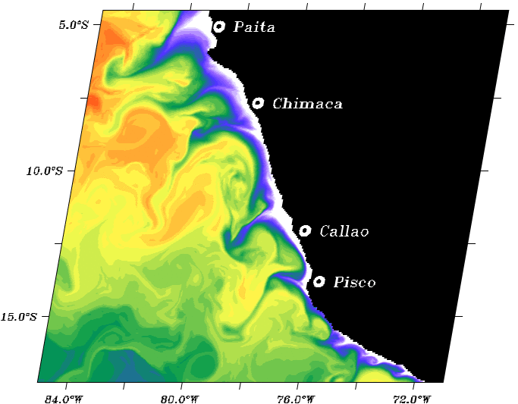
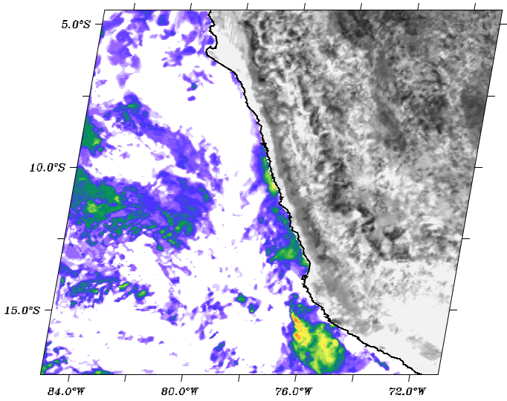
Preliminary results
ROMS: SST (°C)
WRF : 1- Solar heat flux (W/m2)
1/36°
1/18°
1/36°
Observed low solar heat values over Lima region are well simulated only in the high-resolution atmospheric grid
Figures : S. Illig

Slide 28
Conclusions & Perspectives
OASIS3-MCT interface is implemented in ROMS-AGRIF V3.1 and is fully compatible with AGRIF online nesting (1-way and 2-way)
Set up a hierarchy of ROW coupled experiment of increasing complexity to evaluate the respective role of oceanic and atmospheric resolution on the Peruvian upwelling structure :
  forced oceanic and atmospheric simulation
  semi-coupled ocean -> atm.
  semi-coupled atm. -> ocean
  fully coupled
Now, long simulations along Peruvian coast are still running … So, more results next year ;-)
Thanks
Notes:
Due to the flexibility of coupled system developed, we set up a hierarchy of coupled experiment of increasing complexity in order to evaluate the respective role of oceanic and atmospheric resolution on the peruvian upwelling system :

Slide 30
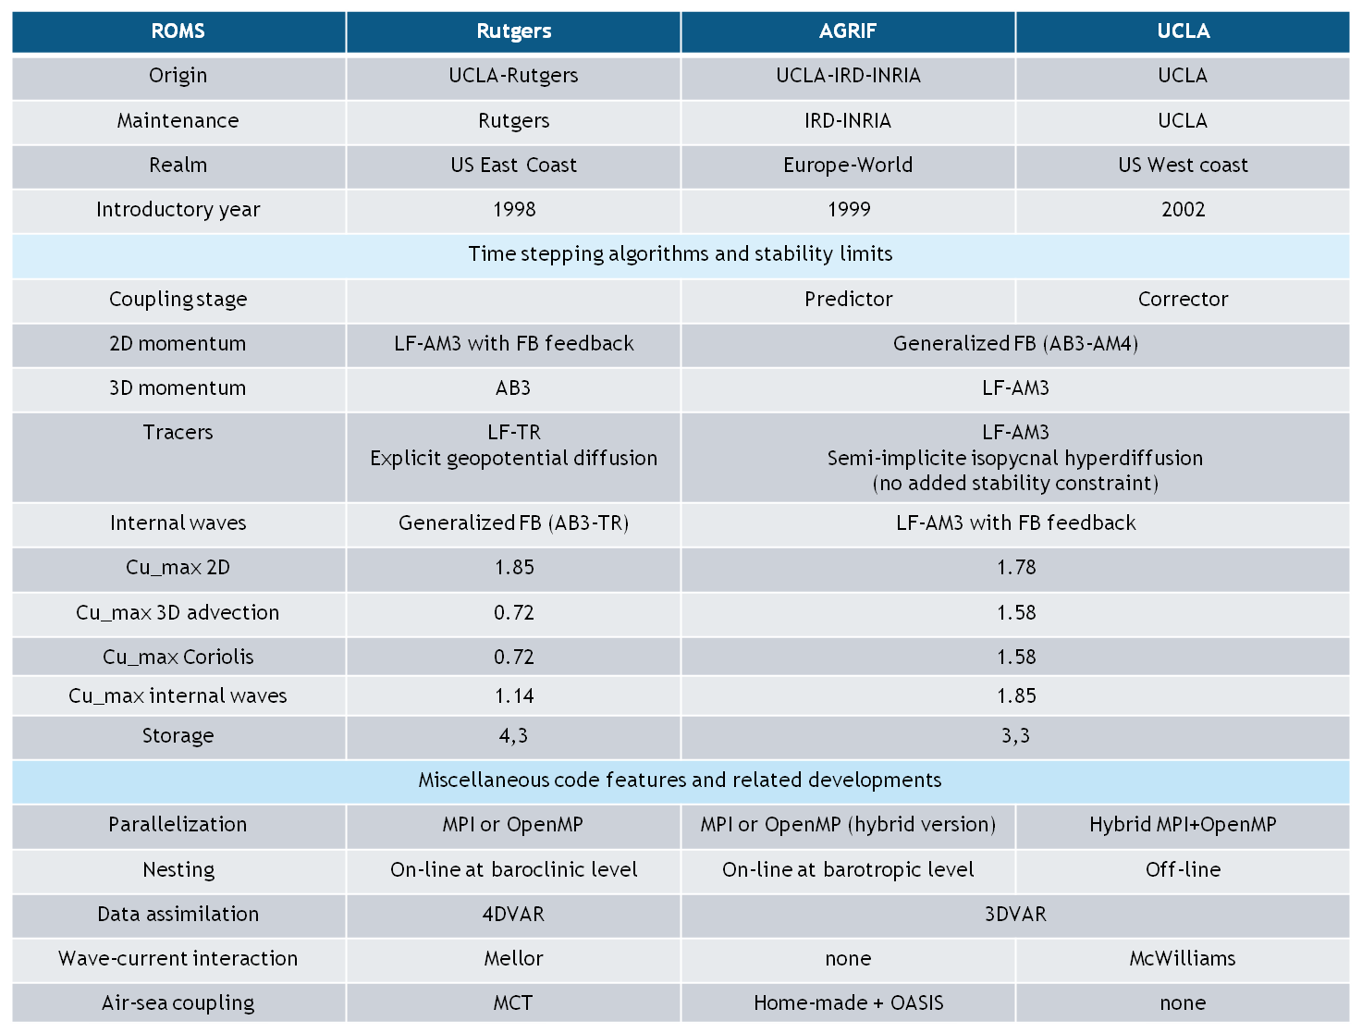
ROMS_AGRIF

Slide 31
    From Chelton et al, 2010

Slide 32
Cross-shore profiles from a two-dimensional model of an eastern boundary current upwelling regime run with full-physics coupling (black lines) and
in an uncoupled configuration (blue lines).
SST, (b) alongshore wind stress (negative for upwelling- favorable equatorward winds), and (c) wind stress curl.

Slide 33
  Exchanged fields between ROMS and WRF
WRF variables used for the coupling
Name | Description / status (SNT or RCV or NONE) | Unity
DT | Time step | s
QFX | Upward moisture flux at surface / NONE | kg.m^{-s}s⁻¹
RAINCV | Time-step cumulus precipitation / NONE | mm
RAINNCV | Time-step non-convective precipitation /NONE | mm
EMP=QFX-(RAINCV+RAINNCV)/ DT | Computed E-P flux / SND | W/m⁻²
GSW | Net short wave flux at ground surface / SND | W/m²
GLW | Downward long wave flux at ground surface (W/m^2) | W/m²
STBOLT | Stefan-Boltzmann constant | W.m⁻²K⁻⁴
EMISS | Surface emissivity (between 0 and 1)
SST | Sea-surface temperature /RCV | °K
LH | Net upward latent heat flux at surface | W.m⁻²
HFX | Net upward heat flux at the surface | W.m⁻²
SNLS=GLW-(STBOLT*EMISS*SST**4-LH-HFX | Surface net longwave flux/ SND | W.m⁻²
TAUX | /SND | N/m²
TAUY | /SND | N/m²
ROMS variables used for the coupling
SUSTR | XI-component of wind stress at U-point / RCV | m²s⁻²
SVSTR | ETA-component of wind stress at V-point / RCV | m²s⁻²
TEMP | Temperature at rho-point / SND | °C
SRFLX | Kinematic surface shortwave solar radiation flux (RHO-point) /RCV | °C.m/s
STFLX(:,:,itemp) | Kinematic surface net heat flux (RHO-point) / RCV | °C.m /s
STFLX(:,:,isalt) | Kinematic surface net salt flux (RHO-point) / RCV | PSU.m/s

