Slide 1
The impact of future changes in weather patterns on extreme sea levels over southern Australia
Climate Adaptation
Frank Colberg and Kathleen McInnes
ROMS – workshop, Brazil 2012

Slide 2
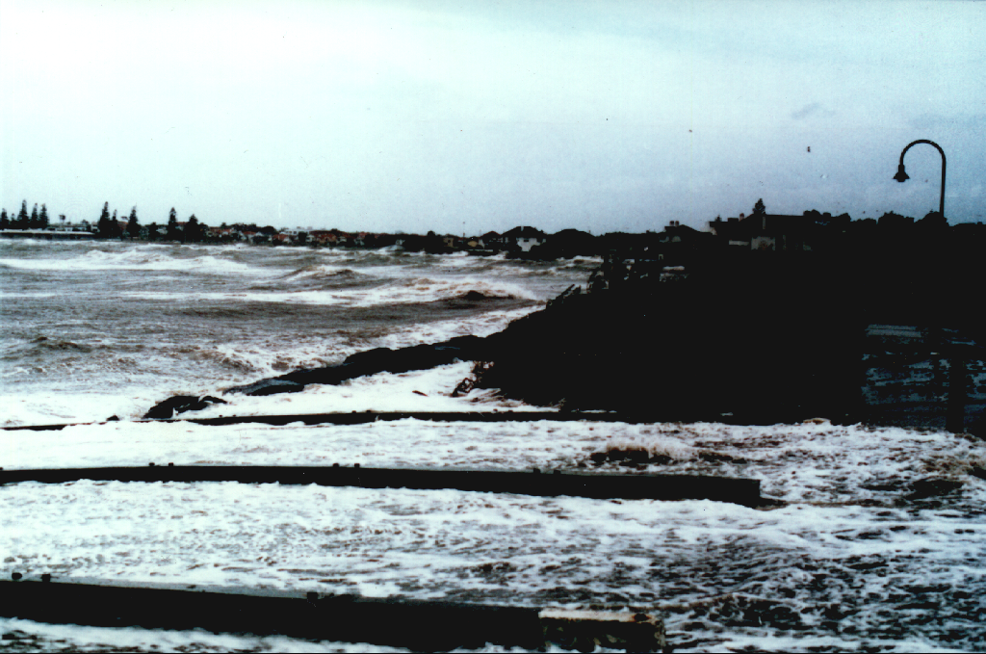
Outline
Introduction and Background
ROMS Model setup and validation
Results Climate change runs
  Seasonality
  Atmospheric conditions
  Daily maximum SSH
  Variability of SSH
Results from Atmospheric downscaling
  How does this affect modelled daily maximum SSH
Summary and Conclusions – Part 1
Preliminary results of current work
Future work

Slide 3
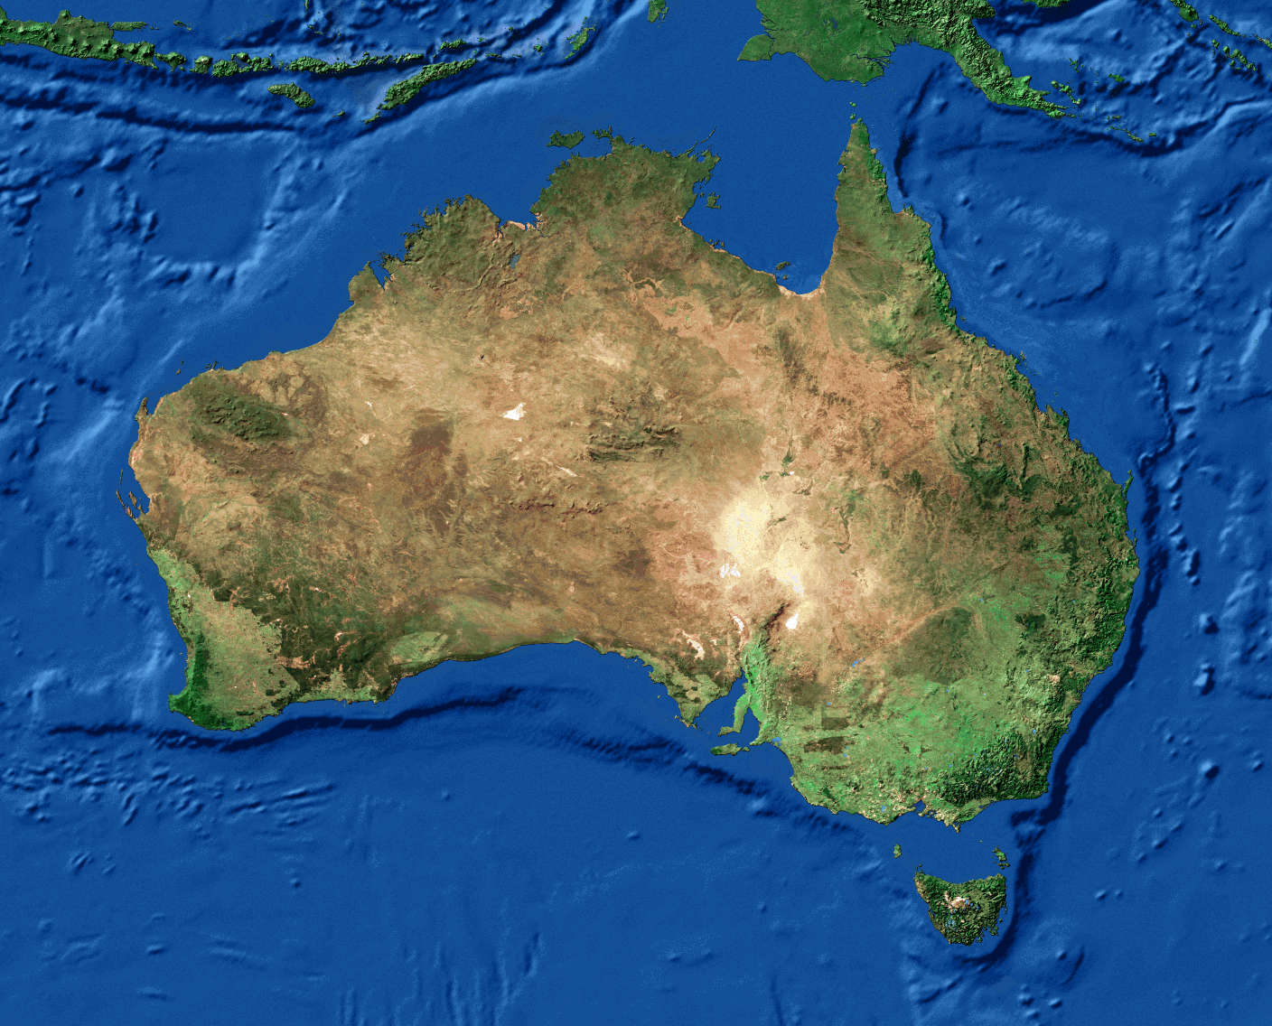
Extreme water levels
Storm surge:
  Inverse barometer (1 hPa ↓=1cm ↑)
  Wind stress
  Weather systems
Wind-wave contributions:
  Wave setup
  Wave runup
Astronomical tides
Longer term variations
  Seasonal
  Interannual (e.g. ENSO)
  Climate change (SLR and change in weather systems)
Continental shelf profiles
  Shallow/wide → large storm surge
  Narrow – wave effects important
tropics
mid-latitudes
Notes:
1.Schematic of different component causing extreme water levels

Slide 4
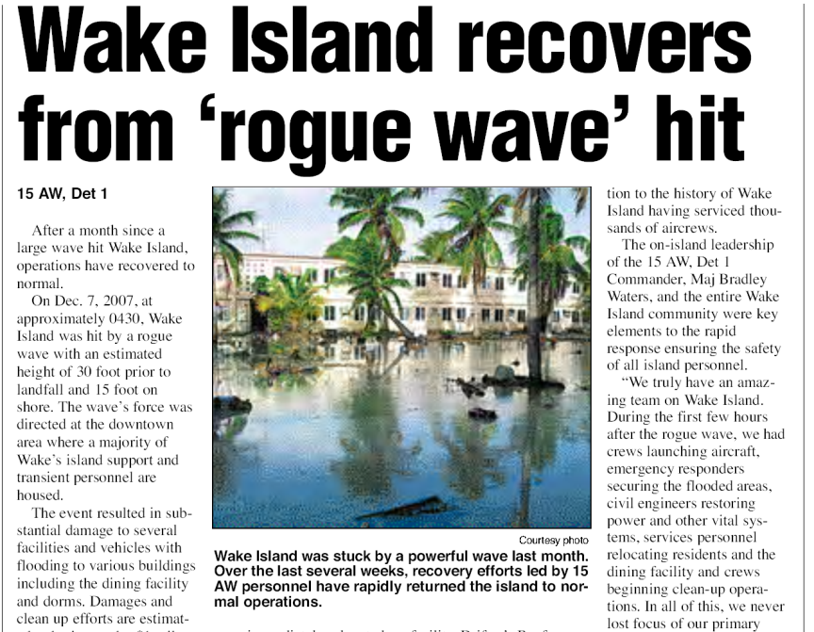
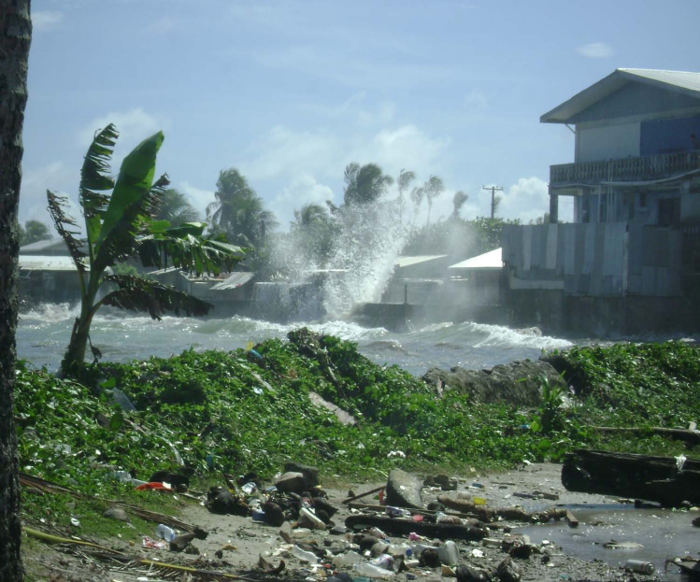
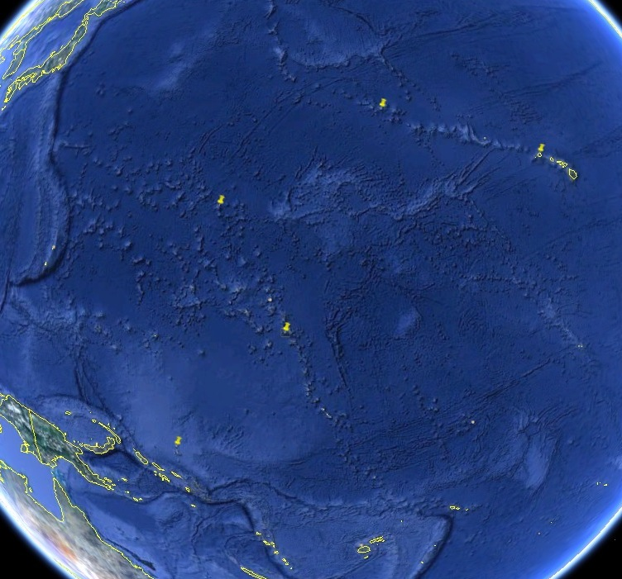
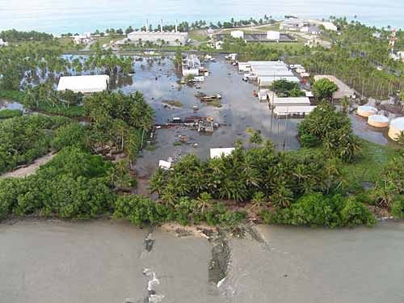
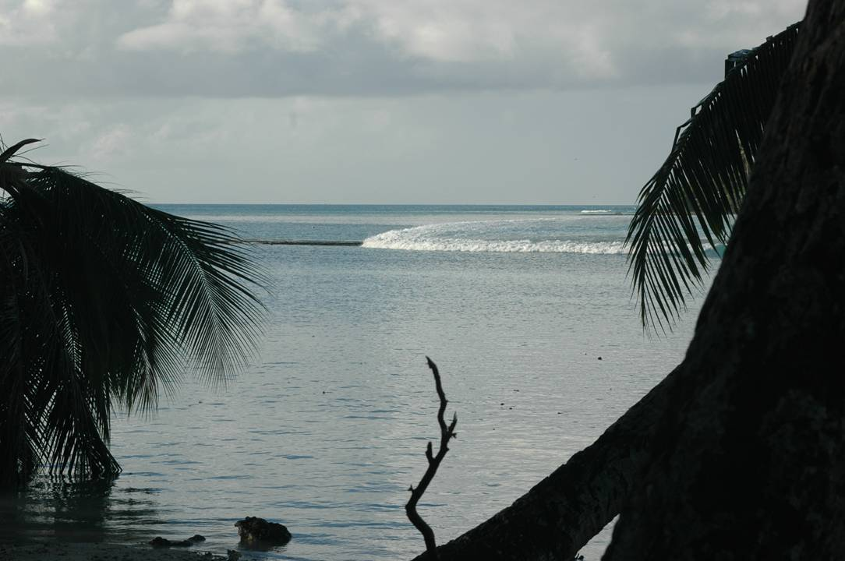
1. (a) Causes of extreme sea levels
High Wave Event – December 2008 – North Pacific
Building a database of extreme water level and inundation events will help increase awareness of such events and their causes throughout the Pacific
The example shown below was caused by a mid-
latitude low pressure system in the north Pacific
which propagated throughout the region to impact
a number of islands
Wake Atoll
Photo: Reginald White
Majuro Atoll
Taku’u Atoll
Roi-Namur (Marshall Islands)
photo: Scott Smithers

Slide 5
1. (b) Extreme Sea Level Climatologies
Honiara, Solomon Islands
Nuku’Alofa, Tonga
Top 10
Extreme
events
total
tides
short
term
seasonal
Sea levels have been decomposed into tidal, short term (weather-related) and seasonal components for 20 tide gauge locations in 13 PCCSP countries to indicate how extreme sea levels vary throughout the year. Ref. Hoeke, McInnes & Merrifield (in preparation)
Notes:
Illustrate the character of extremes for each site –
Usefull tool for diagnosing the nature of extreme events

Slide 6
2. (a) Quantification of extreme sea levels (e.g. estimation of return periods of extreme sea levels) for inundation modelling
1 in 100 year flood level used in combination with sea level rise scenarios to map areas potentially vulnerable to inundation
Source: McInnes et al, 2012

Slide 7
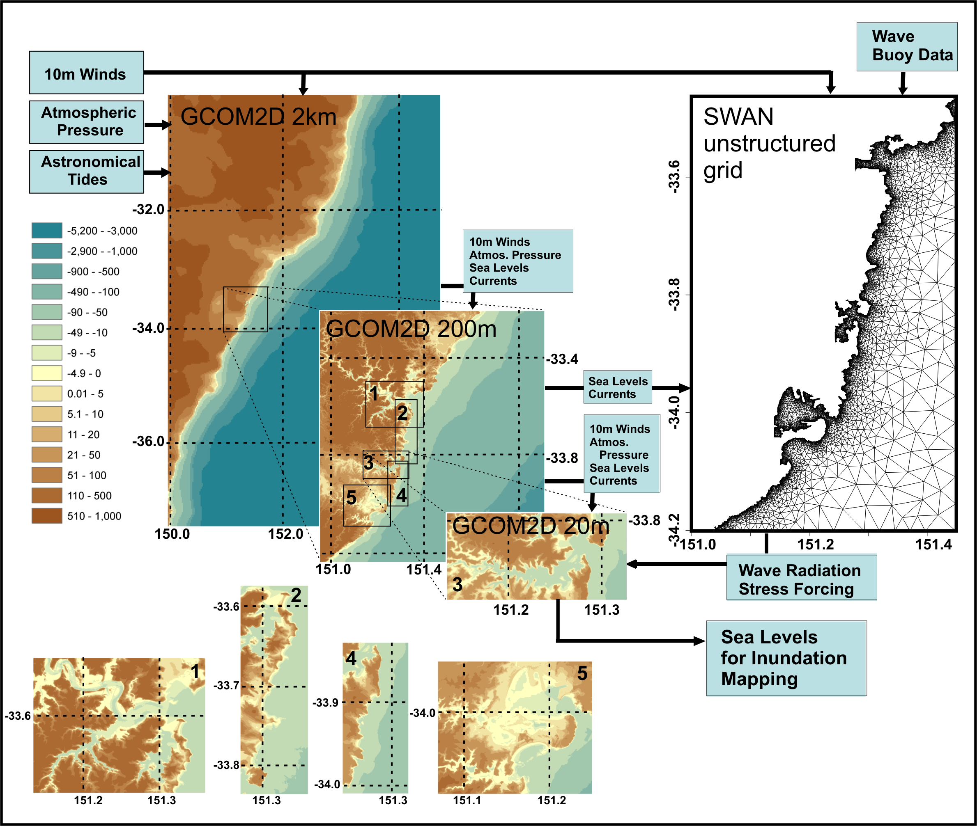
2. (b) Modelling and mapping of inundation in Sydney, Australia
Wave and hydrodynamic models have been coupled to investigate inundation under future sea level rise scenarios due to the combination of wave setup, storm surge and tides under an example of a 1-in-1 year and 1-in-100 year storm tide event based on sea levels at the Fort Denison tide gauge
McInnes and O’Grady, 2012

Slide 8
3. Evaluation of changes to extreme sea levels and inundation due to future climate change
Present and future sea level rise poses a major threat on low-lying coastal communities
Most significant impacts will arise during short lived storm surges and extreme wave events
Climate change may also affect the meteorological drivers leading to extreme sea level events (e.g. McInnes et al., 2011)
Storm surge hazard has been previously investigated for
  Victoria for the Vic Govt ‘Future Coasts’ (McInnes et al, 2009a,b)
  Tasmania as part of ‘Climate Futures for Tasmania’ (McInnes et al, 2011)
For ‘Climate Futures for Tasmania’ the stretched grid climate model CCAM downscaled several GCMs on a 60 and 15km grid (A2,B1)→ increased temporal and spatial resolution
Provides opportunity to investigate changes to extreme sea levels through storminess changes directly using an ocean model forced by raw climate model output !

Slide 9
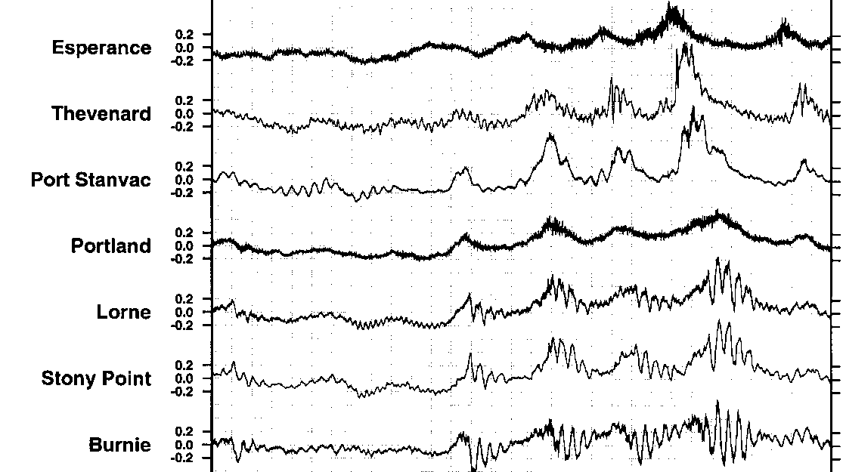
Background
Southern Australian storm surges commonly originate on the SA coastline and propagate eastwards under SW wind forcing due to fronts and lows in the Bight → any changes in atmospheric conditions likely to affect maximum SSH
Previous modelling (McInnes et al., 2009) has quantified current climate storm surge risk + SLR but not storminess changes

Slide 10
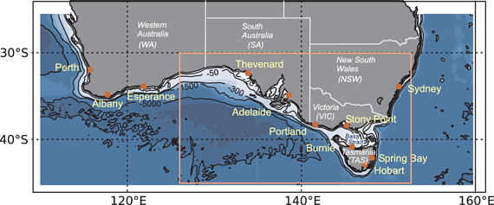
Model setup
ROMS (Shchepetkin et al., 2004)
5km horizontal resolution, Barotropic model simulation (i.e. no tracers), No tides
→ we are modelling SSH and barotropic velocities due to wind and SLP only !
Topography from GEBCO
Atmospheric forcing: range of reanalysis, downscaled GCM and raw GCM → next slide
2 Model domains:
Small: 125E-153E, 45S-31S (SA,VIC)
Large: 110E-160E, 45S-25S (WA,SA,VIC,NSW)
Produced data ~7Tb → high temporal output
1 modelled year in 1 day on VAYU/ KATABATIC, 32CPUS
Thanks to TPAC, APAC

Slide 11
Experimental design
(a) Model performance
Run | Atmospheric forcing | Years
I | NCEP | 1980-1999
II | CCAM (NCEP) | 1980-1999
(b) Present vs. Future
Run | Atmospheric forcing | Years
I | CCAM (GFDL 2.0) | 1980-1999, 2080-2099
II | CCAM (MK3.5) | 1980-1999, 2080-2099
III | Mk 3.5 | 1980-1999, 2080-2099

Slide 12
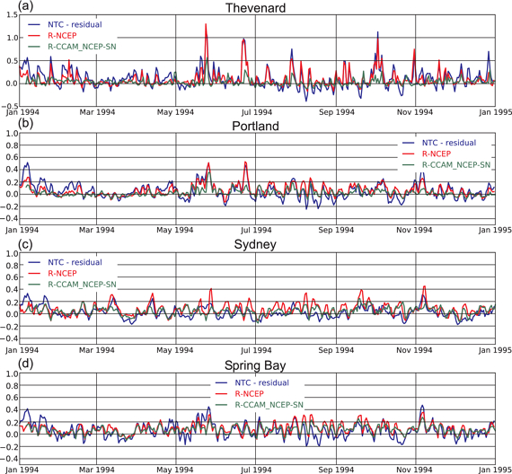
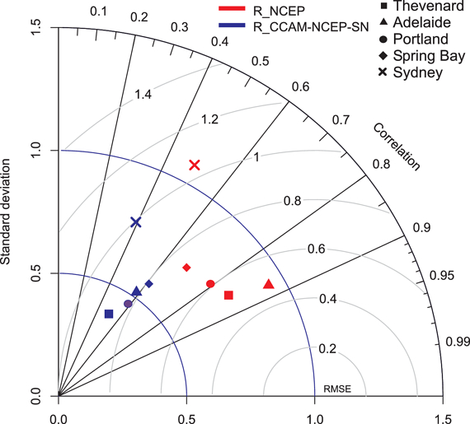
ROMS performance

Slide 13
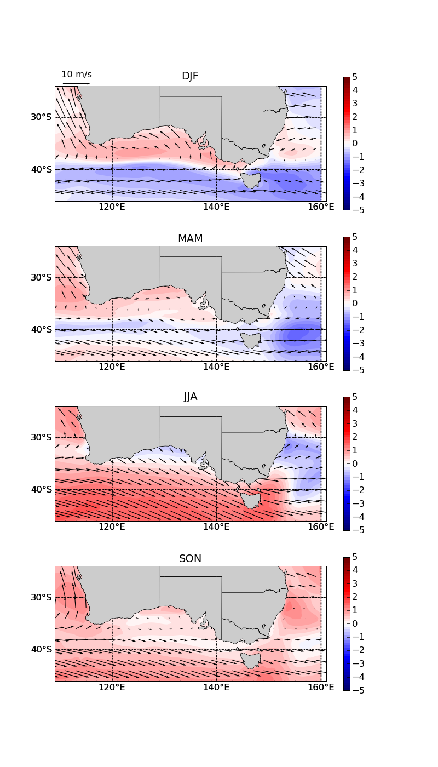
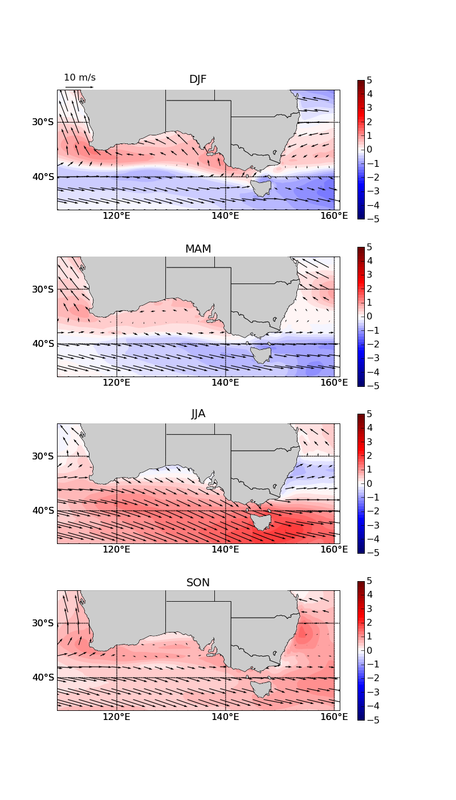
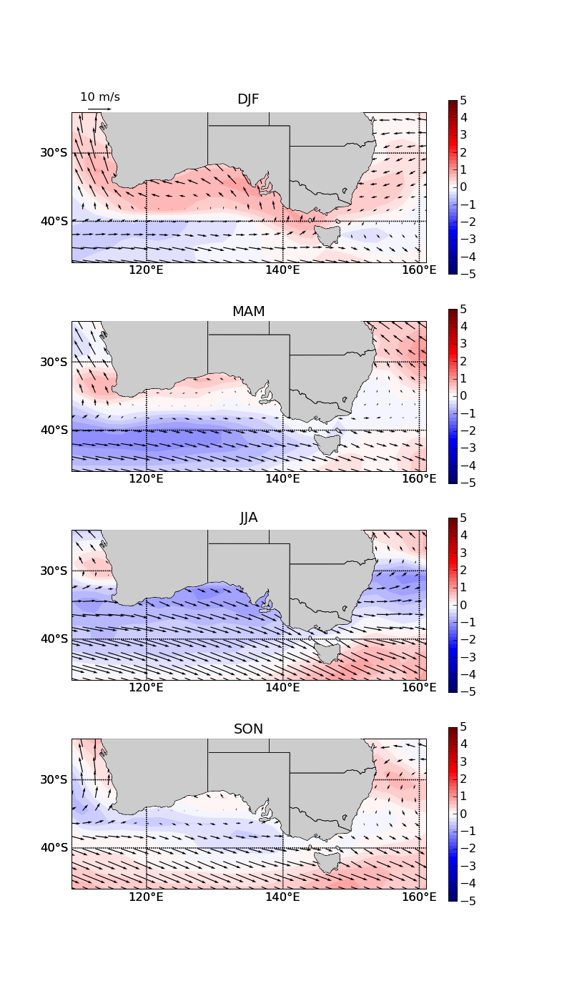
Changes in atmospheric mean conditions
Windspeed: Future-Present
CCAM (GFDL2.0)
CCAM (MK3.5)
MK3.5
Anomalous wind pattern roughly agree for the simulations in DJF and MAM with enhanced easterly winds along the southern Australian coast and reduced westerlies south of 35S
Difference in JJA between CCAM modelled and MK35 model output apparent
In SON pattern start to agree better
DJF
MAM
JJA
SON
Figure: Windspeed anomalies (contour) with overlying arrows indicating the wind climatology
Notes:
\

Slide 14
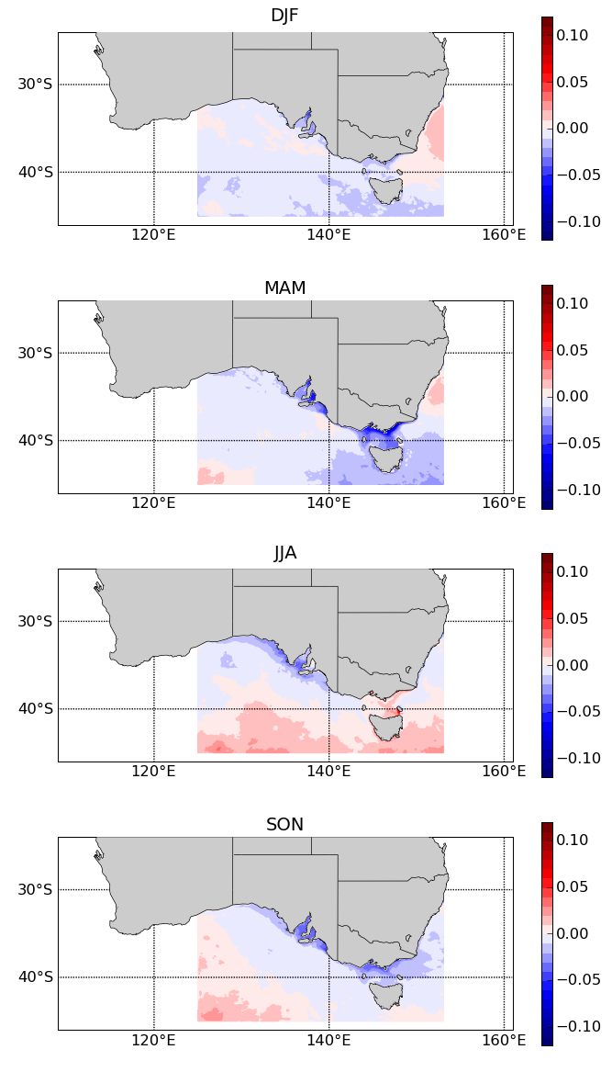
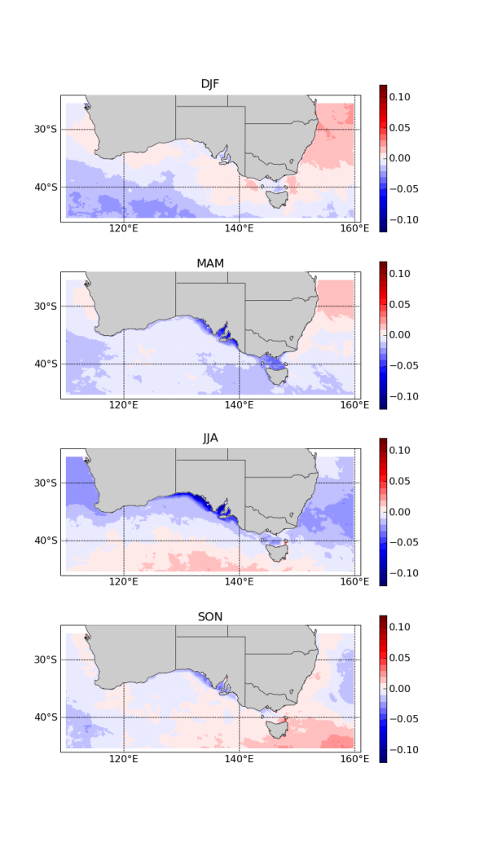
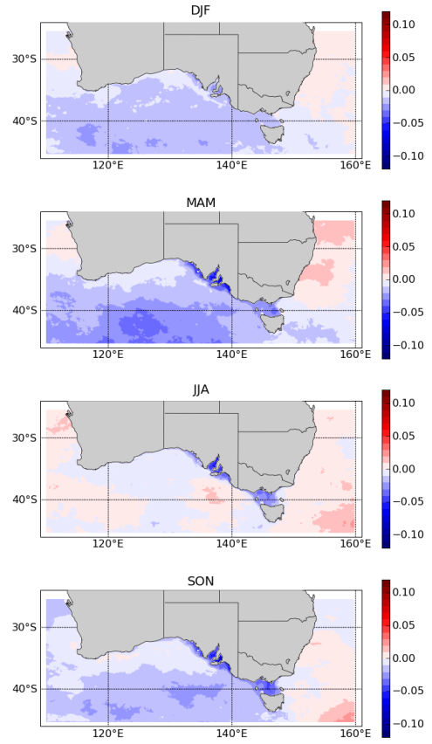
Changes in daily maximum SSH
The 95th percentile
Forcing:
R-CCAM (GFDL2.0)
R-CCAM (MK3.5)
R-MK3.5
DJF
MAM
JJA
SON
Figure: Anomalous 95th percentile of daily maximum SSH for each season.

Slide 15
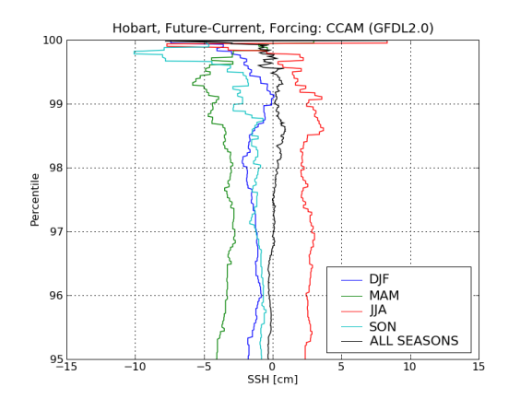
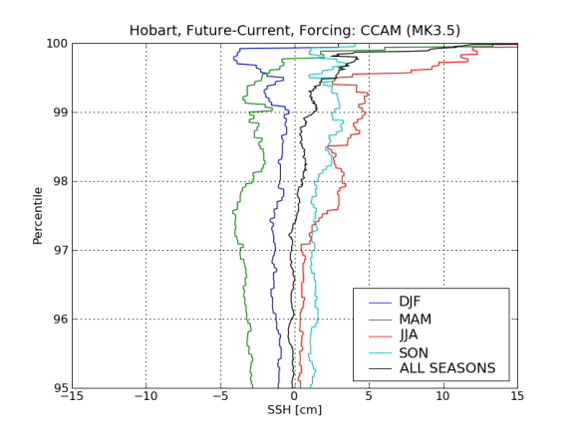
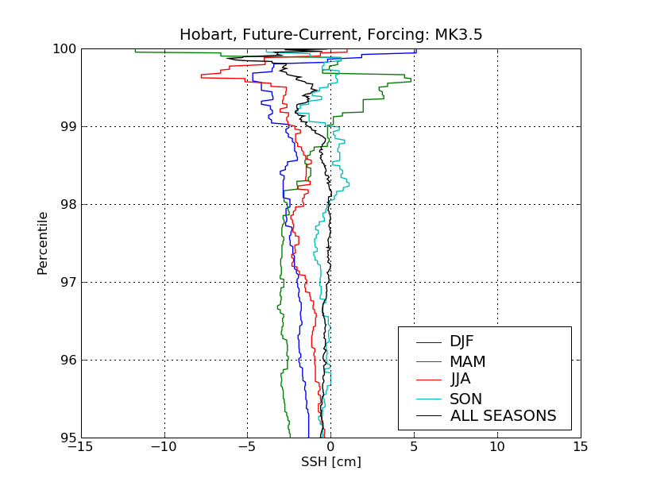
Changes in daily maximum SSH for Hobart
95th-100th Percentile
CCAM (GFDL2.0)
CCAM (MK3.5)
MK 3.5
Figure: Anomalous percentile plot for the 4 seasons for Hobart (upper), Atmospheric conditions for JJA: Windspeed changes with overlying climatology.
CCAM(GFDL20, Mk35):
Overall little change (black Line)
Increase in Zeta max for JJA (red Line)
Decrease in Zeta max for other seasons
Large variability between model simulations
MK 3.5:
Decreased Zeta max for most seasons up to 98 Percentile
Increase in MAM from 99 Perc
Notes:
Not going to discuss this in detail
Looking at a range of percentiles (95-99) for Hobart
Main points again
(1) some coherence signals (e.g. reduceion in SSH in MAM)
(2) Overall lttle change but loking at seasons differences in SSH become apparent
Overall little change – but once splitting up into seasons differences become apparent again
Above 99 % changes are very different, with decrease of zmax in gfdl, incrase for mk35, inbetween for raw climate model forcing
99Percentile SLP predicts well enhanced ZMAX in JJA and reduced in all other seasons for CCAM_GFDL forcing, wind 99perc does not capture reduced ZMAX in Hobart for SON
99Percentiel SLP predicts well enhanced ZMAX in JJA and SON in CCAM_MK35 – less well in MAM and DJF – check is SLP95 percenteil is better here, wind 99PERC better for DJF and MAM but also OK for JJA and SON
MK35:99PErc wind OK for DJF, 99SLP OK for JJA, SON, MAM not well explained by both – check SLP95PERC
Broad agreement over the ragnge 95-100
Pretty good agreement up to 99th percentile
2 points: little change when focussing on yearly mean,
Generally decrease in MAM and (well if you want) increase in JJA
Large variability between model simulations
Values are rather small (in the order of 10cm)

Slide 16
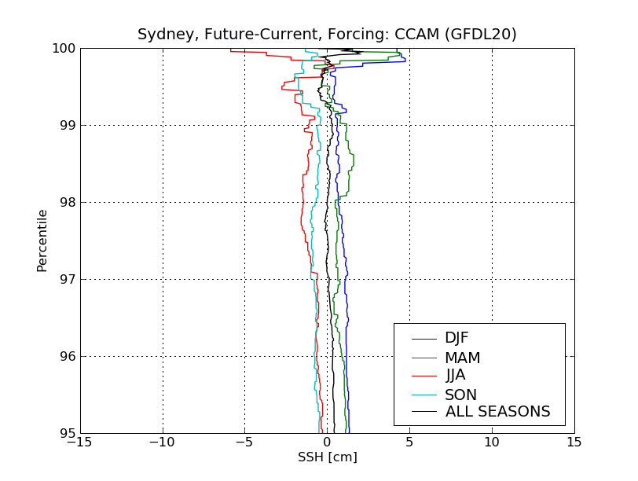
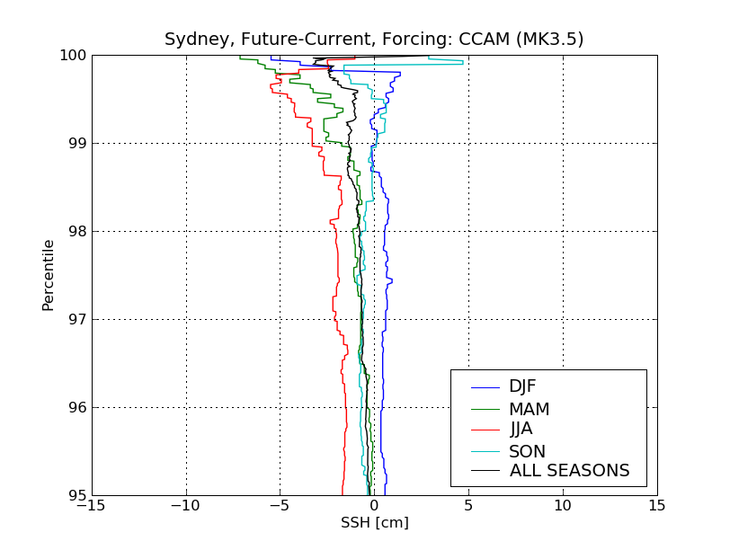
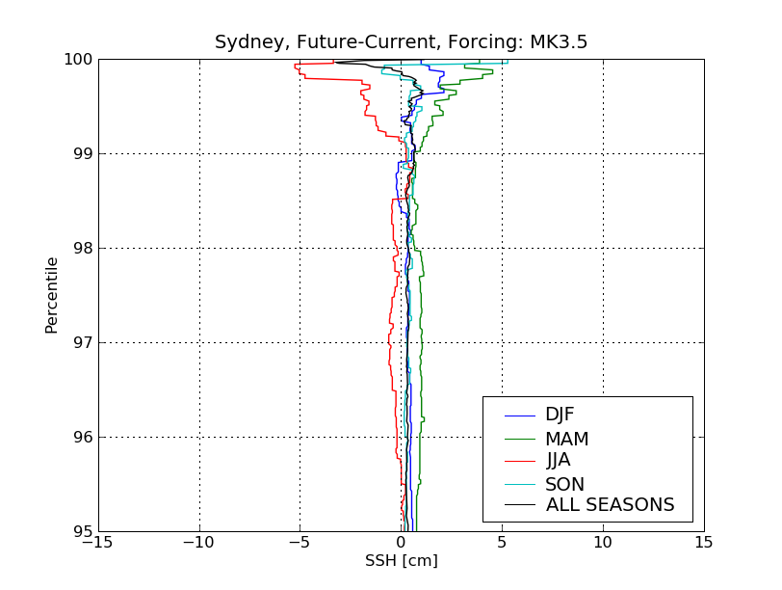
Changes in daily maximum SSH for Sydney
95th-100th Percentile
CCAM (GFDL2.0)
CCAM (MK3.5)
MK 3.5
Figure: Anomalous percentile plot for the 4 seasons for Syndey(upper), Atmospheric conditions for JJA: Windspeed changes with overlying climatology.
Annual mean shows little changes
Seasonality is apparent
But changes are very SMALL, especially for the raw climate model – in the range of few centimetres

Slide 17
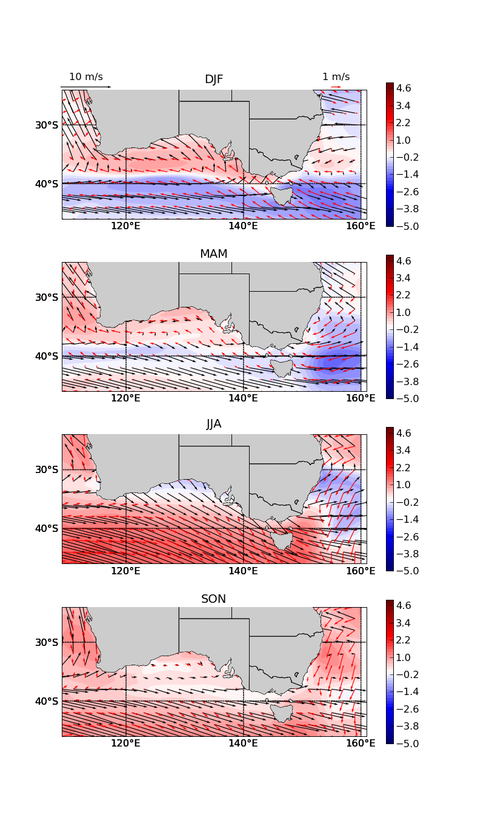
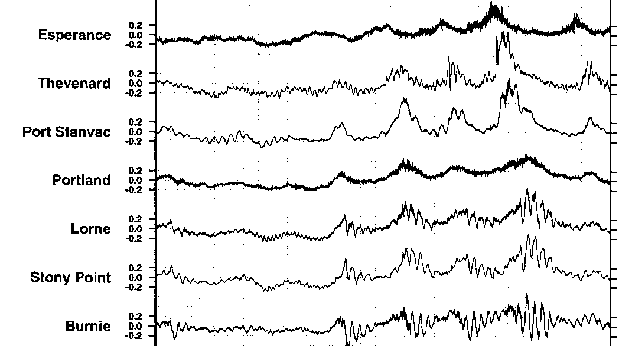
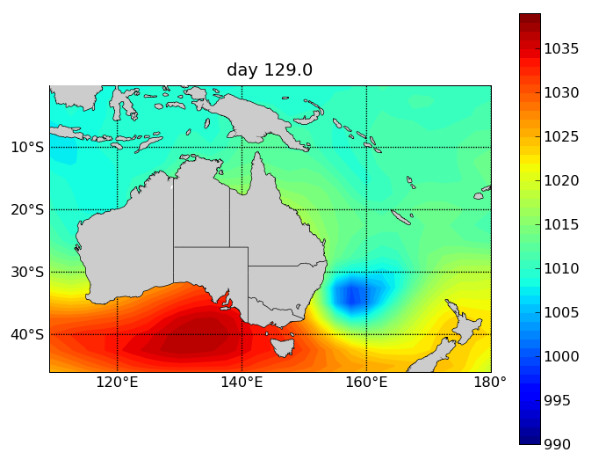
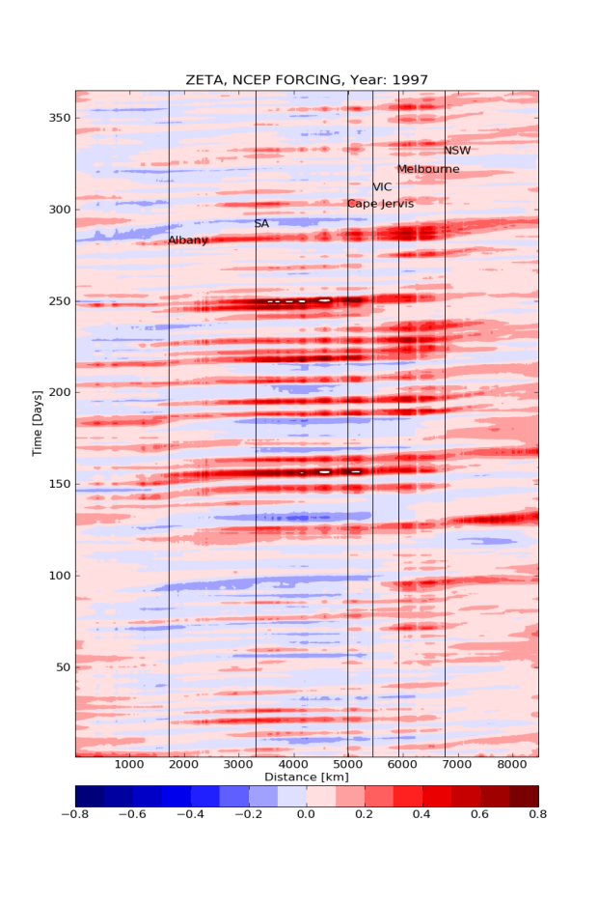
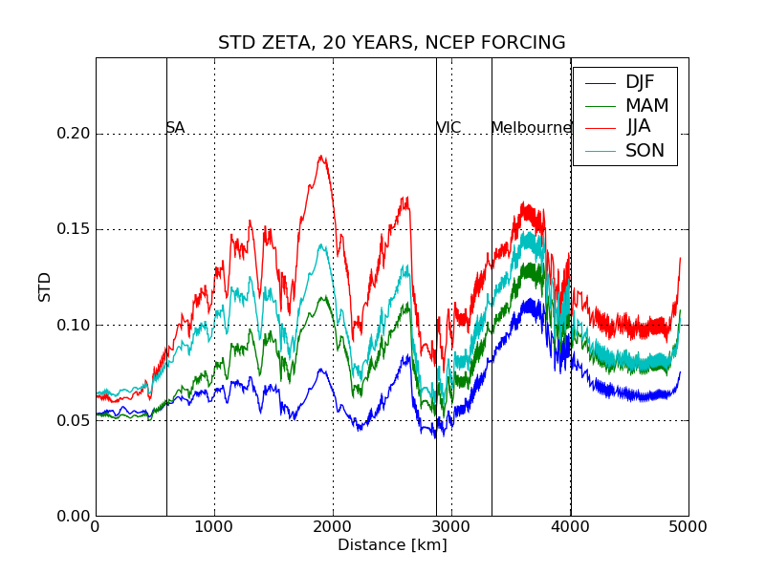
Assessing SSH signals and variability along the 25m isobath
Albany
SA
VIC
NSW
L
H
Time [days]
Distance

Slide 18
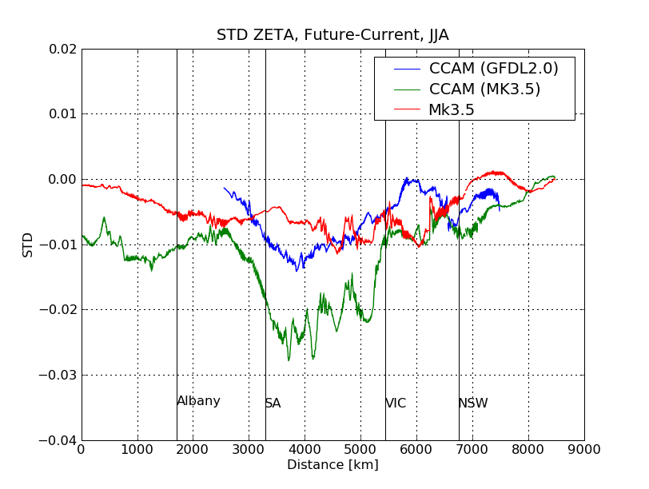
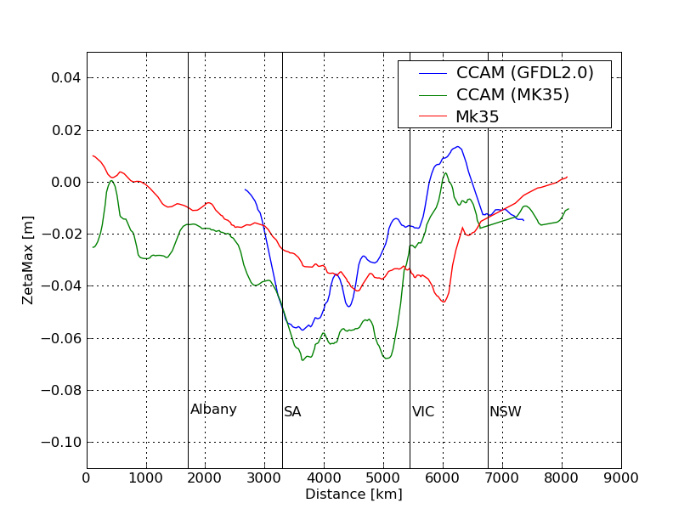
Change in variability and maximum daily SSH along the 25m isobath
STD
SSHmax
JJA
JJA
Reduced STD → Reduced storminess → Reduced daily maximum SSH

Slide 19
Results from CCAM downscaling
How does this affect the ocean model results
2 Examples
CCAM uses a spectral nudging technique if atmospheric fields of sufficient temporal resolution are available [Thatcher and McGregor, 2009].
SN specifies the state of the regional atmosphere by perturbing surface pressure, air temperature and winds and moisture fields at model layers above 850 hPa at large spatial scales (typically 3600 km and above)
The atmosphere at small spatial scales is allowed to evolve freely within CCAM
→downscaled NCEP fields and weather are comparable to original fields due to nudging procedure

Slide 20
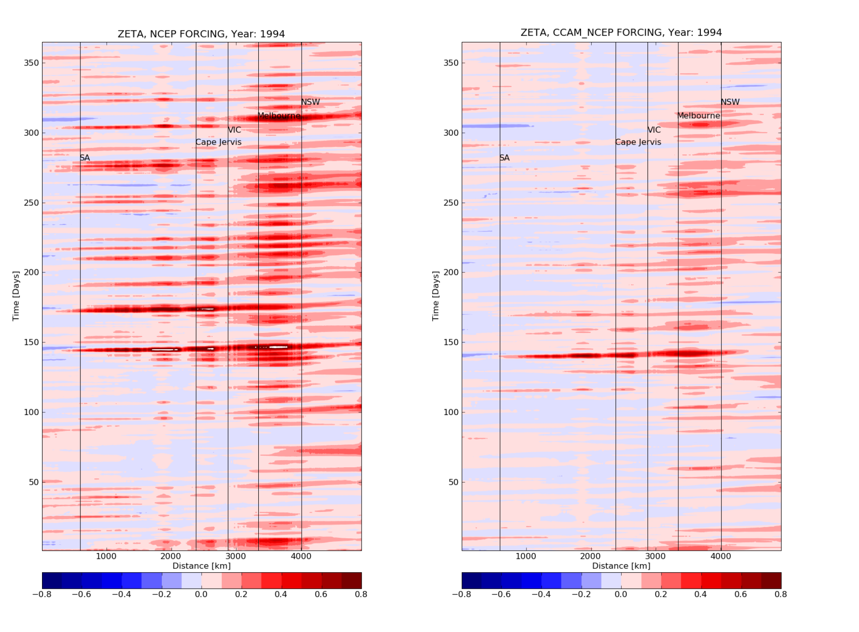
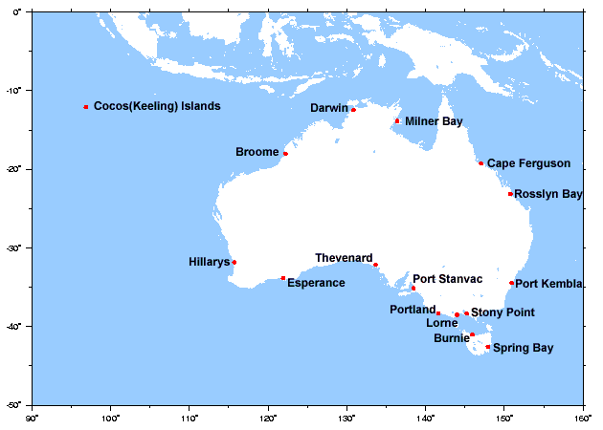
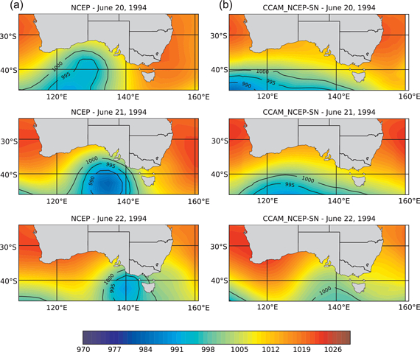
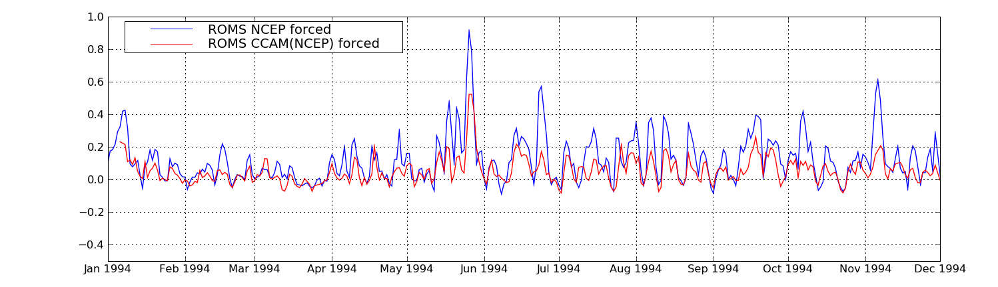
ROMS forced with NCEP reanalyses and downscaled NCEP

Slide 21
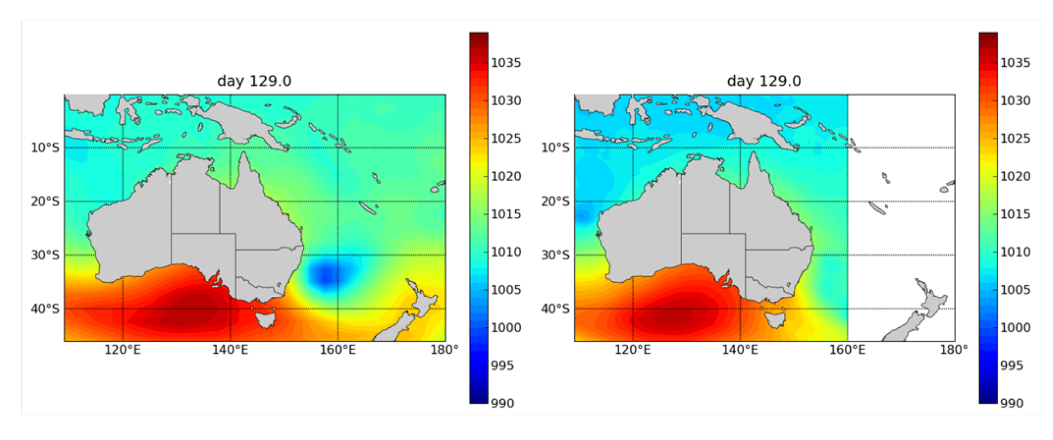
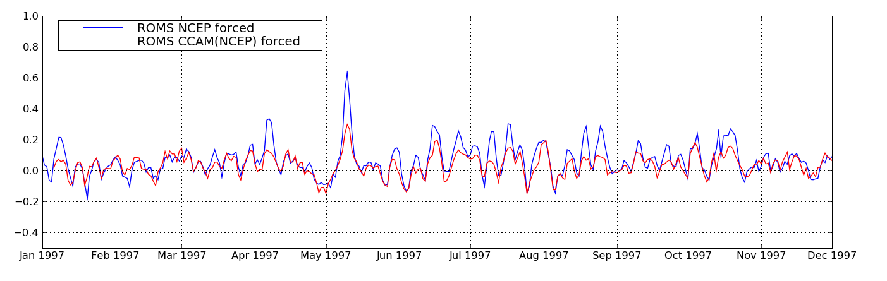
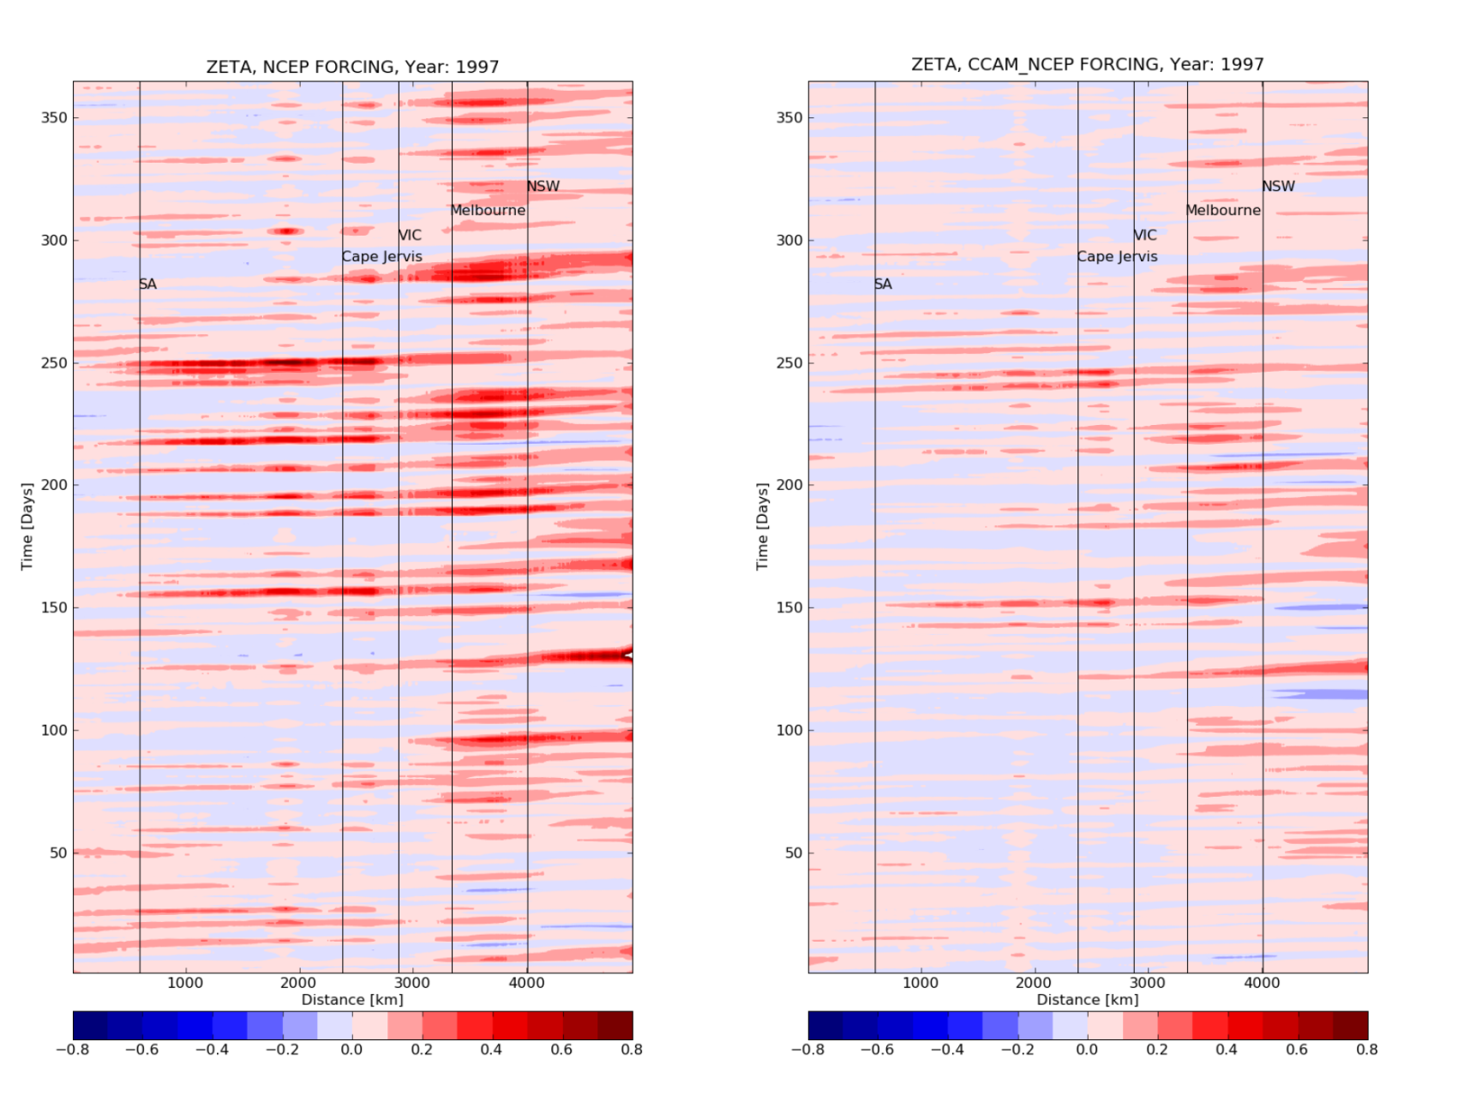
ROMS forced with downscaled and raw NCEP data
Notes:
Focussing on east coast

Slide 22
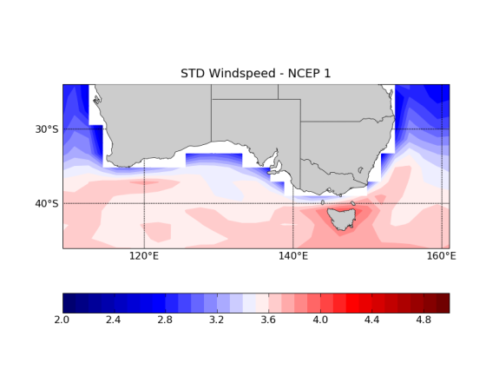
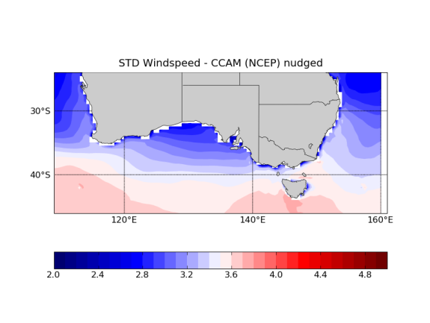
STD Windspeed CCAM(NCEP) vs. NCEP
CCAM underestimates variability slightly along the south coast and over Tasmania when compared to NCEP
To reduced variability for modelled SSH
To reduced magnitude of modelled SSH
Figure: STD climatology of windspeed. NCEP (left) and downscaled NCEP (right).

Slide 23
Summary and conclusions – Part 1
Intra-model variability apparent (SSH and STD)
Downscaling may lead to different response compared to parent GCM
Response in SSH is different for each season and should be considered in the analyses
STD plots suggest a reduction in storminess associated with a overall reduction of daily maximum SSH → in broad agreement with literature (e.g. Lim and Simmonds, 2009)
However irrespective of model uncertainties – mean sea level is the dominant driver in altering extreme sea levels
Here we are modelling changes within the 5-10cm range as compared to the 20-80cm estimated SSL rise by 2100
Most of these results have been published in JGR2012 with more discussion on the atmospheric part
Notes:
Lim, E.-P., and I. Simmonds, 2009: Effect of tropospheric temperature change on the zonal mean circulation and SH
winter extratropical cyclones. Climate Dynamics, 33(1), 19-32

Slide 24
Preliminary results of work in progress
Enlarge the grid to encompass all of Australia and use CMIP5 model output to force ROMS
Include tides in the ROMS simulations
Tidal surge interaction – in order to inform error bars

Slide 25
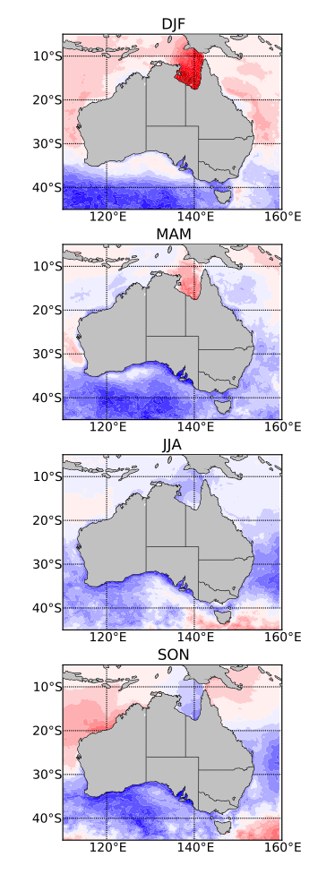
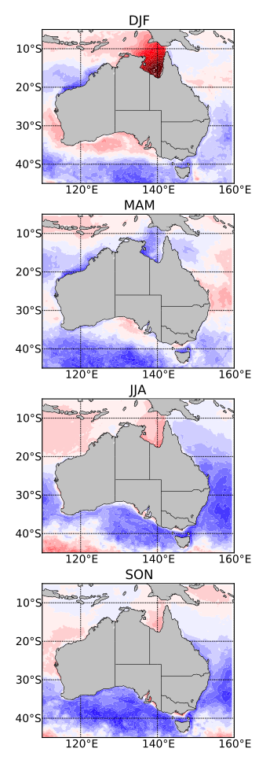
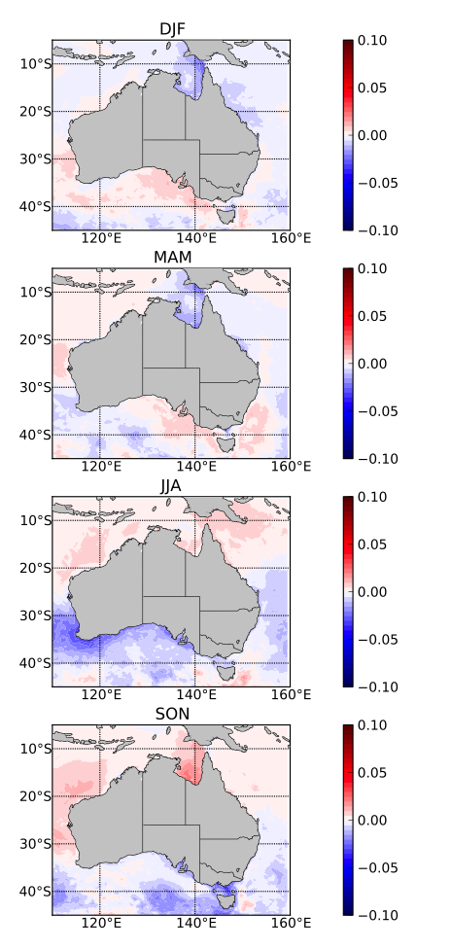
Changes in daily maximum SSH
The 95th percentile
R-CCAM (MK3.5)
R- ACCESS
R- HADGEM
R- INMCM4
DJF
MAM
JJA
SON
Notes:
1. R-ACCES and R-HadGEM show strong increase in surge over GoC
2. Similar pattern of SSH change for R-CCAM and R-ACCESS suggesting some consistency in the results
3. R-HADGEM gnerally similar to R-ACCESS but dieagreas in MAM close to coast
4. R-INMCM4 differs in general quite a bit in terms of magnintude and sign

Slide 26
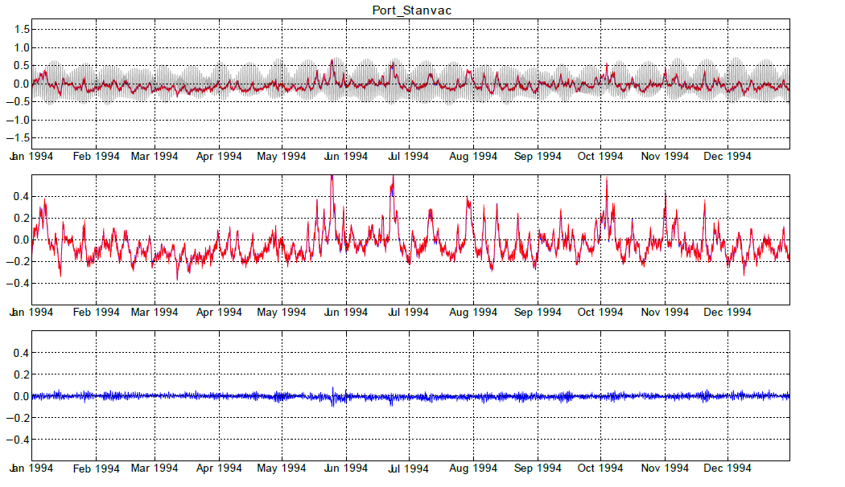
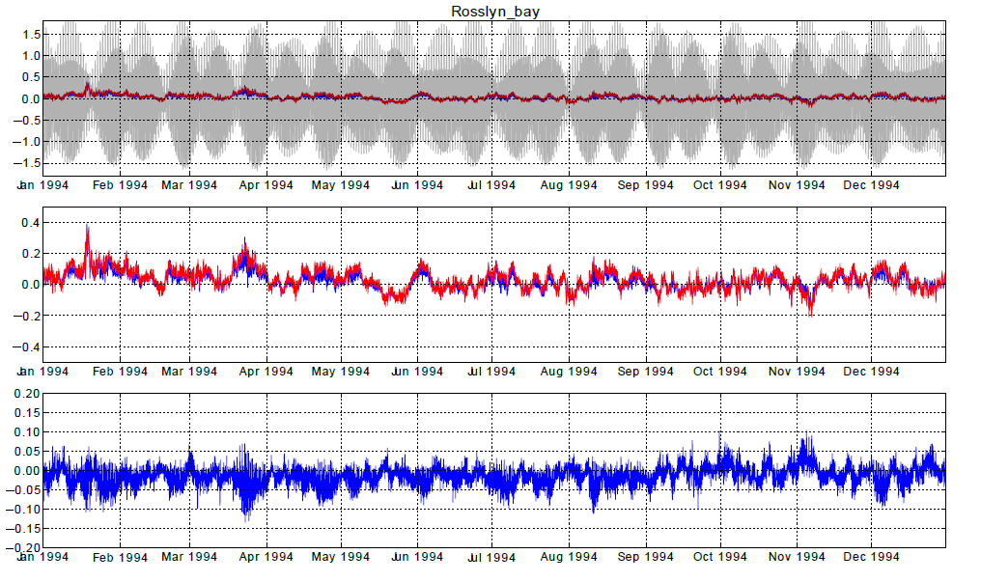
Strategy to incorporate tidal information
Residual = R-Tides+Atmosphere – R-Tides
Surge = R-Atmosphere
TideSurgeInteraction = Residual - Surge
Large Tidal range from 0.5m – 3m
Port Stanvac: Tides and surge are similar in magnitude
No Tide-surge interaction
Rosslyn Bay: Tides are much larger than surge
Larger tide-surge interaction

Slide 27
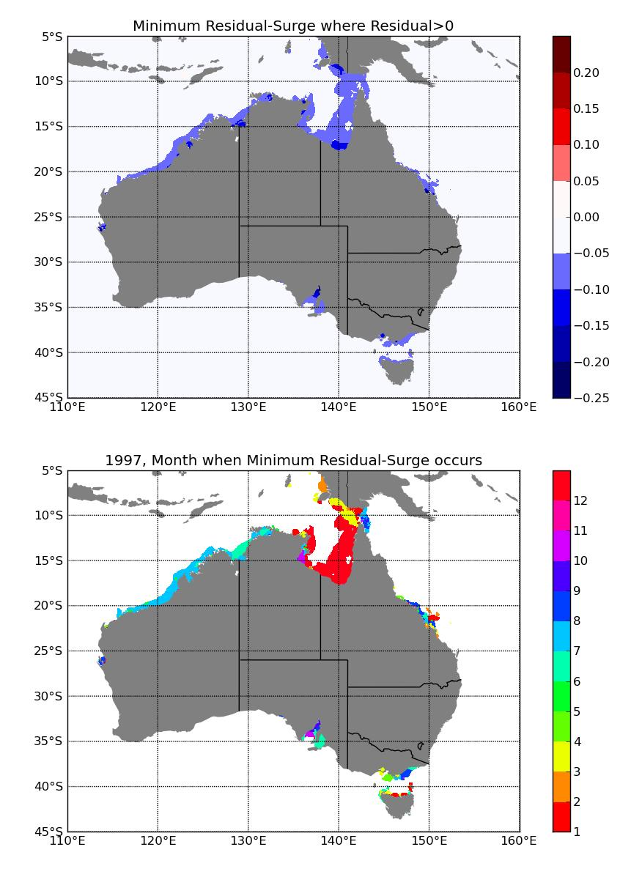
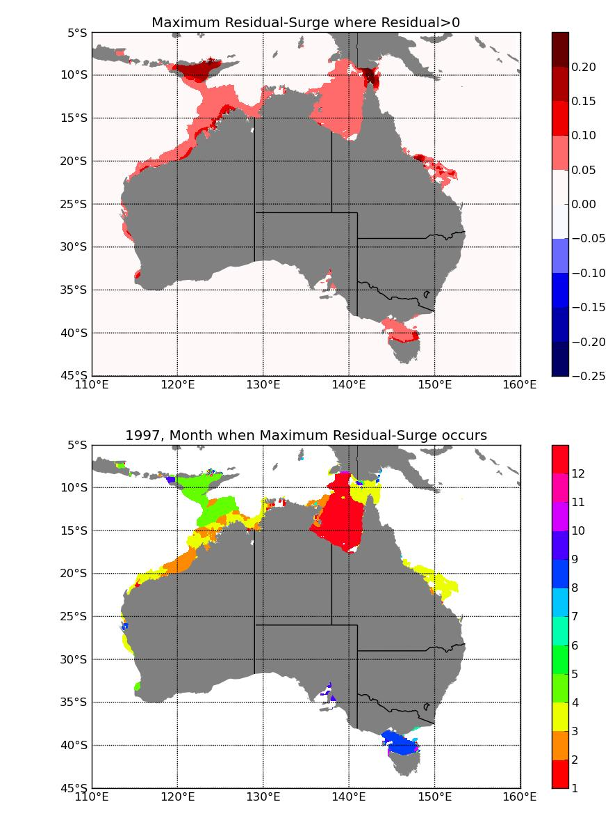
Nonlinear Tidal-Surge interaction
Upper: Minimum/ Maximum difference between Residual and Surge
Lower: Month of occurrence

Slide 28
Future work
Focus on understanding intra-model differences in SSH
Understand the big SSH signal in GoC
Include tidal potentials for 2D simulations ?
Combine work done in WA by e.g. Ivan Haighs with our results
Potentially using ROMS-SWAN to model atolls in the Pacific – depends on grid refinement methods
Transport along the coast and possible changes in sediment transport
Much more …
Thanks …

Slide 29
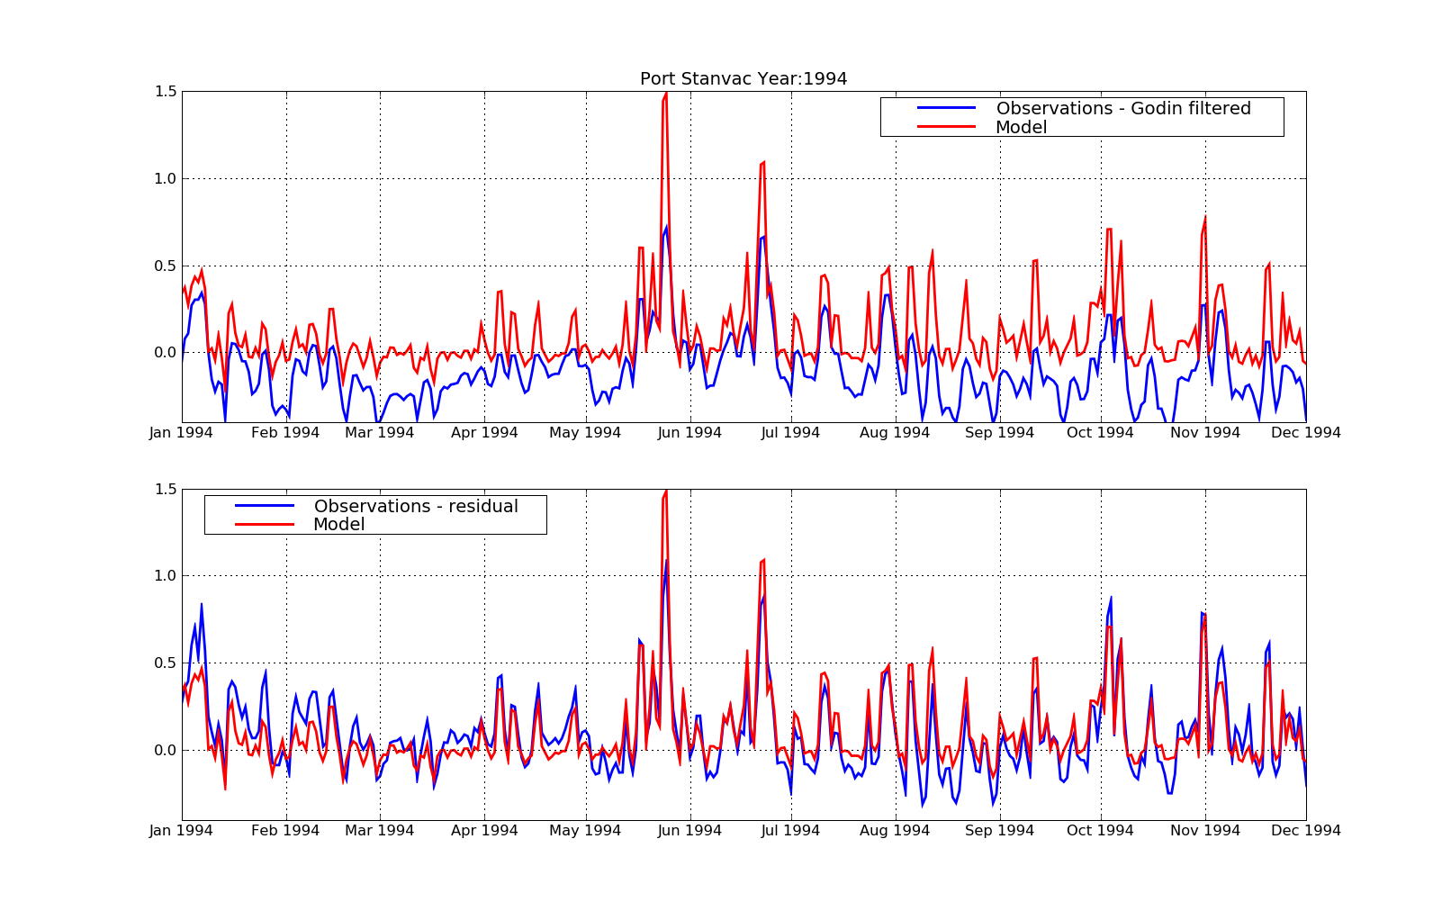
Comparing model results with observations
ROMS forced by NCEP

Slide 30
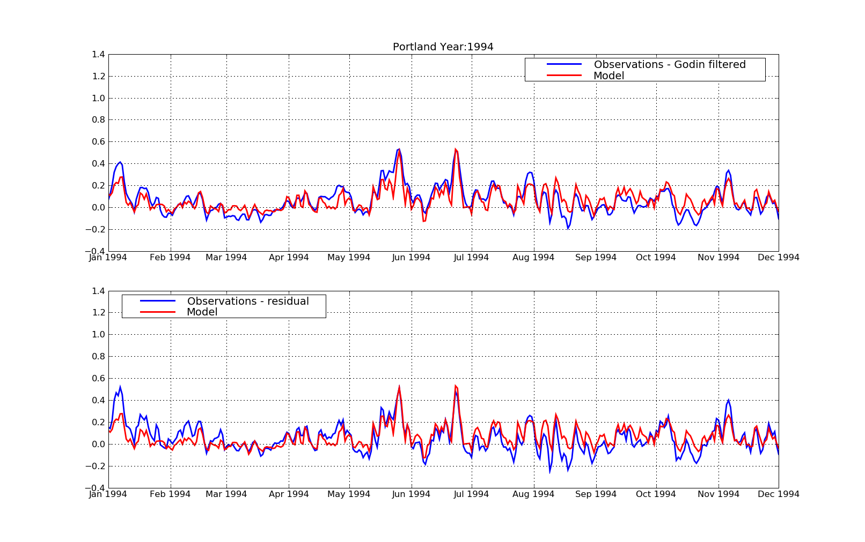
Comparing model results with observations

Slide 31
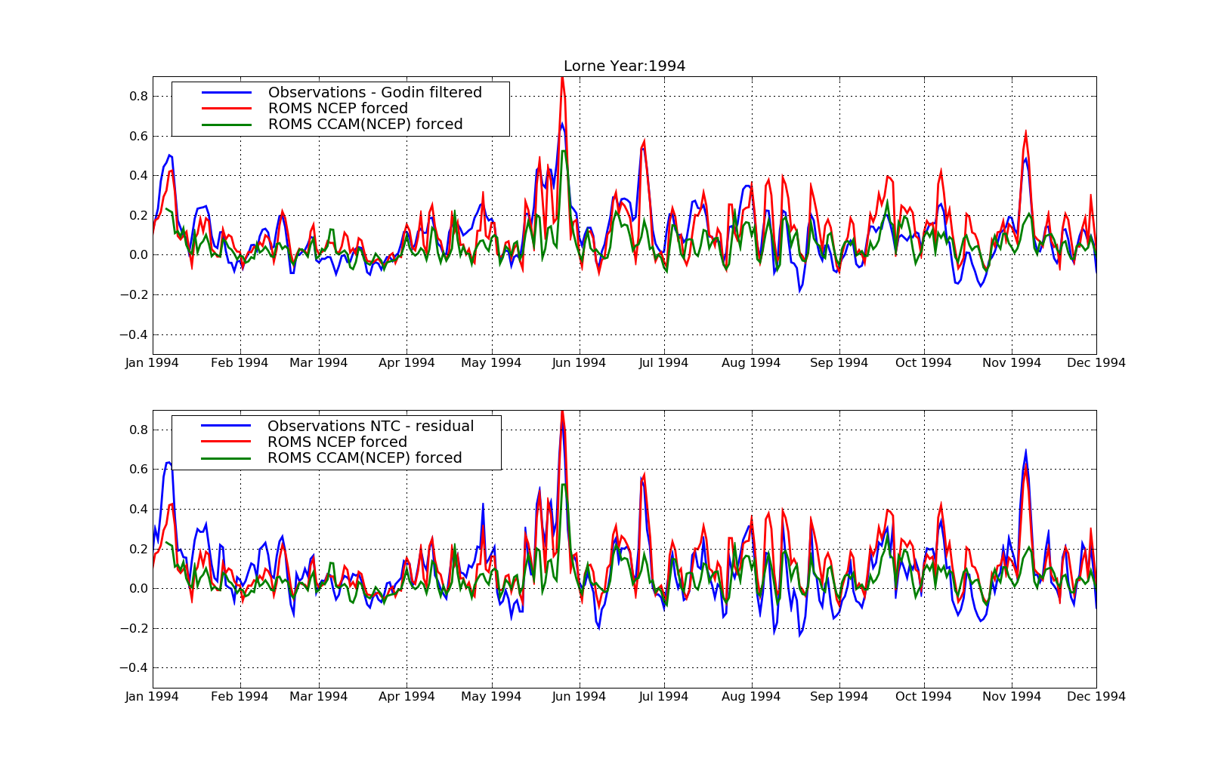

Slide 32

Notes:
ROMS CCAM(NCEP) agrees better with observations beginning of may but this is for the wrong reasons. Port Kembla is in harbour area that is not resolved in model
Point here is to show limitations of CCAM data which does not reproduce east coast low beginning of may. Hence ROMS NCEP shows strong peak but ROMS CCAM(NCEP) does not

Slide 33






Slide 34


Modelled and observed daily maximum SSH for selected locations

Slide 35

Storm surge assessments (Vic – Tas)
Victoria ‘Future Coasts’ and Tasmania ‘Climate Futures for Tasmania’ storm surge studies (McInnes et al, 2009; 2012a,b)
Nested modelling using GCOM2D model
  Vic: 5 km, 1 km, 100-50 m
  Tas: 5 km, 1 km
Storm surge events identified in detided sea level records from tide gauges (~38years)
  Surges and tides modelled separately
  R-largest GEV used to model extreme sea levels
  Joint probability method used to combine tides and surge
  Atmospheric forcing from reanalyses (NCEP and ERA40
Future climate scenarios
  SLR for various future times
  Wind speed change (bi-variate adjustment of wind speed (Tas)

