Slide 1
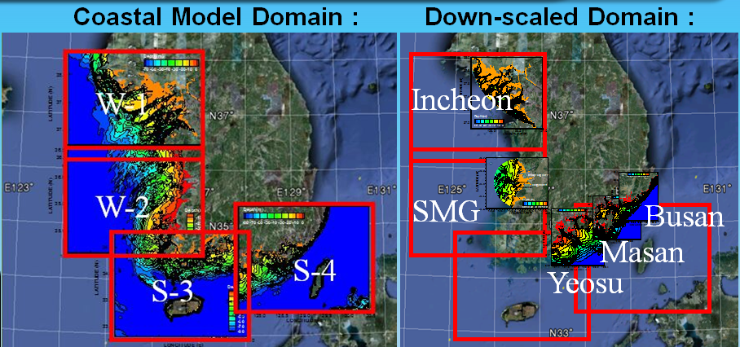
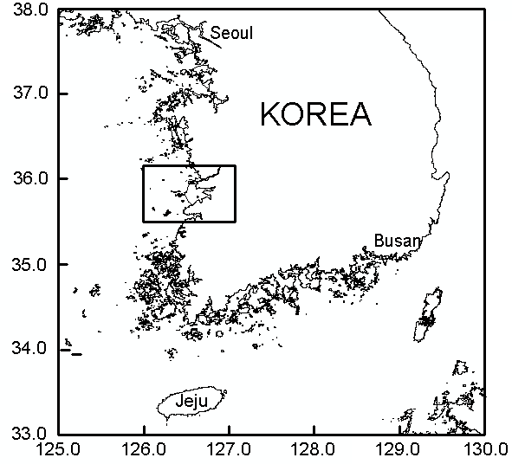
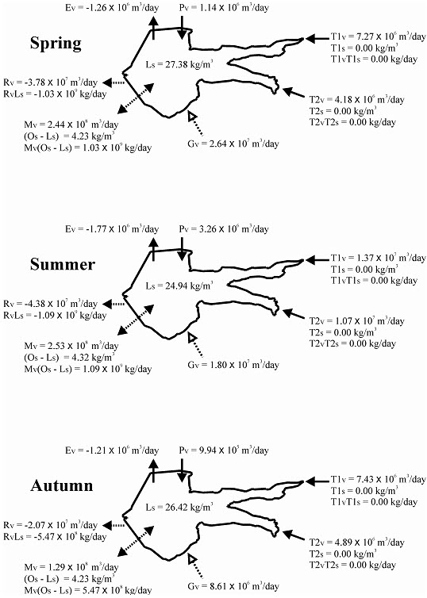

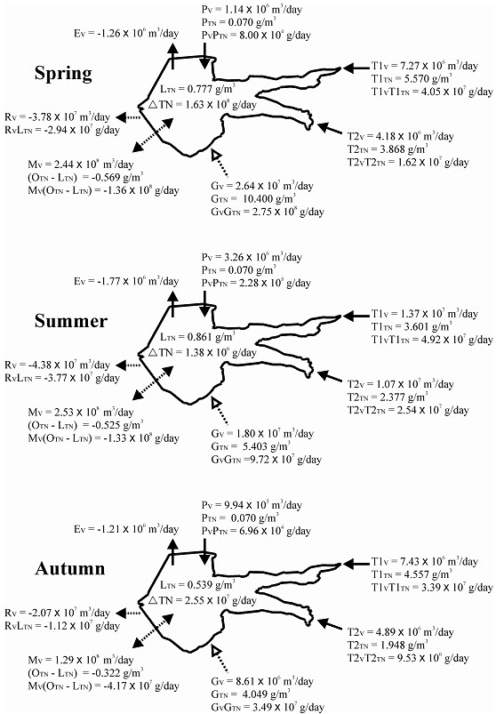
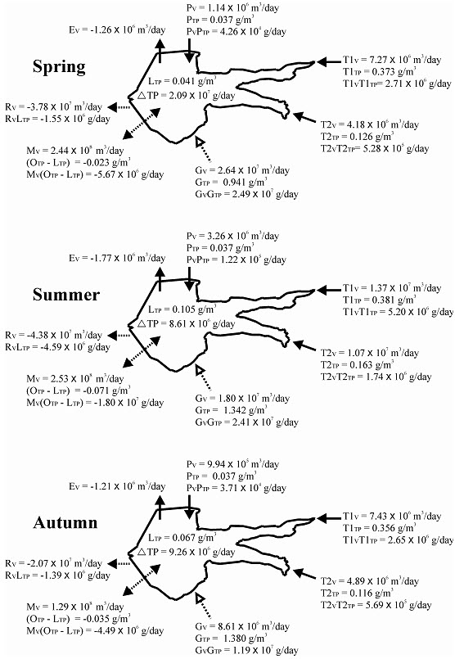
Coastal water quality model ROMS-ICM and its application
Chang S. Kim and Hak Soo Lim
Coastal Disaster Research Center, KIOST, Ansan 426-744, Korea
surfkim@kiost.ac and hslim@kiost.ac
Abstract
A new method for prediction of temporal and spatial variation of water quality accounting for groundwater effect has been proposed and applied to a water body partially-connected to macro-tidal coastal waters in Korea. The method is comprised of direct measurement of environment and water parameters, nutrient budget analysis to estimate indirectly the submarine groundwater fluxes and three-dimensional numerical modeling of water quality using the directly collected data and indirectly estimated groundwater fluxes. The applied area is Saemangeum (SMG) tidal lake that is enclosed by 33km-long sea dyke with tidal opening at two water gates of 240 meters and 300 meters wide. Due to the constraint of water exchange and nutrient loading from the land, the future condition of water quality has been seriously concerned. Especially the unknown but significant contribution of groundwater to the coastal water quality has been an environmental issue.
Field data observed in 2010 as part of environment monitoring of the SMG engineering project have been analysed to investigate the seasonal variation, indication of groundwater dependency and material mass balance of major state variables such as salt, total nitrogen (TN), total phosphorus (TP) and silicate (SiO2-Si). It turns out that the silicate is a referencing variable for groundwater influence along with the water budget quantifying the influx and efflux of materials in the tidal lake.
Temporal and spatial variability of nutrients in the lake has been predicted using the results of the budget study that gives estimation of fluxes of groundwater. The prediction was implemented by the three-dimensional numerical model (ROMS-ICM) consisting of hydrodynamic model of ROMS and eutrophication model of CE-QUAL-ICM (Kim et al., 2011). More detailed structure of variability of nutrients including the groundwater effect could be achieved with mass balance in the tidal lake. The results show that groundwater influx during summer monsoon contributes significantly in 20% more than during dry season to the nutrient concentrations of TN, TP and SiO2-Si. Consideration of groundwater effect on the nutrient budget provides significant amount of bottom deposits more than conventional mass balance estimated by surface flow analysis. The present method would be useful for controlling the terrain loading of nutrients to keep the coastal waters in sustainable standard.
ROMS Coastal Forecasting System
Model Calibration with Water Quality Data
YELLOW SEA
ROMS/SWAN/WRF
forecasted in 72 hours base
HYCOM/UM
nested for BC
Salinity
TN
TP
We have used the three-dimensional water quality model ROMS-ICM that has been developed by linking the hydrodynamic model ROMS (Haidvogel et al., 2008; Kim and Lim. 2009; Kim et al., 2009; Lim et al., 2011) and the eutrophication model CE-QUAL-ICM (Cerco and Cole, 1993; Cerco et al., 2010) with external coupling codes (Kim et al., 2011).
There are many sets of data observed in the SMG waters during last 10 years as part of the SMG monitoring program. To conduct calibration of the ROMS-ICM the existing condition of average state of January 2009 has been set for the initial condition.
After calibration of modules of the model system, the ROMS-ICM has been used to estimate the variability of the structural behavior of water quality parameters. In this prediction the estimated nutrient budget result is used to put the influx from the groundwater.
To increase the accuracy of the prediction, the influx efflux at the water gates have been nudged with the observed data. The influx from the groundwater has been loaded at the seabed.
FTP
DO
(DEC 25, 2009)
Chl-a
COD
Data Server
U/V/T/S boundary nesting
Wave height, direction, period.
Wind, Pressure, Heat fluxes etc.
Nested into coastal models
Coastal Model System
No. of grid | 180 x 120 x 20
Resolution | 1.8 km (1´)
Interval | ROMS Δt = 24 sec SWAN Δt = 60 sec Coupling Δt = 4 min
Down-scaled model grid resolution
KGBAY | 1 km ~ 100 m
SMG | 1 km ~ 100 m
YEOSU | 600 m (20″)
MASAN, BUSAN | 300 m (10″)
Salinity
TN
TP
FTP
Operational system
start
Data download
via ftp
Model
simulation
72 Hrs prediction
web-GIS
Service
DO
Chl-a
COD
(05:00, 17:00)
Water quality modeling using ROMS-ICM
Mass Balance and Ground fluxes
Water Budget : The fresh water inflows to the tidal lake are 7.27×10⁶m³/day (MKriver) and
4.18×10⁶m³/day (DJ river) in spring, 1.37×10⁷m³/day (MK) and 1.07×10⁷m³/day (DJ) in summer, and
7.43×10⁶m³/day (MK) and 4.89×10⁶m³/day (DJ) in autumn, showing a peak in summer due to the rainy
monsoon. The differences between the precipitation and evaporation are -1.21×10⁵m³/day (negative means
more evaporation) in spring, 1.50×10⁶m³/day in summer and -2.17×10⁵m³/day in autumn, showing net loss
of lake water through evaporation except summer.
(2) Salt Budget : In the current paper, we illustrate the result of the
material budget for SiO₂-Si among many other nutrient variables
such as TOC, TP and TN. In spring the in flux and efflux of SiO₂-Si
are as follows.
Through MK and DJ rivers it is 1.87×10⁷g/day, through sea water
transport as -3.46×10⁸g/day through net (residual) flow as -
5.52×10⁷g/day, through precipitation as 2.09×10⁵g/day, through
submarine groundwater as 3.24×10⁸g/day (Figure5). The net
transport of SiO₂-Si is given as -5.81×10⁷g/day, indicating the net
loss to the outer sea.
ROMS-ICM curvilinear grid
No. of Cells : 60 x 50 x 10
ROMS Δt = 30 sec, ICM Δt = 60 sec
Width of Sluice Gate : Shinsi 300 m, Garyeok 240 m
No. of Boxes : 18070, No. of flow faces : 50643
Salt transport is estimated by using following equation with assumption of conservative element
CE-QUAL-ICM developed by USACE
: flexible finite volume eutrophication water-quality model solving fully 3D, time-variable Mass-Conservation equation .
Major state variables
: T, S, Chl, C, N, P, Si, COD, DO etc.
The water budget is calculated according to the following equation
The material budgets of TN, TP are obtained by multiplying the water flux and concentrations of each variable. The total influx and efflux are given:
Operational Oceanographic Networks
Conclusions
In this study, we have investigate the asset test on predictability of submarine groundwater impact on coastal water quality in Saemangeum tidal lake and coastal waters. The model also has been calibrated to reproduce the annual cycle of major water state variables such as temperature, salinity, chlorophyll, chemical oxygen demand (COD), dissolved oxygen, TP, TN etc. Major loadings of nutrients from river flows and controlling points at sea water gates. Being used the boundary conditions of hydrology and nutrient loadings from lands as well as from the open sea and hydrodynamic condition provided by operational prediction (Lim et al., 2011), the three-dimensional water quality model ROMS-ICM shows an excellent performance of predicting the annual cycle of typical condition, and even the stormy summer condition and abnormally episodic events of vulnerable environment.
WRF, UM
ROMS
DB
Web-GIS
Dissemination, Visualization
Coupling
Linkage
DB,
Monitoring,
Model Prediction
SWAN
ICM
MA
HF-Radar, GOCI
Validation
TN
TP
Variables Predicted by Korea Operational Oceanographic System
UM, WRF | SWAN | ROMS | ICM
Surface wind, pressure, heat fluxes, water fluxes | Wave height, direction, period etc. | Tides, currents, T, S, storm surge height, sediment transport | TP, TN, DO, Chl-a, COD etc.

